Slide 1
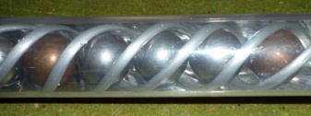
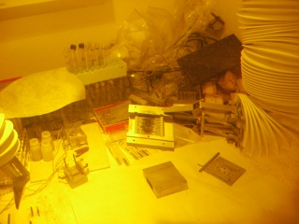
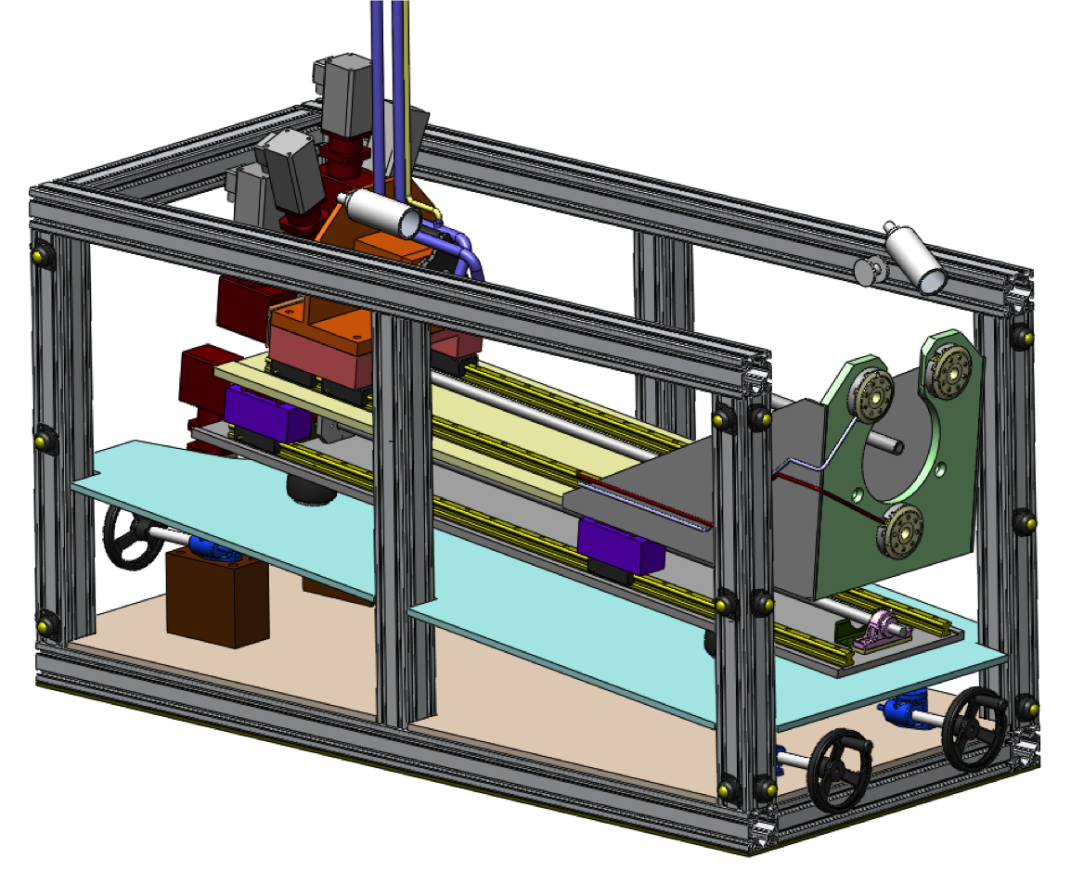
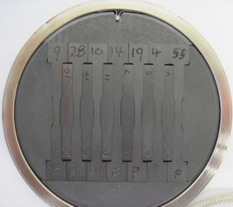
High Power Target Development at Fermilab
Accelerator Sector Planning and Strategy Workshop P. Hurh

Slide 2
Introduction- Where we are
AD/MS and Pbar and Ext. Beams operates 3 target facilities:
  P-bar Source (off) – 70 kW proton beam on inconel (nickel alloy) target with Be cover (110 kW/mm²)
  NuMI/MINOS – 400 kW proton beam on graphite (carbon) target (14 kW/mm²)
  MiniBooNE – 32 kW proton beam on beryllium target
  (1 kW/mm²)
Note: Values in red refer to total beam power divided by nominal 3 sigma spot size

Slide 3
Introduction- What we are working on
Currently have resources working on:
  ANU/NOvA upgrade - 700 kW proton beam on graphite (carbon) target (15 kW/mm²)
  LBNE - 700 kW proton beam on graphite (beryllium?) target (15 kW/mm²)
  LBNE upgrade – 2.3 MW proton beam on graphite (beryllium?) target (36 kW/mm²)
  Mu2e – 25 kW-8 GeV (maybe lower now) proton beam on gold (tungsten?) target (1 kW/mm²)
  G-2 – 27 kW-8 GeV proton beam on inconel target (??)
Note: Values in red refer to total beam power divided by nominal 3 sigma spot size

Slide 4
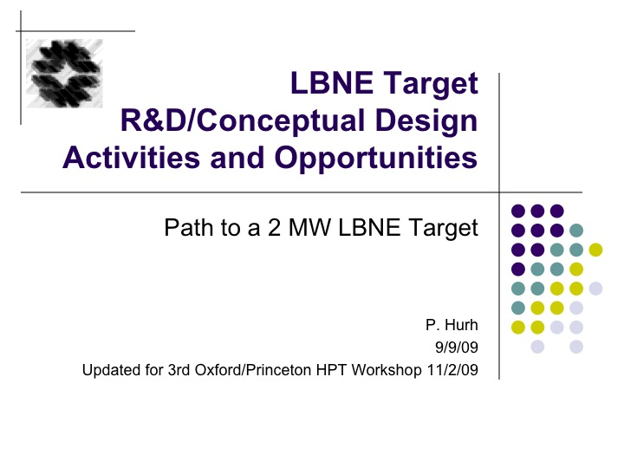
Introduction – Current Issues
Design Challenges
  Heat removal
  Thermal Shock (Stress Waves)
  Radiation Damage
  Radiation Accelerated Corrosion
  Spatial Constraints
  Residual Radiation
  Manufacturing techniques
  Physics Optimization
Not just targets, but entire target systems (beam windows, collection optics, absorber, decay pipe, etc.)

Slide 5
Introduction – Current Issues
Operational/Infrastructure Challenges
  Operational crises divert scarce resources from R&D and future projects
  Reliance on Single Source Vendors
  Radiological Issues
    Shielding
    Air Activation
    Tritium
    Remote handling and long term storage requirements
      Current long term storage filled after 3-4 years of NOvA
      Not just targets, but whole facility design

Slide 6
Introduction – Current Issues
Organizational Challenges
  Resources spread among different organizations with diffuse accountability and competing responsibilities
  Projects only fund specific R&D efforts, not fundamental, general R&D efforts that benefit all
Success at the High Intensity Frontier requires success at High Power Target Facilities

Slide 7
Strategy – Ultimate Goal (10 year)
Support all target facility needs in the Project X era
  LBNE at 2.4 MW
  Muon Experimental Facility at 1 MW
  Kaon Experimental Facility at 1 MW
  Nuclear Experimental Facility at 1 MW
Be poised to embark on informed design of the next large machine (Nu Factory/Muon Collider)

Slide 8
Strategy – Near Term Goals (1-3 yrs)
Remote Handling and Long Term Radioactive Component Storage
  Commission C-0 Remote Handling Facility
  Begin construction of LT RC Storage Facility
Continue radiation damage materials testing
  Finish current data analysis of LBNE graphite testing
  Start irradiation of 2nd generation candidate materials
Single pulse failure testing of target materials at a suitable facility (GSI, AP-0, CERN)
Note: Not including Project CD milestones

Slide 9
Strategy – Near Term Goals (1-3 yrs)
Organizational
  Create HPT team or department
  Tap into global HPT community to form R&D collaboration
  Establish network of vendors (incl labs and universities) to design/build high quality target facility components
  Fully understand Project X era experiment target requirements
Note: Not including Project CD milestones

Slide 10
Project X era target requirements (?)
 | Energy | Power | Target material | Power (in target) | Sigma | Power/3sigma
Beamline | GeV | kW |  | kW | mm | kW/mm^2
Neutrino (LBNE) | 120 | 2400 | graphite (Be?) | 15 | 1.5 | 0.24
Muon (Ring) | 3 | 1000 | tungsten?? | 200 | 2 | 1.77
Muon (CRFI) | 3 | 1000 | tungsten?? | 200 | 2 | 1.77
Kaon (Chrg/Ntrl) | 3 | 1000 | carbon?? | 4 | 3 | 0.02
Nuclear | 1 | 1000 | Thorium?? | 500 | 10 | 0.18
Irradiation | 1 | 1000 | Various | 300 | 10 | 0.11
ADSR | 1 | 1000 | Lead-Bismuth Eutectic | 1000 | 10 | 0.35
 | Spill length | Bunches | P per Bunch | P per spill | Bunch length | Bunch spacing | Spill spacing
 | usec | # | # | # | nsec | nsec | sec
Neutrino (LBNE) | 9.5 | 504 | 3.20E+11 | 1.60E+14 | 2 | 18.9 | 1.3
Muon (Ring) | ?? | ?? | 1.90E+08 | ?? | 0.04 | 12.4 | 1.00E-06
Muon (CRFI) | ?? | ?? | 1.90E+08 | ?? | 0.04 | 12.4 | 1.00E-06
Kaon (Chrg/Ntrl) | ?? | ?? | 1.90E+08 | ?? | 0.04 | 12.4 | 1.00E-06
Nuclear | ?? | ?? | 1.90E+08 | ?? | 0.04 | 12.4 | 1.00E-06
Irradiation | ?? | ?? | 1.90E+08 | ?? | 0.04 | 12.4 | 1.00E-06
ADSR | ?? | ?? | 1.90E+08 | ?? | 0.04 | 12.4 | 1.00E-06

Slide 11
Strategy – Mid-term Goals (4-7 yrs)
PoT (protons on target) goals for operating target facilities
Complete conceptual design of Project X era target facilities
Continue radiation damage and single pulse failure testing of candidate target/window materials
Commission new Long Term Radioactive Component Storage Facility
Continue to build, fill in the HPT group with needed personnel
Note: Not including Project CD milestones

Slide 12
Strategy – Long Term Goals (8-10 yrs)
Complete detailed design and begin construction of Project X era target facilities
PoT goals of operating target facilities
Continue to contribute to the global HPT community by establishing a sustained HPT R&D program including:
  Irradiation Testing (Nuclear facility)
  Single Pulse Failure Testing
  Simulation and Analysis
  Exploring novel target technologies and their applications
Note: Not including Project CD milestones

Slide 13
Strategy – Overall Plan
Recent “white paper” on Target Support at the Intensity Frontier presents, in detail, the overall plan
Lacks implementation schedule, but instead identifies the organization that needs to be in place over the next 5-10 years
Reviewed by Target experts from ORNL, RAL, and CERN

Slide 14
Scope
  Operational Support
    NuMI/NOvA (700 kW)
    LBNE (700 kW)
    Mu2e
    G-2
    MiniBooNE
  Future Target Facility R&D
    LBNE (2.4 MW)
    Project X era facilities (Kaon, Muon, Nuclear)
    Muon Collider/NuFact
    LHC Collimators

Slide 15
Capabilities Required
  Leadership
  Mechanical Design
  Multi-Physics Analysis
  Physics Simulation
  Material Science
  Fabrication & Assembly
  Pulsed Power Engineering
  Cooling Utilities
  Remote Handling
  Alignment and Metrology
  Health Physics
  Instrumentation
Note: Text in red denotes areas of great need

Slide 16
Red indicates roles could be “matrixed” from other organizations

Slide 17
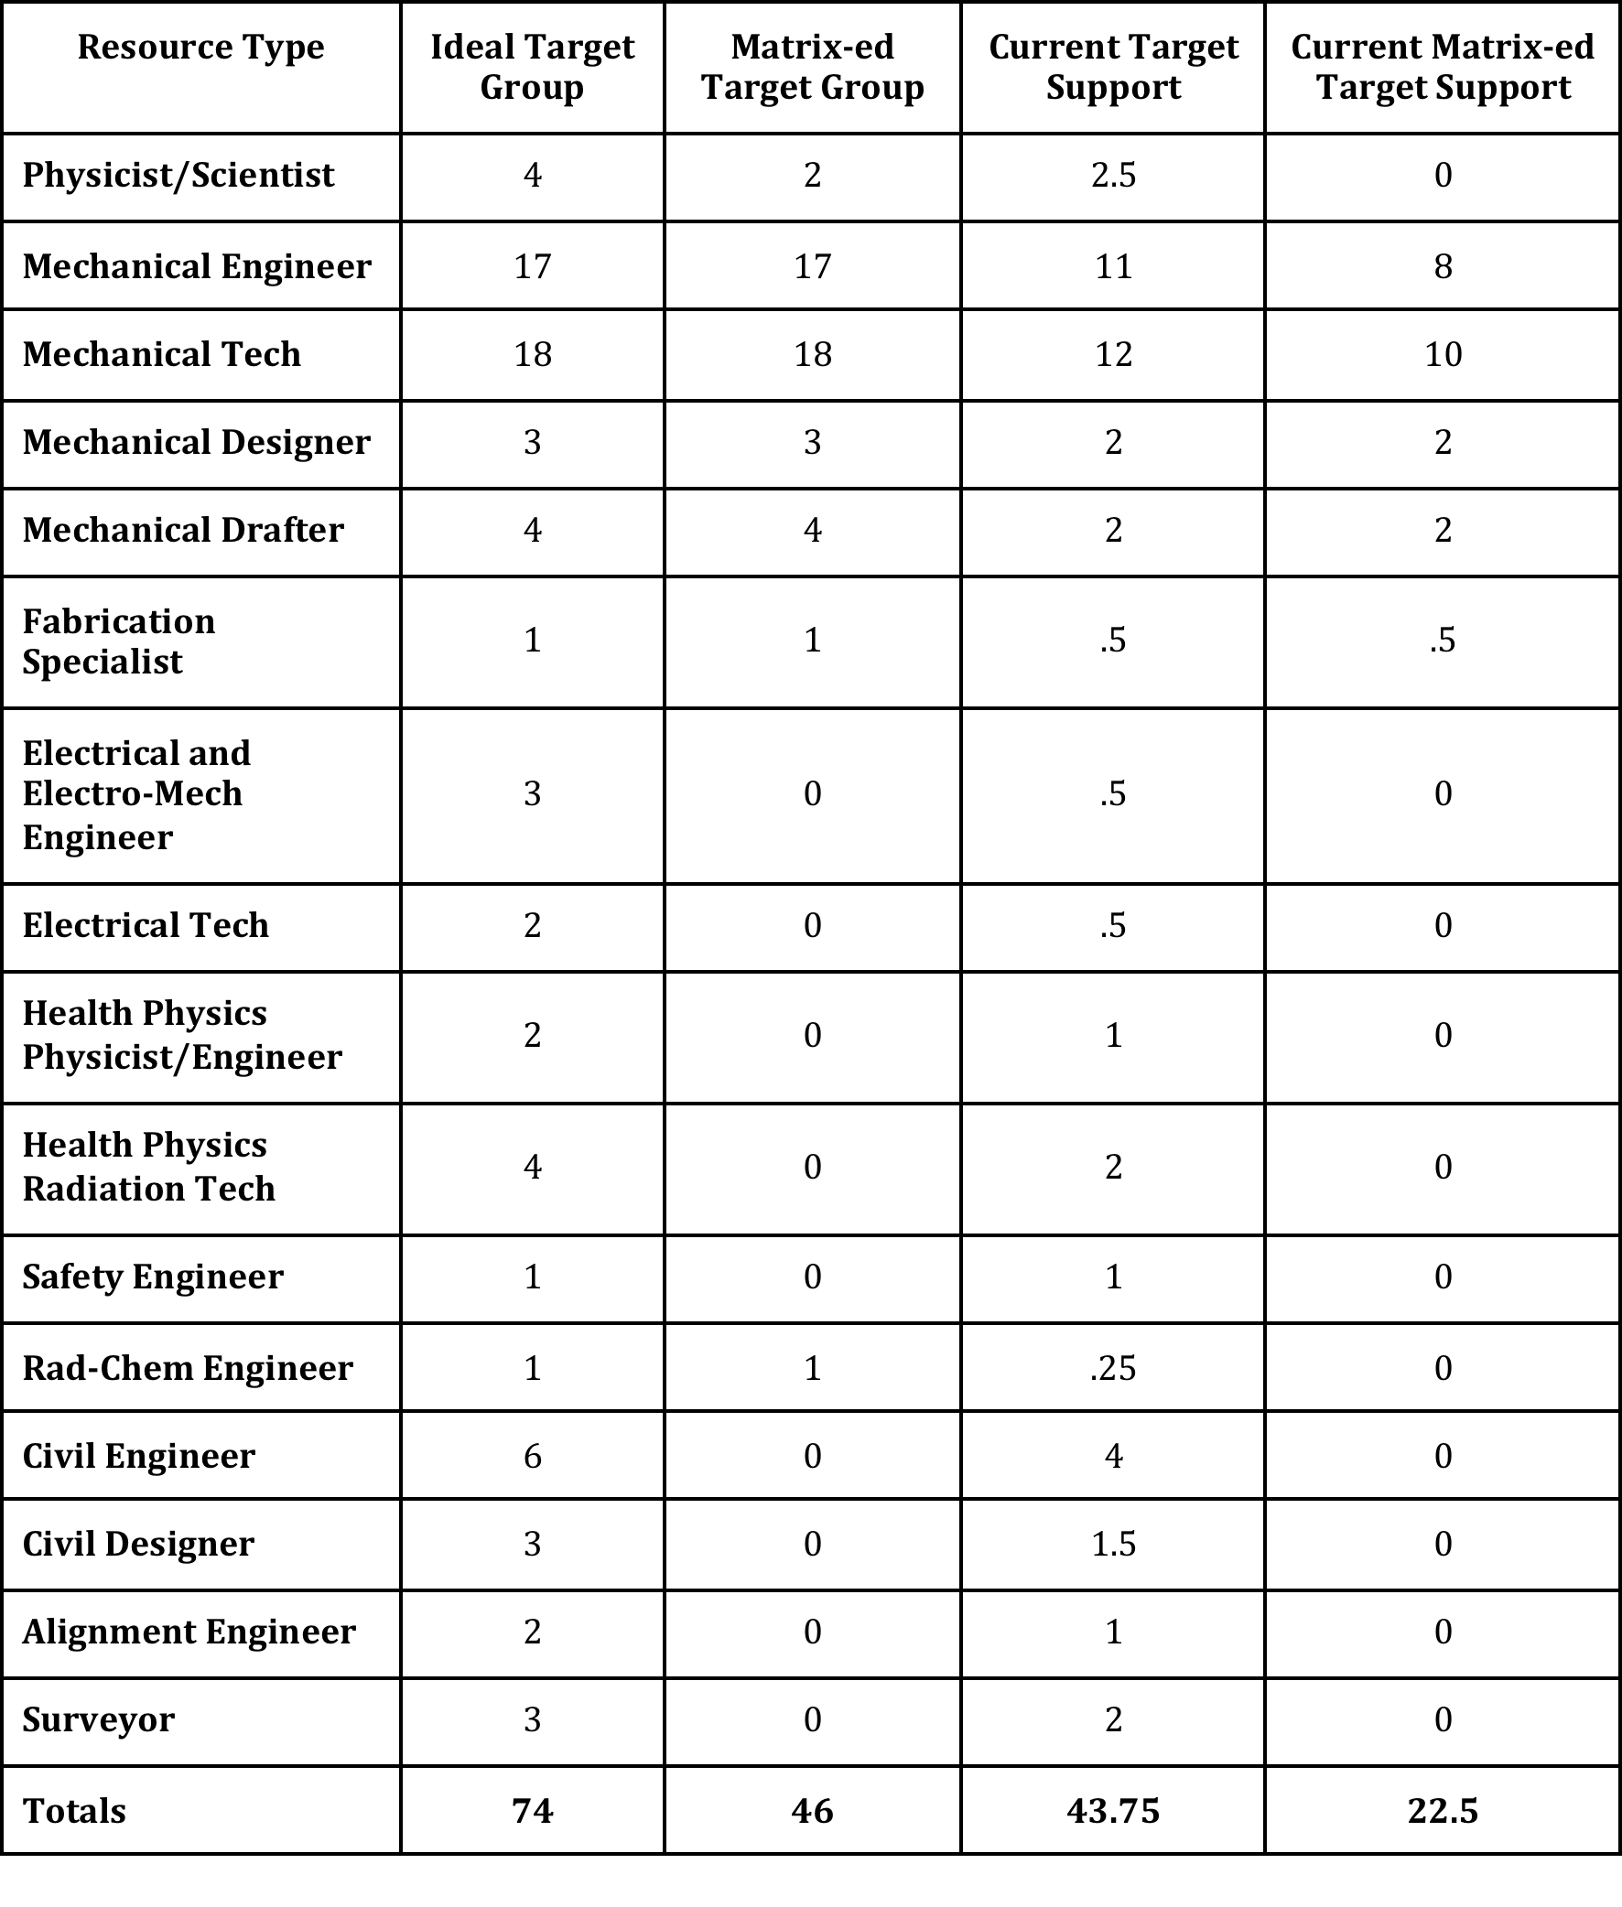
74 FTE required for full support
Approximately twice what we have currently
Probably a low estimate depending upon Project X era target facilities requirements

Slide 18
Current Facilities
  MI-8
  C-0 RHF
  TSB
  AP-0
  MI-65
Additional Req’d Facilities
  LT Radioactive Component Storage
  Assembly and Test Area
  Radioactive Work Cell
  Offices
Note: Does not include actual experimental target facilities

Slide 19
Expense Description | Year-One Costs (K$) | Out-Year Costs (K$)
Thermal Shock Testing | 50 | 30
Irradiation Testing | 100 | 50
Remote Handling Concepts | 30 | 30
Material Studies | 50 | 30
Analysis (software & computing) | 310 | 75
Travel | 75 | 75
Professional Development | 50 | 50
Test Stand Development | 50 | 20
Specialized Tools (LDV, etc) | 50 | 30
Totals | 765 | 390
Note: Only includes General Target R&D M&S costs (not labor, experiment/project and/or facility M&S costs)

Slide 20
Strategy - Barriers
Budget
  Not enough to fund from projects alone
People
  Need more in specific areas
  Can’t do this alone: Need to extend/expand current collaborative activities
R&D/Remote Handling gets pushed “off-project”
  Fine, in theory, but rarely gets addressed appropriately once off the radar

Slide 21
Near Term Plan – FY 12 Activities, Deliverables (D), Metrics (M)
Project/Operations related
  Mu2e CD-1 (D: CDR, M: Approval)
  G-2 CD-1 (D: CDR, M: Approval)
  LBNE CD-1 (D: CDR, M: Approval)
  NOvA upgrade construction/installation
  Complete NuMI/MINOS/MINERvA runs (D/M: PoT goals)
  Continue MiniBooNE running (D/M: PoT goals)
R&D related (LBNE currently funding)
  Complete BLIP graphite irradiation test data analysis (D: Final Report)
  Begin Be 2.4 MW target conceptual design study (D: Accord in place)
  Be single pulse testing plan (NOvA, GSI?)

Slide 22
Near Term Plan – FY 12 Activities, Deliverables, Metrics
Infrastructure/Organization related
  Project X era target facilities requirements report (D: Report, M: Review)
  LT Radioactive Storage Task Force Recommendation (D: Report)
  MOU with STFC in place (with work packages for collaboration identified) (Proton Accelerators for Science and Innovation Workshop, January, 2012) (D: MOU)
  Identify collaborators with material science experience for material characterization (ANL?, LANL?, GSI?)

Slide 23
Near Term Plan – FY 13/14 Activities
Project/Operational related
  Mu2e CD-2/3?
  G-2 CD-2/3?
  LBNE CD-2
  NOvA CD-4
  Project X era experiments CD-0/1??
  NOvA (and MiniBooNE) operations

Slide 24
Near Term Plan – FY 13/14 Activities
R&D related
  Finish LBNE 2.4 MW Be target conceptual design study
  Finish Be single pulse failure testing(?)
  Any required Project X era HPT R&D (may be quite a lot)
Infrastructure/Organizational related
  Construction of LT Rad Storage Facility
  HPT Support organization established

Slide 25
Resources
Near Term
  Project and operational activities utilize almost all available resources
  Leaves few resources to accomplish R&D and Infrastructure/Organization activities
  Some minor progress in R&D and Infrastructure/Organizational activities by myself and collaborators (RAL, BNL, ORNL), but need at least 4-5 FTE more to achieve FY12-14 goals listed
Long Term
  White Paper indicates 30-40 FTE needed to achieve 10 year goals (plus additional facilities and infrastructure)

Slide 26
Risks
Technical Risks
  Could be many of these depending upon Project X era target facilities requirements
  See list of engineering challenges PLUS:
    ADSR – spent fuel on site?
    Increased radiological release?
    Approaching “Nuclear Facility”
Scope, and Schedule Risks
  Largely related to lack of available, knowledgeable resources and lack of “generic” HPT R&D funding
  Visibility of HPT challenges appears to be lower than appropriate at FNAL (talk to SNS, CERN, and PSI)
  HPT facility requirements need to be determined and “vetted” ASAP to determine HPT R&D work in near future.

Slide 27
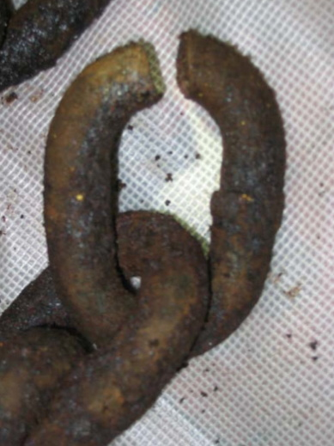
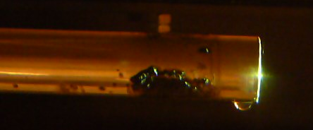
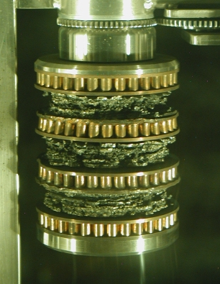
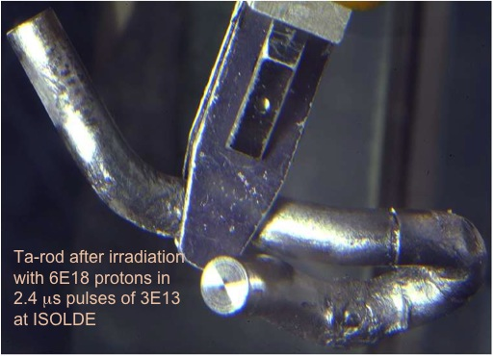
Motivation!

