Slide 1
SCRF Linac Systems Tests
M. Ross
“… Until the lay of the land is settled by further data from the LHC, all plans for future colliders are in suspended animation.”
Director’s Corner, 2011-10-11
But R & D on future lepton colliders is quite alive, even thriving, and each one of us should consider what constitutes an adequate systems test…
ILC SCRF systems testing will be done at Fermilab - NML.
ILC linac tests compatible with Fermilab high intensity program.
What is the plan and strategy?
Notes:
2) System tests for Pac
From previous PAC presentations:
What has been achieved at Flash
Xfel parameters
Nml parameters; stf and Qbeam.
Challenges: s1global issue of managing spread Pds baseline choice.
Mike's perspective: is this enough and what needs effort?
12 slides:
1) Summary previous Pac - the technology has been demonstrated. Grad, current, power, controls. Gradient calibration.
3) State of the art
2) Top level overview - parameters
4) Technical strategies to resolve issues
5) Gradient
6) Current
7) Power - PDS
8) Controls
9) Test facility parameters and near term plans
10) Resources - basis for global effort-kek fermi details. Where is the overlap?
11) Goals and schedule
12) Summary

Slide 2
GeV-class pulsed linacs based on TESLA technology:
  TTF (2001) 250 MeV; 17 cavities
  Demonstrated full current, stable acceleration
  SNS (2006) 1 GeV; 81 cavities
  98% SC linac availability
  FLASH (2005) 1.2 GeV; 56 cavities
    9 mA demonstrations (2008 -)
  KEK-STF (2013 -) ~ 16 cavities
NML (2012 -) ~ 48 high gradient cavities
EU-XFEL (2014) - 800 cavities

Slide 3
ILC Linac
Linac to provide 250 GeV mono-energetic, long-term stable, high power beams, reliably, with minimum cost.
Components:
HLRF Source
Power Distribution
Cavity/CM
“Beam”
Controls
Utilities
Cost Drivers:
Gradient
Cryogenics
Electricity/Cooling
RF Power Source/ Distribution
Pre-installation CM Testing
HLRF=High Level RF
CM=CryoModule

Slide 4
ILC Linac Baseline Testing:
TWO baseline High Level RF options:
  To best suit site topography
  Both require system tests
  Third option: RDR Backup
Gradient, RF Power, Utility, Cryogenic, linac length and controls overhead margins to be specified and tested
  Includes test of gradient ‘spread’
Primary Goal of System Test → COST
  Cost contained by best-effort evaluation of baseline cost ←→ performance relationship

Slide 5
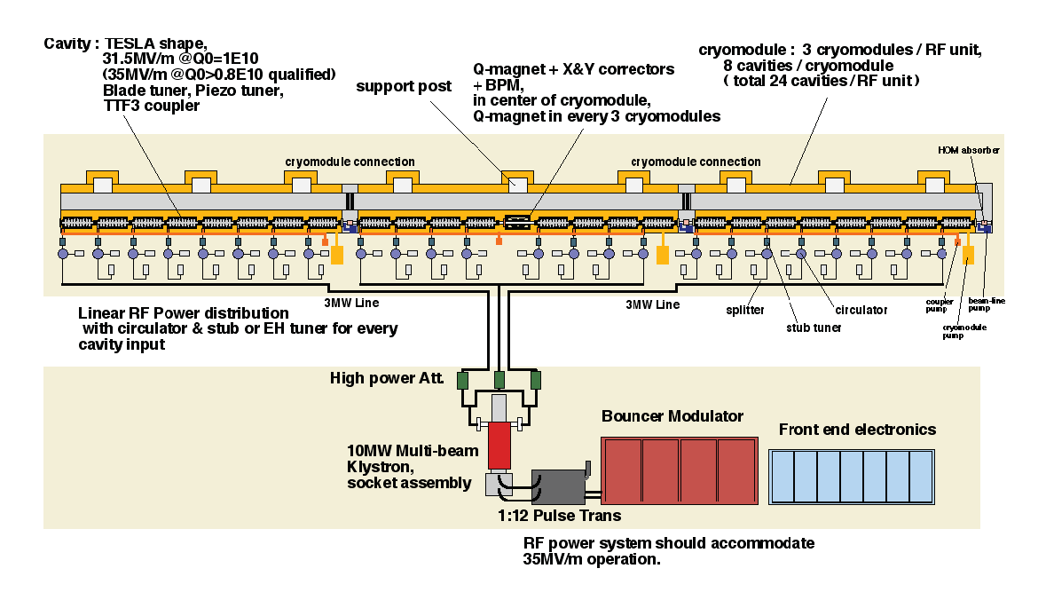
Reference Linac Design - 2007
(Basis for NML)

Slide 6
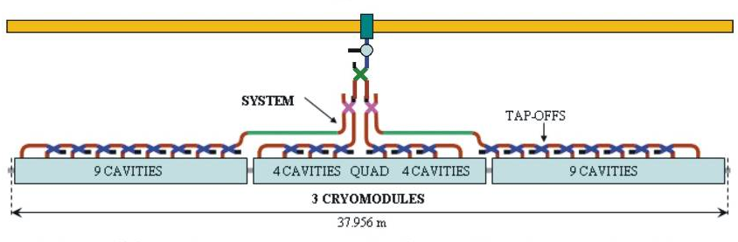
2009 Linac RF (KCS + DRFS):
KCS: 26 cavities powered from a single tap-off (similar to NML)
DRFS: cavities powered in groups of 4

Slide 7
Flattop Operation with a Spread of Cavity Gradients
cavity-by-cavity adjustable power and Q_l.
Rise time is common to all cavities –
Assumes flat distribution of limiting gradients 31.5 +/- 20%
Qext
Fractional Size
Most important slide
Input
Power
Reflected
Power
Gradient
31.5 MV/m
Average
24.5
MV/m
29.8
MV/m
38.5
MV/m
+/- 20% spread allowed

Slide 8
ILC Linac Parameters:
Number of cavities | 14,560
Repetition rate | 5 Hz
Gradient | 31.5 avg. MV/m (25 to 38 at most )
2 K Cryogenic load | 1.3 W / cavity average
Final Energy Stability / energy spread | 0.1% (per RF unit?)
250 GeV/beam | # of bunches | bunch spacing | beam current | beam duration | rf peak power | fill time, t_{i} | rf pulse duration
full beam RDR | 2625 | 369.2 ns | 9 mA | 0.969 ms | 294.2 kW | 0.595 ms | 1.564 ms
½ bunches A DRFS | 1313 | 738.5 ns | 4.5 mA | 0.969 ms | 147.1 kW | 1.190 ms | 2.159 ms (up 38%)
½ bunches B KCS | 1313 | 535.1 ns | 6.21 mA | 0.702 ms | 203.0 kW | 0.862 ms | 1.564 ms
½ bunches B RDR | 1313 | 553.8 ns | 6 mA | 0.727 ms | 196.1 kW | 0.893 ms | 1.619 ms (up 3.5%)

Slide 9
FLASH: Primary ILC System Test
56 Cavities; 7 cryomodules
3 Klystrons (power?)
Gradient demonstration
Cavity coupling (Q_l) control
No individual cavity power control (P_k)
Worse than ILC limit

Slide 10
FLASH (DESY) System Test Achievements:
High beam power and long bunch-trains (Sept 2009)
Metric | ILC Goal | Achieved
Macro-pulse current | 9mA | 9mA
Bunches per pulse | 2400 x 3nC (3MHz) | 1800 x 3nC 2400 x 2nC
Cavities operating at high gradients, close to quench | 31.5MV/m +/-20% | 4 cavities > 30MV/m
Gradient operating margins (Feb 2011)
Metric | ILC Goal | Achieved
Cavity gradient flatness (all cavities in vector sum) | 2% ΔV/V (800μs, 9mA) | 2.5% ΔV/V (400μs, 4.5mA) “Methodology established”
Gradient operating margin | All cavities operating within 3% of quench limits | (Focus of early 2012 run)
Energy Stability | 0.1% at 250GeV | <0.15% p-p (0.4ms) <0.02% rms (5Hz)
Priority

Slide 11
Summary: System Test Objective: 2012→
Remaining topics: Linac engineering @ full gradient
Prove and Characterize Overhead ‘Margins’:
  Gradient
  Power
  Cryogenic
  Utility
  Controls
Study (at nominal parameters):
  Performance
  Controls methodology
  Failure rates / reliability
  Degradation

Slide 12
Gradient: ‘Operational Margin’
Lessons from existing linacs:
  SNS: radiation - generated heating
  Flash: controls strategy / implementation
Gradient Beam-Calibration – a very important benefit of FLASH
Performance may never better than in vertical test; except (possibly) through rinsing
Relationship between Practical (CM) and Intrinsic (VTS) cavity performance;
  e.g. limits due to external constraints… quench, radiation, cryo load.

Slide 13
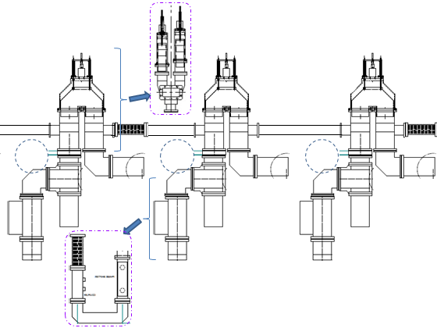
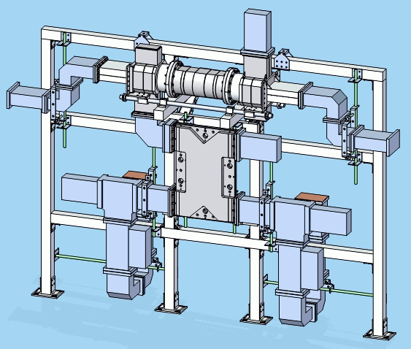
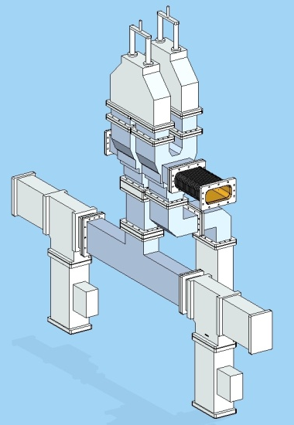
Power Distribution System
How to tailor power feed for each cavity
Cost effectiveness of:
  Circulators
  Power controls (mechanized)
  Cavity pairing
Folded Magic-T’s and Motorized U-Bend s for Each Cavity
remotely adjustable by pairs
no pair sorting required
circulators necessary
Original VTO (Variable Tap-Off) Pair-Feeding Concept
manually adjustable by pairs
requires pair sorting
circulators can be eliminated
Alternate Scheme w/ Folded Magic-T’s and Motorized U-Bend Phase Shifters
remotely adjustable by pairs
requires pair sorting
circulators can be eliminated

Slide 14
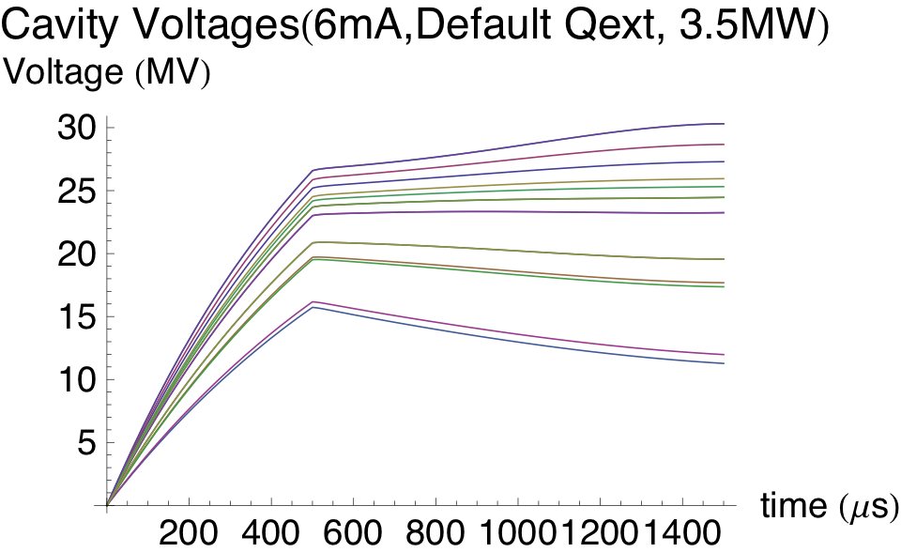
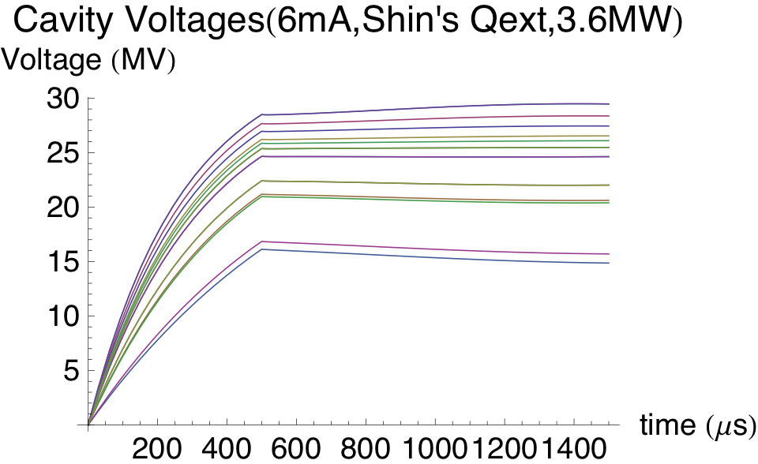
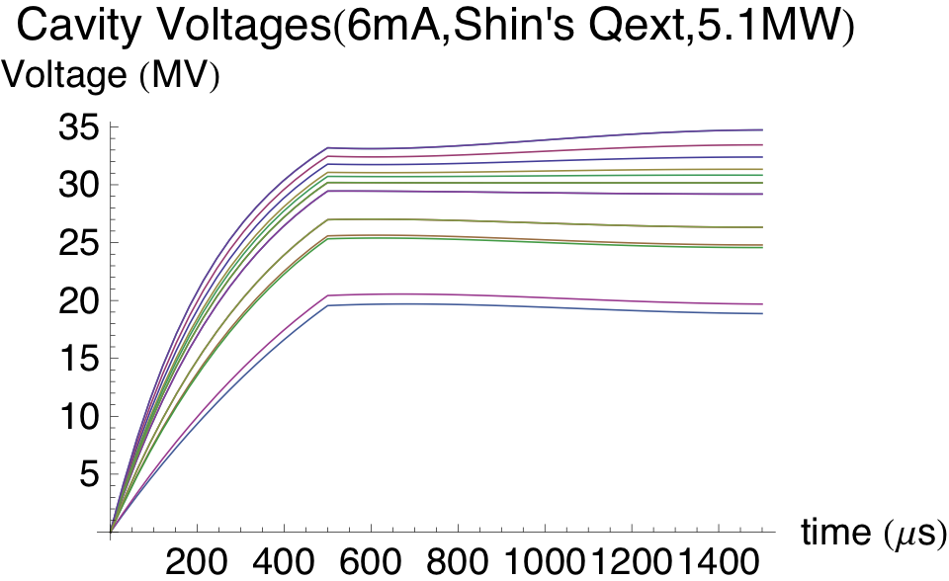
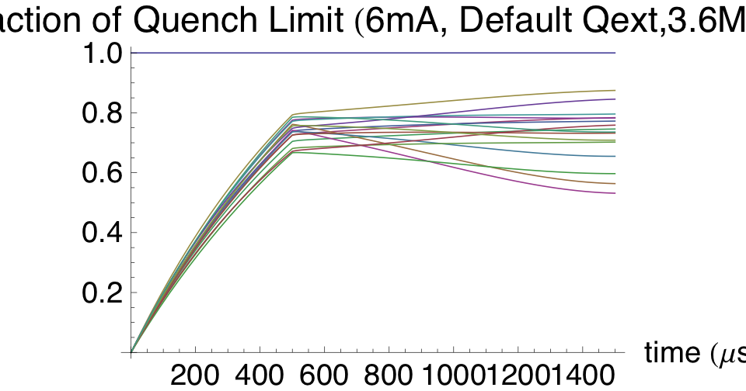
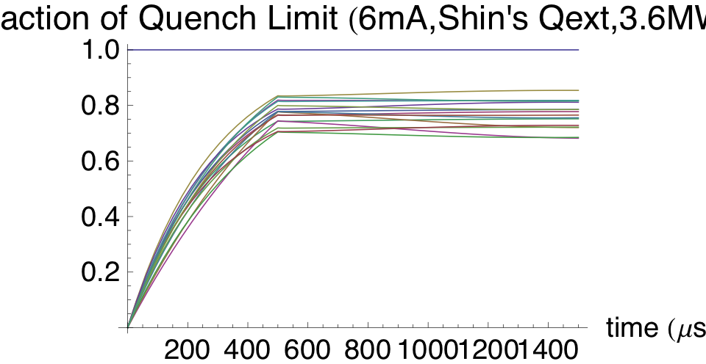
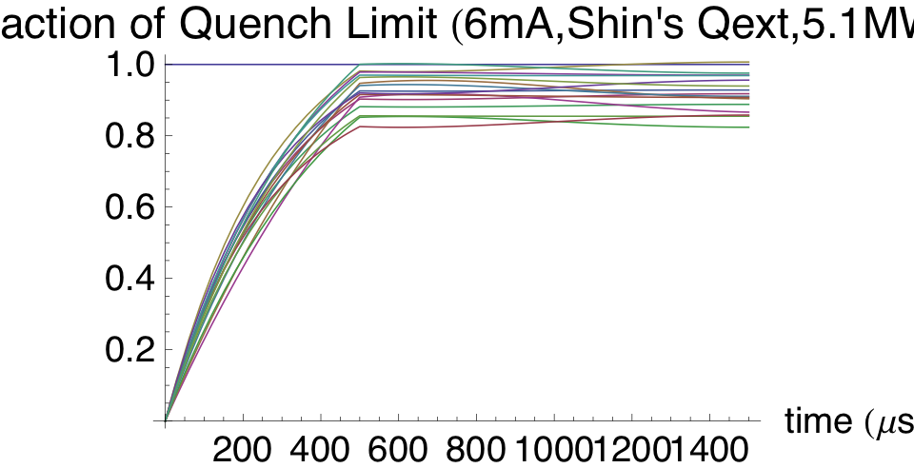
Methodology for ramping to maximum gradient and full beam loading…?
Julian Branlard
Step 1
Step 2
Step 3
Cavity Voltages: 6mA
Default Qexts, 3.5MW
Cavity Voltages: 6mA
Shin’s Qexts, 3.5MW
Cavity Voltages: 6mA
Shin’s Qexts, 5.1MW
Fraction of quench limit
Fraction of quench limit
Fraction of quench limit
Would be possible to do initial tests of methodology in RF-only mode at NML?

