Slide 1
Protoplasma : A strategic initiative
Jayakar Thangaraj
on behalf of the protoplasma team

Slide 2
Why Protoplasma?
Linear colliders are increasing in cost and scale.
Can we make compact accelerators? Plasmas can support large electric fields.
Recent results on electron acceleration
Laser-driven (1 GeV in 3.3 cm)
Electron beam driven (42 GeV in 85 cm)
Problem
Many acceleration stages would be needed to reach TeV.

Slide 3
Protoplasma – a new research frontier
Plasma act as an energy transformer.
“Conventional” accelerators produce TeV proton beam. kJ’s of energy.
Key Idea
Use an existing high energy proton beam to drive a plasma wake and accelerate an electron beam
Implications
We could accelerate electrons to TeV in a single stage. This will be a new research frontier.

Slide 4
Protoplasma experiment: a strategic plan
Where are we going?
Vision: To be the world leader on advanced accelerator research leading proton driven plasma wakefield experiments, theory and simulation.
Where are we now?
Strength, weakness, opportunities
How will we get there?
Plotting the course :Tasks, Timeline, Threats
Monitoring : Metrics and Milestones
Alternatives: Scenario planning

Slide 5
Strategic plan : Where are we now?
Strengths:
A sophisticated proton delivery system already in place.
Ongoing efforts on high intensity proton drivers.
Technical expertise in design, diagnostics and operations.
Proton beams have been our flagship for decades
Weakness
We need to have a strong proficiency in plasma cell design.
Solution: “Enlist UCLA as alliance”. A well-known world leader in plasma physics R&D. We have had great relationship with them.
Opportunities
We will be the first team ever to lead this class of experiments.

Slide 6
Strategic plan : Plotting the course
Phase I: March 2012 to Dec 2013 (2 years)
Simulation
Constructing the plasma cell.
Diagnostics installation
Proton delivery.
Phase II: 2014 – 2015 (2 years)
Develop the laser lab
Develop the electron injector
Phase III: 2015 – 2016 (1+ years)
Actual experiments
Goal : Show energy loss from the proton beam
Goal : Generate the electron beam
Goal : Demonstration, data collection and publications

Slide 7
Strategic plan : Metrics with Milestones
Phase I: (2 years)
Parameter space exploration through simulations
Installing the plasma cell. (10¹⁵/cm³ , 3-5 m)
Proton delivery. (150 GeV, 1ns, 1e11 protons/bunch)
Measurements & Milestone:
Optimal parameters are determined
Demonstrate proton density modulation compare with simulations
Strength of the fields in plasma compare with simulations

Slide 8
Strategic plan : Metrics with Milestones
Phase II: (2 years)
Workout optimal seeding of plasma with a laser
In parallel, develop the electron injector ( 5 MeV, 1ps)
Measurements & Milestone:
Show stronger fields and reproducibility
Generate 5 MeV, 1 ps electron beam
Phase III: (1+ years)
Actual experiments (1 GeV in 3 meters).
Measurements & Milestone:
Electron acceleration with modulated proton bunch

Slide 9
Strategic plan : Charting the course
 | 2011 | 2012 | 2013 | 2014 | 2015 | 2016 | 2017
Approval
Experiment design Simulations Plasma cell R&D
Beamline restructuring
Measurements of proton beam modulation
Seeding
Electron injection
First demonstration of proton wakefield acceleration

Slide 10
Two roads: TeV or external beamline

Slide 11
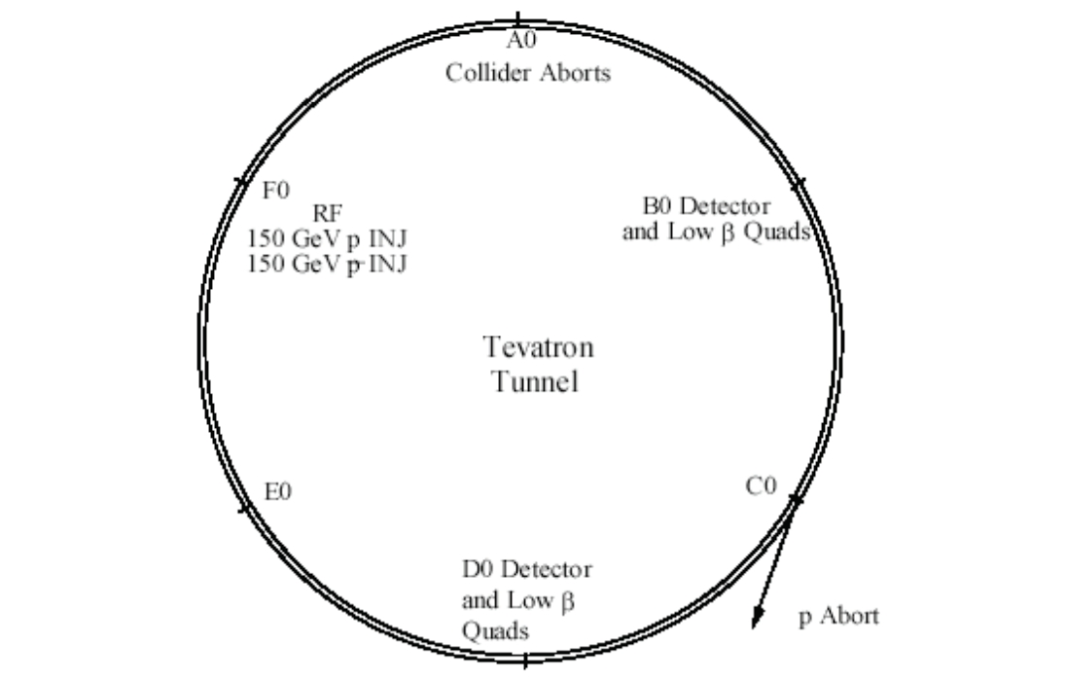
The TeV option for Protoplasma
Recipe
Inject 150 GeV protons at 1E11 protons per pulse from MI to Tevatron.
Beam is single pass from F11 to B17
Beam will interact with plasma located in the CDF collision hall.
There will be detector and beam bump at ~B17
F0 to A49
CDF collision Hall
Portion of B section

Slide 12
The Tevatron : Strengths
Summary of the rounds of talk with the Tevatron folks
The beam optics for 150 GeV falls within the parameter requirements for the wakefield experiment.
The transverse beam size can be small ~100 microns
Will be able to “use the TeV as is” with some modifications. This is a major headway already in the project.
Possible designs to fit the experiment within the CDF hall and reduce cost significantly. Dispersion control.
Notes:
Suggestion by Alex: CDF Hall can it be used completely. Beam dynamics.

Slide 13
The Tevatron : Threats
Installing the plasma cell
CDF Hall space allocation unclear.
Proton delivery at Tevatron
Will need to recertify houses from F11 to B15 for cool down in 2012 to 2013. 24 weeks
Power supply for B sector, Low beta power supply
Tevatron correction circuits
Small impact on the instrumentation and vacuum conflict with NOVA
Controls and LCW.
May have an impact on g-2 and mu2e due to sharing cryo @ F3

Slide 14
The Tevatron : Cost ~ $ 6 M
Cryogenics (The big ticket item)
Refrigerator work 40 weeks (~ 500 K)
We have to run F, A, B sector cryogenically
Half the current running cost of TeV ~ 4 million per year
People 2 post-docs .
Safety 30 K
Plasma cell 500K
Mechanical and Electrical
48 weeks 10 hours a day 5-6 man crew
< 500K (certify TeV)
Power supply (assuming no change the ring , HOPS)
No significant cost M&S (100 K)
6 people (3 techs and 3 engineers) 2-4 weeks
Cost of moving CDF Hall
Notes:
Certifcation, magnets….

Slide 15
Plan B: External Beamline
Summary from talking with the external beamline folks
No experience in operating single turn extraction.
Radiation shielding potentially expensive because of primary beam in a secondary enclosure.
Electron injection may have to be done earlier in the experimental phase compared to TeV option
Difficult to get the transverse beam size be less than a few mm without significant modifications.

Slide 16
Plan B: External Beamline : Cost $ 7 M
Estimates
Magnets, ~ $4 million
Power supply ~ $ 2 million
Cables, dipoles, engineering FTE ~ 400 K
Plasma cell ~ 500 K
Time to install ~ 6 months – 1 year long
Available space is about 200 m long

Slide 17
Plan B: External Beamline : Strength
Long term running
No cryogenics
Far east Meson building (another option under consideration)
Pending investigation of options

Slide 18
…..is to build an accelerator based on this technology
Let’s remember our overarching goal
Once we demonstrate electron acceleration, we could then start
Thinking about proton bunch compression at 150 GeV
For starters, we can imagine using the 8 GeV beam for bunch compression and then drive the plasma.

Slide 19
In a nut-shell…
Protoplasma - a new research frontier in Fermilab AARD
Two options: TeV or the external beamlines
For the TeV : + “As is”
+ Optics
- Cryogenics + other costs
External beamlines :
- Greenfield
- Time
+ Normal magnets
+ Long term advantage

Slide 20
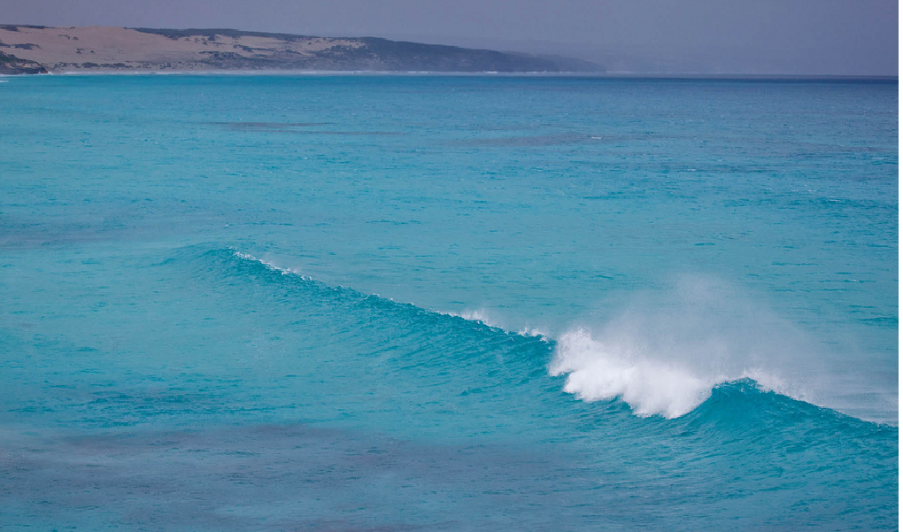
……the hub for leading proton driven plasma wakefield experiments.
Thanks to Dean Still, Spentz, Vladimir, Jerry for terrific advice and support
Looking into the horizon

Slide 21
Questions ?

