Slide 1
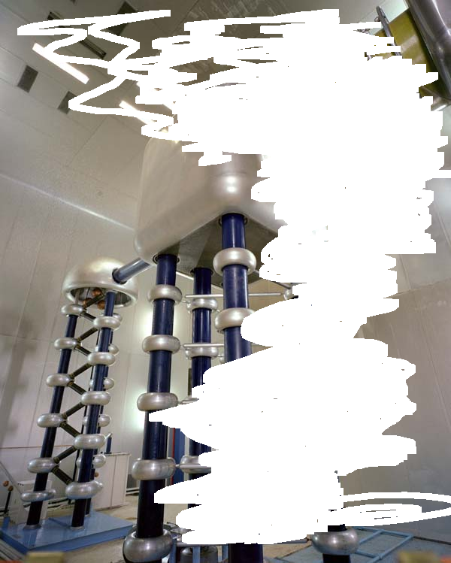
Proton Improvement Plan
Accelerator Sector Planning and Strategy
Oct. 27 and 28
W. Pellico
Bob Zwaska, Keith Gollwitzer, Fernanda Garcia
Valery Lebedev, Elmie Peoples-Evens, Mary Convery

Slide 2
Outline
History of recent Proton Source upgrade effort
Goals
Present Work/Schedule/Plans/Effort/Dreams
  Look at several key systems
Concerns
  Labor
  M&S
  Schedule
Summary

Slide 3
Proton Improvement Plan Development
Proton Task Force FY10
  Initial effort to understand Proton Source Concerns
  Build up RFQ effort
Proton Improvement Plan FY11
  Review of PTF (PIP workshop)
  Review of additional issues associated with FLUX
Management Structure
  Re-arranging the furniture (Bob Webber leaving)
Planning Structure
  Find suitable managers and labor
Cost and Labor Refinement (Ongoing)
  After initial work a continued effort to firm up numbers

Slide 4
Proton Improvement Plan - PIP
Stuart Henderson (PIP Workshop Jan. 2011)
The goals of the Proton Improvement Plan are as follows:
Increase the beam repetition rate from the present ~7 Hz to 15 Hz
Eliminate major reliability vulnerabilities and maintain reliability at present levels (>85%) at the full repetition rate
Eliminate major obsolescence issues
Increase the proton source throughput, with a goal of reaching > 2E17 protons/hour
Ensure a useful operating life of the proton source through at least 2025
The timeframe for realizing these goals will depend on the funding profile. In order to deliver the proton throughput displayed in Figure 3 would require:
Delivering 1.8E17 protons/hour (at 12 Hz) by May 1, 2013
Delivering > 2.2E17 protons/hour (at 15 Hz) by January 1, 2016

Slide 5
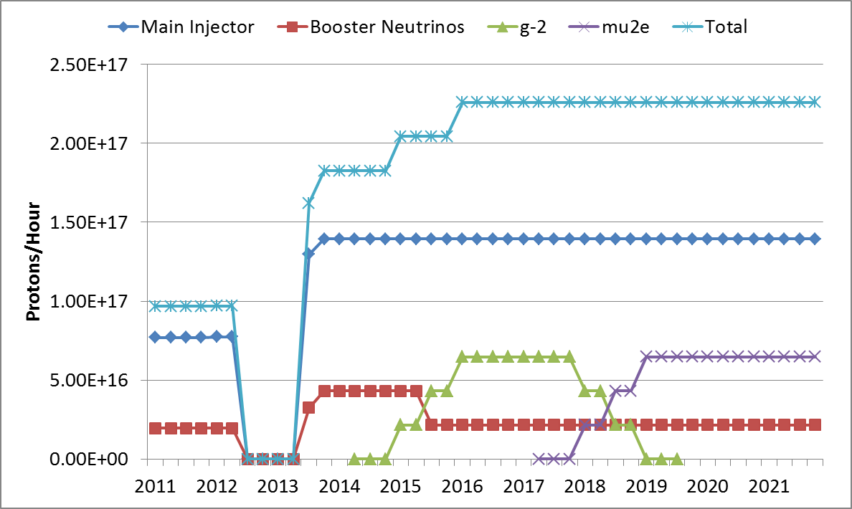
Proton Source Throughput Demands - Goals
This jump in flux requires
completion of Booster RF
Upgrade.
This requires the rest of the PIP
120 GeV ν
LBNE
NOvA Shutdown
g-2
Mu2e
8 GeV ν
Fermilab Institutional Review, June 6-9, 2011

Slide 6

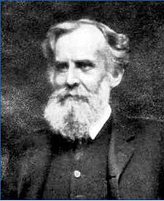
Reliability
Flux
Solid State
Upgrade
Anode Supplies
LCW
Work
Cavity /Tuner
Refurbishment
Bias Supplies
Beam
Physics
Linac Modulators
New Booster
Cavities
Linac
RF Power
Instrumentation
Vacuum
Systems
RFQ
Injector
Cogging
Aperture
Work
New
Tuners
Spare
Cavity
Dampers
Linac
Notch
Utilities
Power
Booster
Notcher
Dump
Shielding
ES&H, Radiation
Physics
The Proton Improvement Plan (using PTF)
generated a list of systems that required
upgrades or work in order to meet PIP directive.
The work/systems can be categorized into three groups.
In FY11 a funding profile with required manpower was
generated and used as guidance for PIP/laboratory planning.

Slide 7
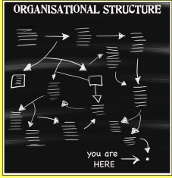
PIP Organization Structure
Bill Pellico
Bob Zwaska, Deputy
Elmie Peoples-Evans, Project Controls Mary Convery, Shutdown Coordinator
Valeri Lebedev, Russian Agent
Note: Not a full or even
part time job for many!!
Linac: Fernanda Garcia
Booster: Keith Gollwitzer
RFQ Injector --
C. Y. Tan
200 MHz Accelerating System --
Fernanda Garcia
  HLRF - ???
  Linac Modulator - Trevor Butler
  7835 Procurement - Fernanda Garcia
Accelerator Physics --
Valeri Lebedev
  Linac Lattice , Orbits and Collimation -
  Hyung Jin Kim
  Linac Notch Creation - Dave Johnson
  400 MeV Optics Matching & Collimation -
  Valeri Lebedev
Instrumentation --
Craig Drennan
  BPM Upgrade - Nathan Eddy
Controls Upgrade --
Mike Kucera
Utilities -
Patrick Karns
  Power Distribution - Steve Hayes
  Cooling System - David Hixson
  Vacuum Systems - Dave Augustine
  Booster RF --
  John Reid
    Anode PS - Rene Padilla
    Bias Supplies - Pat Sheahan
    Cavity & Tuner Refurb. -
    Matt Slabaugh &
    Mary Convery
    New Tuners -
    Matt Slabaugh &
    Ralph Pasquinelli
    New Cavities - Valeri Lebedev
    Cavity Test Stand - Name f/ Reid
    Spare Cavity - Matt Slabaugh
  Solid State --
  John Reid
    Modulators - Pat Sheahan
    Solid State Amplifier -
    Tom Kubicki
  Instrumentation --
  Craig Drenen
    Dampers - Nathan Eddy
  Controls--
  Craig Drenen
  Booster Utilities --
  Todd Sullivan
    Distribution - Steve Hayes
    95LCW System - Maurice Ball
    Vacuum - Dave Augustine
  Intensity & Loss Improvement --
  Bob Zwaska
    Alignment & Aperture -
    Kiyomi Seiya
    Booster Notcher - EE Supt.
    Cogging - Kiyomi Seiya
    Collimation - Valeri Lebedev
    Instabilities & Feedback -
    Bob Zwaska
    Injection Painting -
    Valeri Lebedev
    Radiation Shielding -
    Peter Kasper

Slide 8
Present Task Codes
(Will expand with funding and plans)
2103.00.01 Proton Improvement Plan Program Management
2103.01.01.00 Linac 200 MHz RF Power System Planning & Oversight
2103.01.01.01.01 Linac 200 MHz RF PS PA Prelim Design
2103.01.01.01.02 Linac 200 MHz RF PS PA Prototype
2103.01.01.02.01 Linac 200 MHz RF PS Modulator Prelim Design
2103.01.01.02.02 Linac 200 MHz RF PS Prototype
2103.01.01.03 Linac 7835 Tube Procurement Strategy
2103.01.02.01 Linac Accelerator Physics Studies
2103.01.02.03 Linac Notching System Improvements
2103.01.03.01 Linac Beam Instrumentation
2103.01.04.01 Linac Beam Controls Prelim Design
2103.01.05.01 Linac Power Distribution Planning and Design
2103.01.05.03 Linac Vacuum Systems Replacement
2103.02.01.01.01 Booster RF Anode PS Planning & Oversight
2103.02.01.02.01 Booster RF Bias Supp Planning & Oversight
2103.02.01.02.02 Booster RF Bias Supp Design & Specs
2103.02.01.04 Booster RF Test Stand
2103.02.01.05.01 Booster RF Cavities and Tuners Rework Planning & Oversight
2103.02.01.05.02 Booster RF Cavities and Tuners Rework
2103.02.01.06.01 Booster New RF Tuners Planning & Oversight
2103.02.01.06.02 Booster New RF Tuners Design
2103.02.01.06.03 Booster New RF Tuners Fabrication
2103.02.01.07.01 Booster New RF Cavities Planning & Oversight
2103.02.01.07.02 Booster New RF Cavity Preliminary Design
2103.02.01.08 Booster RF Cavity 20
2103.02.02.01 Booster Accelerator Physics Studies
2103.02.02.02 Booster Aperture and Alignment
2103.02.02.03 Booster Notching System Improvements
2103.02.02.04 Booster Beam Cogging System
2103.02.02.06 Booster Radiation Shielding
2103.02.03.01 Booster Beam Instrumentation Planning & Design
2103.02.03.02 Booster Damper Systems Improvements
2103.02.04.01 Booster Beam Controls Prelim Design
2103.02.05.01 Booster 95 LCW Improvements
2103.02.07.01.01.01.XX Booster RF SS Upgrade CWIP Power Amplifier - Contra Account
2103.02.07.01.01 Booster RF SS Upgrade CWIP Power Amplifier
2103.02.07.01.02 Booster RF SS Upg CWIP SS Driver Amplifier
2103.02.07.01.03 Booster RF SS Upg CWIP 300 kW Modulator
2103.02.07.01.04 Booster RF SS Upg CWIP Installation

Slide 9
PIP Funding Profile
Year | M&S Funding ($44.4M)
FY12 | 6.2
FY13 | 6.2
FY14 | 13.3
FY15 | 12.3
FY16 | 6.4
FY12 M&S (TOP TASK LEVEL)
2103 Proton Improvement Plan 5,117,000
2103.01.01.01.02.AD AD-Linac PIP 200 MHz RF PS PA Prototype 916,000
2103.01.01.04.AD AD-Linac PIP 7835 Tube Acquisitions 211,000
2103.01.06.01.AD AD-Linac PIP Vacuum System Replacement 100,000
2103.02.01.01.01.AD AD-Booster PIP RF Anode PS Planning & Oversight 700,000
2103.02.01.03.02.01.AD AD-Booster PIP RF Tuners Planning & Oversight 748,000
2103.02.01.04.AD AD-Booster PIP RF Test Stand 300,000
2103.02.02.03.AD AD-Booster PIP Prototype Linac Notcher 50,000
2103.02.05.01.AD AD-Booster PIP 95 LCW Improvements 214,000
2103.02.05.05.01.AD AD-Booster PIP Long 13 Absorber and Shielding 118,000
2103.02.06.01.AD AD-Booster PIP Vacuum System Replacement 100,000
2103.02.07.01.01.AD AD-Booster PIP RF SS Upgrade CWIP Power Amplifier 285,000
2103.02.07.01.02.AD AD-Booster PIP RF SS Upg CWIP SS Driver Amplifier 175,000
2103.02.07.01.03.AD AD-Booster PIP RF SS Upg CWIP 300 kW Modulator 1,000,000
2103.02.07.01.04.AD AD-Booster PIP RF SS Upg CWIP Installation 200,000
The BURDEN of business

Slide 10
5+ Year Schedule
15 Hz Capable (NOT FLUX or Reliability Goals)

Slide 11
Solid State Installation Schedule
To finish the Booster solid state by 2013 will require
the requested labor and access time.
Installation Time (months)
Current
Calendar Year

Slide 12
Cycle Rate Increase
PIP Plans vs. Reality
Present Schedule
Going from 7.5Hz to 12 Hz requires about the same effort as 15 Hz.
  Plan is go to directly to 15 Hz
    Solid State Upgrade
    Cavity Refurbishment
      Cooling
      Tuners
      Misc Hardware
    Cooling Systems
    Bias Supplies
  Address reliability concerns as part of the process
    Anode Supplies
    Spare Cavity
    Spare Tuners
Requested (Goals)
12 Hz by 2013
15 Hz by 2016

Slide 13
RFQ Injector (PIP)
Started in 2010
Completion Date – FY12 shutdown
Total cost will be around $1.1 M
  Cost higher on Vacuum and Power Supply
  Cost lower on RFQ and magnets
Reviewed Aug 2011
  Positive Review
  No recommendation other than to test MEBT
Starting Beam testing up to RFQ
Power conditioning of RFQ underway
Note: This project has developed FNAL expertise that can and will assist in operations and further development!
NO SYSTEM IS TURNKEY – Experience can’t be bought!

Slide 14
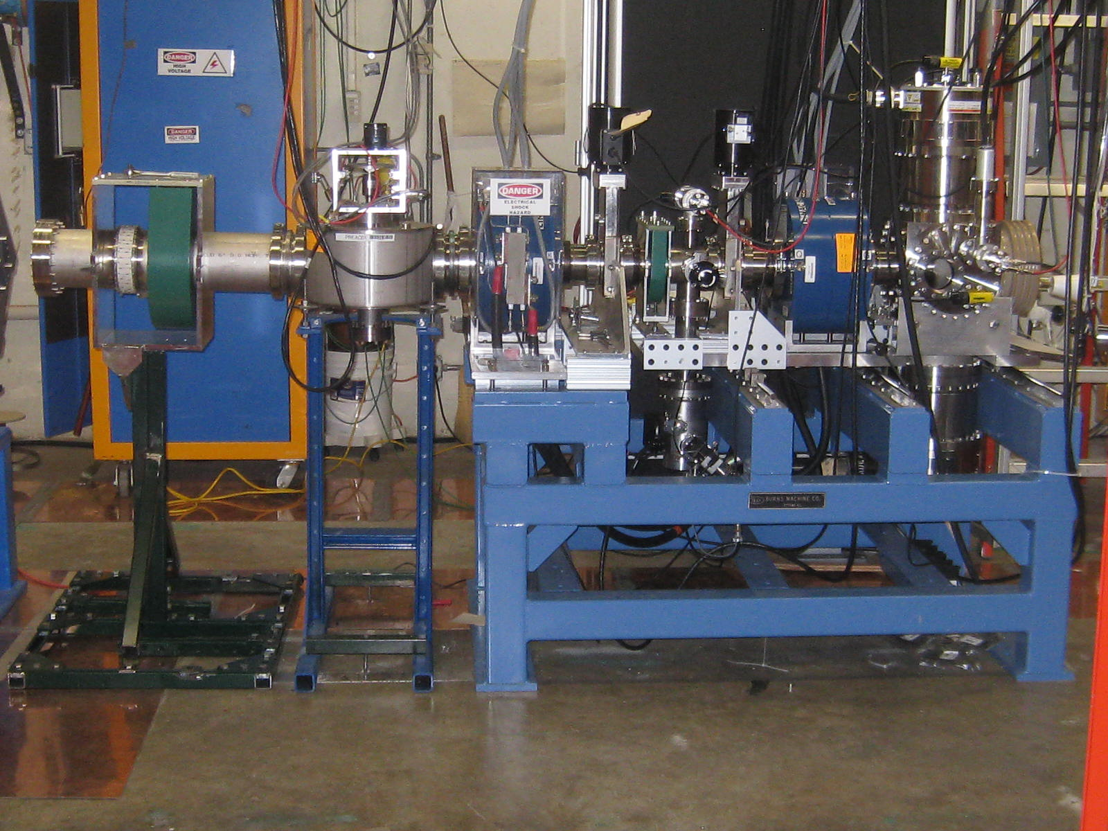
H- source, LEBT and Diagnostic Line
Beam Testing Underway

Slide 15
PIP Concerns
Labor
  Consistent Labor Effort
    People are moving around – (can be seen on SS effort)
      Starts and Stops to work
      Inefficient and difficult to manage
      Domino affect on production effort
  Knowledgeable People
    Key people are not easily replaceable
    Skilled help is tough to get when needed
M&S
  Delays in approval process has slowed some work
  $$ upfront is required to meet early goals (SS, RF)
Too many Project X (now PIXIE) meetings
  This ties up a couple of critical people

Slide 16
Conclusion
The early issues of M&S, labor and organization are still being worked out. Although progress is being made – especially since additional labor became available this FY12, the timeline is going to be difficult to meet. The concern of losing people on a regular basis to other areas is real and has affected our schedule. The other area of concern is finding solutions to several problems in a time consistent with PIP. We expect to reach 15 Hz operations and a higher flux by 2013 or 2014 with requested manpower. However, reliability and the requested flux will require completion of the entire PIP!

Slide 17

Fermilab program expressed in three frontiers
Intensity Frontier
At Fermilab, physicists use a beam of protons from the Main Injector accelerator to create the most intense high-energy neutrino beam in the world. Magnets direct the protons onto a graphite target. …..blah blah blah……
The facility that creates Fermilab's neutrino beam is called NuMI, for Neutrinos at the Main Injector. The neutrinos travel between two detectors for an experiment called MINOS, or Main Injector Neutrino Oscillation Search. One sits at Fermilab; the other is located 450 miles away in the Soudan Underground Laboratory in Minnesota. The NuMI Beamline is aimed downward at a 3.3 degree angle toward the underground laboratory. Neutrinos interact so rarely with other particles that they can pass untouched through the entire Earth.
Just a note to the Directorate and the DOE…Proton Beam comes from the Proton Source and without it the three frontiers circles looks more like a two ring circus!

Slide 18
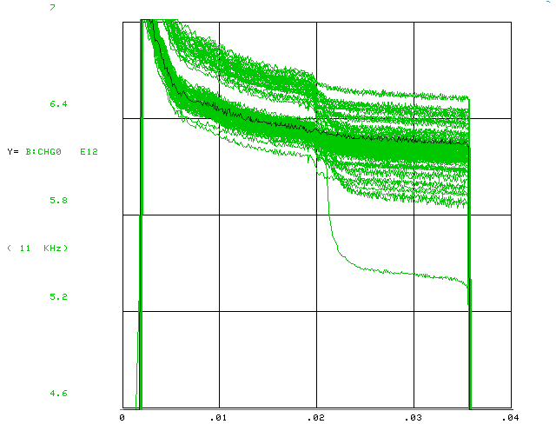
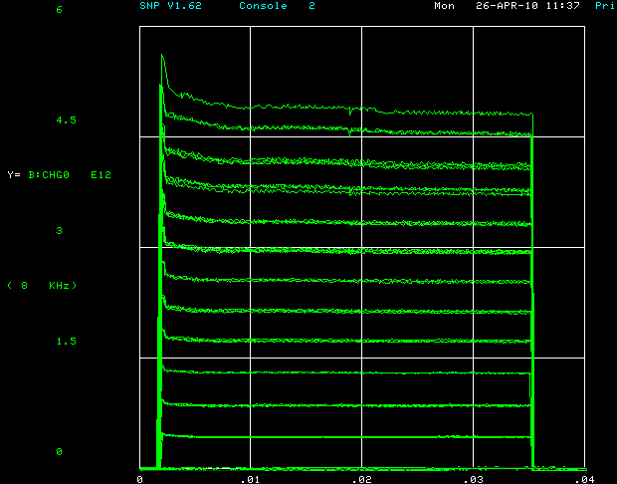
Beyond PIP
What are the limits of what the proton source can provide?
  Have extracted up to 6.6e12
  Can produce beam fairly efficient up to ~ 5e12
  Only promise 4.3e12 to MI
  Beam quaility must be met for MI
Challenging, but in principle, batch intensity could increase 10-40%

Slide 19
Beyond PPI -> MI
Still some fixed time in ramp
  flattop/bottom
  Hysteresis dip
  Gentle parabolas
How far could it be pushed?
  1.2 s?
  1.0 s?
Gains are multiplicative with Booster intensity gains

Slide 20
Beyond PIP, Summary
PIP capability is based on things we mostly know
  Per batch Booster intensity
    4.3e12 @ 0.08 eV.s
  Main Injector
    1.333 s ramp for NOvA
  All of our vulnerabilities
In case replacement of the Proton Source is dragged out, we should see how far we could push it after the PIP
  We may see significant improvement in Booster efficiency and emittance from the RFQ injector upgrade
  For PIP we have applied conservative estimates to the gains we gets from other systems:
    Solid state upgrade
    Booster cavities
    Magnet alignment & Optics improvement
    Collimation & Loss Control
  What if we do get really significant gains?
Potential gains are just speculative, but 50% at 120 GeV can’t be ruled out

Slide 21
What if you only get part of a Project X?
By injecting at a higher energy, we can increase the beam current in a new Booster
  Make a new set of magnets, but reuse as much as possible (civil, utilities, power supplies, etc.)
Using the present maximum space charge tune shift at injection (400MeV) as starting point, we get the following increase of injection beam intensity
  Injection at 1GeV gives 2.5x increase
  Injection at 1.5GeV gives 4.3x increase
Efficiency can be increased
  Losses at the start of ramp
  New Booster will have lower impedance

Slide 22
PrX IC-α
Phase 2 Linac upgrade?
muons
neutrons
…
1.5 GeV CW H⁻ Linac @ 1mA
1.5 GeV users
1.44 MW total
In Switchyard Tunnel
“old” mu2e ring ⇒ Kaons
165 kW for 8 GeV
(slow & fast combined)
2 ms injection
Long flat-bottom or stripping ring
RCS evolved from Booster
1.3 × 10¹³ to 8 GeV @ 20 Hz
Direct or Boomerang Transfer
BNB / Fast 8 GeV spill
120 GeV Fast Spill
Slip Stacking in Recycler
12 batches ⇒ 6
1.6 × 10¹⁴ protons / 1.2 s
2.5 MW
Main Injector
1.2 s Cycle

