Slide 1
Muon (Mu2e/g-2) Accelerator Activities
Steve Werkema
Eric Prebys
Accelerator Sector Planning and Strategy Workshop
October 27 – 28, 2011

Slide 2
Outline
Overview of Mu2e and Muon g-2 experiments
Mu2e and Muon g-2 Goals and Strategy
Near term plan
Resources
Risks – near term and long term

Slide 3
Overview of the Mu2e Experiment
Physics goals
Experimental technique
Beam requirements
Recent history and present status

Slide 4
Mu2e Experiment Goal
Goal:
Measure R_{μe} with a sensitivity of better than 6×10⁻¹⁷, where:
μ → e conversion
μ capture and beta-decay

Slide 5
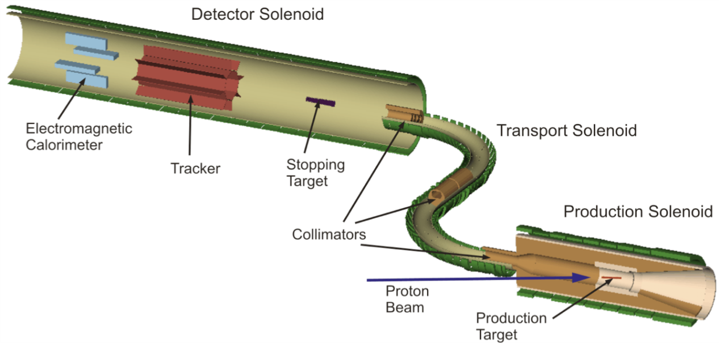
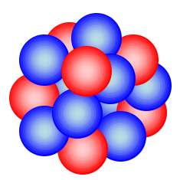


Mu2e Signal
Stop muons in an aluminum target
μ ⁻ N → e⁻ N
Aluminum
Nucleus
μ ⁻
e⁻
Monoenergetic electron
Captured μ ⁻
E_{e} ≈ 105 MeV
M_{μ} = 105 MeV/c²

Slide 6
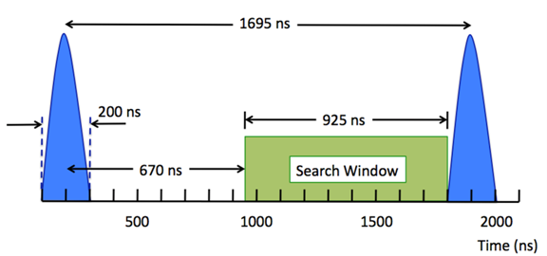
Mu2e Beam Requirements
Total protons on target > 3.6×10²⁰
Mu2e requires a train of beam pulses that are separated in time by an interval that is larger than the μ⁻ lifetime in Aluminum (864 nsec).
The protons for each pulse must be contained within an interval of ±100 nsec of the pulse center.
Out of time beam must be extinguished by a factor of 10⁻¹⁰.
Bunch intensity variation < 50%
Bunch intensity < 50×10⁶
Debuncher T_{rev}
Bunch spacing is given by the Debuncher revolution period
Bunches narrowed with 2.5 MHz RF in the Recycler and the Debuncher

Slide 7
Mu2e Project Recent History & Present Status
CD-0 granted in November 2009
Summer 2011: CDR and cost estimates nearly complete (anticipated CD-1 review ~December 2011)
September 2011: Costs were determined to be too high – Mu2e Accelerator Task force headed by Eric Prebys is formed to radically cut costs
Present: Task force has converged on a new baseline design. Presently re-evaluating cost estimates.
In this talk, only the new baseline is in view.
Future: Soonest CD-1 review ~June 2012

Slide 8
Overview of the Muon g-2 Experiment
Physics goals
Experimental technique
Beam requirements
Recent history and present status

Slide 9
Muon g-2 Experiment Goal
Goal:
Measurement of the value of muon anomalous magnetic moment, a_{μ}, to an uncertainty of 16×10⁻¹¹ (0.14 ppm) where,
Present Situation:
Physics beyond the standard model

Slide 10
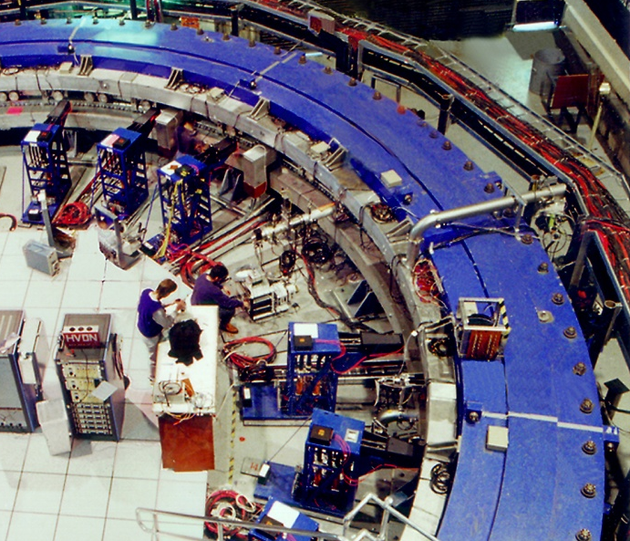
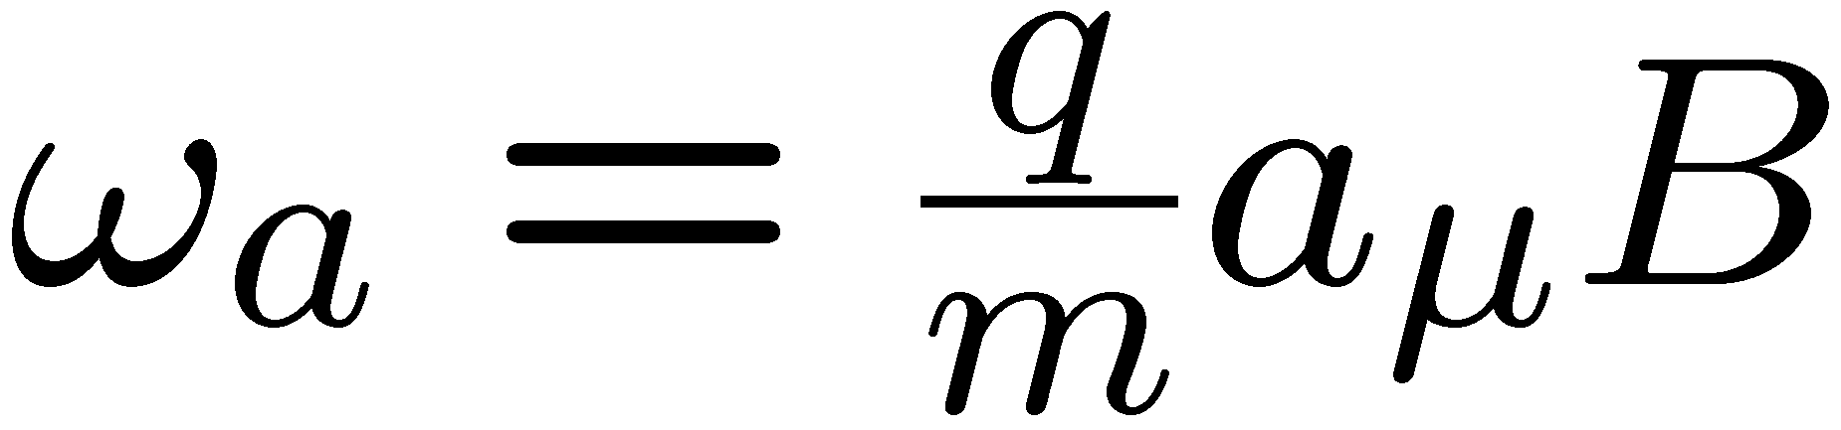
g-2 Experimental Technique
Capture 3.094 GeV/c muons in a uniform magnetic field
Measure the precession frequency of the muon spin
The precession frequency, under special circumstances, is proportional to a_{μ}
e
Momentum
Spin
D. Hertzog

Slide 11
The key ingredients to measure a_{μ} to high precision
(1) Polarized muons from pion decay
~97% polarized for forward decays
(2) Muon spin precession frequency proportional to (g-2)
(3) IF P_{μ} ≡ magic momentum = 3.094 GeV/c
E field doesn’t affect muon spin when γ = 29.3
(4) Parity violation in the muon weak decay correlates muon spin and electron direction
ν π⁺ μ⁺
µ
D. Hertzog

Slide 12
Muon g-2 Beam Requirements
Total of 4×10²⁰ protons on the pion production target
Transport of 3.094 GeV/c secondaries from pion production target
Large aperture (330 π mm-mrad) long (900 m) decay path to allow pions to decay to muons
Very narrow pulse width rms < 50 nsec
Pulse-to-pulse separation time ~10 msec

Slide 13
Muon g-2 Project Timeline
Past
1997 – 2001 Brookhaven runs
May 2008 New g-2 included in P5 strategic plan
March 2009 New g-2 proposal presented to PAC
November 2009 PAC recommends stage-1 approval
April 2010 Proposal submitted to DOE
Now CD-0 paperwork in the hands of the DOE
Future
Q2 FY12 CD-0 (paperwork submitted)
Q3 FY12 CD-1
Q2 FY13 CD-2/CD-3A Construction begins
Q1 FY14 CD-3
Q2 FY16 CD-4 Project Complete
C. Polly 10/20/11

Slide 14
Goals and Strategy for the Mu2e and Muon g-2 Experiments
Mu2e and Muon g-2 Ultimate Goals
Use of Fermilab Accelerators for Mu2e and Muon g-2
Funding Strategy
Accelerator Upgrades and Funding
Barriers

Slide 15
Mu2e and Muon g-2 Experiment Ultimate Goals
 | Mu2e | Muon g-2
Physics Goal | Measure R_{μe} with a sensitivity of better than 6×10⁻¹⁷ | Measure a_{μ} to an uncertainty of 16×10⁻¹¹ (0.14 ppm)
Total Protons on Target | 3.6×10²⁰ | 4×10²⁰
Batches/Super-cycle | 1 – 2 | 6
Protons/sec* | 3.0 – 6.0×10¹² | 18×10¹²
Years of running† | 3 – 6 | 1
* 4.0×10¹² protons per Booster batch
† Assumes 2.0×10⁷ sec/yr

Slide 16
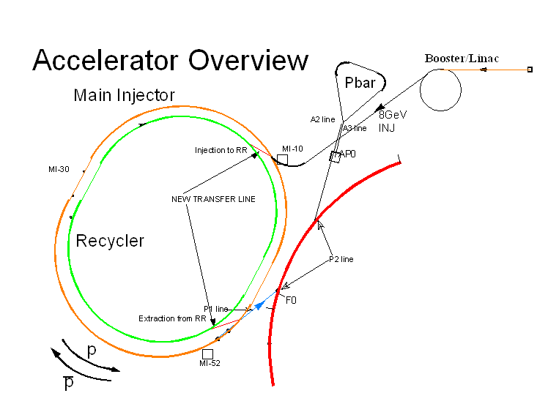
Use of Fermilab Accelerators for Mu2e and Muon g-2
Mu2e
Proton Source → Recycler → Pbar beamlines → Debuncher
Muon g-2
Proton Source → Recycler → Pbar beamlines → Target
Neither Mu2e and g-2 interfere with NOνA slip-stacking in the Recycler
Target
Mu2e and g-2 do NOT run concurrently. Accelerator operation is switched between Mu2e mode and g-2 mode.

Slide 17
Mu2e and Muon g-2 Common Ground
 | Mu2e | Muon g-2
Proton Source | 2 batches/super-cycle | 6 batches/super-cycle
Recycler Injection | Use NOνA kicker & beamline | Use NOνA kicker & beamline
Recycler Ring | Bunch Formation with 2.5 MHz RF | Bunch Rotation and/or Narrowing with 2.5 MHz RF
Recycler Extraction | One bunch extracted every ~40 msec Extraction kicker rate: Average = 3 -- 6 Hz Peak = 25 Hz | One bunch extracted every ~10 msec Extraction kicker rate: Average = 18 Hz Peak = 83 Hz
Transport to Proton Destination | RR → P1 → P2 → AP1 → AP3 → Debuncher Ring | RR → P1 → P2 → AP1 → Target Debuncher used as part of decay channel

Slide 18
Mu2e and Muon g-2 Funding Strategy
Required upgrades held in common by Mu2e and g-2 funded as AIPs.
  Recycler RF
  Recycler extraction and transport to P1 beamline
  Pbar beamline upgrades
  Debuncher collider equipment removal & aperture upgrade
Mu2e and g-2 specific accelerator items will be funded by the projects.

Slide 19
Upgrades Common to Mu2e and Muon g-2
Not funded by either project
 | Mu2e | Muon g-2
Proton Source Upgrades (see earlier Zwaska/Pellico talk) | Max. 2 batches/super-cycle. Concurrent operation with NOνA (10.5 Hz) requires performance above present capabilities. | 6 batches/super-cycle. Concurrent operation with NOνA (13.5 Hz) requires performance above present capabilities
Recycler 2.5 MHz RF Cost: ~$3.5 M | 80 kV with a 1.5 Hz average rep. rate. Use MI 2.5 MHz coalescing cavities(60 kV). Must add active cooling to cavities. | Bunch rotation scheme requires upgraded MI 2.5 MHz coalescing RF + barrier bucket system. Bunch narrowing scheme requires only 2.5 MHz RF, but can only accommodate 4 batches/super-cycle
Notes:
Recycler RF cost from C. Polly 7/27/11 collaboration meeting talk (slide 5)

Slide 20
Upgrades Common to Mu2e and Muon g-2
Not funded by either project
Item | Description | Cost
Recycler Extraction Kicker & associated costs | New, actively cooled, kicker and power supply required. MI-52 service building expansion. | $1.1 M
Recycler to P1 transport | New Beamline | $3.1 M
P1 to Pbar transport | Upgrades to improve aperture, instrumentation and controls (~$6.2 M) | $6.2 M
Debuncher | Collider equipment removal. Controls and instrumentation upgrades. | $0.5 M
AP3 line | If used for g-2 muon transport, upgrades also beneficial to Mu2e | $1.5 M
Total: | Includes $3.5 M for Recycler RF | $15.9 M
Note: Cost estimates above are from preliminary Mu2e BOEs and/or from C. Polly 7/27/11 collaboration meeting talk (slide 5).
Notes:
Recycler Extraction cost from C. Polly 7/27/11 collaboration meeting talk (slide 5) ~ Ioanis estimate
Recycler to P1 transport cost from C. Polly 7/27/11 collaboration meeting talk (slide 5) < Mu2e BOEs
P1 to Pbar transport cost from Mu2e BOEs
Debuncher cost from Mu2e BOEs
AP3 line cost from C. Polly 7/27/11 collaboration meeting talk (slide 5)

Slide 21
Accelerator Upgrades Specific to Mu2e
Upgrade | Description | Cost
Debuncher upgrades | Injection kicker, abort system, controls, instrumentation | $11.5 M
Debuncher RF | 2.4 MHz (h=4) | 5.6 M
Resonant Extraction | Debuncher 3rd – integer resonant extraction system | 5.5 M
Extinction | Internal and External beam extinction system | 5.0 M
External Beamline | Beam transport from Debuncher to pion production target | 5.7 M
Target Station | Target, absorber, heat & radiation shield | 15.3 M
Radiation Safety | TLM system, monitoring electronics, enclosure gates and interlocks | 2.5 M
Machine Protection |  | 0.3 M
Total: |  | $51.4 M
Note: These cost estimates are from preliminary Mu2e BOEs

Slide 22
Accelerator Upgrades Specific to Muon g-2
Upgrade | Description | Cost
Pbar Target Station upgrades | Target, Lens, PMAG, Pulsed power supplies | $1.8 M
AP2 beamline | Add quadrupole magnets | 0.7 M
Debuncher + AP3 | Add quads to AP3, beamline stub to muon storage ring | 2.2 M
Radiological Issues | Monitoring and interlocks | 0.1 M
Beamline diagnostics | SWICs and other diagnostics | 0.5 M
Total: |  | $5.3 M
Note: Cost estimates above are from C. Polly 7/27/11 collaboration meeting talk (slide 5).

Slide 23
Barriers
Barriers Common to Mu2e and Muon g-2
Shortage of engineering resources (primarily ME and EE)
Lack of familiarity with Project Management procedures and EVMS by level 2 and 3 managers
Mu2e specific barriers
FY12 Funding – budget assumes PED funds
Imposed funding cap of $200 M
Design progress stalled by the need to re-baseline
Design progress impeded by the inordinate time required by level 3 managers on BOEs due to a shortage of engineering resources
Under-staffed parts of the Mu2e Accelerator organization (Resonant Extraction, External Beamline)
Longer term: potential conflicts between Mu2e construction and Muon g-2 running
Muon g-2 specific barriers
FY12 Funding – Muon g-2 is not officially in FY12 budget
DOE funding cap of ~$40 M
Shortage of physicists and/or Engineering physicists for level 3 manager positions
Organizational barrier: lack of coordination between Mu2e and Muon g-2 (e.g. Mu2e CDR does not account for g-2)
Longer term: potential conflicts between Muon g-2 construction and NOνA running

Slide 24
Near Term Plans for the Mu2e and Muon g-2 Experiments
Goals and Plans for FY12
Near Term Plans Common to Mu2e and Muon g-2
Goals and Plans for FY13 and FY14

Slide 25
Goals & Plans for FY12
Mu2e granted CD-1
  Determine new baseline for Mu2e Accelerator upgrades
  Rewrite Mu2e CDR
  Revise cost and schedule
  Undergo the appropriate reviews
Muon g-2 granted CD-0 and CD-1
  Complete Muon g-2 conceptual design
  Disassembly and transport of beamline elements from BNL to FNAL
  Develop resource loaded schedule
  Undergo the appropriate reviews
And, very important, … ⇒

Slide 26
Near Term Plans Common to both Mu2e and Muon g-2
Setup, staff, and start AIPs or other non-project funding for:
  Recycler 2.5 MHz RF
  Recycler extraction + Recycler to P1 line transport
  AP2 line upgrades
  AP3 line upgrades
  Instrumentation and control system upgrades that are outside of the scope of either experiment
Begin work to determine how Mu2e and Muon g-2 will co-exist
  Identify all interfaces between Mu2e and g-2
  Create plan to deal with the technical issues identified in:
    S. Werkema, Issues Associated with the Coordination of the Mu2e and Muon g-2 Experiments, Beams-doc-3881
    M. Syphers et al., Preparation of Accelerator Complex for Muon Physics Experiments at Fermilab, Beams-doc-3220
  Create the basic concept for changing operating mode from Muon g-2 mode to Mu2e mode

Slide 27
FY12 – 14 Plans
Mu2e |  | Muon g-2
Oct. – Nov. 2011 | Re-baseline Conceptual Design | Jan. 2012 | CD-0 granted
Dec. 2011 – Apr. 2012 | Re-write CDR, Revise cost & schedule | Jul. 2012 | Conceptual Design complete
Jun. 2012 | CD-1 Review | Jul. – Aug. 20012 | CD-1 Review
Sep. 2013 | CD-2/CD-3a | Jun. 2013 | CD-2/CD-3a
Sep. 2014 | CD-3 | Dec. 2014 | CD-3
2019 | Project Complete | 2016 | Project Complete
Previous plans delayed by ~1 yr

Slide 28
Resources

Slide 29
Mu2e Accelerator Organization
2 Mu2e Accelerator
S. Werkema
V. Nagaslaev (Deputy)
2.01 Project Management
S. Werkema
V. Nagaslaev (Deputy)
2.04 Storage Rings
J. Morgan
B. Drendel (Deputy)
2.07 RF Systems
J. Dey
2.10 Target Station
R. Coleman
2.02 Recycler
I. Kourbanis
2.05 Radiation Safety
A. Leveling
2.08 External Beamline
C. Johnstone
2.11 Operations Prep.
B. Drendel
2.03 Transport to Storage Rings
J. Morgan
B. Drendel (Deputy)
2.06 Resonant Extraction
L. Michelotti
2.09 Extinction
E. Prebys
All L3 slots are filled

Slide 30
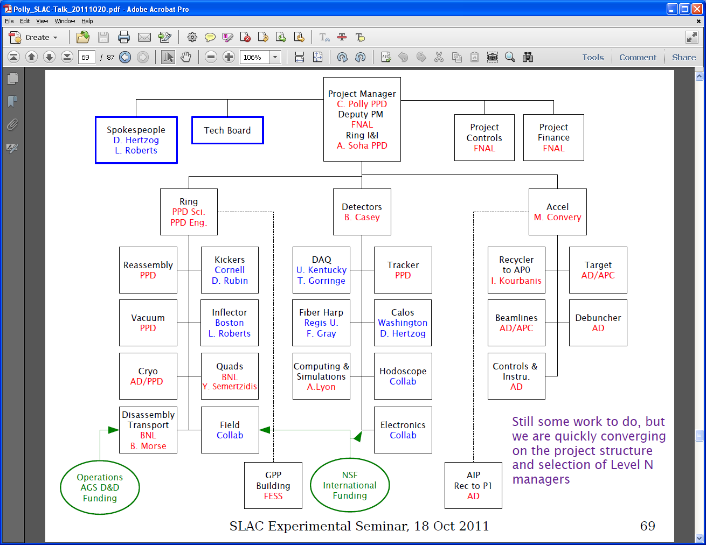
Muon g-2 Organization

Slide 31
Human Resources Required for FY12
Mu2e
Retain physicists and engineers in project management
  7 Physicists, 1 RF Engineer, 3 Engineering Physicists – (50% - 80% each)
Mechanical Engineers: (target station + misc. mechanical)
  5 FTE (2.5 from AD/Mech. Suppt., 2.5 from RAL and Bartoszek Engineering)
Electrical Engineers (pulsed power supplies, magnet power supplies)
  1 FTE
Muon g-2
Fill out Accelerator part of org. chart
  2 Physicists (identified) + ~5 physicists/engineering physicists (yet to be identified) – (50% - 80% each)
Mechanical Engineers (Target station)
  1 FTE (my guess)
Electrical Engineers (target station power supplies, magnet power supplies)
  0.7 FTE (my guess)

Slide 32
Other Resources
Both projects could benefit from beam studies before the NOνA shutdown
  Some studies presently in progress (MI RF, TLM studies, RFKO)
  Presently, neither project is sufficiently staffed to take full advantage of existing studies opportunities
TLM (Total Loss Monitor) R&D
  Need AD and ES&H support (effort led by Tony Leveling)
  Mu2e Radiation Safety plan depends on our ability to implement of such a system
  Beam studies underway in Pbar Accumulator

Slide 33
Risks – Near Term and Long Term

Slide 34
Risks
Mu2e Risks
Erosion of parts of the organization due to redirection of effort elsewhere
Radiation safety issues – Pbar source was not designed for the intensity frontier
Availability of engineering resources to complete design work and cost & schedule estimations required for CD-2 and CD-3
Muon g-2 Risks
Insufficient personnel resources available to complete CDR by mid-FY12
Moving the g-2 super-conducting storage ring from BNL to FNAL (without breaking it)
Failure to promptly organize Mu2e – g-2 coordination, AIPs, and required human resources will potentially cause significant delays

