Slide 1
Project X Strategy
Steve Holmes
Accelerator Sector Planning and Strategy Workshop
October 27, 2011

Slide 2
Outline
Introduction: Background information, recent accomplishments, history
Strategy
Ultimate goal: where should this activity be in 10 years? What is the central overarching goal of this activity?
Goals in the near-term, mid-term and long-term: What are some clear goals for this activity over the next 10 years? What are the targeted outcomes (i.e. specific goals with a milestone)
Overall plan: Describe the full plan for this activity as it develops over the full life of the activity, or over the next 10 years.
Barriers: are there systematic barriers (structural, intellectual, financial, organizational,…) that need to be solved in order to reach the ultimate goal?
Near-term plan
FY12 Plan: what do we plan on doing this year? What are the actual tasks that have to be carried out and what are all the subactivities?
FY12 Deliverables: what will be accomplished by the end of FY12?
FY12 Metrics: how should we measure the success of this activity this year? Identify quantifiable metrics, milestones and goals.
FY13 and 14 Plans and goals: what are the goals for this activity in FY13 and FY14?
Resources
What resources are needed to meet this year’s goals? Are the planned resources consistent with the established goals and milestones?
What resources are needed to meet the 10 year goal?
Risks
What are the risks to this year’s plan?
What are the risks to reaching the 10-year goals?

Slide 3
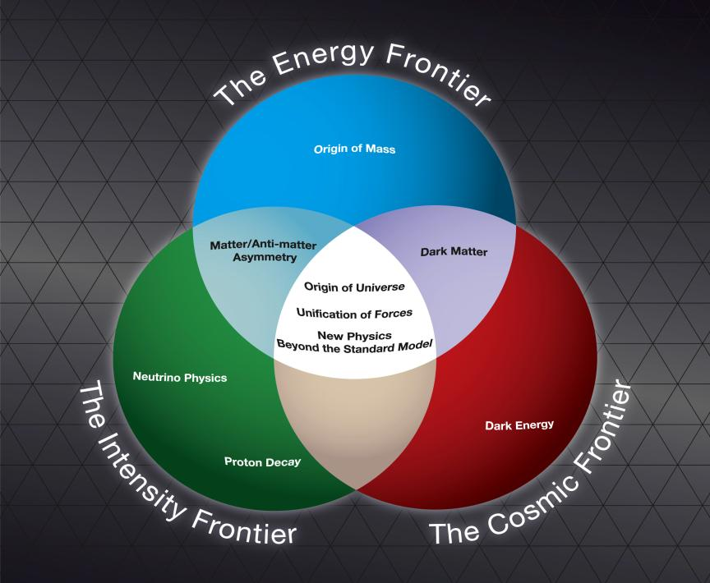
Strategic Context
Fermilab is the sole remaining U.S. laboratory providing facilities in support of accelerator-based Elementary Particle Physics.
The Fermilab strategy is to
mount a world-leading program
at the intensity frontier, while
using this program as a bridge
to an energy frontier facility
beyond LHC in the longer term.
Project X is the key element of
this strategy

Slide 4
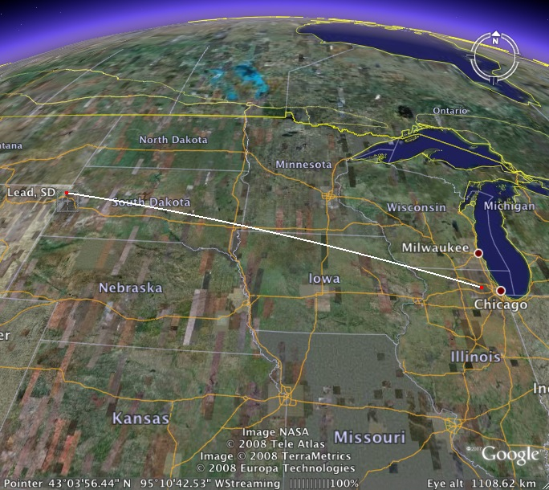
Mission Elements
A neutrino beam for long baseline neutrino oscillation experiments
2 MW proton source at 60-120 GeV
High intensity, low energy protons
for kaon, muon, and neutrino based
precision experiments
Operations simultaneous with the
neutrino program
A path toward a muon source for
possible future Neutrino Factory
and/or a Muon Collider
Requires ~4 MW at ~5-15 GeV
Possible missions beyond EPP
Standard Model Tests with nuclei and energy applications

Slide 5
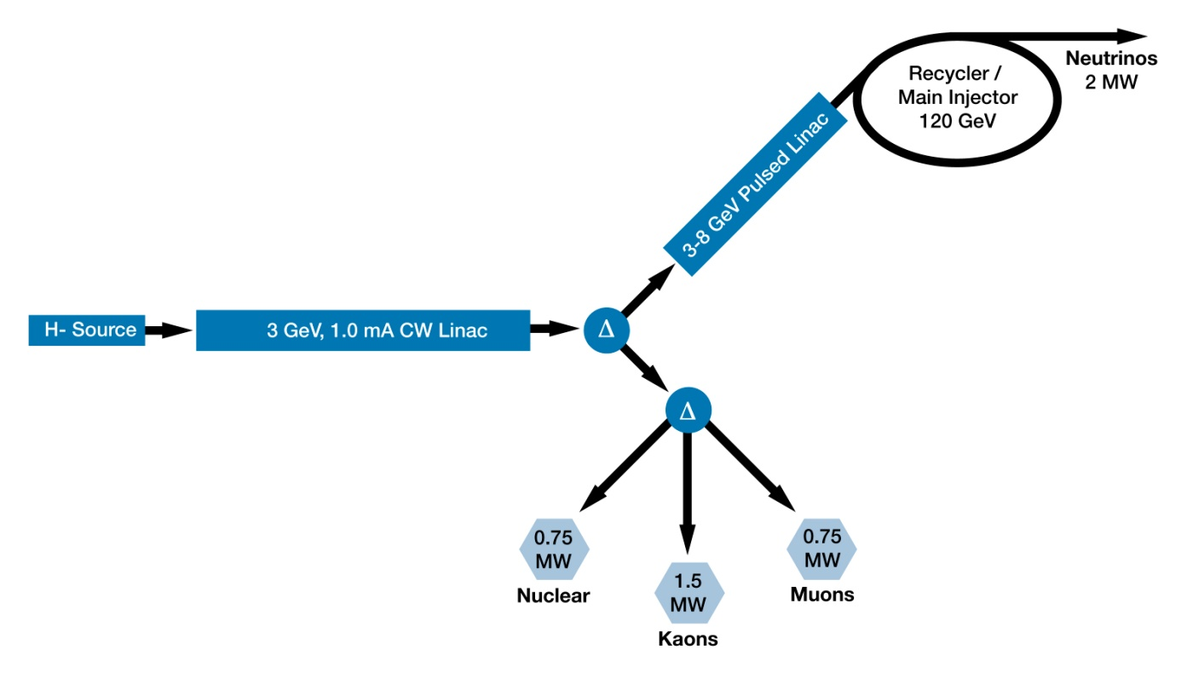
Reference Design
3 MW @ 3 GeV
200 kW @ 8 GeV
2 MW @ 120 GeV
Reference Design supports all mission elements
Stable for more than a year

Slide 6
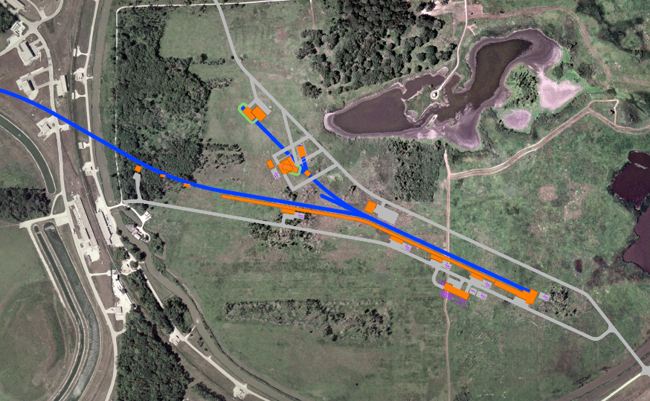
Reference Design Site

Slide 7
Organization
Project Office
Project Manager S. Holmes
Deputy Project Manager TBD
Project Scientist/Accelerators S. Nagaitsev
Project Scientist/Experiments R. Tschirhart
Project Engineer J. Kerby
International Coordinator S. Mishra
Budgeting/Scheduling E. Peoples
Financials M. Smith
Level 2 Managers
CW Linac R. Kephart, B. Lebedev
Pulsed Linac N. Solyak
MI/Recycler I. Kourbanis
Conventional Facilities TBD (R. Alber, acting)
Experimental Facilities R. Tschirhart
Level 3 Managers
We have assigned a complete complement of L3Ms

Slide 8
Collaboration
Two MOUs covering the RD&D Phase
National IIFC
ANL ORNL/SNS BARC/Mumbai
BNL MSU IUAC/Delhi
Cornell TJNAF RRCAT/Indore
Fermilab SLAC VECC/Kolkata
LBNL ILC/ART
Informal collaboration/contacts with CERN/SPL, ESS, China, Korea
Responsibilities of collaborators in the R&D (and construction) phase are becoming relatively well established

Slide 9
Strategy
2021 Goal: Project X construction is nearing completion
Working Timeline (not approved by DOE)
CD-0 FY 2012
CD-1 FY 2013
CD-2 FY 2014
CD-3 FY 2016
CD-4 FY 2021

Slide 10
Strategy RD&D Program
Goal: Mitigate risk associated with technical, cost, and schedule uncertainties
Facility performance
Integrated facility goals defined by Functional Requirements Specification (FRS)
Facility configuration including upgrade paths; systems integration
CW linac
The first 15 MeV is key to the Reference Design concept.
Front-end, chopper, low-β acceleration, beam loss mitigation
Pulsed linac
Pulsed linac has diverged from ILC requirements due to low current
Long-pulse beam operation, β=1 accelerating structures/modules
MI/Recycler
H- injection; factor of three increase in beam intensity (relative to NOvA)
Injection, instabilities, rf systems

Slide 11
Strategy R&D Program
The primary elements of the R&D program include:
Development of a wide-band chopper
Capable of removing bunches in arbitrary patterns at a 162.5 MHz bunch rate
Development of an H- injection system
Require between 4.4 – 26 msec injection period, depending on pulsed linac operating scenario
Superconducting rf development
Six different cavity types at four different frequencies
Appropriate rf sources
Development of partners and vendors
Design development
Beam and e-m modeling
reliability analysis
Upgrade paths: MC and Muons@PX Task Forces
Test Facilities
Next slide
Goal is to complete R&D phase by 2016

Slide 12
Strategy R&D Test Facilities
New Muon Lab (NML) facility under construction for ILC RF unit test
Eventually will house PX style CM (but pulsed)
Meson Detector Building (MDB) Test Facility
2.5 MeV beam (p, H-): 1% duty factor, 3 msec pulse
Initial chopper tests
H⁻ beam instrumentation development
Test stands for dressed cavities at 1.3 GHz, 650 MHz, and 325 MHz
Project X Injector Experiment PXIE)
Prototype of first 10-30 MeV of Project X.
Validate Project X front end concept ⇒ mitigate primary technical risk element within the Reference Design.
Operate at full design parameters
Integrated systems test goals:
1 mA average current with 80% chopping of beam delivered from RFQ
Efficient acceleration with minimal emittance dilution through ~15 MeV
Potential utilization in Project X facility following successful demonstration
Collaboration between Fermilab, ANL, LBNL, (SLAC); India & China?
Oct 2016: Beam through β=0.1 , 0.2 CM at ~10 MeV with nearly final parameters (1 mA cw, 5 mA peak, arbitrary bunch chopping)

Slide 13
Strategy PXIE Scope
Beam Dump
LEBT
RFQ
MEBT
HWR
SSR1
Ion Source
Diagnostics
~40 m
CW H- source delivering 5 mA at 30 keV
LEBT with beam pre-chopping
CW RFQ operating at 162.5 MHz and delivering 5 mA at 2.1 MeV
MEBT with integrated wide band chopper and beam absorbers capable of generating arbitrary bunch patterns at 162.5 MHz, and disposing of 4 mA average beam current
Low beta superconducting cryomodules capable of accelerating 1 mA to 15 MeV
Beam dump capable of accommodating 1 mA at 15 MeV (15 kW) for extended periods.
Associated beam diagnostics, utilities and shielding

Slide 14
Strategy Barriers
Intellectual
Wideband Chopper
Multi-MW target stations
Halo formation/loss control and mitigation
H- injection
Cavity/cryomodule design and fabrication plan
Financial
PXIE will probably cost $40-50M
Another ~$50M to complete srf R&D and get to CD-3
Organizational
Matrix organization – achieving appropriate priority within the divisions
Staff fragmentation
Integration of collaborators
Coordination of Project X, SRF, and GAD activities

Slide 15
Near Term Plan Goals for FY2012
Project Management
Update the RDR to current configuration
Receive CD-0!
Assure all required documentation is up to date
Support laboratory preparations for the DOE Intensity Frontier Workshop
Initiate work on Conceptual Design Report and other documentation for CD-1
Continue reliability modeling with OSU
Receive/evaluate reports from MC and mu2e Task Forces
Coordinate all collaboration activities

Slide 16
Near Term Plan Goals for FY2012
CW Linac/PXIE
Conventional facilities @ CMTF
Complete shielded enclosure – ready for equipment installation.
LEBT
Complete design and all parts ordered*
Ion source commissioning (at LBNL)
RFQ
Complete design, ready for procurement (LBNL/FNAL)
Specifications complete, ready for procurement: rf & water systems*
MEBT
Vacuum prototype chopper kicker tested (bandwidth and average power)*
12 kW prototype beam absorber designed, fabricated and tested (e-beam) *
MEBT design 50% complete
* Need a mechanical engineer assigned to each of these activities: ~2.5 FTE total

Slide 17
Near Term Plan Goals for FY2012
CW Linac/design & development
Complete lattice design for CW linac (including front end)
Preliminary specifications on all linac components: cavities, CM, magnets, correctors, diagnostics
Beam dynamics studies
Preliminary tolerances: alignment, stability, optical mismatch
Failure analysis: effect of failed components on performance and correction schemes
RF sources (w/ SLAC, India)
325 MHz test stand operational at MDB (couplers)
Complete coupler designs; prototype
Solid state development at 650 MHz (w/SLAC)
Cryogenics
Heat load estimates, pre-conceptual design, segmentation
Design SSR1 (test) cryomodule

Slide 18
Near Term Plan Goals for FY2012
Pulsed Linac
Complete lattice design
Specifications for alignment and RF tolerances
Failure analysis
Design of the transport lines to/from pulsed linac
Conceptual design of the HLRF system
Systems specifications
Survey of alternatives (klystron, IOT, magnetron)
LLRF performance study for long pulse operation.
Complete conceptual and EM design of splittable SC (focusing) magnet
Conceptual design of the cryogenic systems and specifications
Specifications for beam diagnostics in Linac and transport lines

Slide 19
Near Term Plan Goals for FY2012
Main Injector/Recycler
RF systems
Complete design of the second harmonic (106 MHz) cavity (w/SLAC)
Fabricate 53 MHz cavity mockup for low level measurements
Instabilities
e-cloud
In-situ measurements of different material samples.
Evaluate beam conditioning effect on SEY (in MI).
Set-up coating facility (sputtering) in E4R.
Space Charge
Continue simulations with SYNERGIA and IMPACT/MLI
H- Stripping injection
Simulate rotating foil with tracking.
Rotating foil prototype (w/ANL)
Order parts for Laser stripping R&D (w/SNS)

Slide 20
Near Term Plan Goals for FY2012
Experimental Facilities
Prepare for DOE workshop
Preliminary identification of day one experiments and facilities
Conventional Facilities
Master planning as relate to PX siting and utility needs
Consolidation of new project (LBNE, MU2E, PX, g-2) infrastructure
Preliminary design of critical infrastructure needs:
Electrical single lines and load tables
Cooling schematics with input from pond studies; cost analysis of various cooling options (cooling towers, new pond(s), ICW, etc.)
Update siting scenarios against latest wetland studies,
Discipline reviews of CD-0 cost estimate Review and revise RLS to support a CD-0 review
General support of alternate configurations, value engineering and phasing options

Slide 21
Near Term Plan Goals for FY2013-14
Primary goal is to get to CD-2 by the end of FY2014
Complete a Conceptual Design Report
Establish Project X configuration
Backed up by beam simulations and technology development
Identify baseline technologies for all major systems
Feasible solutions for: wideband chopper, H- injection, long pulse operations,
Complete baseline cost estimate and resource loaded schedule
Semi-infinite list of documentation
CDR, RMP, RA, AS, PMP, PEP, HA, EA, SVAR
Agreed upon responsibilities among collaborators for the construction phase
Major SRF Goals
Protoype of every cavity type, meeting performance requirements in horizontal test
Cryomodule design for all cavity types.
Prototype cryomodule for each frequency

Slide 22
Resources FY2012 Budget
1.0 Project X
1.1
Project Management
FTE 6.0
M&S $300
Collab $0
MR $200
1.2
CW Linac
FTE 17.5
M&S $2310
Collab $450
1.3
Pulsed Linac
FTE 4.35
M&S $50
Collab $0
1.4
MI/ Recycler
FTE 3.6
M&S $200
Collab $250
1.5 Experimental Facilities
FTE 2.2
M&S $130
Collab $0
1.6 Conventional Facilities
FTE 0
M&S $170
Collab $0
Note: Dollar amounts are direct
$600K of collaborator funding in 1.2 forward funded in FY11
New WBS consistent with what we will use as a project
FY12 budget has been developed within this WBS
A new set of task codes, aligned with this WBS, will become operational on October 1, 2011

Slide 23
Resources Labor Plan/Accelerator Sector

Slide 24
Resources Labor Plan Commentary
Accelerator Division
Primary shortfall is in mechanical engineering
Impact is on PXIE preparation
Primary concern is fragmentation
13 FTE spread over 71 people(!)
Goal is to eliminate half the shortfall and decrease fragmentation
Technical Division
Fragmentation, not as severe as in AD
APC, PPD, CD, DIR
OK as is

Slide 25
Resources FY2013 and Beyond
FTE Requirements
R&D phase (to CD-3) requires ~350 person-years
(This does not include srf development)
(This does not include experimental facilities)
~90 FTE × 4 years
~60 FTE at Fermilab if 1/3 could come from collaborators
Construction phase requires ~854 person-years
This does not include experimental facilities)
~170 FTE × 5 years
~100 FTE at Fermilab if 40% could come from collaborators

Slide 26
Risks
FY2012
Lack of adequate (staff) resources
Lack of community support for the physics program
No CD-0
FY2013-FY2021
Lack of adequate resources
Failure to meet technical specification
Wideband chopper
Recycler injection
High power targets
Failure to meet cost goals
Failure to develop qualified vendors
Unable to establish the required CM production rate
Starting construction before confirmed technical solution
Consequence: Higher contingency requirement
No financing plan for PX within DOE or significantly drawn out schedule
No significant in-kind contribution from overseas

Slide 27
Backup Slides

Slide 28
Budget Commentary
FY2011
Budgeted 27.4 FTE
Averaged ~21 FTE over the year
There will be ~$100K of requisitions in process at the end of FY2011
Under-run will be $70K (M&S) + $672K (SWF) + $632K (OHD) = $1,374K
FY2012
FTE (request) is 35.05
67% increase from FY2011 actual
29.55 allocated
M&S (request, direct) is $4,187K
54% increase from FY2011 budgeted/actual
Includes $1,637K earmarked for collaborators
$347K underfunded relative to identified activities
~$200K is budgeted retained in reserve. Primary candidates for the reserve :
Enhanced support for PXIE
Increased collaborator support
Rebalance
32.0 FTE (engineers, drafters)
$4,570 M&S (direct)

Slide 29
Requests
Carryover of M&S to cover the requisition in process at the end of FY2011 + OHD associated with all uncosted obligations
Projecting $70K direct + $196K OHD
Request carryover of $200K + OHD of SWF
Retain in reserve for the purpose of supporting expansion of the Project Office following CD-0
With this we should be able to maintain sufficient progress toward a construction start in 2016-2017 timeframe.

Slide 30
FY2011 Budget Actual/Projected
FY11 Budget Actual to date* %Spent RIPs
SWF $3,974 $3,077 77%
M&S $2,718 $2,030 75% $714
Overhead $3,837 $2,975 78%
TOTAL $10,529 $8,082 77% $714
*Through 8/31/11
FY11 Budget Projected %Spent RIPs
SWF $3,974 $3,302 83%
M&S $2,718 $2,648 97% $100
Overhead $3,837 $3,205 83%
TOTAL $10,529 $9,155 87% $100

Slide 31
FY2012 Budget
Note: Significant SRF & GAD activities are not included in this budget
GAD supports cavity/CM development at all frequencies
GAD supports MDB beam facility
SRF supports infrastructure, including test stands at MDB and CMTF
Note: The budget presented is for accelerator design/development only
Project Scientist for Experimental Programs is supported on Physics Research/Intensity Frontier
FY2012 Budget Guidance $13,000
Plan DSC Upload
FTE 35.05 29.54
SWF $4,516 $3,924
M&S/FNAL $2,550 $3,473
M&S/Collaborators $1,637 $1,637
Overhead $4,297 $3,966
TOTAL $13,000 $13,000

Slide 32
Labor Plan Laboratory Total

Slide 33
Labor Plan Computing, PPD, Directorate

