Slide 1
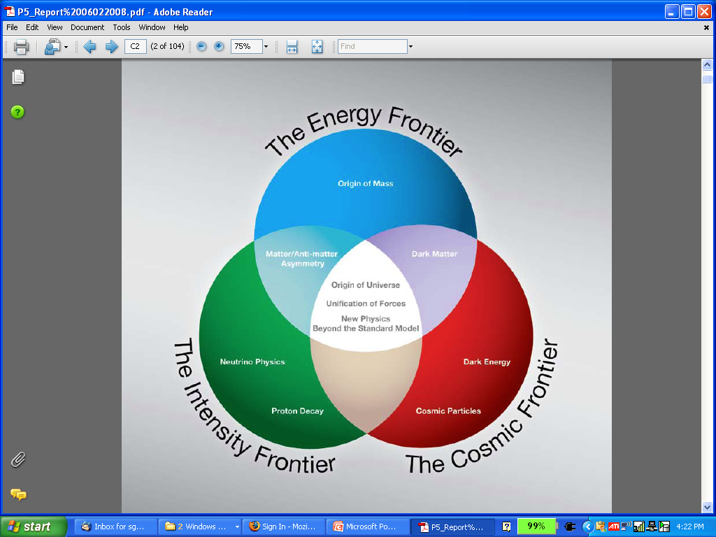
MUON MUON ACCELERATOR PROGRAM (MAP)
and beyond
Steve Geer
Accelerator Physics Center
Fermi National Accelerator Laboratory
Accel. Sector Planning & Strategy Workshop
October 27-28, 2011
μ⁺
μ⁻
ν

Slide 2
We have a mission
We have resources
We have a vision
HOW DO WE GET THERE?

Slide 3
MAP MISSION STATEMENT
The mission of the Muon Accelerator Program (MAP) is to develop and demonstrate the concepts and critical technologies required to produce, capture, condition, accelerate, and store intense beams of muons for Muon Colliders and Neutrino Factories. The goal of MAP is to deliver results that will permit the high-energy physics community to make an informed choice of the optimal path to a high-energy lepton collider and/or a next-generation neutrino beam facility. Coordination with the parallel Muon Collider Physics and Detector Study and with the International Design Study of a Neutrino Factory will ensure MAP responsiveness to physics requirements.

Slide 4
RESOURCES
First
~10 yrs
FY07 –
FY09
FY10
FY11
FY12
≥FY13
NFMCC
+
MCTF
NFMCC
Interim
MAP
MAP
MAP
MAP
12 M$
(guideline)
~15 M$ (anticipated)
~4 M$
~9 M$
10 M$
10.5 M$

Slide 5
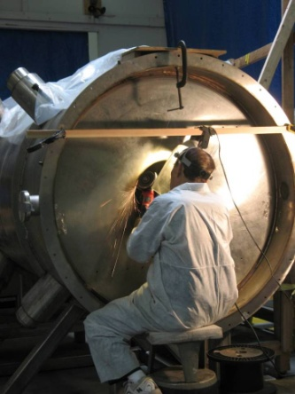
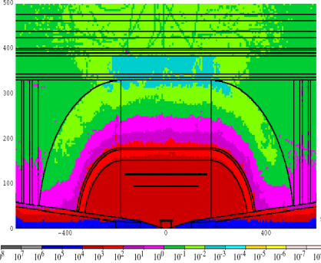
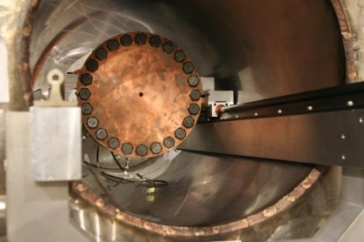
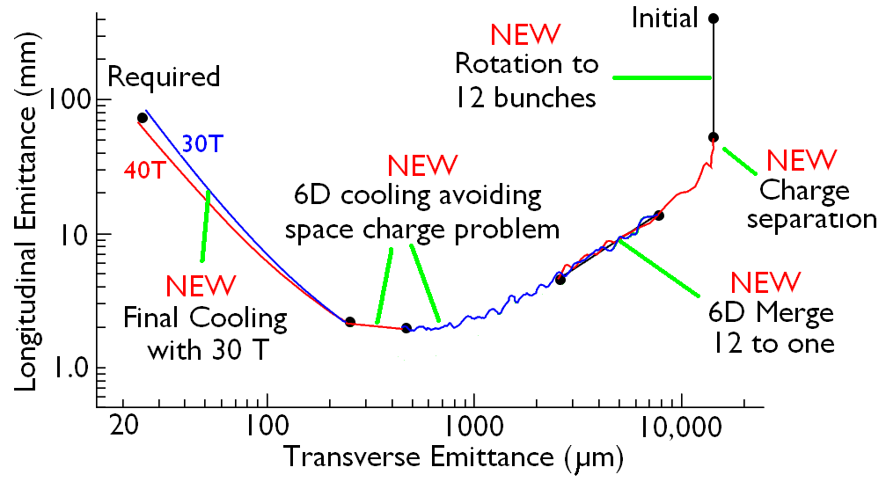
SOME FY11 HIGHLIGHTS
COMPLETED MTA BEAMLINE
MARS MC DETECTOR BACKGROUND FILES DELIVERED & EXPOITED
MICE SPECTROMETER SOLENOID PLAN COMPLETED
FIRST HPRF CAVITY BEAM TEST
PROGRESS ON UNDERSTANDING COMPONENT REQUIREMENTS FOR ALMOST EVERY PART OF COOLING CHANNEL
HCC 4-COIL MODEL TESTS COMPLETED
YBCO COIL ASSEMBLED
& REACHED 21.2T

Slide 6
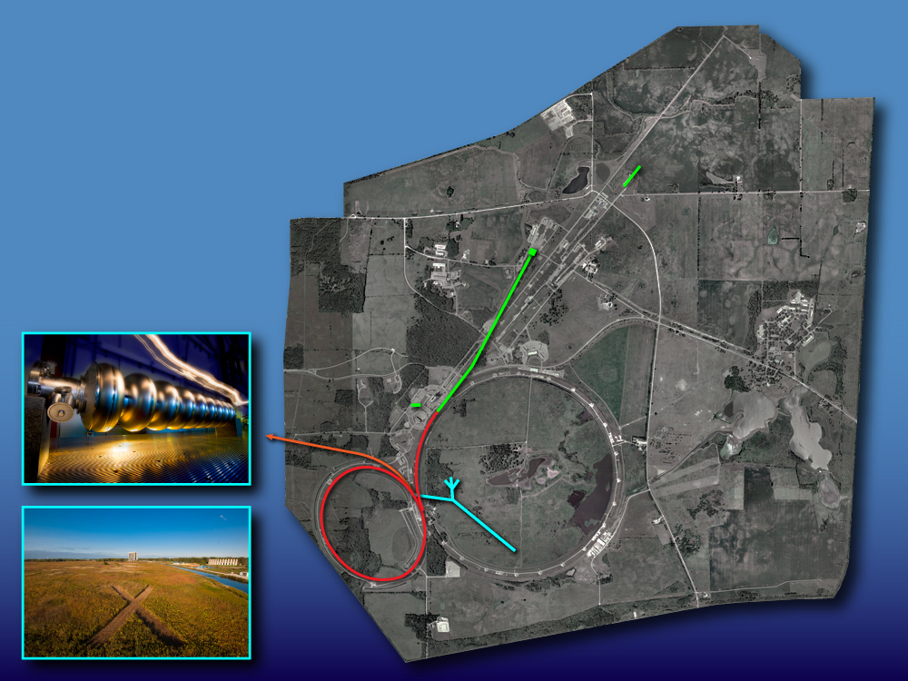
A VISION
START WITH
PROJECT X
Neutrinos
Muons
Kaons
Nuclei
“simultaneously”
2 MW (60-120 GeV)
1300 km
2 MW at ~3 GeV
flexible time structure
and pulse intensities

Slide 7
A VISION
ADD
NEUTRINO
FACTORY
Enhanced Neutrinos
Enhanced Muons
Muon Collider test bed
Kaons
Nuclei
“simultaneously”
4MW protons
5 GeV muons
1300 km

Slide 8
A VISION
ADD
MUON
COLLIDER
μ⁺
μ⁻
4 TeV Collider

Slide 9
HOW DO WE GET THERE ?
NEAR TERM (next 2 years)
  Critical activities
  Defining success
  What’s missing
MEDIUM TERM
  -MC Design Feasibility Study
LONGER TERM
  -Where should we be in 10 years?

Slide 10
NEAR TERM
Two critical activities need to be ballistic now:
  MICE
  RF R&D in the Mucool Test Area
MICE MAGNETS
  -New activity for FNAL-TD: Testing the first MICE
  “Coupling Coils”. THIS IS ON THE CRITICAL PATH.
  -Beyond this, we need a plan to complete the RFCC modules. The lead is LBNL, but FNAL-TD may need to be substantially involved to make it succeed.
MTA
  -Must demonstrate high-gradient NCRF operating in few-Tesla magnetic fields – THIS IS ON THE CRITICAL PATH
  - We need a way to get access to techs and engineers when we need them – this is essential for the MAP plan.

Slide 11
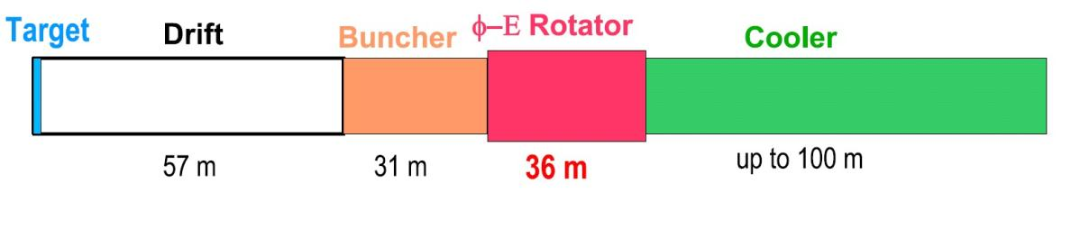
NEAR TERM SUCCESS
Delivering working magnets to MICE
Demonstrating RF operation in magnet fields that meet the front-end muon source requirements (including the initial cooling channel):
Parameter | Drift | Buncher | Rotator | Cooler
Length (m) | 56.4 | 31.5 | 36 | 75
Focusing (T) | 2 | 2 | 2 | 2.5 (ASOL)
RF f (MHz) |  | 360 → 240 | 240 → 202 | 201.25
RF G (MV/m) |  | 0 → 15 | 15 | 16
Total RF (V) |  | 126 | 360 | 800

Slide 12
FY12 MILESTONES / DELIVERABLES
RF-1 Complete Be button test MAP note; Q2
RF-2 Complete 2nd HPRF cavity beam test Draft Journal paper; Q4
RF-3 Prepare MTA for MICE production cavity test Inspection; Q3
MICE-1 SS Vac. certification & cool-down Inspection; Q2
MICE-2 Deliver vacuum pump systems for MICE spectrometer solenoids Inspection; Q2
MICE-3 Support testing of spectrometer solenoids Inspection; Q3
MICE-4 SS field measurements MAP Note; Q3
MICE-5 Review quench calculations for coupling coil MAP note; Q3
MICE-6 Prepare CC Test Stand Inspection; Q3
MICE-7 Test first CC winding MAP Note; Q4
MICE-8 Assemble MICE production cavity Inspection; Q3
MICE-9 Begin MICE production cavity test Inspection; Q4
MICE-10 Evaluate thermal properties of LiH MAP note; Q3
MICE-11 Deliver LiH disks to RAL Production report; Q3
MICE-12 Deliver LiH wedges to RAL Production report; Q3
MAG-1 Wind, react, test Bi-2212 coil with key elements of 30T insert MAP Note; Q4
DS-1 3 TeV MC ring design MAP note; Q4
DS-2 Update conceptual designs for collider arc dipoles & quads MAP Note; Q4
DS-3 Complete Project X – MAP Task Force Report MAP Note; Q3
DS-4 Update IDS-NF Costing model Presentation; Q3
DS-5 Evaluate implications from HPRF measurements MAP Note; Q4
DS-6 Complete front-end beam cleaning study MAP Note; Q3
DS-7 Support MDI studies MAP Note; Q4

Slide 13
NEAR TERM: What’s Missing?
The near-term technical R&D path for a Neutrino Factory is clear:
  International Design Study → “RDR” in 2 years
  MICE & MTA RF R&D deliver
But the full Neutrino Factory will be several B$. We need a to think about a path to a NF that makes contact with the current experimental program
Now is the time to do this, because ….

Slide 14
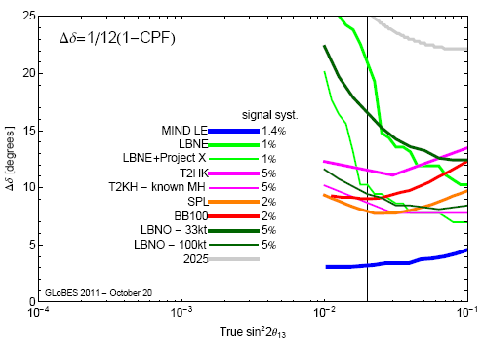
WE WANT A NEUTRINO FACTORY
If θ₁₃ is small, we have known for a long time that a NF offers the only path forward (& would be great)
We now have indications that θ₁₃ is not very small, in which case a NF gives the best precision, and we want it !
Huber
LOW ENERGY NF

Slide 15
NEED TO EXPLORE A PATH TO THE FIRST MUON-DECAY-BASED NEUTRINO EXPERIMENT
This is not MAP (which is focused on a longer-term vision, not on proposing neutrino experiments now) , but strategically important for MAP.
Some low-level activity has begun to explore the possibility of building a muon racetrack storage ring now for a short-baseline experiment and cross-section measurements
  Use Booster beam for proton source
  No bunching, phase rotation, or cooling
  -Capture as many pions as you can in an ~3 GeV ring, & let them decay to muons (within 1 turn), and then store the muons (for ~100 turns).
However, the devil is in the details, and some substantial work needs to be done before we can really tell the community what performance could be achieved (and hence get them really interested).

Slide 16
MEDIUM TERM
MAP PRIORITIES & DELIVERABLES
Deliver on commitments to making MICE and the IDS-NF studies a success.
Focus on key technology development and testing
  RF cavities in magnetic fields
  High-field solenoids for final cooling
  Rapid cycling magnets for RCS (small seed effort)
Deliver a Design Feasibility Study to enable the community to judge the feasibility of a multi-TeV Muon Collider (~FY16):
  Hardware R&D and experimental tests to guide & validate the design work.
  an end-to-end simulation of a MC complex based on technologies in-hand or that can be developed with a specified R&D program.
  Rough cost range.
  R&D plan for longer term activities (e.g. 6D cooling expt)
Coordinate with the physics community on physics capabilities, detector and MDI

Slide 17
MEDIUM TERM
Complete IDS-NF RDR
(FY14)
Complete MICE (FY14)
Select Cooling Ch. RF
technology & design
6D section for bench test
(FY13-15)
Pursue a focused component R&D program as aggressively as resources permit (FY12-16)
Complete end-to-end MC
Study (& report) →
complete list of remaining
required component R&D
& systems tests (FY16)
7
NOW
7. System
Prototype
6
PROPOSED MC-DFS
6. Sub-System
Beam Tests
5
5. Semi-realistic
sub-systems
4
4. Early sub-
system
Bench Tests
3
3. Component
R&D
2
2. Technical
Concept
1
1. Basic Idea
Ring
6D Cooling
Acceleration
Initial Cooling
Final Cooling
Bunch / Phase
Target & Dump
Pre-Acceleration

Slide 18
Where should we aspire to be in 10 Years ?
Should aspire to have, or be constructing, the first muon-decay-based neutrino facility/experiment and have understood the potential upgrade path(s) to the ultimate NF.
Should aspire to have established a complete list of the major high-tech components needed for a MC, and have an ongoing R&D program to prototype & develop each of these components.
Should aspire to be constructing (or running) the next big systems test beyond MICE (6D cooling experiment ?)
Should aspire to have completed an end-to-end simulation of a baseline MC design (needed to establish the component requirements and required systems tests) → feasibility report + estimated cost range

Slide 19
SOME FINAL THOUGHTS
AD and TD are Crucial for the success of MAP, and opening the way for a muon-based future for Fermilab
  TD: support for MICE magnets is the beginning of a long-term sustained need to support solenoid R&D, construction, testing and operation.
  AD: we cannot succeed in the MTA without your help.
Funding: The 15M$/year (in FY09 dollars) is meant to get us to through the present R&D phase … it is barely adequate:
  Vital component R&D is queued. For example, HTS 30T solenoid development is not ballistic, and building and bench testing a 6D cooling section in a couple of years is going to be funding limited.
  The next phase (beyond FY16?) will certainly require more (e.g. for a 6D cooling test).
Ramping up the funding beyond 15M$/yr in FY13 would be effective (the first version of the MAP proposal ramped to 20M$/yer)

Slide 20
ADDITIONAL SLIDES

Slide 21
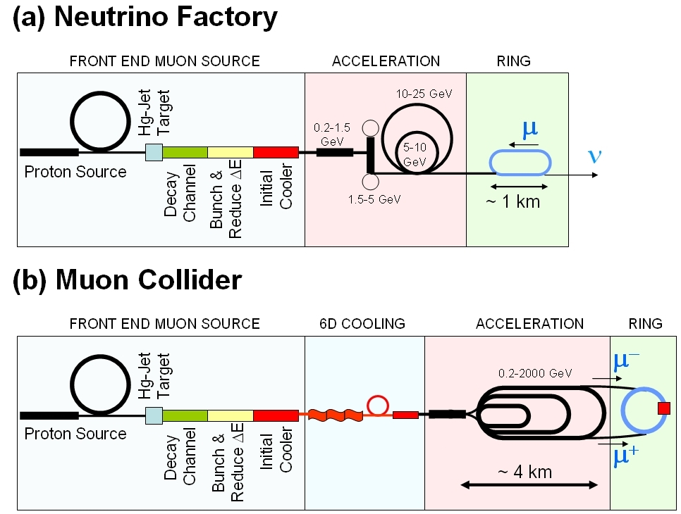
MUON COLLIDER SCHEMATIC
√s = 3 TeV
Circumference = 4.5km
L = 3×10³⁴ cm⁻²s⁻¹ μ/bunch = 2x10¹²
σ(p)/p = 0.1%
ε_{⊥N} = 25 μm, ε_{//N}=70 mm
β* = 5mm
Rep Rate = 12Hz
10²¹ muons per year that fit within the acceptance of an accelerator:
ε_{⊥N}=6000 μm
ε_{//N}=25 mm
Proton source: Example: upgraded PROJECT X
(4 MW, 2±1 ns long bunches)

Slide 22
Muon Collider cf. Neutrino Factory
NEUTRINO
FACTORY
MUON
COLLIDER
In present MC baseline design, Front End is same as for NF
(although the optimal initial coolers might ultimately be different)

Slide 23
FY12 FUNDING DISTRIBUTION
Institution | RF | Key Design Simulation | MICE Non Magnet | MICE Magnet | Target | Non-MICE Magnet | SUMS | Percent
ANL | 185 | 0 | 0 | 0 | 0 | 0 | 185 | 1.70%
BNL | 0 | 1378 | 0 | 0 | 461 | 0 | 1839 | 16.86%
FNAL | 2291 | 1038 | 1119 | 1488 | 15 | 974 | 6925 | 63.50%
LBNL | 0 | 0 | 665 | 500 | 0 | 0 | 1165 | 10.68%
ORNL | 0 | 0 | 0 | 0 | 0 | 0 | 0 | 0.00%
SLAC | 150 | 0 | 0 | 0 | 0 | 0 | 150 | 1.38%
Jlab | 0 | 10 | 0 | 0 | 0 | 0 | 10 | 0.09%
UC-Berkeley | 3 | 0 | 0 | 0 | 0 | 0 | 3 | 0.03%
UCLA | 0 | 50 | 0 | 0 | 0 | 0 | 50 | 0.46%
UC-Riverside | 0 | 0 | 10 | 0 | 0 | 0 | 10 | 0.09%
IIT | 216 | 0 | 42 | 0 | 0 | 0 | 258 | 2.37%
U. Mississippi | 0 | 0 | 0 | 0 | 0 | 230 | 230 | 2.11%
Princeton | 0 | 0 | 0 | 0 | 10 | 0 | 10 | 0.09%
Muons, Inc. | 0 | 58 | 0 | 0 | 0 | 0 | 58 | 0.53%
Pass Thr. OH | 4.38 | 2.16 | 1.04 | 0 | 0.2 | 4.6 | 12.38 | 0.11%
SUMS | 2849.38 | 2536.16 | 1837.04 | 1988 | 486.2 | 1208.6 | 10905.38
% of Allocated | 26.13% | 23.26% | 16.85% | 18.23% | 4.46% | 11.08% | 100.00%
Unallocated |  |  |  |  |  |  | 1094.62
FY12 TOTAL |  |  |  |  |  |  | 12000
FULLY
LOADED
(M&S + SWF)
To cover RFCC
progress + new
initiatives

Slide 24
FY12 FNAL DISTRIBUTION
 | RF |  | Design & Sim |  | MICE non-mag |  | MICE mag |  | Target |  | non-MICE mag |  | Total | FY11
AD | 472.4 |  | 0 |  | 0 |  | 20.86 | [6] | 0 |  | 0 |  | 493.26 | 457
M&S | 20 |  |  |  |  |  | 5 |  |  |  |  |  | 25
SWF | 240 | [1] |  |  |  |  | 8 |  |  |  |  |  | 248
OH | 212.4 |  | 0 |  | 0 |  | 7.86 |  | 0 |  | 0 |  | 220.26
TD | 0 |  | 0 | [3] | 0 |  | 841.5 | [7] | 0 |  | 959.5 | [8] | 1801 | 1800
M&S |  |  |  |  |  |  | 0 | [11] |  |  | 100 |  | 100
SWF |  |  | 0 |  |  |  | 450 |  |  |  | 450 | [12] | 900
OH | 0 |  | 0 |  | 0 |  | 391.5 |  | 0 |  | 409.5 |  | 801
PPD | 170 | [2] | 0 |  | 284.24 | [4] | 0 |  | 0 |  | 0 |  | 454.24 | 599
M&S |  |  |  |  |  |  |  |  |  |  |  |  | 0
SWF | 100 |  |  |  | 152 |  |  |  |  |  |  |  | 252
OH | 70 |  | 0 |  | 132.24 |  | 0 |  | 0 |  | 0 |  | 202.24
APC | 1649.04 |  | 1038.3 |  | 754.12 | [5] | 705.94 |  | 14.586 |  | 14.586 |  | 4176.6 | 3250
M&S | 285 |  | 40 | [13] | 170 |  | 500 | [11] |  |  |  |  | 995
SWF | 702 | [9] | 530 |  | 296 | [10] | 62 |  | 7.8 |  | 7.8 |  | 1605.6
OH | 662.04 |  | 468.3 |  | 288.12 |  | 143.94 |  | 6.786 |  | 6.786 |  | 1576
TOTALS | 2291.44 |  | 1038.3 |  | 1038.36 |  | 1568.3 |  | 14.586 |  | 974.086 |  | 6925.1 | 6106
% | 33.09% |  | 14.99% |  | 14.99% |  | 22.65% |  | 0.21% |  | 14.07%

