Slide 1
Strategic Initiative: HL-LHC and HE-LHC:
Magnet Program
G. Apollinari
NIU Conference Center, Naperville
October 27th – 28th, 2011

Slide 2
Introduction
FNAL has played the leading role in the original development of SC magnet technology for accelerator applications and subsequent developments:
  NbTi for Tevatron, LHC-Triplets, prototype magnets for diverse applications (ILC, PrX, MC,…)
FNAL is one of the leaders in the development of Nb₃Sn technology for the next generation of magnets:
  HFM/LARP quadrupoles, 11 T, ..
FNAL intends to remain a leader in the development, prototyping and construction of future HTS-based magnets for accelerator applications
FNAL has contributed and will continue contributing to national programs that may benefit from the local expertise:
  LHC-Triplet Feedbox, MICE, ITER (?),….

Slide 3
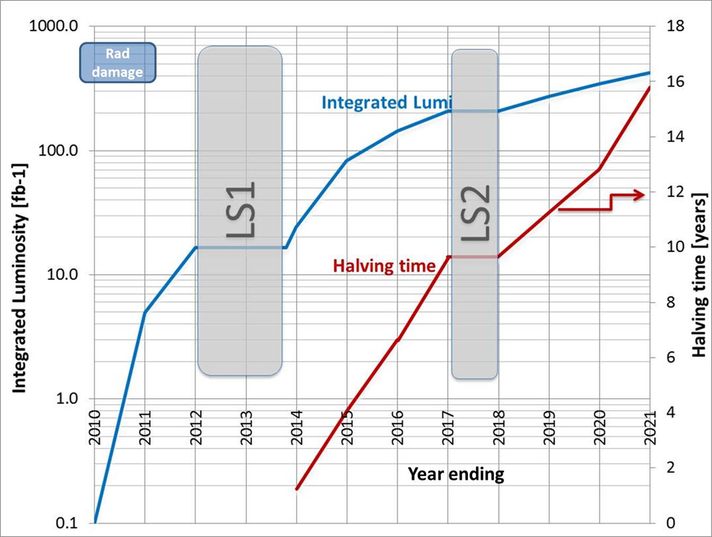

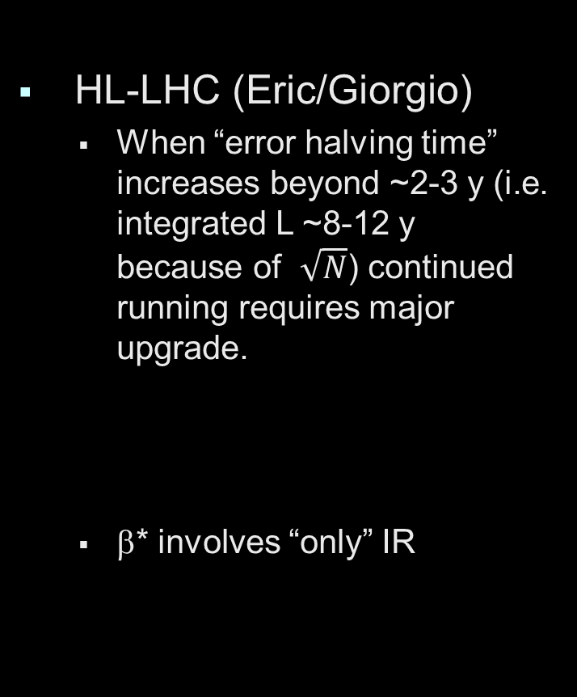
“Certain” Landscape in next 10 years
SC magnet development program needs to support physics research at present facilities (LHC) and planned future facilities (MC, ILC, ….)
HL-LHC (Eric/Giorgio)
  When “error halving time” increases beyond ~2-3 y (i.e. integrated L ~8-12 y because of $\sqrt{N}$) continued running requires major upgrade.
  β* involves “only” IR

Slide 4
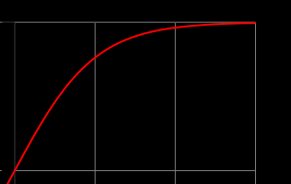
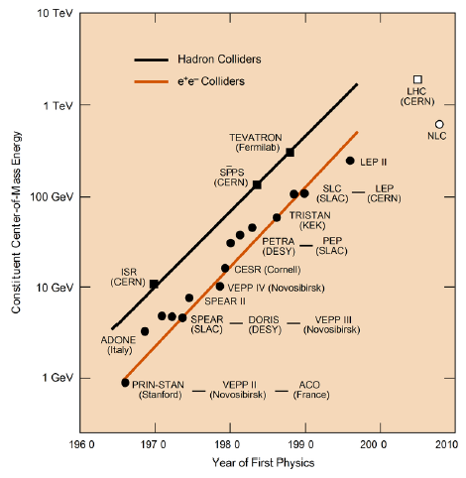
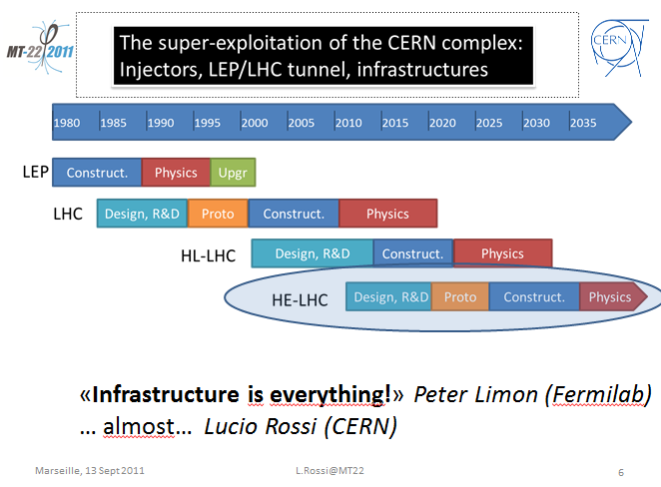
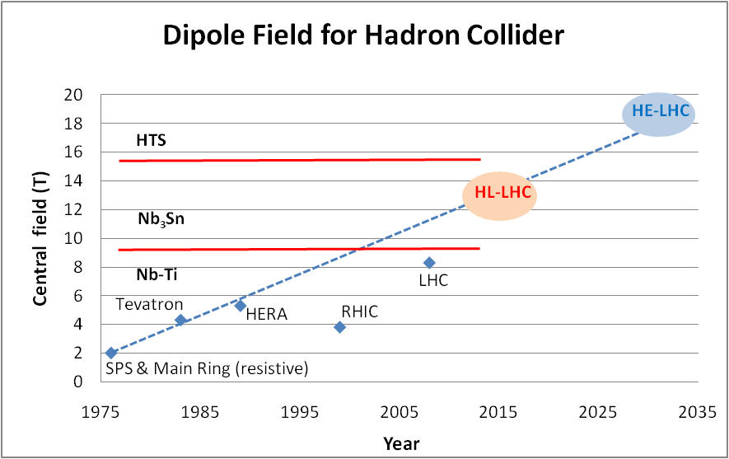
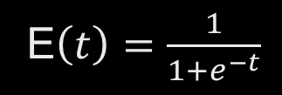
“Possible” Landscape beyond next 10 years
Stopped living on linear section of Livingston plot
  Self-limiting effect, similar to population growth in biological sciences, probably related to Type I (Kardashev scale) Civilization level for humanity.
Energy Frontier exploitation will require a long-lead time SC magnet development program.
  MC technology “might” be on hand (Nb₃Sn)
  Pushing for a HE-LHC (or VLHC) exploiting HF magnets* will require hybrid magnet with an expected development time measured in decade(s), based on Nb₃Sn experience
  * Apparent societal limit of ~20-200 km on tunnel rings
E$\left(t\right)={\frac{1}{1+e^{−t}}}_{ }$

Slide 5
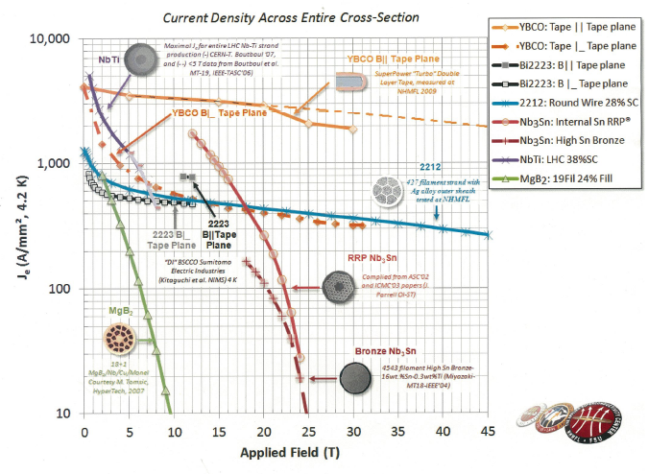
Superconductor Landscape
Consider HTS for its HF performance capabilities
Issues: Performance and Cost Nb₃Sn $ ~ 5 x NbTi $
Bi2212 $ ~ 30 x NbTi $
Order Magnitude cost decrease in production
Nb-Ti
Nb₃Sn
HTS

Slide 6
4-Points FNAL Magnet Strategy
Exploit and maintain present Nb₃Sn (and NbTi) know-how in accelerator-worth magnets for HL-LHC
  “present Nb₃Sn (and NbTi*) know-how”
    SSC-times experience and SRF-development ramp-up have shown that it takes a good fraction of a decade to reconstitute viable group(s) on the technology frontier. FNAL has them now, we cannot afford to loose them by having less than a vibrant program.
    MICE experience at LBL shows that even leading-edge R&D laboratory may be challenged by application of what should be an “acquired technology” to ongoing program
  “accelerator-worth magnets”
    Not interested in record-breakers . As only Accelerator Lab in the country, we WILL carry the weight of “knowing” how to build accelerators and not mere components.
  “HL-LHC” - 11 T, Triplets
Adapt Nb₃Sn know-how to address design and issues for future planned machines in the US
  Muon Collider, VLHC

Slide 7
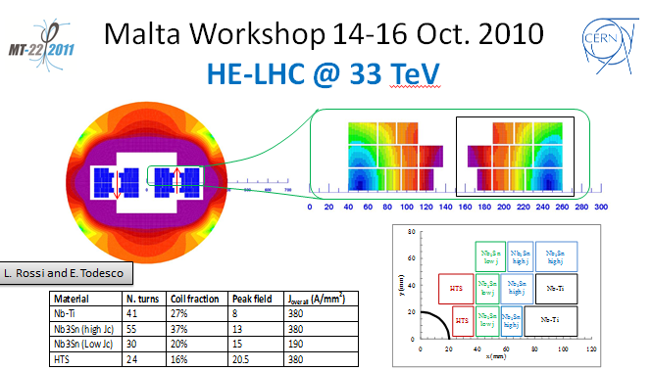
FNAL Magnet Strategy (Cont)
Initiate a conductor and magnet R&D program for hybrid magnets synergetic but distinct from present Eucard2 effort
  “Initiate (Continue) conductor …. program”
    Continue Bi2212 effort initiated by VHFMSC to develop appropriate magnet cables. Monitor and low-scale prototyping (if funding permitted) of simple magnet models (solenoids) based on YBCO tape.
  “..for hybrid magnets synergetic but distinct from present Eucard2 effort”
    Eucard2 will propose an HTS ~10kA-class
    magnet cable to test in a ~5 T accelerator
    quality dipole for insertion in a ~20-21 T
    Main dipole for LHC (16.5 TeV/beam)
    Distinction will come from initiating a
    Quadrupole Hybrid program to achieve
    Gradients of ~300-400 T/m over typical
    Accelerator aperture
4. Support (when requested or synergetic with FNAL goals) SC Magnets national programs such as ITER, NGLS,…

Slide 8
FNAL Magnet Strategy (in picture)
R&D
-----------------
LHC Hi-Energy,
NF/MC, VLHC...
-------------------
HTS + Nb₃Sn
--------------------
Dipoles, Quads
--------------------
Quads LHC-HE
D & Q NF/MC
“Construct. Project”
-----------------
LHC Hi-Luminosity
-----------------
Nb₃Sn
-----------------
Dipoles, Quads
-----------------
“11 T Dipole”
“IR Quads”
R&D
-----------------
NF/MC,
Light sources ..
-------------------
HTS + Nb₃Sn + NbTi
--------------------
Helical channel
Solenoids
Wigglers
….
G. Apollinari
A. Zlobin
G. Ambrosio

Slide 9
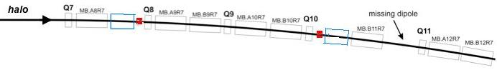
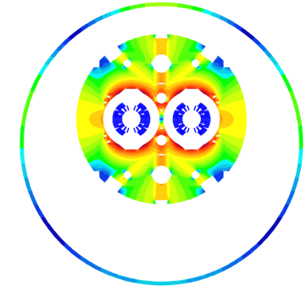
11 Tesla Effort (HL-LHC)
Upgrade for nominal (0.5A), ultimate (0.86A) and higher beam intensities
2017-18: Point-3,7 & IR-2
2020: IR1,5 as part of HL-LHC
MB.B8R/L
MB.B11R/L
∫BdL = 119.2 Tm @ I_{nom} = 11.85 kA
in series with MB
11 T Nb₃Sn
11 m Nb₃Sn
3 m Collim
(11.2 T x 10.6 m), L_{CM} ≈ 11 m, => 12 coldmass + 2 spares = 14 CM
2 x (11.2 T x 5.3 m), L_{CM} ≈ 11.5 m, => 24 coldmass + 4 spares = 28 CM
5.5 m Nb₃Sn
5.5 m Nb₃Sn
3 m Collim
5.5 m Nb₃Sn
3 m Collim.
5.5 m Nb₃Sn

Slide 10
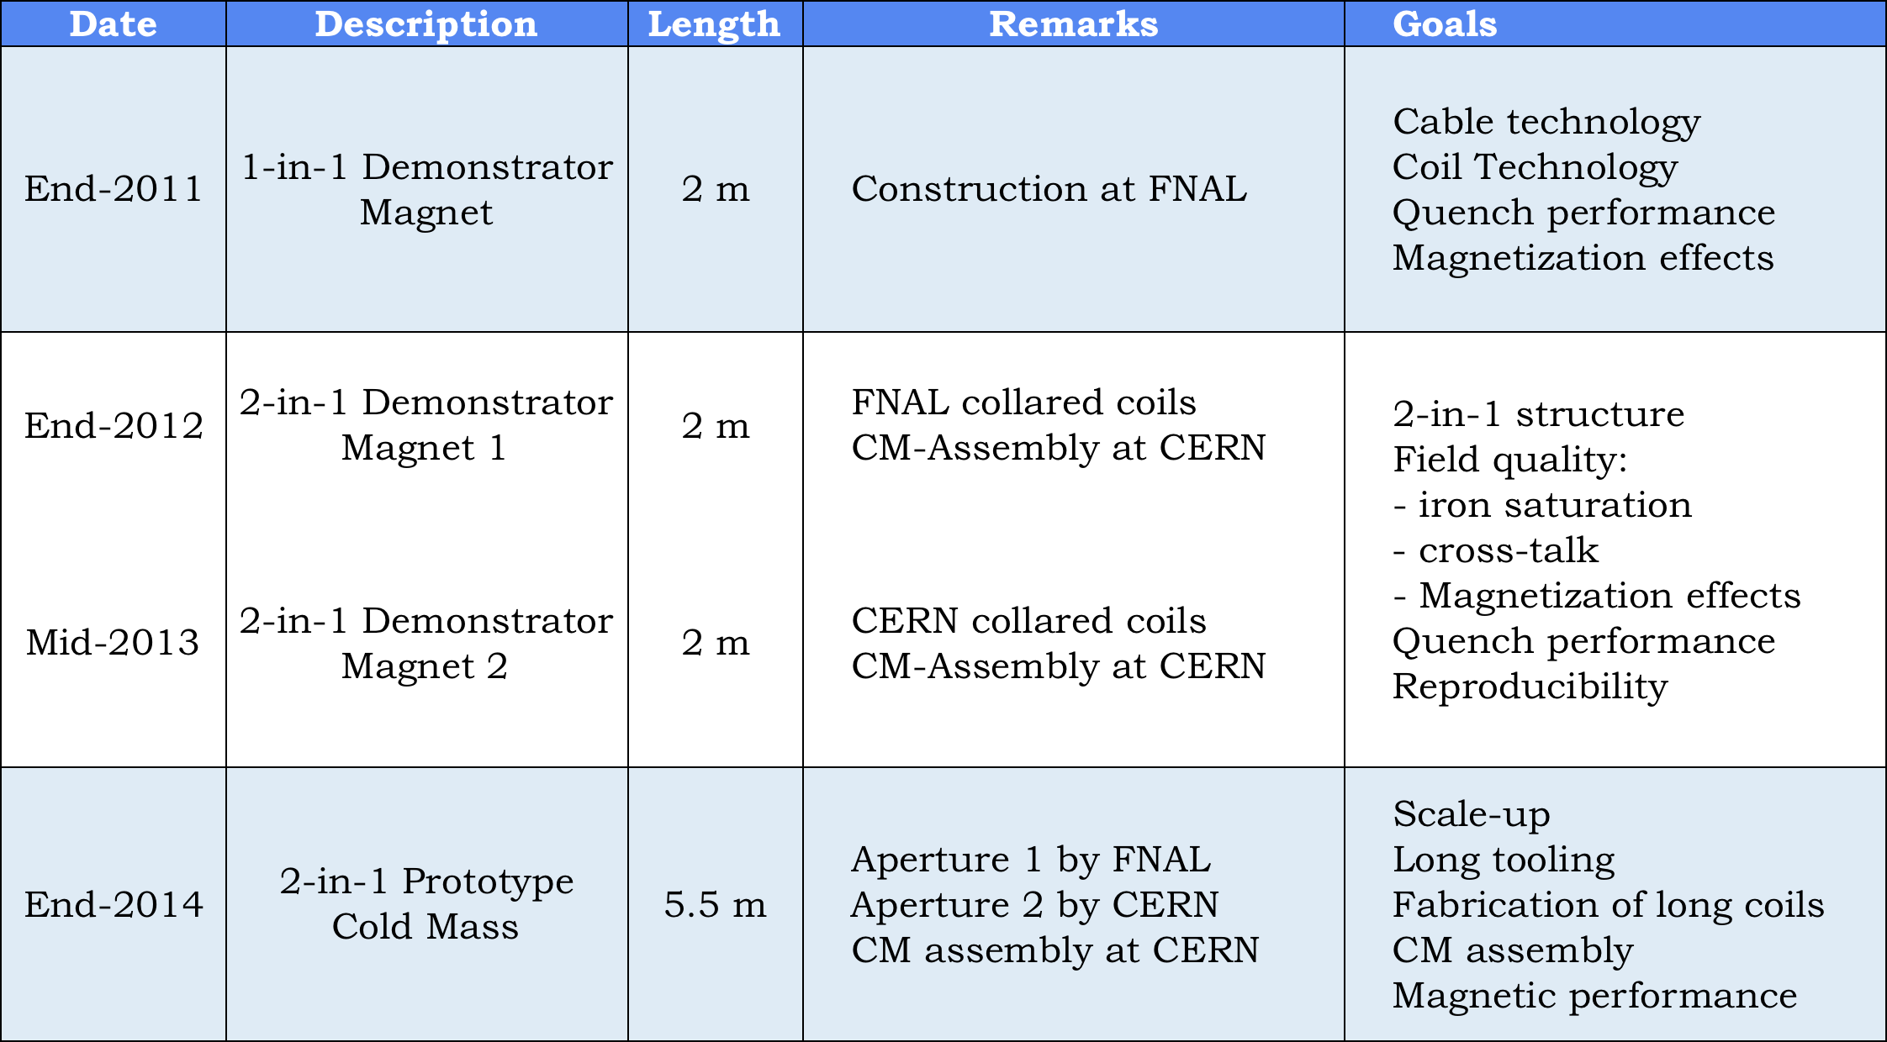
11 T Model Development Program

Slide 11
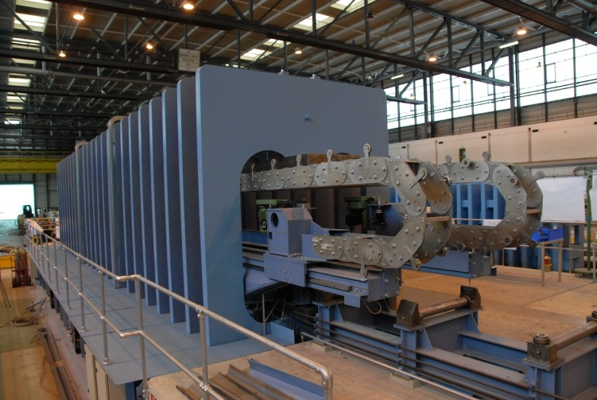
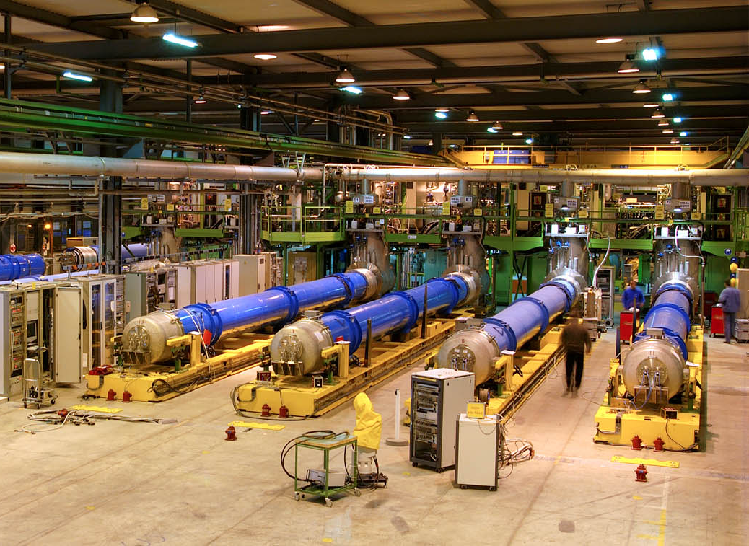
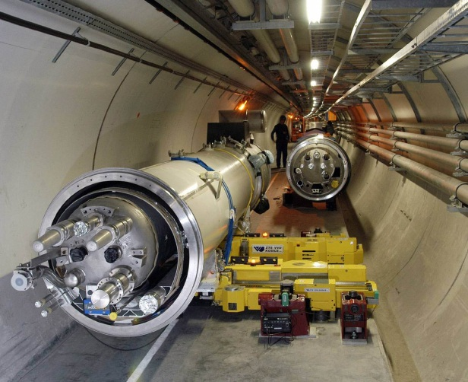
Production Phase 2014-17
Coil production (CERN & FNAL)
Collaring (CERN & FNAL)
Cold mass assembly (CERN)
Cryostat integration (CERN)
Testing (CERN)
Installation in the tunnel
3..4 years

Slide 12
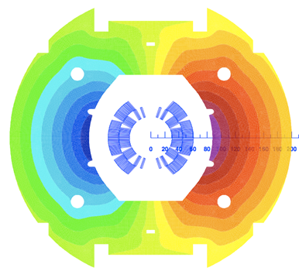
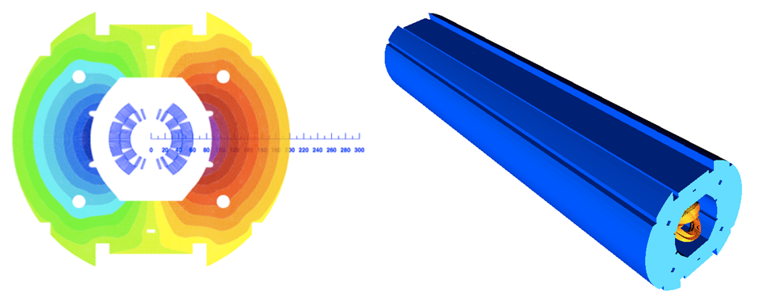
1-in-1 Demonstrator Parameters
Parameter | Value
Aperture [m] | 60
Nominal current I_{nom} [A] | 11850
Nominal bore field (with 400 mm yoke) [T] | 10.86
Short-sample bore field at 1.9 K [T] | 13.6
Margin B_{max}/B_{nom} at 1.9 K [%] | 25.4
Ultimate design field [T] | 12.0
Inductance at I_{nom} [mH/m] | 5.6
Stored energy at I_{nom} [kJ/m] | 473
F_{x} per quadrant at I_{nom} [kN/m] | 2889
F_{y} per quadrant at I_{nom} [kN/m] | 1570
Coil length [m] | 1.9
Magnetic length [m] | 1.79

Slide 13
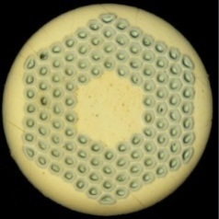
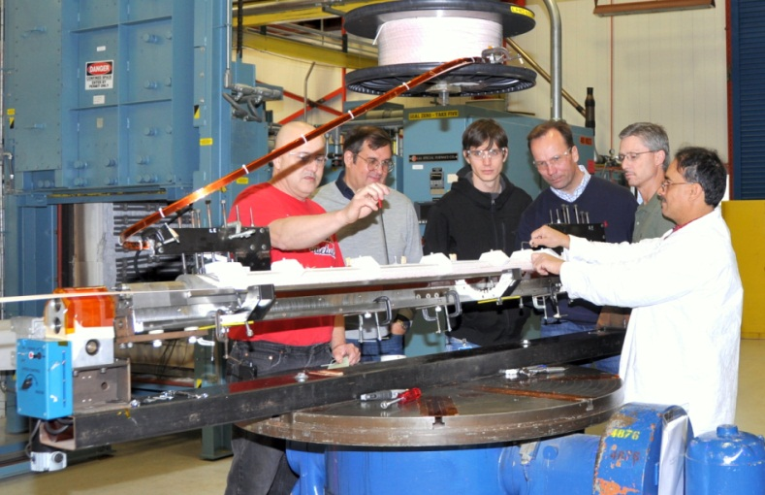
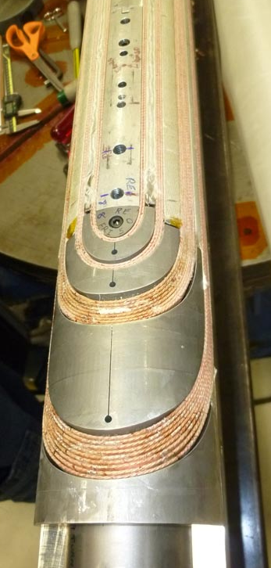
1-in-1 Demonstrator Goals and Status
Design and construction of a 2-m-long single aperture magnet, delivering 11 T at the LHC nominal operating current of 11.85 kA with 20% margin
Cable & Coil technology
  J_{c} degradation
  Fabrication procedures
Quench performance
  Operation margin
  Ramp-rate studies
Magnet protection
  Heater development
  Heater efficiency and delays
Coil Magnetization & coupling currents
Coils under Production, Magnet to be tested in Feb ‘12.

Slide 14
2-in-1 Demonstrator Goals & Plans
Design and construction of a 2-m-long 2-in-1 magnet, delivering 11 T at the LHC nominal operating current of 11.85 kA with 20% margin
Quench performance
  Operation margin
  Ramp-rate studies
Transfer function matching with MB
Field quality
  Iron saturation, persistent current effects & passive correction
  Coupling current effects & Magnetic cross-talk between the apertures
Magnet protection
  Heater development & Heater efficiency and delays
2-in-1 magnet with FNAL coils
  Cold test of 1st aperture Sep-12
  Cold test of 2nd aperture Oct-12
  2-in-1 CM assembly at CERN Jan-13
  2-in-1 cold test at CERN Feb-13
Production plans integrated with IR effort (G. Ambrosio)
Accelerator Sector Planning & Strategy Workshop, October 27th – 28th, 2011

Slide 15
ITER and SolTeF (Solenoidal Test Facility)
Support National program with Nb₃Sn expertise:
  Consultancy on:
    Magnetic/Cryogenic Design
    Quench Detection and Protection Systems
    Cable Performance
  ITER CS Module Test Facility Opportunity
Several present and future activities at FNAL will need the ability to test “naked” (i.e. no containment of return flux) high-field (~5-30T) solenoids.
  MICE, Mu2e
  MC 6-D Cooling and final focusing
  ITER
Ongoing effort to determine best location at FNAL to build and support a Solenoidal Test Facility

Slide 16
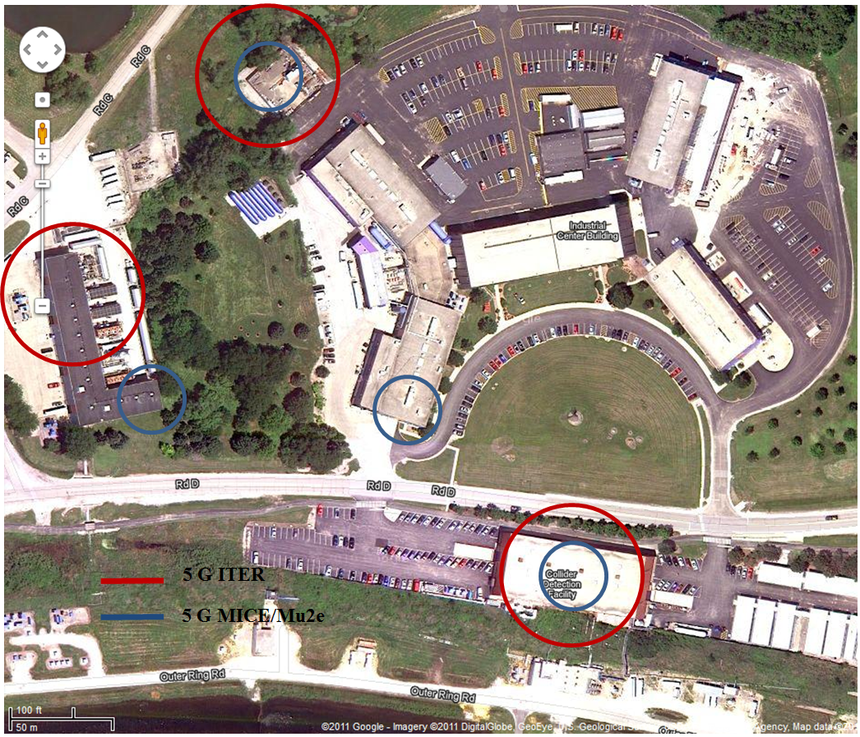
5 G Contours for ITER CS Modules and MICE/Mu2e coils
FESHM 5062.2: Warning signs required for > 5 Gauss field (restricted access for people with pacemakers, medical implants).
From the ITER fringe field point of view, the CHL building appears to be the best option
A short-term solution (6 months) is needed for MICE and shortly thereafter for mu2e
It is better to avoid IB1 because of the risk of permanently magnetizing the building

Slide 17
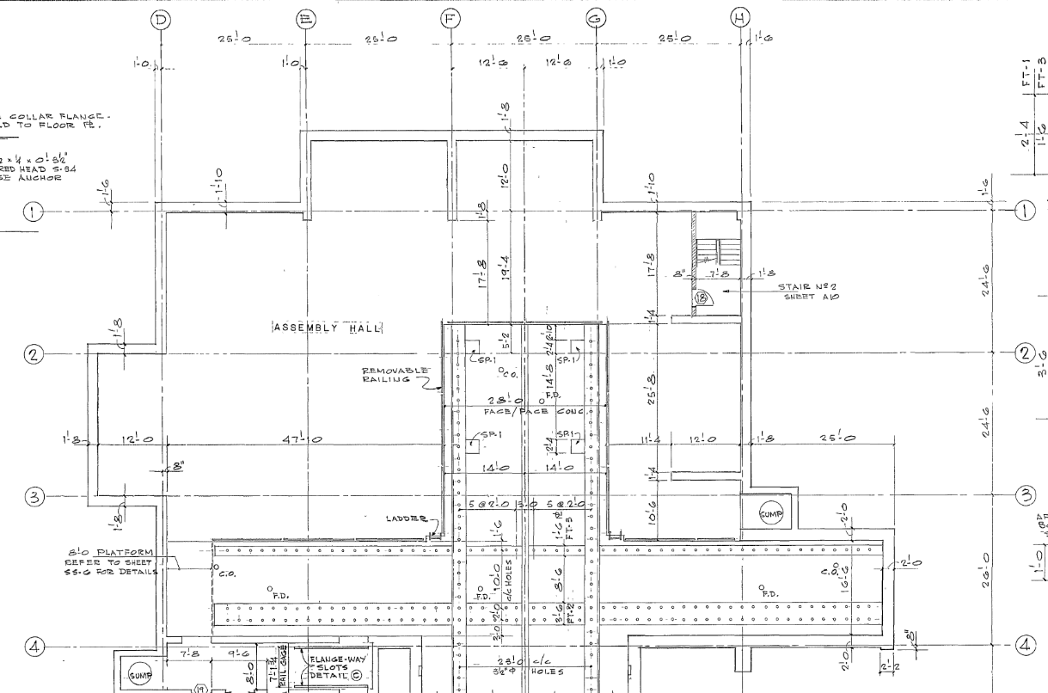
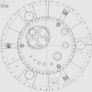
MICE/mu2e Contour Lines at CDF
5 G
5 Gauss Limit :
  Away from General Public areas (main control room, offices, tours) and NOvA test setup
  May spill outside building and reach pedestrian path?
600 Gauss Limit (High Field Hazard):
  Contained within corner area
  > 100 Gauss at exit door and stairwell
Cryostat
100 G
NOVA Test
600 G

Slide 18
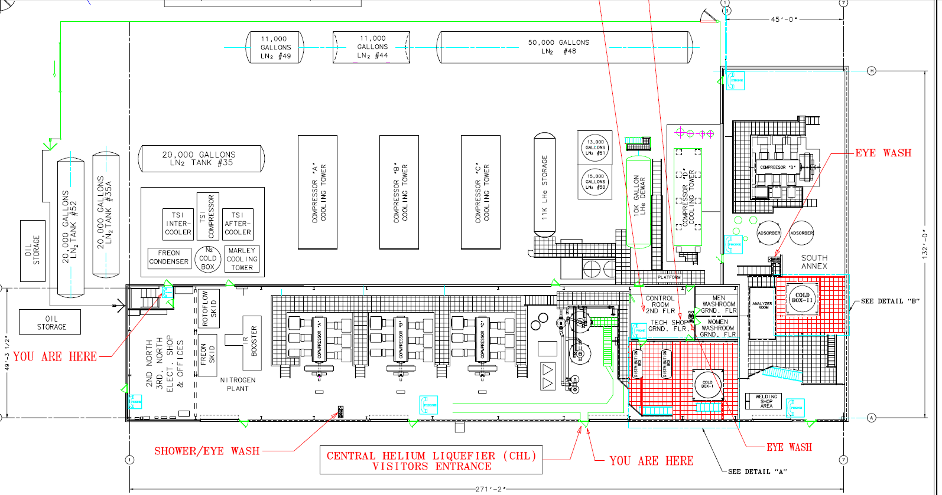

MICE/mu2e Contour Lines at CHL
5 G
100 G
600 G

Slide 19
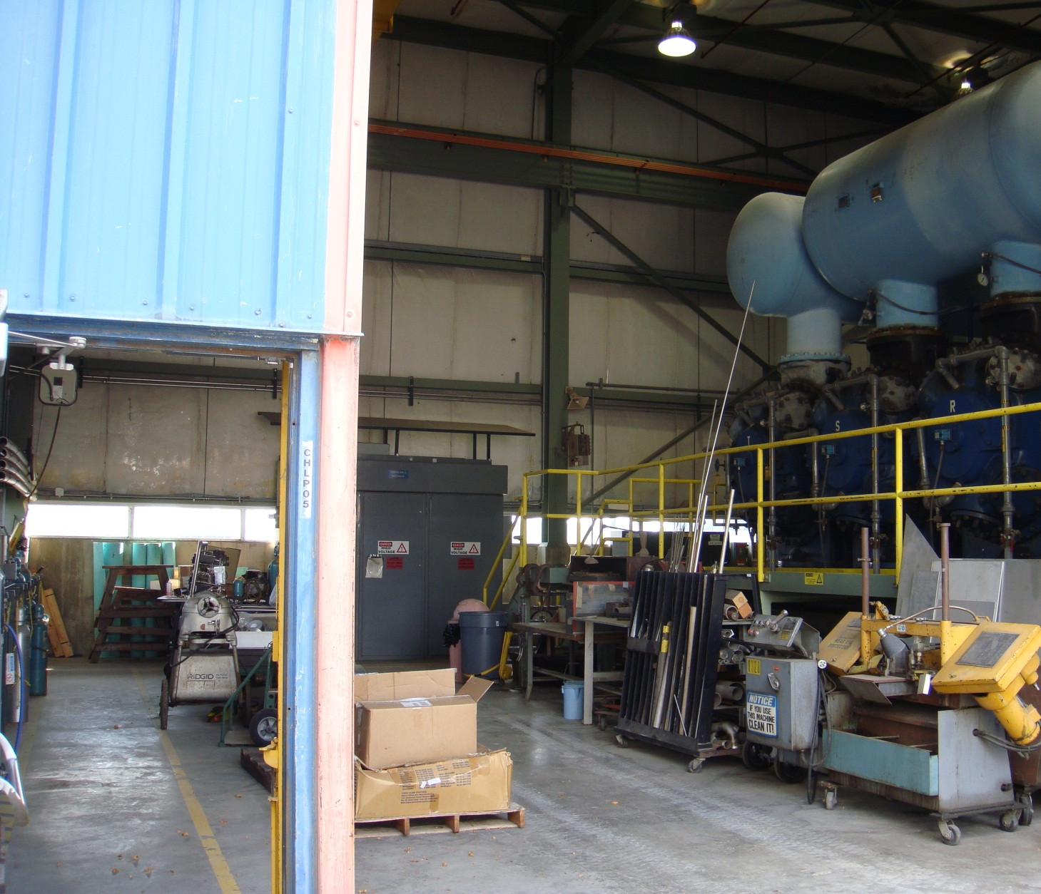

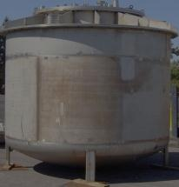
CHL Option for MICE/mu2e
Available space in “South Annex” end, near rollup door and compressor “D”
Need to bring cryogenics and magnet power and energy extraction system to this location
MICE/mu2e Cryostat (to scale)

Slide 20
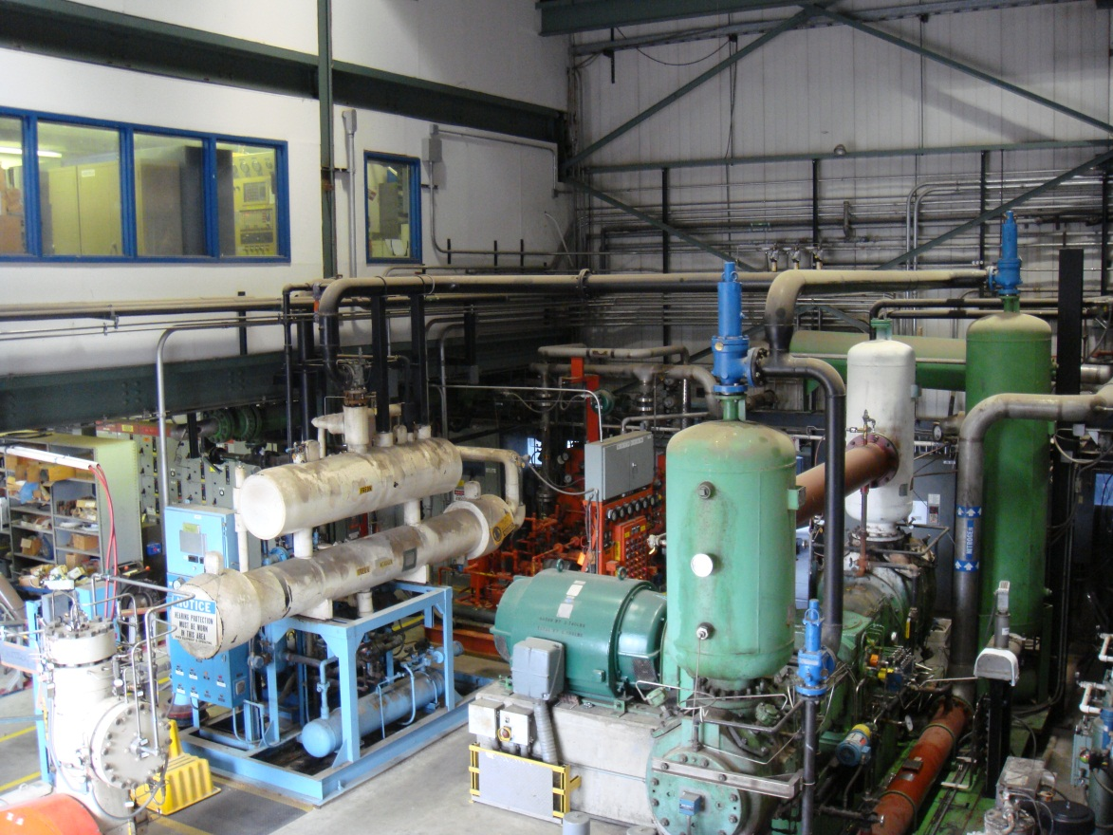
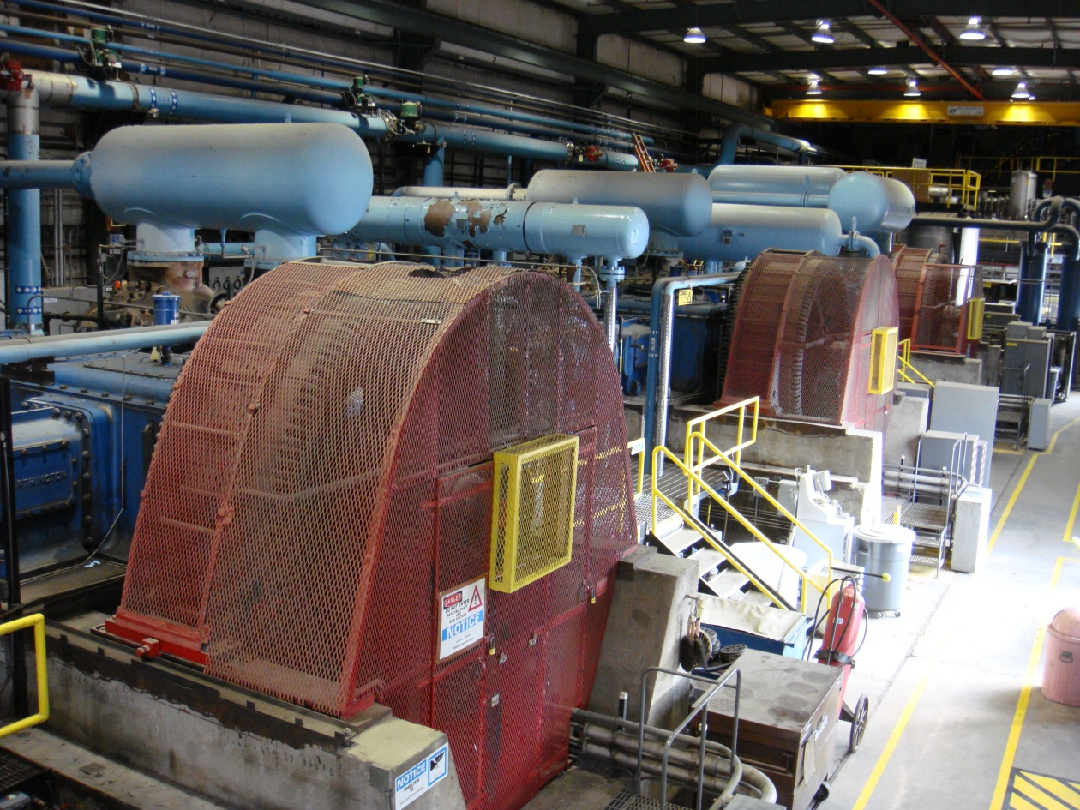
CHL Options for ITER
These are being discussed. One option for the ITER cryostat is to remove the N2 re-liquefier plant (left picture) and install the cryostat there
Another option is to remove old reciprocating compressors and massive concrete foundation and use the empty space for the ITER cryostat and Tevatron satellite refrigerators

Slide 21
Summary of High Field Magnet Strategy
Focus R&D on HTS-hybrid “conventional” magnets (quads, dipoles) searching for complementarity and synergy with other world programs.
Maintain vibrant “hands-on production” capability pursuing 11 T and LHC-IR upgrades.
Maintain capability in design and construction of specific magnets in NbTi and/or Nb₃Sn (MC Cooling Channels, PX/ILC magnets, Wigglers, Experimental Magnets (Mu2e),….)
Maintain interest, contacts with other facilities and ability to build small prototypes of High Field Hybrid Solenoids (~30-40T)
  Consider and plan for possible “step function” involvement at the end of MAP studies and HL-LHC effort (~5-7 y from now)
Address, when requested or synergistic with FNAL activities, issues of national interest related to SC magnet know-how at the Laboratory

