Slide 1
US LHC Accelerator Research Program (LARP)
Eric Prebys, Fermilab

Slide 2
Outline
Overview of LARP
Recent contributions
Long term vision
FY12 plans
Risks

Slide 3
LARP
The US LHC Accelerator Research Program (LARP) coordinates US R&D related to the LHC accelerator and injector chain at Fermilab, Brookhaven, SLAC, and Berkeley (with a little at J-Lab and UT Austin)
LARP has contributed to the initial operation of the LHC, but much of the program is focused on future upgrades.
The program is currently funded at a level of about
$12-13M/year, divided among:
  Accelerator research
  Magnet research (~half of program)
  Programmatic activities, including support for personnel at CERN
Giorgio Ambrosio will talk about this

Slide 4
General Comments About Subprograms
The Magnet Systems portion of LARP is a monolithic program, aimed at demonstrating the viability of Nb3Sn for high gradient/large aperture quadrupole
  Integrated into long term LHC planning
  Hand off to production project ~2015
  More about this from Giorgio Ambrosio
Accelerator Systems works to match US interests and expertise to perceived needs at the LHC
  Generally a faster time scale
  Activities change significantly over time
  Expected to be ongoing
Personnel programs respond to immediate needs of LHC commissioning and optimization.

Slide 5
LARP Contributions to Initial LHC Operation
Schottky detector
  Used for non-perturbative tune measurements (+chromaticities, momentum spread and transverse emmitances) – Operational
Tune tracking
  Implement a PLL with pick-ups and quads to lock LHC tune – Fully integrated
  Investigating generalization to chromaticity tracking
AC dipole
  US AC dipole to drive beam
  Measure both linear and non-linear beam optics – Primary tool for high energy optics
Luminosity monitor
  High radiation ionization detector integrated with the LHC neutral beam
  absorber (TAN) at IP 1 and 5. – Primary fast system (VDM scans, etc)
Synchrotron Light Monitor
  Used to passively measure transverse beam size and monitor abort gap
  Not a LARP project, but significantly improved by LARP – Fully integrated
Low level RF tools
  Leverage SLAC expertise for in situ characterization of RF cavities – Fully integrated
Personnel Programs…

Slide 6
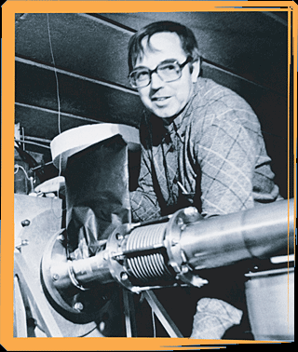
Toohig Fellowship
Named for Tim Toohig, one of the founders of Fermilab
Open to recent PhD’s in accelerator science or HEP.
Successful candidates divide their time between CERN and one of the four host labs.
Past
  Helene Felice, LBNL, now post-doc
  Rama Calaga, BNL, now staff and LTV
  Ricardo DiMaria, BNL, now CERN Fellow
  Ryoichi Miyamoto, FNAL, now ESS (Lund)
  Dariusz Bocian, FNAL, now Poland
Present
  Valentina Prevatali, FNAL
  John Cesaratto, SLAC
If interested, contact John Fox at SLAC

Slide 7
Long Term Visitors Program
LARP Pays transportations and living expenses for US scientists working at CERN for extended periods (at least 4 months)
Extremely successful at integrating people into CERN operations
  Past:
    Jim Strait, FNAL – Machine protection/splice consilidation
    Steve Peggs , BNL – UA9
    Alan Fisher, SLAC – Synchrotron Light Monitor
    Eliana Gianfelice, FNAL – abort gap cleaning
    Uli Wienands, SLAC – UA9, PS2, PSB
    Rama Calaga, BNL – crab cavities and commissioning (now CERN staff)
  Present:
    Chandra Bhat, FNAL – flat bunches for Large Pewinski Angle solution
    Alexexey Burov, FNAL - instabilities
Interested parties coordinate with a CERN sponsor and apply to the program (Uli Wienands, SLAC)

Slide 8
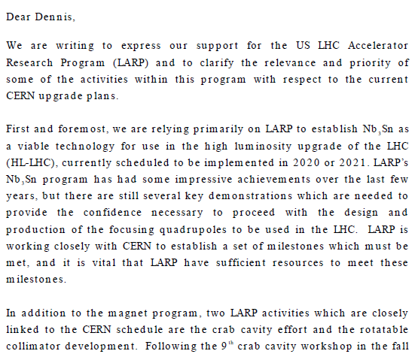

Relevance of LARP to CERN Upgrade*
Letter to Dennis Kovar, Head, DOE
Office of High Energy Physics, 17-August-2010
(…)
*letter suggested at review

Slide 9
Major Ongoing LARP Accelerator Activities
Rotatable Collimators – SLAC
LLRF – SLAC
High Bandwidth Feedback for SPS – SLAC, LBL
Crystal Collimation
  UA9 at CERN – SLAC, FNAL
  T980 at FNAL – FNAL
General beam physics and beam-beam – FNAL, SLAC, LBNL
Hollow electron beam collimation – FNAL
Crab cavities – FNAL, SLAC, LBNL, BNL
Energy deposition studies in magnets – FNAL, LBNL
Significant FNAL activity

Slide 10
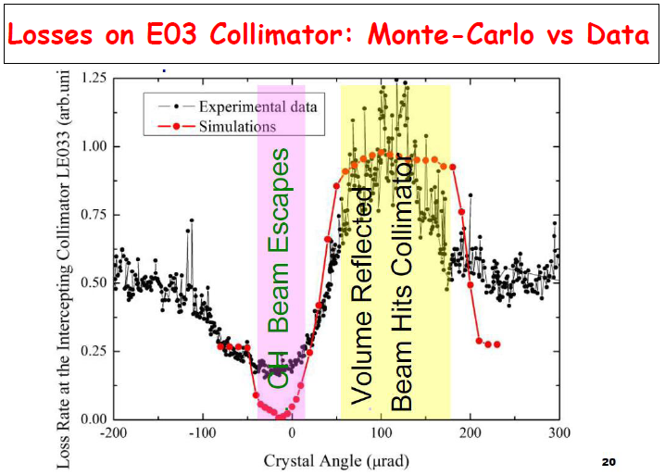
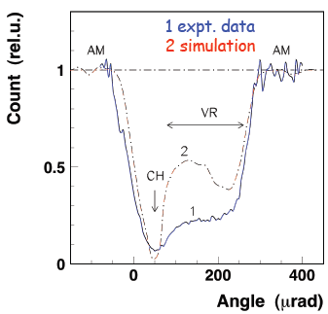
Crystal Collimation: UA9(CERN) and T980(FNAL)
Both experiments benefitted from improved configurations
  UA9: improved goniometers and instrumentation installed over winter shutdown
  T980: New crystals and instrumentation
Very impressive channeling data from both experiments
T980
UA9

Slide 11
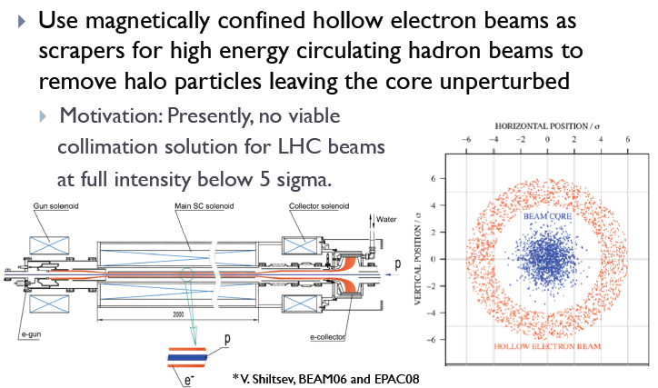
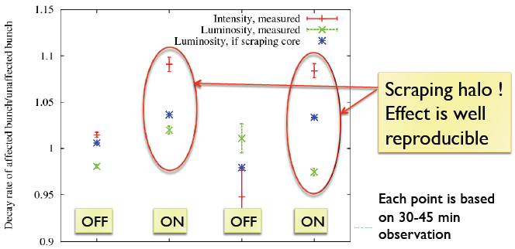
Hollow Electron Beam Collimation

Slide 12
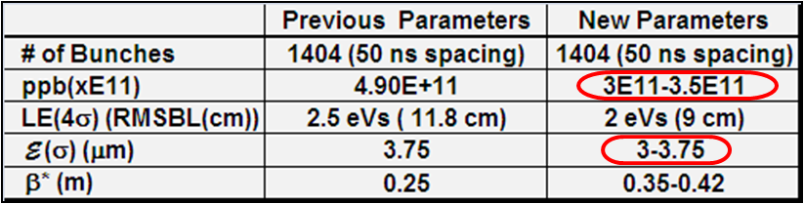
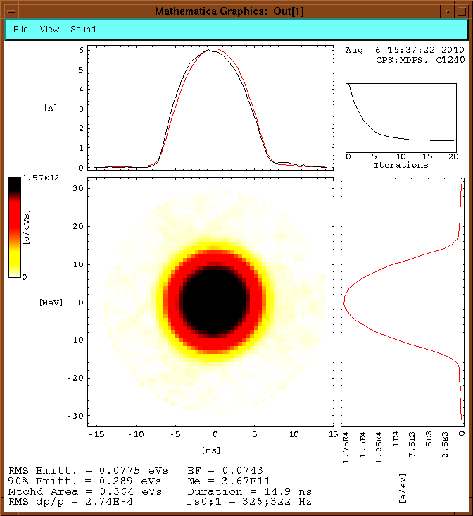
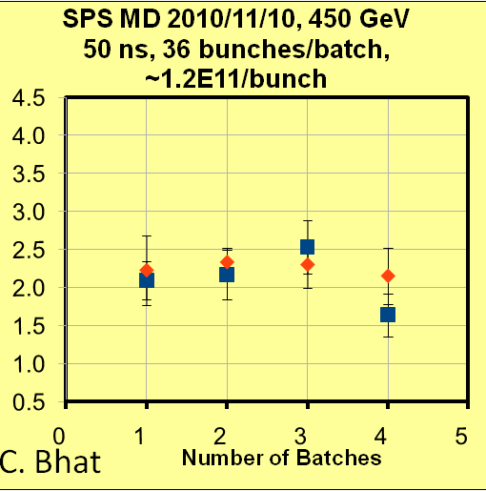
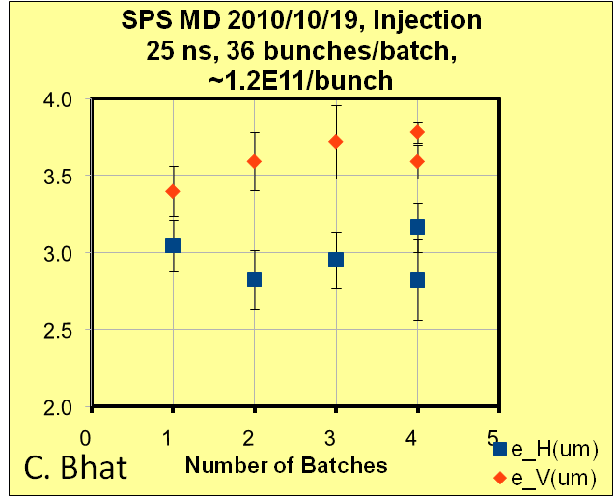
Large Bunch Studies for LPA Solution (C. Bhat)
Have come up with a new set of flat bunch (LPAS) parameters in view of the re-stated SLHC L_{peak} goal (≥5×10³⁴cm⁻²sec⁻¹) & estimated bb tune shift (<0.02) from LHC data
Performed studies of large bunches in the PS, as well as emittance growth studies for various bunch spacings
Bunch at 20ms before
Ejection
Aug. 6, 2010:
~3.7E11p/bunch

Slide 13
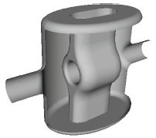
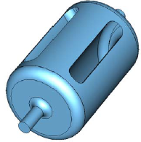
Crab Cavities
Important decisions at CC10
  KEK crab cavity test in SPS canceled
    Still feel a test of some sort in SPS is required, but should be better thought out and more closely aligned with ultimate goals.
  Adopt 400 MHz, compact, local scheme as base line unless proven unworkable.
  Appear to be 3-4 potentially workable
  designs.
    LARP has combined SLAC and JLAB
    designs
    May support new BNL concept.
  Complete conceptual design of 800 MHz
  elliptical as a backup.

Slide 14
Long Term Crab Cavity Strategy
LARP plans to continue to support crab cavities at the ~$600k/year level.
This is enough to complete a conceptual design.
Perhaps construct a prototype cavity and test in a cryostat.
Longer term plan
  Spawn off a construction project to take on some large portion of the overall crab effort
    Full prototype with cryomodule?
    Build some fraction of the final cavities
      4 stations per IR for full local scheme
  Hope FNAL can run this effort
    Will discuss at crab cavity workshop in November

Slide 15
The Future: HiLumi-LHC
Upgrade planning will be organized under FP7, which authorizes EuCARD*,
  Centrally managed from CERN (Lucio Rossi)
  Non-CERN funds provided by EU
  Non-EU partners (KEK, LARP, etc) will be coordinated by HL-LHC, but receive no money.
Work Packages:
  WP1: Management
  WP2: Beam Physics and Layout
  WP3: Magnet Design
  WP4: Crab Cavity Design
  WP5: Collimation and Beam Losses
  WP6: Machine Protection
  WP7: Machine/Experiment Interface
  WP8: Environment & Safety
Significant LARP and other US Involvement
Over and above current collimation plan (IR3, 7 and Phase II)
*European Coordination for Accelerator R&D

Slide 16
Letter in support of HiLumi-LHC Design Study

Slide 17
US Participation in HL-LHC Design Study
LARP and other (Average FTE’s for four years):
Submitted: November, 2010
  Proposal received a perfect 15/15 score
  Approved for $4.9M Euro
Goals
  Preliminary Design Report: 2014
  Technical Design Report: 2015

Slide 18
Where we’ll be in 10 years?
We have only committed as far as design studies, but conceivably
  Completing installation of crab cavities?
  Installing hollow electron beam collimators?
  Crystal collimation?

Slide 19
FY12 Plans for FNAL
Beam-beam studies
  .8 FTE
Crab cavities (beam simulations)
  .5 FTE
Hollow beam
  ~1.5 FTE
Crystal collimation
  ~1 FTE
Energy deposition studies
  .8 FTE
LTV
  Bhat and Burov, ~1/2 year

Slide 20
Risks
LARP has been and continues to be resource limited
  More interest and activities than we can support
  Contingency is always in scope.
The Fermilab portion of LARP is not currently committed to any hard deliverables.
We have committed a certain level of studies to the HL-LHC design study
  Crab cavities
  Energy deposition
  Optics and beam-beam studies
We are hoping to grow activities in some other areas
  Hollow electron beams
  Crystal collimation

