Slide 1
2011 Accelerator Sector Planning & Strategy Workshop: High Field Magnet Program
Alexander Zlobin
NIU Conference Center, Naperville
October 27th – 28th, 2011

Slide 2
HFM Program Mission
The mission of the High Field Magnet Program at Fermilab is the development of advanced SC accelerator magnets and baseline technologies for present and future particle accelerators.
The focus at the present time is on the development of high-field accelerator magnets with operating fields up to 15 T based on Nb₃Sn superconductor.
In the longer term, the program will support the development of accelerator magnets with operating fields above 20 T.
SC materials R&D is a key part of this program.

Slide 3
Major Results
FNAL HFM program developed and demonstrated
10-11 T 43.5 mm Nb₃Sn dipoles for VLHC (1998-2007)
12 T 90-mm Nb₃Sn quadrupoles for LHC IRs (2005-2011)
Nb₃Sn technology scale up (2007-2011)
Rutherford cables based on Nb₃Sn, Nb₃Al and Bi-2212 strands (since 2000)
Solenoidal and helical coils based on YBCO (2009-2011)
Contributed to VLHC, LARP, MCTF-MAP, CDP, VHMFC, etc. studies
Good position and time to start
implementing Nb₃Sn magnets with magnetic fields up to 15 T into real machines, e.g. HL-LHC
exploratory accelerator magnet R&D to achieve magnetic field up to 20 T based on HTS/LTS for energy frontier machines

Slide 4
Long-term Strategy
Possible post-LHC scenarios: HE-LHC, VLHC, MC
2021-2022 – next machine and technology review/selection
VLHC
Nb₃Sn/Nb-Ti technology
No R&D is required => input from LARP, HL-LHC
HE-LHC
20 T nominal operation field => HTS/LTS hybrid technology
R&D plans (EuCARD) => twin-aperture arc dipole
2012-2016 – 10 kA HTS cable (YBCO) and 5 T dipole insert (background field 13 T FRESCA-2 Nb3Sn dipole)
2017-2021 – dipole demonstrator
HE-LHC energy could be limited by IR quadrupoles
B_{peak}=18.3 T (22 T with 20%) for 70 mm aperture => HTS/LTS hybrid technology => Critical R&D for HE-LHC

Slide 5
R&D direction
Muon Collider (Storage Ring and IR)
1.5 TeV machine is based on 10 T arc dipoles and 15 T IR quadrupoles => Nb₃Sn technology
R&D issues
10+ T large aperture (>100 mm) dipole - LBNL, CERN
IR quadrupoles – input from LARP
2+ TeV machine favors combined function arc and IR magnets with B_{peak}>17 T => HTS/LTS hybrid technology
R&D issues
Hybrid high-field combined function arc and IR magnets
=>Initiate R&D program at FNAL for HTS/LTS magnets
Start with hybrid IR quadrupoles for HE-LHC
When progress achieved involve combined function magnets for MC

Slide 6
Ultimate goal
Develop infrastructure and “know-how” for high field hybrid accelerator magnets based on HTS and LTS coils
Explore and demonstrate possibilities and limitations of accelerator magnets with magnetic fields up to 20 T and hybrid coils
Provide critical input for the machine and technology review/selection including magnet technical parameters and cost

Slide 7
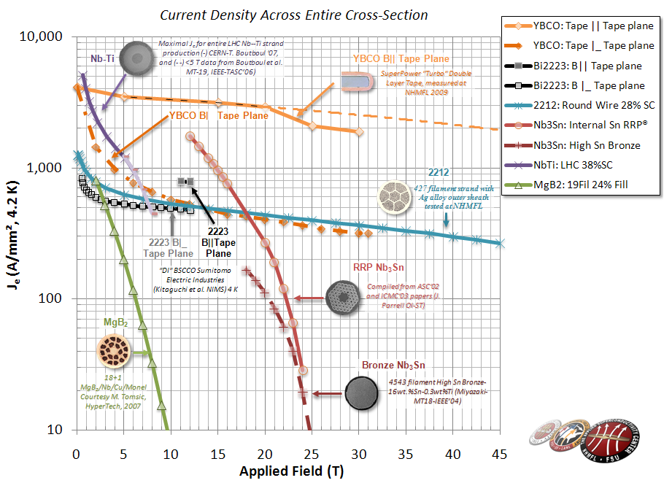
HTS Choice
Bi-2212 round wire
Rutherford cable
Complicate W&R process
Stress/strain sensitive
YBCO tape
Ready to use material
Limitation on bending radius
Complicate Roebel cable
=>Focus HFM program on Bi-2212 strand and cable
Good progress in Je (U.S. BSCCO collaboration)
Experience with Bi-2212 cable at Fermilab
42-strand cabling machine
=>Collaborate with EuCARD on YBCO cable R&D

Slide 8
Background field
Use TQC quadrupole to produce the background field for HTS quadrupole insert
90 mm aperture, 1 m long
B_{peak} up to 12-13 T
Well understood performance, available
Thin inserts with ID>40 mm and OD<90 mm
120 mm 1-m long HQ quadrupoles with B_{peak} up to 14-15 T will be available by 2014
Under development by LARP
Inserts with larger ID/OD and separate support structure
HTS coil
Nb₃Sn coil

Slide 9
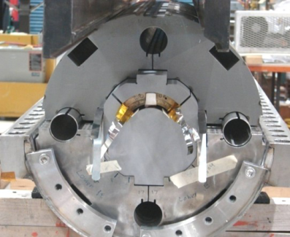
HTS Coils
Shell-type design, W&R technology
R&D issues: structural materials, HT, stress management, QP
Bi-2212 strand is very expensive (factor of 10+ wrt Nb₃Sn RRP strand)
To reduce the cost and turnaround time use coil test structures (quadrupole mirrors) to test individual HTS coils w/o and with background field
TQM: coils with ID >40 mm and OD<90 mm up to 1 m long
HQM: coils with ID >40 mm and OD<120 mm up to 1 m long
Both structures are available

Slide 10
Timeline (mid-term plan)
Phase I (FY2012-2016):
FY2012 – design studies, program proposal, review
FY2013 – insert coil, cable and tooling design, cable development using copper strand, Bi-2212 strand procurement
FY2014 – Bi-cable fabrication and test, tooling procurement and practice coil fabrication
FY2015 – fabrication and test series (2-3) of Bi-coils using coil test structure
FY2016 – HTS quadrupole insert fabrication and test in self-field and background field, program review
This plan is well aligned with EuCARD plan for HE-LHC.

Slide 11
Timeline (long-term plan)
Phase II (FY2017-2021):
Development, fabrication and test a large-aperture high-field demonstrator IR quadrupole for HE-LHC based on hybrid HTS/LTS coils
Development and test a laarge-aperture combined function demonstrator magnet for MCSR
FY2021 – program review

Slide 12
Resources
What resources are needed to meet this year’s goals? 0.5 FTE (EDIA)
Are the planned resources consistent with the established goals and milestones? Yes.
What resources are needed to meet the 10 year goal?
 | 2012 | 2013 | 2014 | 2015 | 2016 | 2017 | 2018 | 2019 | 2020 | 2021
EDIA | 0.5 | 0.5 | 0.5 | 0.5 | 0.5 | 1 | 2 | 2 | 2 | 2
tooling |  | 0.5 | 0.5 | 0.2 | 0.2 | 1 | 2 | 2 | 1.5 | 1.5
strand & cable |  | 0.3 | 0.3 | 0.3 | 0.3 | 0.3 | 0.3 | 0.3 | 0.3 | 0.3
coils |  |  | 0.5 | 0.5 | 0.5 | 0.5 | 1 | 1 | 1.5 | 1.5
assembly |  |  |  | 0.3 | 0.3 | 0.3 | 0.5 | 0.5 | 0.5 | 0.5
test |  |  |  | 0.3 | 0.3 | 0.3 | 0.5 | 0.5 | 0.5 | 0.5
Total (FTE) | 0.5 | 1.3 | 1.8 | 2.1 | 2.1 | 3.4 | 6.3 | 6.3 | 6.3 | 6.3

Slide 13
Barriers, Risks
Are there systematic barriers (structural, intellectual, financial, organizational,…) that need to be solved in order to reach the ultimate goal?
We need stable funding and a well organized team.
What are the risks to this year’s plan?
The risk is low. The presented plan could be turned into a solid proposal by the end of this year.
What are the risks to reaching the 10‐year goals?
It is an exploratory R&D. Coordination of efforts and collaboration with similar programs in U.S. and abroad will help to achieve an objective result (even if it will be negative).

Slide 14
Summary
Proposed R&D strategy and plan consistent with the HFM program mission.
Focusing the HFM program on high-field hybrid quadrupoles provides
provide an optimal place of Fermilab’s program as a part of the national and world-wide efforts in this area
the best use of Fermilab’s expertise in SC accelerator magnets
reduce the R&D cost and time
good position for collaboration with national and international high-filed magnet programs

