Slide 1
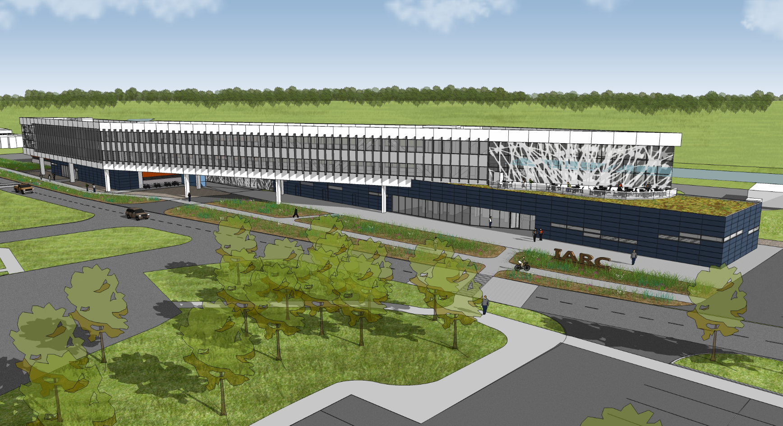
Illinois Accelerator Research Center (IARC)
Robert Kephart
Fermilab

Slide 2
IARC: What is it?
A partnership between Department of Energy and the State of Illinois to work encourage and enable Fermilab to work closely with industry and universities on Accelerator Technology Development and Accelerator Education

Slide 3
IARC Mission Statement
Work with Industry, University, and Laboratory partners to promote the development of accelerator technology, projects, and applications
Promote the growth of high tech industry based on accelerator technology leading to new products and capabilities
Work with University partners to create an educational center for accelerator science and technology

Slide 4
IARC: The investment
A large new building is being built at Fermilab
The Office Technical & Education (OTE) building is part of the larger Illinois Accelerator Research Center
OTE is fully funded at $ 20 M by a grant from the Illinois Dept of Commerce and Economic Opportunity (DCEO)
DOE’s contribution to IARC is the site preparation, the refurbished CDF heavy assembly building ( valued at $ 38 M ), and funds to outfit the completed IARC complex
In total the IARC physical plant will represent an investment of more than $ 60 M

Slide 5
New Building Status
The contract is awarded and the DOE funded site preparation work is almost done (utilities, parking lots)
OTE building conceptual/engineering designs complete
Out for bids shortly
Dec 16, press release & groundbreaking
Beneficial occupancy of OTE bldg in fall 2013
Refurbished CDF heavy assembly building in ~ 2014
IARC funded by DCEO as a means for the lab to encourage new high tech industries in Illinois
IARC “Program” is under development

Slide 7
IARC OTE Building

Slide 8
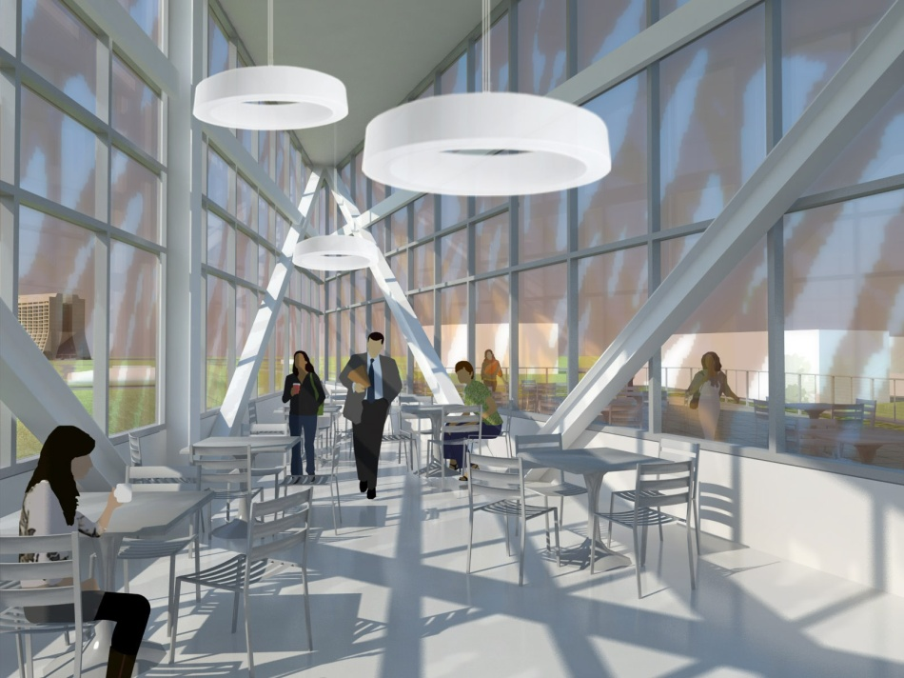
Lecture Hall
2-Story Lunch Room
175 person capacity
Sloped/Tiered Seating
Fixed desks with power and wireless
Seating for 90 on 2 levels
Outdoor Dining area

Slide 9
New Office Technical & Education Building
23,000 SF of Office Space (145 offices)
3,900 SF New Lecture Hall
900 SF Executive Meeting Room
3,700 SF Light Tech Space
New Dining Area with cold food service
New 55-car parking
Interior connection to CDF bldg

Slide 10
The Opportunity for Fermilab
Opportunity to put substance behind the claim that HEP is the developer/steward of accelerator technology within the Office of Science
Opportunity to function as a center for accelerator based projects ( e.g. Project X, or other non-HEP Projects in the Office of Science, e.g. NGLS,FRIB)
Opportunity for Fermilab to become a National center for accelerator education
Opportunity to establish additional funding sources outside HEP or with industry develop IP
Opportunity to develop technologies that benefit society bringing recognition to HEP and FNAL

Slide 11
The Opportunity for Industry
Fermilab has
a world-leading accelerator engineering and scientific staff that have the potential to make an impact beyond the field of high-energy physics.
core capabilities and infrastructure that are unique, and that could potentially be used in application beyond the field of high-energy physics.
And will have the IARC physical plant in 2013-2014
Industry can leverage these assets to create new accelerator based products and capabilities

Slide 12
IARC Business Model (Gaps)
New ideas in accelerator technology seem to die for three reasons
Inadequate resources (financial or personnel) in industry, universities, or labs to demonstrate feasibility of an idea
During the transition from small scale technology demonstration to a commercial product
Lack of acceptance of the new technology by potential customers (ignorance or prejudice) that is cured only by large scale demonstrations
IARC can help fill these gaps

Slide 13
Next Steps
Although it has been a long process to get the IARC building approved and designed, the construction process is largely ballistic.
However this was the EASY part…
Next we have to establish an IARC program that works ➔ have to understand what Industry wants/needs, understand and open up funding sources, understand impediments of doing this at a DOE lab (safety culture, IP, WFO, etc)
This is the challenge for the next year

Slide 14
Conclusion
IARC program is new territory for Fermilab
Even without a “formal” IARC program announcement there seems to be lots of interest in Industry
A great opportunity for both of us
But… a challenge to craft a successful program
Will be developing the business model and “listening” to get this part right…
Stay tuned

