Slide 1
Primary Beam Instrumentation
LBNE Near Site Conceptual Design Review
November 1st – 3rd, 2011
Manfred Wendt
manfred@fnal.gov
The Long-Baseline Neutrino Experiment

Slide 2
Outline
Charge and Personal Remarks
NuMI Beam Diagnostics
LBNE Beam Parameters and Requirements
LBNE Beam Instrumentation R&D
Summary of the Instrumentation BOE
  Work through detailed BOEs as required
Summary
November 2, 2011
Manfred Wendt – LBNE Near Site Conceptual Site Review

Slide 3
Given Charge of the Review
(My personal short form)
Technical, R&D
  Have physics requirements clearly stated and documents, and transformed into technical performance requirements and specifications?
  Can the design constructed, installed, tested, maintained and operated satisfactory?
  Is there adequate supporting documentation?
  How about comparison of alternative designs?
Management
  Understanding of risks (technical, costs, schedule)!
  Have areas of value engineering identified? Is this documented?
  Definition of responsibilities along subproject boundaries and interfaces, e.g. beam-line, near detector, CF, etc.
  Any other issues for CD-1 to be addressed?
November 2, 2011
Manfred Wendt – LBNE Near Site Conceptual Site Review

Slide 4
View from a Beam Diagnostics Expert
What makes LBNE primary beam-line different from other projects:
  No new magnet technology, no RF, no superconductivity, no fancy beam gymnastics!
  No exotic beam optics, no high precision requirements.
  No ultra high resolution beam diagnostics required (nm, fsec).
  Beam instrumentation seems to be very similar to NuMI.
  Pretty standard beam parameters, except:
High initial beam power, later very high beam power!!!
  Initially 700 kW, up to 2.3 MW after upgrade with Project X.
  Reliability & long term stability of guide fields and beam diagnostics.
  Real-time, fail-safe machine protection system.
  Beam loss mitigation.
  Limited use of invasive beam instrumentation (residual losses).
Charge is pretty general, a mix of technical and management objectives
November 2, 2011
Manfred Wendt – LBNE Near Site Conceptual Site Review

Slide 5
NuMI Beam Diagnostics
The LBNE beam instrumentation has many common aspects with the
NuMI (NOvA) beam-line diagnostics:
  Beam intensity
    2 Pearson toroidal transformers, with MADC read-out electronics
  Beam trajectory
    24 split-plane (single plane) beam position monitors (BPM),
    utilizing an Echotek based read-out system.
  Beam profile (transverse)
    10 Secondary emission monitors (SEM), based on foils / wires
  Beam losses
    54 Ion chamber based beam loss monitors (BLM)
    4 long (~200 ft) total loss monitors (TLM)
November 2, 2011
Manfred Wendt – LBNE Near Site Conceptual Site Review

Slide 6
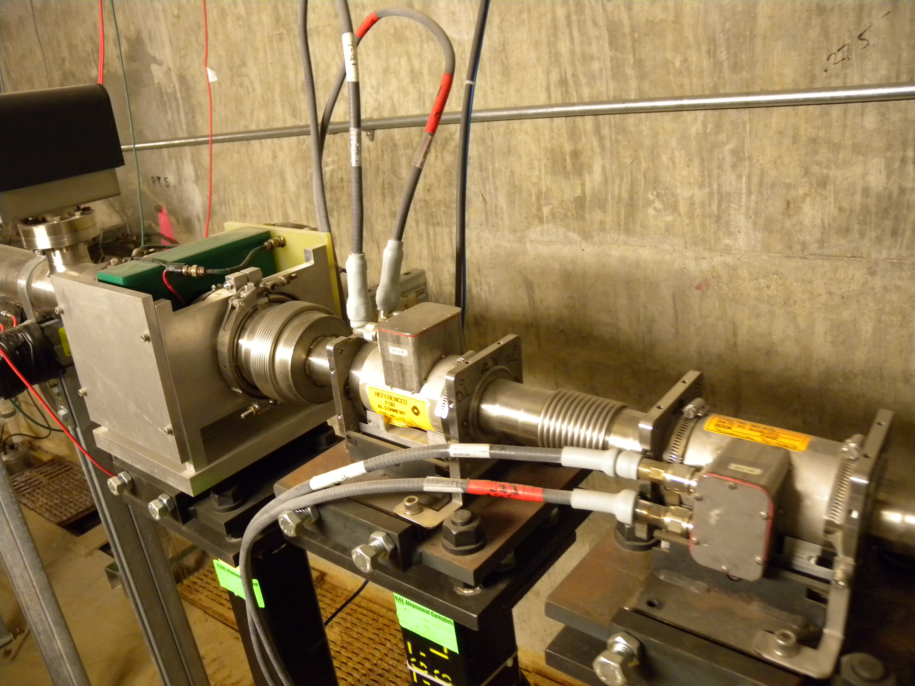
NuMI Target Toroid
Pearson toroid TRTGTD
“naive” toroid stability estimation
November 2, 2011
Manfred Wendt – LBNE Near Site Conceptual Site Review

Slide 7
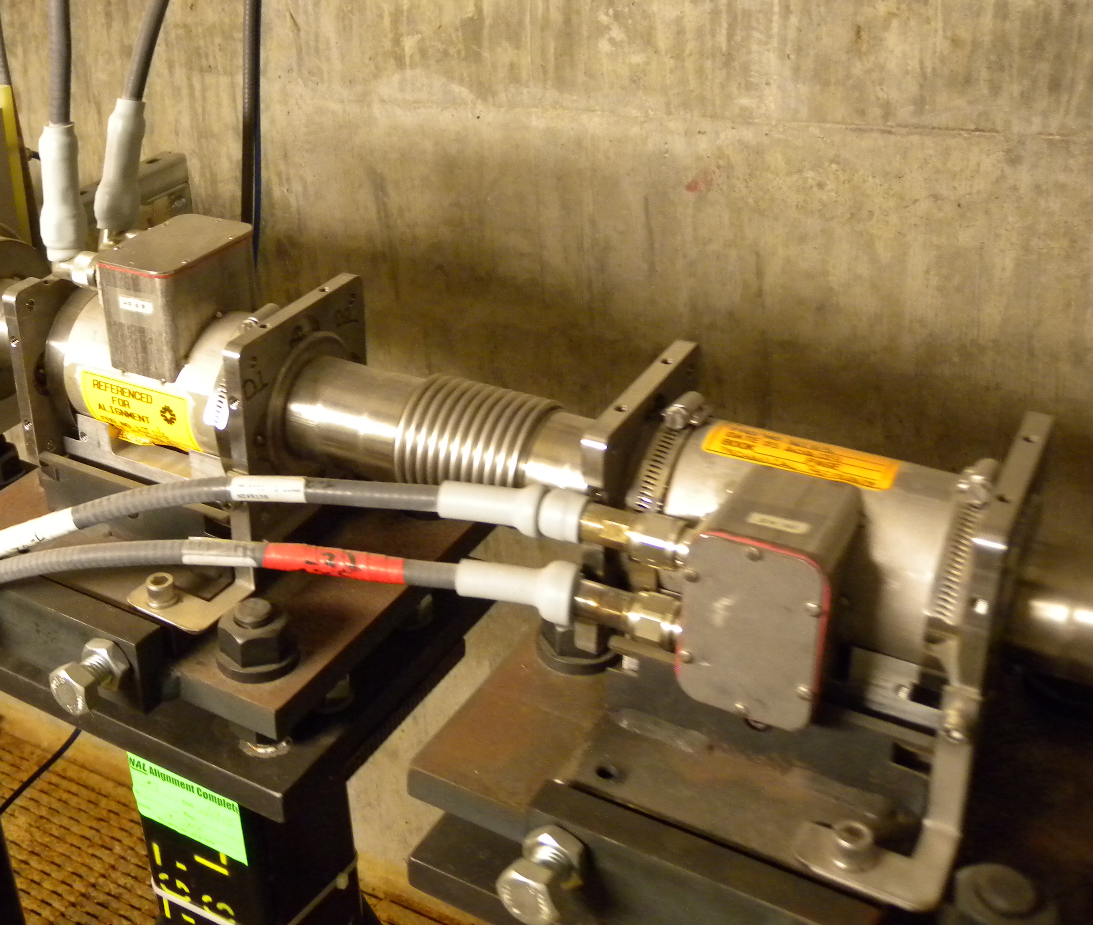
NuMI Split-plane BPM (MI-8 Style)
Pros
  Linear behavior
  Strong beam-electrode coupling (almost 50 %)
Cons
  Single plane
  Complex mechanics, tolerances
  No ground guards
November 2, 2011
Manfred Wendt – LBNE Near Site Conceptual Site Review

Slide 8
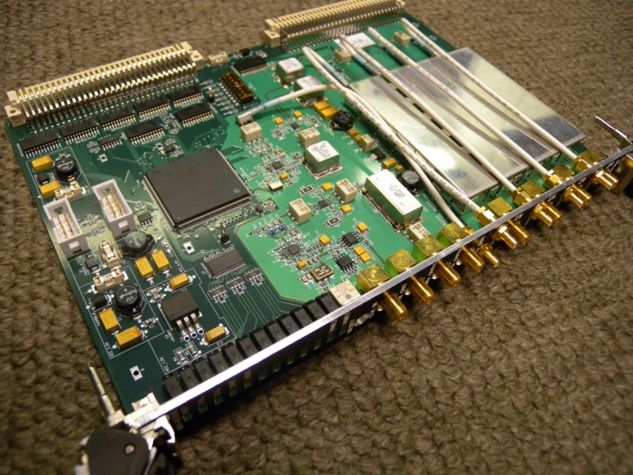
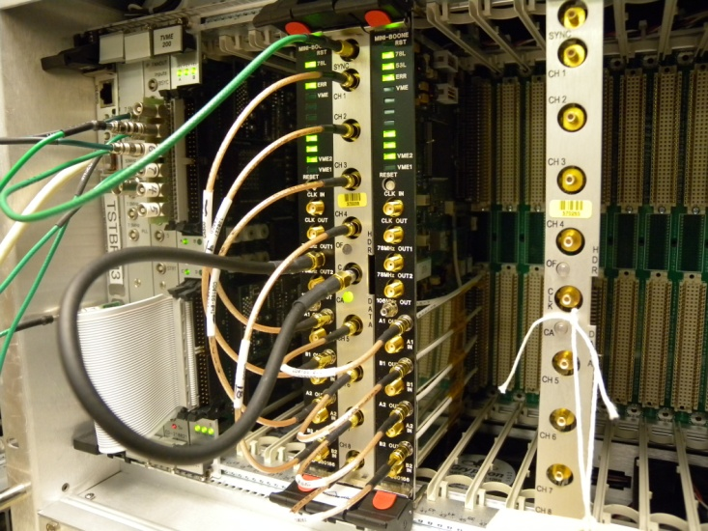
BPM Read-out Electronics
Commercial / in-house VME system
  Echotek digitizer and digital down-converter
    Similar to RR, TeV, MI, and most transfer lines
    Undersamples 53 MHz batches (operates in the 2nd Nyquist passband, ~75 MSPS)
  In-house analog signal conditioning
    Simple gain stages, band-pass filter (~10 MHz BW), attenuator.
  In-house timing and trigger module.
  Motorola CPU board
    Runs VxWorks
    Interfaces to AcNet
November 2, 2011
Manfred Wendt – LBNE Near Site Conceptual Site Review

Slide 9
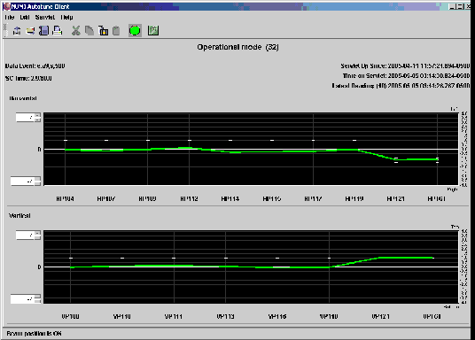
Autotune: Primary Beam Position Control
Automatic adjustment of correctors using BPM positions to maintain primary transport & targeting positions
Commissioned at initial turn on for correctors
Vernier control for targeting. Initiate tuning when positions 0.125 mm from nominal at target
Very robust . Separate corrector files for mixed mode and NuMI only
Autotune Beam Control Monitor
Courtesy S. Childress
November 2, 2011
Manfred Wendt – LBNE Near Site Conceptual Site Review

Slide 10
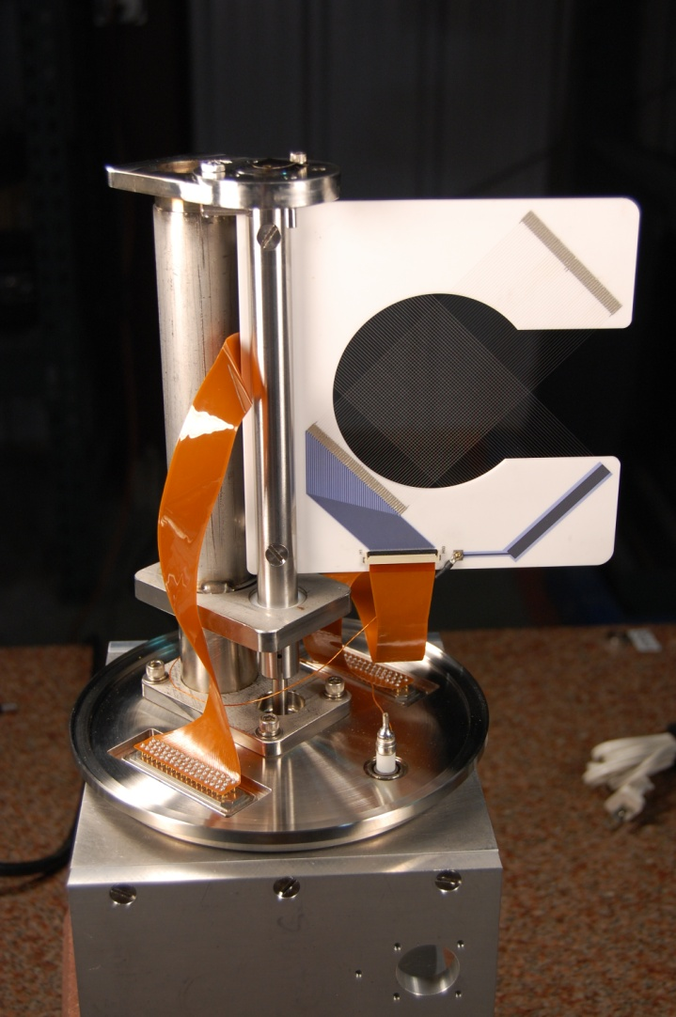
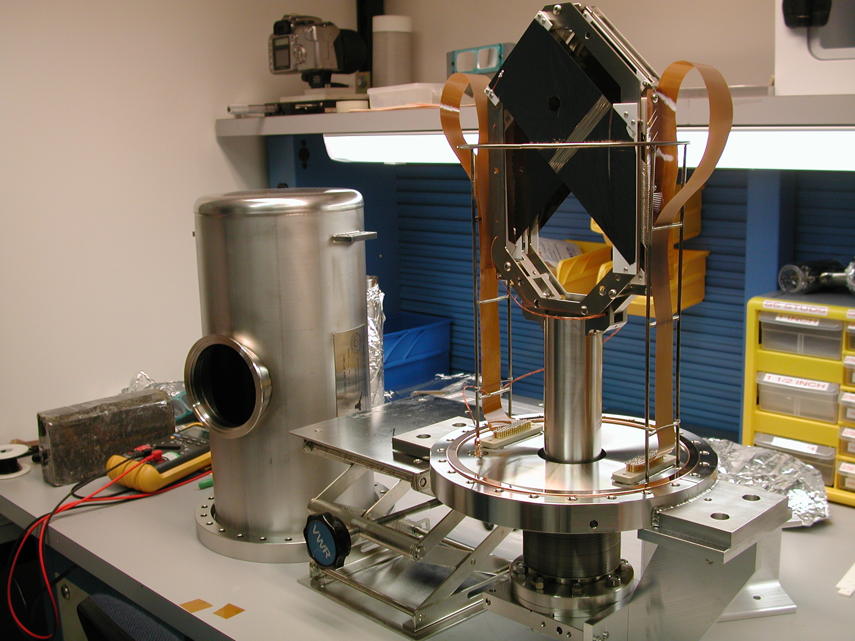
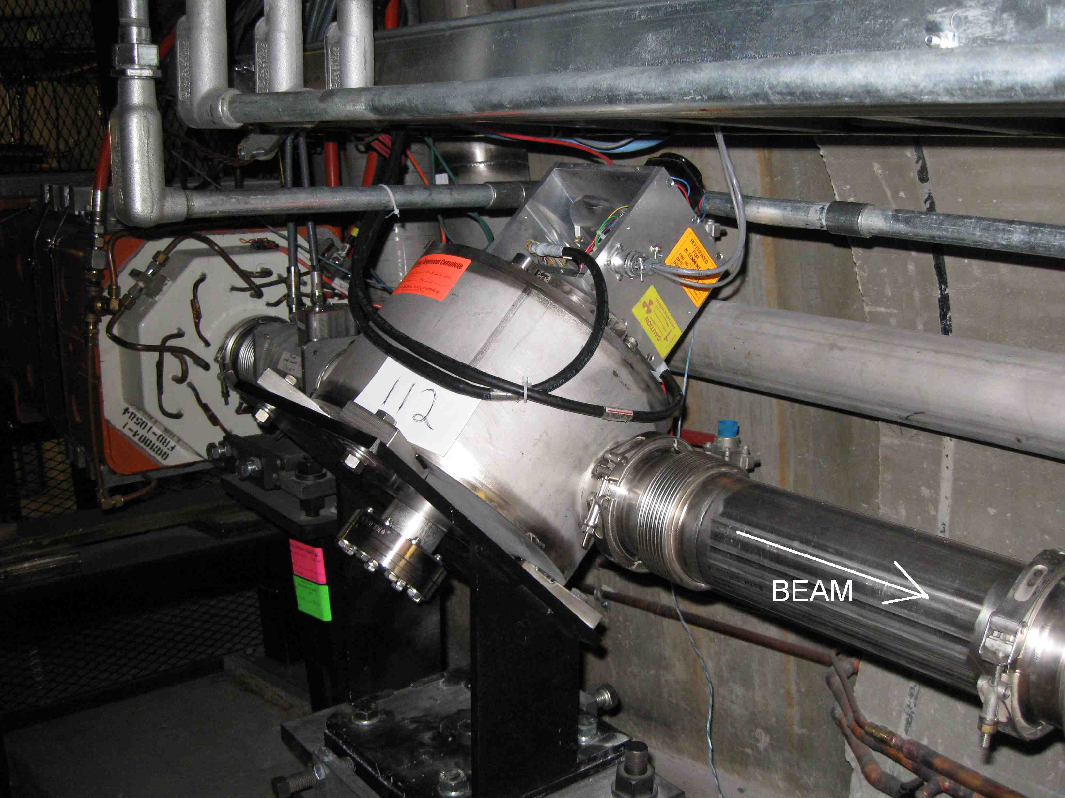
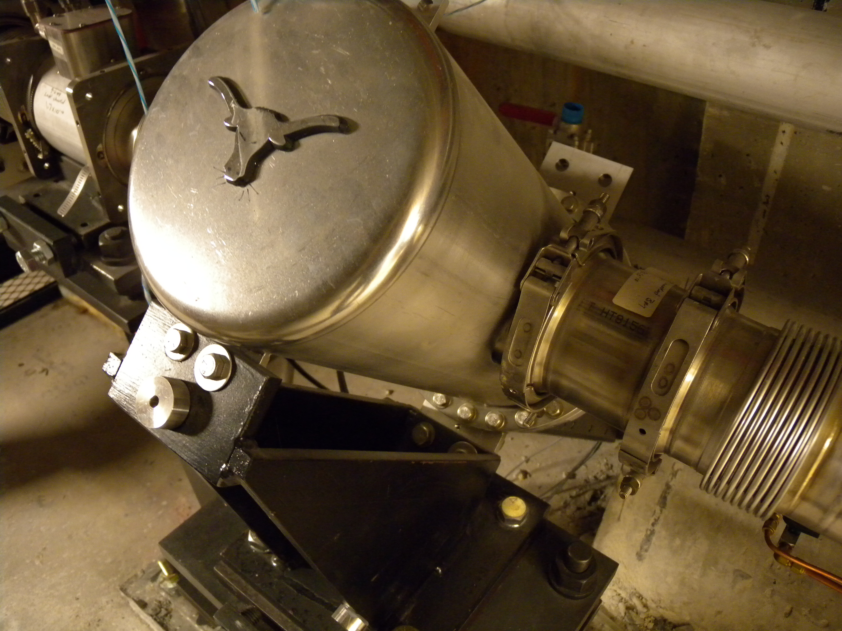
SEM Beam Profile Monitors
Fermilab
  Rotary motion, slotted wire-frame
  25 μm Ti wire,
  1 mm pitch
UTA
  Linear motion
  5x125 μm foils,
  1 / 0.5 mm pitch
Fermilab rotary motion SEM
UTA linear motion SEM
November 2, 2011
Manfred Wendt – LBNE Near Site Conceptual Site Review

Slide 11
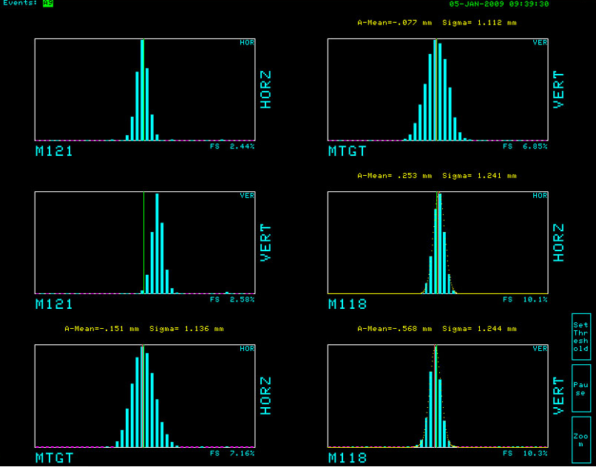
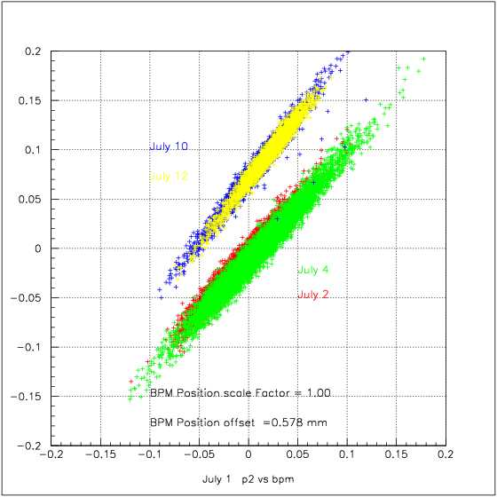
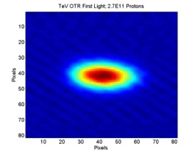
Issues on NuMI / NOvA SEM R&D
UTA SEM foil monitors
  Mechanical issues, motion system not used during NuMI operation
    Foil shortening
    Residual background (HV & suppression foils, closed frame)
  Target monitor
    Motion system not operated!
    No HV & suppression foils.
Fermilab SEM wire monitors
  Reliable mechanics, successful test operation since 2009.
    Some 500,000 motions tested
UTA-Fermilab collaboration has halted
  Baseline: Fermilab 25 μm Ti wire SEMs.
  R&D: 33 μm C wire, flat Ti wires & foils.
  However, no 2D beam profiles.
November 2, 2011
Manfred Wendt – LBNE Near Site Conceptual Site Review

Slide 12
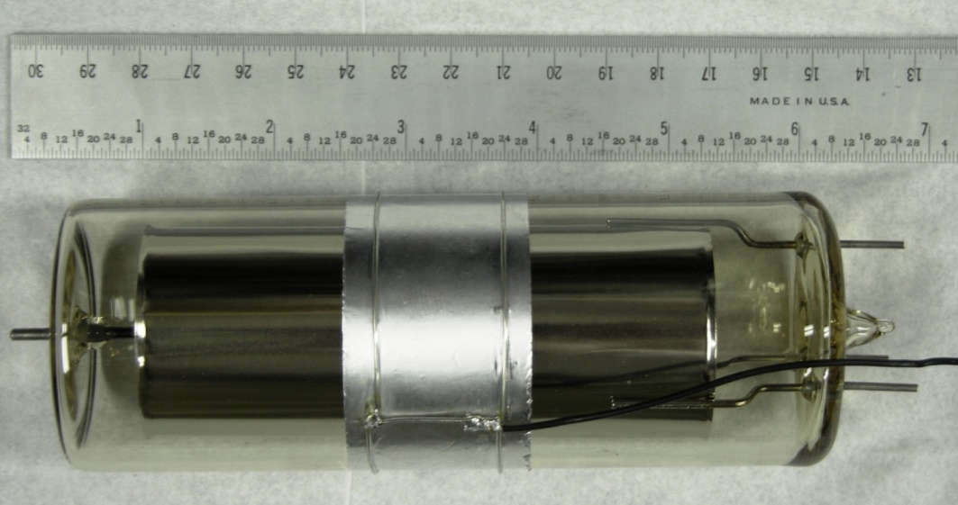
NuMI Beam Loss Monitors
Beam Loss Monitors (BLM)
  Based on Ion chambers, and analog integrator acquisition electronics.
  Wide dynamic range, ~ 1mrad – 100 rad.
Total Loss Monitors (TLM)
  Based on long Ar-filled Heliax coaxial cable ion chambers
  Integrates total beam loss dose along the beam-line
Specifications
Materials | Glass, Nickel
Volumen | 110 ccm Argon gas at 1 Atm
Calibration | 70 nC / rad
Response time | 1-2 µsec
Leakage current | < 10 pA
Operating range | 1 mrad – 100 rad
Cathode @
+2000 V
Signal Out
1.5” ANODE
Guard to reduce
Leakage current
Guard Lead
November 2, 2011
Manfred Wendt – LBNE Near Site Conceptual Site Review

Slide 13
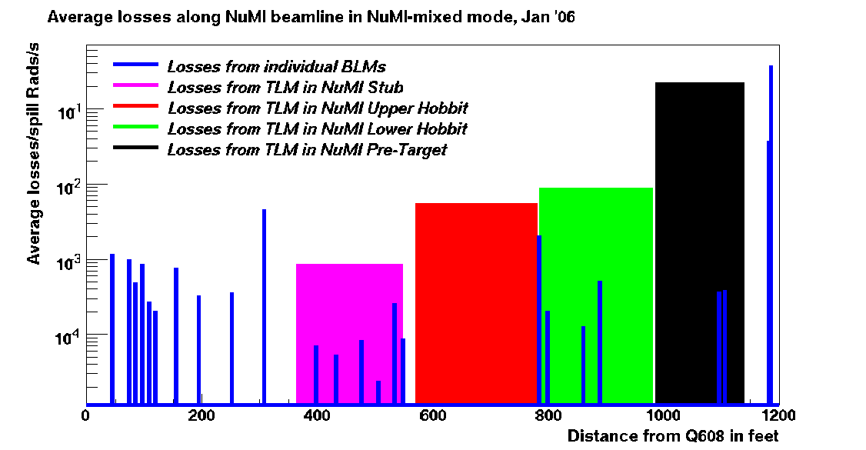
Typical NuMI Beam Losses – Mixed Mode
Average Losses per Pulse for One Month
~1 E-5
Loss from profile monitor
Extraction
Courtesy S. Childress
November 2, 2011
Manfred Wendt – LBNE Near Site Conceptual Site Review

Slide 14
NuMI Beam Instrumentation – Status 2011
Beam intensity (toroids)
  Basically no problems
    Consider read-out system improvements (PIP linac)
    Integrated calibration system(?)
Beam trajectory (BPMs)
  Basically no problems
    Go for double plane (x-y)
    Improved read-out system
    Automatic gain correction
Beam losses (BLMs &TLMs)
  Basically no problems
    Consider digital signal processing
Beam profile (SEMs & other)
  Most problems understood
    Reliable design for up to
    700 kW (Fermilab)
    Abandon UTA foils, go with Fermilab rotary mechanics and 25 μm Ti wires.
    Residual losses?
  Only 1D profiles
    OTR target monitor similar to SNS?!
  Losses, heating at 2.3 MW???
    Need to look for alternatives
    Non-invasive monitors, e.g. IPM, e-beam scanner, fluorescence.
November 2, 2011
Manfred Wendt – LBNE Near Site Conceptual Site Review

Slide 15
LBNE Beam Parameters
Beam energy | 60 – 120 GeV
Number of protons per pulse (6 batches each 84 bunches) | 4.9x10¹³ (NOvA) 1.6x10¹⁴ (Project X)
Repetition rate | 1.3 sec (@ 120 GeV) 0.7 sec (@ 60 GeV)
Nominal beam power | 700 kW (NOvA) 2.3 MW (Project X)
Beam intensity / batch (84 bunches) | 8x10¹² (NOvA), 2.67x10¹³ (Project X) 3x10¹¹ (minimum, commissioning)
Beam size (RMS, transverse) | 0.6…2 mm
~1000…2000 ft beam-line length, 2…4 service buildings
Optics phase advance: 60⁰…90⁰
Nominal vacuum chamber aperture: 3 inch (circular)
November 2, 2011
Manfred Wendt – LBNE Near Site Conceptual Site Review

Slide 16
Counts and costs on Beam Diagnostics
 | MI-60 deep (status March 2010) | MI-10 shallow (status November 2011)
Toroids | 1 | 1 (2)
BPMs (dual-plane) | 48 | 24
BLMs | 96 | 30
TLMs | 8 | 4
SEMs | 12 | 6
M&S total | $1,525k | $975k
Labor total | 10,300 hours | 7,750 hours
MI-60 shares the first toroid with NuMI
Dual-plane BPMs at each quadrupole
BLMs at quadrupoles and dipoles
Counts and costs do NOT include spares, contingency, overhead, etc.
Advanced beam diagnostics, e.g. 2D beam profile at the exit window, non-invasive diagnostics, is not listed.
November 2, 2011
Manfred Wendt – LBNE Near Site Conceptual Site Review

Slide 17
LBNE Diagnostics Requirements: Toroid
Project engineer: Aisha Ibrahim
Need only one toroid end of the beam-line, plus one spare unit
Toroidal transformer based measurement (AC-coupled)
Integration time 20-84 bunches
Pulse-to-pulse measurement stability: ~0.3 %
Required hardware:
  3½ inch Pearson standard model 3100 toroid (for 3 inch aperture)
  Vacuum hardware
    Ceramic break, bellows, flanges, etc.
  Support mechanics (stand)
  Analog signal conditioning board (gain stage)
  Calibration loop
  VME-based front-end read-out system
    Digitizer, timing & event decoder, CPU, VME crate
  Cables, connectors & other infrastructure elements
November 2, 2011
Manfred Wendt – LBNE Near Site Conceptual Site Review

Slide 18
LBNE Diagnostics Requirements: BPMs
Project engineer: Peter Prieto
Need at least 24 dual plane BPMs, plus some spares
Required BPM resolution and drift stability: 25…30 µm RMS
BPM pickup detector choices:
  Split-plate type (like NuMI)
    Pros: linear response, strong coupling
    Cons: $$$ (complex mechanics), frequency dependent response
  Stripline type (shortened)
    Pros: 50 Ω matched impedance, rigid mechanics, double plane
    Cons: λ/4 for 53 MHz too long, $$$, weaker coupling, non-linear
  Dual-plane “button” type BPM electrodes, preferred solution!
    Pros: $, rigid mechanics, very simple, double plane
    Cons: non-linear, weaker coupling
BPM read-out electronics
  In-house VME/VXS digitizer with 125 or 250 MSPS & sufficient memory
  Integrated automatic gain correction system, a la BNB
November 2, 2011
Manfred Wendt – LBNE Near Site Conceptual Site Review

Slide 19
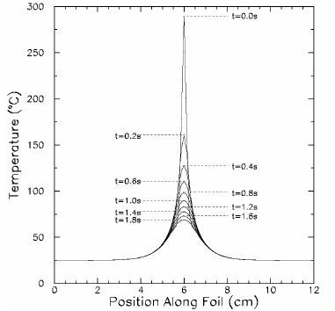
LBNE Diagnostics Requirements: SEMs
Project engineer: Gianni Tassotto
Need 6…12 beam profile monitors (SEMs), plus spares
SEM Multi-foil/wire monitors based on NuMI / NOvA experience
  Rotary motion system
  25 µm dia. Ti wires (Fermilab) or Ti flat wires / foils,
  1 mm pitch (0.5 mm @ target station)
Issues to be addressed
  Wire/foil heating
  at beam powers >1000 kW
  Fractional beam loss (2.5x10⁻⁶?)
  Reliable operation (O.K.!)
Alternatives, Additions
  Graphite wire or foil targets (2 MW)
  IPM?
  e-Beam scanner?
  Backward OTR system at the exit window
Ti foil 5μm thick
NuMI beam
Courtesy S. Kopp
November 2, 2011
Manfred Wendt – LBNE Near Site Conceptual Site Review

Slide 20
LBNE Diagnostics Requirements: BLMs & TLMs
Project engineer: Marv Olson
Need at least 30 ion chamber based BLMs, plus some spares
Need 4…8 ~250 ft. long Heliax cable based TLMs
  No specific requirements given, should operate as well as at NuMI
    Same dynamic range, reproducibility, pedestal control, etc.
  We will look into more “modern” read-out electronics, e.g. LHC
Important note:
  Toroid, BLM & TLM, and BPM signals / data will be used in the real-time beam permit system for machine protection purposes!
November 2, 2011
Manfred Wendt – LBNE Near Site Conceptual Site Review

Slide 21
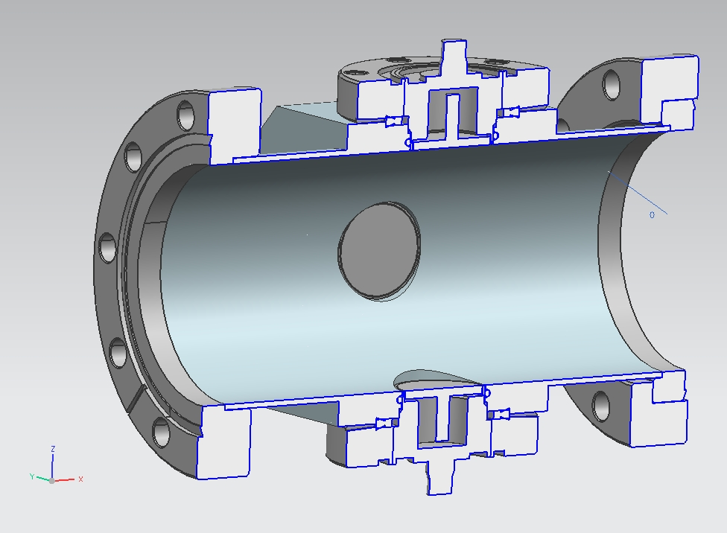
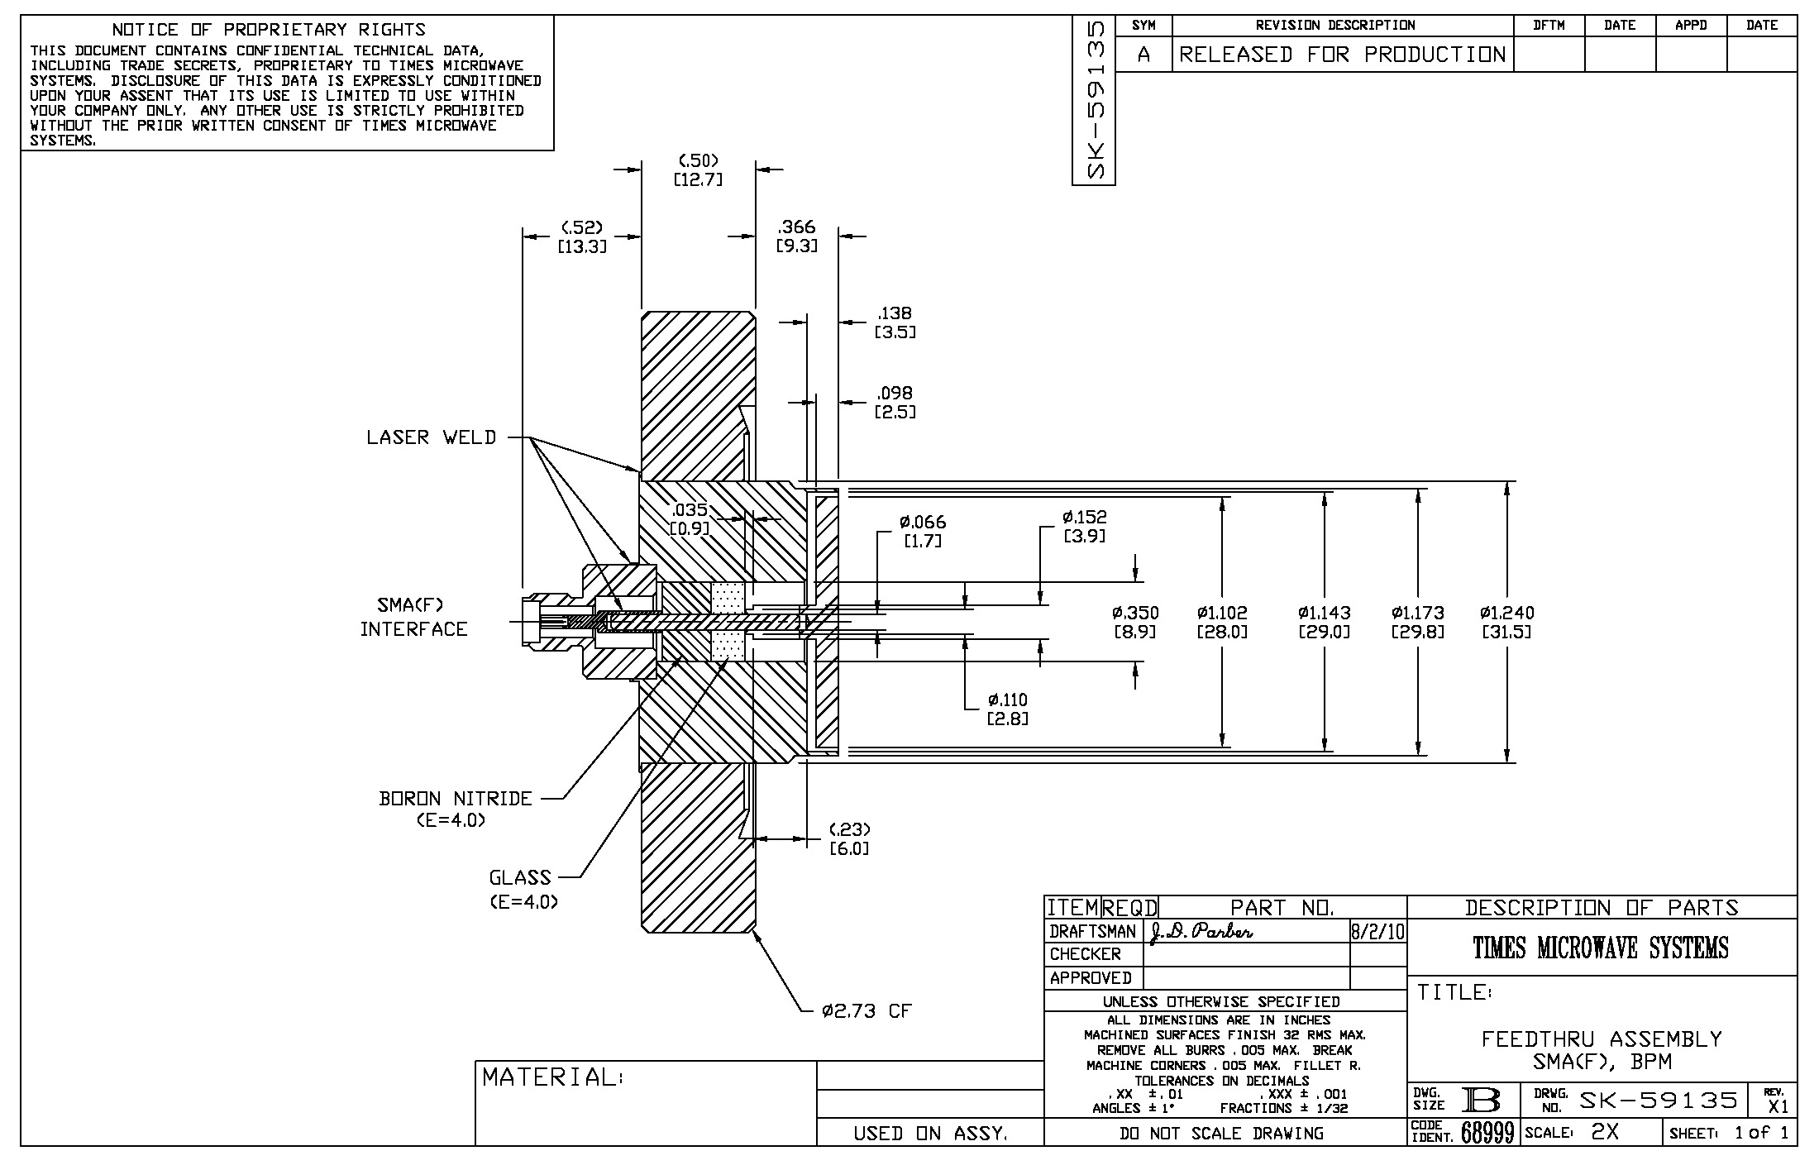
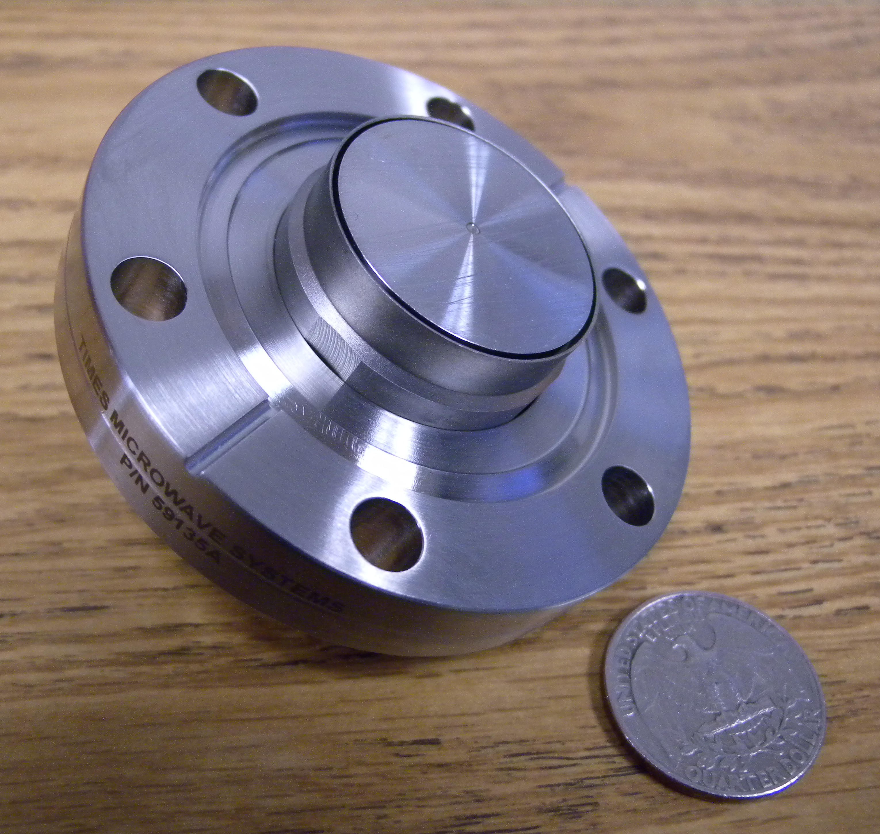
Beam Position Monitor Pickup R&D
LBNE BPM utilizing a
28 mm dia. button electrode
(preferred solution)
November 2, 2011
Manfred Wendt – LBNE Near Site Conceptual Site Review

Slide 22
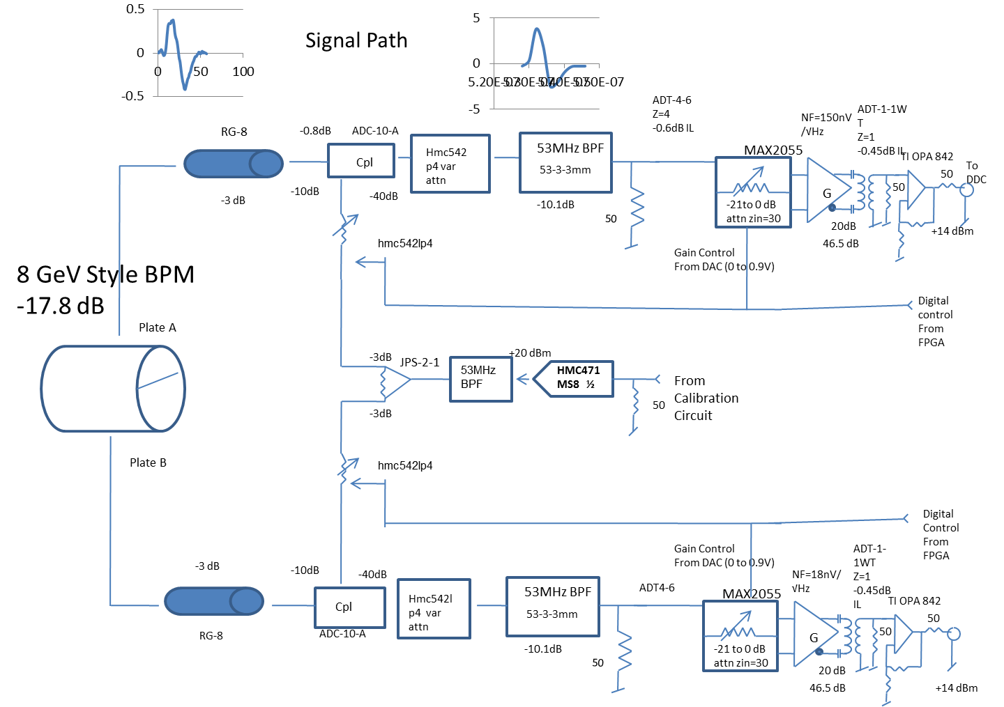
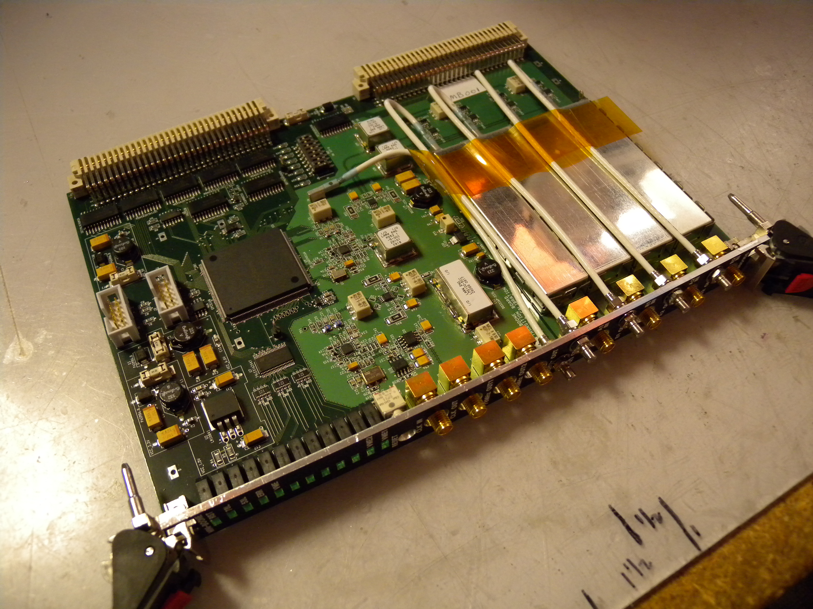
BPM Read-out System R&D: BNB Front-End
Example BPM Front-End
  BNB (MiniBooNE) analog BPM signal conditioning
  VME form-factor
  Interleaved CAL signal at the read-out frequency
November 2, 2011
Manfred Wendt – LBNE Near Site Conceptual Site Review

Slide 23
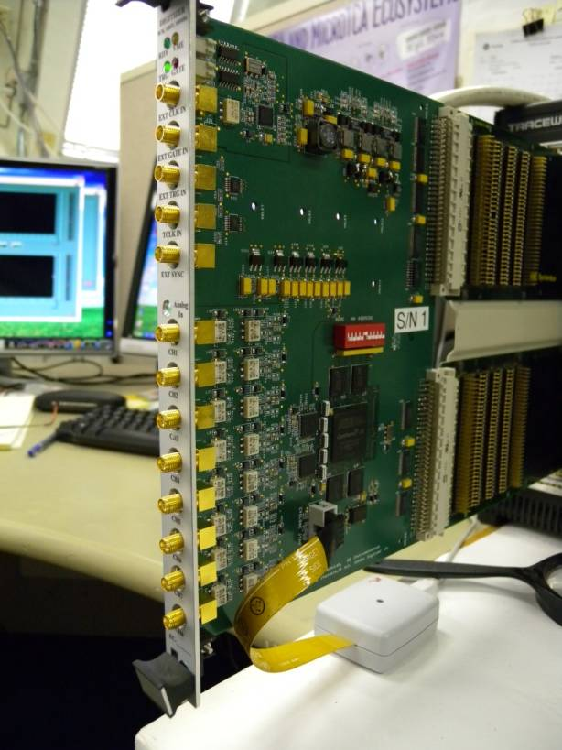
BPM Read-out System R&D
BLOCK DIAGRAM
Generic Digitizer
VME bus
GATE
FPGA
Altera
Cyclone III
VME
Drivers
External Control
TRIGGER
TCLK
SYNC IN
4x32M
DDR2
SDRAM
SYNC OUT
AC passive
ADC
JTAG
8 Analog Inputs
4 Channels per Chip
EPCS4
Interface
ADC
125 MSPS, 500 MHz BW
4-ch serial ADC chips
8-ch, AC passive (or DC active)
PLL/VCO CLK distribution
SNR > 72 dB (@50 MHz)
Oscillator
CLK IN
Clock Driver (PLL & DIV)
Oscillator
CLK OUT
November 2, 2011
Manfred Wendt – LBNE Near Site Conceptual Site Review

Slide 24
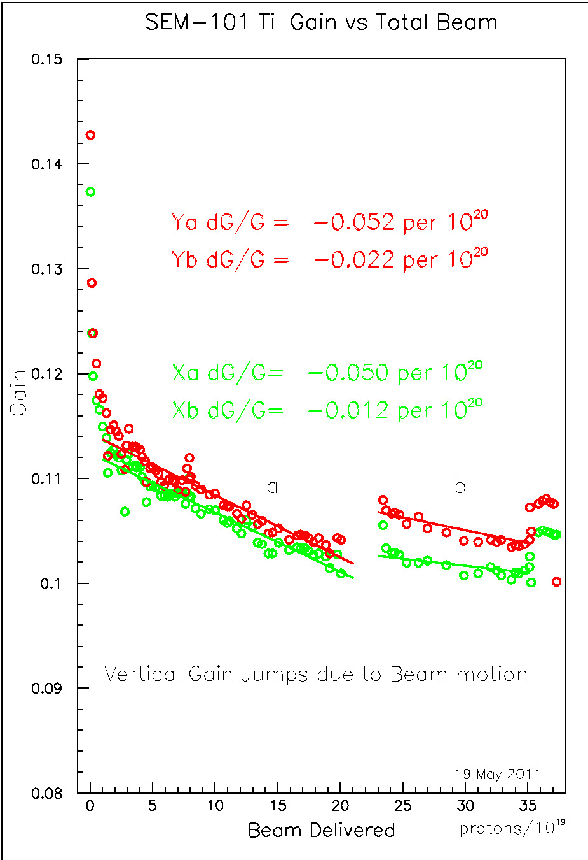
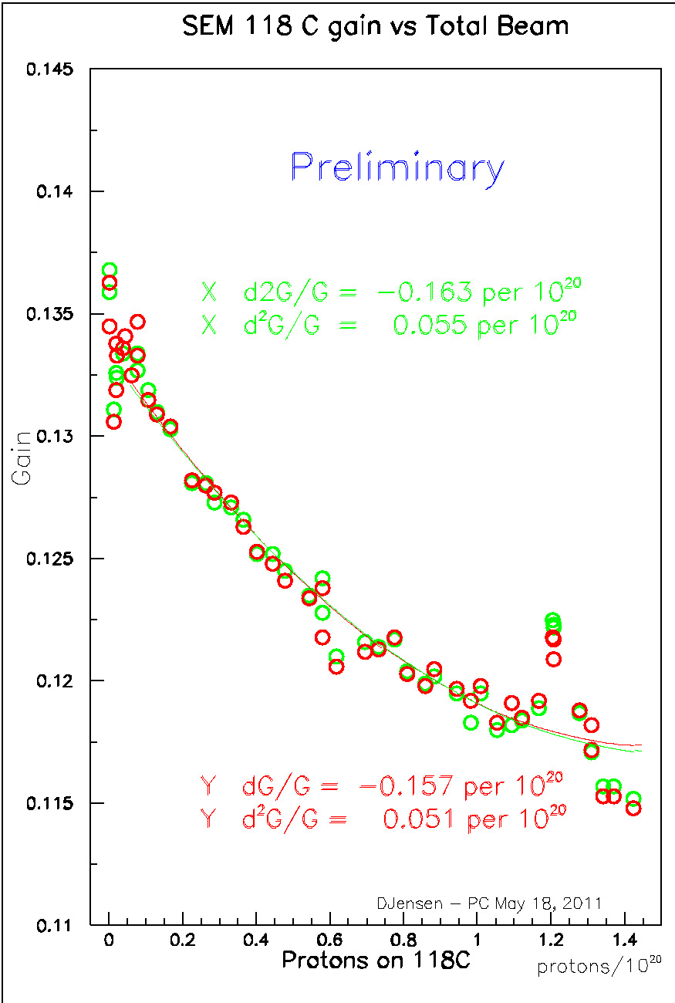
Multiwire SEM R&D: Long Term Effects
Device | Wire Size | Beam Size (RMS) | Observed dG/G | Normalized dG/G
mw101 | 25 μm Ti | 0.68 x 0.68 mm | 5.0 | 2.9
mw118C | 33 μm C | 1.08 x 1.18 mm | 11.0 | 14.0
mwTGT | 25 μm Ti | 1.80 x 1.10 mm | 1.8 | 3.6
Normalized dG/G (gain) to 1.0 x 1.0 mm beam size
  Note: dG/G for mw118C is based on a linear fit, not the quadratic shown
  Courtesy Doug Jensen
November 2, 2011
Manfred Wendt – LBNE Near Site Conceptual Site Review

Slide 25
Summary
LBNE primary beam instrumentation is based on NuMI experience
  No new challenges for non-invasive beam monitors,
  e.g. BPMs, BLMs, toroids
    However, will apply conservative improvements in read-out systems and automatic calibration / correction technologies.
    Will use dual-plan button-style BPM pickups for higher redundancy on the orbit measurement.
  Invasive beam profile monitors for LBNE beams are challenging
    Target heating and residual losses
    Fragile targets, reliable operation
    Ti wires / foils OK for 700 kW beam power, but perhaps not for 2 MW!
    Continue R&D, also on non-invasive technologies.
  Need for additional beam profile monitor R&D
    2D beam profile monitor at the exit window (see SNS!)
    Non-(minimum) invasive profile monitors for >2 MW beam power!
November 2, 2011
Manfred Wendt – LBNE Near Site Conceptual Site Review

