Slide 1
AF Implementation Task Force
Thomas Roser for the Implementation Task Force
September 2, 2021

Slide 2
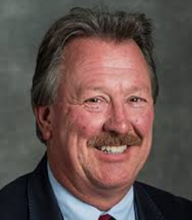
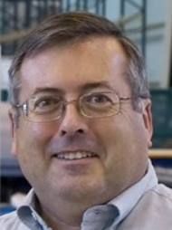
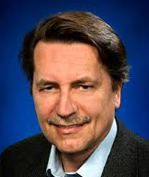
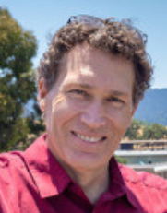
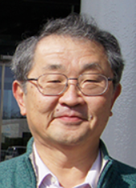
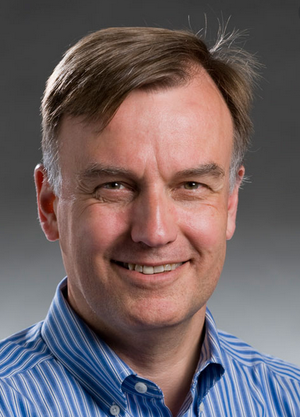
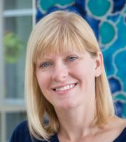
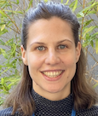
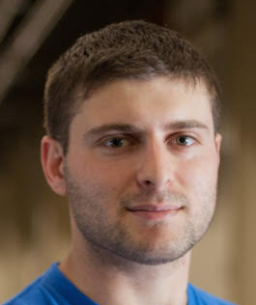
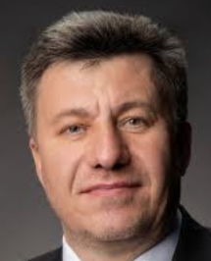
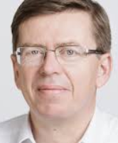
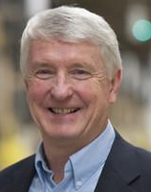
AF Implementation Task Force
Key question for Snowmass’21 Accelerator Frontier to address: “…What are the time and cost scales of the R&D and associated test facilities as well as the time and cost scale of the facility?”
A large number of possible accelerator projects: ILC, Muon Collider, gamma-gamma and ERL options, a large circumference electron ring, and a large circumference hadron ring amongst others.
Comparison of the expected costs (using different accounting rules), schedule, and R&D status for the projects.
The Accelerator Implementation Task Force is charged with developing metrics and processes to facilitate a comparison between projects.
Philippe Lebrun (CERN)
Steve Gourlay (LBNL)
Thomas Roser (BNL, Chair)
Tor Raubenheimer (SLAC)
Katsunobu Oide (KEK)
Jim Strait (FNAL)
Sarah Cousineau (ORNL)
Marlene Turner (LBNL)
Spencer Gessner (SLAC)
Vladimir Shiltsev (FNAL)
Reinhard Brinkmann
(DESY)
John Seeman (SLAC)

Slide 3
Charge items
Develop the metrics to compare projects’ cost, schedule/timeline, technical risks (readiness), operating cost and environmental impact, and R&D status and plans;
Select the accelerator projects to be evaluated (provided by the AF topical groups);
Work with the proponents of the selected accelerator projects to evaluate them against the metrics from item 1;
Consider the ultimate limits of various types of colliders: e+/e-, p/p, mu+/mu-;
Consider limits and timescales due to accelerator technology for various types of colliders: e+/e-, p/p, mu+/mu-;
Lead the evaluation of the different HEP accelerator proposals and inform and communicate with the Snowmass AF, EF, NF and TF;
Document the metrics, processes, and conclusions for the Snowmass meeting in the Summer 2022; write and submit a corresponding White Paper.

Slide 4
Status
ITF continued to meet during the last year
ITF is focusing on collider facilities. ITF developed a set of metrics to evaluate the proposals and concepts.
Parameter spreadsheets (21) collected from proponents, and analysis and comparison has started on four topics:
Size, complexity, power consumption, environmental impact
Physics reach (impact), beam parameters
Technical risk, technical readiness, validation
Cost, schedule
Proposal for four categories:
Existing facilities for references (LHC, XFEL, …)[Existing]
Proposals with TDR and/or CDR [CDR/TDR]
Proposal without TDR or CDR but reasonably well thought through and mostly based on existing technologies. An estimate for component counts exists. [Concept]
Future concepts and ideas [Future concepts]
Tentative schedule: draft report by end of 2021 to be shared with proponents; final ITF report by March 2022; Snowmass discussions in Seattle in July 2022;

Slide 5
Example of comparison of proposal parameters (1)
Accelerator | Beam Energy (TeV) | COM Energy (TeV) | Site Power (MW) | Single Beam Power (MW) | Beam Power/ Site Power | Luminosity (1E34 cm^-2 s^-1) | Lumi/Beam Power (1E34/MW) | Lumi/Site Power (1E34/MW)
ILC | 0.125 | 0.25 | 111 | 3 | 0.02 | 1.35 | 0.50 | 0.01
ILC 6X | 0.125 | 0.25 | 270 | 16 | 0.06 | 8.10 | 0.51 | 0.03
ILC 55 MV/m, 2 | 1 | 2.00 | 345 | 24 | 0.07 | 7.90 | 0.33 | 0.02
ILC 70 MV/m, 2 | 1 | 2.00 | 315 | 24 | 0.08 | 7.90 | 0.33 | 0.03
ILC 70 MV/m, 3 | 1.5 | 3.00 | 400 | 30 | 0.08 | 6.10 | 0.20 | 0.02
ILC 80 MV/m, 3 | 1.5 | 3.00 | 525 | 30 | 0.06 | 6.10 | 0.20 | 0.01
CCC 250 | 0.125 | 0.25 | 30 | 1 | 0.03 | 2.00 | 2.00 | 0.07
CCC 2000 | 1 | 2.00 | 200 | 9 | 0.05 | 4.50 | 0.50 | 0.02
CLIC 380 | 0.19 | 0.38 | 170 | 3 | 0.02 | 1.50 | 0.52 | 0.01
CLIC 3000 | 1.5 | 3.00 | 580 | 14 | 0.02 | 5.90 | 0.42 | 0.01
CEPC 91 | 0.045 | 0.09 | 267 | 2,000 | 7.49 | 2.90 | 0.00 | 0.01
CEPC 240 | 0.12 | 0.24 | 267 | 21,000 | 78.65 | 2.90 | 0.00 | 0.01
FCC-ee 91 | 0.045 | 0.09 | 259 | 63,400 | 244.79 | 230.00 | 0.00 | 0.89
FCC-ee 160 | 0.08 | 0.16 | 277 | 63,400 | 228.88 | 28.00 | 0.00 | 0.10
FCC-ee 240 | 0.12 | 0.24 | 282 | 63,400 | 224.82 | 8.50 | 0.00 | 0.03
FCC-ee 365 | 0.182 | 0.39 | 340 | 63,400 | 186.47 | 1.55 | 0.00 | 0.00
ERL 91 | 0.045 | 0.09 | 70 | 169 | 2.41 | 96.00 | 0.57 | 1.37
ERL 160 | 0.08 | 0.16 | 80 | 270 | 3.38 | 118.00 | 0.44 | 1.48
ERL 240 | 0.12 | 0.24 | 85 | 297 | 3.49 | 73.00 | 0.25 | 0.86
ERL 365 | 0.182 | 0.37 | 90 | 184 | 2.04 | 35.00 | 0.19 | 0.39
ERL 500 | 0.25 | 0.50 | 95 | 88 | 0.93 | 13.80 | 0.16 | 0.15
ERL 600 | 0.3 | 0.60 | 100 | 49 | 0.49 | 9.00 | 0.18 | 0.09

Slide 6
Example of comparison of proposal parameters (2)
Accelerator | Beam Energy (TeV) | COM Energy (TeV) | Site Power (MW) | Single Beam Power (MW) | Beam Power/ Site Power | Luminosity (1E34 cm^-2 s^-1) | Lumi/Beam Power (1E34/MW) | Lumi/Site Power (1E34/MW)
Collider Under the Sea | 250 | 500.00 | 2000 | 25,000 | 12.50 | 50.00 | 0.00 | 0.03
FCC-hh | 50 | 100.00 | 560 | 26,000,000 | 46428.57 | 30.00 | 0.00 | 0.05
SPPC | 37.5 | 75.00 | 400 | 3 | 0.01 | 10.00 | 3.33 | 0.03
SWFA 1 | 0.5 | 1.00 | 100 | 2.5 | 0.03 | 1.00 | 0.40 | 0.01
SWFA 3 | 1.5 | 3.00 | 185 | 15.6 | 0.08 | 5.90 | 0.38 | 0.03
SWFA 15 | 7.5 | 15.00 | 925 | 78 | 0.08 | 50.00 | 0.64 | 0.05
LWFA 1 | 0.5 | 1.00 | 100 | 4.4 | 0.04 | 1.00 | 0.22 | 0.01
LWFA 3 | 1.5 | 3.00 | 315 | 12 | 0.08 | 10.00 | 0.83 | 0.03
LWFA 15 | 7.5 | 15.00 | 1100 | 64 | 0.12 | 50.00 | 0.78 | 0.05
PWFA 1 | 0.5 | 1.00 | 67 | 1 | 0.01 | 1.00 | 1.00 | 0.01
PWFA 3 | 1.5 | 3.00 | 200 | 3 | 0.02 | 5.90 | 1.97 | 0.03
PWFA 15 | 7.5 | 15.00 | 1000 | 15 | 0.02 | 50.00 | 3.33 | 0.05
MC Higgs | 0.063 | 0.13 | 200 | 1 | 0.00 | 0.01 | 0.01 | 0.00
MC 1.5 | 0.75 | 1.50 | 216 | 4 | 0.02 | 1.25 | 0.35 | 0.01
MC 3 | 1.5 | 3.00 | 230 | 6 | 0.03 | 2.25 | 0.39 | 0.01
MC 10 | 5 | 10.00 | 260 | 7 | 0.03 | 20.00 | 2.86 | 0.08
MC 14 | 7 | 14.00 | 290 | 10 | 0.03 | 40.00 | 4.00 | 0.14

Slide 7
Higgs factory concepts / proposals
Name | Details | POC | AF Group
CepC | e+e-, $\sqrt{s}=$ 0.24 TeV, L= 3.0 $×{10}^{34}$ | Jie Gao (gaoj@ihep.ac.cn) | AF3
CLIC (Higgs factory) | e+e-, $\sqrt{s}=$ 0.38 TeV, L= 1.5 $×{10}^{34}$ | Steinar Stapnes (Steinar.Stapnes@cern.ch) | AF3
Circular ERL ee collider | e+e-, $\sqrt{s}=$ 0.24 TeV, L= 73 $×{10}^{34}$ | Thomas Roser (roser@bnl.gov) | AF3
FCC-ee | e+e-, $\sqrt{s}=$ 0.24 TeV, L= 17 $×{10}^{34}$ | Katsunobu Oide (katsunobu.oide@ern.ch) | AF3
gamma gamma | X-ray FEL-based $γγ$ collider | Tim Barklow (timb@slac.stanford.edu) | AF3
ILC (Higgs factory) | e+e-, $\sqrt{s}=$ 0.25 TeV, L= 1.4 $×{10}^{34}$ | Shin-ichi Michizono (shinichiro.michizono@kek.jp | AF3
LHeC | $ep$, $\sqrt{s}=$ 1.3 TeV, L= 0.1 $×{10}^{34}$ | Oliver Bruening (oliver.bruening@cern.ch) | AF3
MC (Higgs factory) | $μμ$, $\sqrt{s}=$ 0.13 TeV, L= 0.01 $×{10}^{34}$ | Mark Palmer (mpalmer@bnl.gov) | AF3

Slide 8
High energy concepts / proposals
Name | Details | POC | AF Group
Cryo-Cooled Copper (C^3) linac | e+e-, $\sqrt{s}=$ 2 TeV, L= 4.5 $×{10}^{34}$ | Emilio Nanni (nanni@slac.Stanford.edu) | AF3
High Energy CLIC | e+e-, $\sqrt{s}=1.5−$3 TeV, L= 5.9 $×{10}^{34}$ | S.Stapnes (steinar.stapnes@cern.ch) | AF4
High Energy ILC | e+e-, $\sqrt{s}=1−$3 TeV | Hassan Padamsee (hsp3@cornell.edu) | AF4
FCC-hh | pp, $\sqrt{s}=100$TeV, L= 30 $×{10}^{34}$ | M.Benedikt (Michael.Benedikt@cern.ch) | AF4
SPPC | pp, $\sqrt{s}=75/150$TeV, L= 10 $×{10}^{34}$ | J.Tang (tangjy@ihep.ac.cn) | AF4
Collider-in-Sea | pp, $\sqrt{s}=500$TeV, L= 50 $×{10}^{34}$ | P.McIntyre mcintyre@physics.tamu.edu | AF4
Gamma-gamma | ?? | W.Krasny (mieczyslaw.witold.krasny@cern.ch) | AF4
LHeC | $ep$, $\sqrt{s}=1.3$TeV, L= 1 $×{10}^{34}$ | Oliver Bruening (oliver.bruening@cern.ch) | AF4
FCC-eh | $ep$, $\sqrt{s}=3.5$TeV, L= 1 $×{10}^{34}$ | Oliver Bruening (oliver.bruening@cern.ch) | AF4
CEPC-SPPpC-eh | $ep$, $\sqrt{s}=6$TeV, L= 4.5 $×{10}^{33}$ | Y.Zhang (yzhang@jlab.org) | AF4
VHE-ep | $ep$, $\sqrt{s}=9$TeV |  | AF4
MC – Proton Driver 1 | $μμ$, $\sqrt{s}=1.5$TeV, L= 1 $×{10}^{34}$ | D.Schulte (daniel.schulte@cern.ch) | AF4
MC – Proton Driver 2 | $μμ$, $\sqrt{s}=3$TeV, L= 2 $×{10}^{34}$ | D.Schulte (daniel.schulte@cern.ch) | AF4
MC – Proton Driver 3 | $μμ$, $\sqrt{s}=10−14$TeV, L= 20 $×{10}^{34}$ | D.Schulte (daniel.schulte@cern.ch) | AF4
MC – Positron Driver | $μμ$, $\sqrt{s}=10−14$TeV, L= 20 $×{10}^{34}$ | D.Schulte (daniel.schulte@cern.ch) | AF4
LWFA-LC (e+e- and $γγ$) | Laser driven plasmas; e+e-, $\sqrt{s}=1−30$ TeV | Carl Schroeder (CBSchroeder@lbl.gov) | AF6
PWFA-LC (e+e- and $γγ$) | Beam driven plasmas; e+e-, $\sqrt{s}=1−30$ TeV | Gessner, Spencer J. (sgess@slac.edu) | AF6
SWFA-LC | Structure wakefields; e+e-, $\sqrt{s}=1−30$ TeV | Chunguang Jing (jingchg@anl.gov) | AF6

Slide 9
Summary
ITF continued its work during the pause
Parameter spreadsheets collected for major proposals of future colliders
We are still accepting additional proposals or updates to proposals during the next couple of months.
Tentative schedule:
draft report by end of 2021 to be shared with proponents
final ITF report by March 2022
Snowmass discussions in Seattle in July 2022

