Slide 1
Workshop on Maintaining PIP-II within the Accelerator Complex
Cryoplant and CDS
Ben Hansen
07/15/2021

Slide 2
Outline
Availability and Maintenance Related Requirements
Preliminary Availability Analysis of Cryoplant
Maintenance Schedules and Impacts
Maintenance Planning
Summary

Slide 3
Cryoplant Maintenance/Availability Requirements
Functional Requirements Specification
→ 11 months
Currently there is no requirement to keep Linac < 20K throughout lifetime of the machine and/or during maintenance periods
Preliminary estimate is cryogenic system can be shutdown for ~8-10hrs w/o thermal cycling CMs based on static heat load and assuming CM starts at 2K.

Slide 4
Cryoplant Maintenance Requirements Cont’
Jointly written BARC/Fermilab cryoplant specification includes detailed maintenance requirements:
  The design of the WCS shall allow easy access for maintenance and repair.
  The design shall provide valve and electrical lock out points for LOTO during maintenance activities.
  Design of each skid layout shall facilitate troubleshooting and maintenance including compressor and motor alignment, seals and bearing replacement. All the components including the valves, filters and instrumentation shall be easily accessible for operation, troubleshooting and maintenance. The design and layout shall be presented to the BUYER for approval
  Each compressor skid shall be equipped with manual isolation valves to allow isolation of all circuits for maintenance.
  All items likely to require maintenance, repair or replacement shall be easily and quickly accessible and shall not require other items to be cut out.
  The vacuum vessel shall be designed in order to allow easy access for maintenance of components.
  The SELLER shall make provisions to allow for operation of the PLANT with a reduced capacity during maintenance of any TEX
  The PLANT shall be suitable for continuous operation for periods of up to 8000 hours. Any maintenance required during this time shall be carried out with the PLANT running.
  The SELLER shall furnish a maintainability plan for the PLANT.
  The maintainability plan shall include but is not limited to a table of scheduled maintenance that is deemed necessary to maintain the PLANT system in a high state of reliability.
  The expected availability for the PLANT shall be 98% or better. The design shall provide for some redundancy among its components and sub-systems to achieve the mentioned availability. The spares of “critical path” PLANT components shall be accordingly offered by the SELLER along with the proposal.

Slide 5
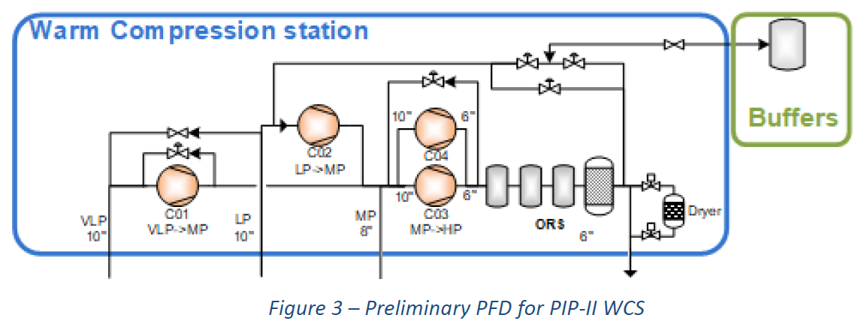
Preliminary Availability Analysis - Cryoplant
Cryogenic Plant Availability Analysis was revised with CSI configuration (ED0010630) and will be updated throughout contract.
Warm compressor station will in-effect have a redundant compressor at reduced capacity modes
  2 x HP Compressors → Can maintain reduced capacity mode with 1 HP compressor
  1 x LP Compressor
  1 x VLP Compressor
Compressor skid designs include redundancy for components requiring most maintenance, e.g., oil pumps, oil filters, enabling corrective and preventative maintenance without bringing down the plant.
Can maintain reduced 4.5K capacity mode if either LP or VLP drops out

Slide 6
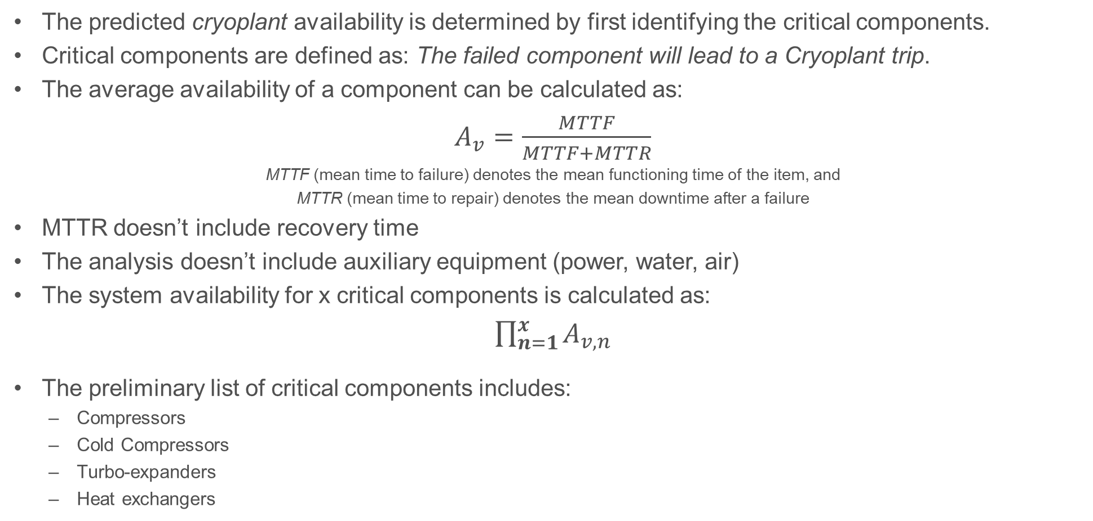
Availability Analysis Continued
The predicted cryoplant availability is determined by first identifying the critical components.
Critical components are defined as: The failed component will lead to a Cryoplant trip.
The average availability of a component can be calculated as:
$A_{v}=\frac{MTTF}{MTTF+MTTR}$
MTTF (mean time to failure) denotes the mean functioning time of the item, and
MTTR (mean time to repair) denotes the mean downtime after a failure
MTTR doesn’t include recovery time
The analysis doesn’t include auxiliary equipment (power, water, air)
The system availability for x critical components is calculated as:
$\prod_{n=1}^{x}{A_{v,n}}$
The preliminary list of critical components includes:
  Compressors
  Cold Compressors
  Turbo-expanders
  Heat exchangers
  Valves required for normal operating and utility modes
  Instruments required for normal Cryoplant operation
  Controls PLC and modules
  80K and 20K Adsorber Beds

Slide 7
Availability Analysis Continued
A preliminary critical component list was compiled with corresponding MTTF and MTTR
Two MTTR values were analyzed:
  All spares are on-hand except heat exchangers
  No spare compressors (bodies/motors) or heat exchangers
Because of the long lead time for some critical components, approximately 6-8 months, this has a significant effect on the MTTR and overall availability
System Availability
w/ Spares | 98.9%
w/o Comp Spares | 78.1%
Spare compressor bodies and motors are needed!

Slide 8
Utility Maintenance Impacts
High Voltage Maintenance
  4160 V Transformers – Redundant Transformers with dual feeds allow maintenance without impacting Cryoplant reduced capacity operations.
  480 V Transformer – Dual feeds and back-up generator allows maintenance without impacting the Cryoplant operation
  Switchgear – Requires yearly maintenance ~8-10 hr shutdown of Cryoplant
Cooling Water System
  Heat Exchanger cleaning and pump maintenance - ~8-10 hr shutdown of Cryoplant
Air Compressors and Dryers
  Two fully redundant systems will allow maintenance without impacting Cryoplant operations

Slide 9
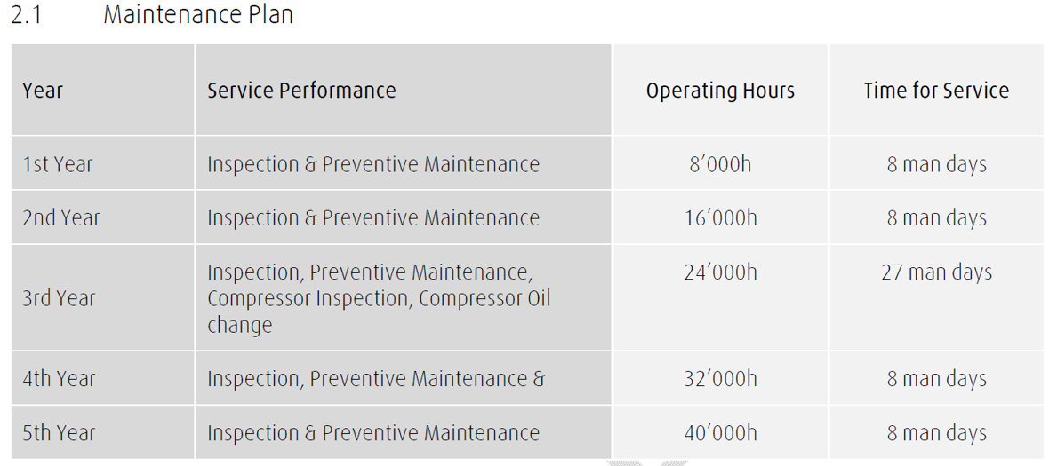
Cryoplant Maintenance
Cryoplant vendor will provide a detailed maintenance plan, including recommended preventative maintenance schedules, spare parts list, maintenance procedures and recommend inspections.
Majority but not all preventive maintenance plan is related to the compressor system and typically performed during ~8-12 week yearly shutdown.
Additional maintenance activities:
Vacuum Pump Maintenance
System clean-ups / deriming Heat Exchangers, Turbines, etc
Regeneration of Adsorbers/Dryers
Filter inspections and replacements
Critical wire terminations tightening
Helium sniffing / leak checking
Relief valve inspections and recertifications
Recalibrations

Slide 10
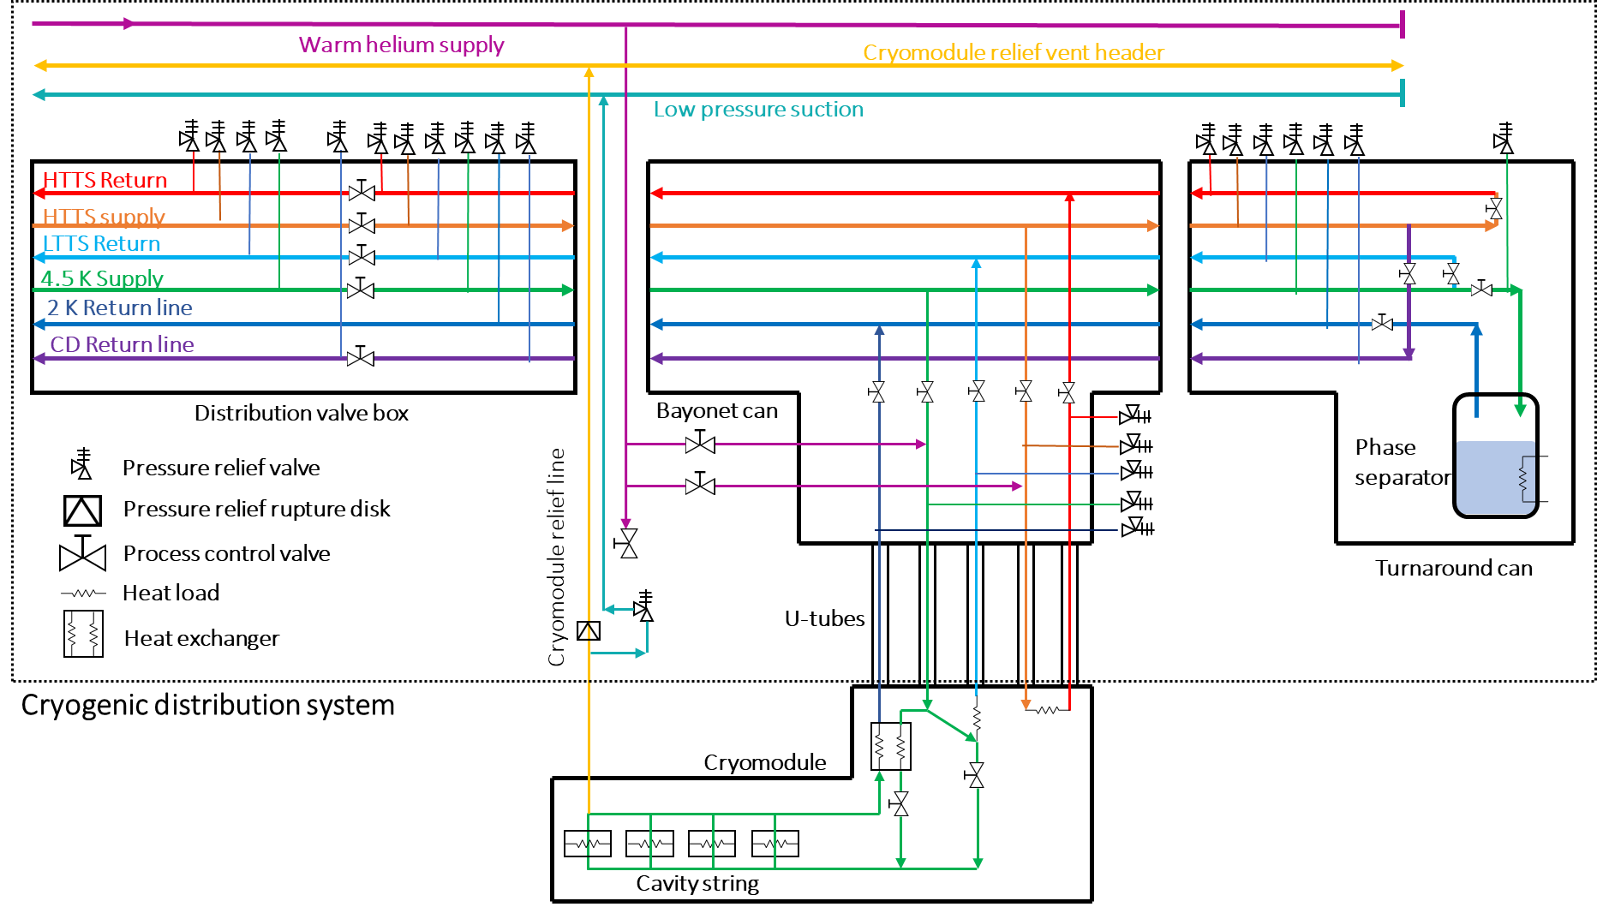
LINAC Maintenance –
Segmented CDS/CM Design
Segmented design allows corrective maintenance of individual Cryomodules without impacting the rest of the LINAC
Removable U-tubes & 1:1 cryo TL control valves provide modularity
  Provides independent isolation, cool-down, warm-up, & removal per CM
CDS can be isolated from CP through DVB
  Allows corrective maintenance of CDS while keeping cryoplant cold
Note: CM relief valves are permanent in the Tunnel (do not move with CM)
Operating Mode | Description
1 | CDS cool down
2 | CDS warm up
3 | CDS pump down
4 | CM controlled cool down
5 | CM fast cool down
6 | CM warm up
7 | Steady state at 2 K
8 | Standby at 4.5 K
9 | Linac configuration change

Slide 11
CDS Maintenance - Pressure safety valve re-certification
Per FESHM 5031.4:
  “Re-closing primary relief devices … interval between tests may not exceed five years.”
  “Non-re-closing (burst disk), trapped volume, and parallel plate primary relief devices … need not be tested, but must be inspected every three years.”
Recertification of CDS & CM relief devices requires removing them from service
Inspection of CM rupture discs *may* require partial removal from service
 | CDS | CM (CDS provided) | Totals | Testing Interval [yrs] | Inspection Interval [yrs]
Recloseable Primary Reliefs | 13 | 23 | 36 | 5 | -
Non-reclosable Rupture Discs | - | 23 | 23 | - | 3
Trapped volume reliefs | > 125 | - | > 125 | - | 3
Parallel plate reliefs | > 25 | - | > 25 | - | 3

Slide 12
CDS Maintenance – Insulating vacuums & maintenance
Insulating vacuum
  CDS has 125 cryogenic U-tubes connecting CDS TL to each CM
  CDS TL has 3 unique insulating vacuums along > 260 m total length
  128 total insulating vacuum segments (not including CMs)
  TL insulating vacuums may need dedicated pumping –or– on-demand pumping (especially during warm-ups)
    Dedicated pumping → requires periodic oil change and service of pumps
    On-demand pumping → requires pumps, technicians, and time to bring vacuum to acceptable levels
Seals, O-rings, & gaskets
  CDS has ~500 o-rings and non-metal gaskets in the Tunnel
    Radiation, fatigue, and humidity can break down seals and o-rings over time → causing leaks and/or contamination

Slide 13
Maintenance Planning
A comprehensive maintenance program will consist of the following:
  Asset inventory and management (maintenance docs, drawings, manuals, equipment database, updates of inspection and maintenance plans)
  Spare parts analysis and management (inventory, including consumables)
  Maintenance Procedures and documentation management
  Work order management and control (efficient use of resources in tight shutdown schedule)
  Quality Assurance and Control (important to avoid premature failures and rework)
  Evaluation of performance (data feeds back to optimize availability, reliability and cost)
Corrective maintenance - is performed immediately or delayed until next maintenance period, depending on criticality of the failure
Preventive maintenance - is done according to the maintenance plan and agreed upon schedule and is typically performed during ~8-12 week yearly shutdown (e.g. oil changes, filter changes, etc)
Predictive maintenance – maintenance based on measured data before a failure (e.g. motor vibration, oil samples, turbine efficiencies)
Inspections – local verifications with checklists, (e.g. wire terminations, oil levels, water samples, vibration monitoring, etc)
Notes:
All of the components of a maintenance plan are interrelated.
An inventory management of procedures and manuals associated with each piece of equipment allows streamlining corrective maintenance response to reduce MTTR and increase availability
Spare parts inventory management is critical to ensure you have the critical spares to reduce the MTTR and meet high availability ruiquirements
Preventative maintenance

Slide 14
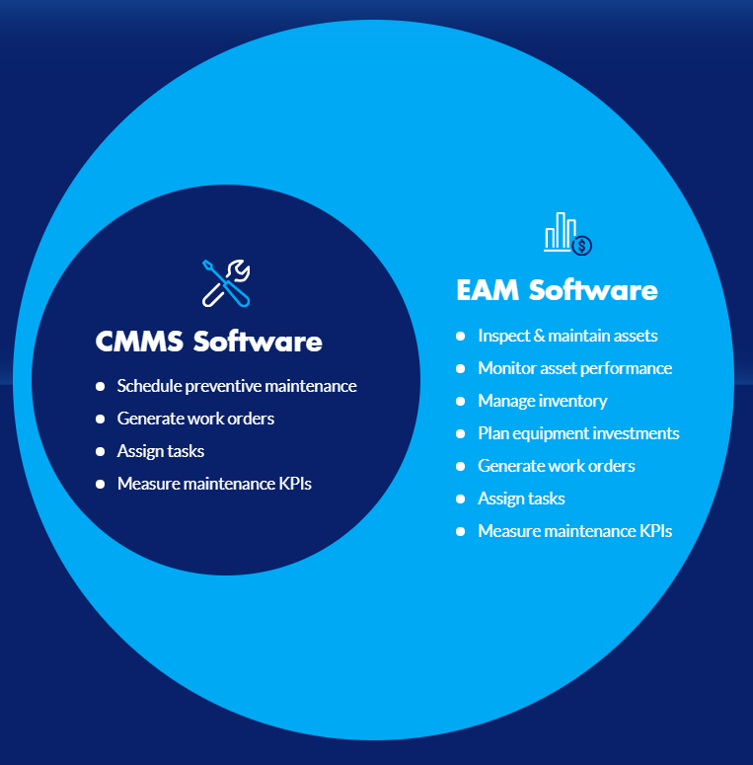
Maintenance Planning Continued
A machine of this complexity, scale and availability requirements would benefit from a modern CMMS or EAM Software solution.
These softwares help organize and integrate the maintenance program, including scheduling, automatically generating work orders, assigning tasks with corresponding procedures and HAs, and measuring performance
Other accelerator complexes successfully use commercially available software solutions:
  CERN → CMMS Infor EAMTM
  SNS → DataStream now owned by Infor
Accelerator Division has home brewed Inventory Database that may be further developed and used for this purpose.
Both options need to be investigated further
Notes:
CMMS - computerized maintenance management system
EAM - Enterprise Asset Management

Slide 15
Summary and Path Forward
Cryoplant availability and maintenance requirements are defined
Thermal cycling requirement needs further discussion
Plans are in place to ensure that reliability and maintenance requirements are verified throughout the contract
Critical component redundancy exists in compressor system to maintain LINAC at nominal capacity during preventative and corrective maintenance
Spare compressor bodies and motors are needed to meet required availability – currently not in scope
Segmented machine permits in depend CM corrective maintenance
Utility maintenance schedule is anticipated to have minimum impact on Cryoplant availability, but durations of shutdowns need to be further understood to determine risk of thermal cycling during these shutdowns
Relief valve 5-year recertification requirement and application to Cryomodule 2 bar relief needs further investigation with CSS and MSS.
A Computerized Maintenance Management System (CMMS) needs to be implemented to manage and optimize the preventative maintenance plan of the Cryogenic System. Further investigation of options needs to be explored.

