Slide 1
Conventional Facilities Utilities
S. Dixon, L2 Manager
Maintaining PIP-II within the Accelerator Complex
July 15, 2021

Slide 2
Conventional Facilities

Slide 3
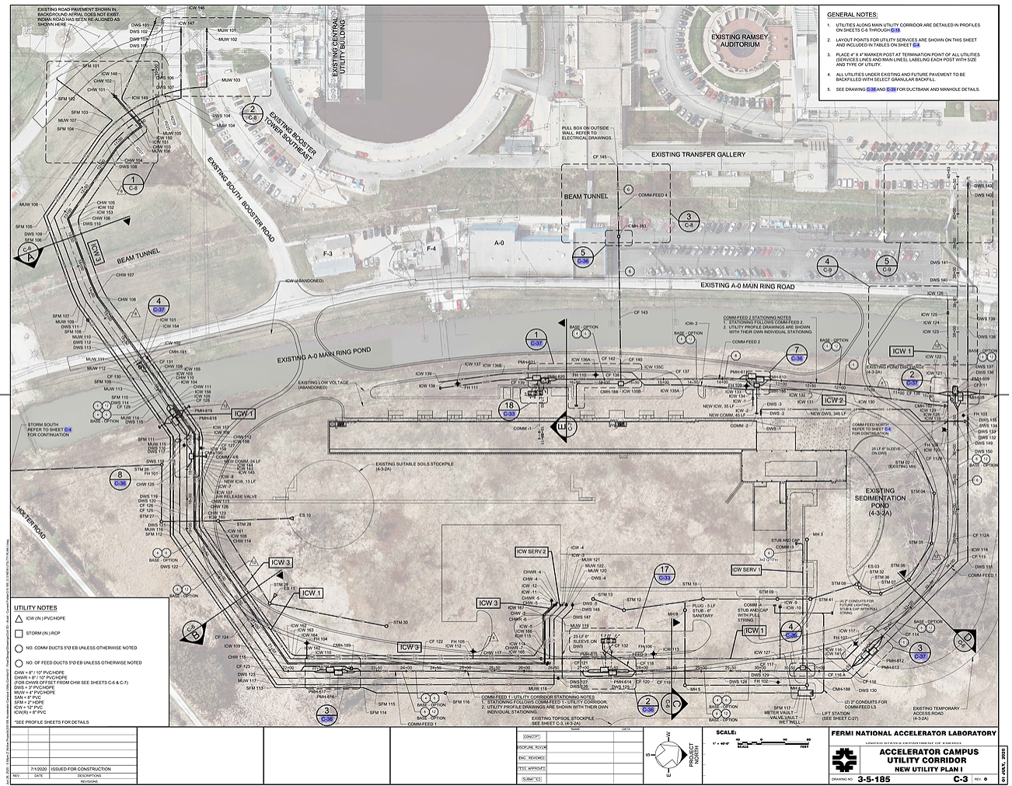
Conventional Facilities

Slide 4
Questions

