Slide 1
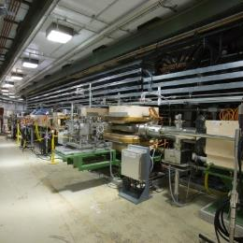
Cryo Plant and Linac Operations at SNS
Workshop on Maintaining PIP-II within the Accelerator Complex
Matthew Howell
Cryogenics Group Leader
July 15, 2021

Slide 2
Outline
Central Helium Liquefier (CHL) overview
CHL availability
CHL maintenance
Superconducting Linac (SCL) Overview
SCL availability
SCL maintenance
Summary

Slide 3
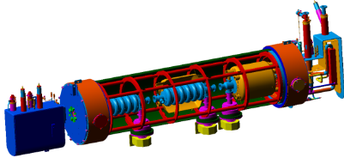
CHL Block Flow Diagram
To LDS Shield Supply
1st Stage Compressor
2nd Stage Compressor
To LDS
Primary
Supply
4K Cold Box
From LDS
Shield Supply
To LDS
Shield Return
2K Cold Box
From LDS
Primary
Supply
He Dewar

Slide 4
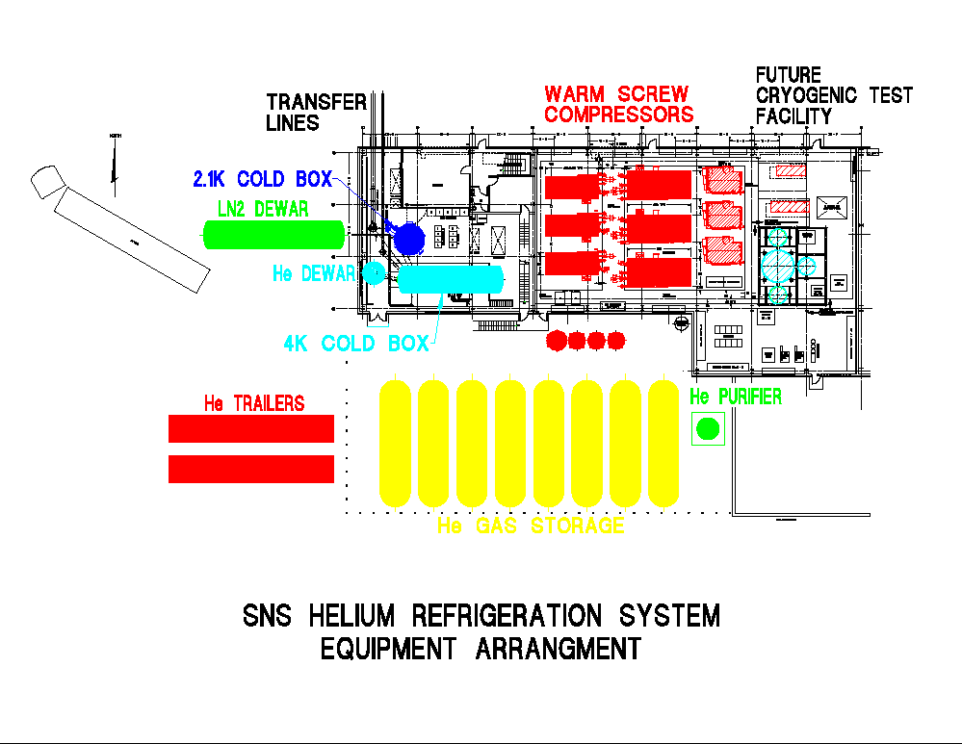
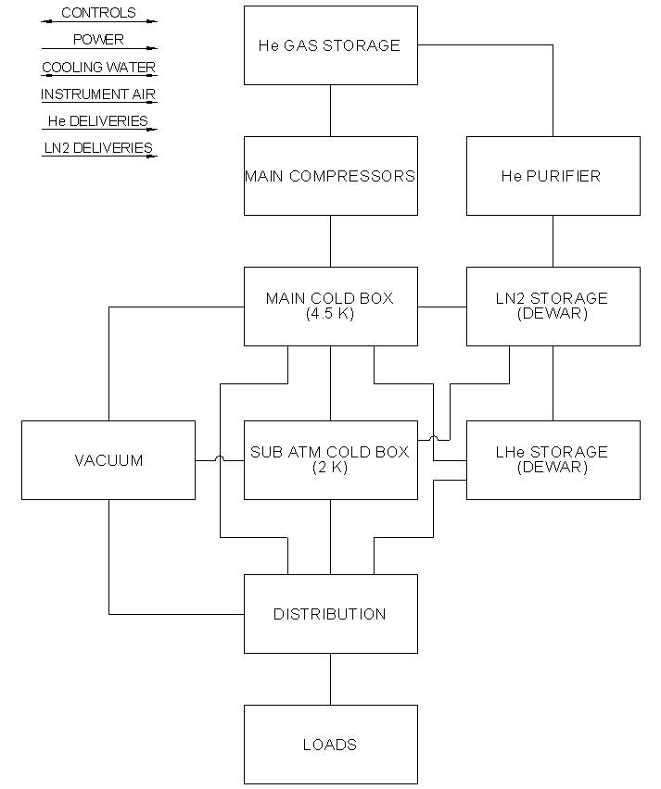
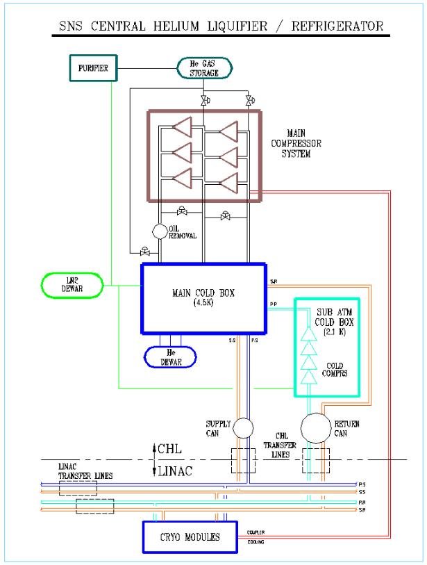
SNS CHL

Slide 5
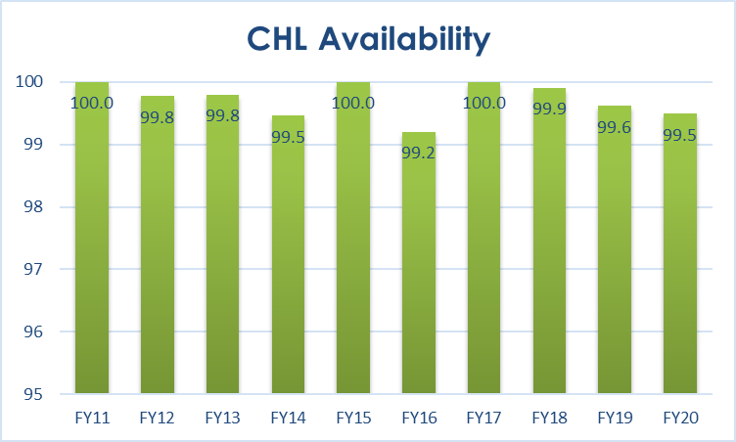
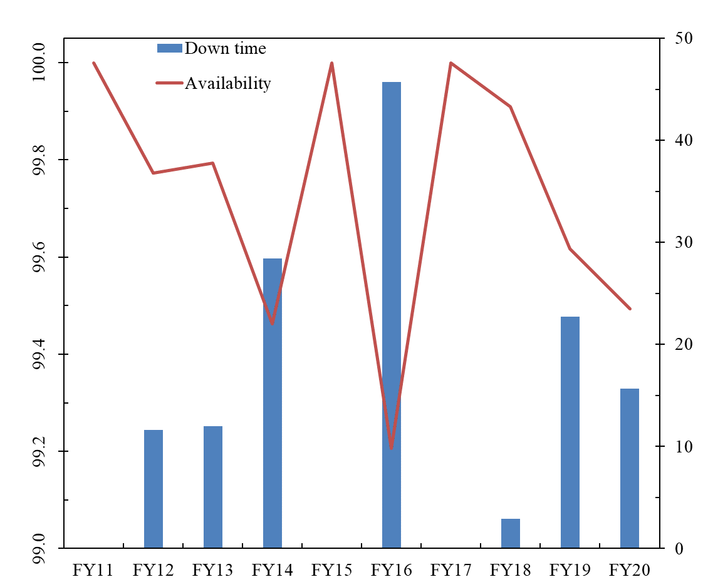
CHL Availability Statistics
The availability of the CHL is outstanding
Availability %
Availability %
Down time hrs
Fiscal Year

Slide 6
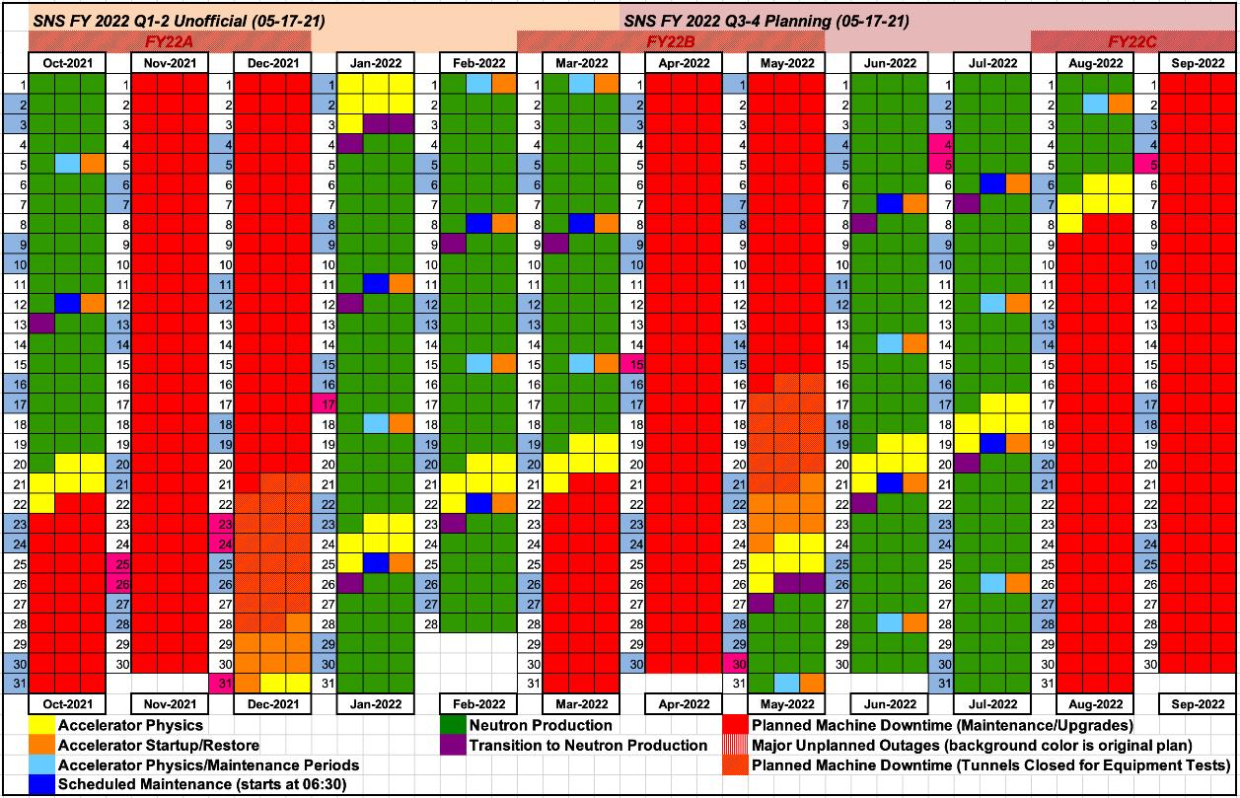
Available time for Maintenance
Maintenance outages
Two outages per year lasting 4 – 9 weeks
Scheduled maintenance days
Every other Tuesday
Coordinate the cryogenic plant and the superconducting linac maintenance during these outages to avoid beam interruptions

Slide 7
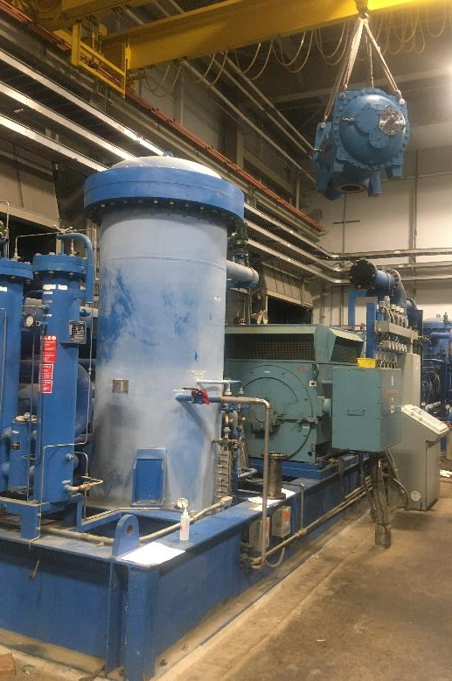
CHL Maintenance
Maintenance strategy
Keep the system cold to avoid thermal cycling
Avoid any outage of the CHL more than eight hours
Purify all helium entering the system
Compressors
One spare in line compressor for both first and second stage
All compressors ready to operate during a run
Coordinate annual maintenance during scheduled maintenance outages
Smaller maintenance requirements conducted during maintenance days
Routine rotation of compressors occurs every Friday
Other maintenance scheduled and coordinated for maintenance outages
Controls
Ancillary systems
Cold box issues
Compressor 4 being craned into place

Slide 8
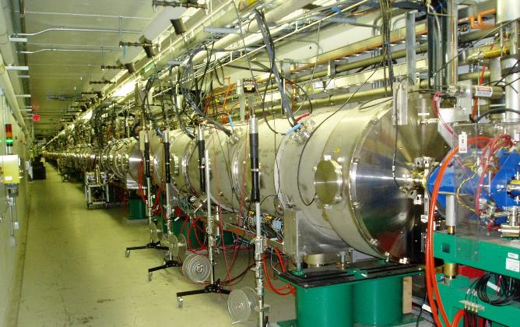
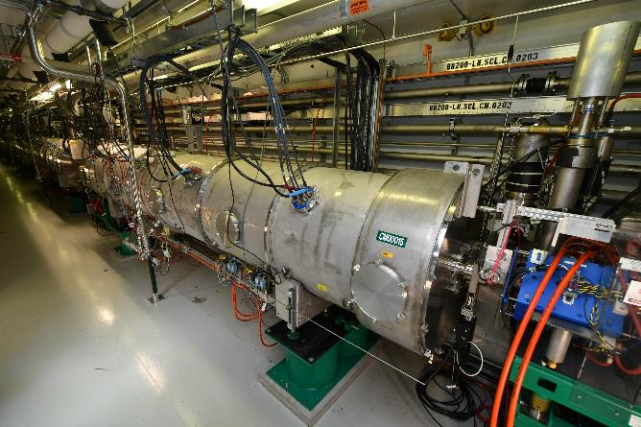
SCL Overview
23 operating cryomodules
Containing 81 Superconducting cavities
Operating temperature of 2.1 K
Contains a 35K thermal shield
Nine empty slots to allow expansion
Tunnel equipped with ancillary systems
Beam line and insulating vacuum pumping
Water cooling for couplers and magnets
3 atmosphere helium, guard vacuum and cooldown headers to support cryomodule operation and maintenance
Segmented design
Cryomodules are separated from the adjacent cryomodules by warm sections containing beam pipes and quadrupoles
Cryomodules are connected to the cryogenic plant through 4 u-tubes
Warm Section
Cryomodules in SNS Linac
U-tube
Cryomodule 15 in Linac

Slide 9
SCL Repairs
Determine whether repair can be made in the tunnel or if the cryomodule must be removed
External to the tunnel repairs
Spare cryomodules available to support external repairs
Helium leaks on feed throughs
HOM Feed through replacement
Internal to the tunnel repairs
Tuner repairs
Instrumentation
Thermal cycling to regain gradient
Apply plasma processing to increase gradient
Repairs previously done external to the tunnel can be done internal to the tunnel as a result of development
Coupler replacement

Slide 10
SCL Availability Statistics
The availability of the SCL is outstanding
FY21 is as of end of May

Slide 11
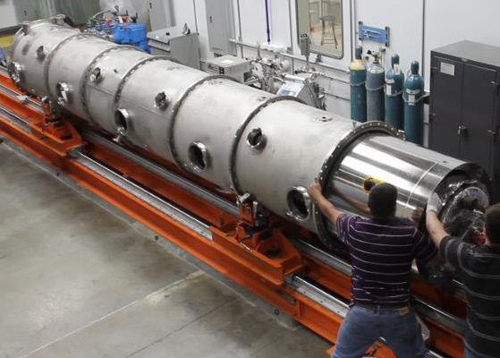
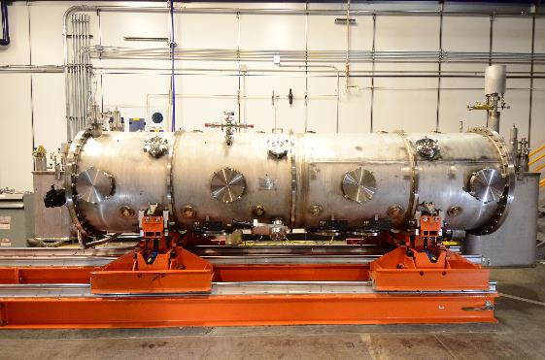
Fabricated High and Medium Beta Spare Cryomodules
Spares
Allows for removal of cryomodules for repair while maintaining the same beam energy
HB spare cryomodule completed and installed in summer of 2012
MB spare cryomodule completed and installed in winter of 2020
Based on our experience, a spare PPU cryomodule has been added to the scope of the project
HB CM Spare Assembly Effort
MB Spare

Slide 12
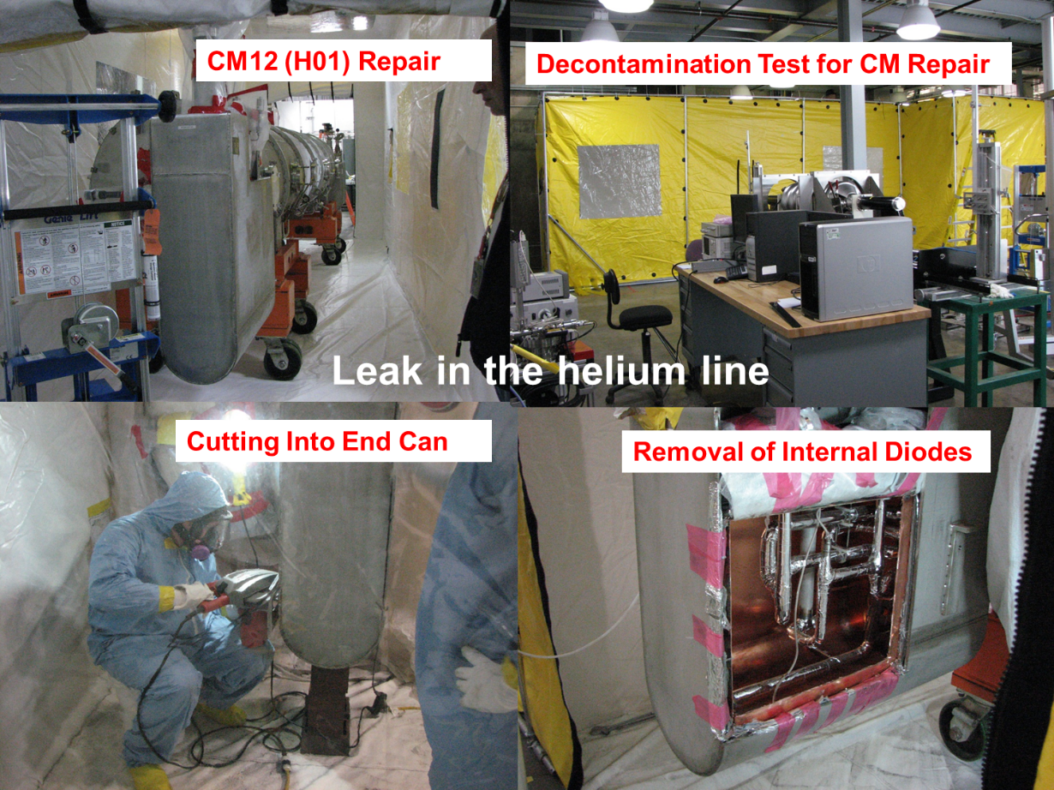
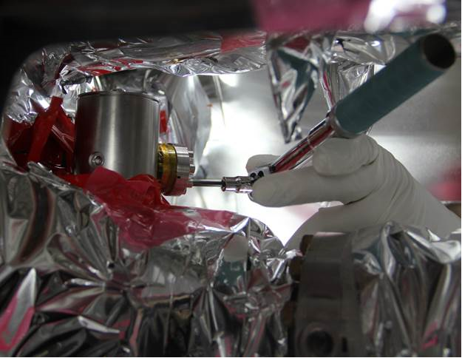
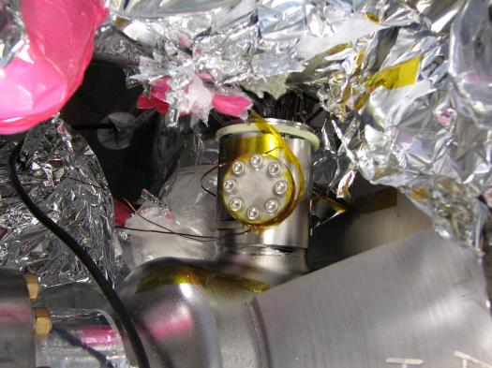
Repairs requiring cryomodule removed from tunnel
HOM – Higher Order Mode
Not necessary for SNS
Only installed to protect against the unknown
About half leaked between insulating vacuum and beam line vacuum
Helium Leaks
Predominantly from diode feed throughs in the end cans
Decontamination Tent for Cryomodule Repair
Blanking off HOM feed through port
HOM Feed through flange

Slide 13
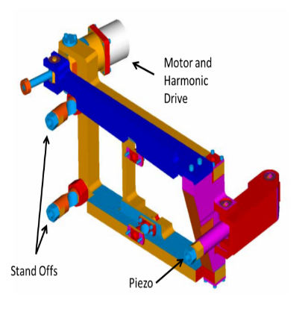
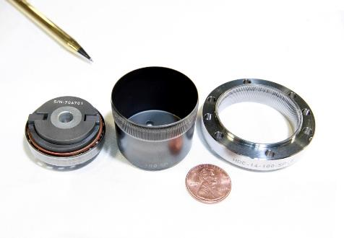
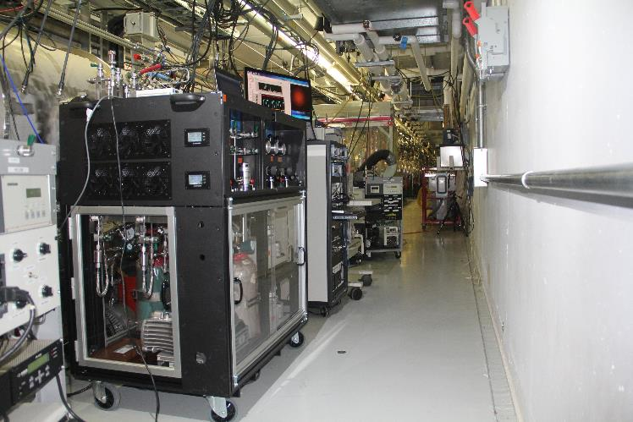
Repairs completed in tunnel
Tuner repairs
Harmonic drive wearing
Replacement of tuner stepper motors
Piezo tuners breaking due to mechanical stress
Instrumentation
Replacement of pressure, temperature, and RF instruments
Plasma
Developed though a comprehensive R&D plan to recover and improve cavity gradients
Now able to deploy in the tunnel
CAD model of an SNS Tuner
Harmonic Drive Assembly
First Plasma Processing of a Cryomodule in the Tunnel

Slide 14
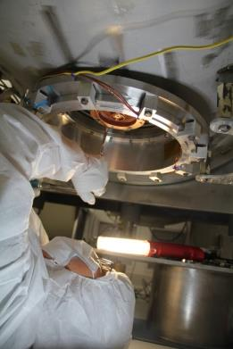
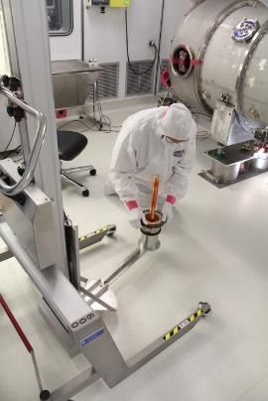
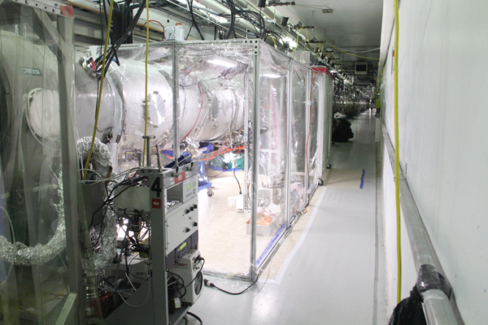
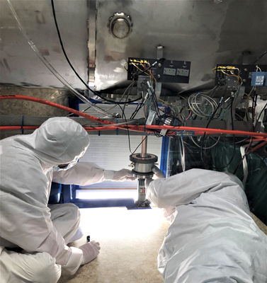
Developing methodology to do more repair in tunnel
SNS has experienced 7 coupler window leaks
Leaks were 10e-7 Torr L/s or lower
Previously repaired external to the tunnel in the clean room as shown
Repairs 4 with this methodology
Methodology developed to build a temporary clean room around an installed cryomodule and replace the coupler
Repaired 3 with this methodology
One more schedule for the winter of 2021
Work on coupler in clean room
Coupler install in clean room
Local clean room setup for CM repair
Installation of coupler
in the tunnel

Slide 15
Summary
The CHL and SCL have been very reliable components of the SNS accelerator complex
Maintenance strategies have been utilized to ensure the reliability and availability of the machine is maintained
Spare high and medium beta cryomodules are available to facilitate cryomodule repairs
Methodologies are evolving to conduct more repairs in the tunnel to reduce the amount of time to complete them

