Slide 1
Mu2e Experiment and Issues
Rick Coleman, Fermilab
RESMM’12, February 2012

Slide 2
Mu2e talks
Today
  Now: Mu2e Experiment and Issues
    Overview, Status of Project, Production & Transport Solenoids
  16:30 Superconducting Magnets of Mu2e- Michael Lamm
  17:00 Mu2e Production Solenoid- Vadim Kashikhin
Tuesday
  16:00 Radiation Studies for Mu2e Magnets- Vitaly Pronskikh
Special Thanks to: R. Bernstein, J. Miller, D. Glenzinski, for some material used

Slide 3

Introduction
Mu2e experiment is a search for Charged Lepton Flavor Violation (CLFV) via the coherent conversion of μ⁻N→e⁻N
In wide array of New Physics models CLFV processes occur at rates we can observe with next generation experiments
The proposed experiment uses current proton source at Fermilab with some modifications
Target sensitivity has great discovery potential

Slide 4
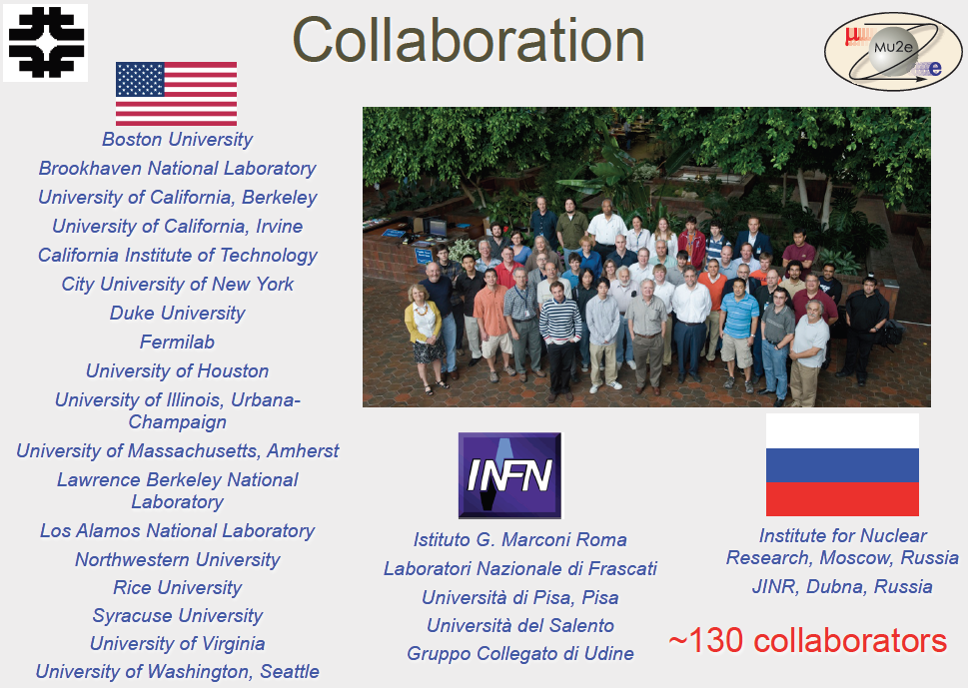

Slide 5
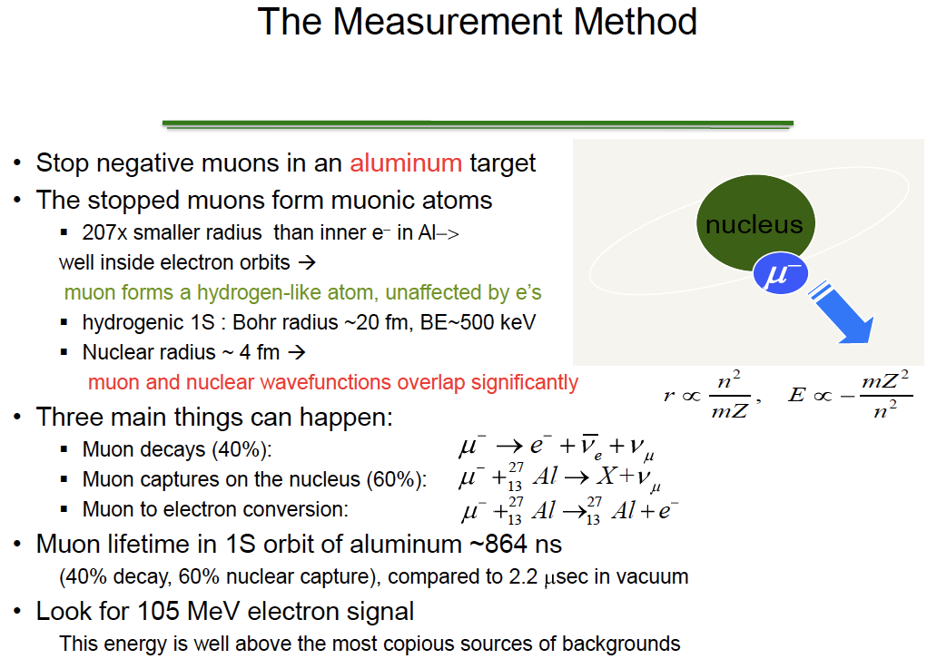
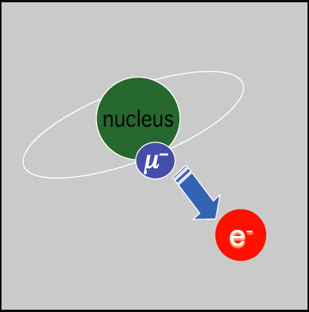

Slide 6
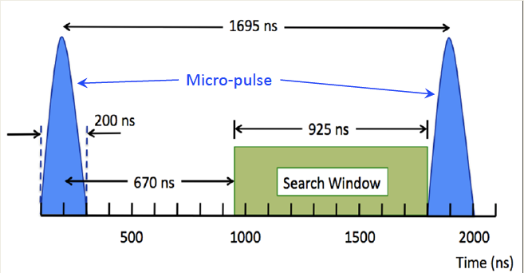
Beam Intensity and Pulsed Proton Beam
  Deliver high flux μ⁻ beam to stopping target
    proton flux ~6 x 10¹² /sec at 8 GeV (8 kW)
    ~2 x 10¹⁰ Hz μ⁻ , 10¹⁸ total, 4 conversion e⁻ at R_{μe}~10⁻¹⁶
    10³ more muons than SINDRUM II previous best limt
  Pulsed Proton beam – Wait 670 ns to reduce prompt background, extinction = 10⁻¹⁰ using Debuncher Ring and oscillating (AC) dipole sweeper in external proton beamline
τ_{μ}(Al)=864 ns

Slide 7

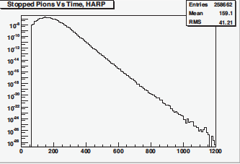
Pulsed Beam and Radiative Pion Capture Background
reduced 10¹¹
Wait ~ 700 ns
time (ns)

Slide 8
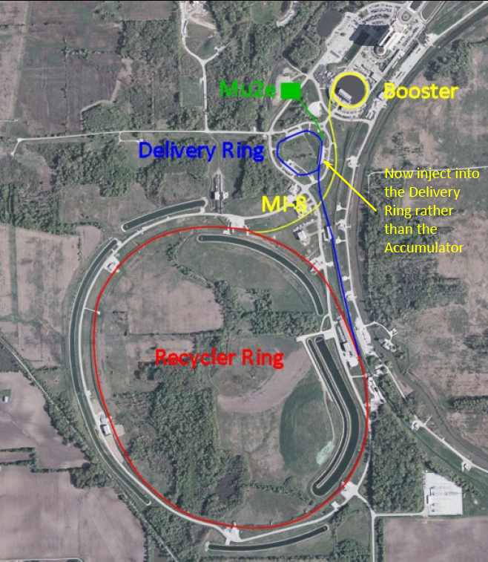
Protons from 8 GeV Booster to Mu2e
New beamline
shared by Mu2e
and g-2
Steve Werkema

Slide 9
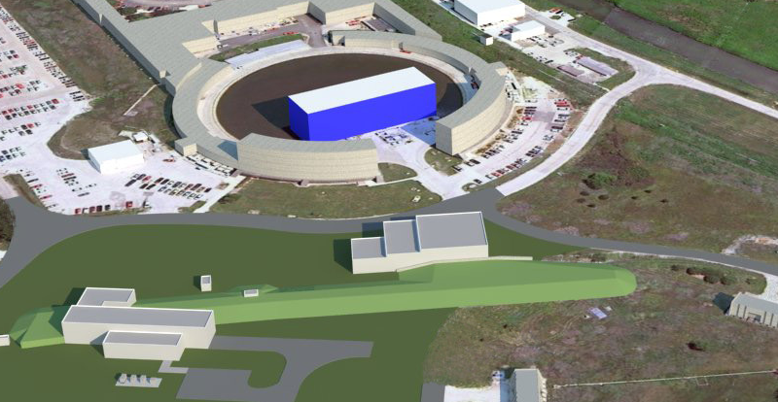
Muon Campus for Mu2e and g-2 with Cryo Plant
g-2 building (MC-1) has evolved to support needs of g-2 and Mu2e
Low bay is Muon Campus Cryo Building
Medium Bay will house beamline power supplies and equipment.
Compressed He
from existing TeV
compressors
New transfer line for
compressed He built
from recycled parts
Cold He lines
to experiments
Three TeV refrigerators
installed in MC-1

Slide 10
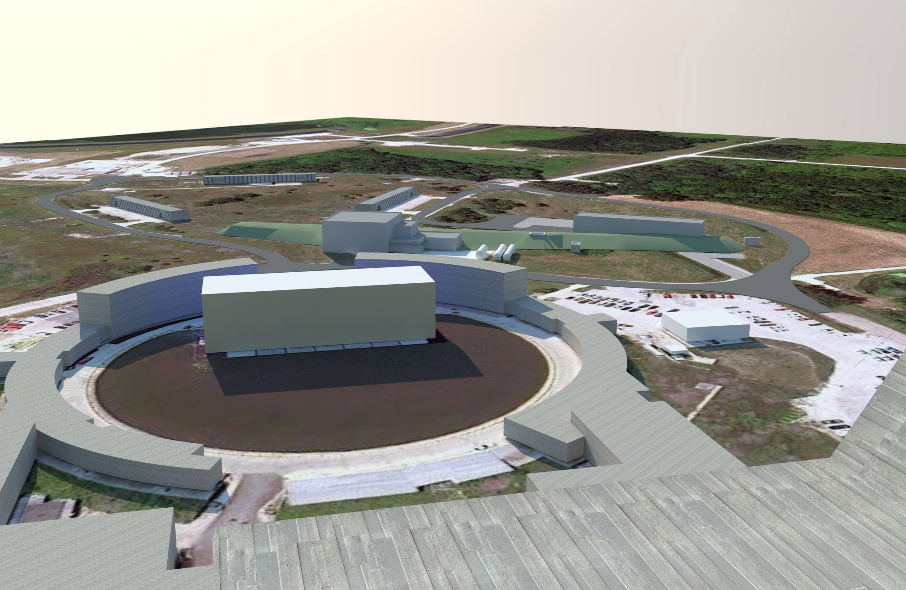
g-2
Mu2e

Slide 11
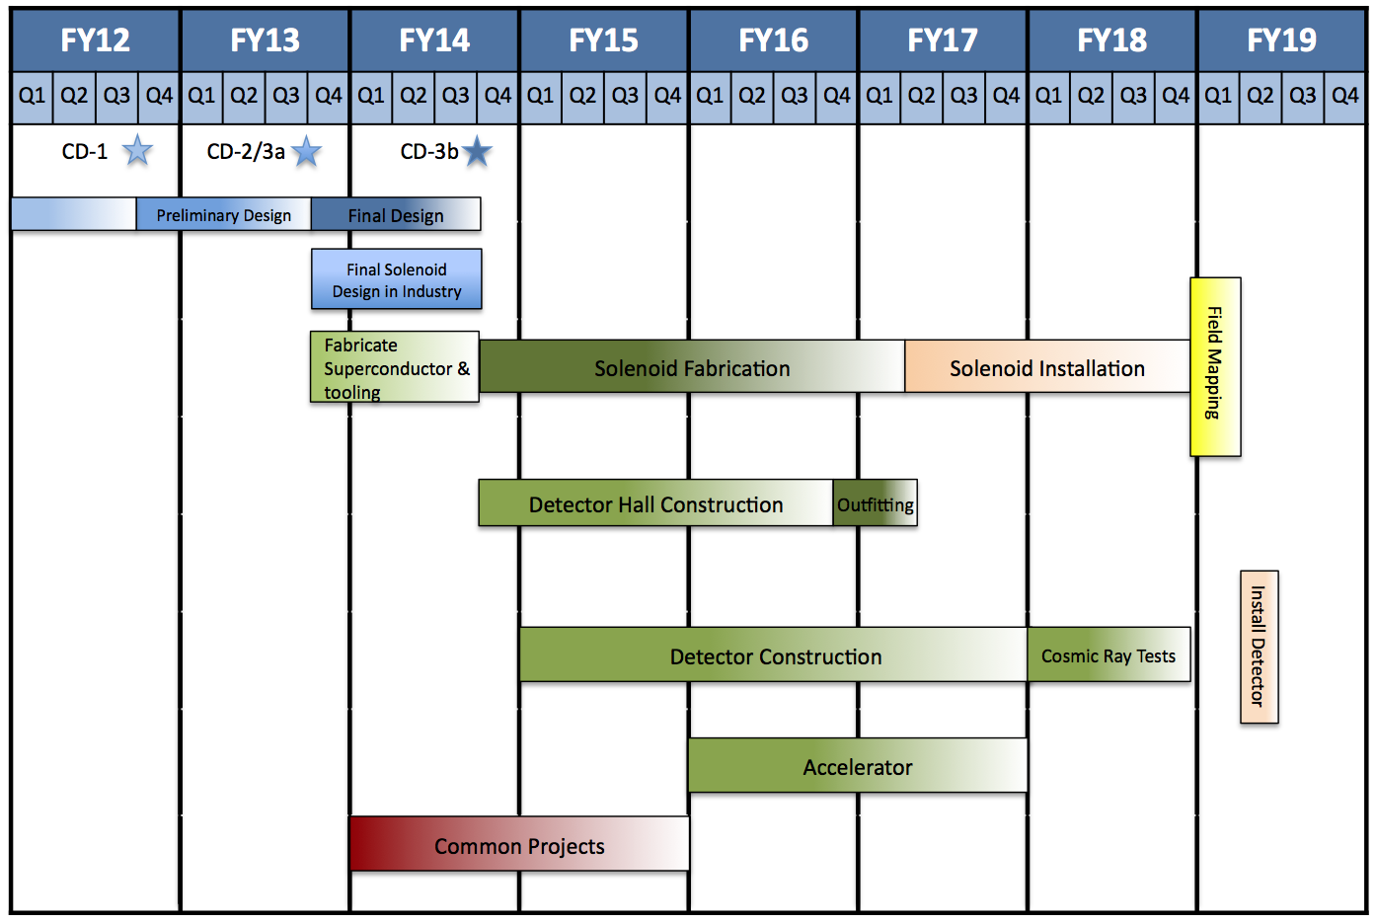
Schedule

Slide 12
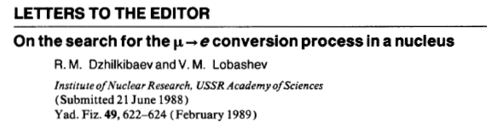
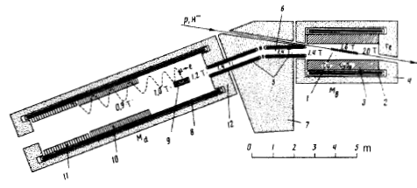
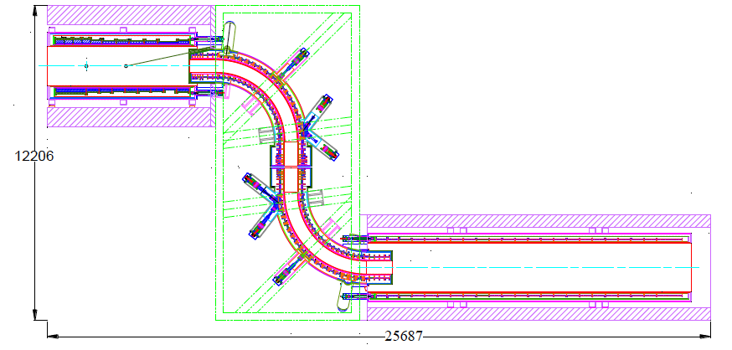
MELC at Moscow
1989
μ/p ~ 10⁻⁴ vs
conventional ~10⁻⁸
MECO at BNL
1996-2005
COMET at J-PARC: proposal Nov 2007 & Mu2e at FNAL: proposal Oct 2008

Slide 13
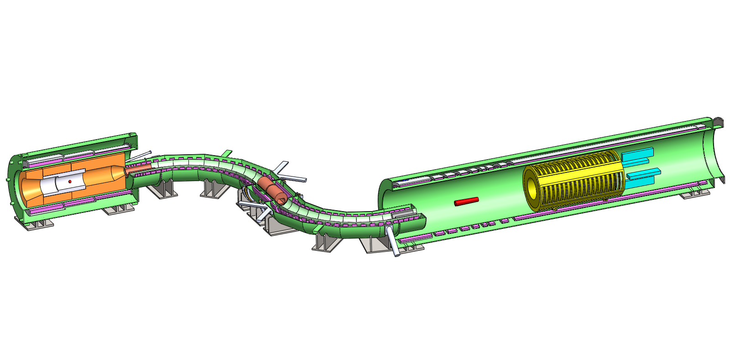
Mu2e Apparatus
Production
Solenoid
Transport
Solenoid
Detector
Solenoid
Production
Target
Stopping
Target
Collimators
Tracker
Calorimeter
(not shown: Cosmic Ray Veto, Proton Dump, Muon Dump, Proton/Neutron absorbers, Extinction Monitor, Stopping Monitor)
Mu2e experiment consists of 3 solenoid systems

Slide 14
Mu2e Apparatus
Production
Solenoid
Transport
Solenoid
Detector
Solenoid
1.0T
protons
e−
μ⁻, π⁻
2.5T
~5T
Production
Target
2.0T
Stopping
Target
Collimators
Tracker
Calorimeter
(not shown: Cosmic Ray Veto, Proton Dump, Muon Dump, Proton/Neutron absorbers, Extinction Monitor, Stopping Monitor)
Mu2e experiment consists of 3 solenoid systems

Slide 15
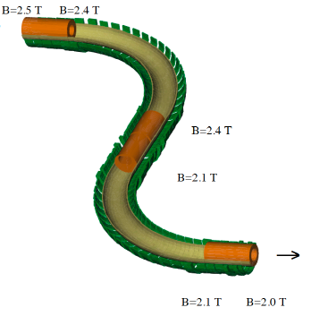
Transport Solenoid
Inner radius=24 cm
Length=13.11 m
TS1: L=1 m
TS2: R=2.9 m
TS3: L=2 m
TS4: R=2.9 m
TS5: L=1 m
  Goals:
  Transport low energy
  μ⁻ to the detector solenoid
  Minimize transport of positive
  particles and high energy particles
  Minimize transport of neutral particles- curved section
  Absorb antiprotons in a thin window
  Minimize particles with long transit time

Slide 16
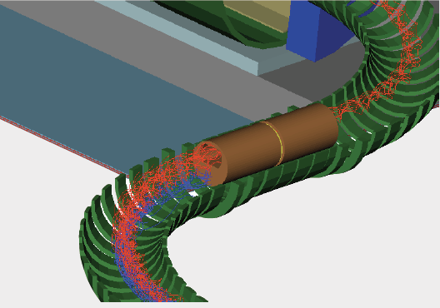
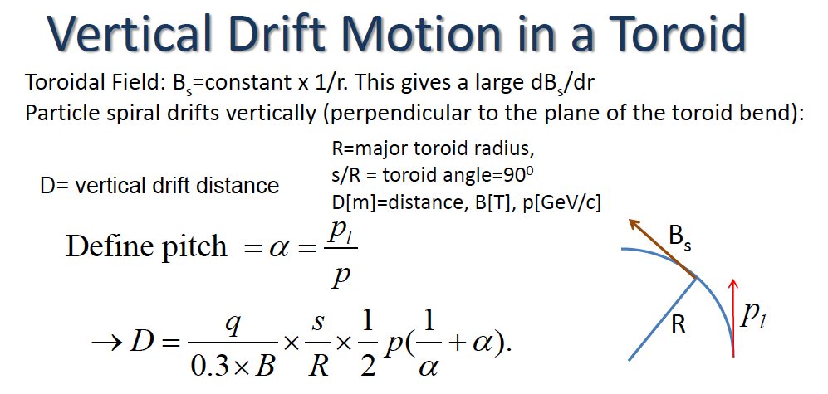
Charge, Momentum Selection and Rejection of Long-lived Particles

Slide 17
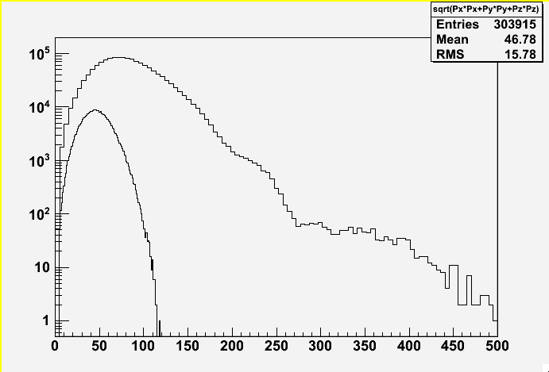
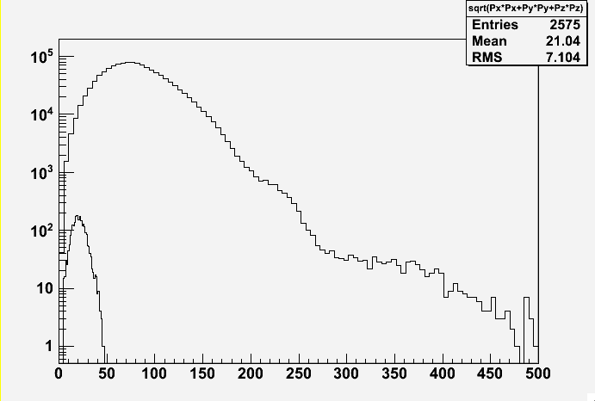
Muon Flux-
before and after Transport Solenoid
Negative Muons
p(MeV)
Positive Muons
p(MeV)

Slide 18
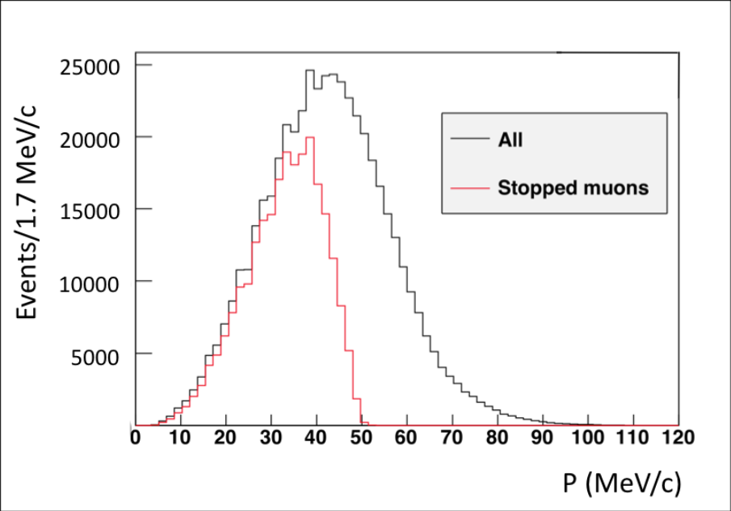
Muons Reaching the Stopping Target in the Detector Solenoid

Slide 19
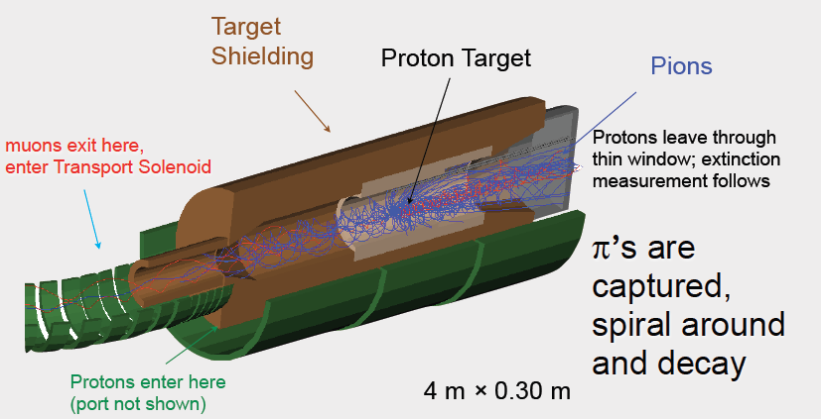
Production Solenoid
L=
radius

Slide 20
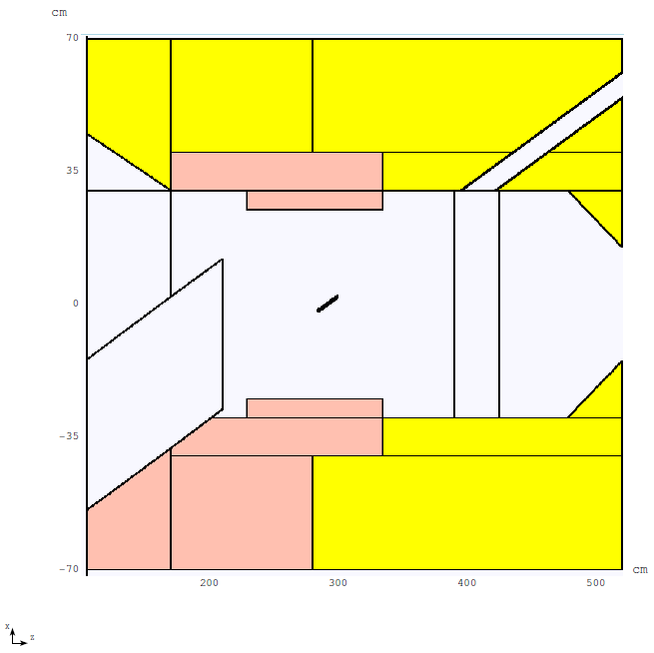
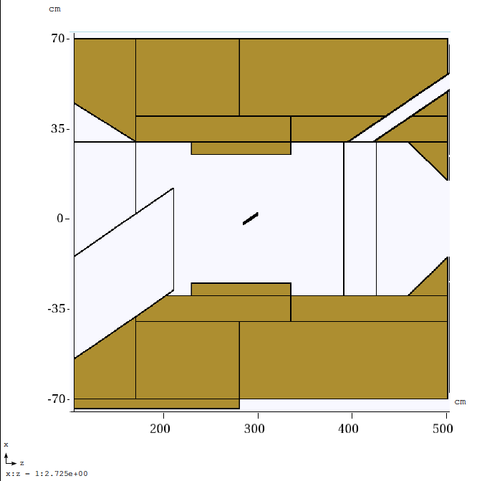
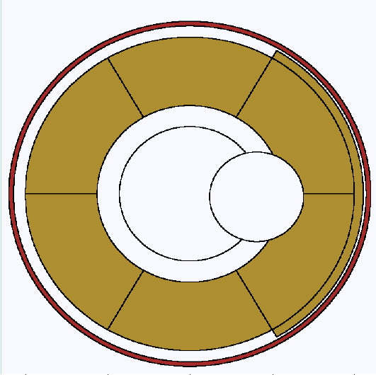
Heat and Radiation Shield Dimensions from Simulation
25 kW
0.6 m
1.4 m
W
Cu
4 m
8 kW
Bronze
W
See Vitaly Pronskikh’s talk
tomorrow
Cu

Slide 21
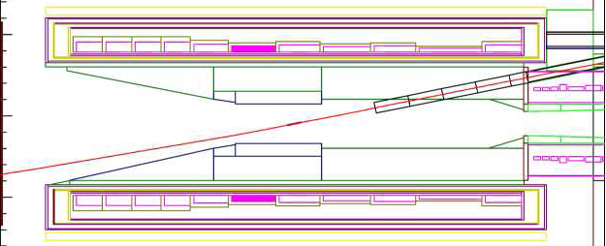
Some Early Comparisons to MECO (2009)

Slide 22
Study of Muon Yield vs Maximum Field in Production Solenoid

Slide 23
Target z position Study (2009)

Slide 24
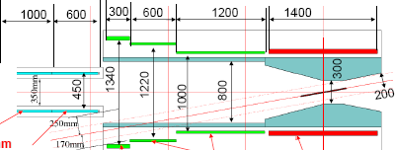
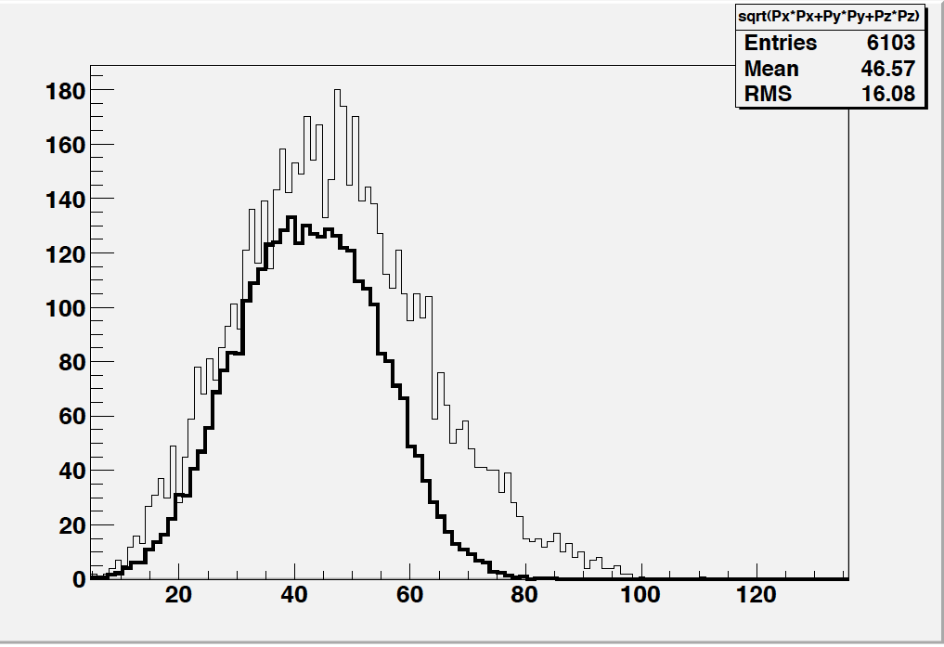
MECO
5200
1 m
0 m
1400
400
Joint Meeting in Berkeley Jan 2009
with COMET group- direct comparisons
difficult due to differing physics models
COMET

Slide 25
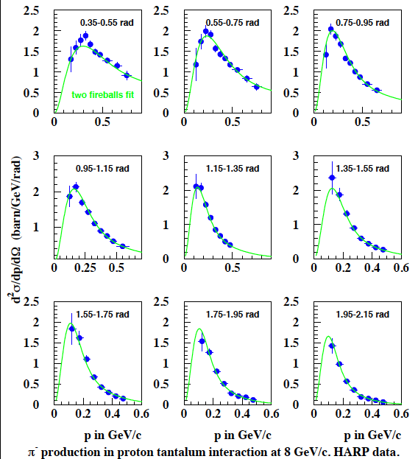
Sergei Striganov
improved
fit for Mu2e
2009, similar fits
by Bob Bernstein
File of pions weighted
by HARP data used

Slide 26
Pion Production- what energies and angles are important?
~60% from 20-60 MeV kinetic energy
or p = 77- 143 MeV

Slide 27
MECO

Slide 28
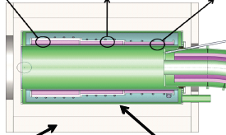
Optimize target z position for Stopped muon yield for L= 4m Mu2e PS
With this target location
muon yield is down ~ 7%
with L=4 m vs L=5.2 m (MECO)
Some cost savings reducing L, but most important feature is
DPA requirements can be satisfied in region where proton beam exits PS-
see Vitaly’s talk tomorrow

Slide 29
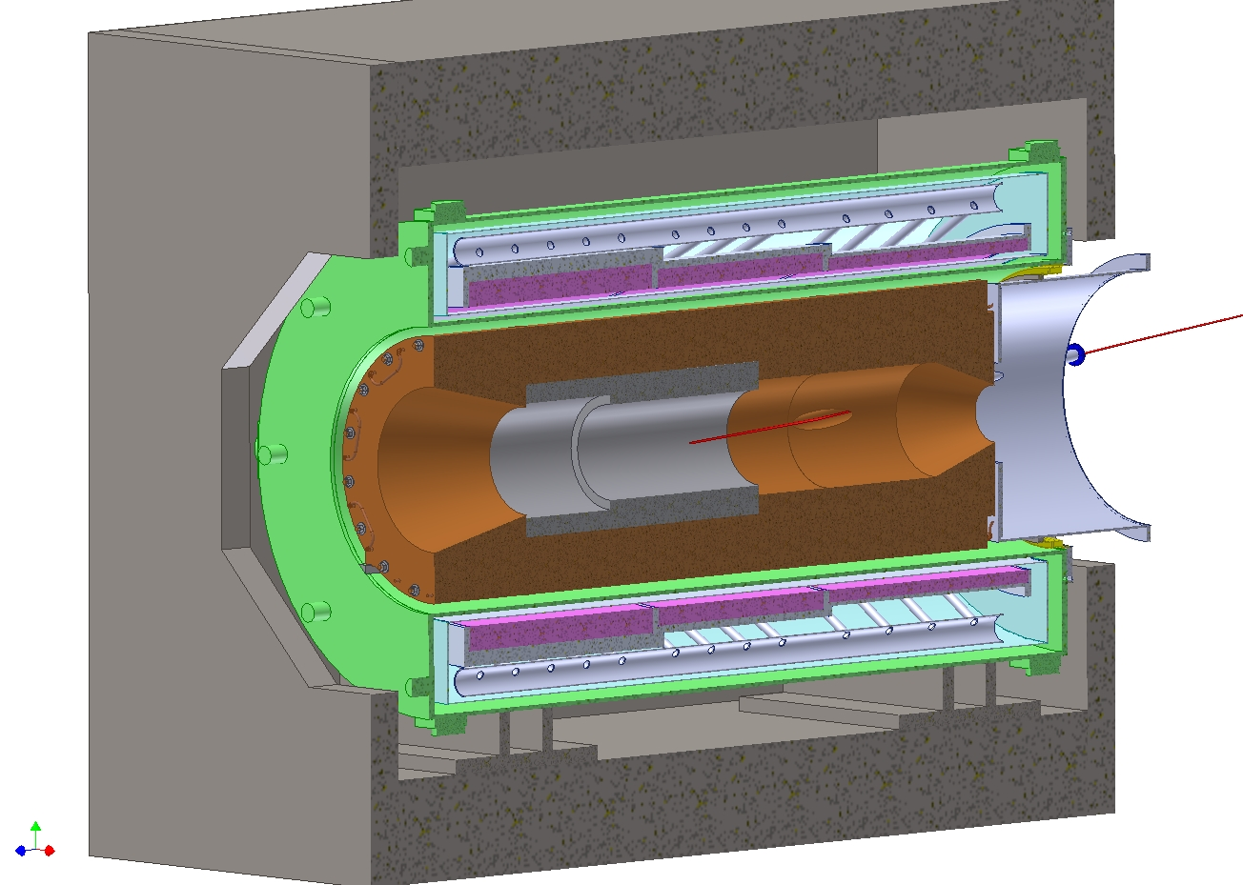
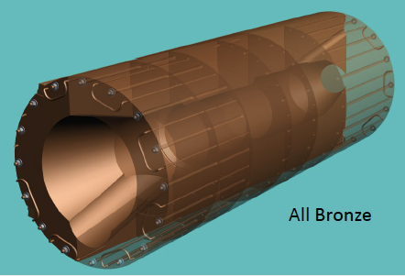

Production Solenoid- Some Engineering Aspects – Heat Shield
8.3 kW current version
25 kW version
Requires Tungsten ➔ $$$
Heat Transfer issues

Slide 30
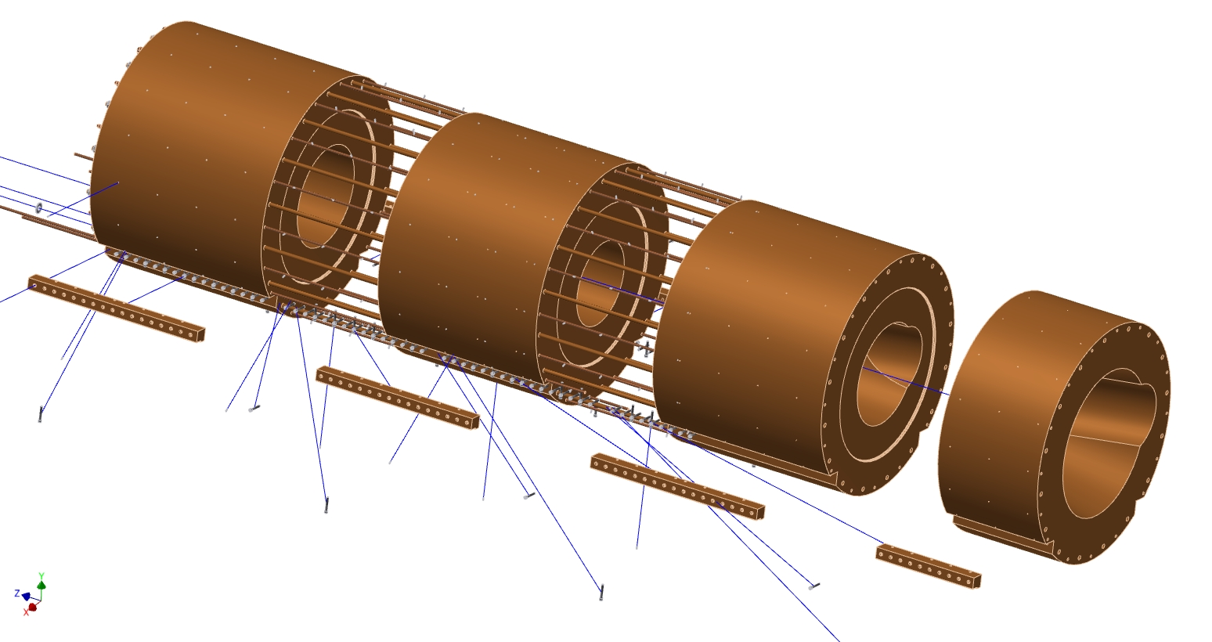
The Mu2e All-Bronze Heat and Radiation Shield Design
Exploded view showing radiation labyrinths and all parts
13.6 tons
12.4 tons
13.2 tons
6.6 tons
46 tons total
Bolt-on rails
L. Bartoszek
BARTOSZEK ENGINEERING

Slide 31
Status of Heat Shield Engineering
We have to build drawings on all-bronze 8.3 kW
3 cost estimates, very consistent, significant savings in 8.3 kW version over 25 kW version which uses tungsten
Thermal analysis in progress, not expected to be a problem
Need to explore other materials (Copper, Copper/Nickel)
Continue simulations to optimize design

Slide 32
Backup Slides

Slide 33
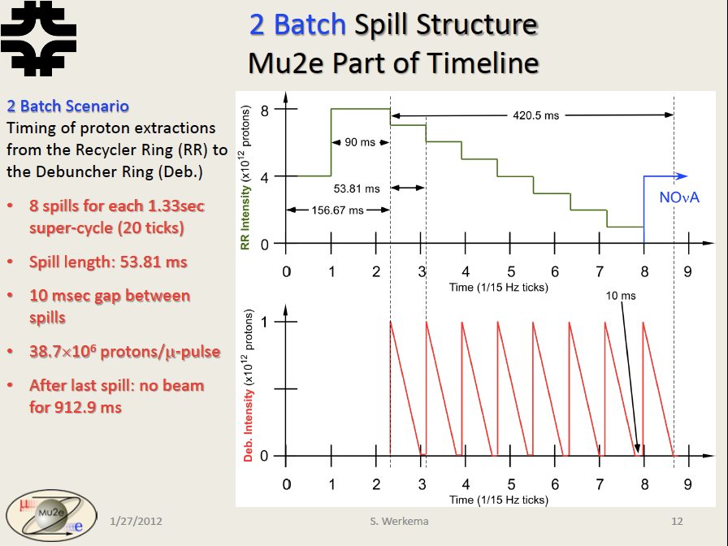

Slide 34
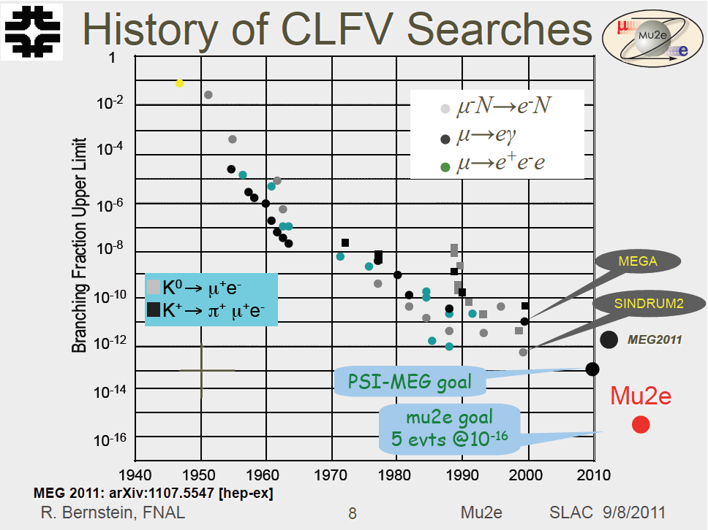

Slide 35
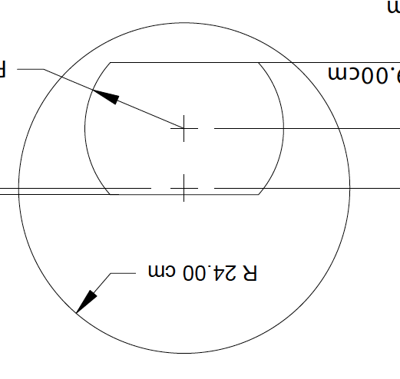
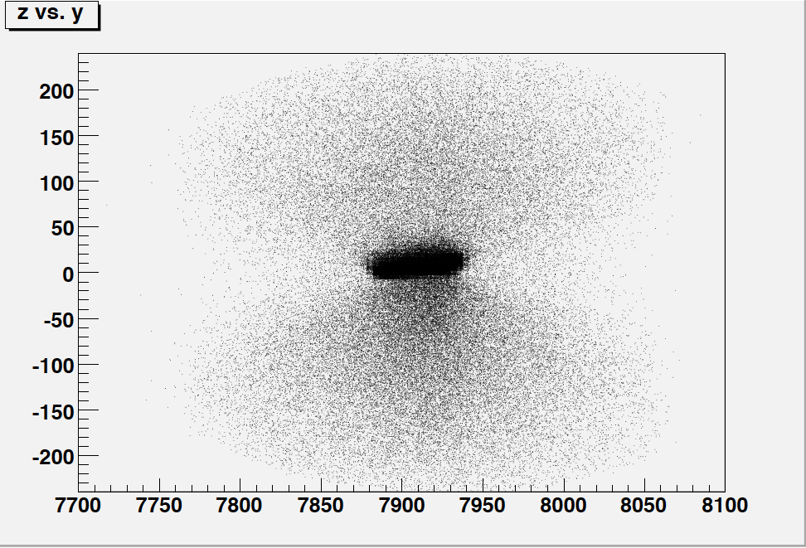
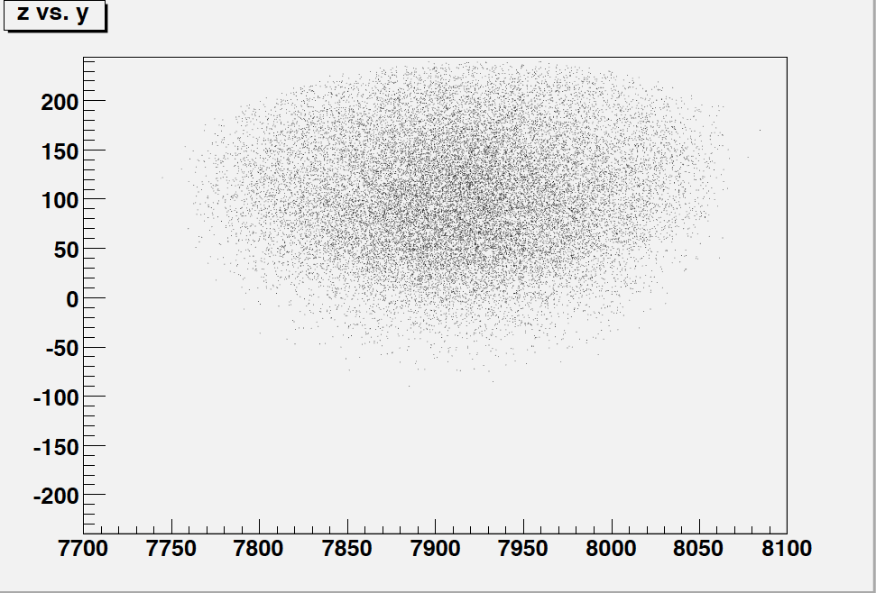
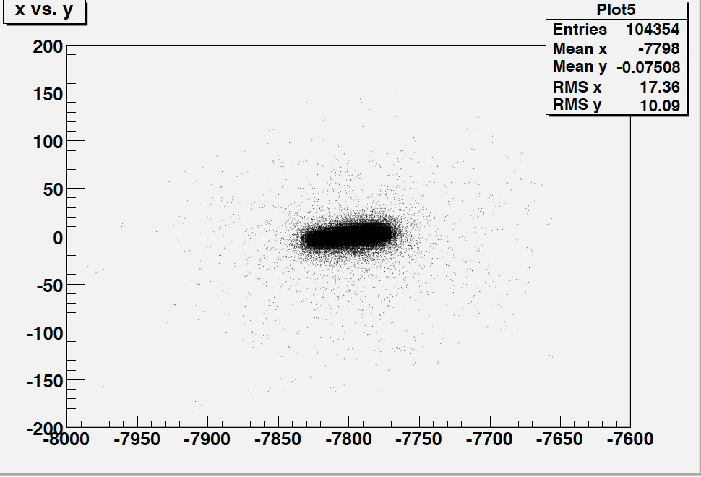
Electron Flash and Middle-Collimator
All particles
negative muons
electrons
e/μ ~20 -> 1 & stopped μ reduced 20%

Slide 36
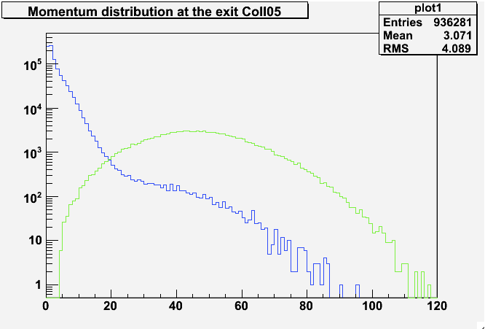
e⁻ /μ ⁻ flux entering the Detector Solenoid
e⁻
μ ⁻
Momentum (MeV/c)

Slide 37
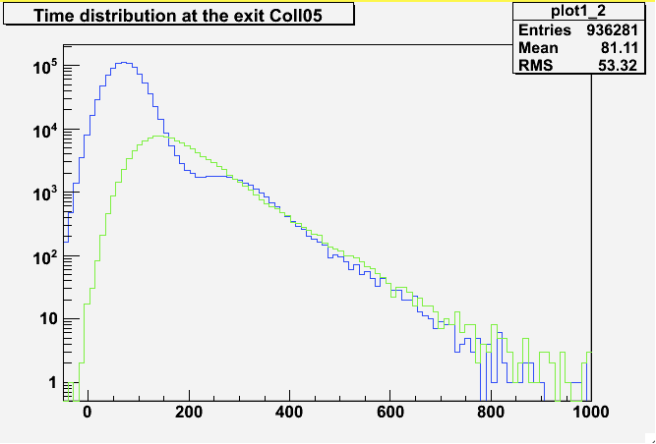
Time distribution entering Detector Solenoid
e⁻
μ ⁻
Time (ns)

Slide 38
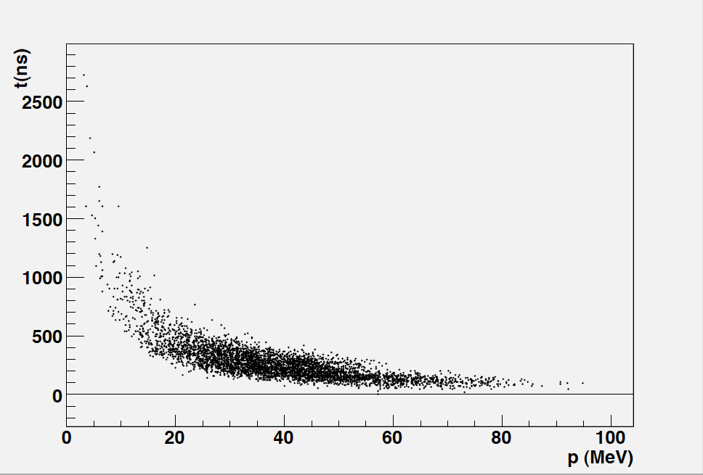
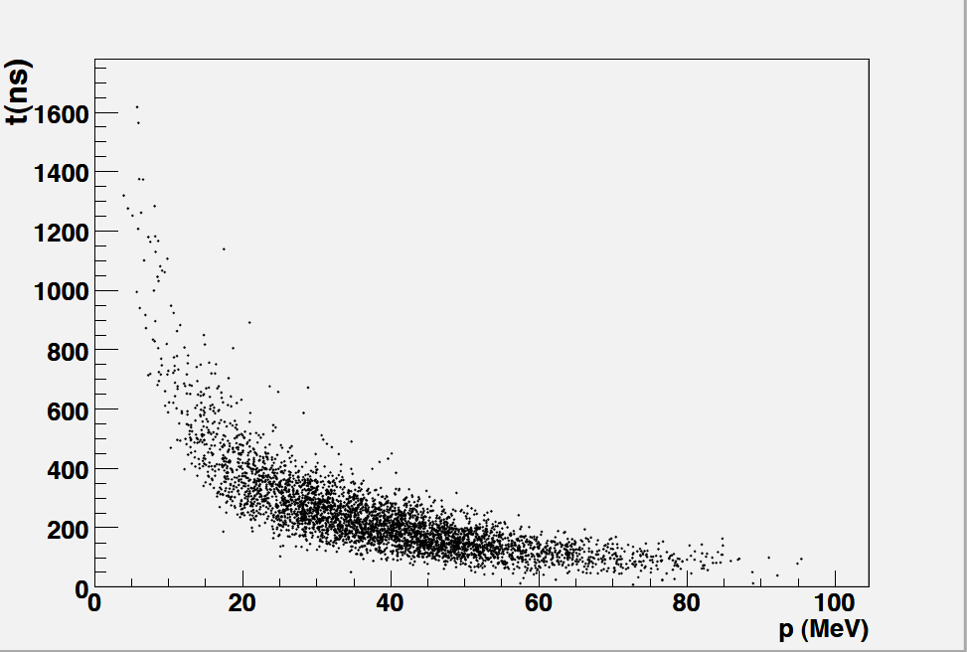
Time vs p - negative muons reaching stopping target
MECO PS
Mu2e PS
5/3/11
38

Slide 39
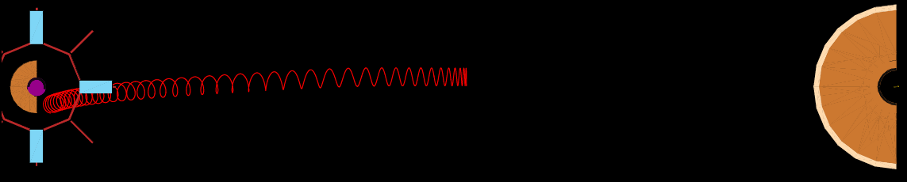

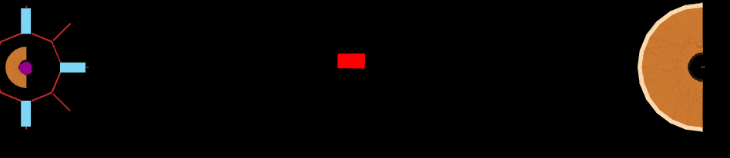
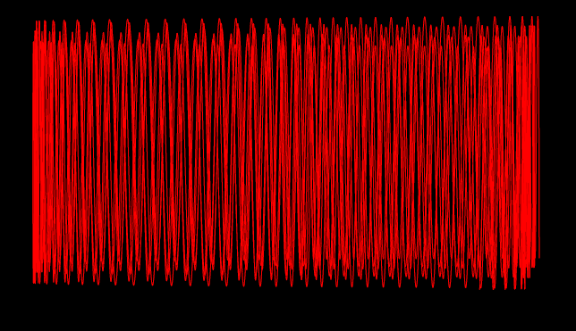
TS with gradient
t= ~200 ns
p_{π}=54 MeV scatters to ~0 pitch angle
in pbar windowpbar window
TS without gradient
t= ~900 ns

Slide 40
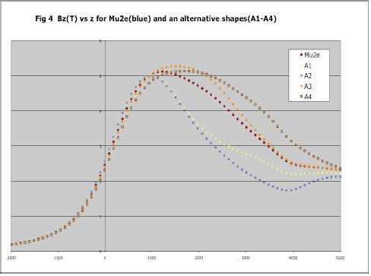
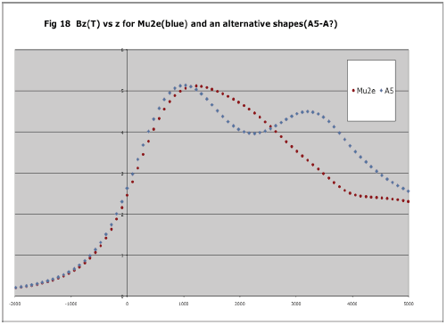
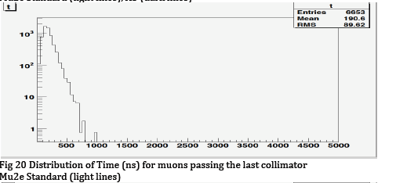
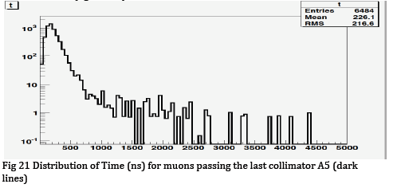
Study of the Production Solenoid Gradient vs Muon Yield
normal time
distribution
positive gradient
leads to long times

Slide 41
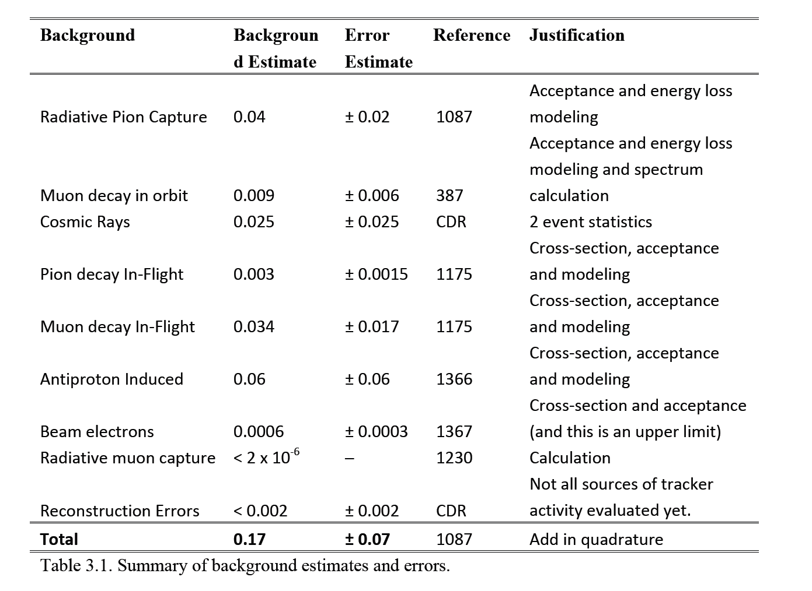

Slide 42
