Slide 1
Re-engineering Frameworks for Concurrency
FNAL, 21-22 November 2011
B. Hegner & P. Mato, CERN

Slide 2
Vision
Universal framework for simulation, reconstruction, analysis, high level trigger applications
Common framework for use by any experiment
Decomposition of the processing of each event into ‘tasks’ that can be executed concurrently
Ability to process several events concurrently
Optimal scheduling and associated data structures
Minimize any processing requiring exclusive access to resources because it breaks concurrency
Supporting various hardware/software technologies
Facilitate the integration of existing LHC applications code (algorithmic part)
Quick delivery of running prototypes. The opportunity of the 18 months LHC shutdown

Slide 3
Why?
We need to adapt current applications to the new many-core architectures
Expected no change in the overall throughput with respect trivial one-job-per-core parallelism
Scaling to a much larger number of cores
Reducing the required resources per core
I/O bandwidth
Memory
Connections to DB, open files, etc.
Reduce latency for single jobs (e.g. trigger, user analysis)
Run a given job in less time making use of available cores

Slide 4
Why the Framework managing the concurrency?
Concrete algorithms can be parallelized with some effort
Making use of Threads, OpenMP, MPI, GPUs, etc.
But difficult to integrate them in a complete application
E.g. MT-G4 with Parallel Gaudi
Performance-wise only makes sense to parallelize the complete application and not only parts
Developing and validating parallel code is difficult
‘Physicists’ should be saved from this
Concurrency will limit what can and can not be done in the algorithmic code (policies)
At the Framework level you have the overall view and control of the application

Slide 5
Concurrent ‘Task’ processing
Framework with the ability to schedule modules/algorithms concurrently
Full data dependency analysis would be required (no global data or hidden dependencies)
Need to resolve the DAGs (Direct Acyclic Graphs) statically and dynamically
Not much gain expected with today’s designed ‘Tasks’
Algorithm decomposition can be influenced by the framework capabilities
‘Tasks’ could be processed by different hardware/software
CPU, GPU, threads, process, etc.
Input
Processing
Output
Time

Slide 6
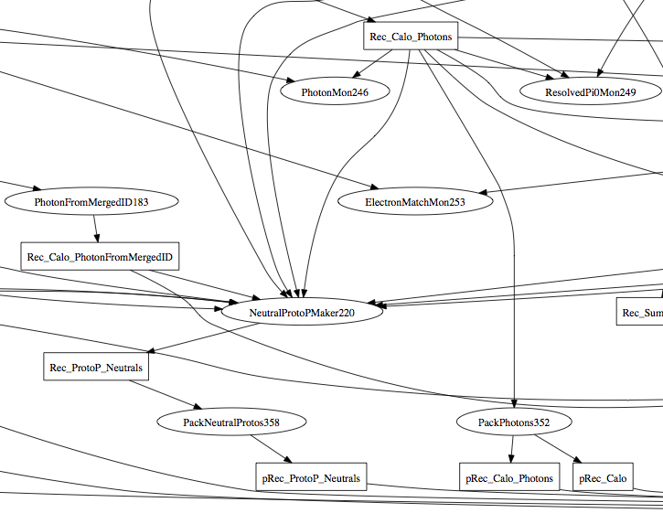
Example: LHCb Reconstruction
DAG of Brunel
Obtained from the existing code instrumented with ‘Auditors’
Probably still missing ‘hidden or indirect’ dependencies (e.g. Tools)
Can serve to give an idea of potential ‘concurrency’
Assuming no changes in current reconstruction algorithms

Slide 7
Many Concurrent Events
Need to deal with the tails of sequential processing
Introducing Pipeline processing
Never tried before!
Exclusive access to resources or non-reentrant algorithms can be pipelined e.g. file writing
Need to design or use a powerful and flexible scheduler
Need to define the concept of an “event context”
Time

Slide 8
Concurrency Programming
It is not simple but we are not alone
Technologies like the Apple’s Grand Central Dispatch (GCD) are designed to help write applications without having to fiddle directly with threads and locking (and getting it terribly wrong)
New paradigms for concurrency programming
Developer needs to factor out the processing in ‘chunks’ with their dependencies and let the framework (system) to deal with the creation and management of a ‘pool’ of threads that will take care of the execution of the ‘chunks’
Tries to eliminates lock-based code and makes it more efficient

Slide 9
Framework as a Set of Services
Better than a “new” complete and self-contained framework, LHC experiments would like to see a set of functional components from where to pick and choose what to incorporate into their frameworks
Experiments have a huge investment in ‘algorithmic’ code and configuration based of a specific framework
Complete solution should be provided for new experiments
The previous constraint does not apply to new experiments
The timing is less critical for them

Slide 10
Framework Services
Logging
Scheduling
non-const
Configuration
Direct Acyclic Graph
Algorithm
Algorithm
Algorithm
Random
Geometry
Data Store
EventStore
EventStore
const
Material
B-Field
Persistency
Services
(*) Any resemblance to Gaudi is pure coincidence

Slide 11
Single “Memory Model” is Essential
Algorithm scheduling will be driven by the semantics of the memory model
Knowing what data items an Algorithm “consumes” (reads) and “produces” (modifies, creates) determines when it can be scheduled without conflicts
Thorough design of shared “Services”
Ensure state integrity (e.g. caches)
Avoid case-by-case ad-hoc solutions
Products like ROOT and Geant4 will need to be accommodated to the same memory model

Slide 12
Development of Key Services
“Concurrent White Board” (multi-event data store)
Data declaration (in, out, update)
Get synchronized data access (being executed)
API for input, output, update and commit
“Dispatch Service” (scheduler)
Management of task queues and threads
For example could be based on GCD
“Logging Service”
Ensuring message integrity
Sorting by event

Slide 13
Prototyping of Physics Services
Modeling them as ‘servers’
Genuinely asynchronous
Supporting concurrent clients (caching issues)
Possible use of new hardware architectures (e.g. GPU, MIC)
E.g. Random Service
Reproducibility in a concurrent environment
E.g. Magnetic Field Service
Given a point, return the best estimate of the B-field
It may involve complex interpolations and/or parameterizations
E.g. Material Service
Given two points, return the best estimate of material between them

Slide 14
Concurrency in Geant4
With an approach like the GDC we could exercise different factorizations
Processing each event (set of primary particles) could be the ‘task’ (same as GeantMT)
We could also go at the sub-event level
Development of Rene’s ideas of ‘baskets’ of particles organized by particle type, volume shape, etc.
Would need to develop an efficient summing (‘reduce’) of the results
Would require to study the reproducibility of results (random number sequence)

Slide 15
Re-using Algorithmic Code
It is essential to be able to re-use existing algorithmic code
We need to explore whether existing modules/processors/algorithms could be wrapped and interfaced to the new services
Performance would not be great but could be used to evaluate the real benefits for concurrency
Adiabatic adaption
Obviously the issues of re-entrance and thread safety remains
Algorithm
Marlin Processor
EventProxy
Data Store
Collection
Collection
Collection

Slide 16
Project
Collaboration of framework developers of CERN, FNAL, LBL, DESY and possible other Labs
Start with small number of people (at the beginning)
Open to people willing to collaborate
Strong collaboration with ATLAS and CMS (and others)
E.g. Instrumentation of existing applications to provide requirements
Strong collaboration with Geant4 team
Quick delivery of running prototypes (I and II)
First prototype in 12 months :-)
Agile project management with ‘short’ cycles
Weekly meetings to review progress and update plans

Slide 17
R&D Activities
Investigate current LHC applications to gather requirements
Dependencies, data access patterns, opportunities for concurrency
Investigate design and implementations of state–of-the-art concurrency frameworks
Scheduling (static, dynamic, adaptive), memory model, I/O
Prototype framework elements
Identify ‘exemplar’ algorithms to be parallelized
Data structures and memory allocation strategies
New languages (C++11, Go, pypy, …)
and libraries (OpenCL, CnC, STM, …)
The idea would be to organize these R&D activities in short cycles
Coordinating the interested people to cover all aspects
Coming with conclusions (yes/no) within few months

Slide 18
Straw man Project Timeline
Today
Project definition
2011
R&D, technology evaluation and design of critical parts
2012
Services and Integration Prototype I
Initial adaptation of LHC and Geant4 applications
LHC shutdown
2013
Complete Prototype II with experience of porting LHC applications
2014
First production quality release

Slide 19
Summary
Presented initial ideas for the development of a set of generic data processing framework services with concurrency to exploit new CPU/GPU architectures
LHC experiments should be the main players providing specific requirements, participating into the project development and taking advantage of the new framework
Would imply some re-engineering of parts of the experiment applications
Need a R&D program to evaluate existing technologies and development of partial prototypes of critical parts
Some initial ideas for the project definition being outlined

