Slide 1
ND-LAr Integration and Installation (I&I) QAQC, Manufacturing, Procurement Plans
Jonathan Asaadi
Andrew Lambert

Slide 2
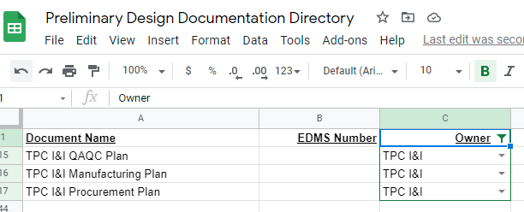
Documentation List
QAQC Plan
Manufacturing Plan
Procurement Plan
Series of other documents exist in various forms of maturity related to I&I activities, need entering in PD Documentation Directory
Near Site activities
EDMS: 2480337, 2480338, 2480340, 2480341, 2480342, 2480343, 2480344, 2480345
These cover surface work such as foreseen critical lifting procedures, functional verifications, and integration steps
EDMS: 2480346, 2480347, 2480348, 2480349
These cover work in the cavern
EDMS 245099 and 2458074
These are for physical interfaces with the cryostat and LBNF cryo
EDMS 2591433
This is a summary of the prototyping and testing plans
EDMS 2480350
High level summary of TPC installation activities and timelines

Slide 3
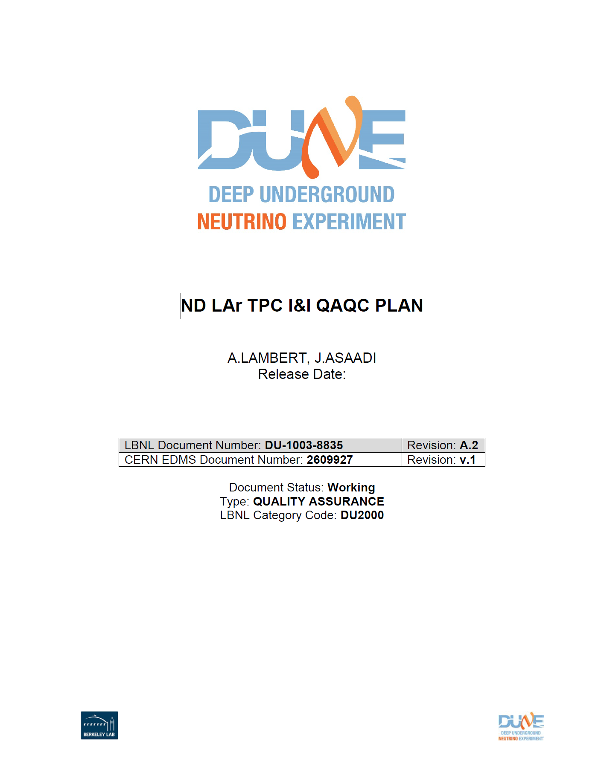
QAQC Plan
EDMS 2609927
Requirements
Components Inspected/Tested
Description of QC tests
QC test locations
Technical justification of QC tests

Slide 4
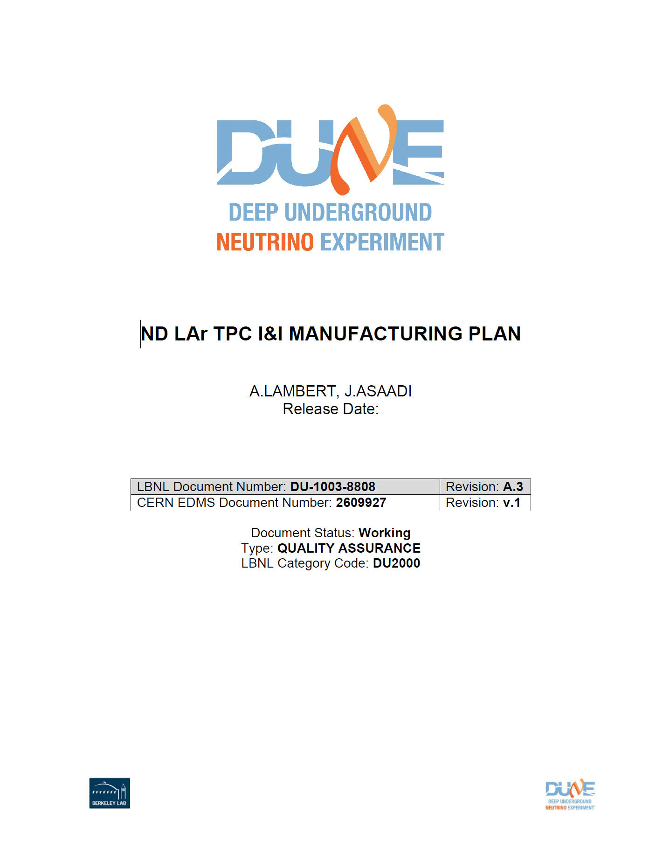
Manufacturing Plan
EDMS 2609929
Outline of ND LAr activities at the Near Site to produce module row assemblies and install to cryostat:
Responsible persons & points of contact
I&I scope of work at Near Site
Manufacturing processes (module rows, module array)
Material concerns
Inspection requirements
Shipping

Slide 5
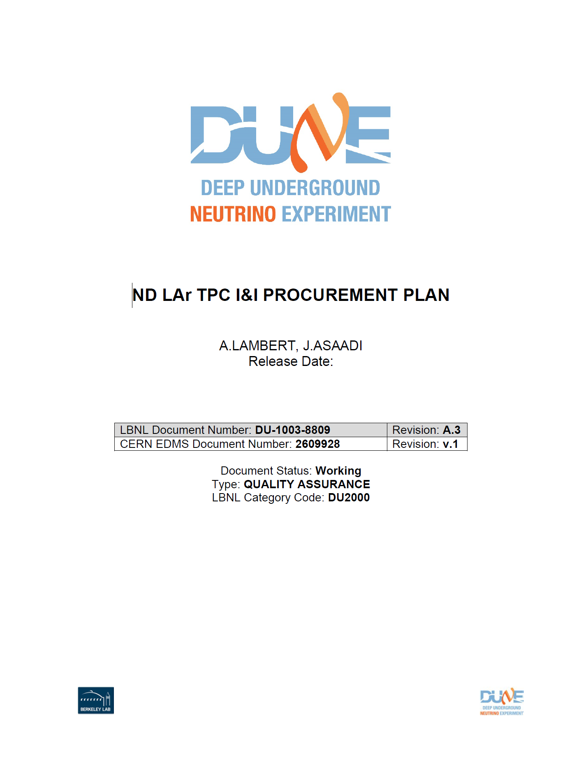
Procurement Plan
EDMS 2609928
List of fixtures and procurements to produce module row assemblies and install to cryostat at Near Site:
Key items to be procured & timelines
Procurement management
Vendor management
Approval processes

Slide 6
Remaining Issues / Requests for Information / Next Steps
Remaining Issues
QC activities not well defined yet
Designs for fixturing are not mature - manufacturing/procurement plans will most likely evolve with these
Need to better understand any need for clean spaces or cleanrooms
Requests for Information
Will need to coordinate with TPC Assembly & Testing on assembled module QC tests that should be done before crating at MATF and after uncrating at Near Site
Fixturing that requires load testing - do these load tests need to be done at FNAL, or will FNAL accept an LBNL certified lifting fixture - need to follow up on this with DUNE safety
Next Steps
Coordinate with LBNL cryostat and I&I teams on prototyping activities for the fixtures and procedures (QA)
Further develop preliminary designs and update QAQC, Manufacturing, and Procurement plans as necessary
Identify components that require load tests/certification

