Slide 1
Triangle Quadbars
Ralf Ehrlich
University of Virginia
January 24, 2022

Slide 2
Triangle Quadbars
Number of events with both channels >5PEs
This seems to indicate a channel order of 1-0-3-2, i.e. inner and outer channels are swapped.
We have seen this before at CMBs for the LDMX Hcal quadbars.
Need to verify this at the quadbar.
 | 0 | 1 | 2 | 3
0 | 19593 | 9616 | 1940 | 8869
1 | 9616 | 18657 | 1206 | 1798
2 | 1940 | 1206 | 19435 | 9713
3 | 8869 | 1798 | 9713 | 19816
1 0 3 2

Slide 3
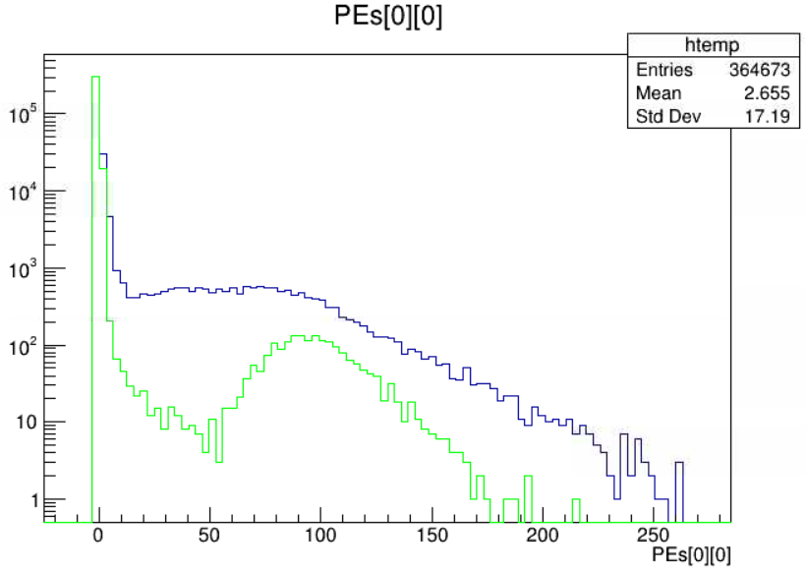
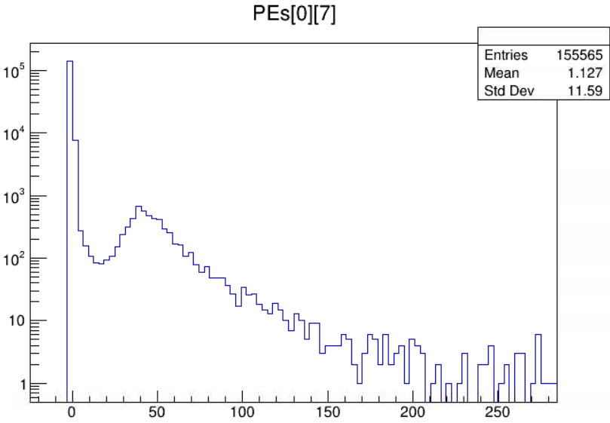
PE distribution
PE distribution of triangle counter of channel 0 (one of the two center counters)
without cuts (muon track shared with neighboring counters)
when neighboring channels 1 and 3 have PEs < 4 (muon track almost exclusively in counter of channel 0)
Rectangular counter
Much higher peak compared to rectangular counters (same thickness, but newer scintillator)

Slide 4
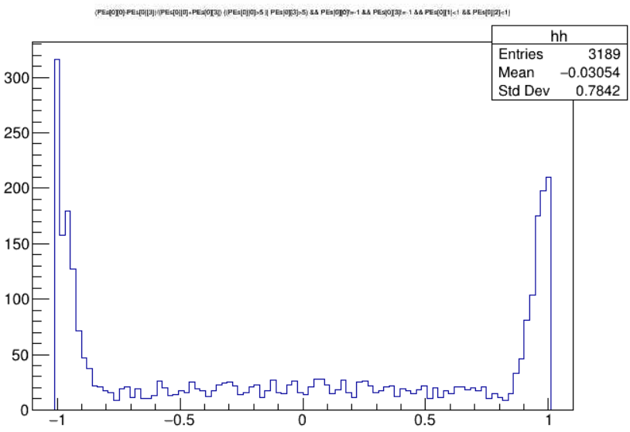
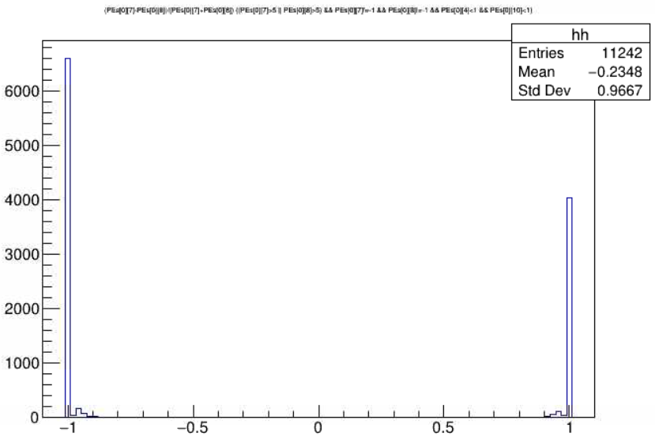
PE distribution between neighboring counters
PE distribution between neighboring triangle counters 0 and 3 for events which had no hits in counters 1 and 2 $\frac{{PE}_{0}−{PE}_{3}}{{PE}_{0}+{PE}_{3}}$
Peaks at around +/-1 come from tiny pulses (<5 PEs) at one counter and “regular” pulses at the other counter.
Comparison with rectangular dicounters
Hits only on one of the two counters
1 0 3 2
Hits at both counters
excluded +1 0 -1 excluded
At 0: PEs equally distributed
Hits only on one of the two counters

