Slide 1
MQXFA Magnet Status Update
Giorgio Ambrosio and MQXFA L3s/CAMs
2nd Steering Committee of the CERN-FNAL Collaboration for the HL-LHC Project
July 14, 2021

Slide 2
Outline
Documentation
Status Updated by L3
Schedule Update

Slide 3
Documentation – No changes
Nominal & Ultimate Current
EDMS 2114564 v. 3.1
Released
MQXFA Functional Requirement Spec
EDMS 1535430 v. 1.5
Released
MQXFA Acceptance Criteria
EDMS 2031083 v. 1.5
Released

Slide 4
Outline
Documentation
Status Updated by L3
Schedule Update

Slide 5
302.2.02: Conductor Procurement & QC
All conductor has been received or is under contract
Conductor delivery is timely
1920 km ordered on-project
81% received, 19% to go
100% of raw material in house at the vendor
Last procurement on schedule to be completed by end of CY21
Order for additional conductor (8 cables = 160 km) is in progress
Past issues were minor and under control:
Root causes identified and corrective / preventative actions applied for all issues; all affected strand re-worked (e.g. cleaning) or replaced
Small shift of vendor QC data (within specs) in first two batches of last contract triggered an audit and increase to 100% verification testing
Due to QC tests at vendor, plus negative trend within specs
Strand verification, Cable qualification & Witness Sample tests are on schedule
Assessed possibility of phased CERN-AUP strand exchange program (phase 1: 140 km) if needed

Slide 6
302.2.03: Cable Fabrication Status
Cale Fabrication Status:
Fabricated:
Bare cable up to #74;
Insulation braiding up to #68;
Completed QC: 64 cables
To be fabricated:
30 cables
Milestones and yield:
~ 2/3 cables fabricated
Yield is ~92.6% (2 rejected, 6 on-hold), vs. 90% assumed
Decreased because of bearing failure and strand lubrication issue causing cable mechanical instability
Exploring cable cleaning to improve mechanical stability

Slide 7
302.2.04: Coil Parts Procurement Status
FY21 procurement is completing MQXFA coil parts:
Pole Parts
PO with 12 sets was placed with the estimated delivery date 12/31/2021
PO with 4 extra sets is in preparation process (last PO for the project) and will be placed by the end of this September.
End Parts
PO with 12 sets of end parts was placed with the estimated delivery date 12/31/2021
PO with 12 sets of Plasma coated parts was placed with the estimated delivery date 2/26/2022
PO with 4 extra sets is in preparation process (last PO for the project) and will be placed by the end of this September.

Slide 8
302.2.05: Coil Fab at FNAL
Accepted: 20*
In Fabrication: 5
Rejected: 3
On Hold: 3
Total 31*
Coils to be started: 21
Passed 50% Coil Fabrication milestone
Simple Coil yield computation: 83.7%
In fabrication = 1/3
On hold = ½
* Accepted for shipment; includes QXFP06 (4 m prototype coil)

Slide 9
302.2.06: Coil Fab at BNL
Accepted: 17
In Fabrication: 6
Rejected: 2
On Hold: 1
Total 26
Coils to be started: 22
Simple Coil yield computation: 88.6%
In fabrication = 1/3
On hold = ½
Two coils successfully repaired
Overall Coil Yield after fabrication & magnet integration: 84.9%
including one coil that degraded during magnet assembly at LBNL and is on-hold

Slide 10
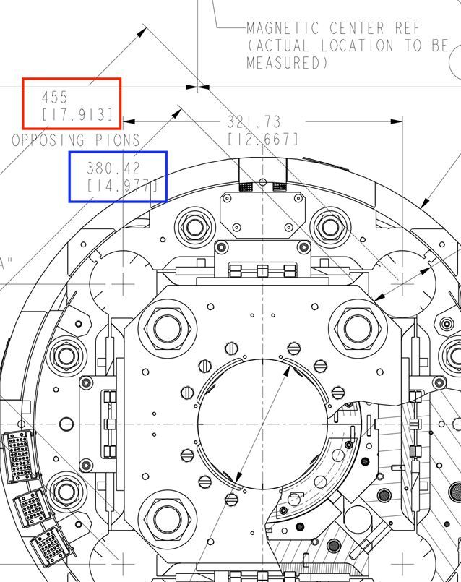
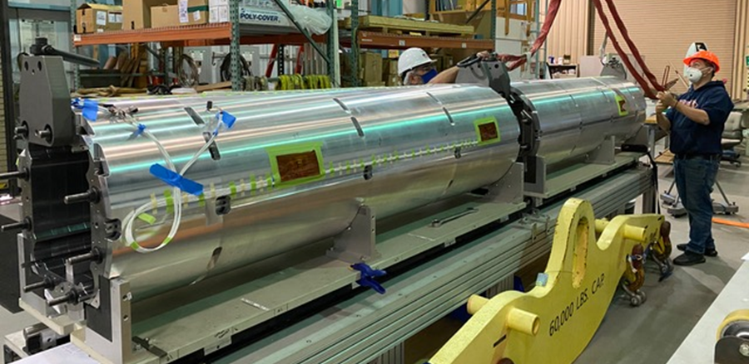
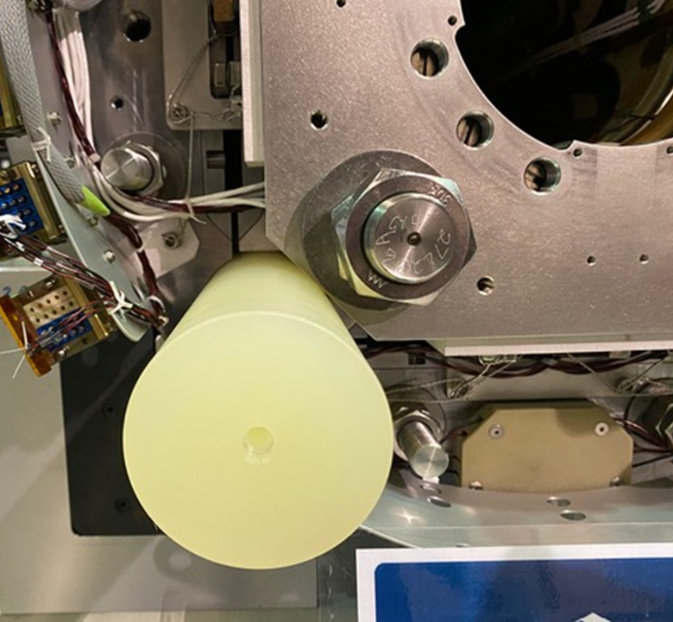
302.02.07 MQXFA Structures and Assembly (1)
MQXFA07 magnet assembly is complete
To be shipped to BNL next week
Second magnet assembly line is complete after minor adjustments
MQXFA08 assembly is in progress
DCR to axial end-plates and G11 splice box in order to avoid interference with coldmass heat exchangers
~76.95 mm
MQXFA08 shell-yoke assembly in process

Slide 11
302.02.07 MQXFA Structures and Assembly (2)
Procurements
FY20 Master Agreement Procurements are mostly complete
FY20 parts orders are slated for Magnets A09-A14
All shells completed, with the exception of last set due to a rejected shell. This shell will be completed during the fabrication of the FY21 shell orders, summer of 2021
All parts at least through MQXFA13 have been received already
FY21 Procurement orders are in process
FY21 orders are slated for Magnets A15-A20
Second bladder vendor’s first articles were tested successfully and production is on-going for the balance of the project’s needs.
Currently, enough bladders are in hand through Magnet MQXFA12, with vendor deliveries continuing to arrive before existing stock is exhausted.
In order to reduce risks of uncontrolled cost escalation (ie. Not controlled by Master Agreements), some component procurements also included the three sets originally planned for the FY22 orders

Slide 12
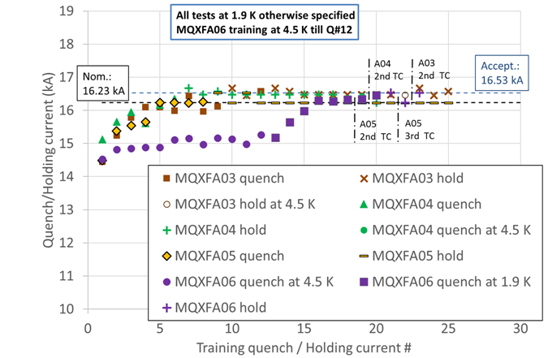
302.2.01: Magnet Integration & Coordination
Coil and Magnet shipments:
No coil/magnet rejected because of shipping issues; no delays
Magnet Post-Test Analysis:
Magnets MQXFA03, MQXFA04 and MQXFA05 met all requirements tested at BNL
MQXFA03 and MQXFA04 accepted for use in 1st Coldmass
MQXFA05 to be accepted shortly
MQXFA06 successfully completed 1st thermal cycle

Slide 13
Outline
Documentation
Status Updated by L3
Schedule Update

Slide 14
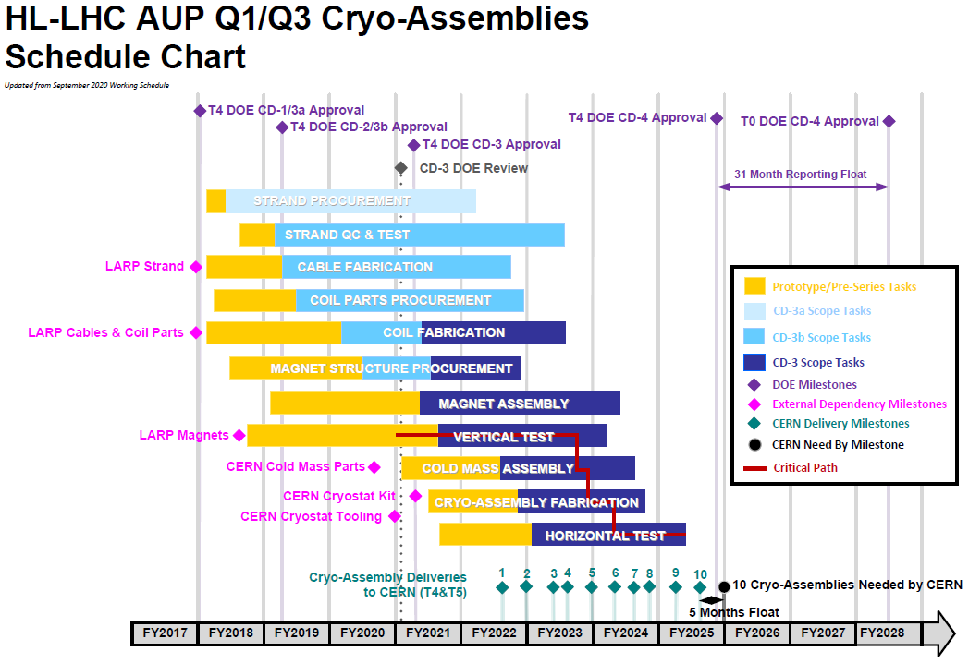
WBS 302.2: Schedule
302.2

Slide 15
Coil Schedule
From May 2021 Working Schedule
Working schedule
includes COVID inefficiencies provided by L3s
QXFA-138 | 27-Jul-21 | 24-Nov-21
QXFA-139 | 20-Aug-21 | 22-Dec-21
QXFA-140 | 16-Sep-21 | 24-Jan-22
QXFA-141 | 12-Oct-21 | 17-Feb-22
QXFA-142 | 5-Nov-21 | 15-Mar-22
QXFA-143 | 3-Dec-21 | 8-Apr-22
QXFA-144 | 4-Jan-22 | 4-May-22
QXFA-145 | 31-Jan-22 | 31-May-22
QXFA-146 | 24-Feb-22 | 24-Jun-22
QXFA-147 | 22-Mar-22 | 21-Jul-22
QXFA-148 | 15-Apr-22 | 16-Aug-22
QXFA-149 | 11-May-22 | 12-Sep-22
QXFA-150 | 7-Jun-22 | 6-Oct-22
QXFA-151 | 1-Jul-22 | 1-Nov-22
QXFA-152 | 28-Jul-22 | 29-Nov-22
QXFA-153 | 23-Aug-22 | 27-Dec-22
QXFA-154 | 19-Sep-22 | 25-Jan-23
QXFA-155 | 13-Oct-22 | 20-Feb-23
QXFA-156 | 8-Nov-22 | 16-Mar-23
QXFA-157 | 6-Dec-22 | 11-Apr-23
QXFA-158 | 5-Jan-23 | 5-May-23
QXFA-228 | 30-Jul-21 | 30-Nov-21
QXFA-229 | 30-Aug-21 | 5-Jan-22
QXFA-230 | 24-Sep-21 | 1-Feb-22
QXFA-231 | 20-Oct-21 | 25-Feb-22
QXFA-232 | 15-Nov-21 | 23-Mar-22
QXFA-233 | 13-Dec-21 | 18-Apr-22
QXFA-234 | 12-Jan-22 | 12-May-22
QXFA-235 | 8-Feb-22 | 8-Jun-22
QXFA-236 | 4-Mar-22 | 5-Jul-22
QXFA-237 | 30-Mar-22 | 29-Jul-22
QXFA-238 | 25-Apr-22 | 24-Aug-22
QXFA-239 | 19-May-22 | 20-Sep-22
QXFA-240 | 15-Jun-22 | 14-Oct-22
QXFA-241 | 12-Jul-22 | 9-Nov-22
QXFA-242 | 5-Aug-22 | 7-Dec-22
QXFA-243 | 31-Aug-22 | 6-Jan-23
QXFA-244 | 27-Sep-22 | 2-Feb-23
QXFA-245 | 21-Oct-22 | 28-Feb-23
QXFA-246 | 16-Nov-22 | 24-Mar-23
QXFA-247 | 14-Dec-22 | 19-Apr-23
QXFA-248 | 13-Jan-23 | 15-May-23
QXFA-249 | 9-Feb-23 | 9-Jun-23
QXFA-250 | 7-Mar-23 | 6-Jul-23
Coils are being fabricated at peak production rate (1 coil every 20 days at each fabrication line)

Slide 16
Magnet Assembly Schedule
From May 2021 Working Schedule
MQXFA-08 | 30-Apr-2021 A | 1-Jul-21
MQXFA-09 | 21-Jun-21 | 1-Oct-21
MQXFA-10 | 27-Aug-21 | 2-Nov-21
MQXFA-11 | 11-Oct-21 | 16-Dec-21
MQXFA-12 | 22-Nov-21 | 3-Feb-22
MQXFA-13 | 11-Jan-22 | 18-Mar-22
MQXFA-14 | 23-Feb-22 | 13-May-22
MQXFA-15 | 2-May-22 | 1-Aug-22
MQXFA-16 | 22-Jun-22 | 21-Sep-22
MQXFA-17 | 12-Aug-22 | 10-Nov-22
MQXFA-18 | 4-Oct-22 | 9-Jan-23
MQXFA-19 | 21-Dec-22 | 27-Mar-23
MQXFA-20 | 16-Feb-23 | 16-May-23
MQXFA-21 | 7-Apr-23 | 7-Jul-23
MQXFA-22 | 23-Jun-23 | 22-Sep-23
MQXFA-23 | 7-Aug-23 | 18-Oct-23
MQXFA-R1 | 19-Sep-23 | 22-Nov-23
MQXFA-R2 | 31-Oct-23 | 11-Jan-24
MQXFA-R3 | 14-Dec-23 | 23-Feb-24
MQXFA-R4 | 1-Feb-24 | 10-Jun-24
Magnet re-assembly
Some delays due to set-up and commissioning of 2nd assembly line, and for addressing axial end-plate interference
Magnet assembly team is expected to reach peak production rate (1 magnet every 2 months) in next couple of months

Slide 17
Conclusions
Conductor procurement is 81% complete, and strand for 8 additional cables is being ordered
Cable yield decreased in last months; nonetheless, still above yield assumed in BL. Cause is understood and preventive actions applied to future cables
Coil parts are being procured as planned
Coil yield keeps getting better and closer to the yield assumed in BL
Magnet assembly has some delay, nonetheless procurement is going ahead well, and second assembly line is complete
MQXFA03, MQXFA04 and MQXFA05 met all requirements tested at BNL; MQXFA06 meet all requirements during 1st thermal cycle

Slide 18
Backup Slides

