Slide 1
AUP strand activities at Fermilab
AUP MQXFA weekly meeting
Vito Lombardo

Slide 2
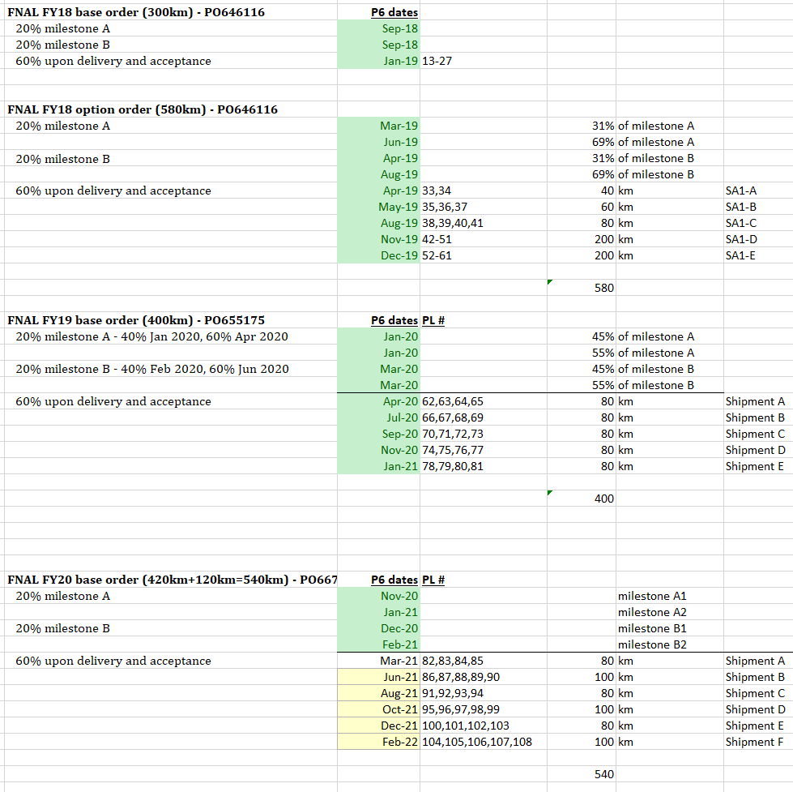
Progress
Cable qualification at Fermilab
Completed
1134,1135,1136,1137,1138,1139, 1140,1141,1142,1143,1144,1145, 1146,1147,1148,1149,1150,1151,1152,1153,1154,1155,1156,1257,1158,1161,1162,1125,1163, 1164,1165,1166,1167 completed
Heat Treated, In the queue for testing
1168 being tested now
1169 reacted, test later this week,
1170 reacted, test next week
1172A,1173A,1174A shipped from LBNL. Not yet at Fermilab.
1260 quarantined due to popped strands/cleaning, Ic test on hold
Coil witness sample tests at Fermilab
Completed
Witness coil 117,119,121,122,123,124,125,126,127,128,129,130,131,132,133,134 done
Witness coil 211,212,213,214,215,216,217,218,219,220,221,222,223,224,225 done
In the queue for testing:
Witness coil 226 at Fermilab in the queue for testing
Strand procurement
665175 shipment F (replacement spool) in the works
667037 shipment B partial shipment. Waiting for LBNL confirmation of delivery.
SHIPPED: Billets 642, 643, 655, 656, 658, 659, 663
HOLD: Billets 657, 660, 661
667037 shipment C on track for August
Vendor visit first week of August
BCR for 8 additional cable length approved at June CCB. REQ in the system for approval.
You are here

Slide 3
FNAL/CERN exchange
shipment A to CERN | 98,415 km | 15 crates | Feb-21 | Shipped from FNAL. Received at CERN.
shipment B to CERN | TOTAL ~140 km
- B1 (LBNL to FNAL) | ~18 km | 4 crates | Feb-21 | Received and stored at FNAL.
- B2 (LBNL to FNAL)
- B3 (LBNL to FNAL)
- B4 (LBNL to FNAL)
- B5 (LBNL to FNAL)

Slide 4
Inefficiencies by CTC
302.202x0001 | LOE | No impact other than what’s resulting from schedule deferrals.
302.202M0002 | Strand procurement | No $ impact (fixed price). No schedule impact. Vendor classified as essential business, worked tirelessly through our shut down. No impact foreseen in current or next order. FY21 order placed on time despite COVID.
302.202x0003 | Verification strand test | Nothing other than deferrals. Activities to resume soon as FSU transitions to Phase II. Verification tests do not drive strand shipment, so no impact to CP even if deferrals drag on.
302.202x0004 | Cable verification and witness sample preparation and testing | No recurring on a per sample basis; nevertheless start/stop cost money and time.

