Slide 1
MQXFA06 SG First Thermal cycle data (In Process)
D. Cheng, L. Garcia-Fajardo, C. Myers, P. Ferracin
19-Jul-2021
LBNL

Slide 2
MQXFA SG Gauges Layout
LE
MID
RE
Shell 2
Shell 4
Shell 7
Coil Stations
Only HBM gauges are installed.
Shell gauges --- three axial locations:
Shell gauges (T & Z): on shell 2, 4, & 7
Coil gauges (T & Z): on the axial location of 3989 mm (RE) from LE.
Rod stations are located on the RE (not shown here)
Each station is full bridge with four individual gauges.

Slide 3
Data Processing Notes
Cooldown Data captured from initial cooldown during 9-Jun-2021 to 15-Jun-2021
Warmup Data captured during 2-Jul-2021 to 10-Jul-2021
Cooldown data was processed using offsets the “preload” SG files
Observed swapped Coil 4 T&Z channels, so swapped back when processing

Slide 4
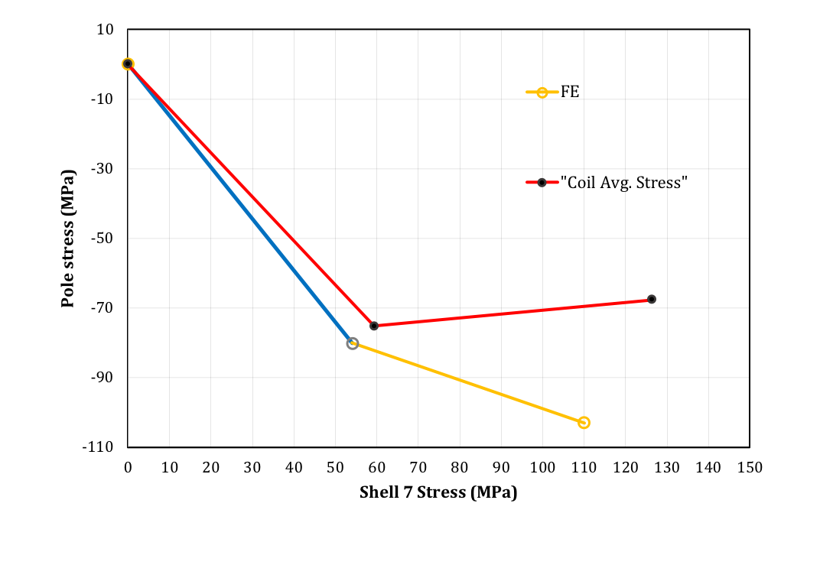
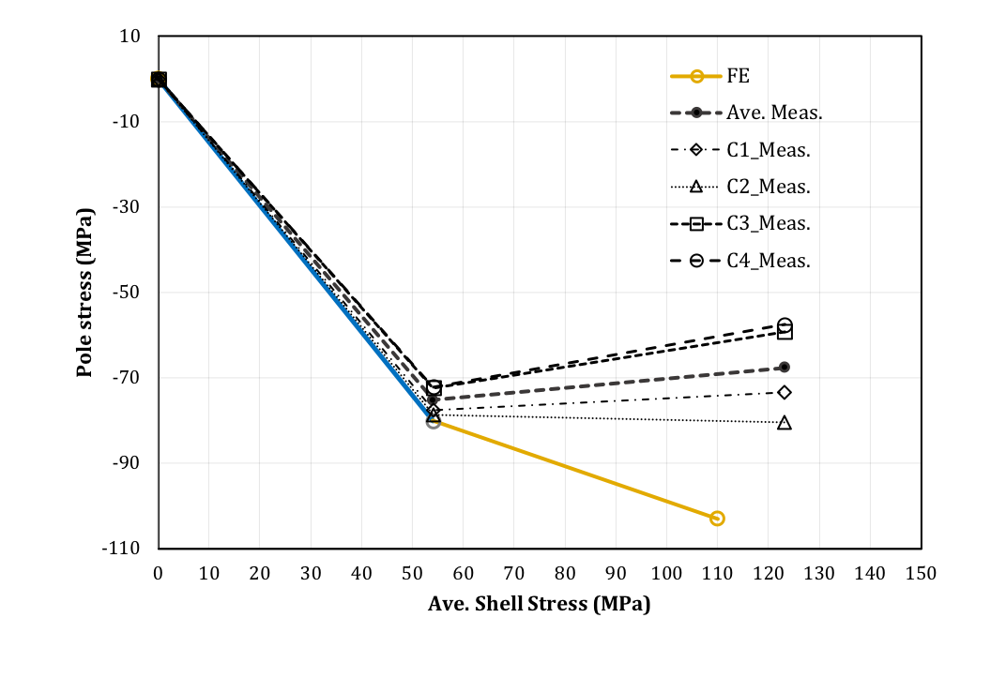
Cooldown SG Readings
The Targets set for MQXFA06
The TF plots of MQXFA06
(Preliminary, still processing
Quench data)
The stresses are average stress: (MPa)
 |  | MQXFA06 (Target) | MQXFA06 (Meas.)
RT | Coil | -80±8 | -75
 | Shell | 58±6 | 59 (Shell 7)
CD | Coil | -103 | -68
 | Shell | 110 | 126 (Shell 7)
Measurements spread
Proposed target window
To get reasonable TF plot, the coil data pairs with the shell 7 data.
Average Coil stress is on target, the average stress of each shell is higher than target (similar to earlier magnets tested)
 | Shell 02 | Shell 04 | Shell 7
R.T. | 54 MPa | 48 MPa | 59 MPa
CD | 125 MPa | 119 MPa | 126 MPa

Slide 5
SG Readings in the Cooldown and Warmup Cycles

Slide 6
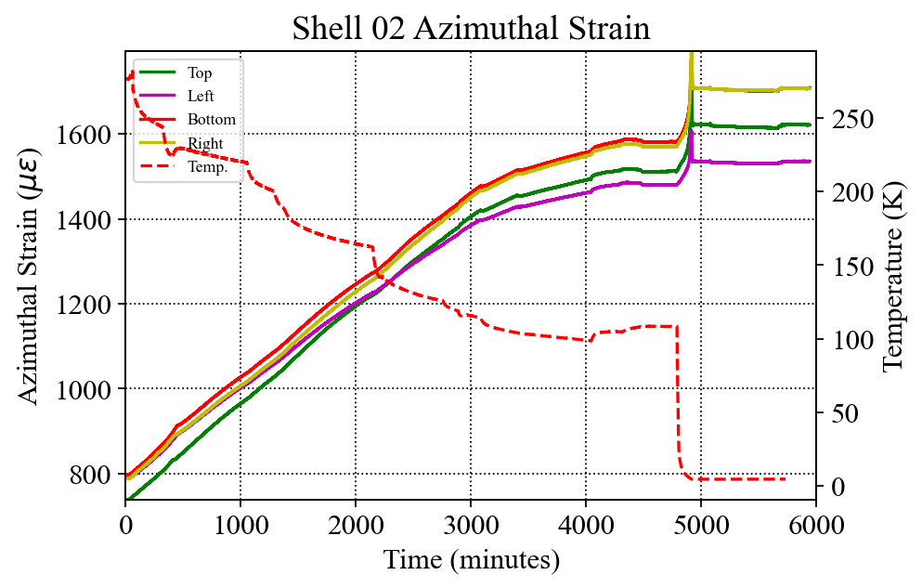
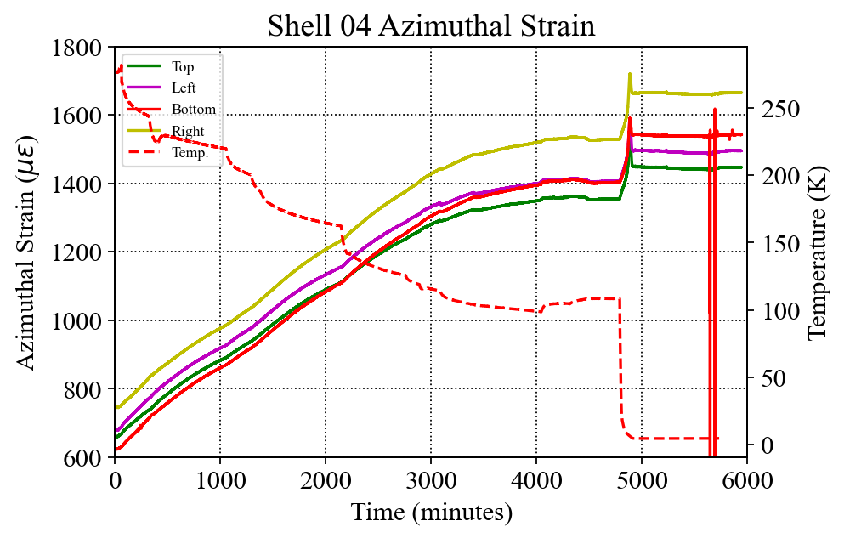
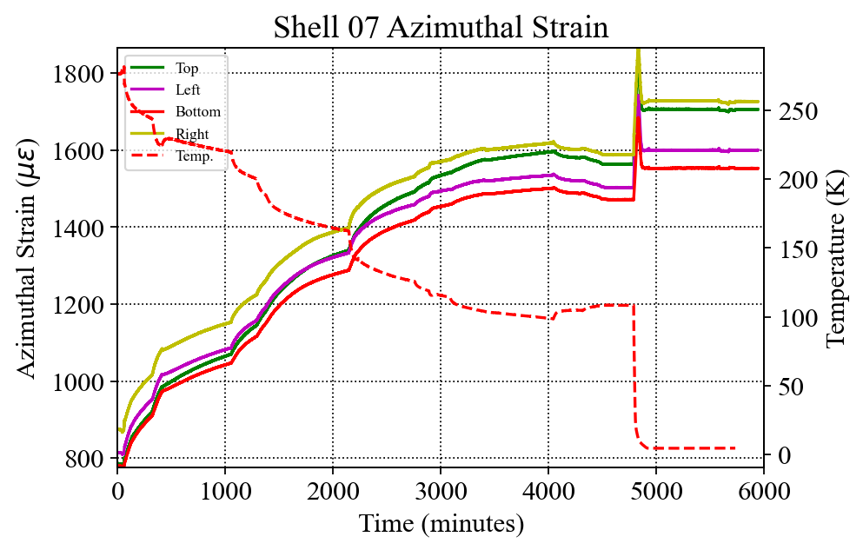
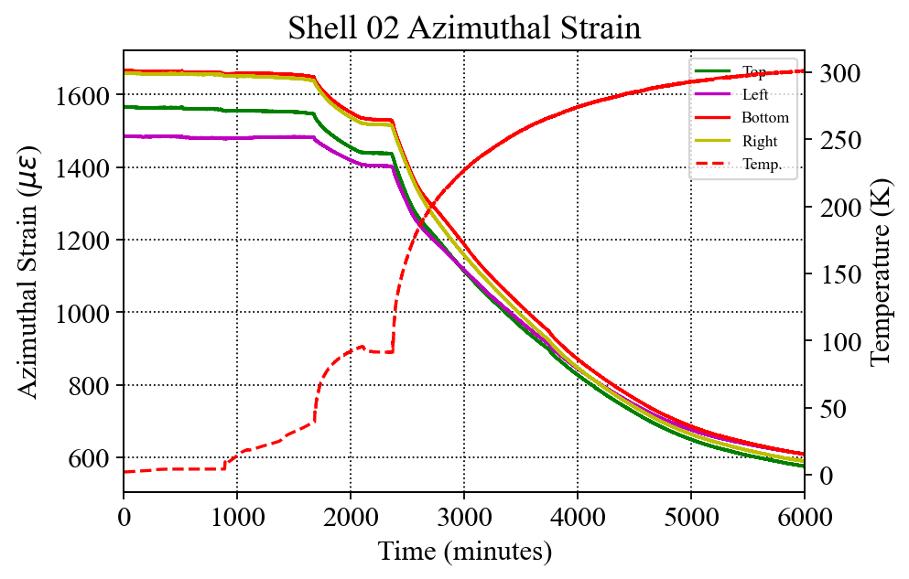
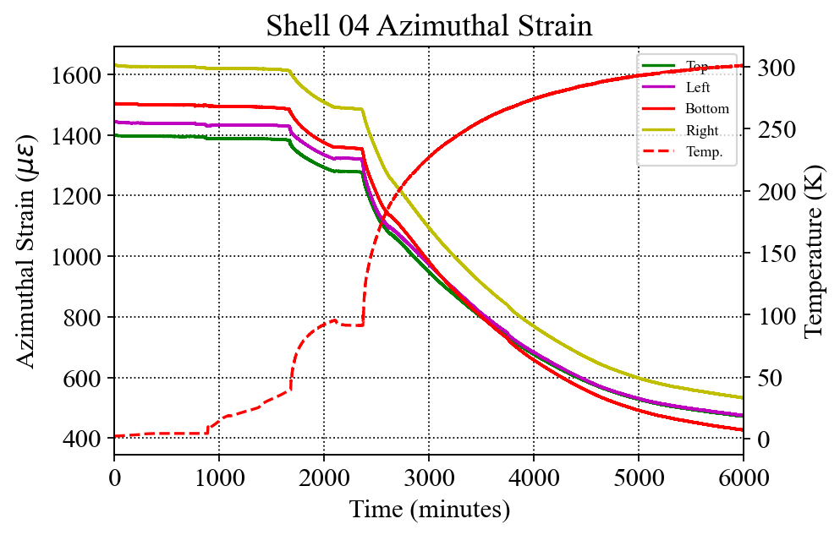
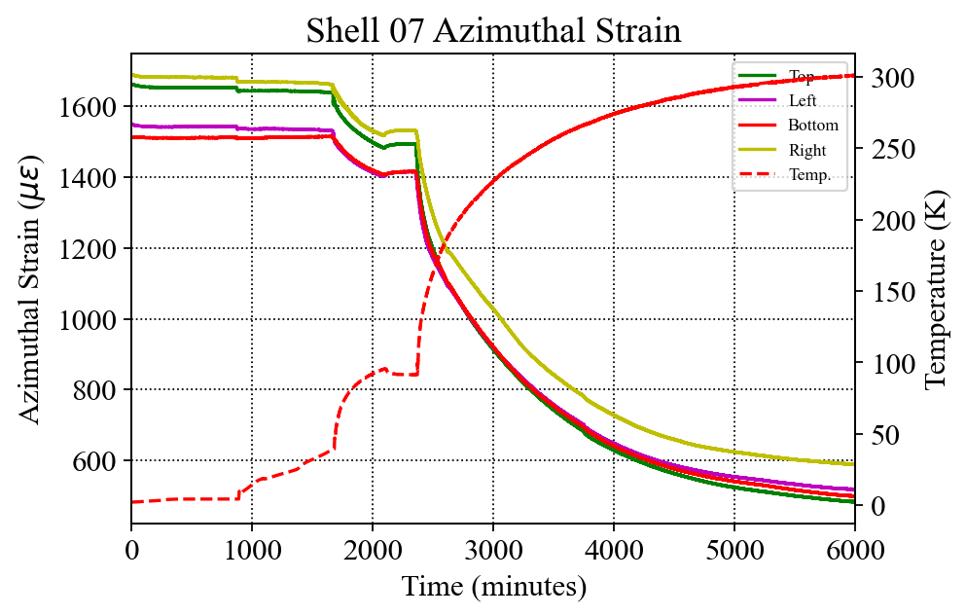
Shell Azimuthal Strain (Cooldown and Warmup)
Cooldown
Warmup
Target: 110MPa @4 K
Target: 110MPa @4 K
Target: 110MPa @4 K

Slide 7
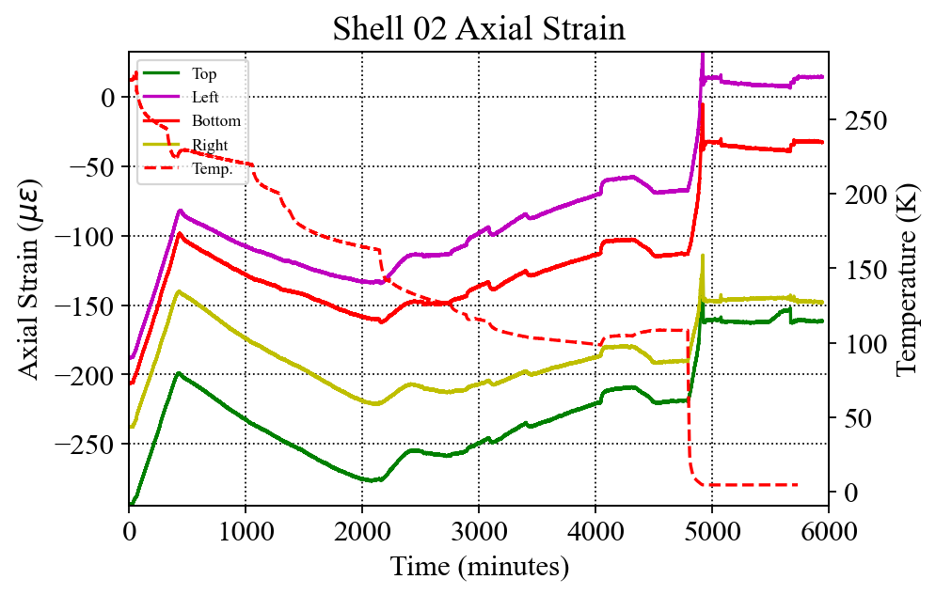
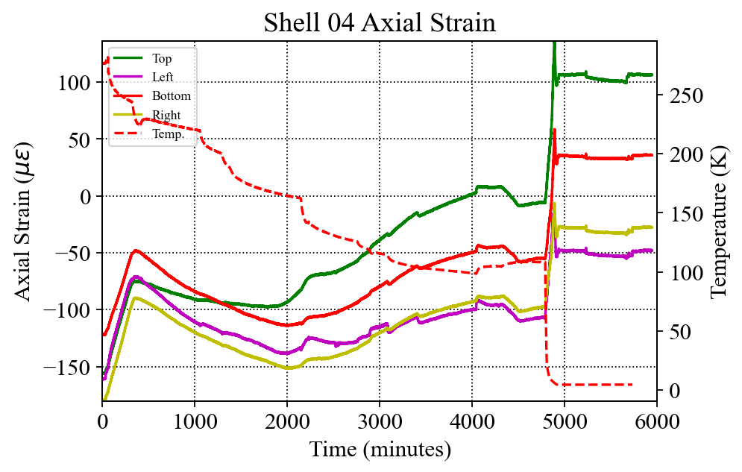
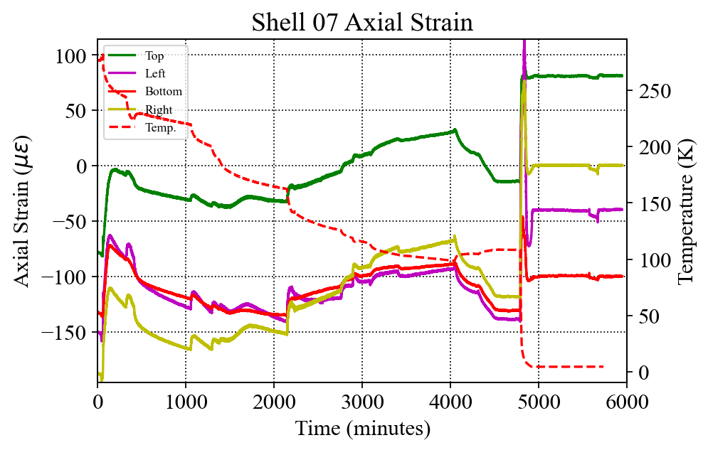
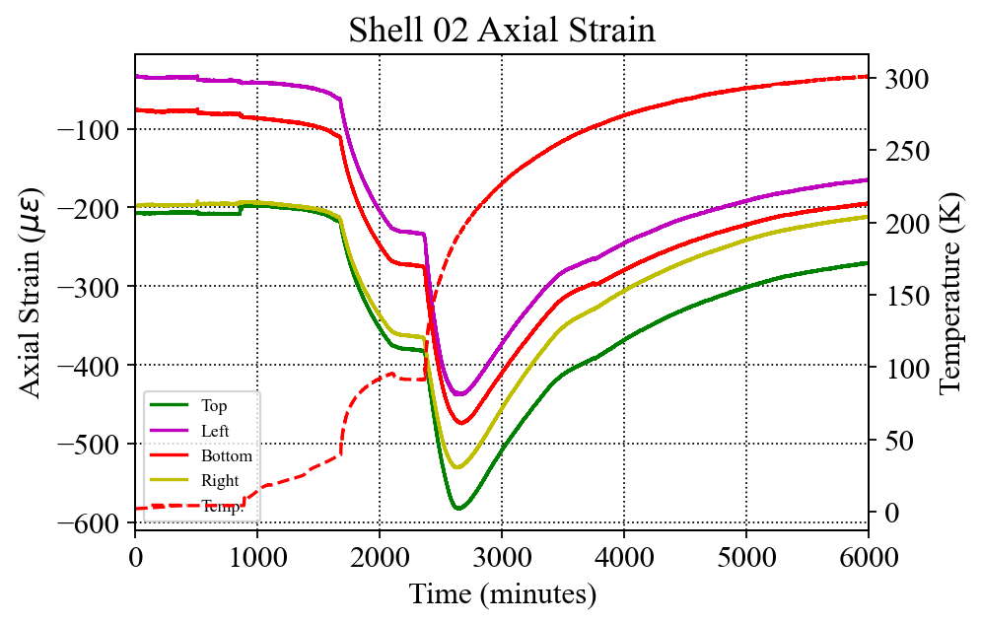
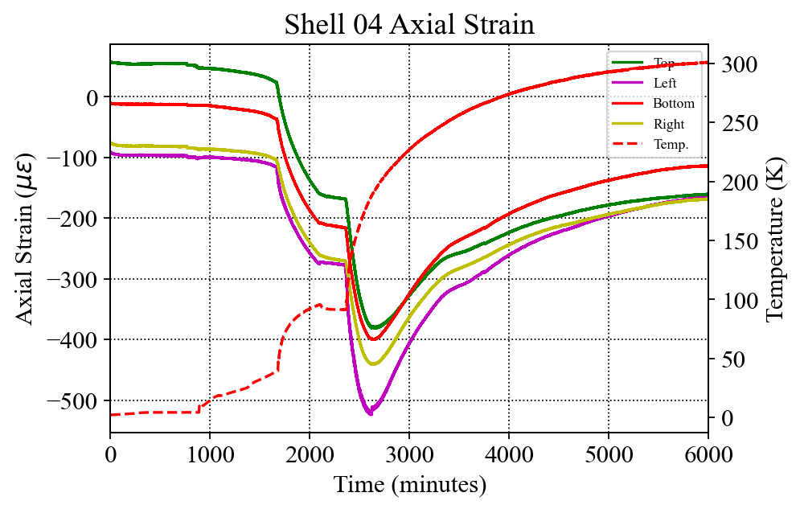
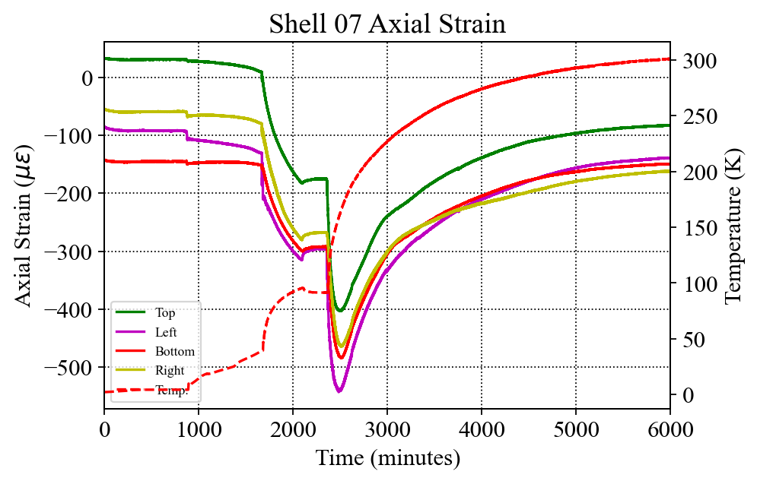
Shell Axial Strain (Cooldown and Warmup)
Cooldown
Warmup
Event ~@3700 sec
(see also coil axial and rod data)

Slide 8
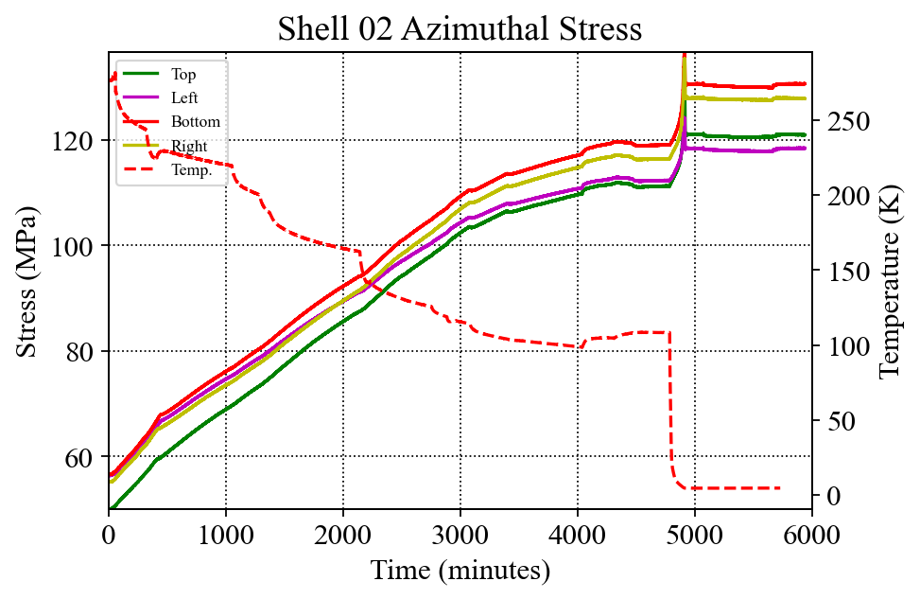
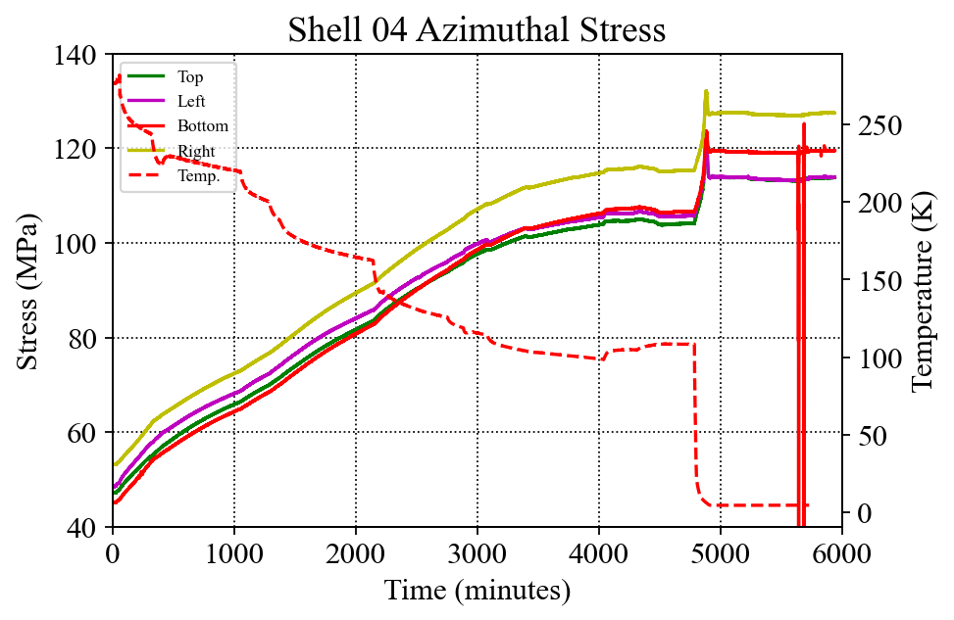
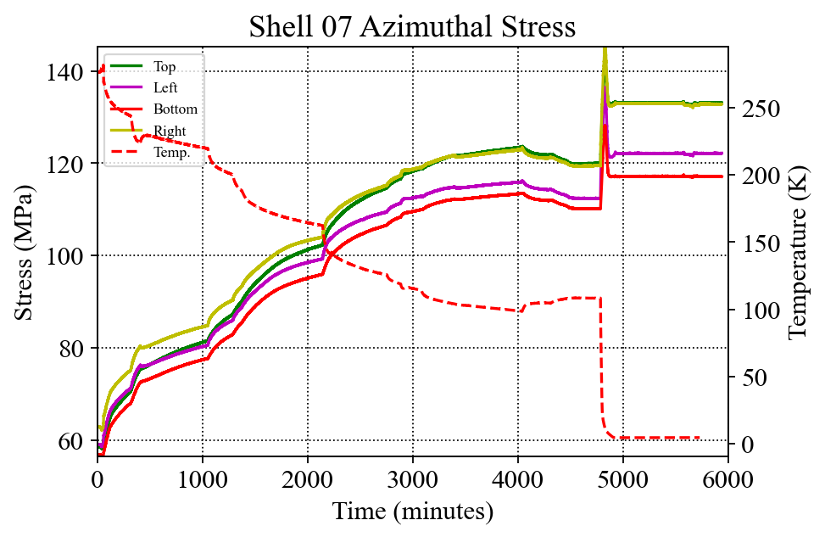
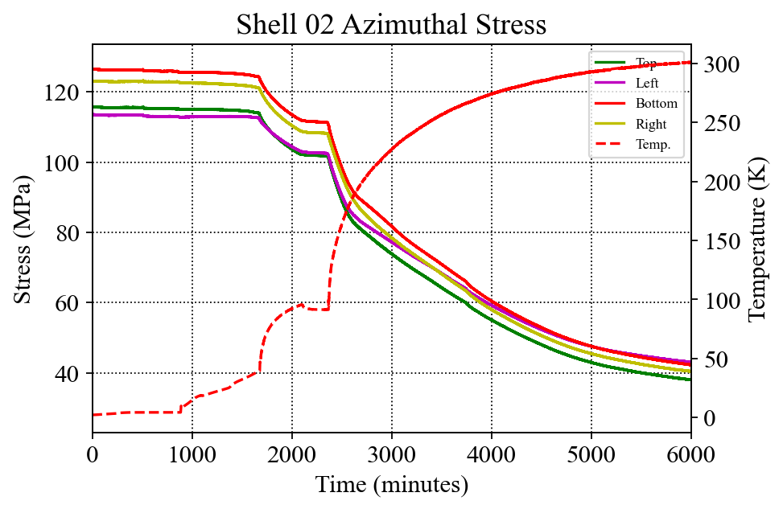
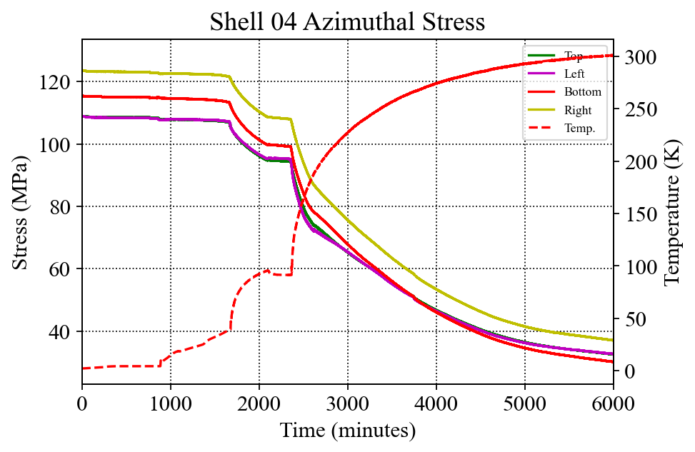
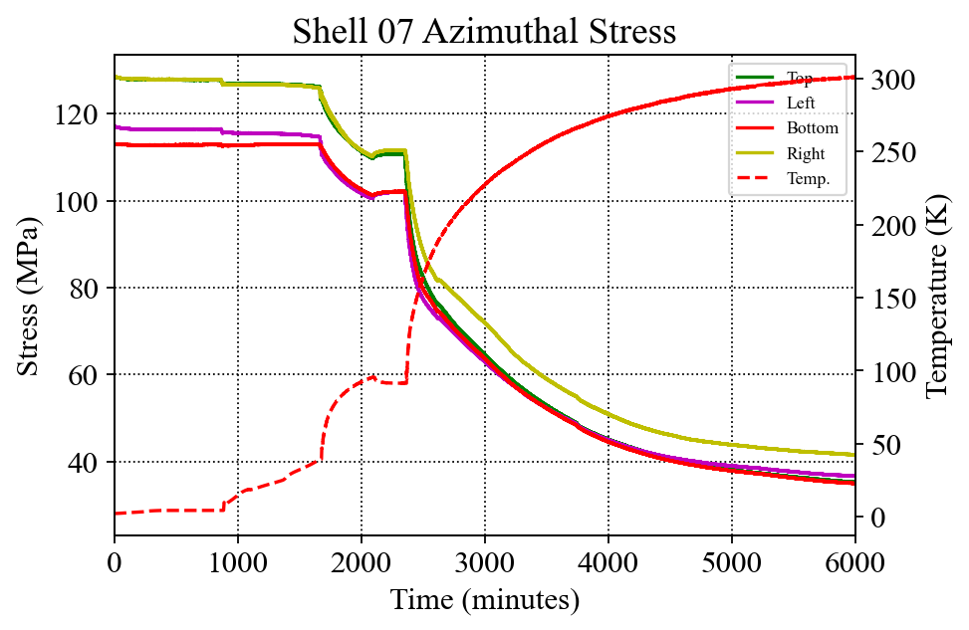
Shell Azimuthal Stress (Cooldown and Warmup)
Cooldown
Warmup
Target: 110MPa @4 K
Target: 110MPa @4 K
Target: 110MPa @4 K
Some relaxation (~10 MPa) was observed on return to RT

Slide 9
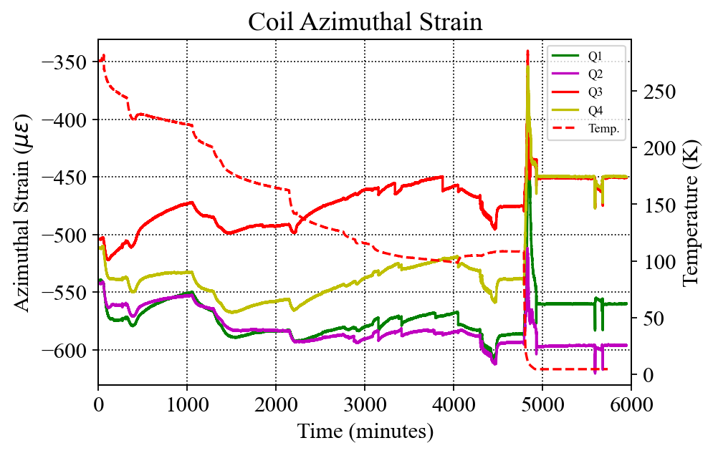
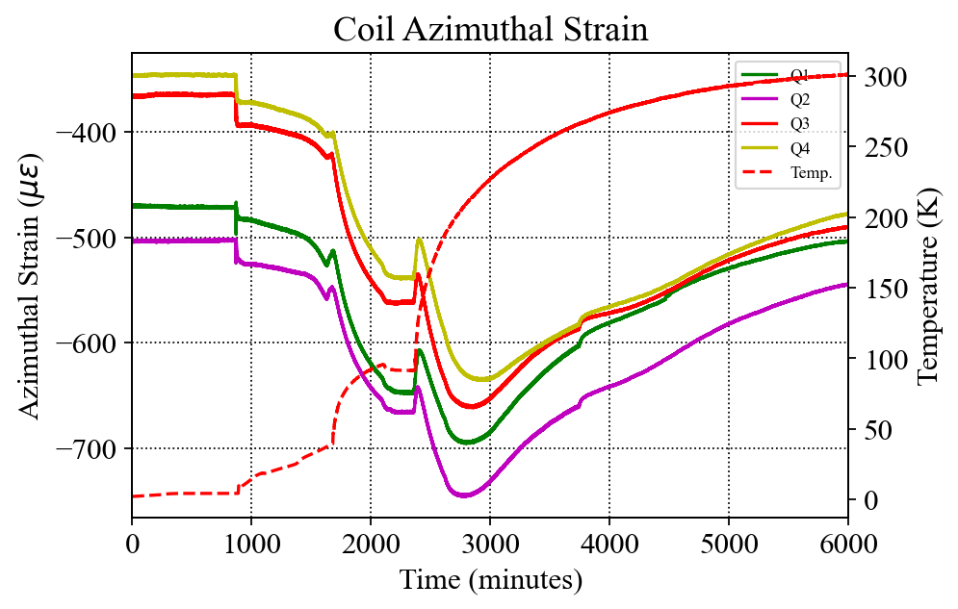
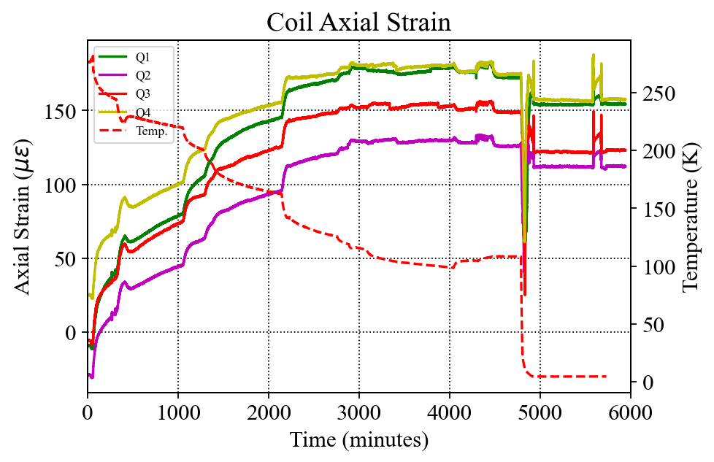
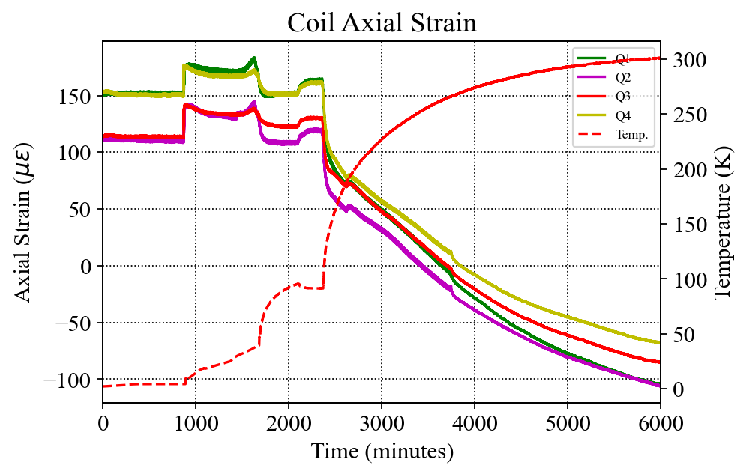
Coil Strains (Cooldown and Warmup)
Cooldown
Warmup
Shift/slippage ~@3700 sec

Slide 10
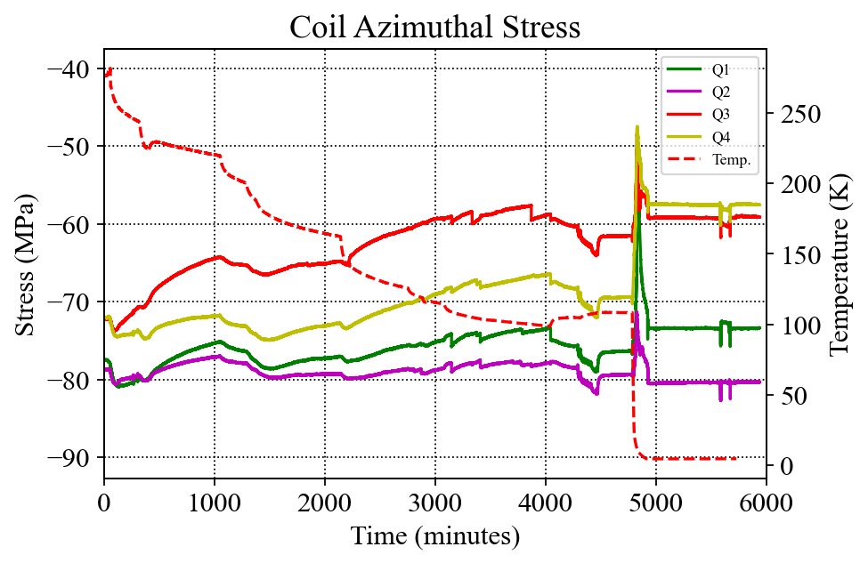
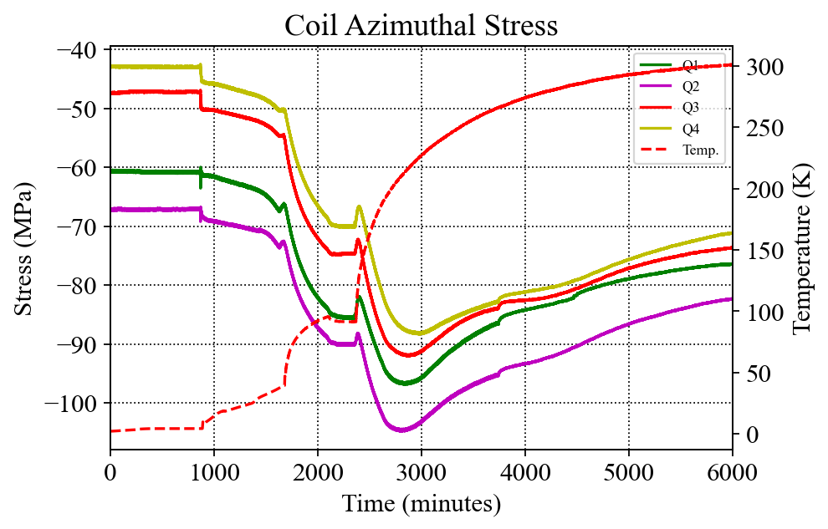
Coil Stress (Cooldown and Warmup)
Cooldown
Warmup
Target: -103MPa @4 K
Shift/slippage ~@3700 sec
The average coil stress decreased after cooldown
Still under examination, but quench performance still showed ~nominal preload levels
The average coil stress increased after cooldown (opposite expected, as in cooldown as well)
RT preload average is close to pre-test conditions

Slide 11
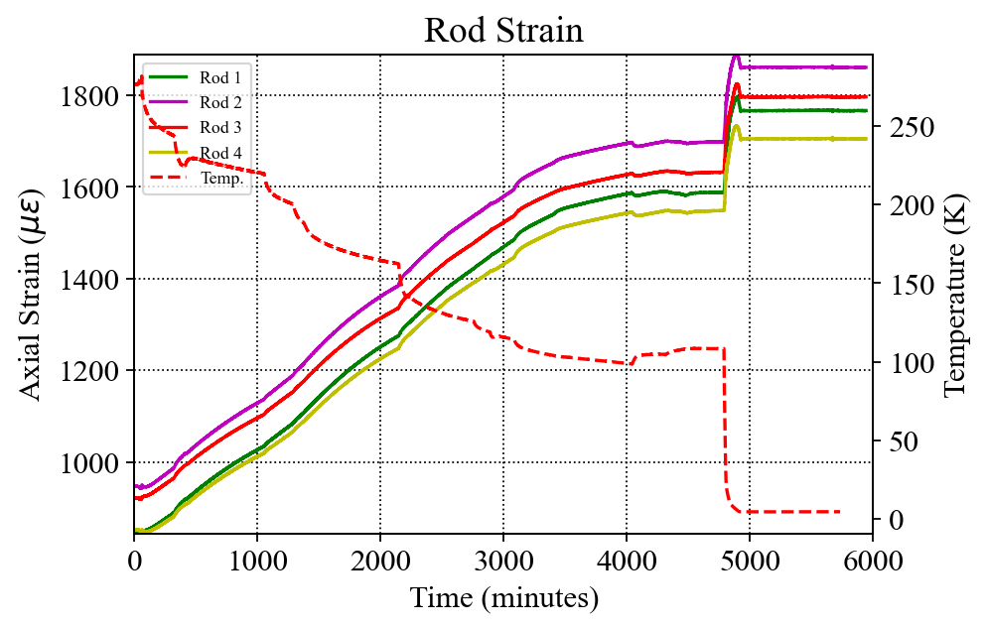
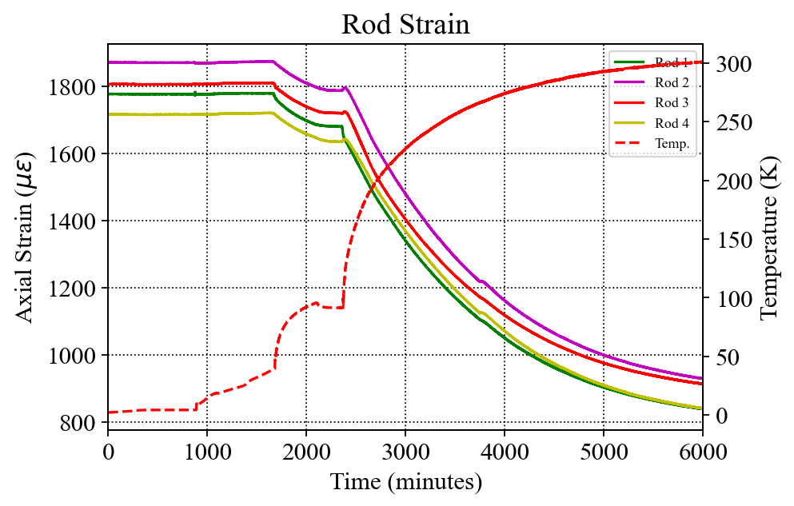
Rods (Cooldown and Warmup)
Target: 1800 µε @4 K
Shift/slippage ~@3700 sec
Axial preload returned to ~nominal values at RT

Slide 12
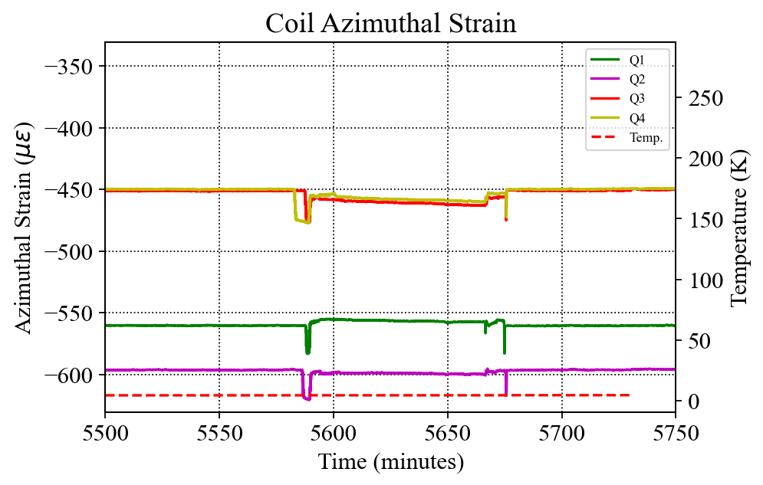
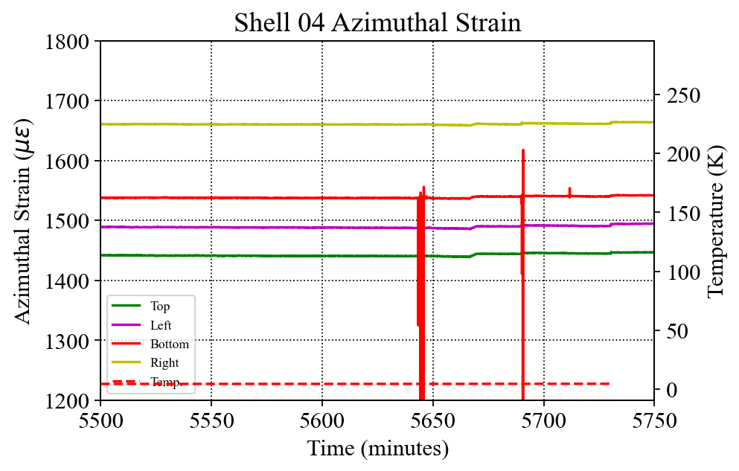
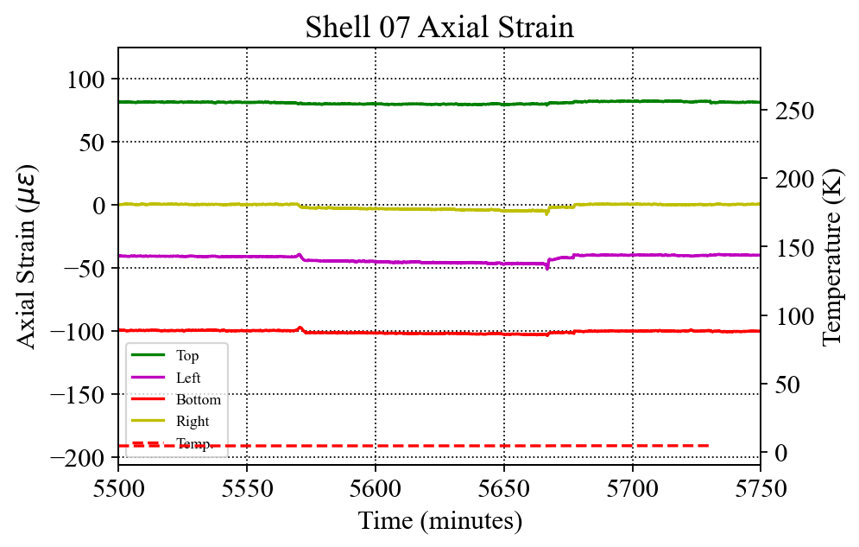
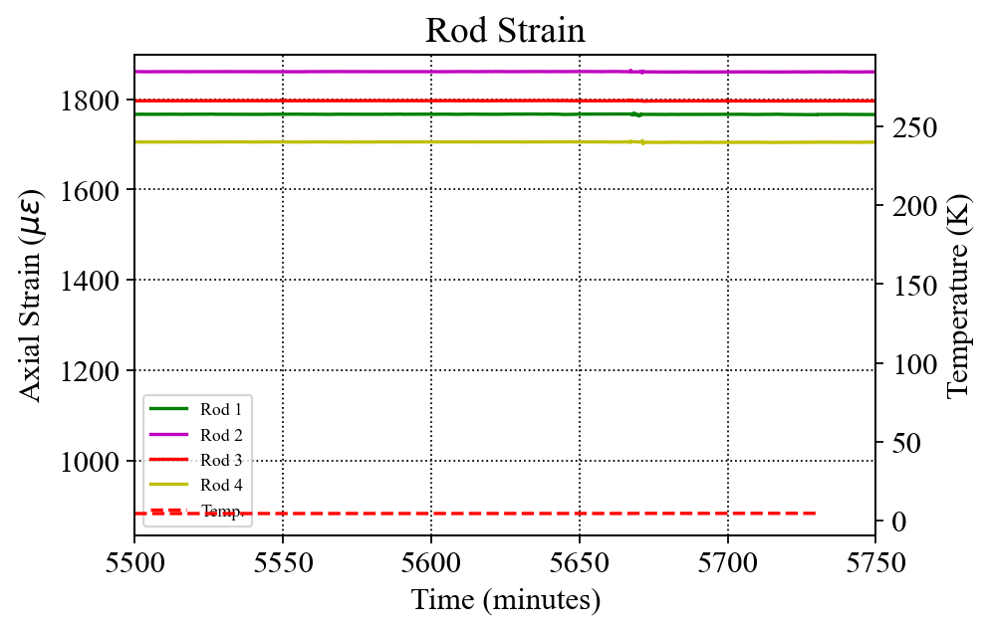
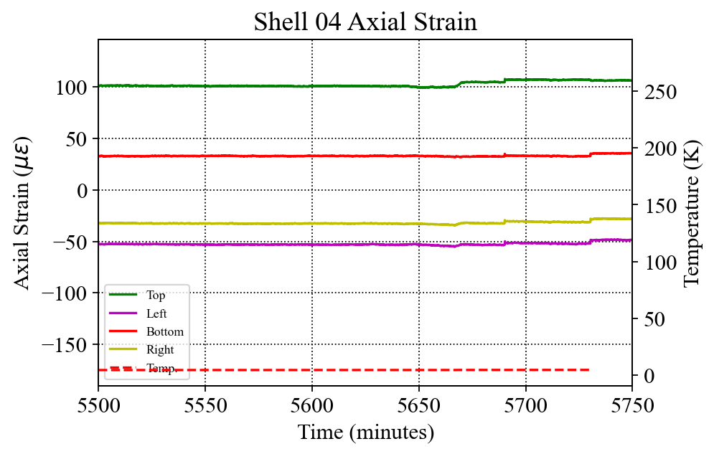
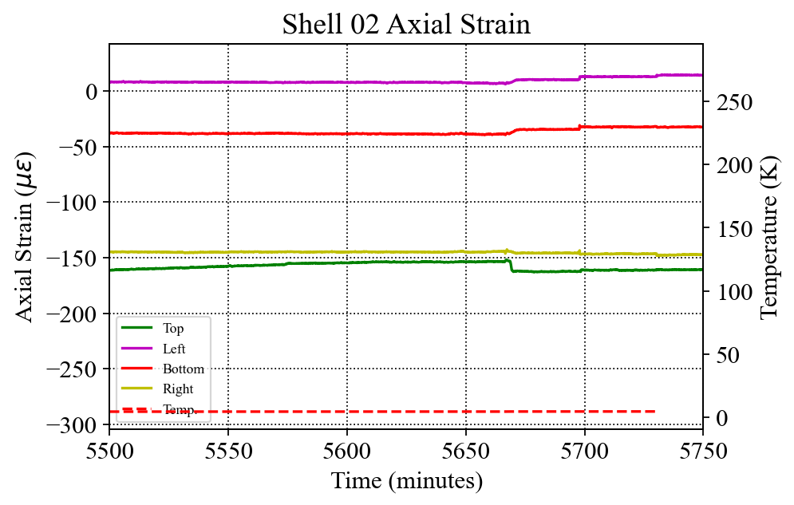
Additional Cooldown Notes
Some events and/or drift noted after magnet reached 4K
Plotted zoomed timescale between 5500 min and 5750 minutes
Coils see several shifts then goes back
Rods see a small event
Large signal may not be a real event—no other gauges repond
Shells 2 & 7 see drifts

Slide 13
SG Readings in Quenches 1 (4.5K) and 13 & 16 (1.9K) (on-going)

Slide 14
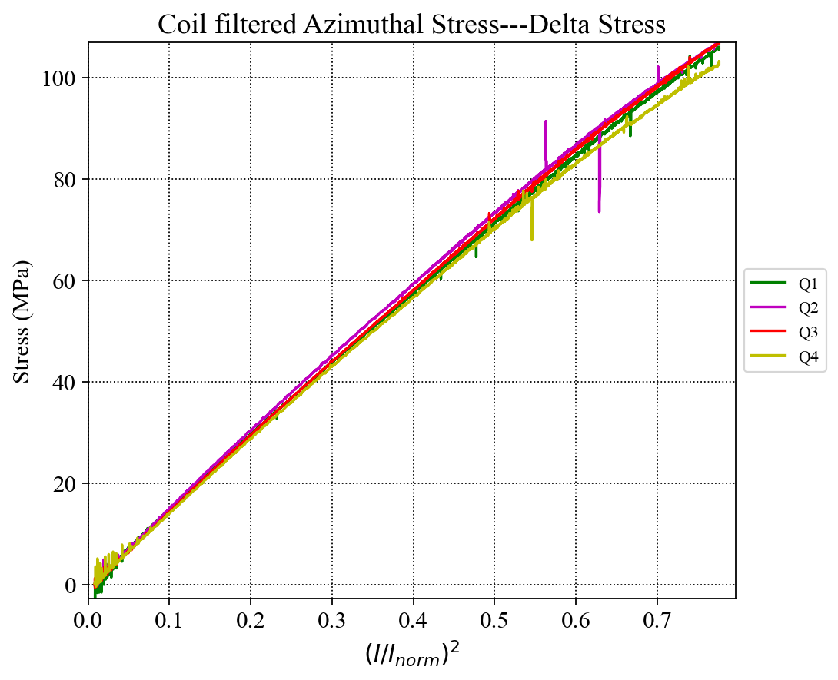
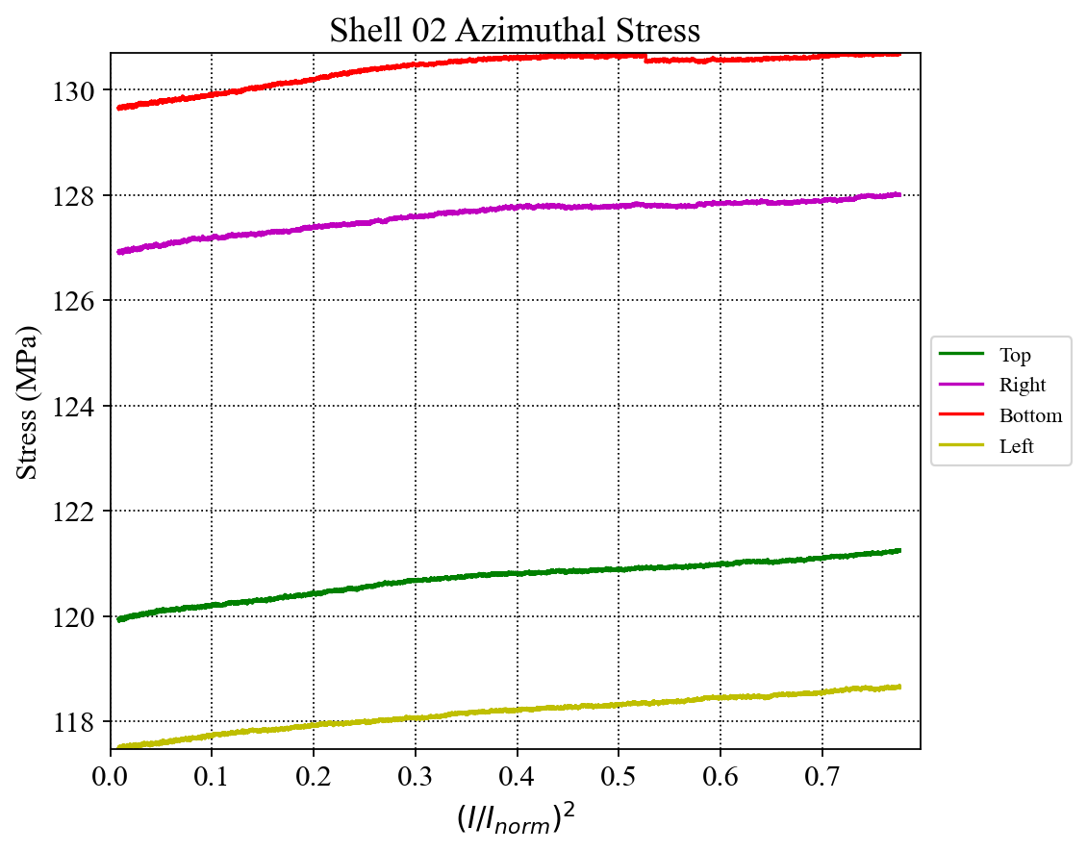
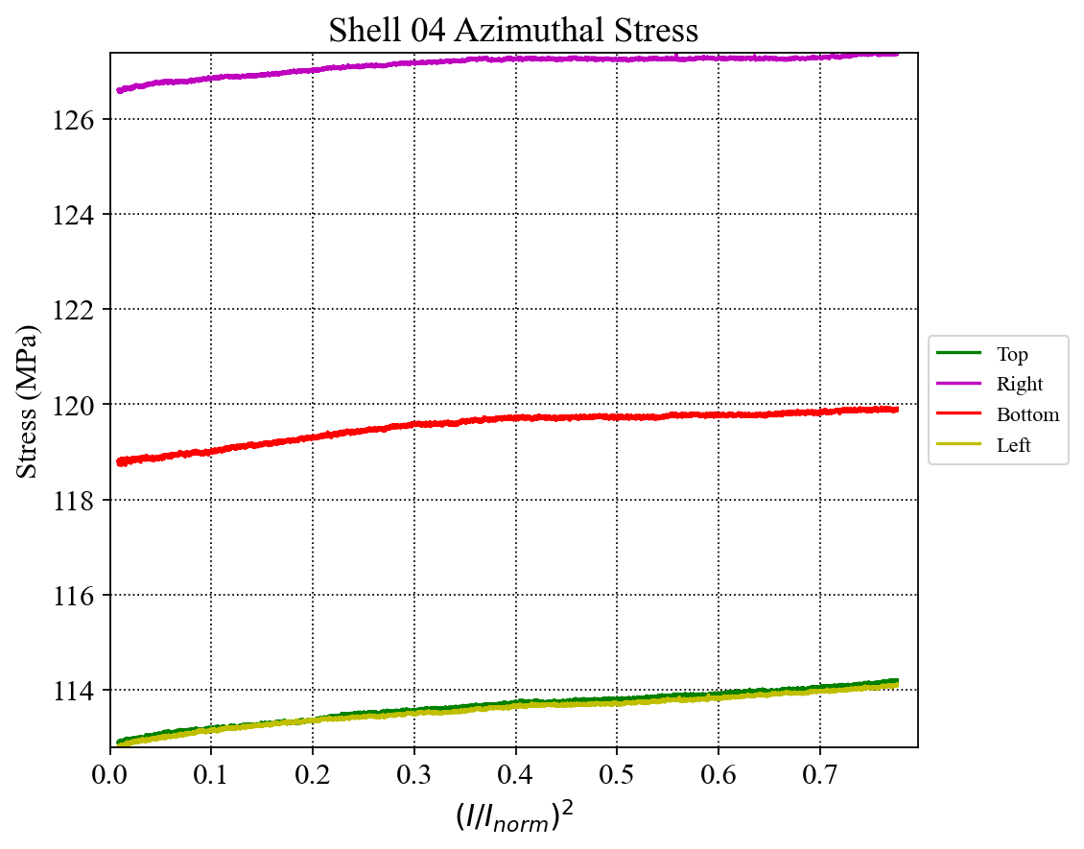
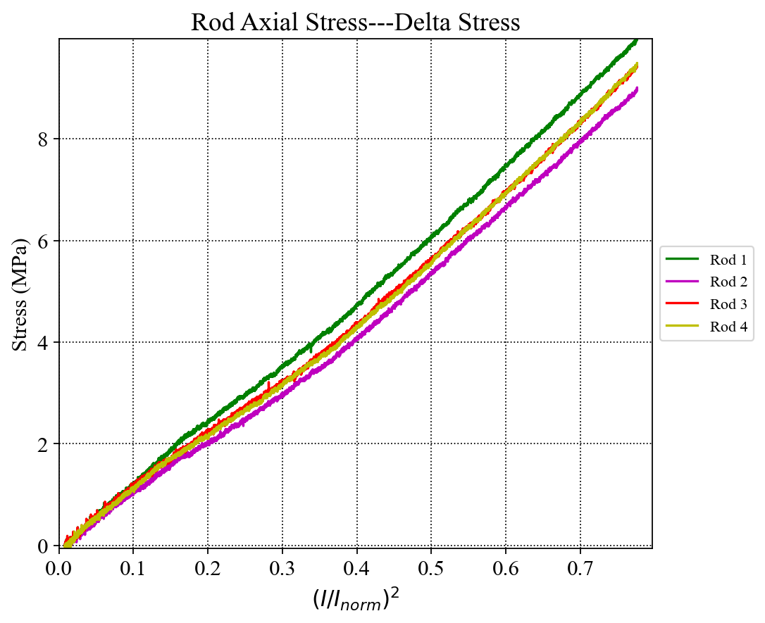
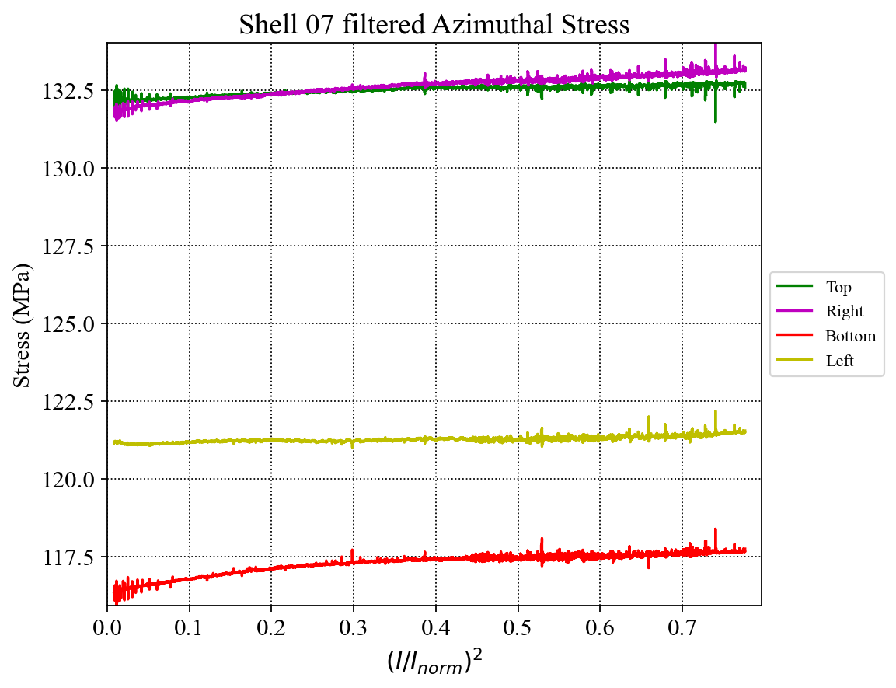
Quench 1 @4.5K (Preliminary, and on-going)
Initial data (still to be examined)

Slide 15
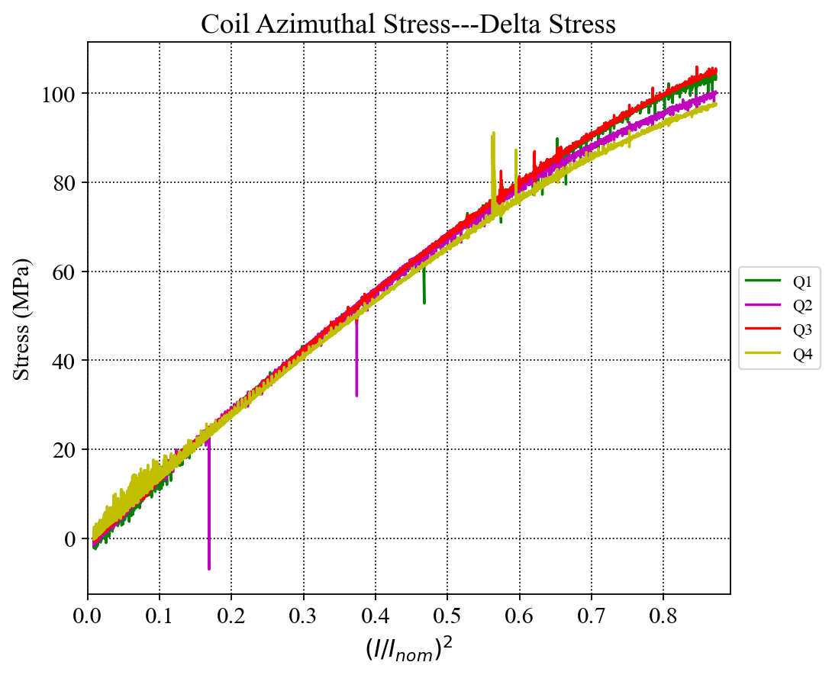
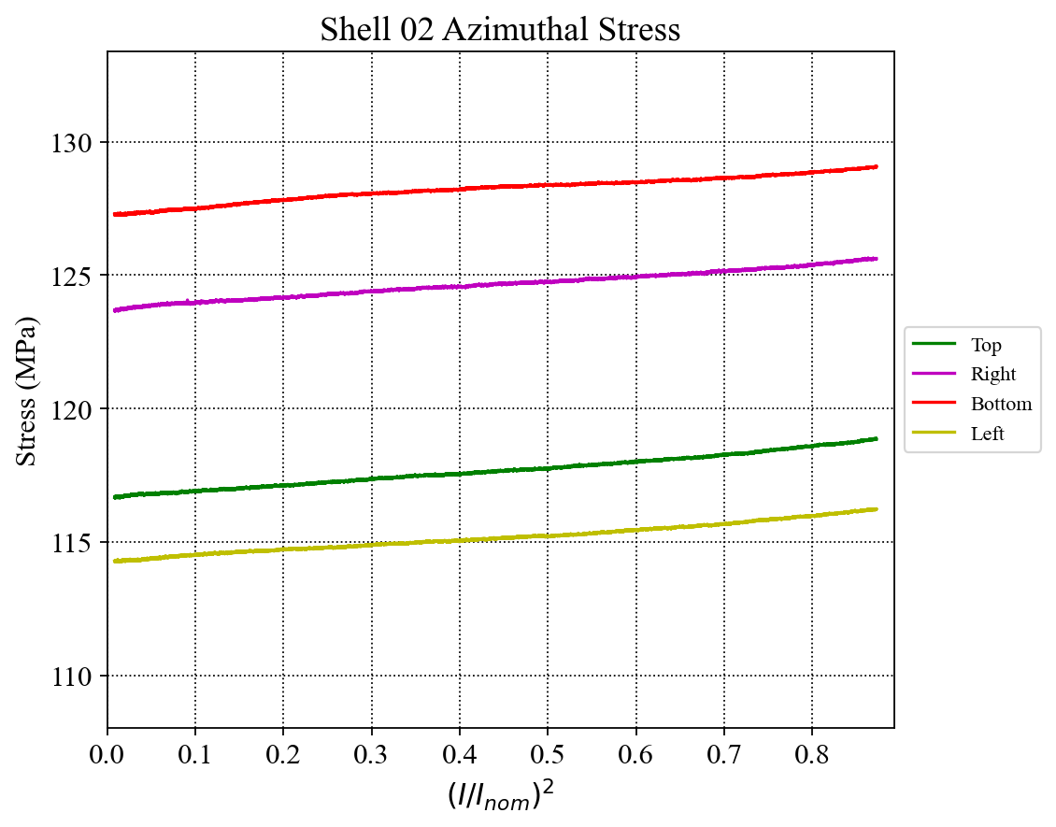
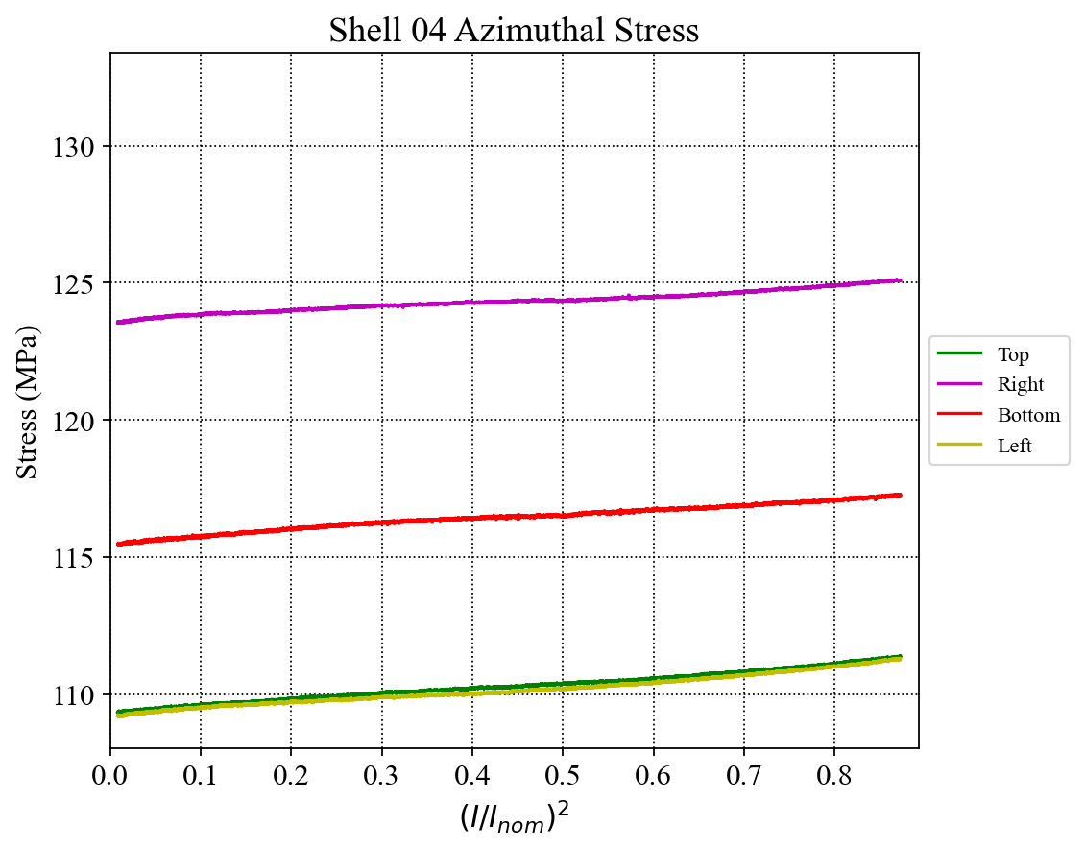
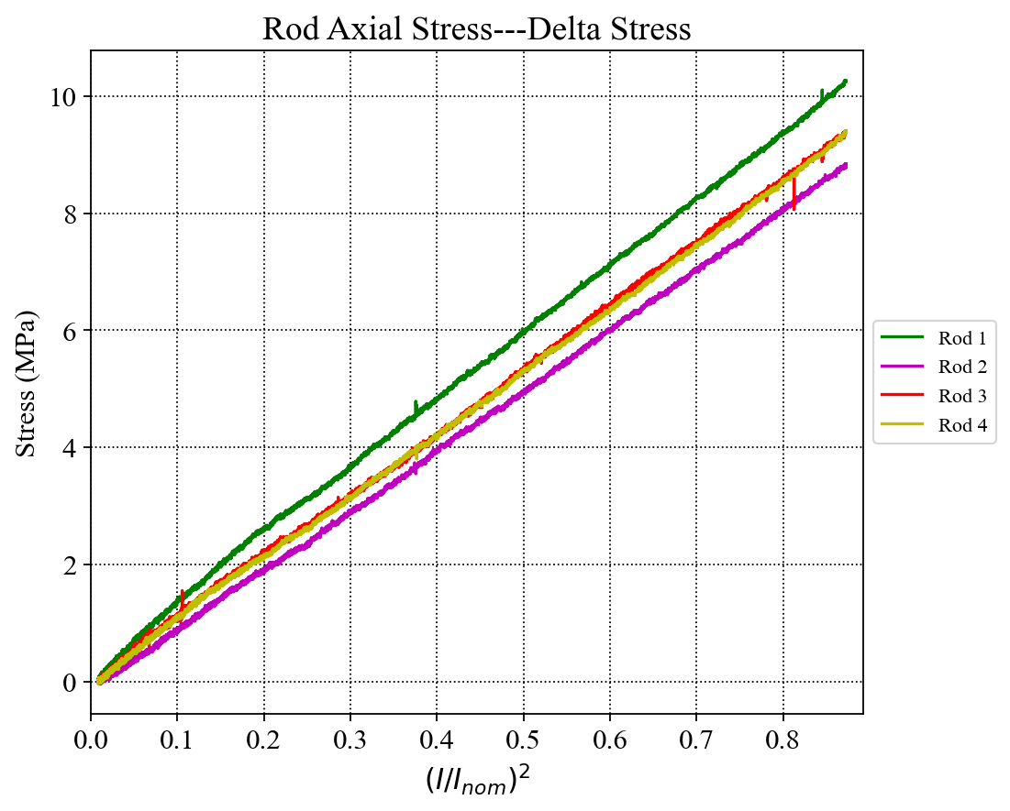
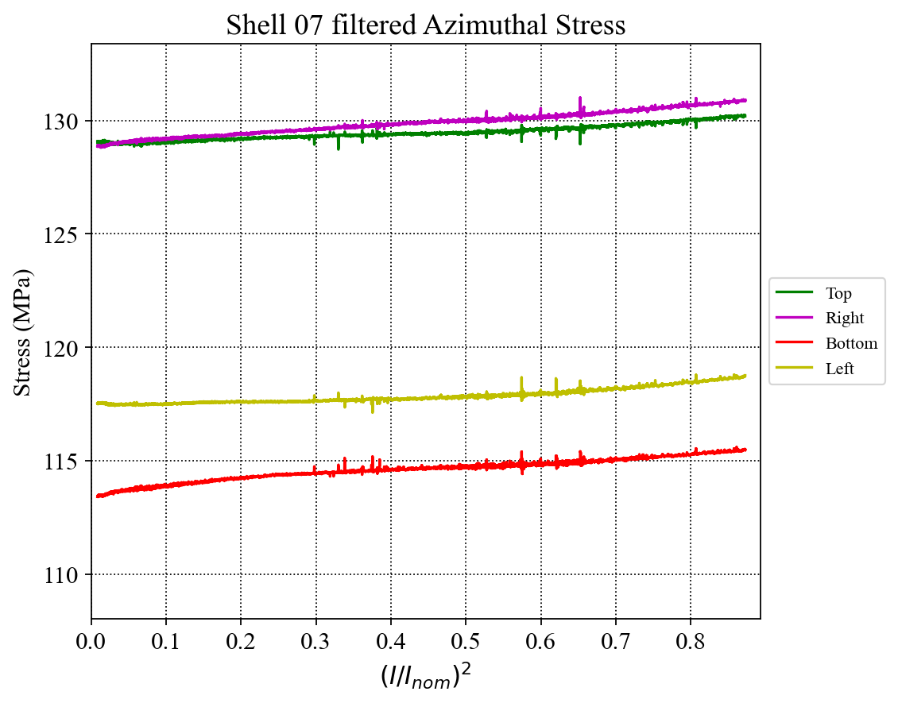
Quench 13 @1.9K (Preliminary, and on-going)
Initial data (still to be examined)

Slide 16
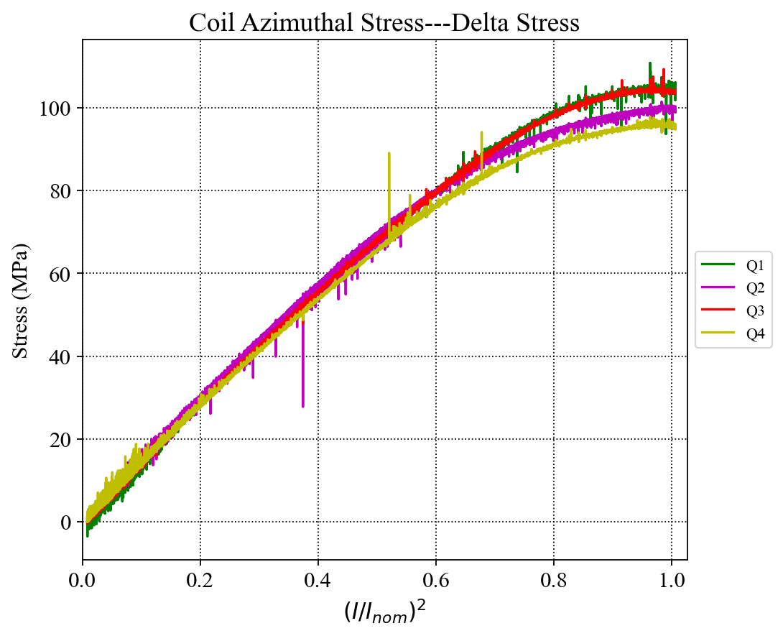
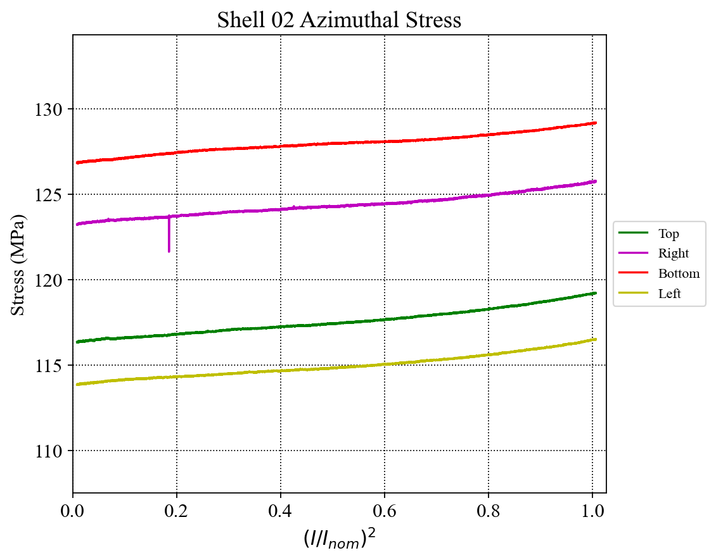
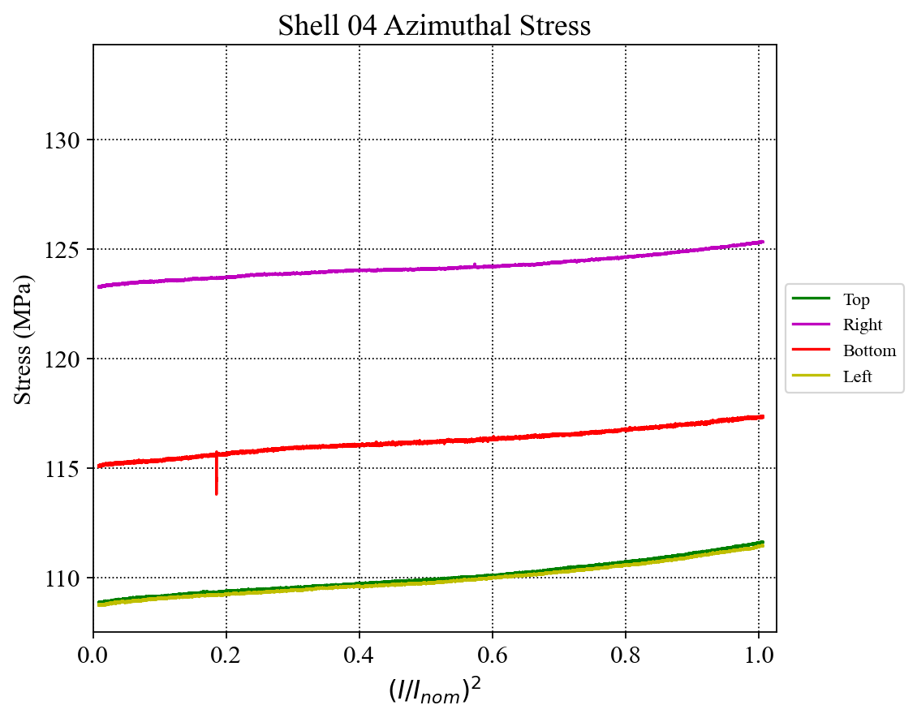
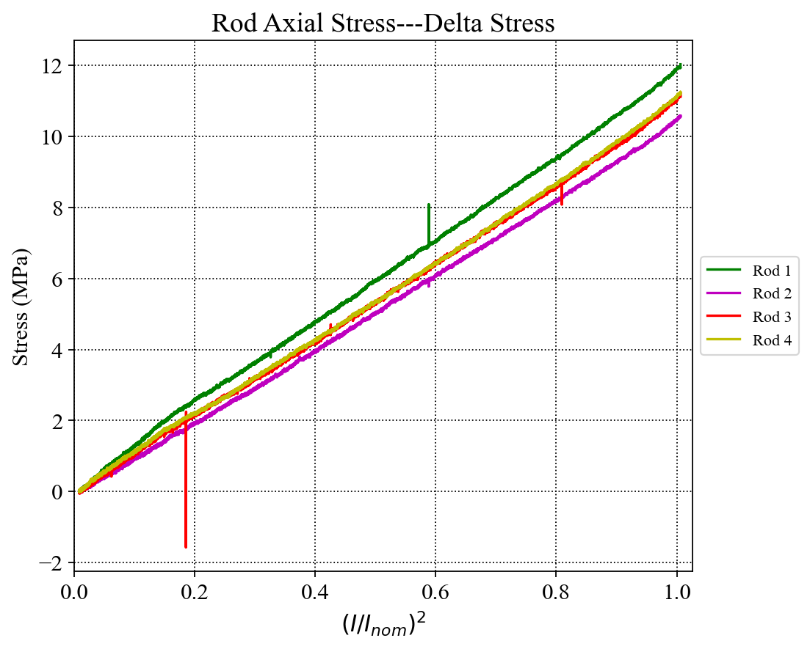
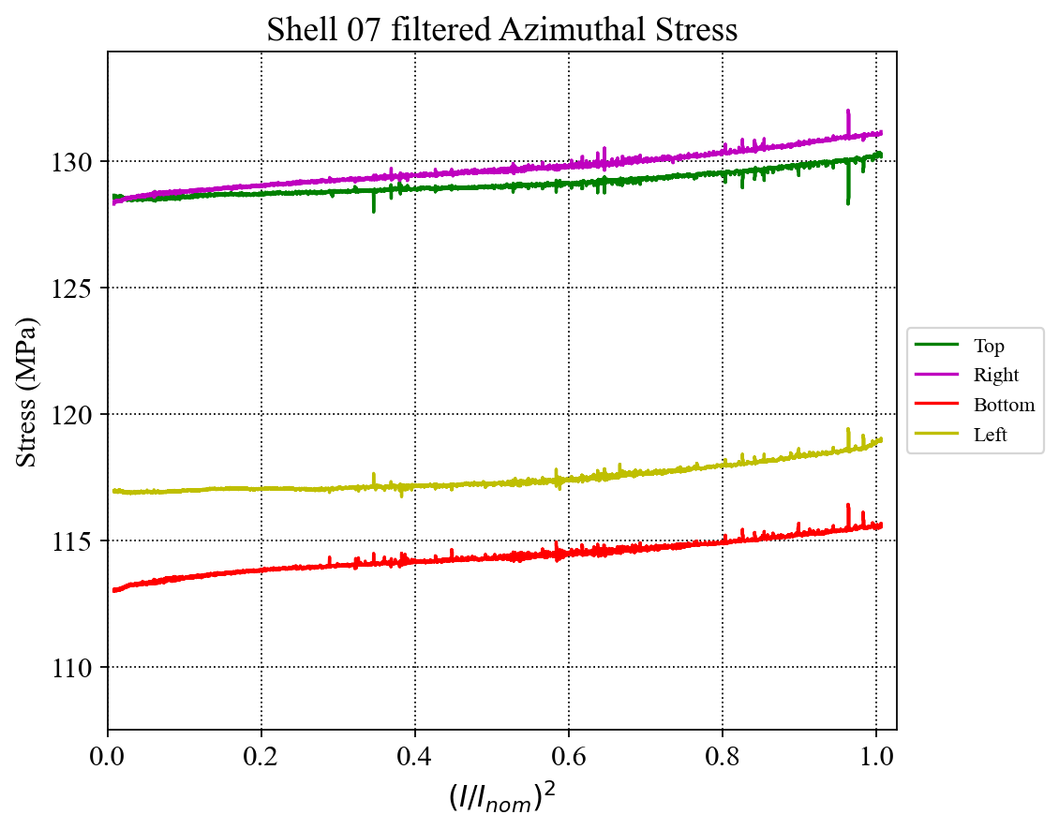
Quench 16 @1.9K (Preliminary, and on-going)
Initial data (still to be examined)
Noted by Joe M. that this was a “noisy” quench with both precursors and ringing afterwards

Slide 17
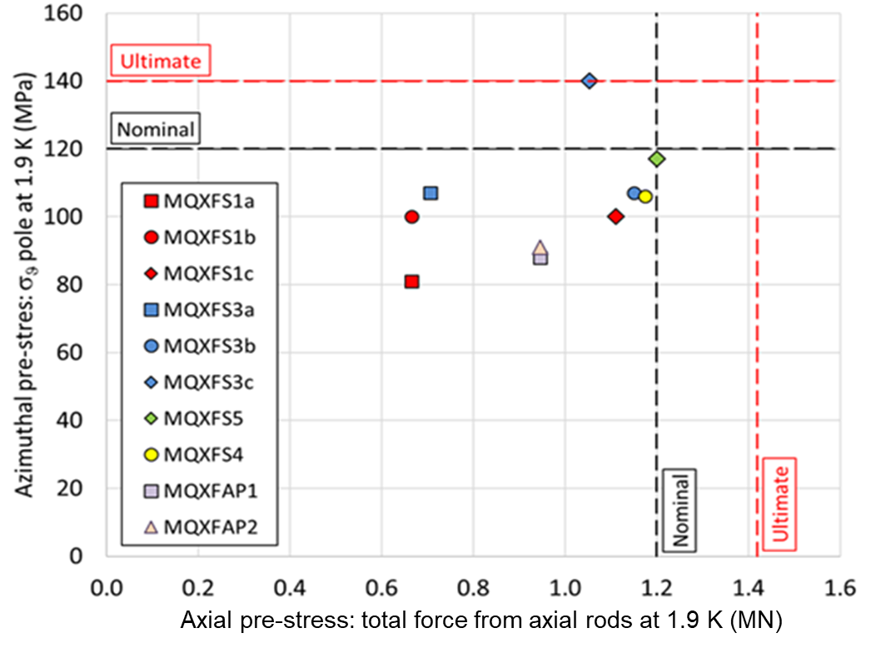
The Load Condition of MQXFA06 after CD (Preliminary)
MQXFA04/05
MQXFA06 (Will likely increase, based on Quench Data)

