Slide 1
PDS Mechanical Design, Layout and Fabrication
David Warner for the Photon Detector Consortium
FD-2 (VD) Photon Detector Workshop
July 26, 2021

Slide 2
Outline
Layout of FD2 PDS
Baseline layout
Alternate (fallback) layout
PD module design
Fabrication concept
QC Testing
Installation and integration
Other opportunities for involvement

Slide 3
Baseline design (Cathode mounted PD modules with membrane mount auxiliary)
320 cathode-mount PD modules
4 modules/cathode module
80 cathode modules
320 membrane-mount modules
20 columns
8 modules/column
2 sides of cryostat
Cathode mount
PD Modules
Membrane mount
PD Modules (outside field cage)

Slide 4
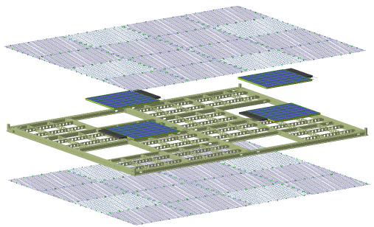
PD modules mounted in cathode module (4 tiles/module)
HV conducting
Surfaces
(both sides)
FR-4 cathode
structure

Slide 5
PD Modules mounted in cathode module
Mesh screens
Over PDs (nominally 86%
Transparent)

Slide 6
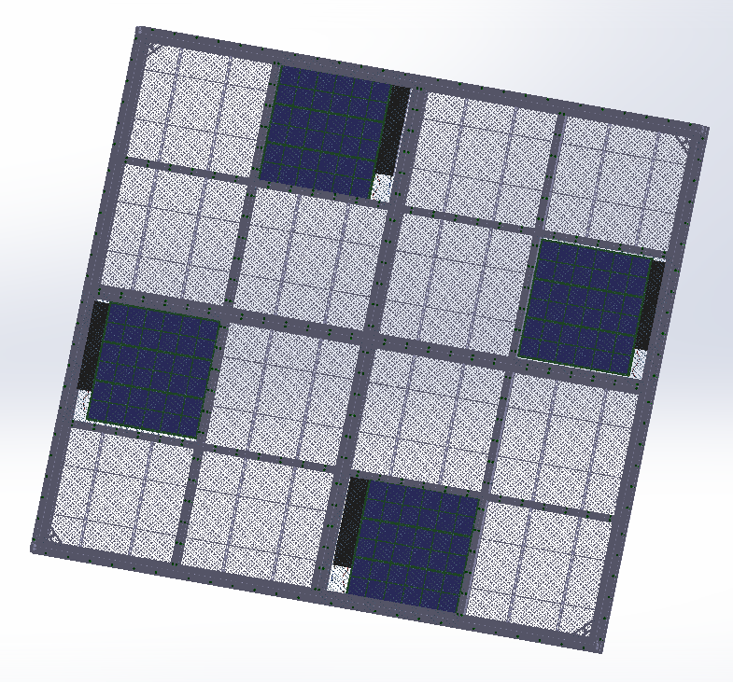
Frame mounting
Analog Signals
4 PD modules per cathode module
Baseline electronics consolidation: One readout electronics assembly per cathode module
~200mm^
Two PCBs in vertical stack: One analog board with amplifiers, (4 ADCs?) one digital board with signal readout, power, slow control
May not be possible/desirable due to concerns around possible impact on PD electronics due to pickup of large signals from cathode HV breakdown on copper PD wires routed inside cathode module
Power in
Signal out
Electronics
Control
module

Slide 7
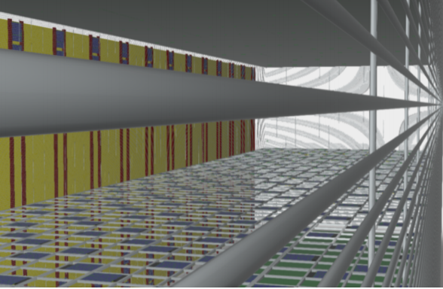
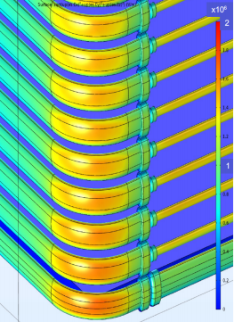
70% Transparent field cage concept
Narrow field cage profiles
For improved transparency

Slide 8
Alternate layout (all membrane mount) Does not require power over fiber or fiber readout (though could use them)
20 columns of
18 tiles (9 in top
Drift region, 9 in bottom
Drift region-- 720 total
PD Modules)

Slide 9
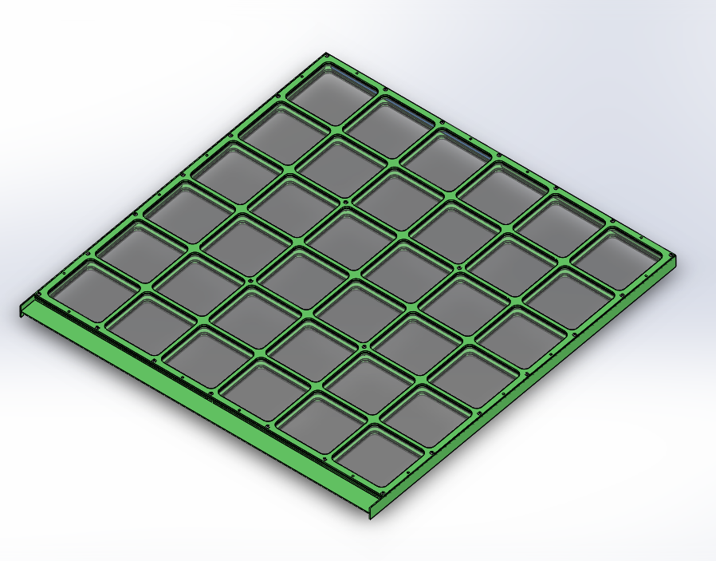
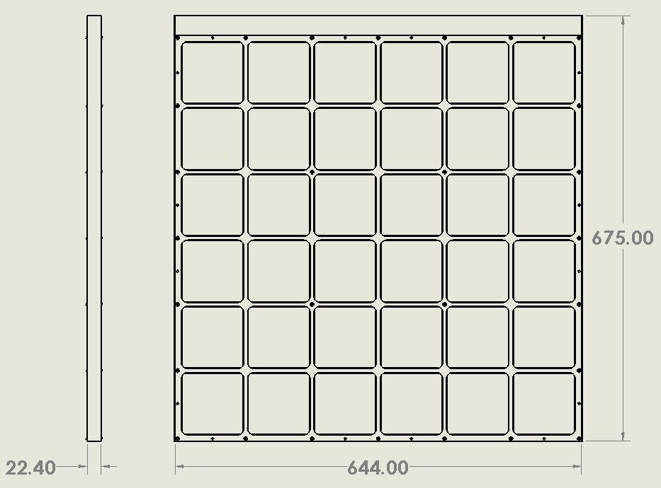
Mechanical frame (Concept)
Side SiPM
Routing PCBs (X2)
Total PD module area ~675 X 644 X 22.4 mm³
Total active area ~3380cm^2 (X2 sides for cathode mounted PD modules)
Estimated mass ~5.5kg per PD module
160 SiPMs (40 per side)
FR-4 G-10 Frame components
End readout PCB

Slide 10
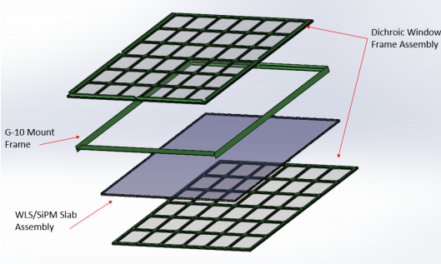
PD module- exploded view
Rear assembly replaced by
Reflective Vikuiti-covered G-10 plate
For membrane mount

Slide 11
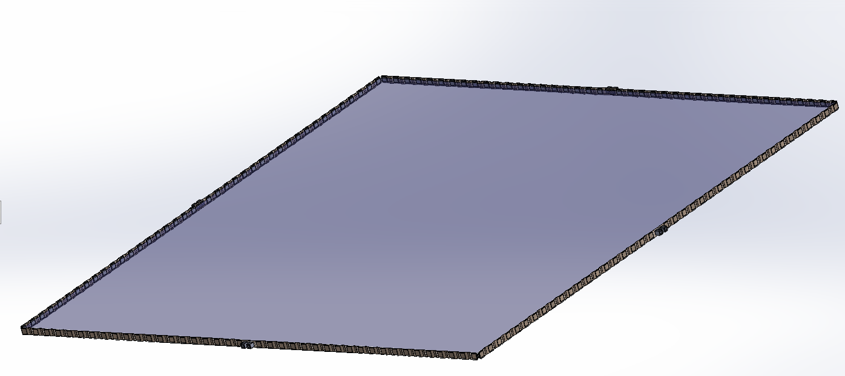
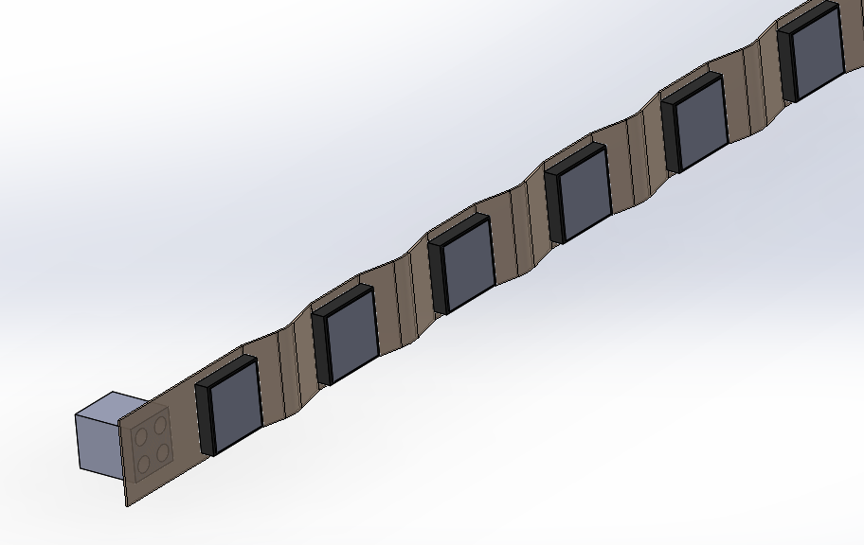
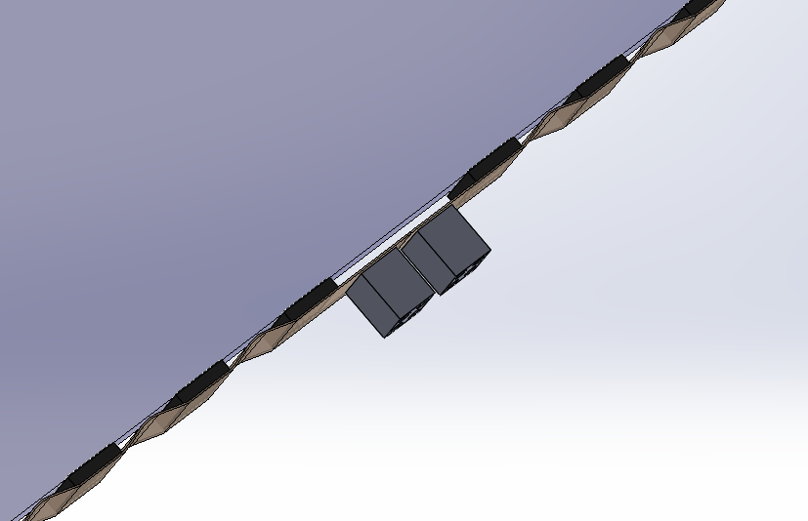
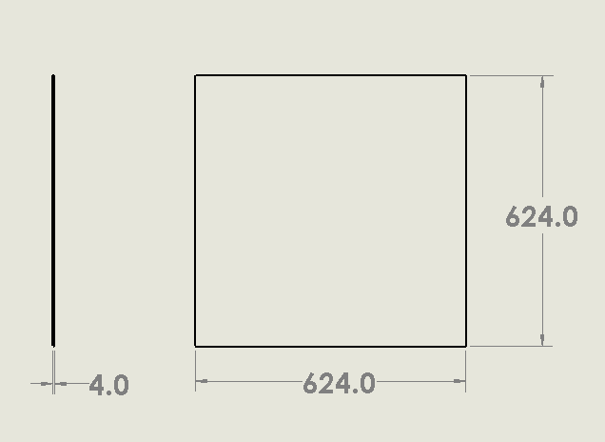
WLS plate assembly
160 SiPMs (40 per side)
Glued to WLS Bar for improved performance
SiPMs mounted on Kapton flexi-PCB
Addresses relative thermal contraction of WLS plate/frame.
Glass to Power FB-118 WLS plate (Milano) (Note: May use 600 X 600 X 3.8mm)
Concept new to VD PD-- under development

Slide 12
PD module component summary
Item | Cathode tile | Membrane tile
Module frame | 1 | 1
Dichroic filters | 72 | 36
Filter frame assemblies | 2 | 1
WLS plates | 1 | 1
SiPMs | 160 | 160
Flexi PCB assemblies | 8 | 8
Ganging amp./Signal readout boards | 1 | 1
Reference design: 320 cathode PD modules, 320 membrane PD modules
Alternate (fallback): 720 membrane PD modules

Slide 13
Fabrication elements & steps (PD Modules)
SiPMs
Procurement
Assembly to flexi PCBs
Testing
WLS plates
Procurement & testing
Assembly to WLS plates & testing
Filter assemblies
Filter procurement & testing
Filter coating & testing
Assembly into filter assembly frames
Ganging amplifier PCB
Procurement
Testing
PD module assembly (multiple sites)
PD module frame fabrication
PD Module assembly
Testing
Possible variations between cathode mount and membrane mount PD modules

Slide 14
QC Testing
Very conceptual at this point!
PD Module assembly facility
Scan in LED scanner (similar to FD1 plan)
Cryogenic immersion in LN2?
PD Module reception facility (Final stop before storage prior to use in DUNE)
Repeat Scan in LED scanner (similar to FD1 plan)
Cryogenic immersion in LN2?
LED scan prior to integration into cathode modules/cryostat
Cold box test prior to installation in cryostat (?)

Slide 15
Installation and Integration
PD modules are integrated into the cathode modules underground at SURF
Membrane mount PD modules are assembled into strings underground at SURF
Cathode modules and membrane PD module strings will be tested prior to insertion (cold box?)
Following integration in the cryostat, operation in situ and periodic monitoring until the cryostat is closed

Slide 16
Additional opportunities
Mechanical supports
Cathode PD module integration
Membrane mount PD module support structure
Fiber and copper cable design, routing, fabrication
Monitoring system design, fabrication, installation
Detector optimization for Xenon
Test equipment, QC plan

Slide 17
Conclusions
An X-ARAPUCA based photon detector design is in development for FD2
The baseline design presents two options--
Hybrid Cathode mount/cryostat membrane mount PD modules(preferred option, requires power over fiber)
Membrane mount PD modules only (disfavored option, only requires copper readout)
There are significant synergies between the two designs, and with the FD1 PD system.
PD module design allows for multiple fabrication and assembly sites. Many opportunities exist for involvement in the production!
Please contact us to get involved!

