Slide 1
DUNE PD Workshop
W Pellico
Power over Fiber (PoF)
26/27 -7 -2021

Slide 2
Outline
Concept
Technology
Testing
Past Year
FNAL (PAB – A building that contains large dewers/cryogens)
CERN Cold Box
Next Stages

Slide 3
What are we doing – Investigating power over fiber for cold electronics on a high voltage plane
Can we meet power needs of SiPMs?
Can we meet power needs of data pipeline electronics?
Analog systems look to require less power.
Digital system – more power, possibly more voltage levels, higher current
Limited power density and overall power loss. (1W cm^3 and < 2kW)
Can we demonstrate/ensure system viability?
System redundancy
System modeling
Manufacturing process modification
Looking at vendor capabilities and options
Two vendors are working with us but in a limited way
Looking at universities
Several have shown interest – discussing roles/work

Slide 4
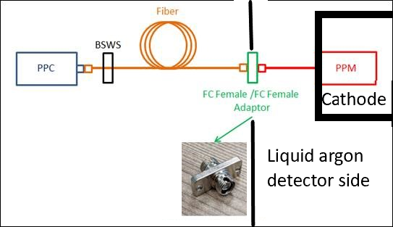
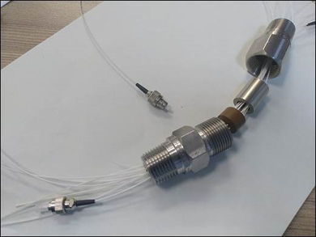
DUNE PoF Concept
Electronics on HV cathode - like many HV systems
Provides isolation
Low noise
Few components
PoF System
Lasers/Housing
Fiber
Feed Throughs
Sheathing
PC receiver units
200 W analog
800 W digital
Voltage Regulators

Slide 5
Power over Fiber PoF
Power over Fiber (PoF) is relatively new technology
Used for systems requiring isolation
Cell Towers
Transformer Yards
Low Noise Experimental Systems (isolation from noise)
Floating diagnostics systems safe from ground faults
Rapidly developing technology that is aligned with solar systems
Increasing used in military systems
Used with fiber or open-air laser system to power drones
Used to power remote sensors

Slide 6
Technology - PC cell - PoF
GaAs option
The process is somewhat typical of semiconductor device manufacturing.
This is a multistep process which uniquely designed for each voltage/current device.
Higher power devices tend to have more layers with greater spacing.
The process has more complexity for rare earth materials verses crystalline Silicon cells.

Slide 7
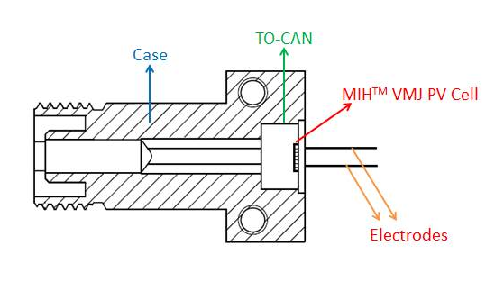
Technology - Fiber and Power converter unit
FC connector
Jacket
Core – 62.5/0.27 NA
Cladding - 125
Connector Style: FC has been dependable, but attention needs to paid to connection
NASA fiber optic group recommends we consider: Diamond AVIM connector

Slide 8
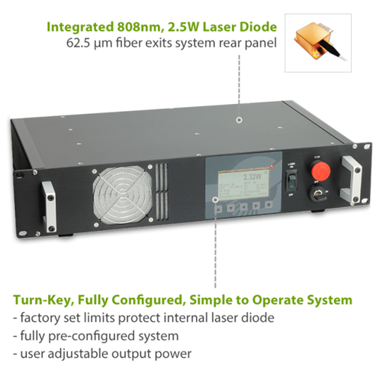
Technology - PoF 808 nm Laser options
We have 971 laser selected
New Laser – about the same power (2 – 4 W)
Wavelength: 808nm Output Power: 3000mW Operating Temperature: +10℃ ~ +30℃ Storage Temperature: -20℃ ~ +60℃ Lifetime: >10,000 hrs
Order placed yesterday

Slide 9
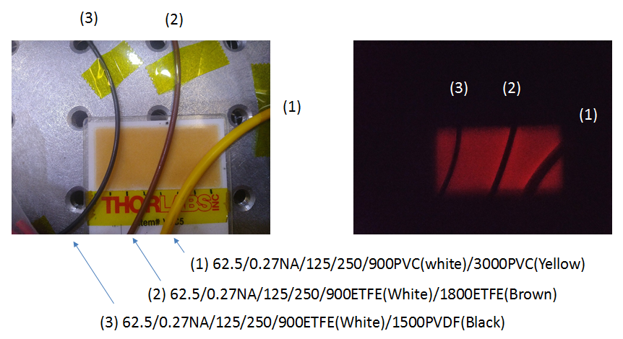
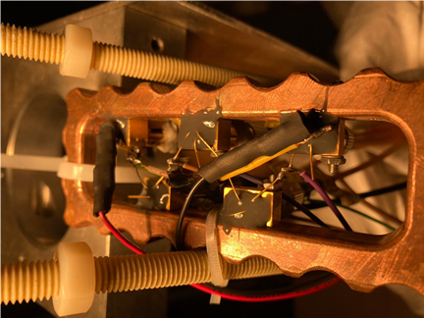
PoF Testing Status
Fiber Jacket Material
ETFE, PVC,PVDF
PPC Units: series and parallel
PPC efficiency
Housing units for Si PC
PC stability
PC heat loss – point sources
Power converters/regulators
Efficiency/Viability
6 units tested
Epoxy materials – Thermal/electrical properties
GaAs – building voltage specific units (+ tunable laser)
Present
Testing
Next (July/August)
A PoF PC unit
Tested at CERN

Slide 10
Testing at FNAL - PAB
Will like to use both 971 and 806 system at PAB
971 will power SiPM boards (36 to 48 volts - < 1ma)
806 will power analog (and digital systems) ( 5 v, 250 ma)
All laser are contained in box with pigtails output
Bullets are all wrapped to ensure no tampering and no leakage
Feedthroughs tested –
Connections in cryo are wrapped and can be viewed through viewport for light leakage.
Initially testing may include PoF diagnostics – transmit voltage levels

Slide 11
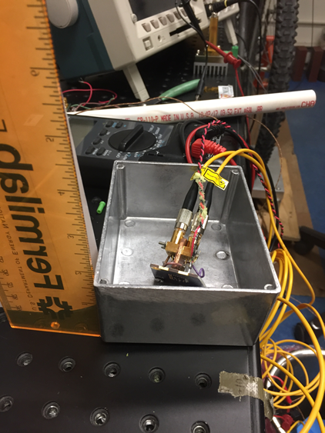
Laser Testing (PAB)
Testing of with new 806 laser(s)
Run room temp checks with electronics
Testing new warm housing units
Look for light leakage
Look for heat points
Look at stability
Check with power meters, IR gun
Check bullet connectors – sealed
Test all power units with lasers – fall testing deadline
Cold temp check – liquid nitrogen bath
Look at efficiency, heating, light leakage, bubble formation
Purity testing at PAB – repair of LUKE test vessel

Slide 12
Testing Continued – Extended R&D
PPC Output Voltage: By adjusting PV cell junction number, PPC output voltage can be set to the target voltage level.
PPC Efficiency: The efficiency is also related to the heat and bubble issues. The PV cell material and laser wavelength pretty much decide the efficiency, there’s little room for improvement. Elevating the PV cell temperature shall be able to improve the efficiency of silicon devices, and this is the direction for efficiency improvement for silicon devices.
PPC Reliability: There’re two different epoxies used in the PPC, and epoxies are organic which would be the weakest link for PPC reliability.
GaAs PPC units are better suited for low temperatures.
Units from a vendor with FC connector being built for testing.
Can be built for desired voltage – reducing the need for power converters.

Slide 13
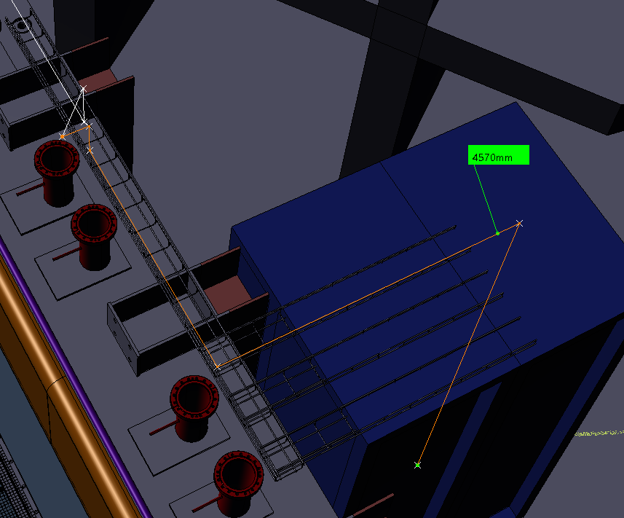
Cold Box Test Prep
Laser fiber will be terminated at SC patch top – back
2 14 fiber bundles will exit through the top
Two orange fiber conduits will connect to top of rack and carry the fiber that have been placed in feed through connectors.
Two 14 pin feed throughs with the fibers already terminated will be connected after the fibers are fed into cold box.
Fiber Jumpers from cathode housing will extend to edge of cathode.
Final connection at edge of cathode to incoming fiber and jumper done inside and secured to cathode and wall.
28 10-meter fibers
Original
Benoit
Back
cathode
PoF Fiber Jumpers

Slide 14
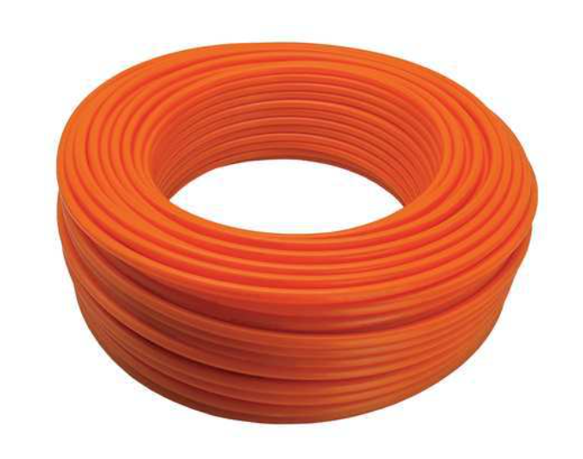
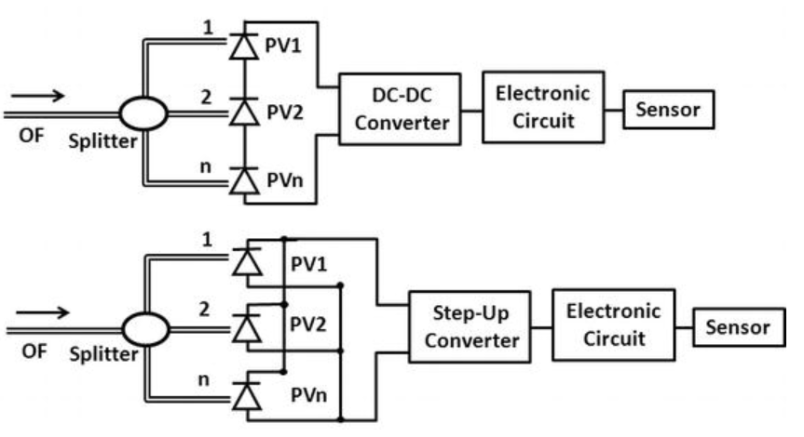
PoF – Cold Box
6 - 8 Laser Housing Units
Each Contains 5 PoF lasers
Change to Eu power plugs
Fans, screens, fiber conduit – need to purchase
On wheels – does it need to be somewhat mobile?
40 fibers in sheathing off top
Laser Power Light Indication – laser safety
Labeling – safety – what is required and where
Enable Key – we do not have – removed for now?
Led for power, Leds for faults, enable & on switch
There will be no remote controls.
If we do not get our GaAs components – need more 976 lasers and not sure we can meet the needs in a single rack.
Tubing from rack to cold box feedthrough
All power over fibers will be grouped into 1 or 2 FT
28 single mode fibers
Arapuca 1 SiPM (48 v, 30 ma) 976 nm
1
Arapuca 2 SiPM (48 v, 30 ma) 976 nm
2
Analog 1 (3.3,5.5 v, 200 ma) 806 nm
3
Analog 2 (3.3,5 v, 200 ma) 806 nm
Digital 1 (1,3.3,5 v, 500 ma) 806 nm
4
Digital 2 (1,3.3,5 v, 500 ma) 806 nm
5
Cryo Sub (1,3.3,5 v, 500 ma) 806 nm
6
Cryo Sub (1,3.3,5 v, 500 ma) 806 nm
7
8

Slide 15
Future -
Working with several outside groups:
Boeing – GaAs units
Harvard – modulator systems (talk)
UIUC – PPC GaAs systems (talk)
JPL/NASA – fibers and connectors in cryo environment
Ideally – would like to have fewer lasers but high power/efficiency.
Would reduce number of cables
However more localized heating in argon
Lager diameter fiber to accommodate the higher power –
Need to watch light leakage – DUNE sensitive to photons!
Ordering sheathing to protect fiber – for initial PoF testing
We will have sheathed fiber from Power unit to detector feedthrough

Slide 16
Conclusion
PoF has been shown to be a valid solution to power electronics at cryo temps.
The PoF offers a low noise isolated power deliver system.
Optimization will take time –
Efficiency
Laser choice
PC cells
Fibers and connectors
Final design of cathode layout and modeling will determine final engineering parameters

Slide 17
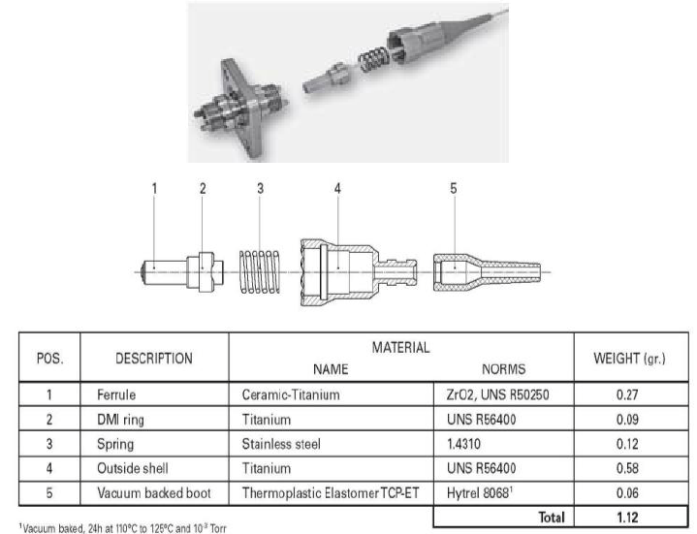
Backup – Diamond AVIM connector

Slide 18
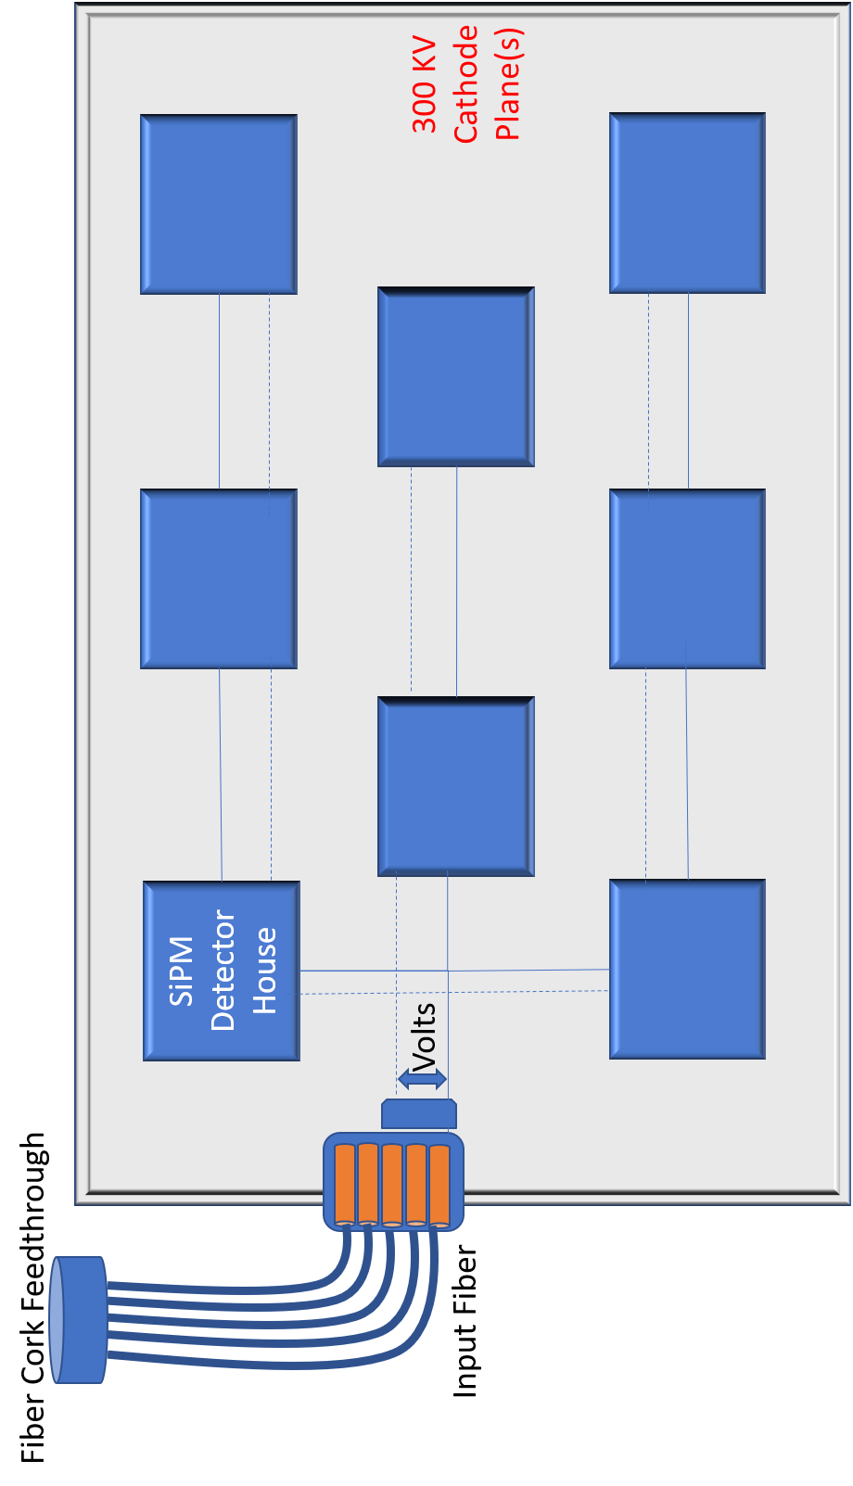
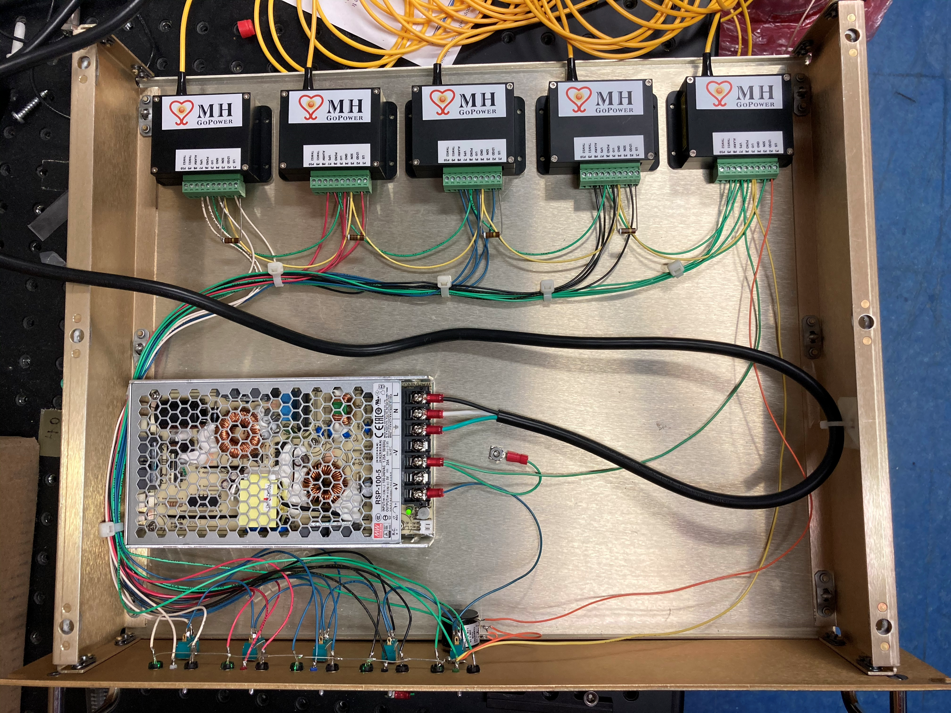
Backup – Two Systems
810 nm Lasers (class 4)
Order placed for two vendors (Lower Volts higher current)
977 nm Lasers (class 4)

