Slide 1
CSU proposal to work on FD2 PDS system

Slide 2
DUNE PDS Group at CSU
Technical:
David Warner - PD Consortium Technical Lead (Mechanical)
Zack Rautio – Newly hired mechanical engineer, experience in CSU HEP projects as a student prior to recent hiring
Jay Jablonski - FD1 ProtoDUNE PD production
Faculty:
Norm Buchanan - ProtoDUNE-SP PD production; Cryogenic Detector Facility; DUNE L3 PD project manager (former)
Bob Wilson –Photosensor Group Convener (former) ; FD1 CDR and TDR, and FD2 CDR PDS Chapter editor
John Harton – Proposed new addition (see following)
Post doc:
Bishu Behera - PD for calorimetry studies; ICEBERG
Andrew Mogan (with Harton/Mooney)– Recent post-doc hire, SIPM readout development
New post doc (with Wilson) – FD2 focus
+ Numerous students including Christian Norris (experience on SingleCube cryogenics)

Slide 3
Introduction to John Harton, Professor of Physics, CSU
Twenty-six years of experience (1995 to present) as a faculty member at CSU in HEP hardware production, characterization, and use.
Work at CSU has been on SLD (analysis only, electroweak), BaBar, Auger, the DRIFT dark matter experiment, and DUNE.
Post-doc based at CERN during LEP-1 with University of Wisconsin, 1988-95. Electroweak analysis: Z mass and width, number of light neutrinos, tau polarization.
PhD at Fermilab, E745, 1-meter bubble chamber in a neutrino beam dump, MIT 1988. High energy neutrino nucleon scattering.
Harton’s other commitments: John has current responsibility on DUNE for production and quality assurance/control of the FD1 TPC cold electronics mechanical parts that will hold the enclosures, with Jablonski. We just shipped initial parts. And Harton/CSU is on the list of intuitions to test FD1 TPC FEMBs when that starts.
Next a brief look at JH’s most relevant past hardware experience.
Skipping over work led by other faculty at CSU on BaBar DIRC, ICARUS CRT, T2K P0D
Then thoughts for working on the FD2 PDS.

Slide 4
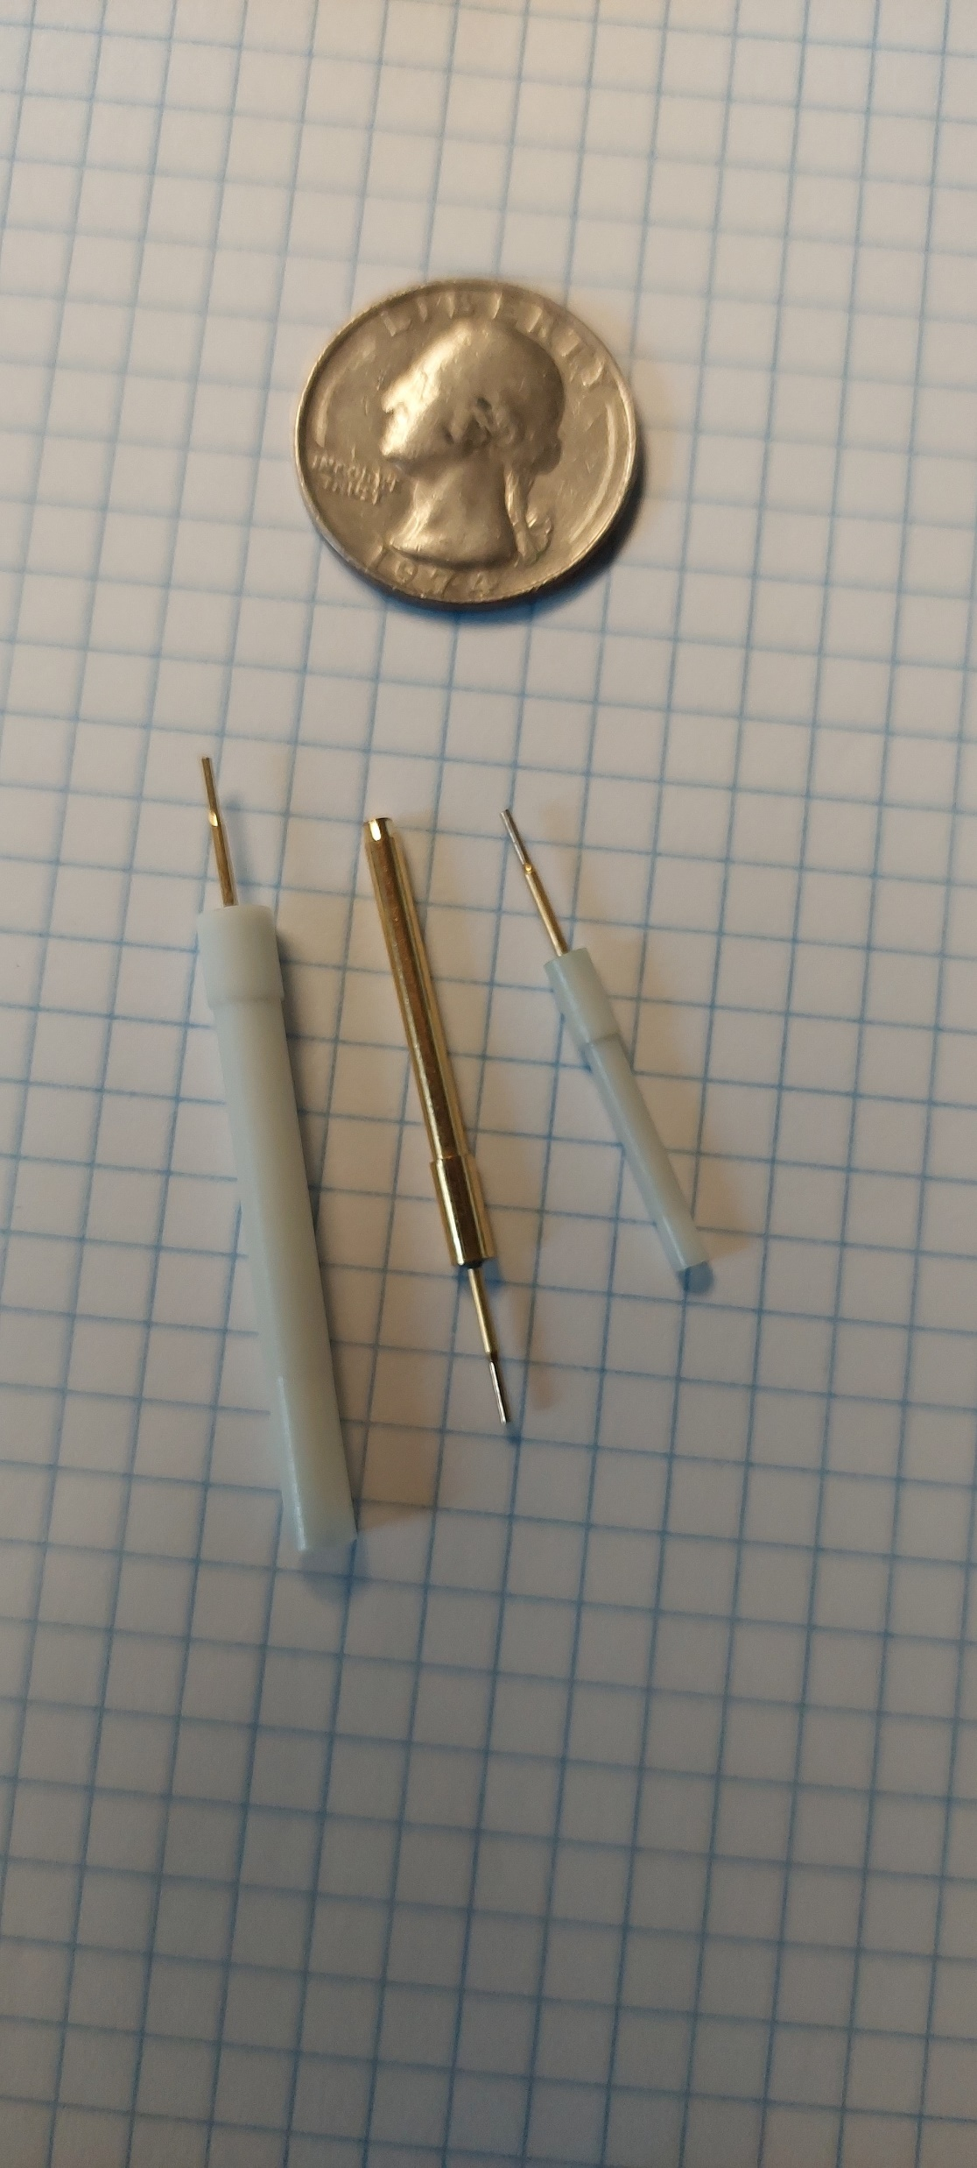
BaBar drift chamber feed throughs
Three designs: HV, ground, sense
Drawn metal made by a Swiss watch-parts maker - Medelec
Initial plastic parts made at CSU industrial arts department
Tested under voltage at CSU
Measured concentricity at CSU
Dave Warner lead technical person
Thousands of parts

Slide 5
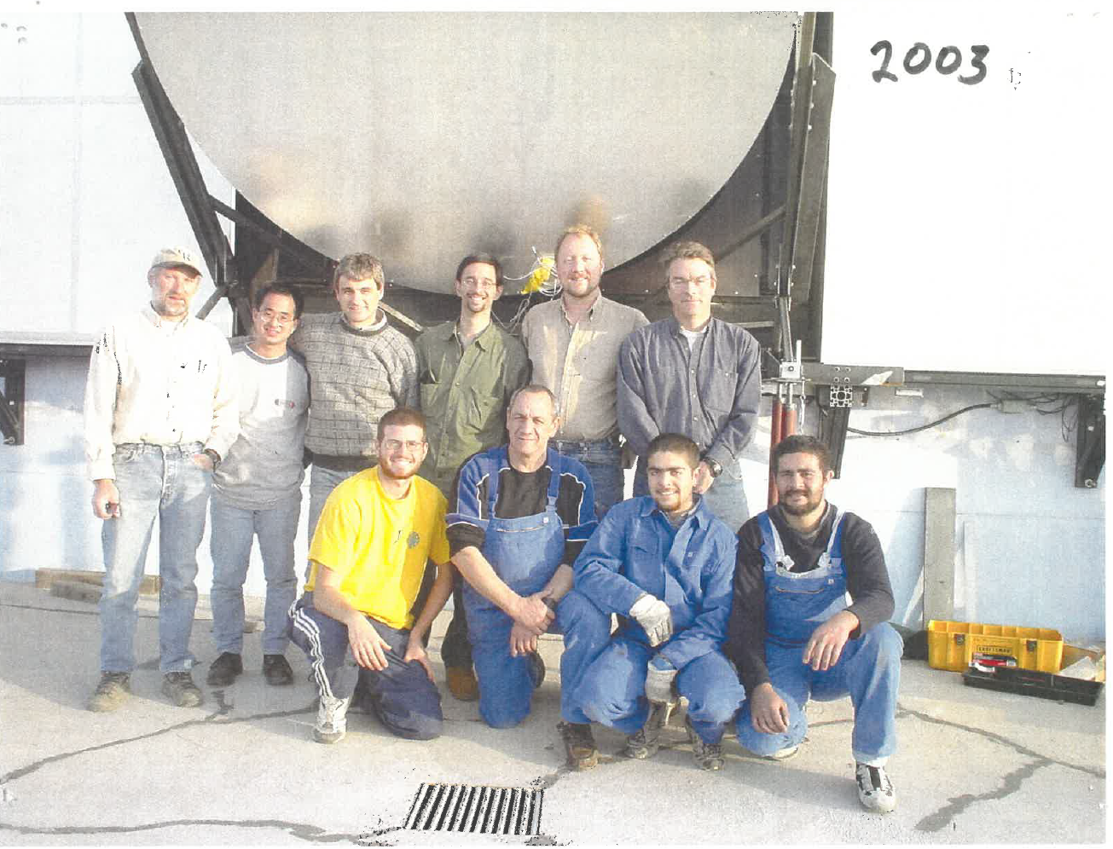
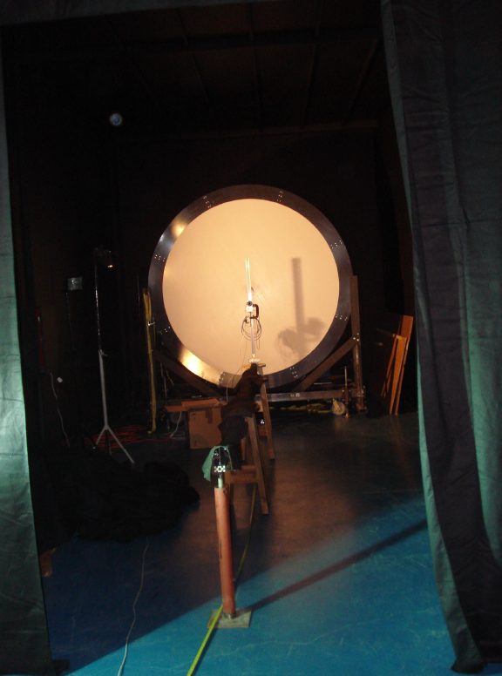
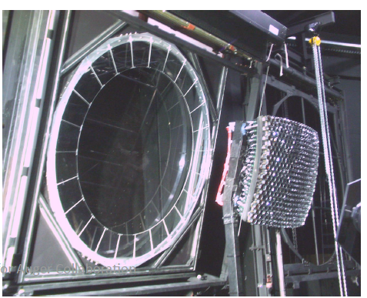
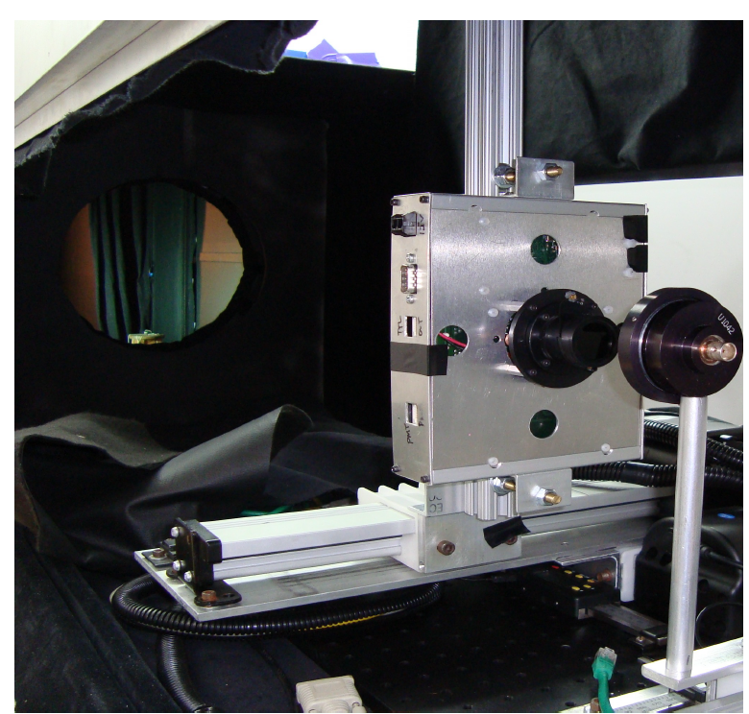
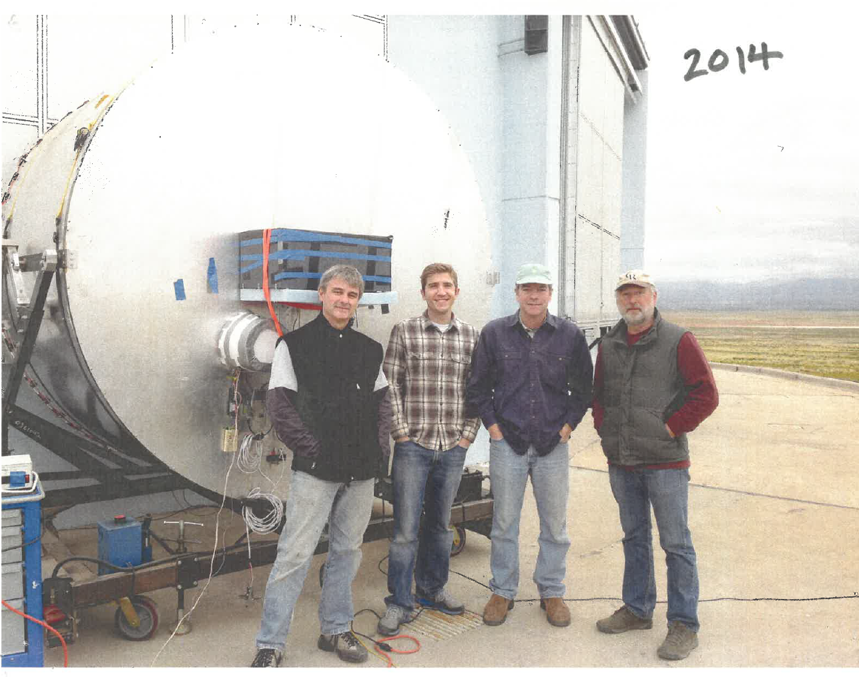
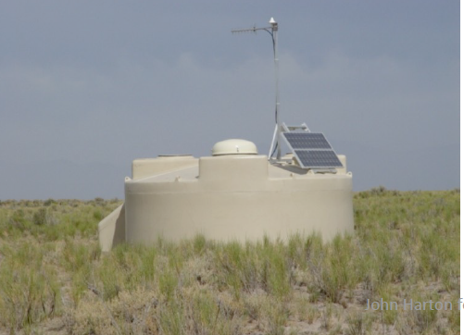
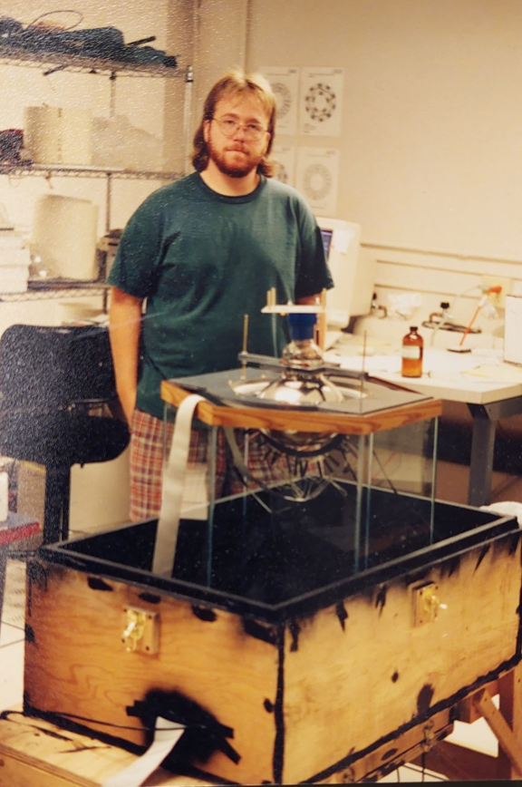
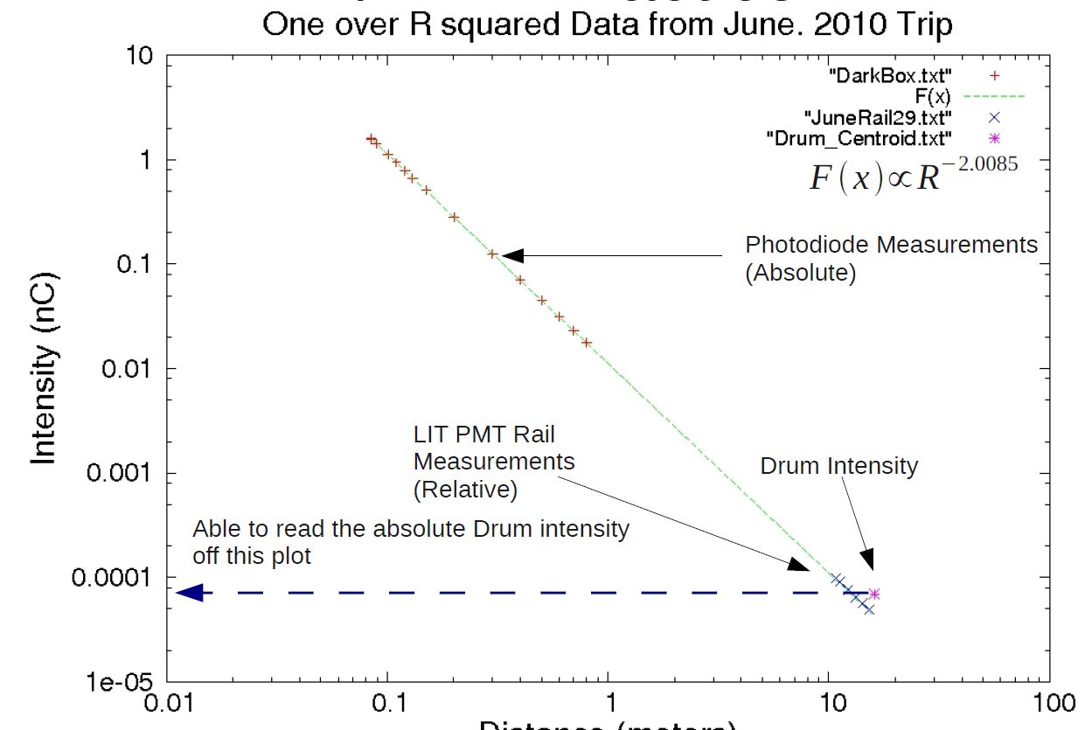
Auger ground array tank liners and PMT windows and housings
Auger fluorescence detector calibration
3 * 1600 PMTs enclosures and 1600 tank liners with windows for PMTs.
Developed optical coupling PMT-glue-window-water
Field-development of deployment procedure for ground array tanks with PMT’s preinstalled on liner and liner inflated in the tank.
Passed on final assembly of liner tops to liner body to Argentine collaborators
Early PMT coupling R&D

Slide 6
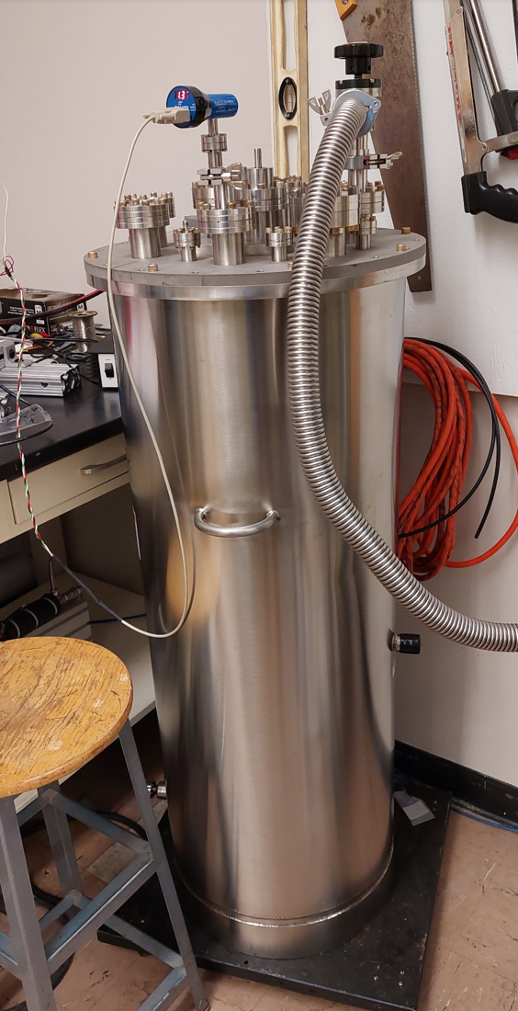
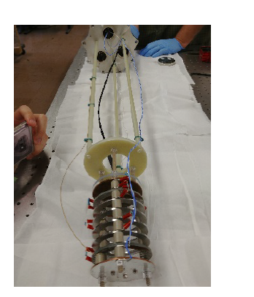
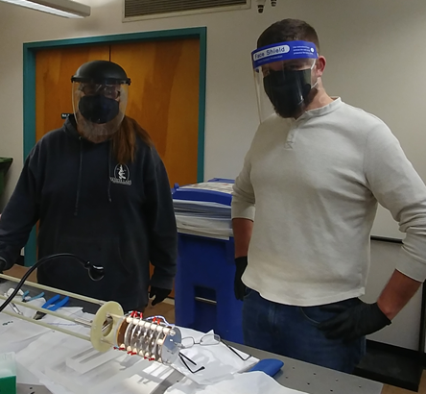
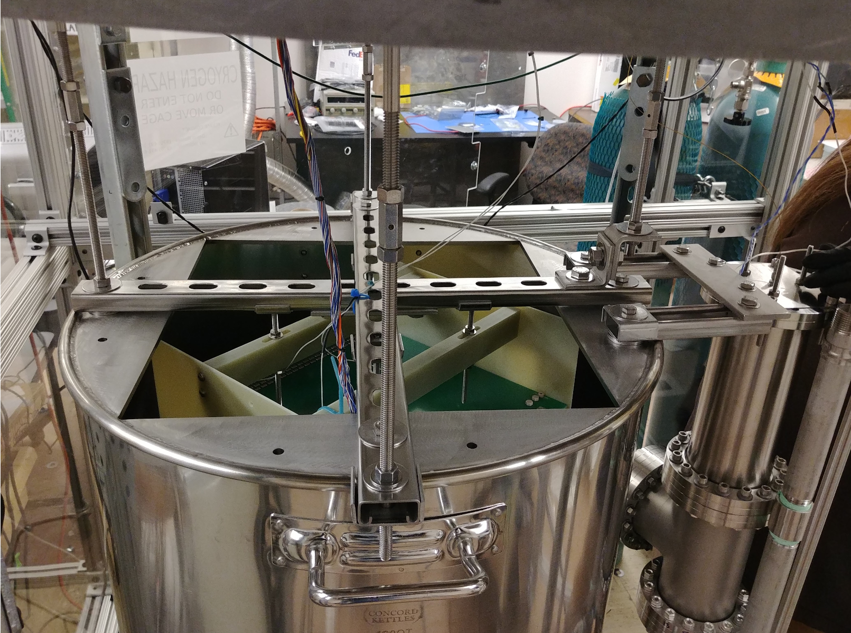
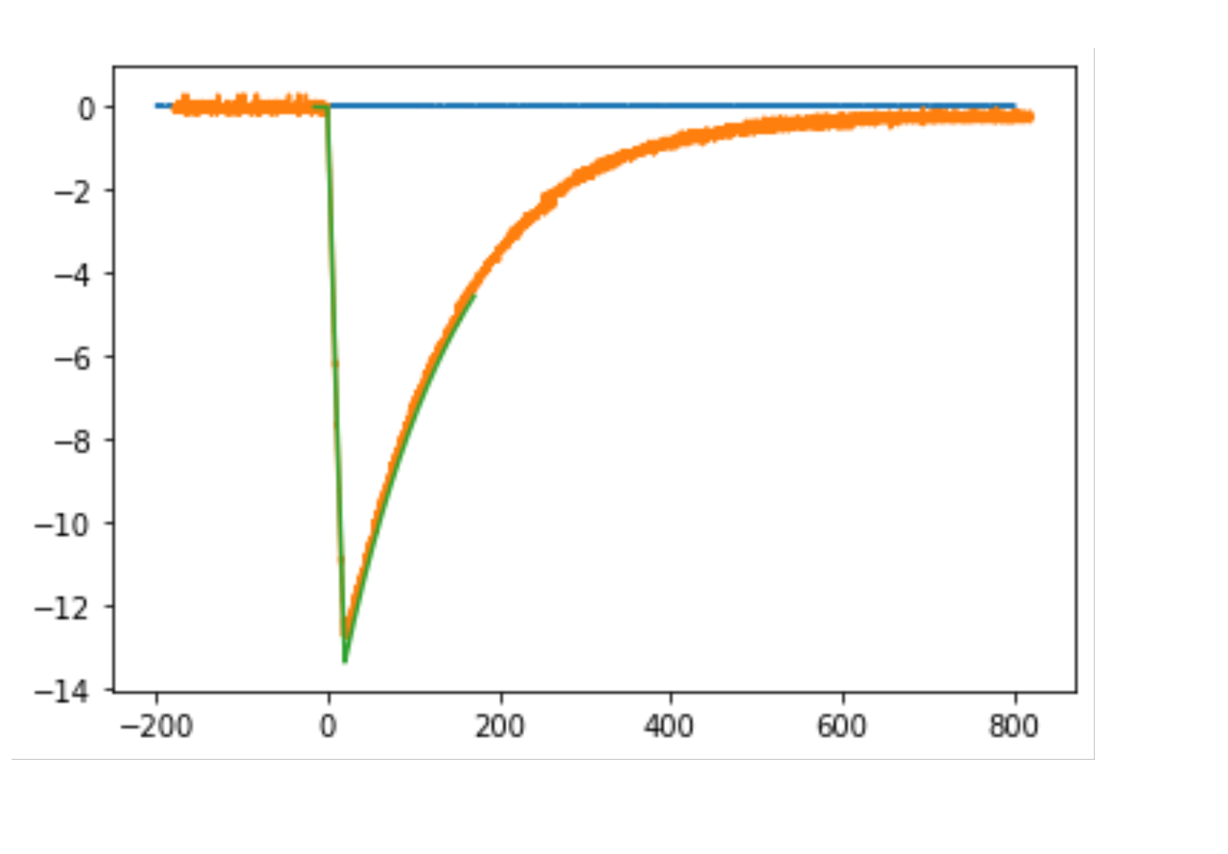
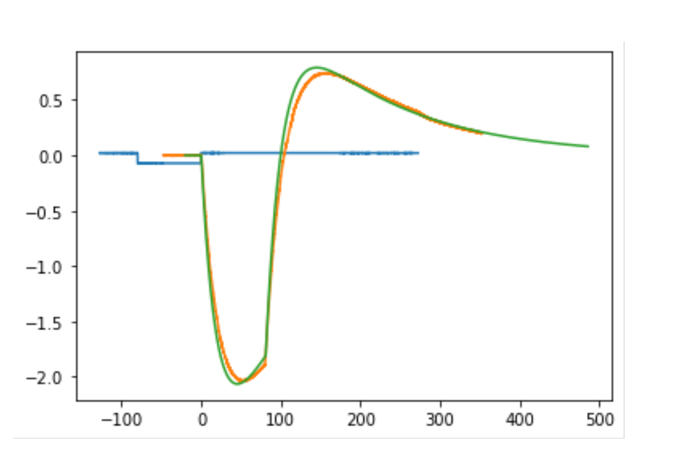
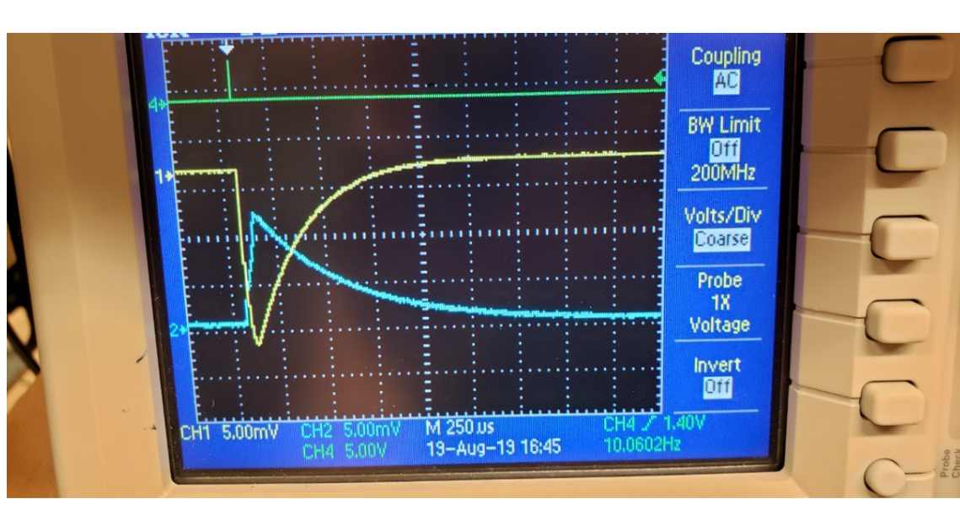
Recent work on LAr purity monitor at CSU
Single-Cube team Mike Mooney, J. Jablonski, GRA Lane Kashur, Chris Norris, Zach Rautio, et al.
Initial purity monitor
from UT
volts
Zack Rautio
Jablonski
SingleCube and PrM at CSU
Scaled down ND-LAr
Small, portable cryostat. Used in D218 and D206
PrM front end pulser test data w/ calculation.
Cathode and anode PrM signals in vacuum
μsec
μsec
2nd-year GRA Sam Fogarty is on the PrM work.

Slide 7
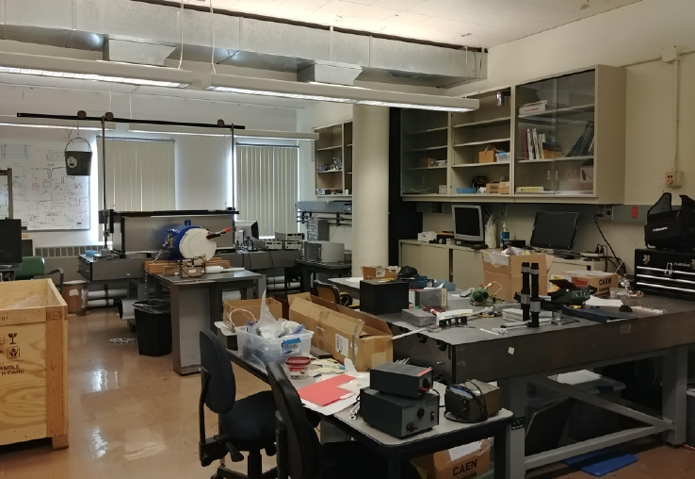
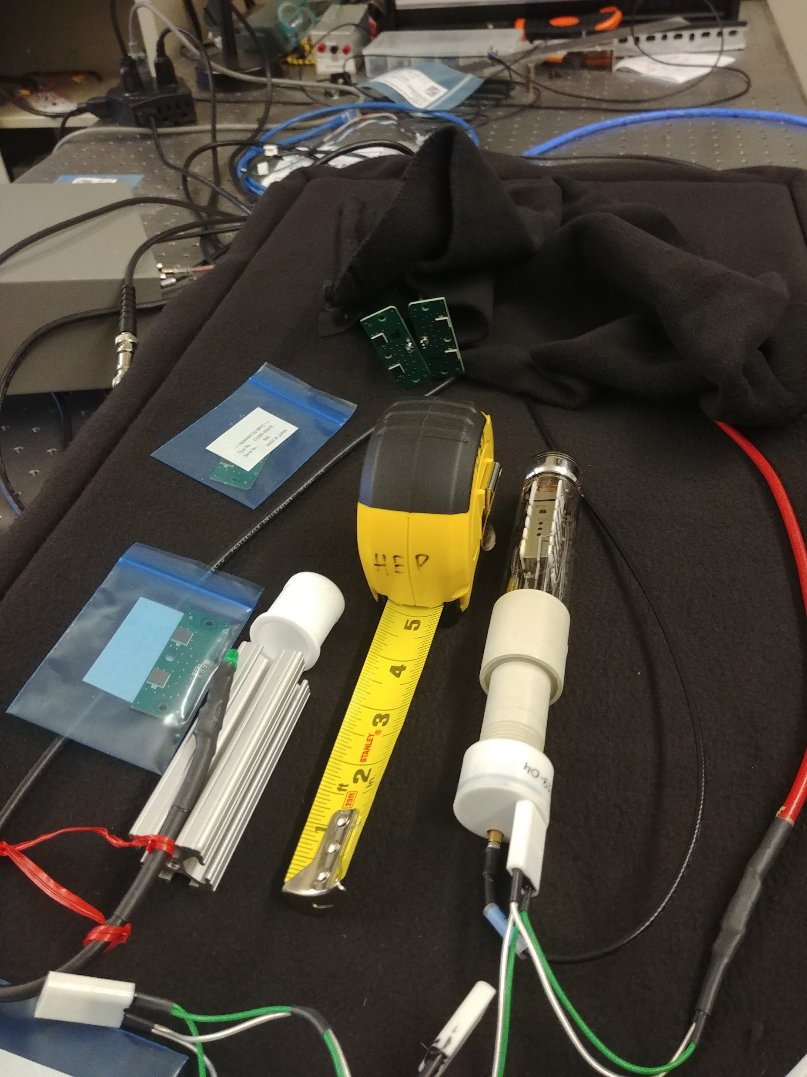
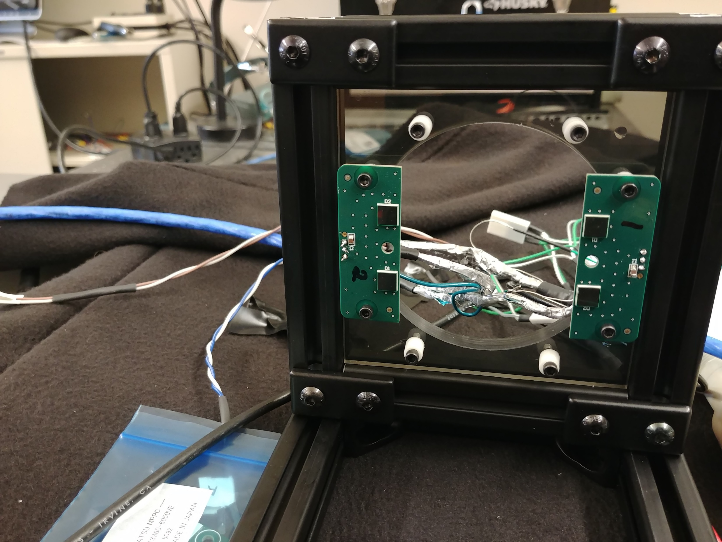
Directly applicable to FD2 PDS work
Small dark box with SiPM readout into ‘scope or CAEN DT 5702 module (the Bern module). LED pulses.
Harton lab, D218.
Down the hall from D206 w/ SingleCube
Master’s degree student reading out SIPM’s using CAEN module and root scripts (Connor Wallis). Passed along to new post doc, Andrew Mogan.
There are two small dark boxes in D218.
Space in this room is potentially available FD2 PDS activities

Slide 8
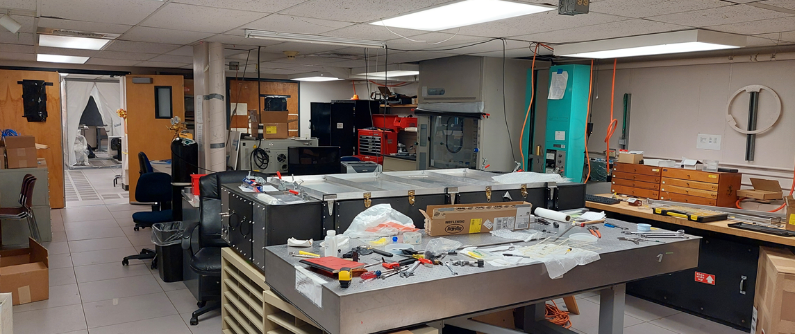
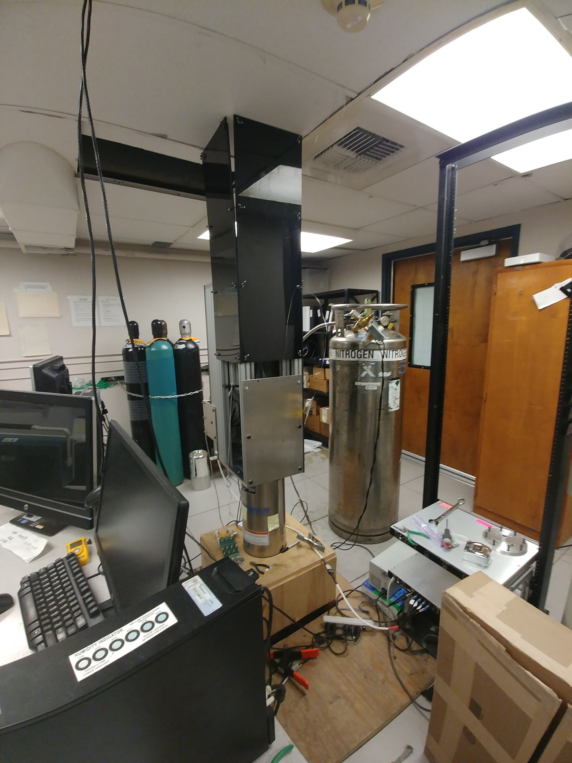
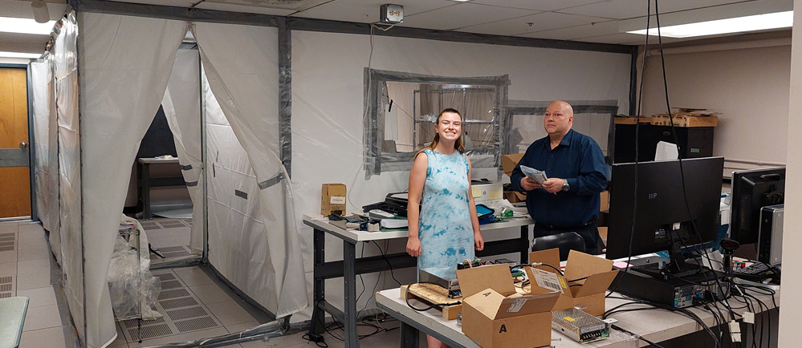
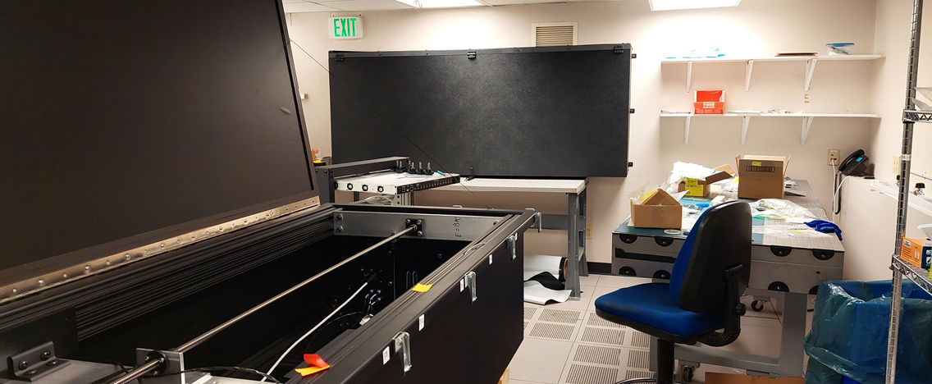
Common CSU HEP lab, E10
Partial view or E10. Short dewar for cold tests
E10 front room
E10 middle room
Norm Buchanan with
undergrad, preparing
for FD1 PDS
E10 back room
Dark boxes,
LabView slow control

Slide 9
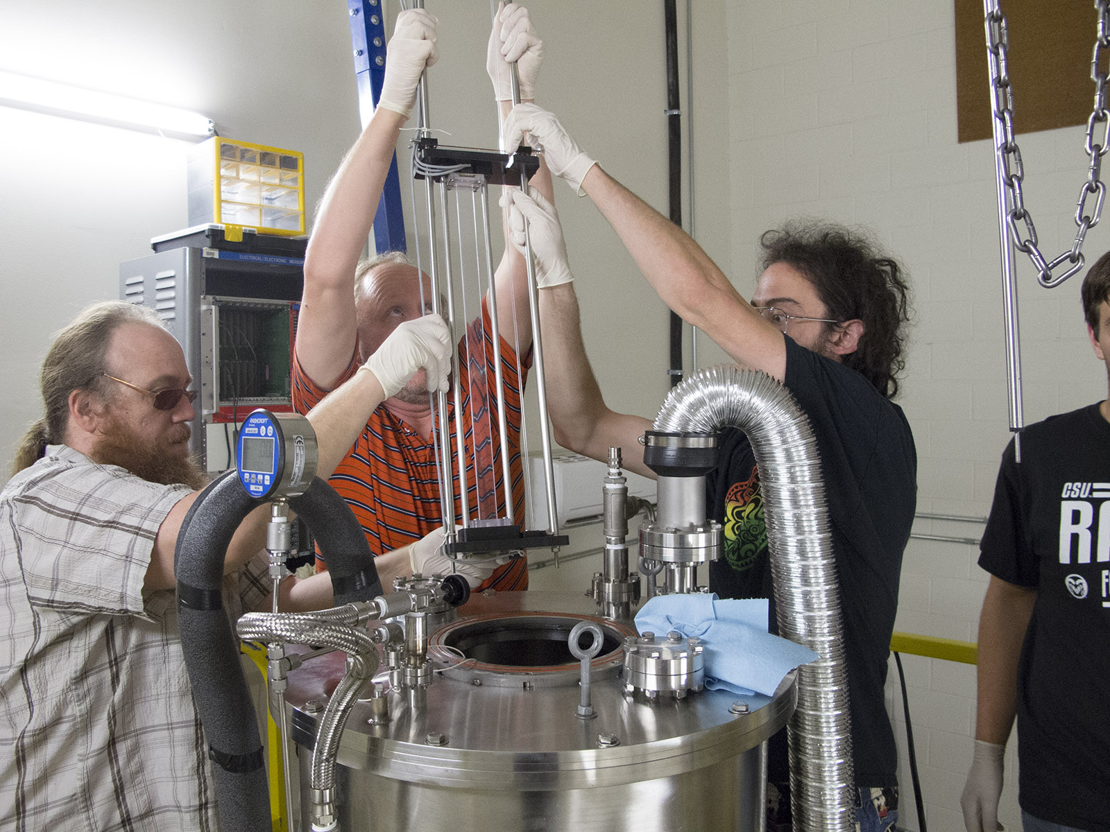
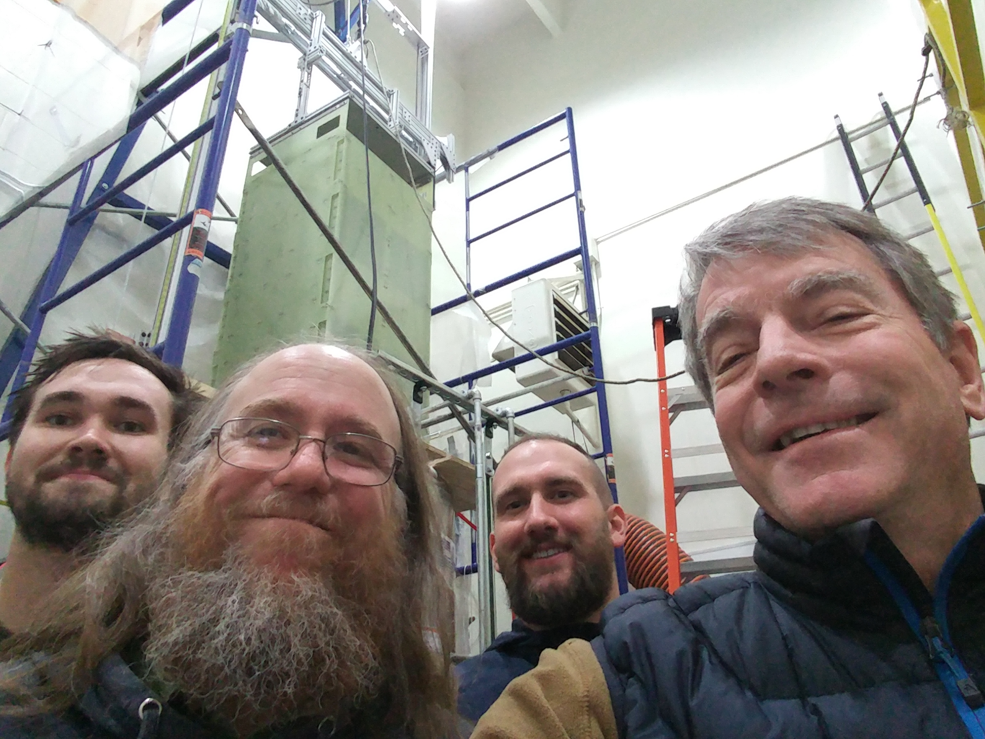
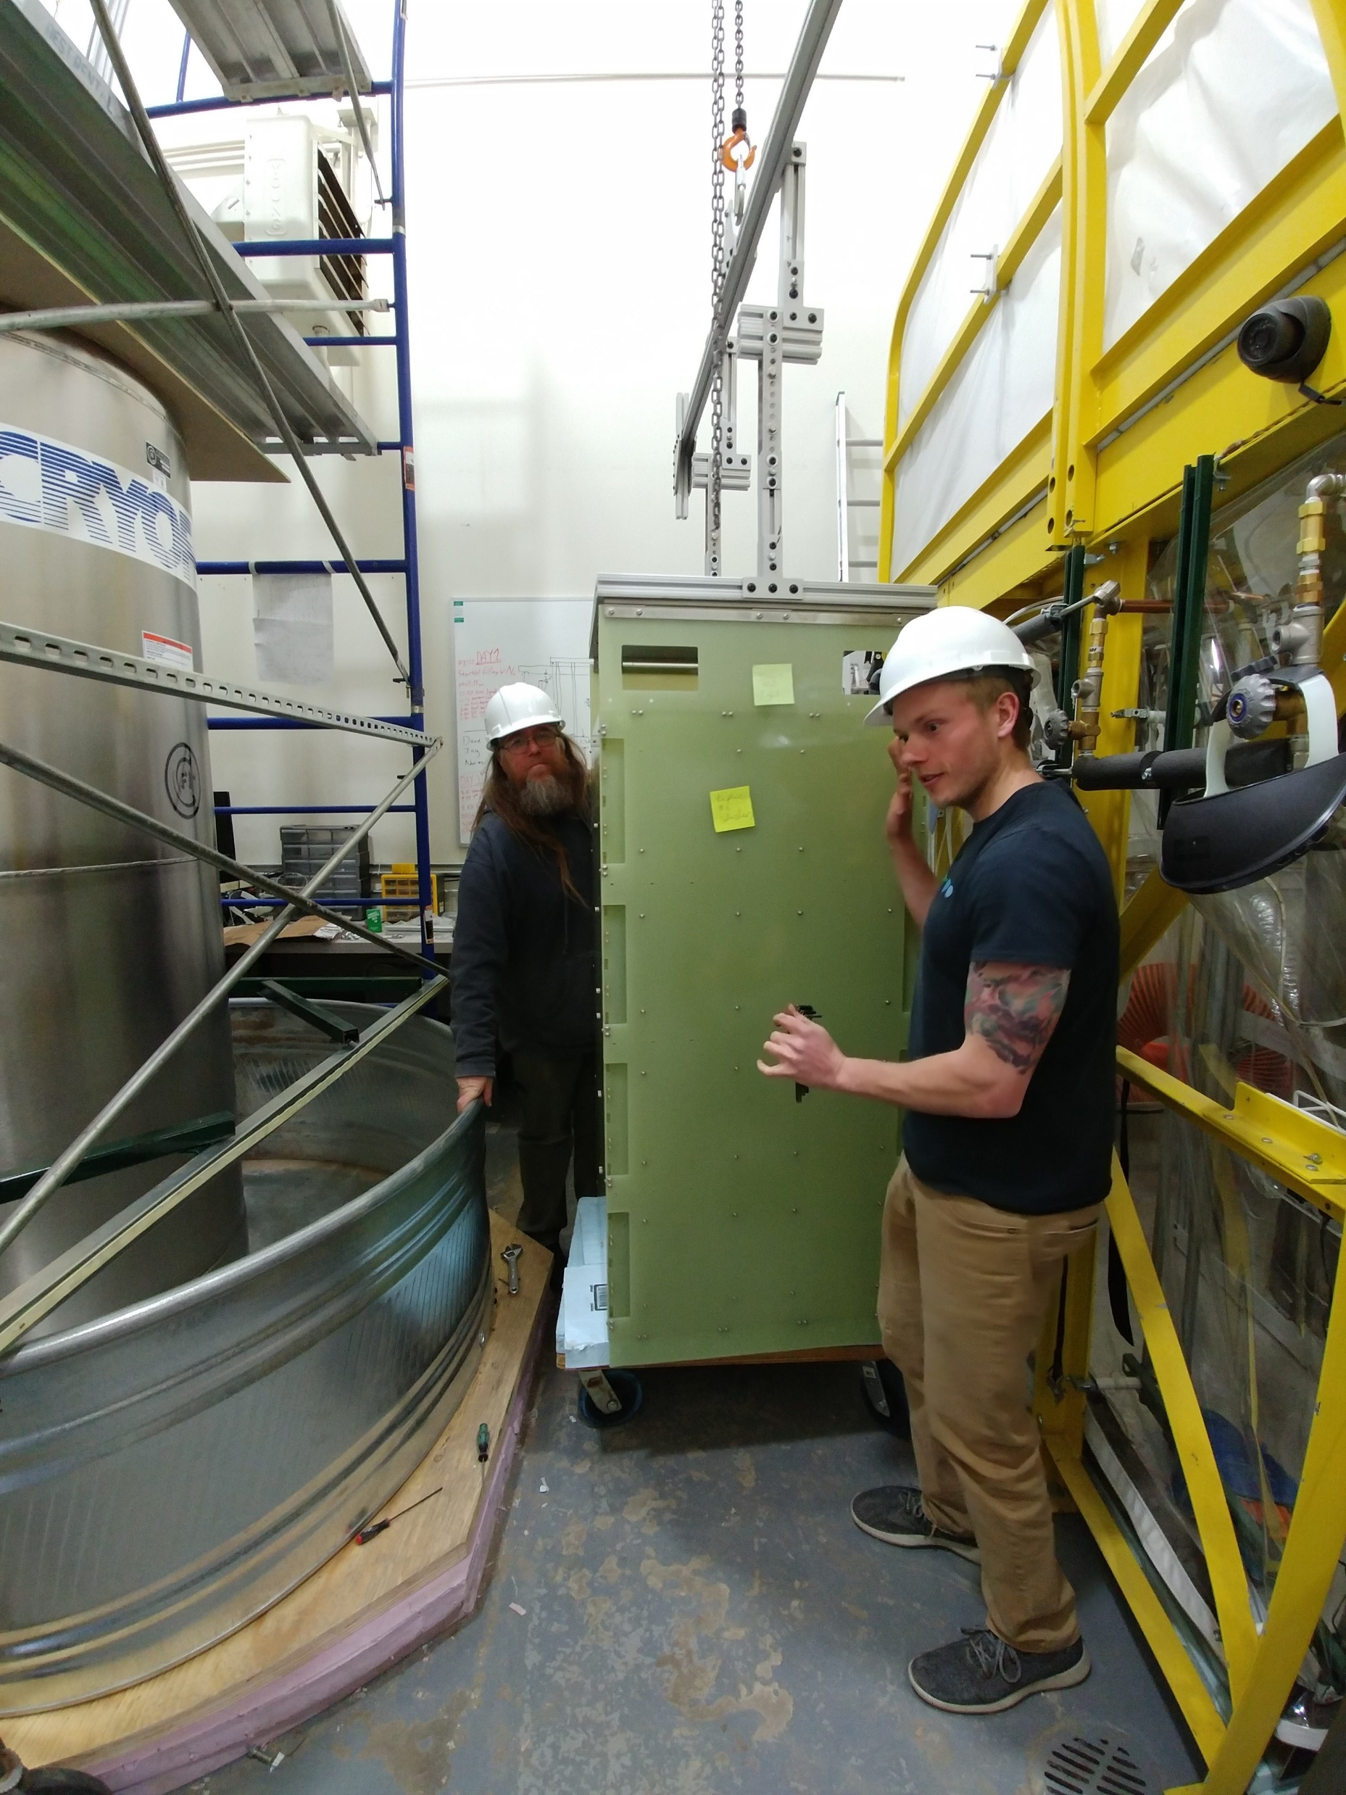
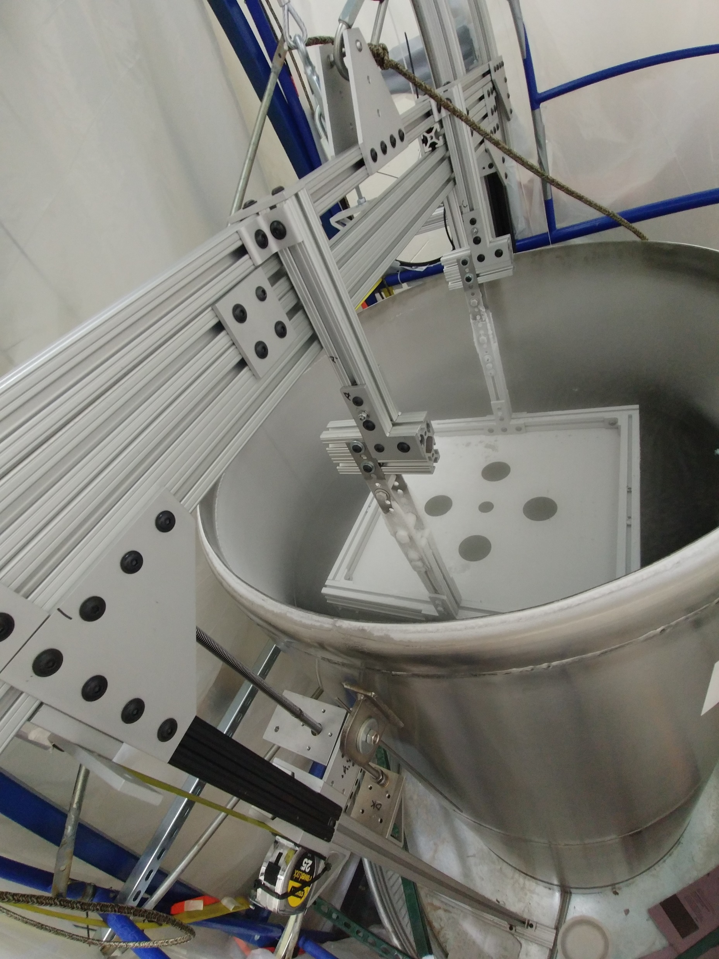
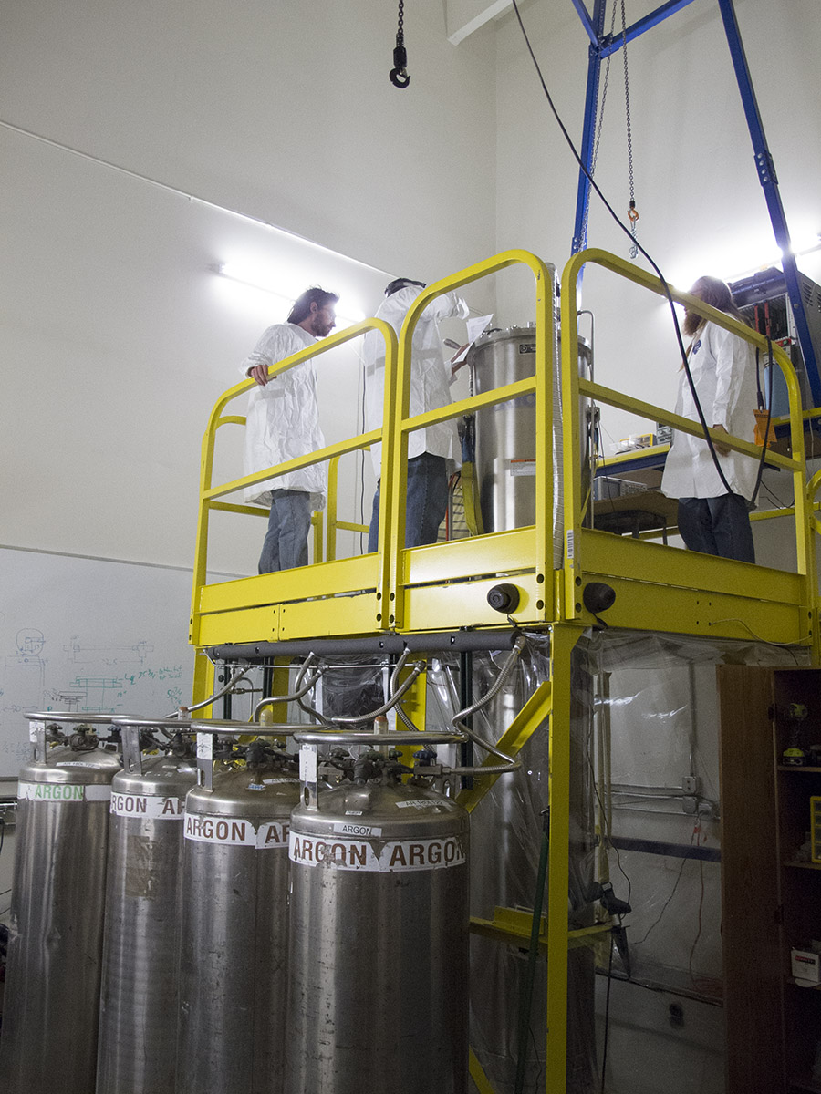
CSU HEP space at the CSU Foothills campus “Simlab” high-bay facility
Big Dipper
Cold test of scaled-down ND module. There was no damage after LN submersion and removal. Manual crank lift. Module was assembled in D206, Mooney lab.
This open Dewar is can house a full 60 X 60cm PD tile.
This wide dewar has been moved outside the room with the Big Dipper.
This cryostat has been used to test full scale FD1 PD modules.
Big Dipper

Slide 10
Plan for CSU involvement in FD2 PDS system
A main point: FD2 PDS will benefit from FD1 PDS experience, and FD1 may well benefit from FD2 PDS effort.
FD1 PDS system, with Dave Warner and CSU faculty members Buchanan, and Wilson is well ahead of FD2 PDS
Several resources at CSU can be used for both FD1 and FD2 PDS systems, with Harton and Buchanan coordinating:
Small tests (cold or warm) in D10 dewar and/or dark boxes
D218 dark boxes are also available
Full length cold tests in the Big Dipper
(The wide dewar at SimLab is less useful for signal tests, but could be made dark)
Quality testing may be very similar for FD1 and FD2 PDS’s.
Harton and Buchanan have agreed to coordinate development of test processes, including data base elements (Buchanan)
The CSU SingleCube TPC system (a scaled down ND-LAr cube) could house PDS elements (small), benefitting both.

Slide 11
Plan for CSU involvement in FD2 PDS system, continued
CSU people on FD2 PDS:
Dave Warner - Consortium Technical Lead
Harton would work with CSU HEP engineer Zach Rautio
Initial work would be on cold testing FD2 PDS modules
Bob Wilson
FD2 PD Simulation, Data Analysis, and ProtoDUNE Installation overseen by Bob Wilson
New post doc, primarily FD2 PD in the first year - based at Fermilab and available to travel to CERN for ProtoDUNE. Application deadline August 10 – please advertise https://jobs.colostate.edu/postings/89969
Jay Jablonski, Zach Rautio
Students and technicians (e.g., Chris Norris) as needed
Long term thinking:
CSU to be involved in development and testing of prototypes at CSU and elsewhere until design is finalized
Mass production and assembly could happen elsewhere as with FD1
CSU proposes to do final testing and packaging for shipment to South Dakota
Harton proposes to be lead faculty member

