Slide 1
Ethernet readout for DUNE: Discussion, planning and timelines
Alessandro Thea /
RAL-CERN

Slide 2
Timelines
Ethernet work embedded into the overall DUNE-DAQ timeline
1.1.2022
PDR
VD coldbox fully integrated
1.7.2023
FDR
PD-II VD
PD-II HD
PD-II VD
Now Summer 2022 Summer 2023
10.2022
VD coldbox bottom
(top standalone)

Slide 3
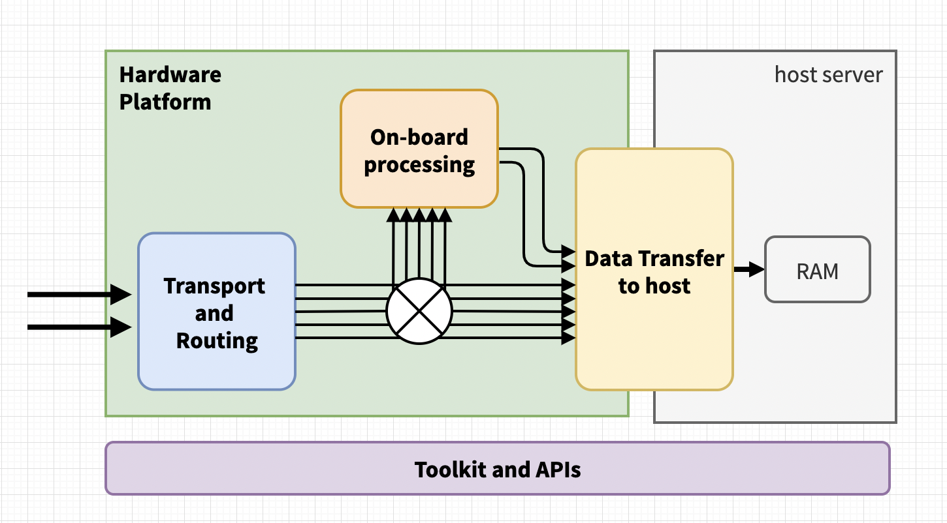
The DAQ PDR milestone
The DAQ PDR (1.1.2022) is a major milestone for the consortium
Description of a coherent DAQ design, including specifications and interfaces
Documented design of the main DAQ components
Prototype implementation based on the design to demonstrate that there is a clear path to satisfy the specs
Ethernet readout will not yet be mature
Use FELIX readout of HD+VD bottom electronics as demonstrator that we know how to implement readout/trigger
Demonstrate individual components of Ethernet readout to show that we know where we are heading to

Slide 4
Timelines & Deliverables
WIB 1,2 with FW TPG
HD-PDS without TPG
HD-PDS with FW TPG
Full VD with FW TPG
WIB 1,2 with SW TPG
VD Top el without TPG
VD Top el with TPG
VD PDS without TPG
1.1.2022
PDR
VD TPC coldbox fully integrated
1.7.2023
FDR
PD-II VD
PD-II HD
PD-II VD
Now Summer 2022 Summer 2023
10.2022
VD coldbox bottom
(top standalone)

Slide 5
Planning
Very intense work period ahead, from now to PD-II VD
Limited resources available to drive this new development
Planning crucial to be on solid footing by PDR on both serial-based and ether-based readout.
But we’re reinventing the wheel
The DAQ readout model is established demonstrated
We have experience with each key functional components
And in building, debugging and testing

Slide 6
Main components to demonstrate

Slide 7
Immediate steps
Define what demonstrators to pursue
Collect/formalise interest from different groups
Converge on Aug 10 or 17 UDAQ meeting?
Firm up the Top Electronics interface (data format details, etc…)
Closely track progress within UDAQ
Along the progress towards the end-to-end FELIX-based demonstrator
Aim at defining the baseline for each component by the PDR
Move to integration in the final solution after the PDR

Slide 8
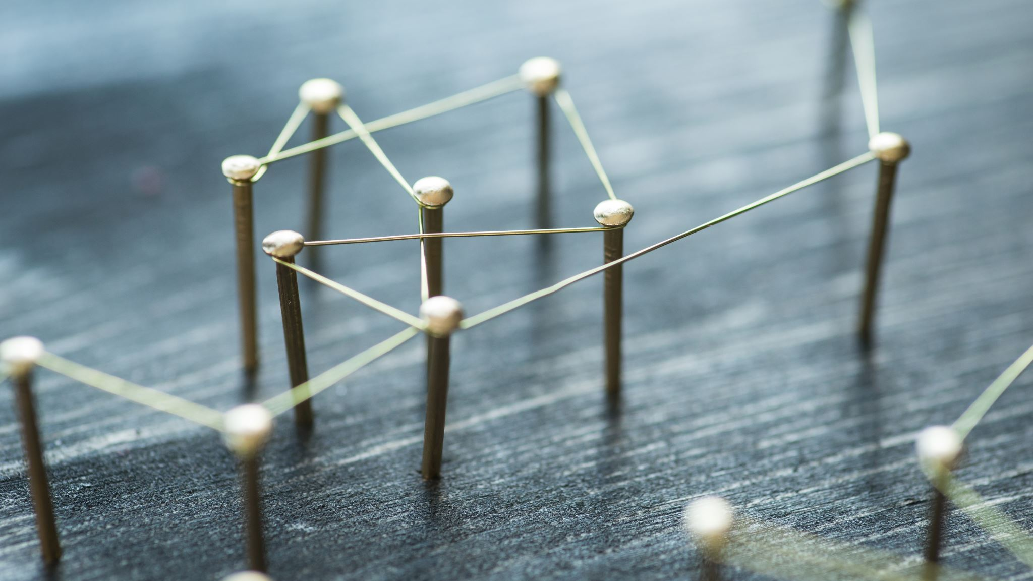
Floor open for discussion

