Slide 1
H- Injection Simulations for Multi-MW Upgrade
Matthew Hoppesch, UIUC
Supervisors – Jeffrey Eldred and David Neuffer
SIST Internship
11 August 2021

Slide 2
Motivation
Beam Power upgrades at Fermilab have the goal of delivering more power to the DUNE/LBNF experiments
Injection at higher energies allows for higher intensity -> more powerful beams
PIP-II is planned for 2027
0.7 MW -> 1.2 MW
Two proposals for after PIP-II (PIP-III) to increase power to 2.4 MW
2 GeV RCS (Rapid Cycling Synchrotron)
8 GeV SRF Linac
These new high intensity beams are demanding of foil injection, which is the focus of my summer project
Image from J. Eldred

Slide 3
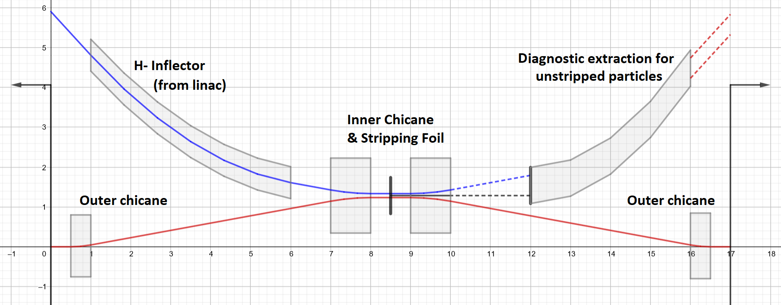
Foil Stripping Injection
How do we inject p+ from a Linac into a circulating beam
Magnets around injection bend injected H- (primary) and circulating p+ (secondary) together
Foil strips two e- from the H-, leaving two p+ circulating in beam
Problems
Foil heating from foil interactions
Power loss from large-angle scattering (especially at higher energies)
Both problems scale with number of foil hits. Minimized by decreasing foil hits.
Secondary hits scale quadratically with injection time
Image from J. Eldred
Notes:
Talk about minimizing secondary hits

Slide 4
Beam Painting Schemes
$$x_{offset}$$
$y_{offset}$
Images from D. Raparia
$y_{offset}$
$$x_{offset}$$
Correlated Painting
Anti Correlated Painting
Used in PIP-II
Painting decreases secondary hits by moving foil out of already circulating protons

Slide 5
Foil Size
Foil Size – A smaller foil decreases the interaction probability by presenting a smaller target.
In order to capture 99% of the beam, the foil must have Area = L x W = ${2.576}^{2}\left(σ_{Linac,x}×σ_{Linac,y}\right)$ [ cm^2 ]
Linac sigma i$s σ_{Linac| x,y}= \sqrt{\frac{ε_{Linac}^{RMS}}{βγ}β_{Linac| x,y}}$ . It is dependent on the Twiss Beta Parameter $β_{Linac| x,y}$
Some Injection mismatch $ξ=\frac{β_{Linac}}{β_{Ring}}<{\left(\frac{ε_{Linac}}{ε_{Ring}}\right)}^{1/3}$ was shown to decrease secondary hits without drastically increasing emittance
$${2.576 σ}_{Linac,x}$$
$${2.576 σ}_{Linac,y}$$
Notes:
Painting on next slide

Slide 6
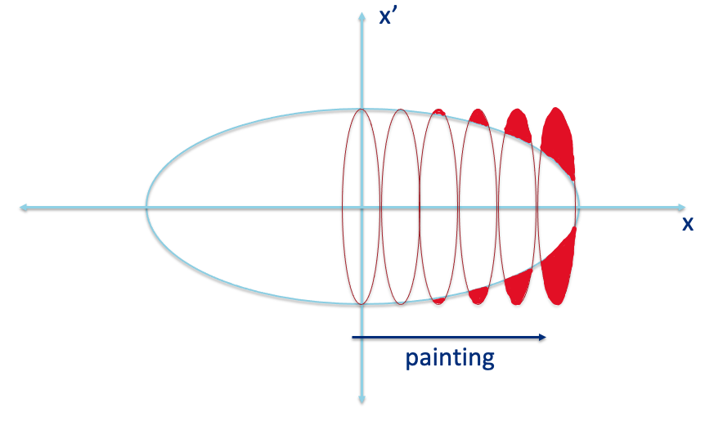
Injection Mismatch
For PIP-III injection, matched injection would be a ξ of ~.42
Emittance growth minimal until beam is severely mismatched
Significant reduction in total foil interactions by reducing ξ
Pick a ξ of .2 to run PIP-III simulations
$$ξ=\frac{β_{Linac}}{β_{Ring}}$$

Slide 7
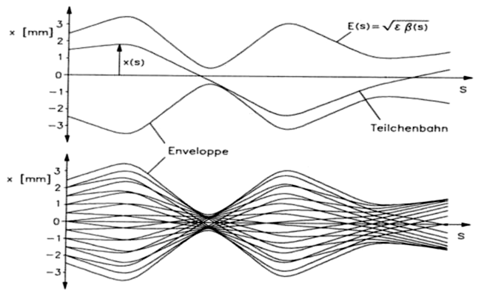
Beam Dynamics
Beam propagates through transverse phase space according to the transfer matrix
$\left[\begin{matrix}x_{n+1} \\ x_{n+1}^{′} \\ \begin{matrix}y_{n+1} \\ y_{n+1}^{′}\end{matrix}\end{matrix}\right]=\left[\begin{matrix}\begin{matrix}\cos{ν_{x}+α_{x}\sin{ν_{x}}} & β_{x}\sin{ν_{x}} \\ {−γ}_{x}\sin{ν_{x}} & \cos{ν_{x}−α_{x}\sin{ν_{x}}}\end{matrix} & \begin{matrix}0 & 0 \\ 0 & 0\end{matrix} \\ \begin{matrix}0 & 0 \\ 0 & 0\end{matrix} & \begin{matrix}\cos{ν_{y}+α_{y}\sin{ν_{y}}} & β_{y}\sin{ν_{y}} \\ {−γ}_{y}\sin{ν_{y}} & \cos{ν_{y}−α_{y}\sin{ν_{y}}}\end{matrix}\end{matrix}\right]\left[\begin{matrix}x_{n} \\ \begin{matrix}x_{ n}^{′} \\ y_{n}\end{matrix} \\ y_{n}^{′}\end{matrix}\right]$
Transfer matrix creates a “one turn map”, describing the transverse position of the beam at the injection point after one revolution
$β_{x,y} and α_{x,y} are the Twiss parameters of the machine, γ_{x,y}= \frac{1+α_{x,y}^{2}}{β_{x,y}}$
Only fractional tune matters in this simulation, $ν_{x}$ and $ν_{y}$ chosen to avoid resonance
Wille

Slide 8
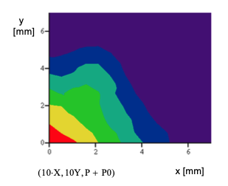
Benchmarking PIP-II Simulations
Python simulation matched Valeri Lebedev’s MathCad for PIP-II CDR
Included
Dispersion
Multiple Scattering
Longitudinal Painting
My Simulation (Top) gives results similar to PIP-II CDR (Bottom)
Top Hot Spot $=59 {hits}/{p^{+}∙{cm}^{2}}$
Bottom Hot Spot $=63 {hits}/{p^{+}∙{cm}^{2}}$
Used this simulation as a jumping off point for the 2 GeV RCS and 8 GeV Linac Scenarios, with a few key differences
Both the Linac and RCS are injected into dispersion free regions, which simplifies the simulation to 4D
PIP-II Injection takes places over ~300 turns while the Linac and RCS scenarios are considering injecting over 1000 turns
Image from V. Lebedev

Slide 9
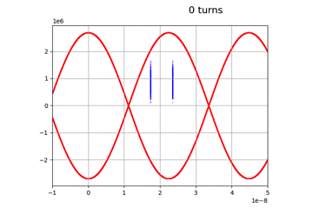
PIP-II Longitudinal Injection Scheme Foil Hits
Off momentum (CDR)
Booster Window: 0 < |φ| < 0.55π
Momentum offset: 7e-4
On Momentum (Paul Derwent)
Booster Window: 0.15π < |φ| < 0.7π
No momentum offset
Results
~ 50% increase to total foil hits
~ 7% increase to peak hit density
Paul Derwent
Booster Separatrix injection for CDR (left), Paul (Right)

Slide 10
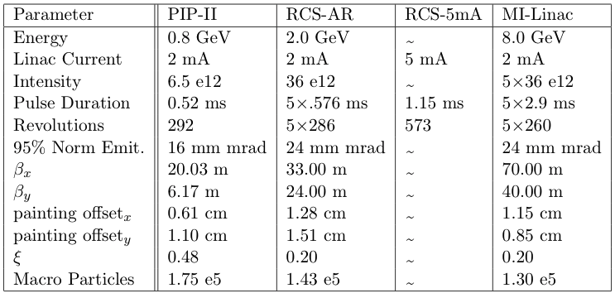
Multi MW Upgrade Scenarios
Long Injections have painting split into five parts
PIP-III scenarios inject at higher intensity which requires longer injection
PIP-III injects into a larger emittance than PIP-II
Injection mismatch causes a minimal emittance increase
Image from J. Eldred

Slide 11
Simulation Results
Conclusions
The MI Linac and RCS-AR scenario prefers correlated painting, as the alternative increases secondary hits by > 75%.
The 5mA RCS also prefers correlated painting, but to a lesser degree which offers more options.
For the 5 mA RCS scenario, the peak hit density per particle could be optimized close to PIP-II injection

Slide 12
MI-Linac Painting Comparison
Notes:
Mention Cut Corner Scenario

Slide 13
Summary
Created a simulation in Python, benchmarked by PIP-II CDR
Investigated an on-momentum injection scheme for PIP-II
Ran both correlated and anticorrelated simulations for several PIP-III scenarios
Results of those simulations indicate that correlated painting becomes preferable as the time of injection rises. (more turns per injection)
Further investigations should include space charge, transverse coupling, dispersion from chicane magnets
Acknowledgments
I would like to especially thank my supervisors Jeffrey Eldred and David Neuffer as well as my group mentors Michael Geelhoed, Ahmed Syed, and Linden Carmichael for their support, guidance, and encouragement throughout my summer internship.
I would also like to thank Fermilab and the SIST Committee for allowing me to participate in research this summer.

Slide 14
Accessory Slides

Slide 15
Beam Painting Bump Functions
$y_{offset}$
Images from D. Raparia
$$x_{offset}$$
Correlated Painting
$x_{corr}\left(n_{turns}\right)=x_{offset}\sqrt{\left(\frac{n_{turns}}{N_{turns}}\right)\left(1−Δ\right)}+Δ$
$y_{corr}\left(n_{turns}\right)=y_{offset}\sqrt{\left(\frac{n_{turns}}{N_{turns}}\right)\left(1−Δ\right)}+Δ$
$Δ$ represents starting painting off center
Anti Correlated Painting
$x_{anticorr}\left(n_{turns}\right)= x_{offset}\cos\left[\left(\frac{π}{2}−∅\right)\frac{n_{turns}}{N_{turns}}+∅\right]$
$y_{anticorr}\left(n_{turns}\right)= y_{offset}\sin\left[\left(\frac{π}{2}−∅\right)\frac{n_{turns}}{N_{turns}}+∅\right]$

Slide 16
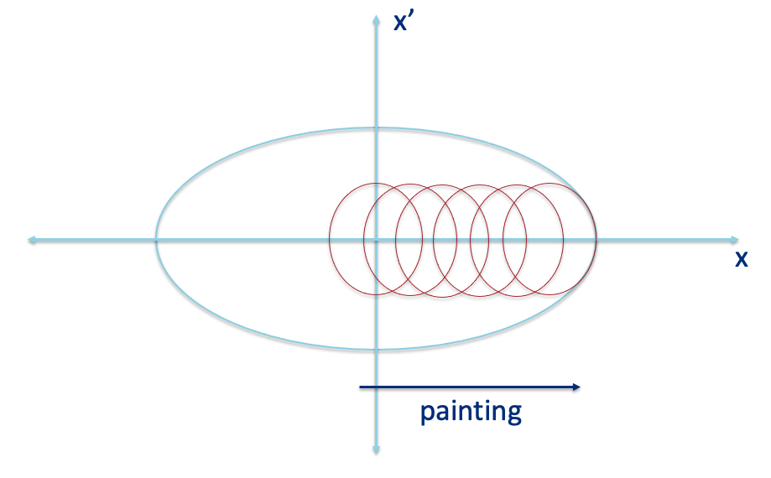
Injection Mismatch
Method 1
Mismatch refers to the ratio of $ξ=\frac{β_{Linac}}{β_{Ring}}$
Method 1 is typical $ξ={\left(\frac{ε_{Linac}}{ε_{Ring}}\right)}^{1/3}$
Linac is geometrically matched to the ring
Allows room for emittance growth through multiple scattering in the foil
More foil interactions, due to greater Linac spread
Method 2 presents a more aggressive painting scheme $ξ=\frac{ε_{Linac}}{ε_{Ring}}$
Linac is mismatched to to beam
Greater emittance from particles injected outside of ring acceptance, less room for emittance growth
Foil can be smaller due to compressed beam at injection, less foil interactions
Optimal Mismatch is somewhere between methods 1 and 2 and different for anticorrelated and correlated painting
Method 2

Slide 17
Injection Mismatch
95% emittance tolerable for the degree of mismatch proposed
Slightly Different Minima for Anticorrelated vs Correlated Painting
Anticorrelated minimized at $ξ \sim .14$
Correlated minimized at $ξ \sim .1$
This simulation indicates that future foil injection could benefit from some injection mismatch
Realistic painting scheme will likely be more conservative, this simply demonstrates how injection mismatch can reduce foil hits
Injecting at $ξ \sim .2$ would represent at 40 – 50 % reduction in foil interaction depending on the painting scheme.
Note on Multiple Scattering
RMS scattering angle scales as 1/p therefore small angle scattering is less of a concern at 2 and 8 GeV than at 800 MeV
Power loss from large scattering is a concern at higher energies, minimizing foil interactions can help mitigate this effect
Scenario 2
Scenario 1

Slide 18
2 mA RCS Painting Comparison
14.69 hits/p+
8.65 hits/p+
Peak hits spot is ~15% less hot for Anticorrelated Painting
Total hits is ~70% greater for Anticorrelated Painting

Slide 19
5 mA RCS Painting Comparison

