Slide 1
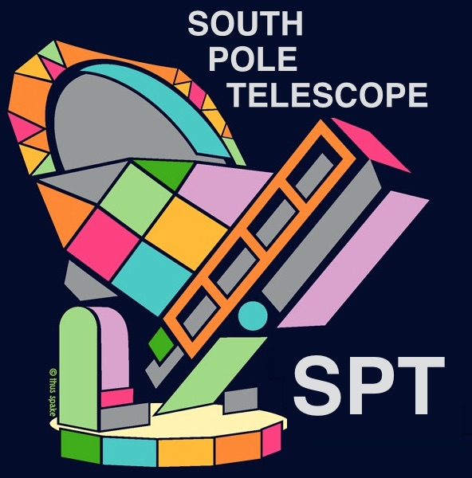
Searching for Cosmic Strings using SPT-3G Data
Ebtihal M. Abdelaziz
Supervisor: Adam Anderson and Brad Benson
8/11/2021

Slide 2
The South Pole Telescope
Unique 10 m primary mirror, largest of its kind
Resolution of 1.0 to 1.5 arcmin, highest resolution CMB maps
High sensitivity to polarized CMB

Slide 3
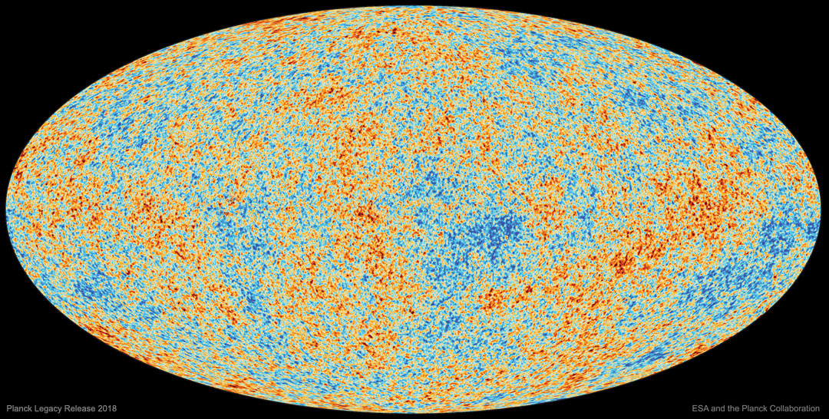
Cosmic Microwave Background
Formed about 380,000 years after the Big Bang
Helped us measure cosmic parameters very accurately.
CMB maps show fluctuations in temperature or polarization
It is measured by microwave telescopes such as the South Pole Telescope (SPT) or satellites like Planck
Cosmic Strings have been constrained to be less than 10% of the total CMB anisotropy

Slide 4
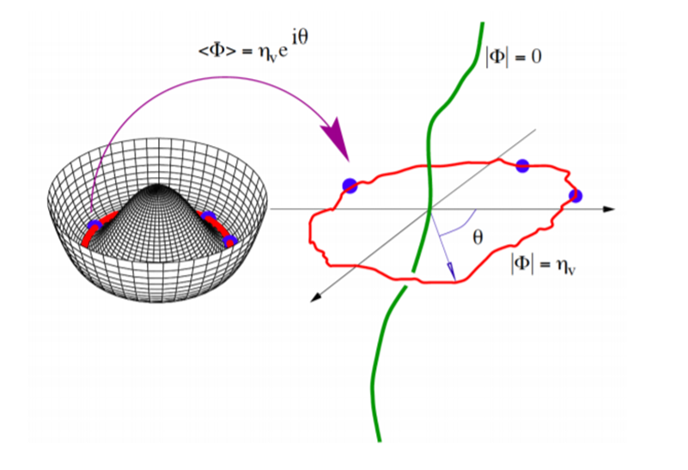
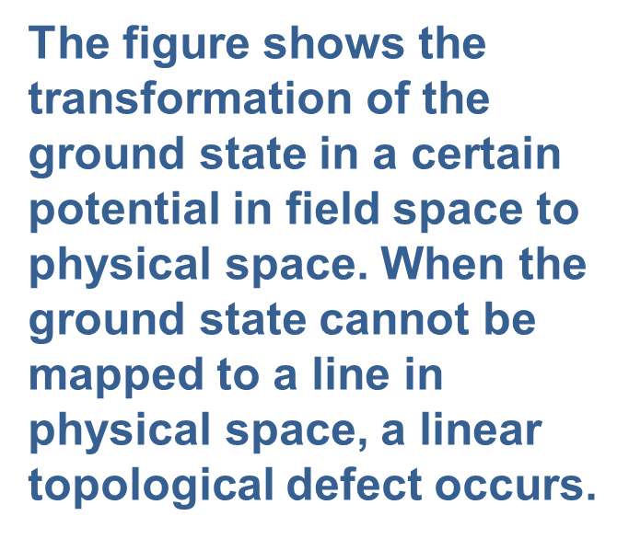
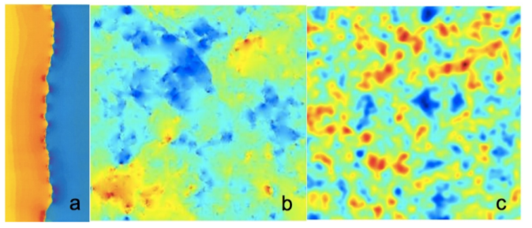
Cosmic Strings
Strings are linear topological defects
Have not been detected before
Possible detection methods include examining their power spectrum and edge detection algorithms
a) a line-discontinuity in CMB temperature caused by a single string on a uniform background (image provided by Proty Wu and Paul Shellard, (J.H.P.Wu PhD thesis, U. of Cambridge, 2000)). b) anisotropy caused by a network of strings alone (0708.1162). c) anisotropy caused by a network of strings with CMB anisotropy (1004.2885) .

Slide 5
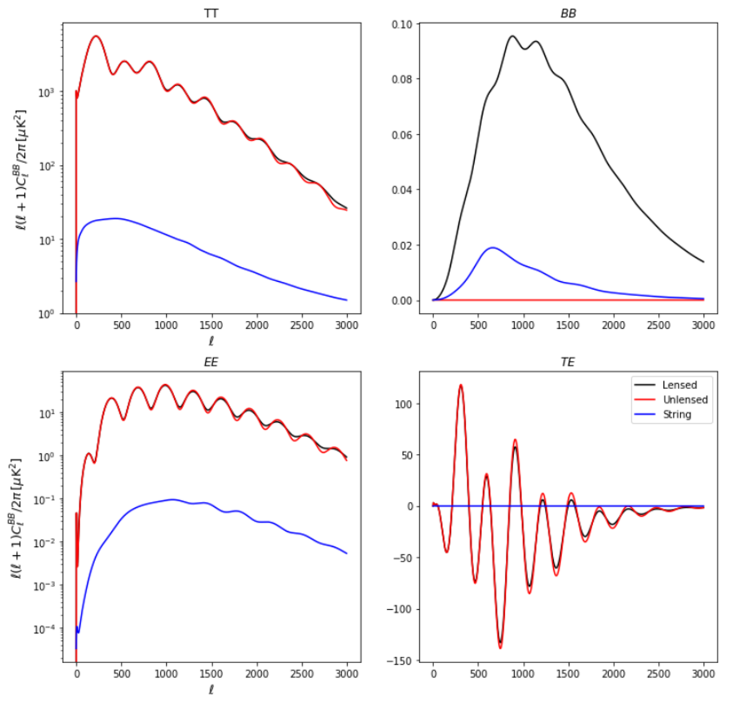
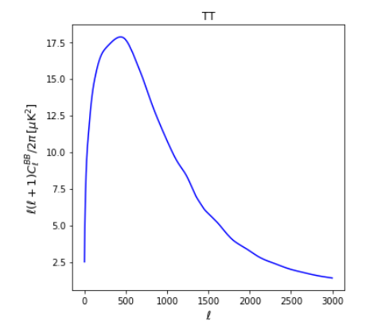
Power Spectrum
(Pictures from CAMB, CMBACT)

Slide 6
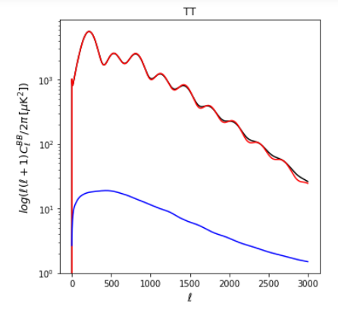
Fisher Forecast
Tells us about the maximum uncertainty in the values we are trying to measure
Can also be thought of as a way to know the maximum sensitivity of the experiment
Provides reliable values without the need of performing the full analysis
(Picture from CAMB, CMBACT)

Slide 7
Forecasts
Configuration | $$Ω_{b}h^{2}$$ | $$Ω_{c}h^{2}$$ | $$H_{0}$$ | $$τ$$ | ns | As / log(As) | Gμ
Lmax =3000 Lmin = 100 Lensed Srini’s 2_year noise curves Tau = 0.0070 (prior) Fsky = 1500 / 41253 | 1.46E-4 | 2.03E-3 | 7.68E-1 | 6.76E-3 | 7.35E-3 | 2.72E-11 5.626E-3 | No strings
Nexp = 120 Gmu = 10^(-7) Tau = 0.0070 (prior) | 1.49E-4 | 2.13E-3 | 8.01E-1 | 6.78E-3 | 7.43E-3 | 2.81E-11 5.80E-3 | 1.12E-8
BB included Nexp = 120 Gmu = 10^(-7) Tau = 0.0070 (prior) | 1.44E-4 | 1.8E-3 | 6.71E-1 | 6.78E-3 | 6.7E-3 | 2.72E-11 5.62E-3 | 8.37E-9
Planck Fsky = 0.73 | 1.12E-4 | 1.37E-3 | 5.51E-1 | 6.77E-3 | 4.11E-3 | 2.944E-11 6.09E-3 | 1.92E-8
Planck and SPT-3G combined | 7.84E-5 | 1.05EE-3 | 4.07E-1 | 4.7E-3 | 3.13E-3 | 1.94E-11 4.01E-3 | 6.59E-9

Slide 8
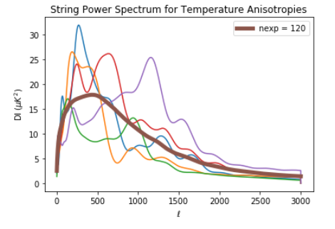
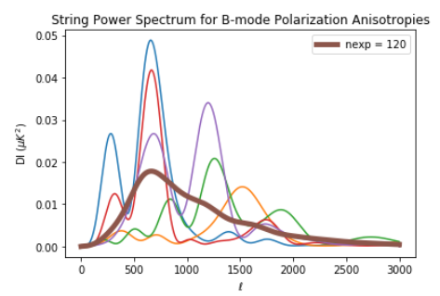
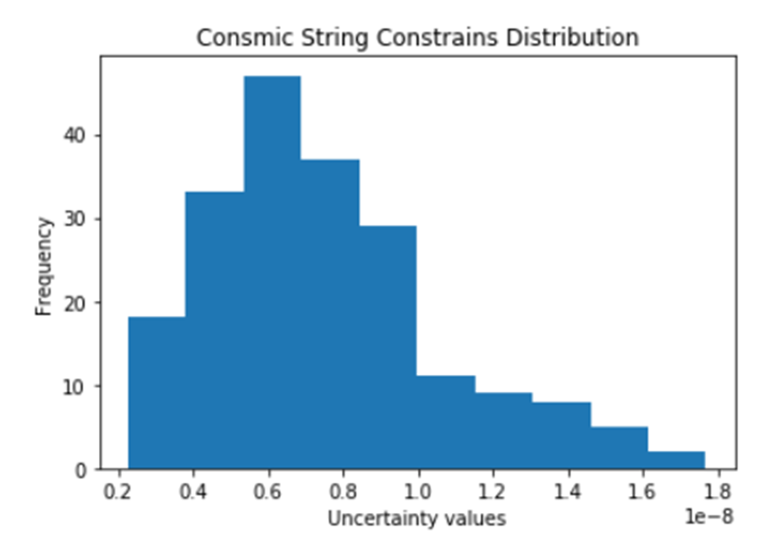
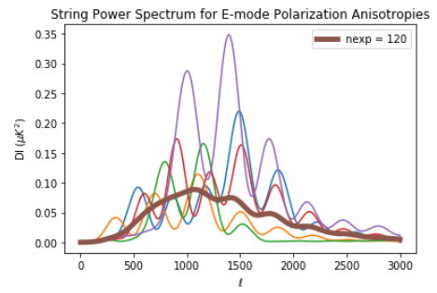
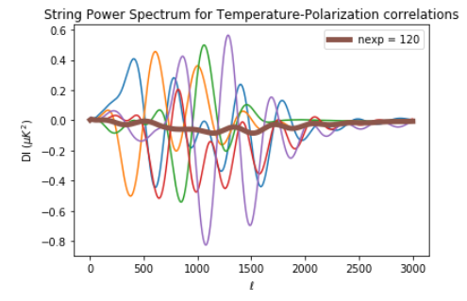
String Realizations and Distribution

Slide 9
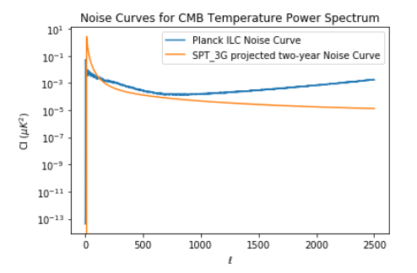
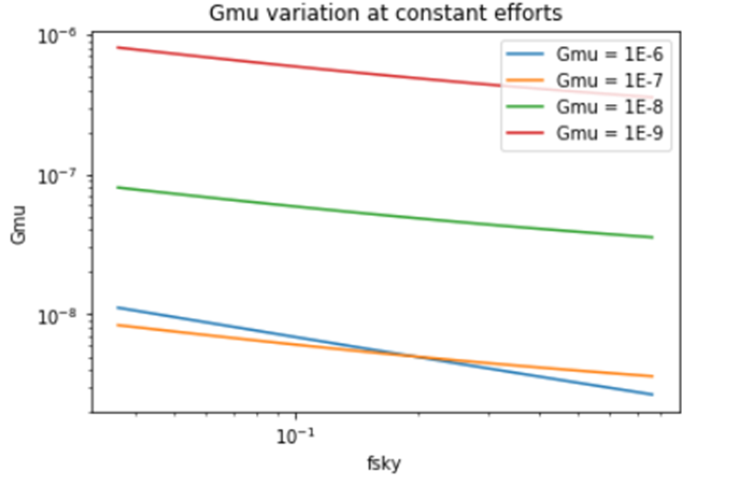
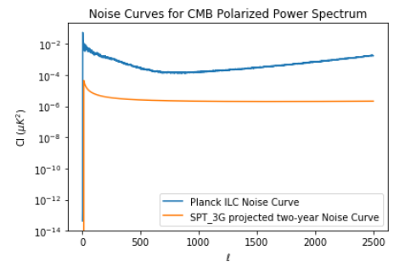
Noise and Fsky Variation
Noise Curves of different experiments. These curves were used in different configuration of the fisher forecast.

Slide 10
Conclusions
SPT-3G is more sensitive to cosmic strings than Planck
Increasing the observed sky fraction improves the uncertainties
Combining SPT-3G data and Planck’s data yields better constraints.
Acknowledgment
I would like to thank my wonderful supervisor, Adam Anderson, for all his help and encouragement this summer!
Special thanks to Brad Benson, my other supervisor!
Thank you to my mentors, Aisha, Brian, and Andres!
Thank you to the SIST committee and Judy Nunez for this opportunity!

Slide 11
References
Dvorkin, Cora, Mark Wyman, and Wayne Hu. “Cosmic String Constraints from WMAP and the South Pole Telescope Data.” Physical Review D 84.12 (2011): n. pag.
Crossref. Web. 4. Ade, P. A. R. et al. "Planck2013 results. XXV. Searches for cosmic strings and other topological defects". Astronomy & Astrophysics 571. (2014): A25.
Dan Coe, . "Fisher Matrices and Confidence Ellipses: A Quick-Start Guide and Software." (2009).
Wu, W. L. K. et al. "A GUIDE TO DESIGNING FUTURE GROUND-BASED COSMIC MICROWAVE BACKGROUND EXPERIMENTS". The Astrophysical Journal 788. 2(2014).
L. Balkenhol, et al. "Constraints on LambdaCDM Extensions from the SPT-3G 2018 EE and TE Power Spectra." (2021).
Aghanim, N. et al. "Planck 2018 results". Astronomy & Astrophysics 641. (2020): A6.
M. Landriau and E. Shellard, Phys.Rev. D83, 043516 (2011), 1004.2885.
A. A. Fraisse, C. Ringeval, D. N. Spergel, and F. R. Bouchet, Phys.Rev. D78, 043535 (2008), 0708.1162.

Slide 12
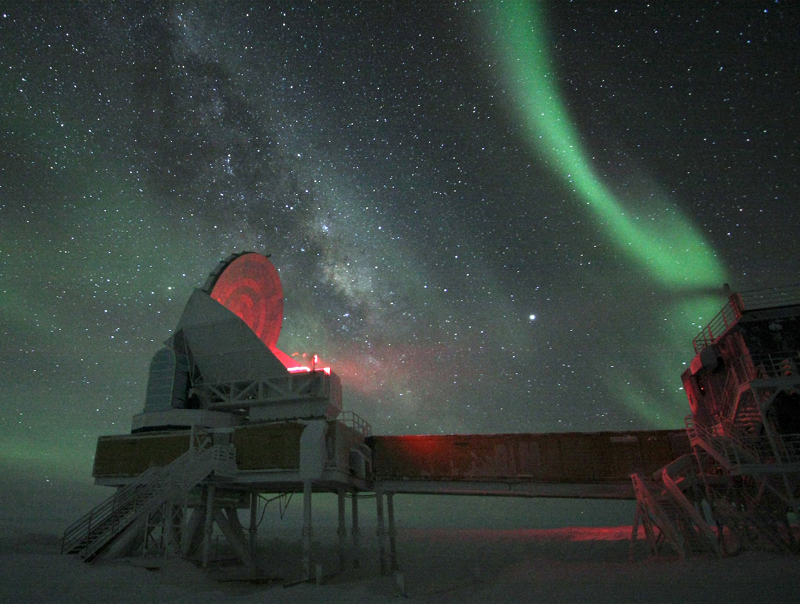
Thank you so much!

