Slide 1
“I can probably CAD that” or “It goes in the square hole”
Aaron Schwan

Slide 2
Cage
It’s a box!

Slide 3
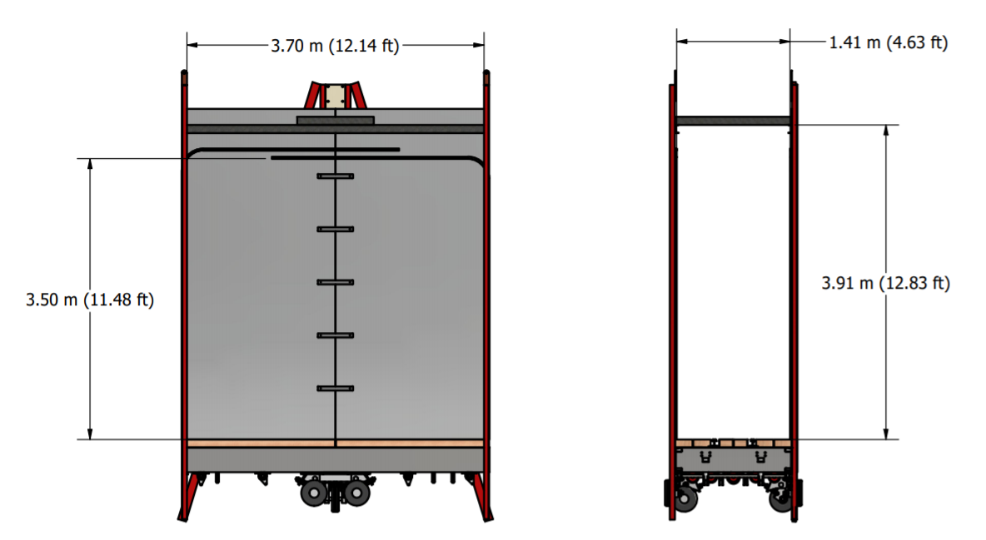
Cage

Slide 4
Cage Continued

Slide 5
Why?
Integrate into the model of the shaft and headframe
Easy first check for materials to verify it can fit
Planning for material loads

Slide 6
Loads
1) Not very awkward loads
2) Very awkward loads

Slide 7
L-Beams
Too Large to fit in cage
Must be rotated to fit through headframe then rotated to fit into cage
Mostly 5.5 meters (18ft) and 3.6 meters (12ft)
Weighs 5458 kg (12,033 lb)
Notes:
1 pickup truck in length
2 pickup trucks in weight

Slide 8
Paths
Path 1: Green
Through Southwest Door
Around Cage
Rotate on 10T
North
Path 2: Orange
Through Southwest Door
Through Cage
Rotate on 10T
Path 3: Blue
Through Northeast Door
Through Cage
Rotate on 10T
Path 1: Green
Path 2: Orange
Path 3: Blue
Path 4: Purple
Path 4: Purple
Through Southeast Door
Rotate while entering
More technical Lift
Will be in the correct orientation

Slide 9
Path 1

Slide 10
Rotation Idea
One chain hoist at a time is moved
Alternating process
Shorten long side
Lengthen short side
Maintained below critical angles of hoists

Slide 11
I-Beams
Short
Below 7.5 Ton
Shorter than 8m
Long
Above 7.5 Ton
Longer than 8m
Notes:
2.5 pickup trucks in length
Almost 3 pickup trucks in weight

Slide 12
Path into Headframe For Long I-Beam
Minimum angle of 13-degrees entry
Floor conditions
Shelfing outside headframe
Custom rigging

Slide 13
Path into Headframe For Long I-Beam

Slide 14
Guide Shoe Cart Combination
That could maybe work if physics doesn’t step in

Slide 15
Guide Shoe Cart Combination
Cart Mode
Guide Mode

Slide 16
Guide Shoe Cart Animation

Slide 17
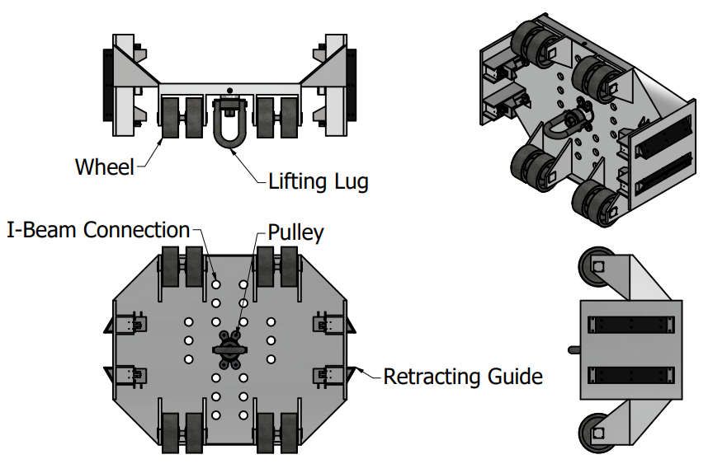
Guide Shoe Cart Overview
Retracting guides like how a door locks
Two sets of wheels
Lifting lug able to control insertion and extraction
Pulley system that retracts the opposite guides
Primarily designed around commercially available parts

Slide 18
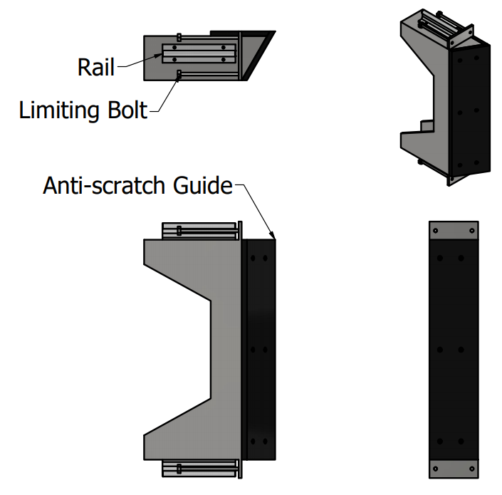
Guide Shoe Cart Retracting Guides
Linear rail reduces forces required
Anti-scratch guides
Spring loaded position in locked state

Slide 19
Guide Shoe Cart Next Steps
Define parameters of operation
Evaluate practicality given the current facility
Submit requests for information to designing firms
Build the cart

Slide 20
Bridge Crane RFI
Does it fit?

Slide 21
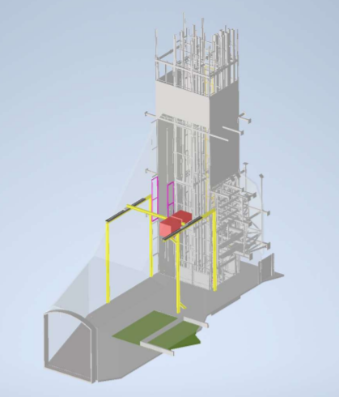
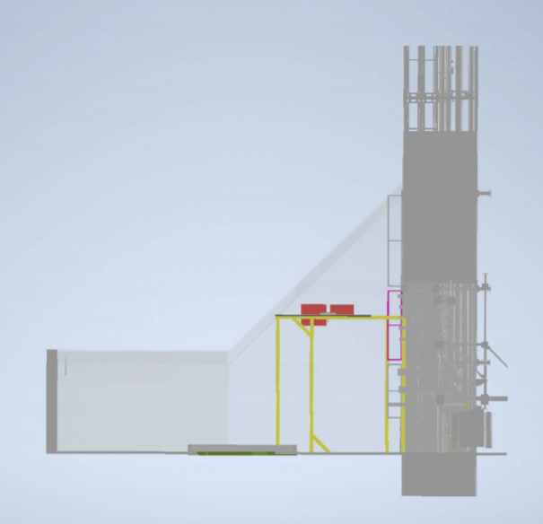

Slide 22
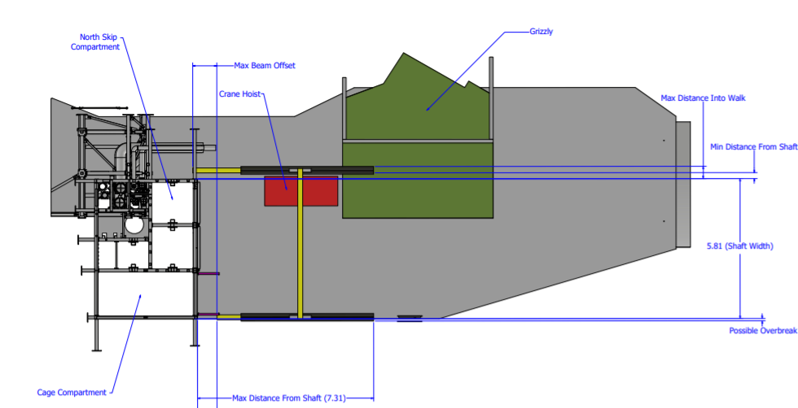

Slide 23
What was done
Defined minimum hoist height
Defined travel and span
Identified possible issues with integration (brattice, doors, NE support, etc. )

Slide 24
The Future
Who knows. It’s the future

Slide 25
My Takeaways
Technical Skills
Large CAD projects
Finite Element Analysis and Engineering Analysis
Logistics and item transport
Soft Skills
Working as a small part of a large project
Think about the whole process not just the “best design”
Communication in a team

Slide 26
Thanks for listening! Questions?

Slide 27
Appendix

Slide 28
Other things I have done
Transport summary doc
Non-awkward lifts & Packing
Cage summary doc
Chimney rotations
Started floor discussion for headframe
4850L Bridge Crane RFI
4850L Winch Integration Ideas/Starting
Other Awkward Materials
Warm Skin Flat and Corner (Not completed)
APAs (Not Completed)

Slide 29
The square hole
https://www.youtube.com/watch?v=jkz7bnYfuOI

Slide 30
Bridge Crane RFI

Slide 33
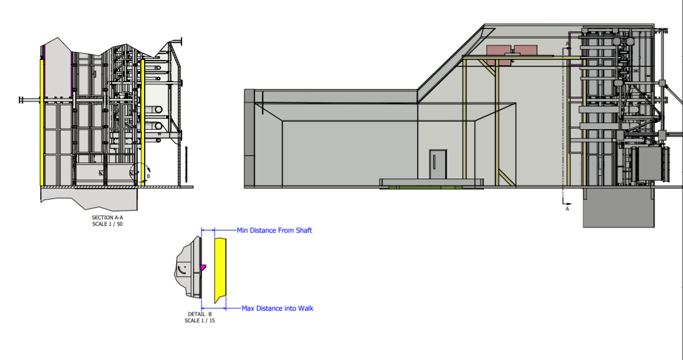

Slide 34
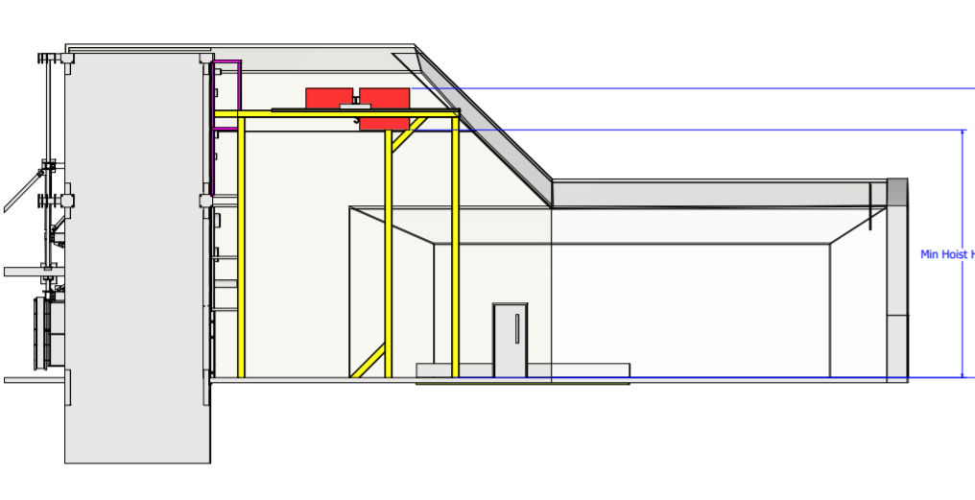

Slide 35
Brow Winch Integration

Slide 36
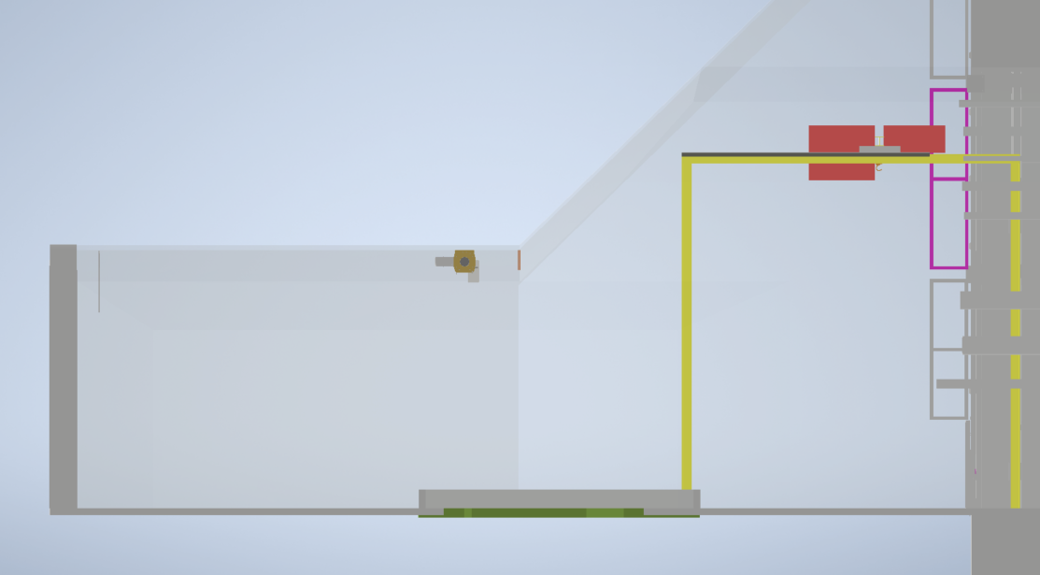
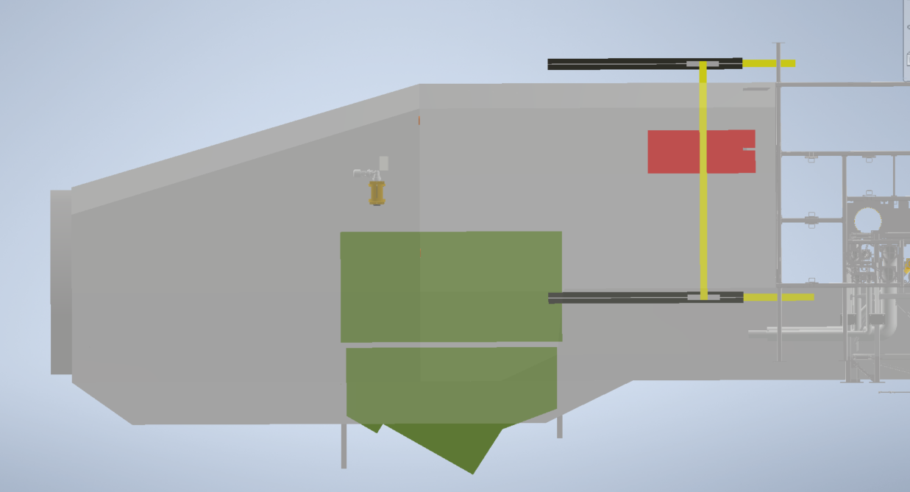

Slide 37
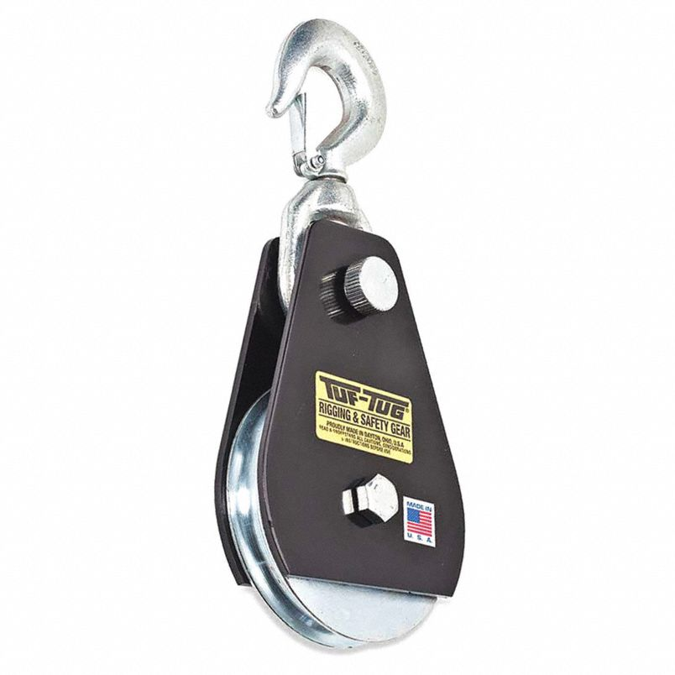
Anchors
Rock anchors
Centered in cage compartment and north skip
Winch mounted on ceiling
Snatch block transferred from anchor to anchor

Slide 38
Chimney Rotation

Slide 40
Ground Conditions
Cautionary Tale
Current
Possible Solutions

Slide 41
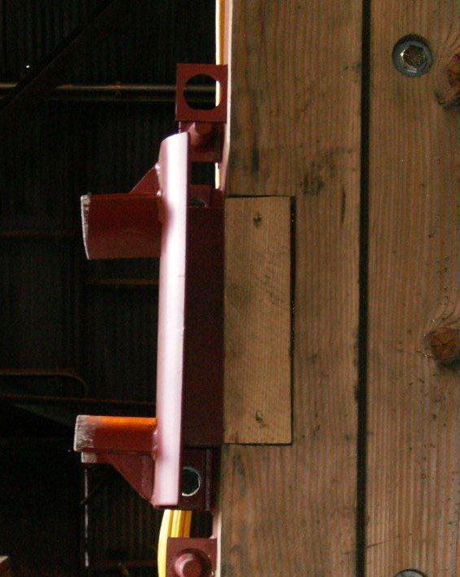
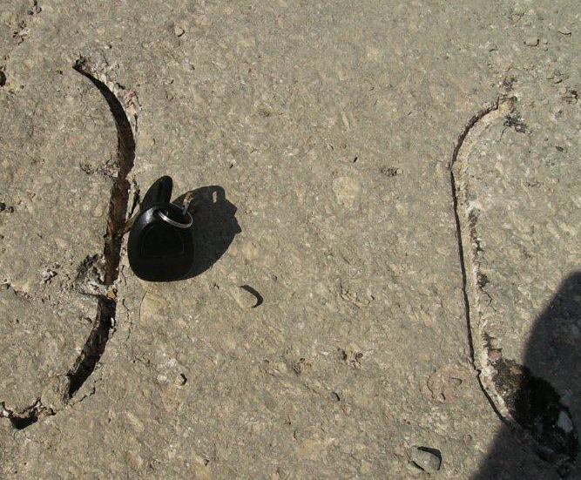
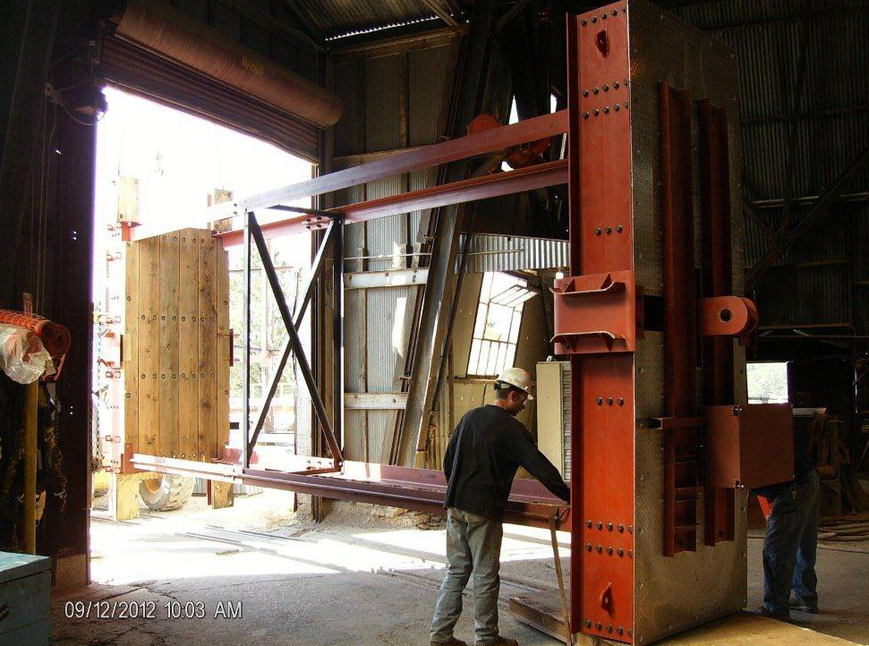
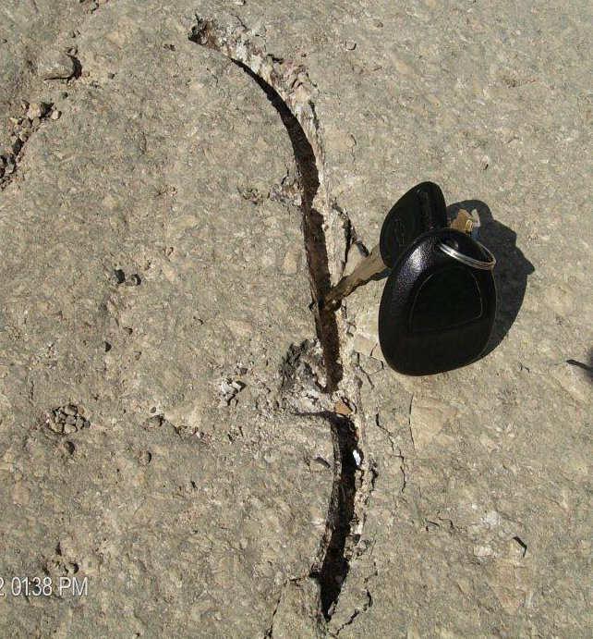
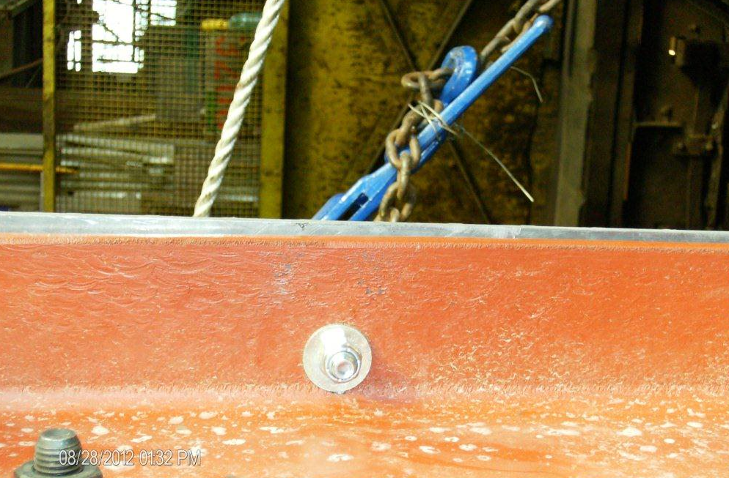
Ground Conditions a Cautionary Tale

Slide 42
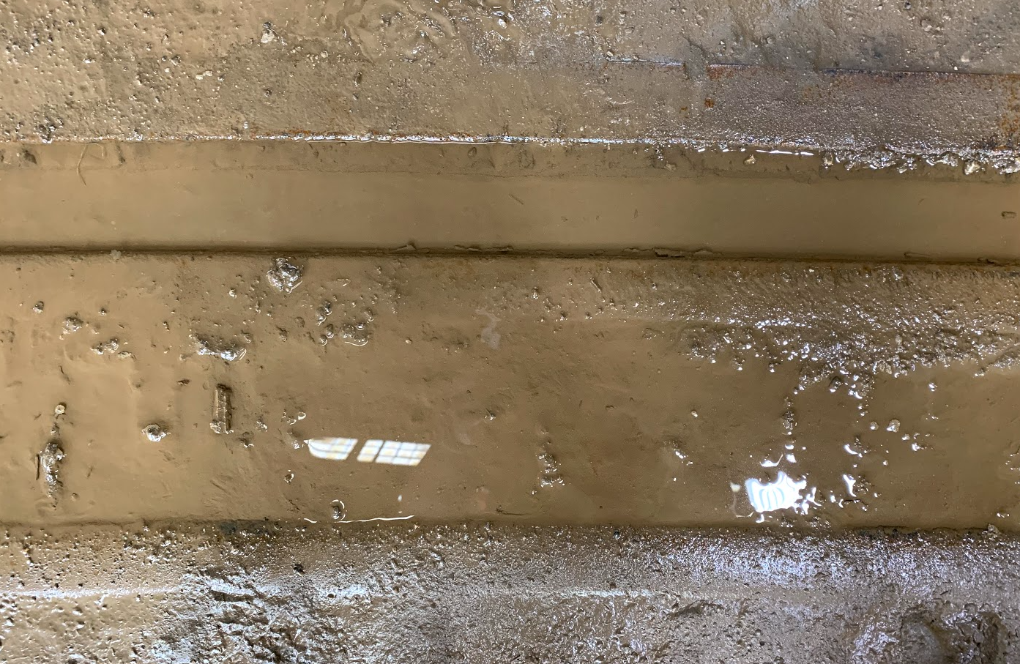
Rails
Rails are not perfectly flat
There will be slight tilts that must be evaluated if used
L-beam vertical position maximum of a 5-degree tilt horizontal is a 11-degree tilt
½ cm below the water
½ cm above the water

Slide 43
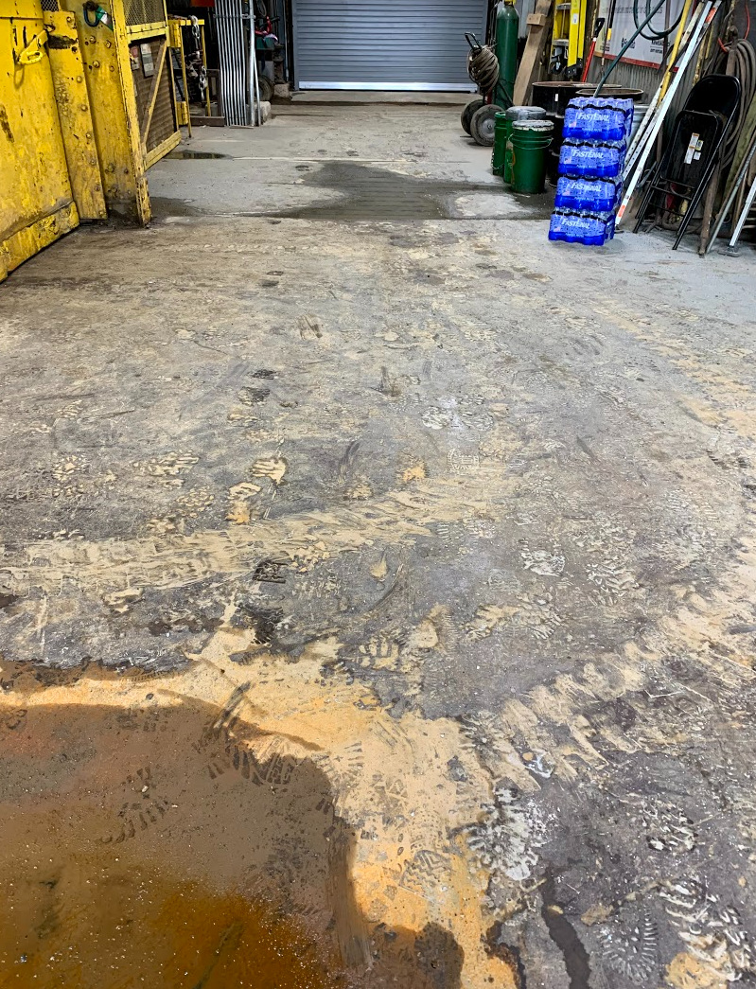
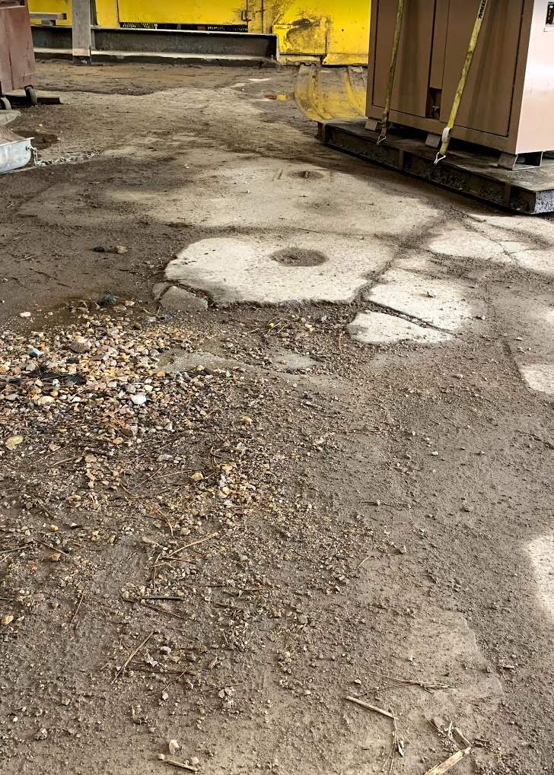
Current Ground Conditions Images
In-between the rails still a problem
Steel Plates in front of cage
Mini-headframe
Foundation
Standard Flooring in Headframe

Slide 44
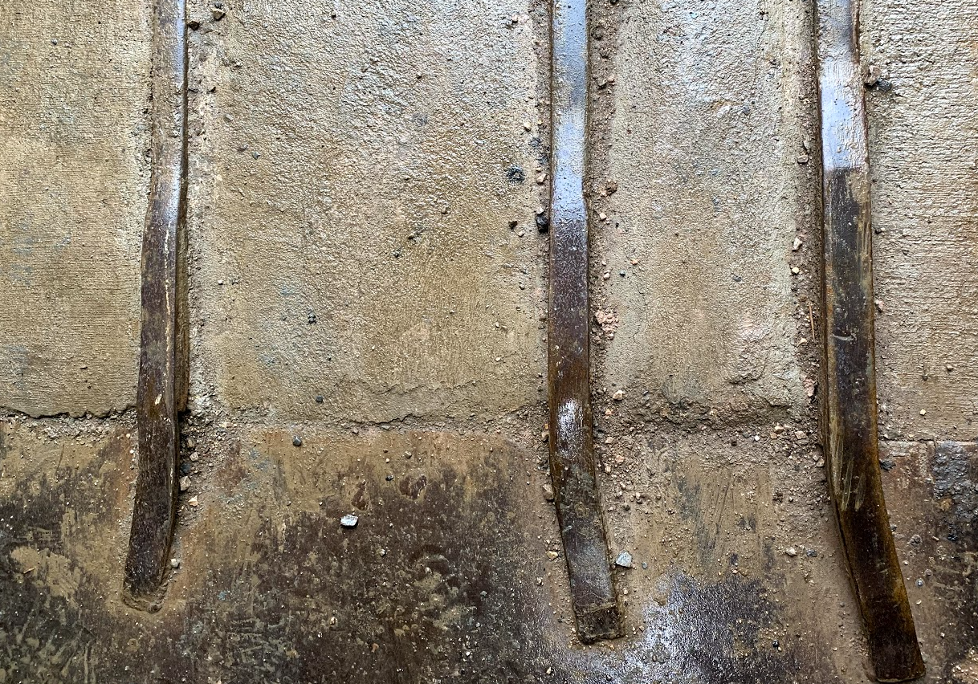
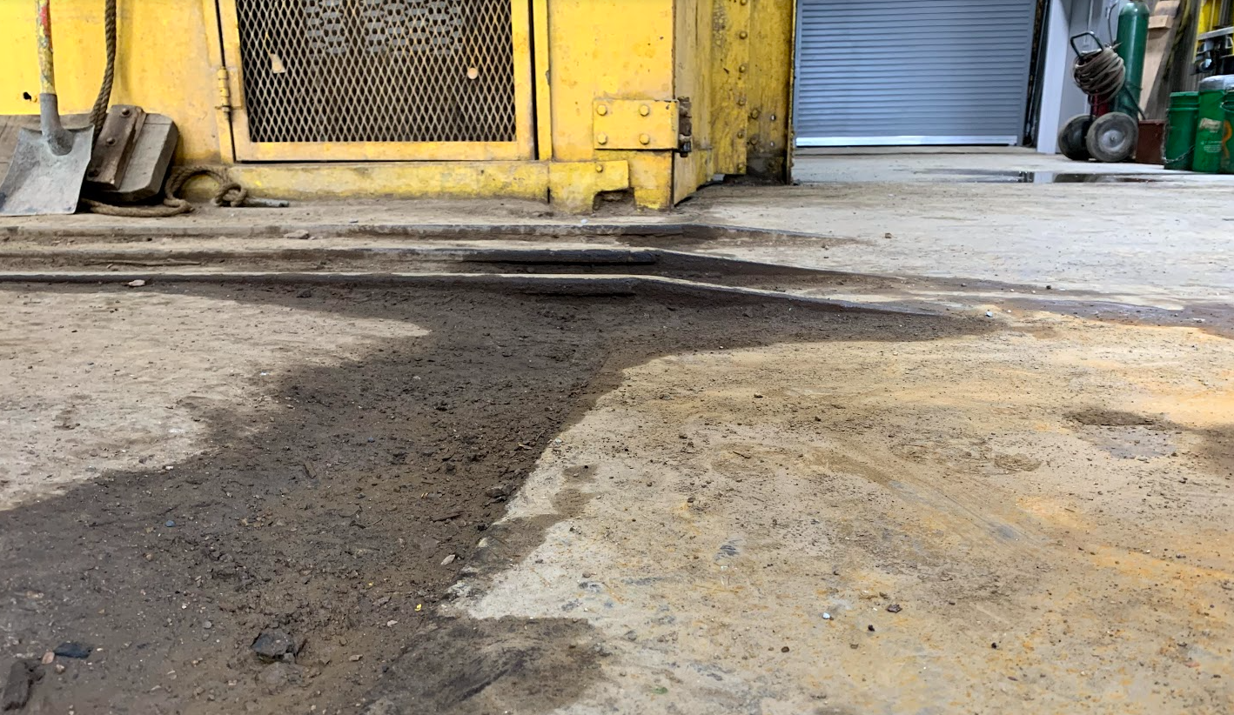
Entrances
Rail or cart has a bump to account for
Rails have a bump while being brought in
Northeast door has a concrete slab

Slide 45
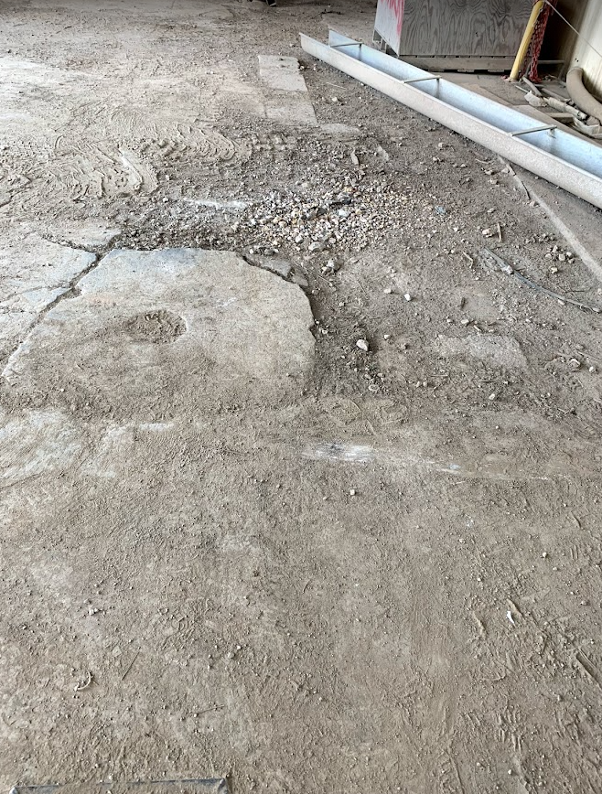
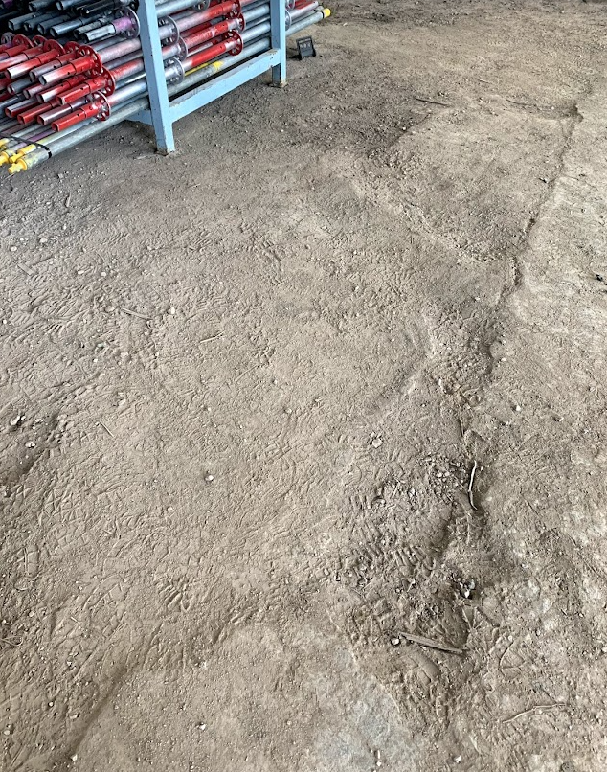
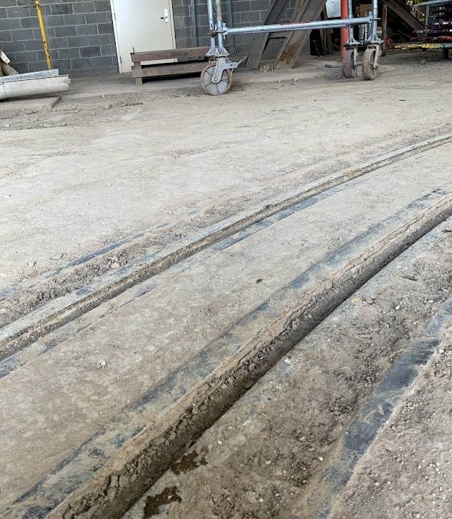
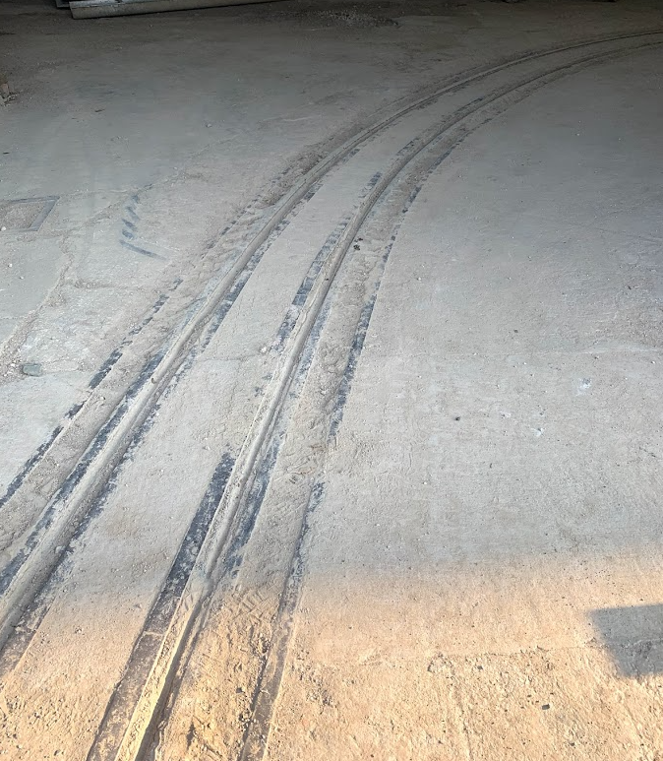
Mostly broken concrete the closer you get to the mini-headframe
After rails there is a slight grade to the floor approximately 5cm over 20cm
Crosses rails mostly flat initially

