Slide 1
An Upgrade Path toward Multi-MW Beam Power at Fermilab
Jeffrey Eldred, for Accelerator Working Group
Scientists Advisory Committee
August 4th 2021

Slide 2
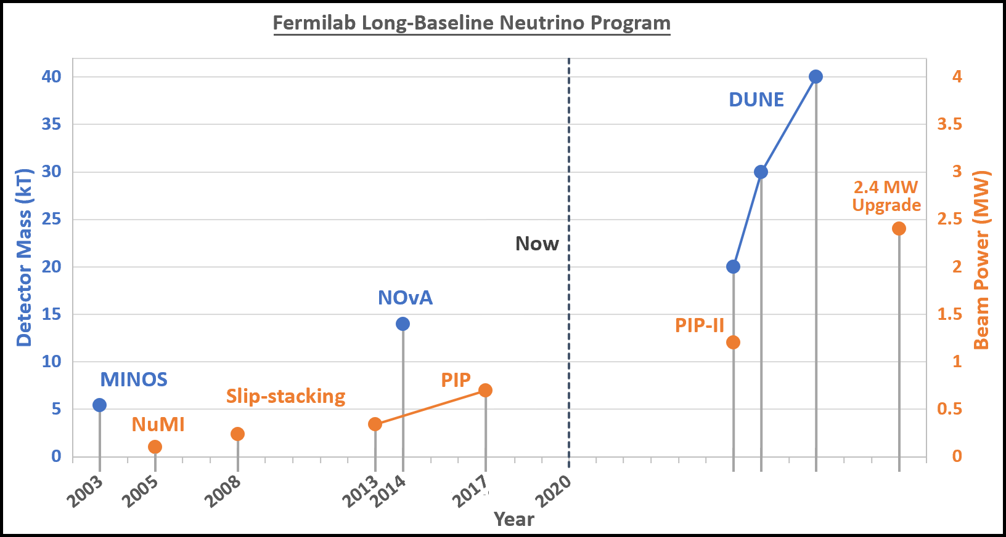
2
Beam Power and Detector Size
DUNE long-baseline neutrino program calls for 2.4 MW
J. Eldred, JINST 2019
2
Jeffrey Eldred | An Upgrade Path toward Multi-MW Beam Power at Fermilab
Notes:
2
2
2

Slide 3
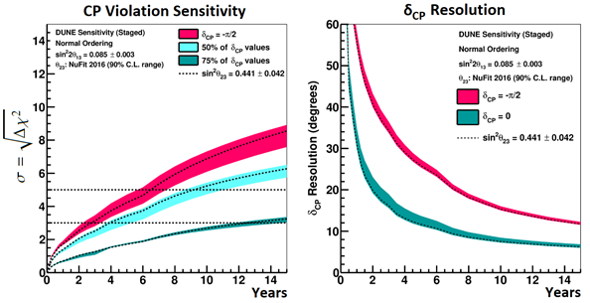
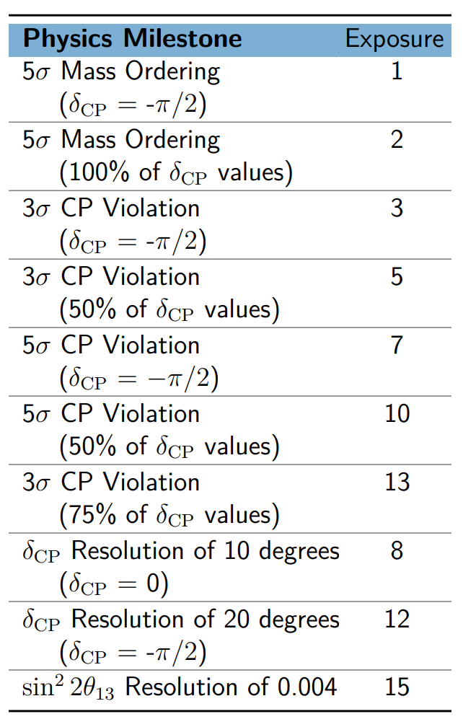
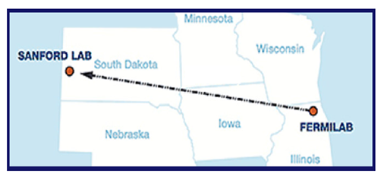
3
DUNE Physics, with 2.4 MW at 6 years
DUNE TDR, 2018
3
Jeffrey Eldred | An Upgrade Path toward Multi-MW Beam Power at Fermilab
Notes:
3
3
3

Slide 4
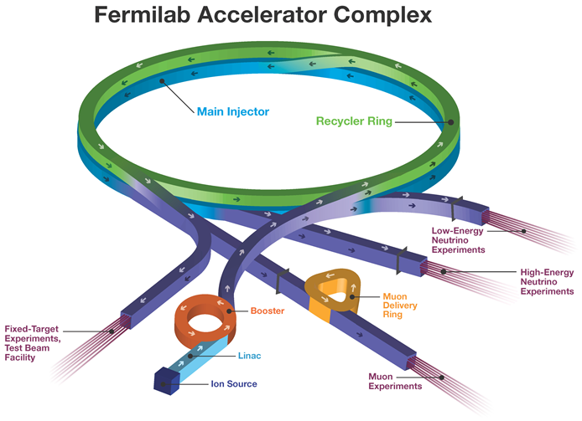
4
4
Fermilab Upcoming Upgrades Future 2.4MW
2.4 MW LBNF
Neutrinos
to DUNE
Recycler?
Replace
Booster
PIP-II SRF
Linac
1-3 GeV
4
Jeffrey Eldred | An Upgrade Path toward Multi-MW Beam Power at Fermilab
Notes:
4
4
4
4
4
4

Slide 5
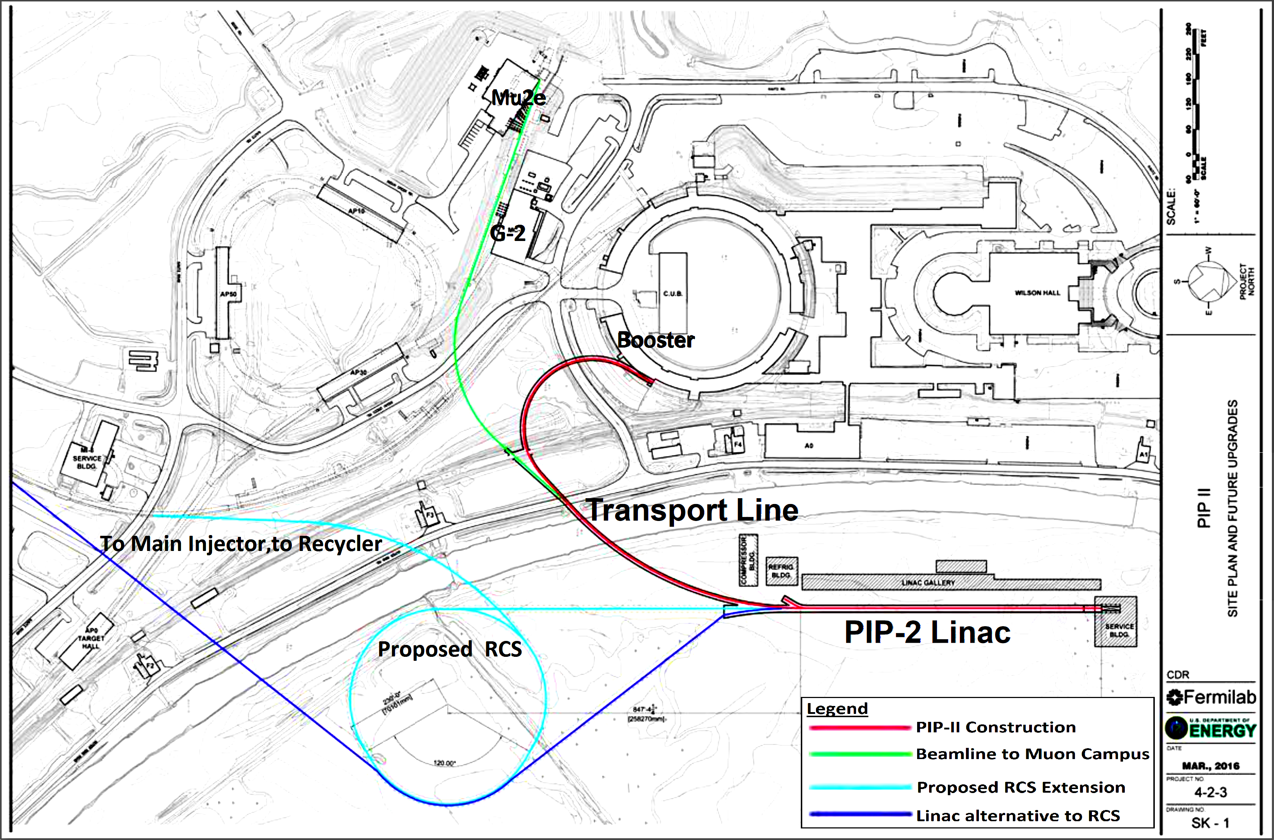
5
5
2.4 MW Upgrade: Build RCS and/or Linac to 8 GeV
(Linac and RCS not to scale)
5
Jeffrey Eldred | An Upgrade Path toward Multi-MW Beam Power at Fermilab
Notes:
5
5
5
5
5
5

Slide 6
6
8 GeV Linac Option
Main Injector
(MI)
Recycler?
Optional
Storage
Ring
PIP-II
Linac
8 GeV Linac
J. Eldred
6
Jeffrey Eldred | An Upgrade Path toward Multi-MW Beam Power at Fermilab
Notes:
6
6
6

Slide 7
7
Rapid-Cycling Synchotron (RCS) Option
Main Injector
(MI)
Optional
Storage
Ring
RCS
Optional
Storage
Ring
PIP-II
Linac
Optional 1-3 GeV Linac Upgrade
J. Eldred
7
Jeffrey Eldred | An Upgrade Path toward Multi-MW Beam Power at Fermilab
Notes:
7
7
7

Slide 8
8
Upgrade Design History & Process
In 2008, Project X: 8 GeV SRF Linac, directly into Main Injector.
In 2010, Project X ICD-2: 2 GeV Linac, New 2-8 GeV RCS.
In 2018, S. Nagaitsev and V. Lebedev: updated version of ICD-2.
In 2019, J. Eldred, V. Lebedev, A. Valishev: parametric study of RCS design.
The RCS path to multi-MW are well-considered, design requirements are needed.
In 2020, Committee for Fermilab Booster Upgrade an integrated design effort:
- Science Working Group (R. Harnik & about 25-75 people)
- Accelerator Working Group (M. Syphers & about 25 people)
We have been asked to develop a scenario, to present to the Fermilab directorate and to present on Fermilab’s behalf for Snowmass.
However, this design team does not represent any decision at higher levels.
2 GeV Linac + RCS Scenario:
- Accelerator Working Group paper - recent ArXiv paper.
- Science Working Group paper - mostly complete, still open.
8
Jeffrey Eldred | An Upgrade Path toward Multi-MW Beam Power at Fermilab
Notes:
8
8
8

Slide 9
9
R. Harnik, 2020
overleaf.com/read/scgtzvbngfxr
9
Jeffrey Eldred | An Upgrade Path toward Multi-MW Beam Power at Fermilab
Notes:
9
9
9

Slide 10
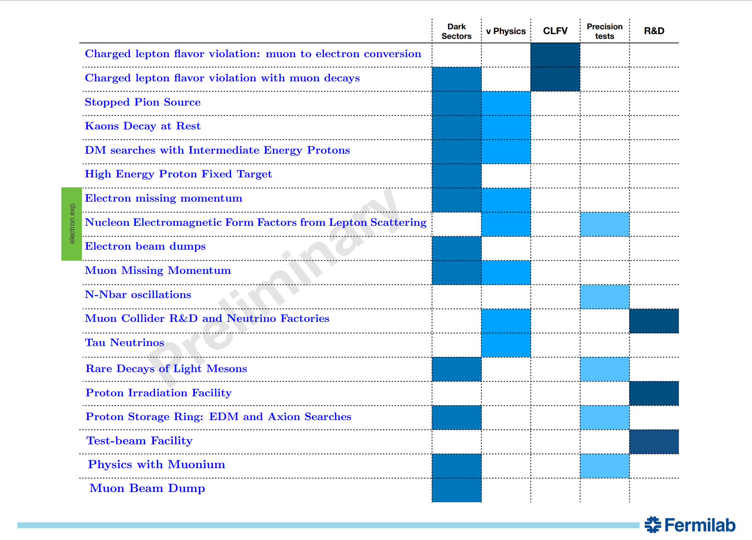
10
R. Harnik, 2020
10
Jeffrey Eldred | An Upgrade Path toward Multi-MW Beam Power at Fermilab
Notes:
10
10
10

Slide 11
11
Proposed Experiments
2 GeV CW-capable beam, 2mA
- mu2e-II type charged-lepton flavor violation experiment
- Low energy muon experiments (muonium, muon decay)
- REDTOP run-II/run-III program (rare-decays)
- neutron-antineutron oscillation experiments
2 GeV pulsed beam from Storage Ring, ~1 MW
- stopped pion source experiments
- dark matter search at GeV-scale
- PRISM charged-lepton flavor violation experiments
8 GeV RCS program, ~1 MW
- kaon decay-at-rest program
- dark matter search from intermediate energy protons
- proton irradiation facility
- any successors to short-baseline neutrino program
- NuSTORM and muon-collider R&D
- muon beam dump, missing muon momentum
120 GeV Slow-Extraction program, 8e12 over six second, once per min.
- dark matter spectrometer experiment
- muon missing-momentum experiment
- test beam program
11
Jeffrey Eldred | An Upgrade Path toward Multi-MW Beam Power at Fermilab
Notes:
11
11
11

Slide 12
12
Accelerator Design Criteria
I) Assume PIP-II proceeds according to current plans.
II) Scenario should enable the Main Injector to achieve the 2.4 MW at 120 GeV for DUNE/LBNF in the near term.
- and for a 60 GeV MI cycle, at least 2 MW.
III) Scenario should allow a robust experimental program and enable future high-power upgrades.
IV) Identify topics which may require R&D.
12
Jeffrey Eldred | An Upgrade Path toward Multi-MW Beam Power at Fermilab
Notes:
12
12
12

Slide 13
13
Linac + RCS Scenario
At 2 GeV injection energy, space-charge is manageable for ~37e12 RCS,
- For 20 Hz rep. rate, the beam can be stacked directly into Main Injector.
- If we stack directly into MI, there will be extra cycles for 8 GeV program.
- Sidebar: Whether it would be possible/preferable to get to 2.4 MW with a Recycler-like 8-GeV storage ring is hotly debated.
At 2 mA linac injection current, long injection time becomes an issue for high-intensity, fast-ramping RCS.
Solution 1: Retrofit PIP-II linac for 5-10 mA pulses, 0.6-1.2 ms injection.
- This strategy has strong precedents at other facilities (SNS, J-PARC)
- If that retrofit were to take place earlier, would benefit PIP-II Booster.
Solution 2: Create 2 GeV storage ring for injection, transfer to RCS.
- Allows dedicated injection optics and longer accumulation time.
- With a subsequent laser stripping update, allows additional opportunity for MW-class pulsed 2 GeV proton program (capability overlaps with SNS).
Path to 4 MW Main Injector, by upgrade MI ramp rate.
13
Jeffrey Eldred | An Upgrade Path toward Multi-MW Beam Power at Fermilab
Notes:
13
13
13

Slide 14
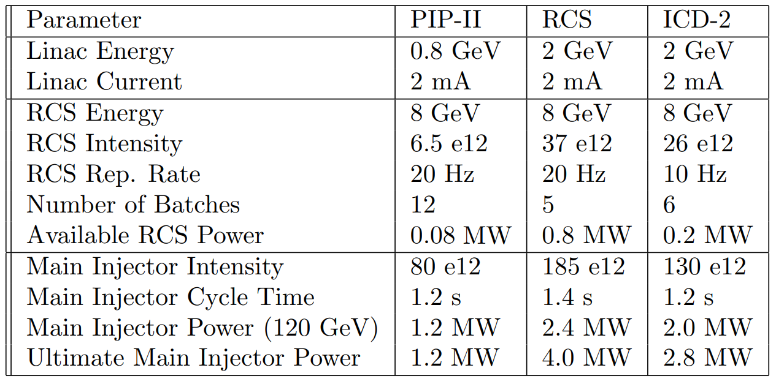
14
High-Level Parameters of Possible Upgrade Scheme
14
Jeffrey Eldred | An Upgrade Path toward Multi-MW Beam Power at Fermilab
Notes:
14
14
14

Slide 15
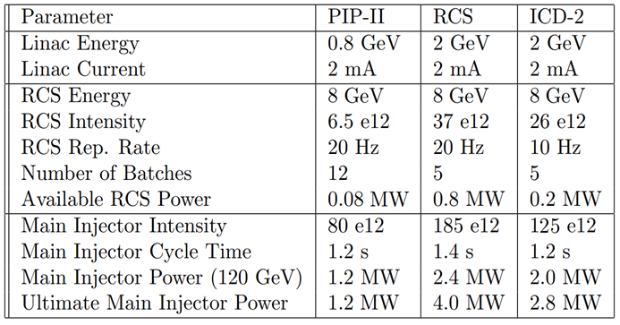
15
High-Level Parameters of Possible Upgrade Scheme
Differs from ICD-2 scenario by:
- higher RCS intensity & Main Injector power
- an updated 2.4 MW scenario is in the works.
- RCS does not use Recycler Ring for stacking.
- higher rep. rate and RCS power.
15
Jeffrey Eldred | An Upgrade Path toward Multi-MW Beam Power at Fermilab
Notes:
15
15
15

Slide 16
16
Facility Capabilties (2mA CW + 2 GeV SR scenario)
2 GeV CW-capable beam, 2mA
- upgradeable to 4 MW shared with any pulsed 2 GeV program.
2 GeV pulsed beam from Storage Ring, ~1 MW
- requires laser stripping and 2 GeV Storage Ring.
- 37 e12 at 60-120 Hz.
- investigating ~400ns pulse compression.
8 GeV RCS program, 0.8 MW
- 37e12 every 20 Hz.
- 0.8 MW concurrent with 120 GeV program.
- upgradeable to ~2 MW with RCS ramp-rate and optics improvement.
120 GeV DUNE/LBNF program, 2.4 MW
- upgradeable to 4 MW with Main Injector ramp-rate.
120 GeV Slow-Extraction program, 8e12 over six second, once per min
- loss-limited, may be upgradeable.
16
Jeffrey Eldred | An Upgrade Path toward Multi-MW Beam Power at Fermilab
Notes:
16
16
16

Slide 17
17
Proposed Experiments
2 GeV CW-capable beam, 2mA
- mu2e-II type charged-lepton flavor violation experiment
- Low energy muon experiments (muonium, muon decay)
- REDTOP run-II/run-III program (rare-decays)
- neutron-antineutron oscillation experiments
2 GeV pulsed beam from Storage Ring, ~1 MW
- stopped pion source experiments
- dark matter search at GeV-scale
- PRISM charged-lepton flavor violation experiments
8 GeV RCS program, ~1 MW
- kaon decay-at-rest program
- dark matter search from intermediate energy protons
- proton irradiation facility
- any successors to short-baseline neutrino program
- NuSTORM and muon-collider R&D
- muon beam dump, missing muon momentum
120 GeV Slow-Extraction program, 8e12 over six second, once per min.
- dark matter spectrometer experiment
- muon missing-momentum experiment
- test beam program
17
Jeffrey Eldred | An Upgrade Path toward Multi-MW Beam Power at Fermilab
Notes:
17
17
17

Slide 18
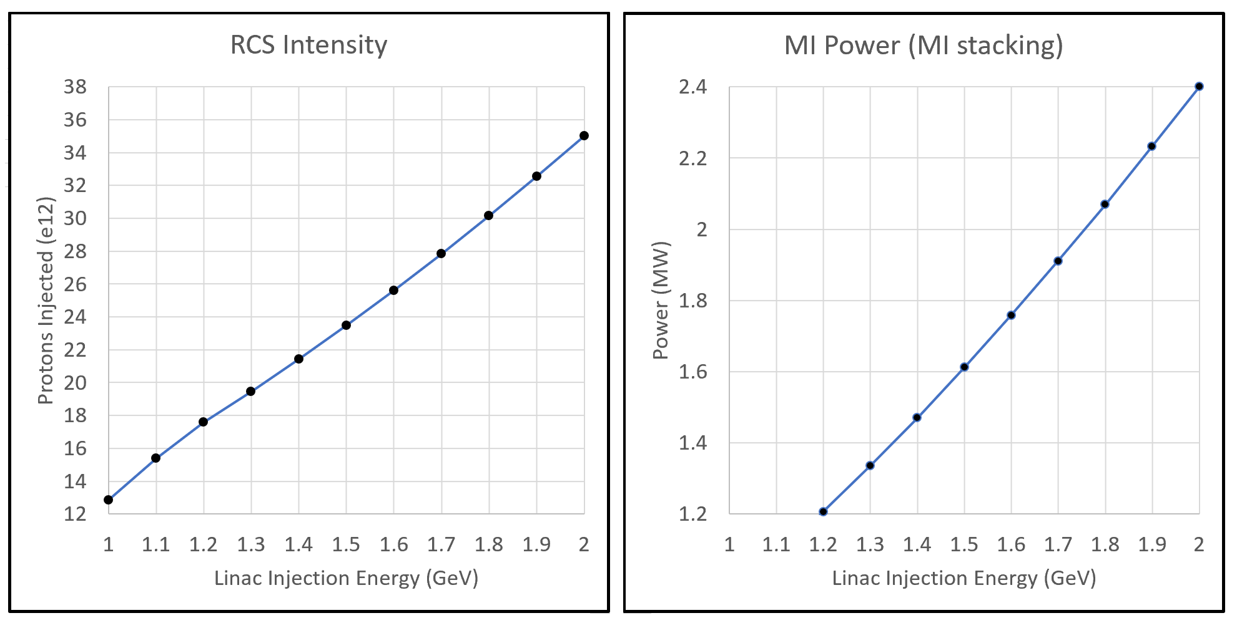
18
Staging RCS with partial upgrade of Linac & MI
Linac can be commissioned concurrent with PIP-II operations, RCS can be commissioned at partial linac energy, etc.
At ~1.2 GeV, the PIP-II Booster 1.2 MW benchmark is crossed.
At ~1.6 GeV, we have 1.8 MW without Main Injector RF upgrade.
- If we can still use Recycler, RCS rep. rate only needs 10 Hz.
18
Jeffrey Eldred | An Upgrade Path toward Multi-MW Beam Power at Fermilab
Notes:
18
18
18

Slide 19
19
Summary
We have a self-consistent design for to 2.4 MW DUNE:
- 2 GeV upgrade of PIP-II + new 570m 8 GeV RCS.
- Upgrade is compatible with a wide range of proposed experiments.
- Accelerator design details are in paper and backup slides.
This specific scenario is unique for:
- does not require slip-stacking or Recycler.
- proposing a 2 GeV accumulator ring.
- provides path to 4 MW upgrade of DUNE/LBNF.
- these details can be revisited without changing the bottom line.
The scenario also has options for being staged or scaled down.
Next Steps
Feedback on physics prioritization and experiment siting from Snowmass.
Further and more in-depth design is possible after CD-0.
19
Jeffrey Eldred | An Upgrade Path toward Multi-MW Beam Power at Fermilab
Notes:
19
19
19

Slide 20
20
20
Backup (Facility Design)
20
Jeffrey Eldred | An Upgrade Path toward Multi-MW Beam Power at Fermilab
Notes:
20
20
20
20
20
20

Slide 21
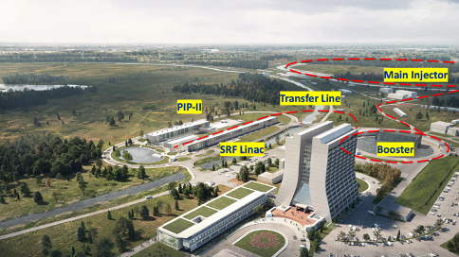
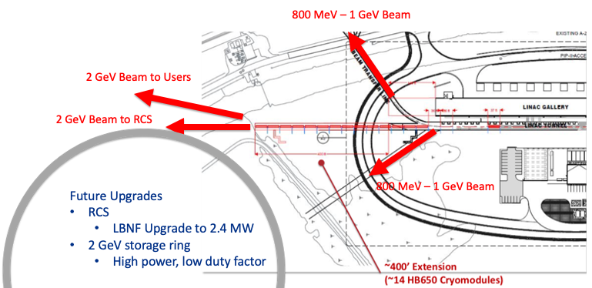
21
PIP-II Linac Upgrade to 2 GeV
Linac Parameters | PIP-II Multi-users | with 2 GeV Upgrade
Beam Energy | 0.8 | 2.0 | GeV
Ave. Beam Current | 2 | 2 | mA
Bunch Length | 4 | 4 | ps
Min. Bunch Spacing | 6.2 | 6.2 | ns
Max. H- per bunch | 4 | 4 | 10⁸
Beam Power | 1.6 | 4 | MW
E. Pozdeyev, 2020
21
Jeffrey Eldred | An Upgrade Path toward Multi-MW Beam Power at Fermilab
Notes:
21
21
21

Slide 22
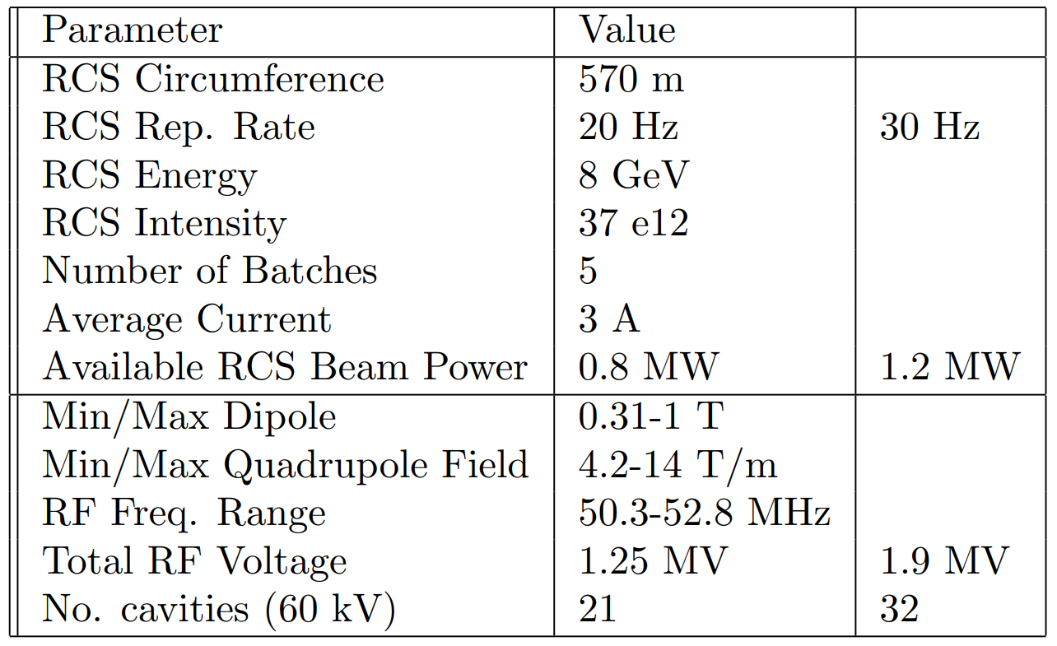
22
Rapid Cycling Synchrotron (RCS)
The RCS would operate at 20 Hz and accelerate from 2 to 8 GeV
A second ring operating at 2 GeV is proposed to be located above the RCS and used to accumulate charge from the upgraded linac.
22
Jeffrey Eldred | An Upgrade Path toward Multi-MW Beam Power at Fermilab
Notes:
22
22
22

Slide 23
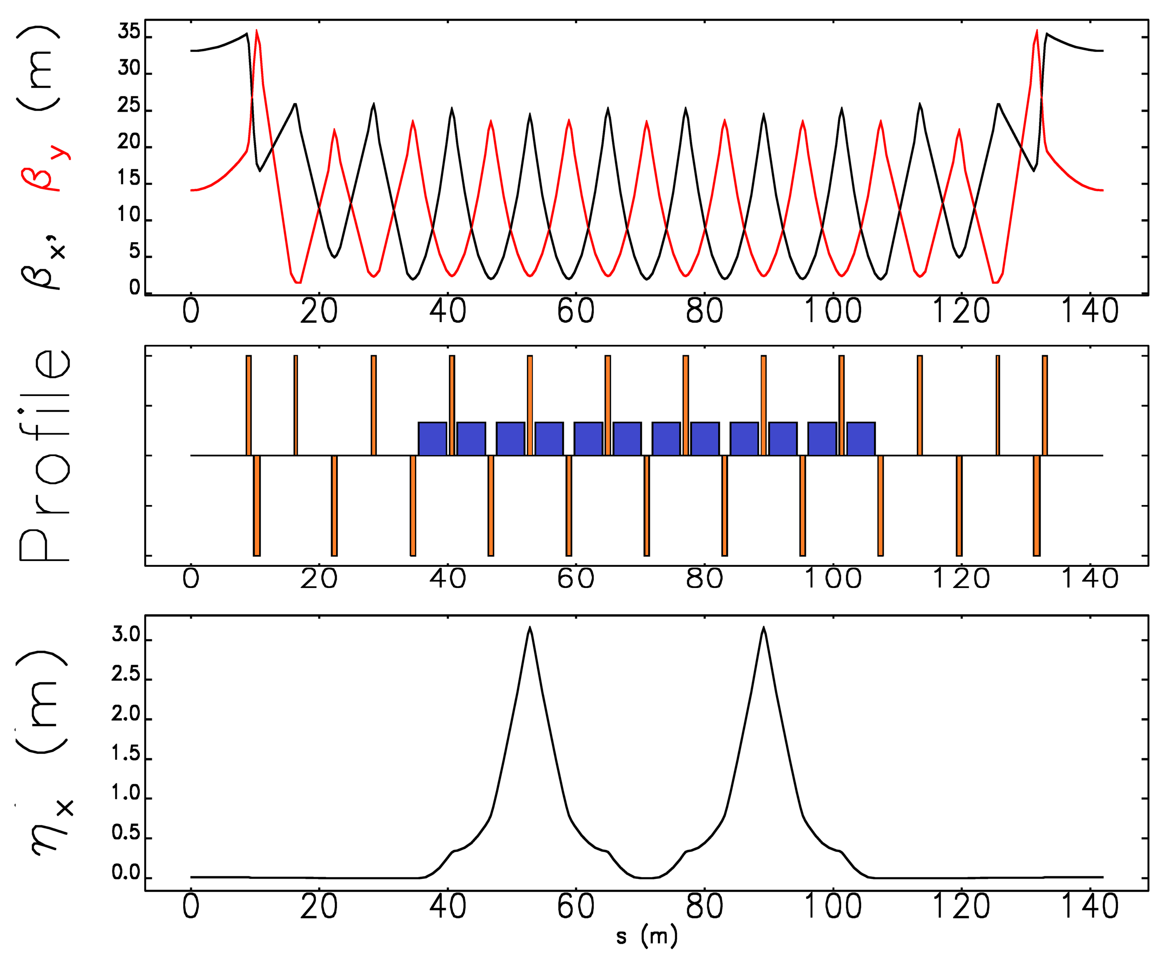
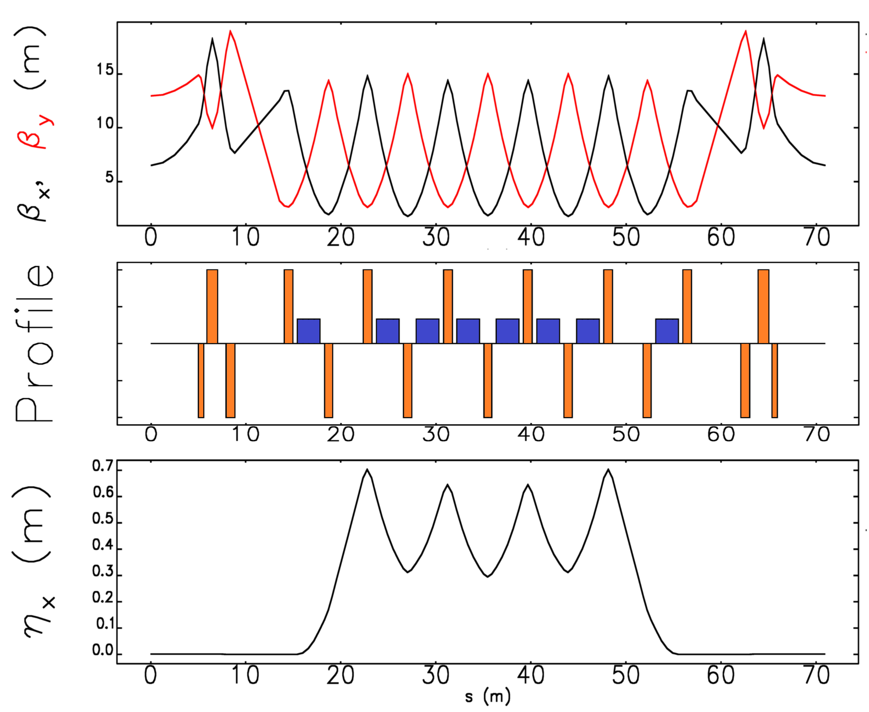
23
Preliminary RCS Lattice Configurations
2 GeV Injection Ring,
one of four periods
2 - 8 GeV RCS Ring,
one of eight periods
2 GeV Ring Optimized for Injection
8 GeV Ring Optimized for Acceleration
23
Jeffrey Eldred | An Upgrade Path toward Multi-MW Beam Power at Fermilab
Notes:
23
23
23

Slide 24
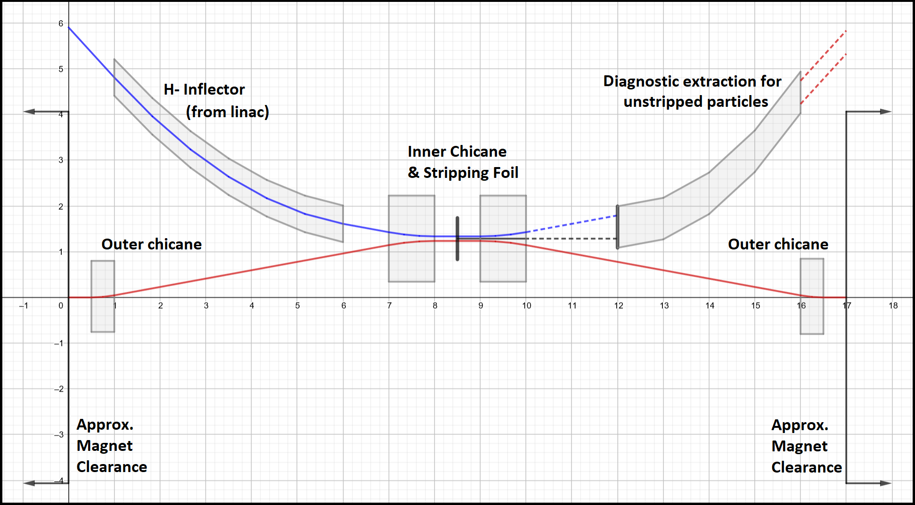
24
Beam Accumulation and H- Stripping in a Storage Ring
SR Circumference | 570 | m
SR Energy | 2 | GeV
Superperiodicity | 4
Injection Insertion Length | 12 | m
Dipoles per Superperiod | 12
Dipole Strength | <0.4 | T
H- Foil Stripping Injection
17 m straight.
24
Jeffrey Eldred | An Upgrade Path toward Multi-MW Beam Power at Fermilab
Notes:
24
24
24

Slide 25
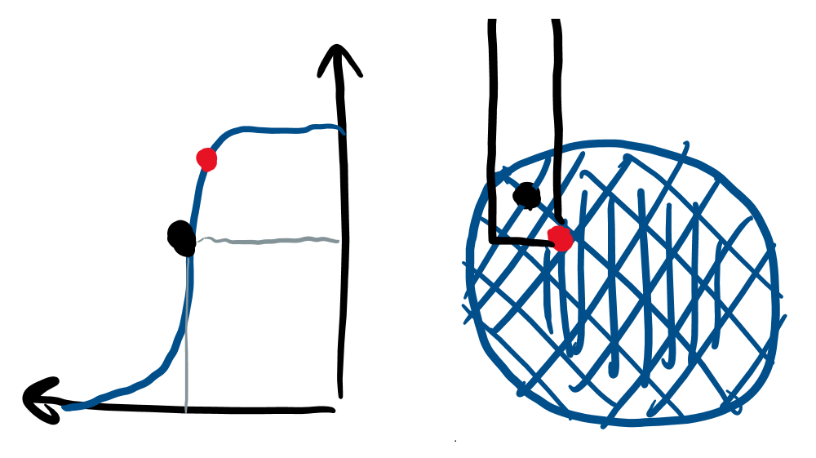
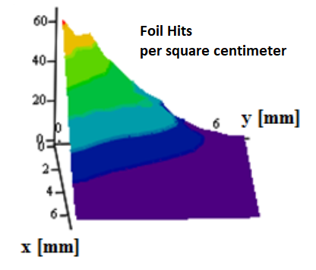
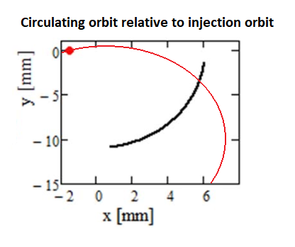
25
Anti-Correlated Painted Injection
Beam Distribution during Injection
Peak Temperature on corner
(PIP-II)
Anti-correlated Painting Injection
Injection painting scheme chosen to:
Minimize foil hits from the circulating beam.
Optimize stability of the beam distribution.
25
Jeffrey Eldred | An Upgrade Path toward Multi-MW Beam Power at Fermilab
Notes:
25
25
25

Slide 26
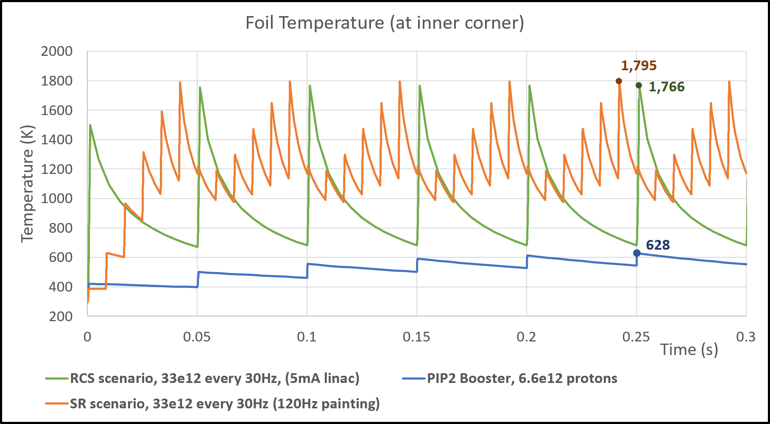
26
Beam Accumulation and H- Stripping in a Storage Ring
Scenario 1: Retrofit PIP-II linac to 5mA pulsed.
Scenario 2: Use six 120 Hz painting cycles to accumulate beam in storage ring every 20 Hz.
26
Jeffrey Eldred | An Upgrade Path toward Multi-MW Beam Power at Fermilab
Notes:
26
26
26

Slide 27
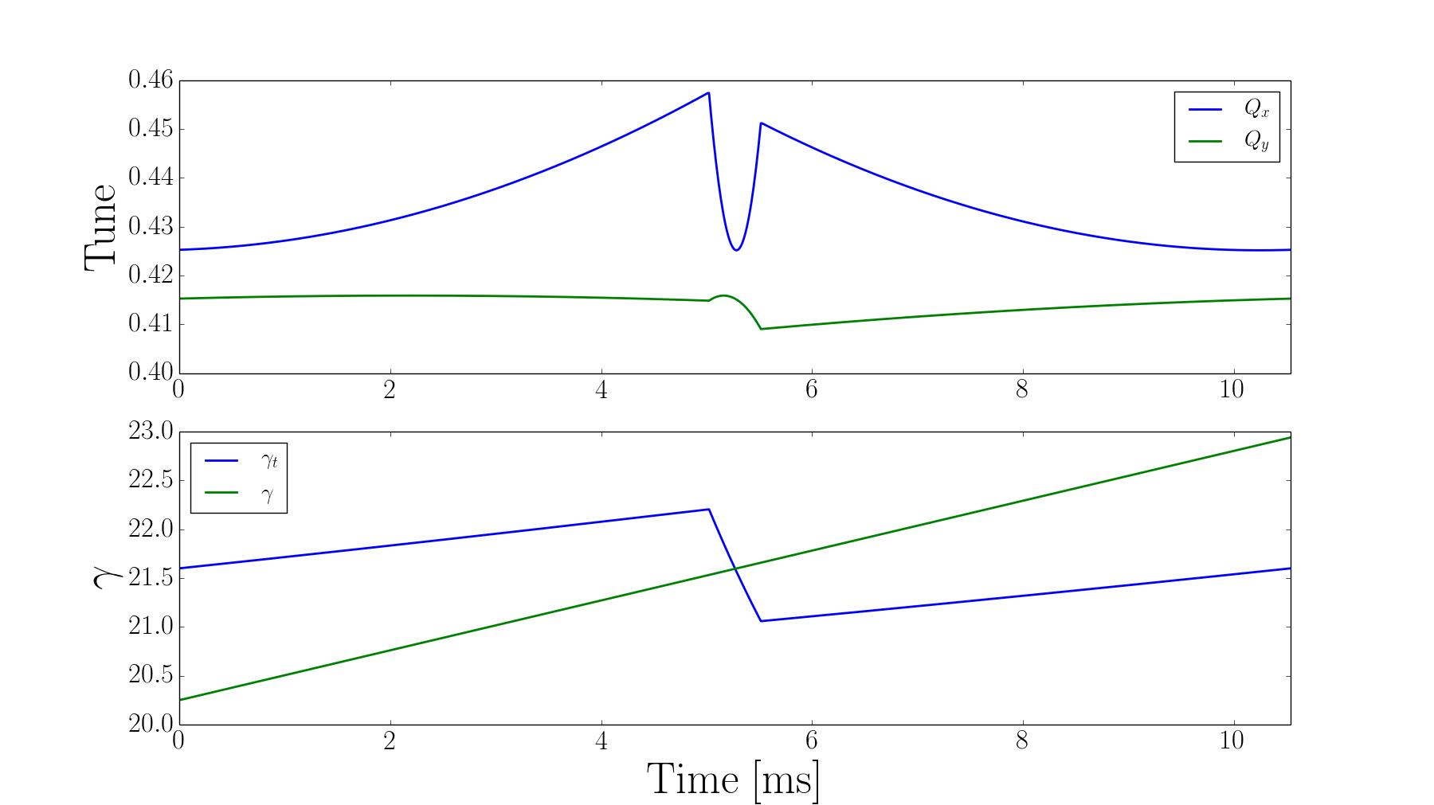
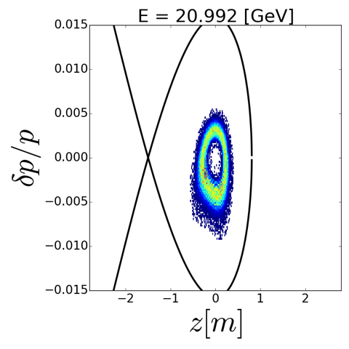
27
Main Injector Operations
Keep 8 GeV injection into MI, re-using portions of Recycler as injection line
Removing slip stacking operation (Recycler) creates lower momentum spread in MI; helps to alleviate issues at crossing of transition energy
“Transition”: energy where revolution frequency is independent of momentum
Special optics manipulation at the transition energy (left; part of PIP-II) and smaller momentum spread provide adequate phase space through transition:
R. Ainsworth, I. Kourbanis
transition energy in
Main Injector ($γ$ = 21.5)
27
Jeffrey Eldred | An Upgrade Path toward Multi-MW Beam Power at Fermilab
Notes:
27
27
27

Slide 28
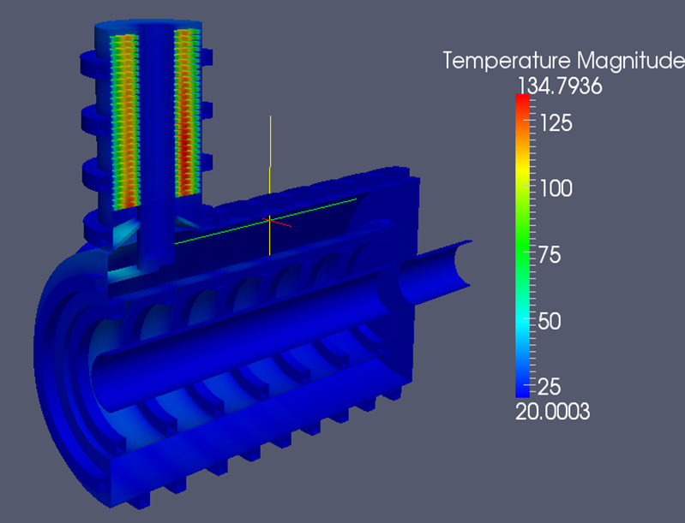
28
Main Injector RF System
MI RF system would be upgraded with new modern RF cavity system
increases RF power to meet final intensity requirements
also enables increased ramp rate to achieve higher overall beam power above 2.4 MW
RF System Specifications
Frequency | 52.617 — 53.104 | MHz
Max. Acceleration Rate | 240 | GeV/s
Acceleration Voltage | 2.7 | MV
Peak Beam Power | 7.1 | MW
Average Beam Power | 3.6 | MW
Peak Voltage | 4.8 | MV
Average Beam Current | 2.7 | A
Fundamental RF Current | 4.6-5.2 | A
No. RF Stations required | 31
I. Kourbanis
28
Jeffrey Eldred | An Upgrade Path toward Multi-MW Beam Power at Fermilab
Notes:
28
28
28

Slide 29
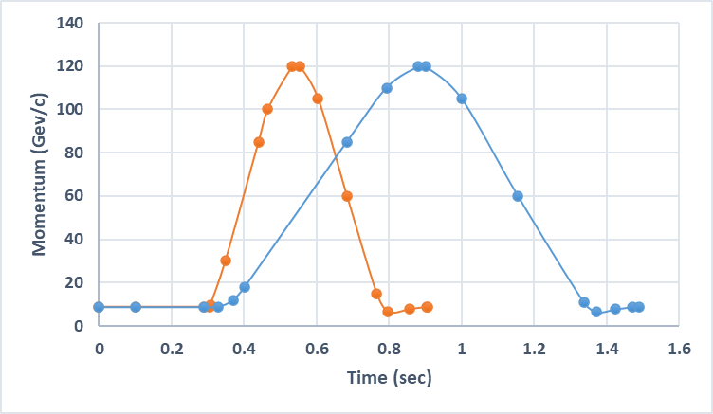
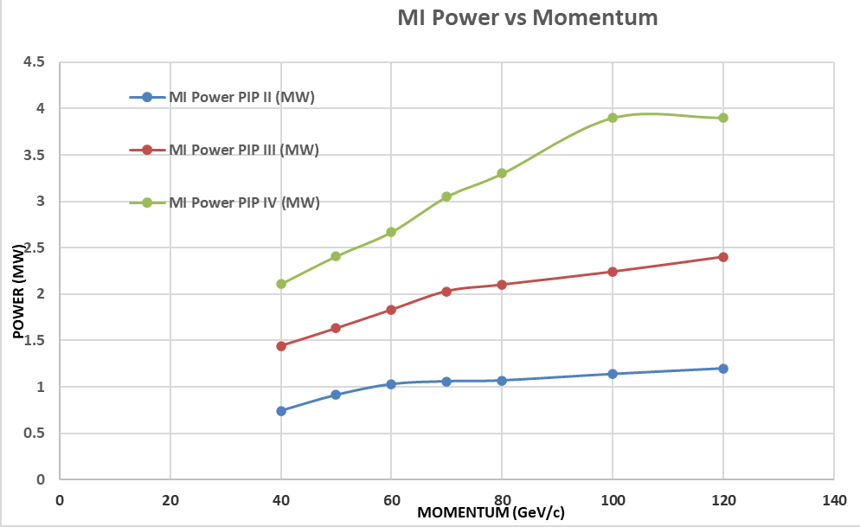
29
Possible MI Upgrade for Higher Power Beyond 2.4 MW
Upgrade magnet power supply system to support higher ramp rate — reduce cycle time from ~1.5 s to about 0.9 s — factor of ~ 5/3
240 GeV/s —> 600 GeV/s
MI PS
upgrade
this
upgrade
PIP-II
I. Kourbanis
29
Jeffrey Eldred | An Upgrade Path toward Multi-MW Beam Power at Fermilab
Notes:
29
29
29

Slide 30
30
Some R&D Areas
High-Power Targets:
- neutrino target for DUNE/LBNF, designs for other experiments.
H- Stripping Laser Technology:
- anticipating progress at SNS, J-PARC, FNAL.
Conventional RF design:
- large frequency sweep, significant beam-loading, high-gradient
IOTA Technology:
- innovations in electron lens and nonlinear optics.
Ceramic beampipes:
- reliability and cost for ceramics, metallization, brazed-flanges.
30
Jeffrey Eldred | An Upgrade Path toward Multi-MW Beam Power at Fermilab
Notes:
30
30
30

Slide 31
31
31
Backup
31
Jeffrey Eldred | RCS for Multi-MW Facility at Fermilab
Notes:
31
31
31
31
31
31

Slide 32
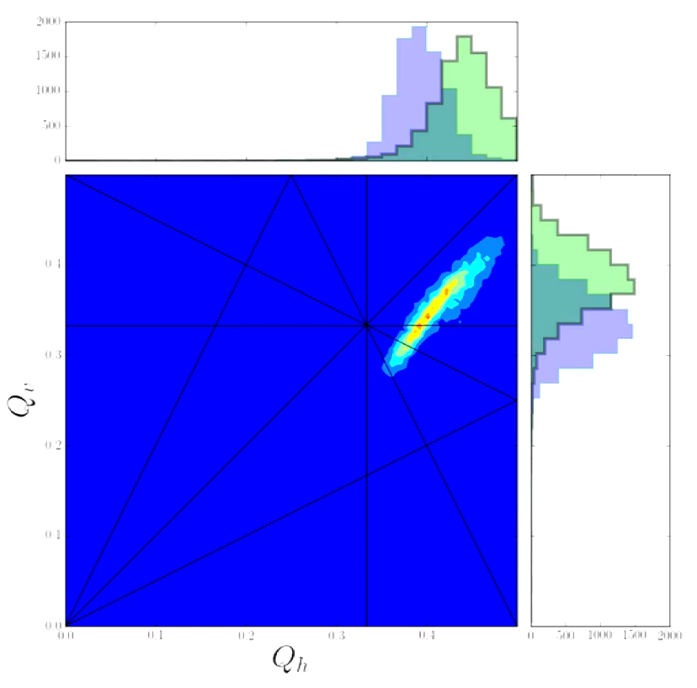
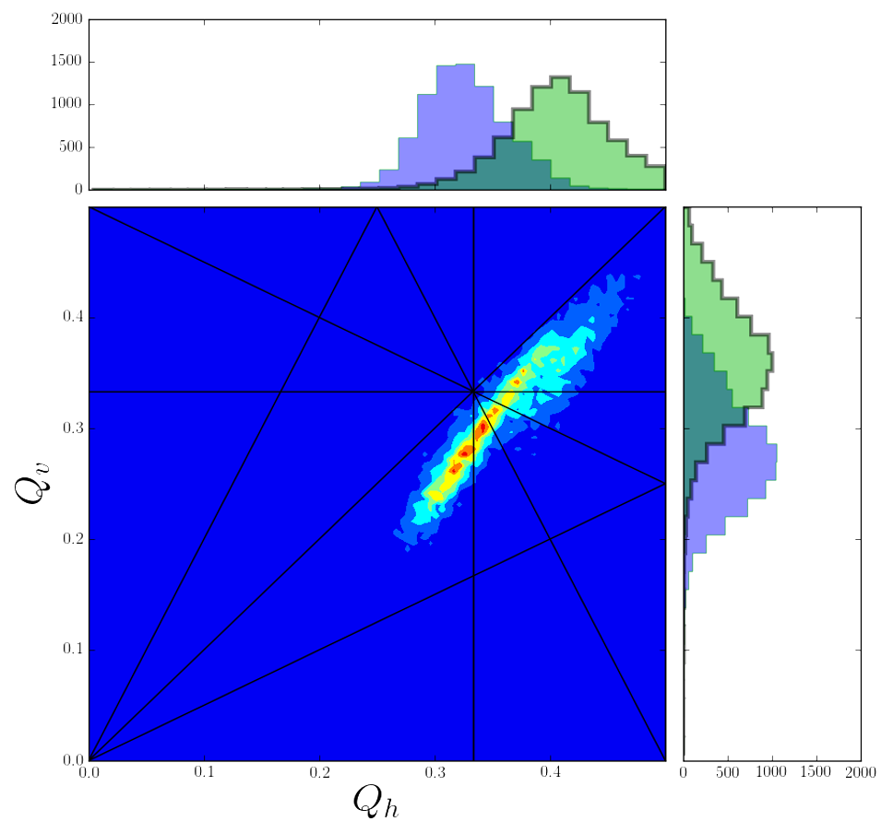
32
Recycler Intensity Challenges
Space-charge Tune-spread Losses:
If we go to higher than PIP-II intensity, but without a momentum separation between the beams, we will cross the same res. lines.
How well can we compensate the resonances lines?
Current Tune-Spread
PIP-II Tune-Spread
R. Ainsworth
32
Jeffrey Eldred | RCS for Multi-MW Facility at Fermilab
Notes:
32
32
32

Slide 33
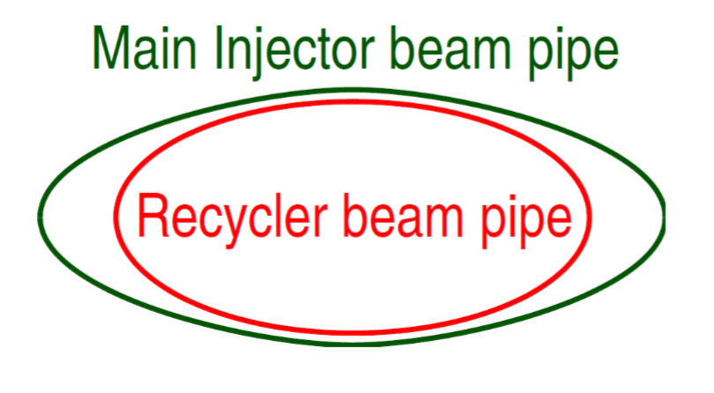
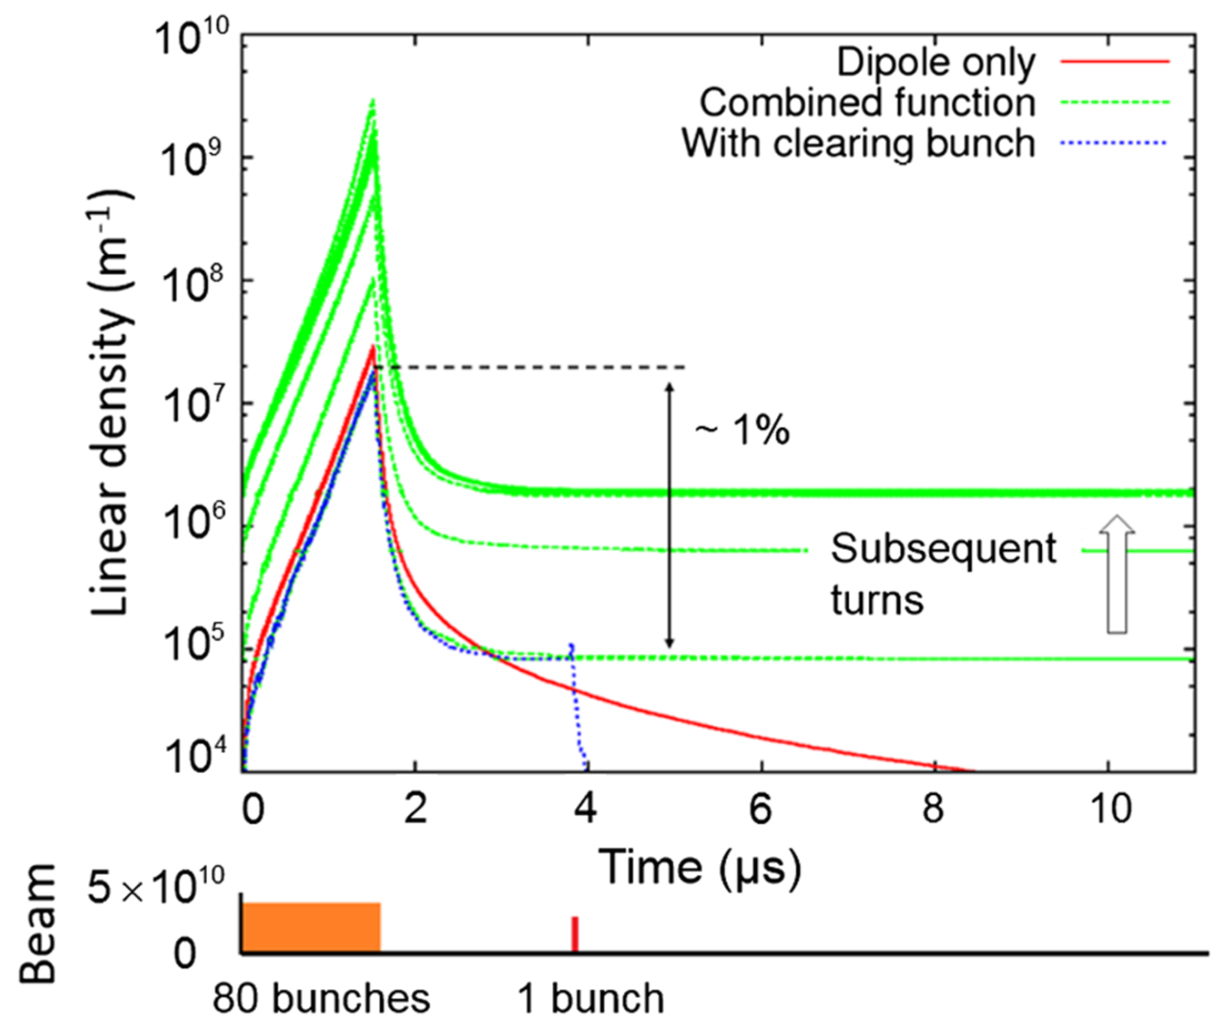
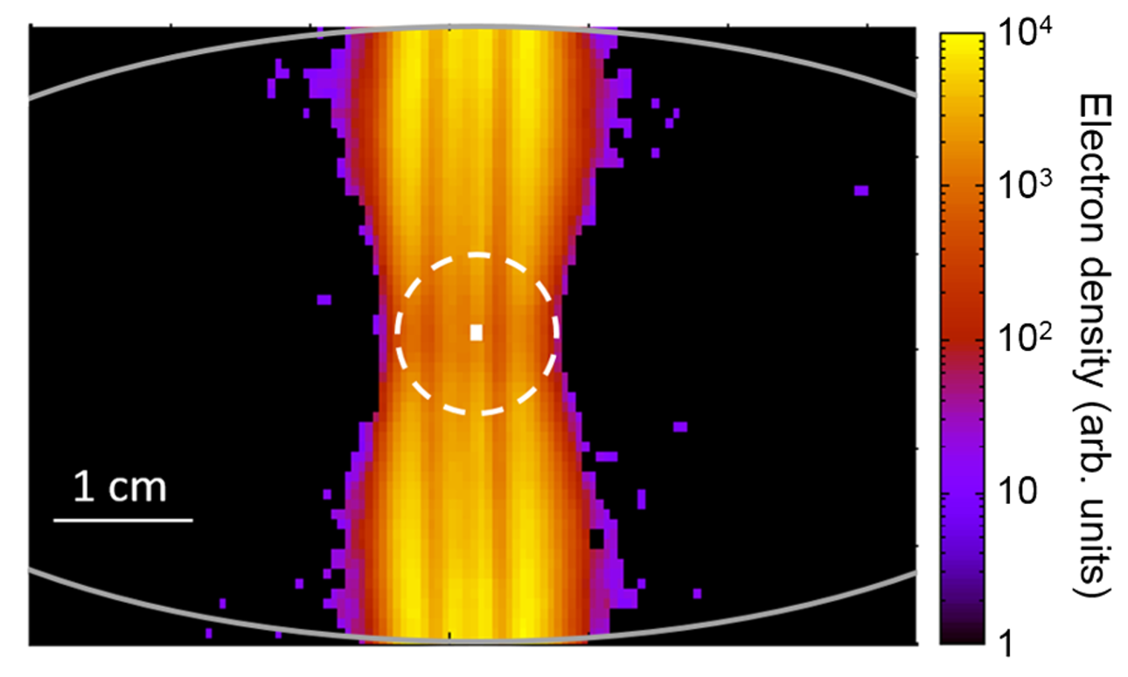
33
Recycler Intensity Challenges
Tight Aperture Losses:
Aperture limits RCS normalized emittance
Electron Cloud Instability:
S. Antipov et al. PRSTAB 2017
33
Jeffrey Eldred | RCS for Multi-MW Facility at Fermilab
Notes:
33
33
33

Slide 34
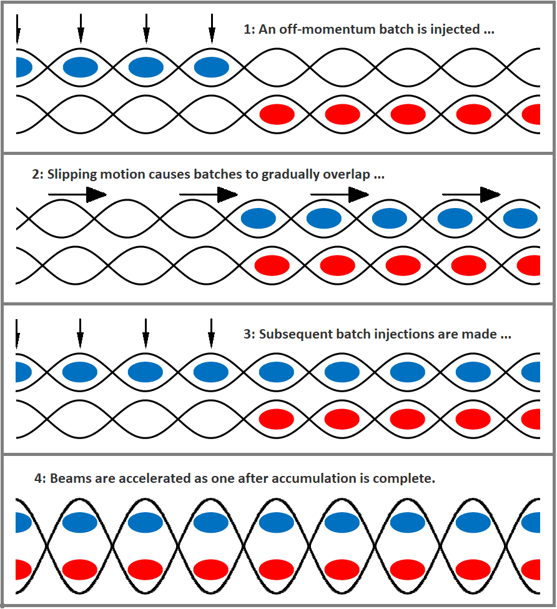
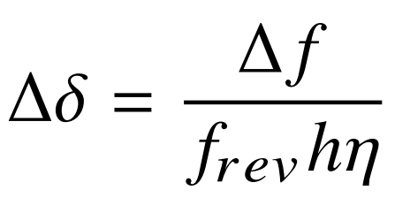
34
Slip-stacking Accumulation
RF frequency separation:
Momentum separation:
34
Jeffrey Eldred | RCS for Multi-MW Facility at Fermilab
Notes:
34
34
34

Slide 35
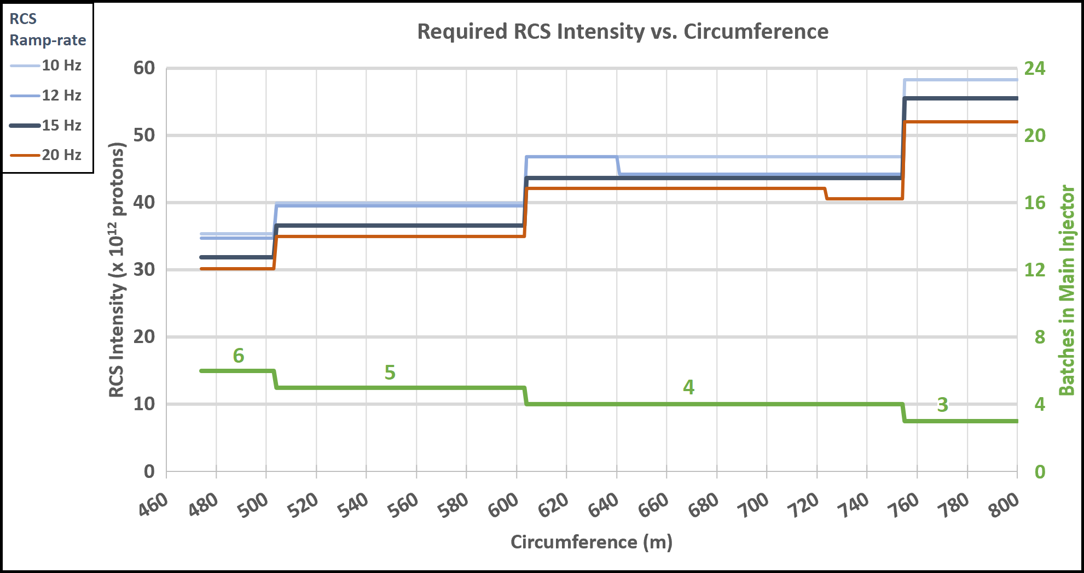
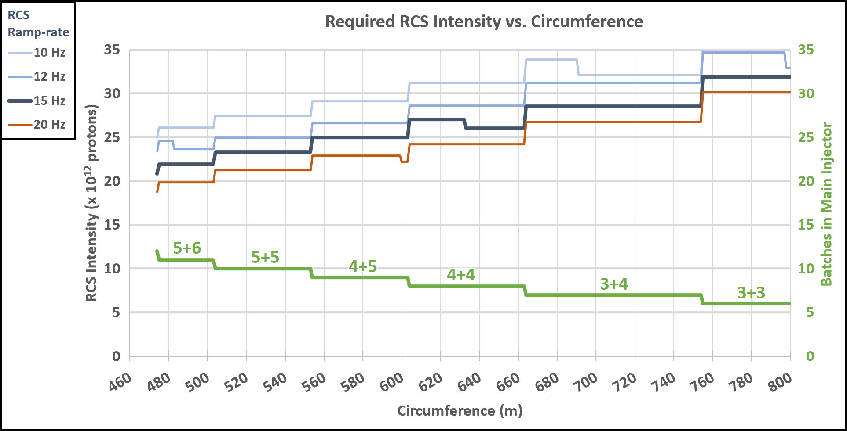
35
2.4 MW with Slip-stacking
Conventional
Stacking:
Slip-stacking:
35
Jeffrey Eldred | RCS for Multi-MW Facility at Fermilab
Notes:
35
35
35

