Slide 1

ArgonCube 2x2 Cryogenics Update
Mike Zuckerbrot
ArgonCube 2x2 Cryogenics Update
July 26 2021

Slide 2
Overview
PFD (Process Flow Diagram)
Cryocoolers
Condenser vessel/Water Chiller
Turbomolecular Vacuum Cart
Filter Vessels
Relief Valve Sizing/Selection
Miscellaneous
  Transfer lines, regen., gas analysis, ODH, controls

Slide 3
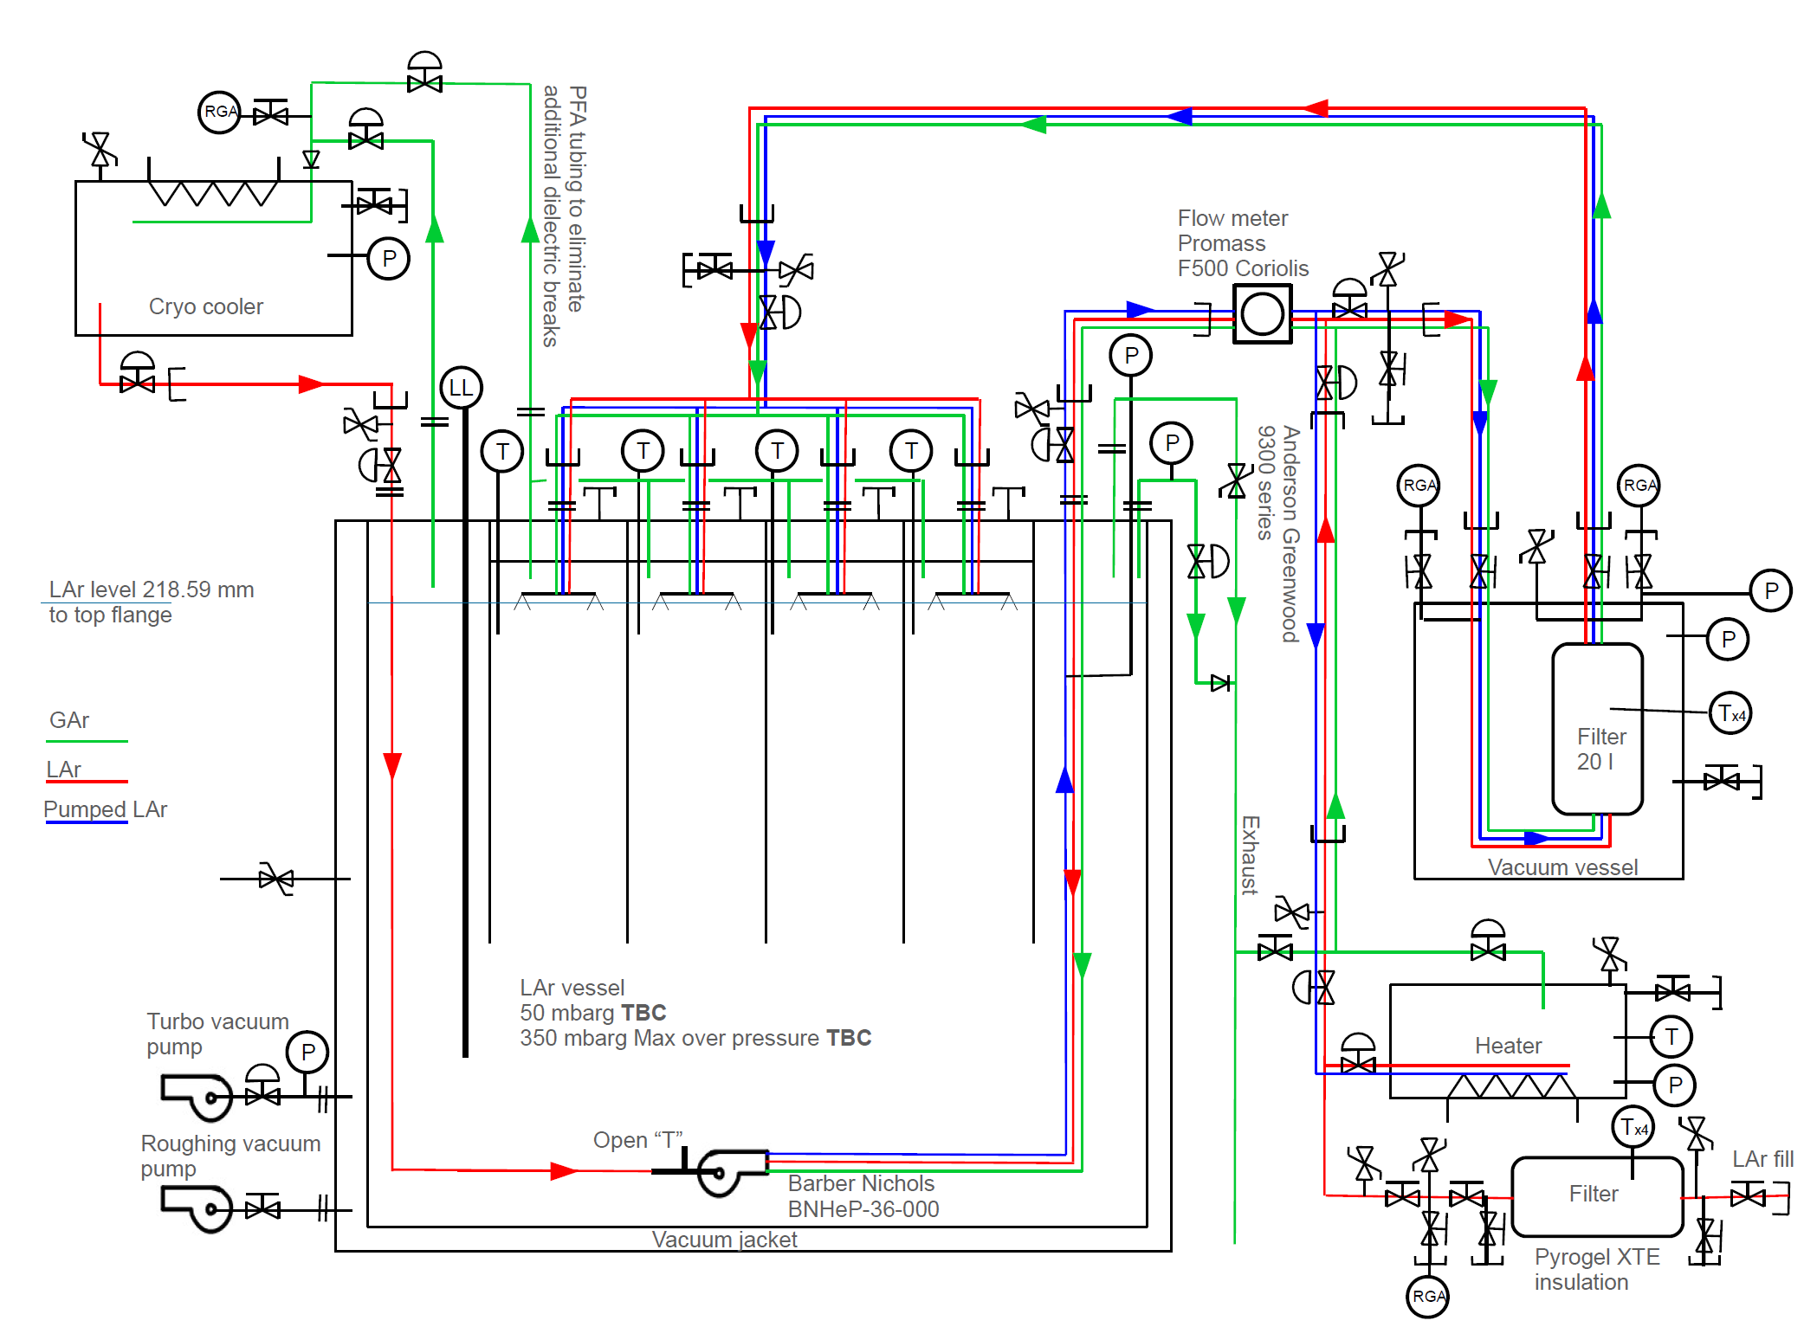
PFD (Process Flow Diagram)

Slide 4
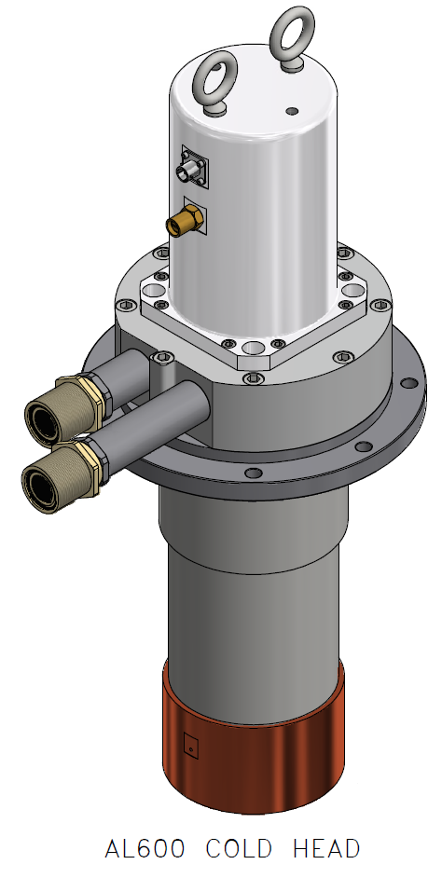
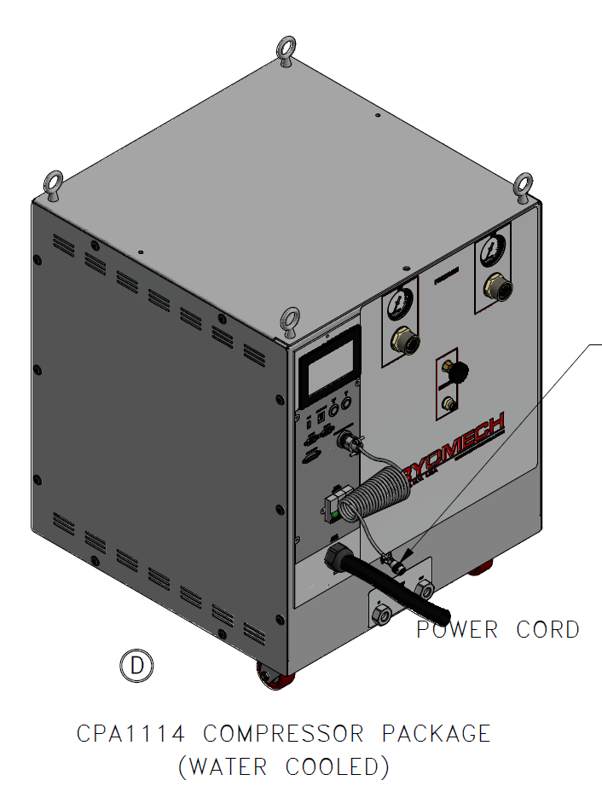
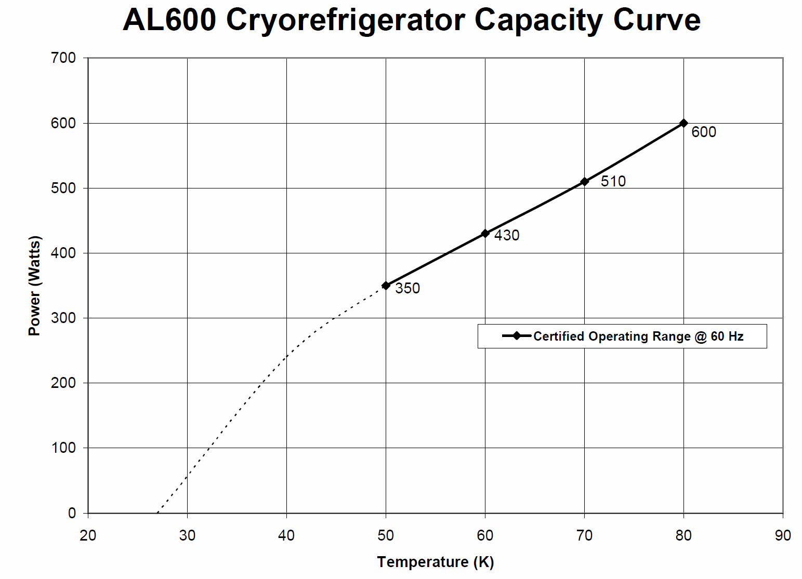
Cryocoolers
Cryocoolers
  Cryomech AL600 (x3)
  600W+ per cold head
  Trim heaters, RTD’s on coldheads
PO awarded 7/21/21
Delivery Date 2/8/22

Slide 5
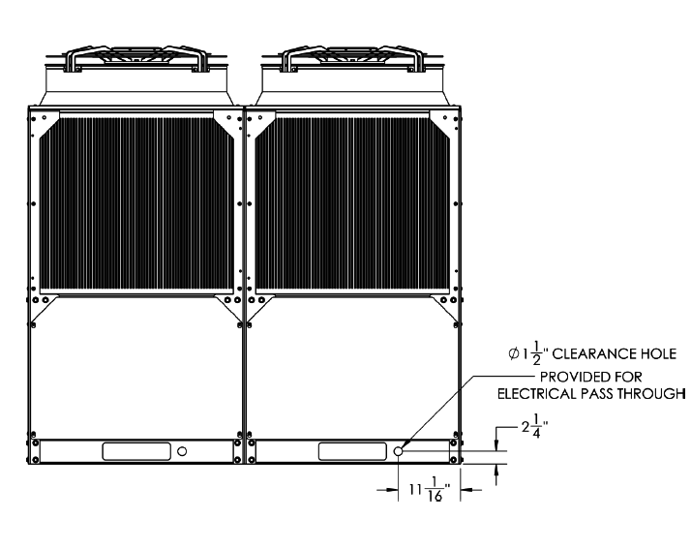
Condenser/Water Chiller
Condenser Vessel
  To be designed for up to 5 coldheads
    Heat load uncertainty
  Cryomech to design, assemble, test as a unit with cryocoolers
  Including instrumentation, trim heaters and RTD’s
  Will connect to Fermi PLC for control
  Waiting for Cryomech quote, expected to be delivered with cryocoolers
Water chiller
  Haskris (Cryomech recommended)
  Air cooled
  35 gpm @50psi capacity,
  Compressors require 3 gpm each
  Onboard PLC, remote on/off capabilities
  Req entered, PO to be awarded soon

Slide 6
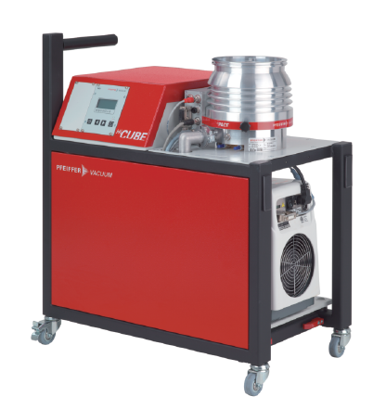
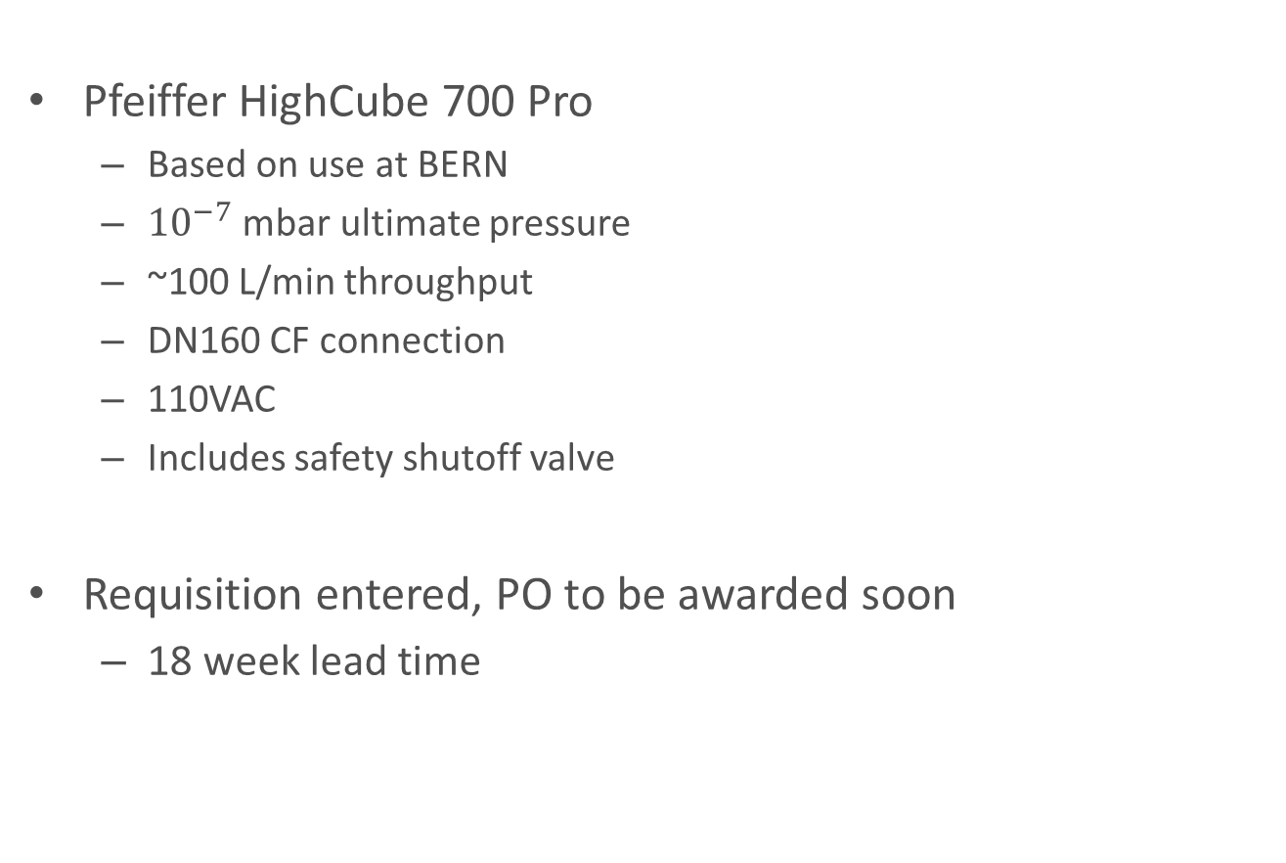
Turbomolecular Vacuum Cart
Pfeiffer HighCube 700 Pro
  Based on use at BERN
  ${10}^{−7}$ mbar ultimate pressure
  ~100 L/min throughput
  DN160 CF connection
  110VAC
  Includes safety shutoff valve
Requisition entered, PO to be awarded soon
  18 week lead time

Slide 7
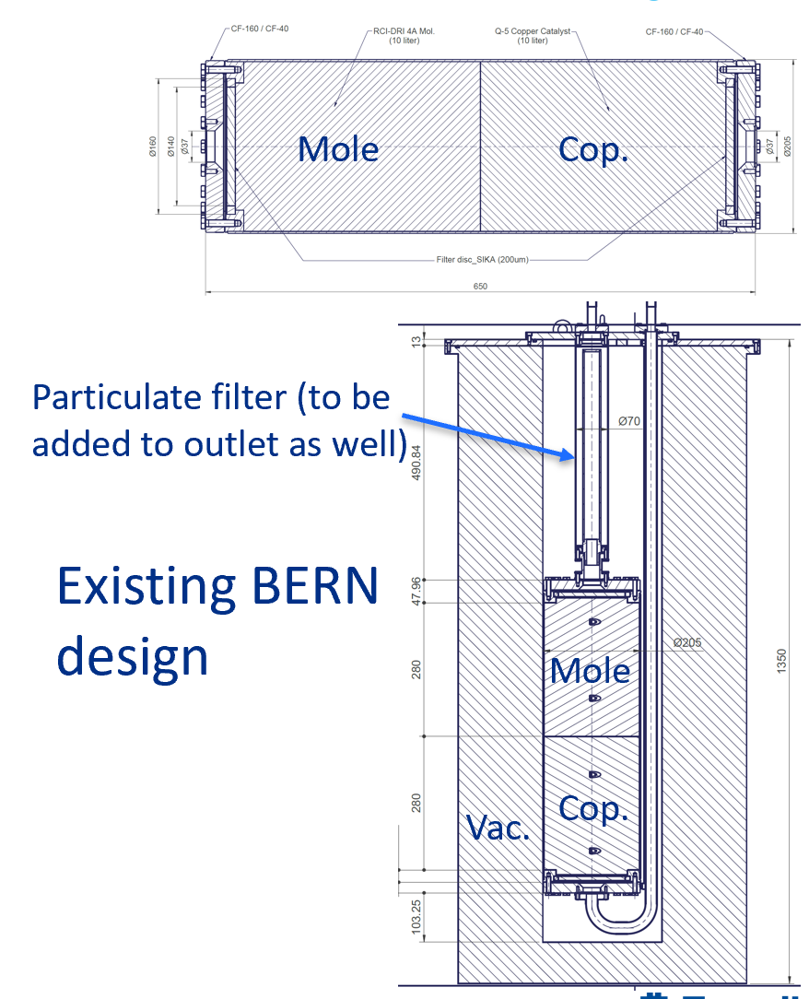
Filter Vessels
Specification to be written for outside manufacturing, testing
To be based on successful BERN design
  10L mole sieve, copper media (each)
Identical vacuum jacketed fill filter, circulation filter
  Can be swapped if saturated
  Can be regenerated in LArTF pit w/existing uboone infrastructure
    Including gas analyzers
Particulate filter to be added to outlet
Mechanical separation to be added
  Increases efficiency
  Prevents bed lift
Top down flow – molecular sieve to copper
  Normal circulation and regeneration

Slide 8
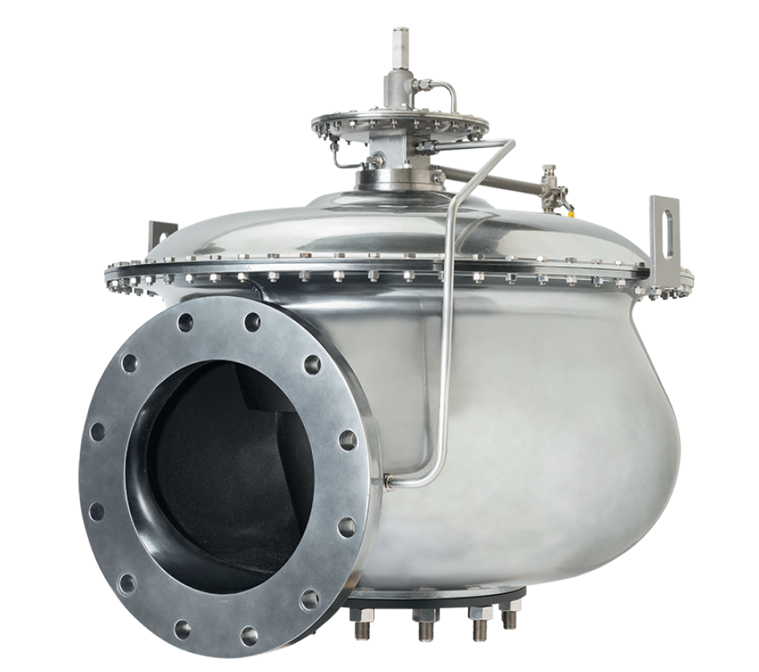
Relief Valve Sizing/Selection
Anderson Greenwood 9300 Series
  Overpressure only, 350 mbarg setpoint
  Pilot operated
    Backpressure not too much of a concern
  Requisition to be placed this week
  28-30 week lead time
    Expediting an option for a price
    Should hear back today on expediting
  Inlet/outlet lines to be sized
    Inlet losses need to be looked at
      Mat require direct pilot connection
    Backpressure/outlet losses need to be checked
  Burst discs looked into (Fike), nothing on the market with such low set pressures and small size
    Low pressure model being developed, no release date yet

Slide 9
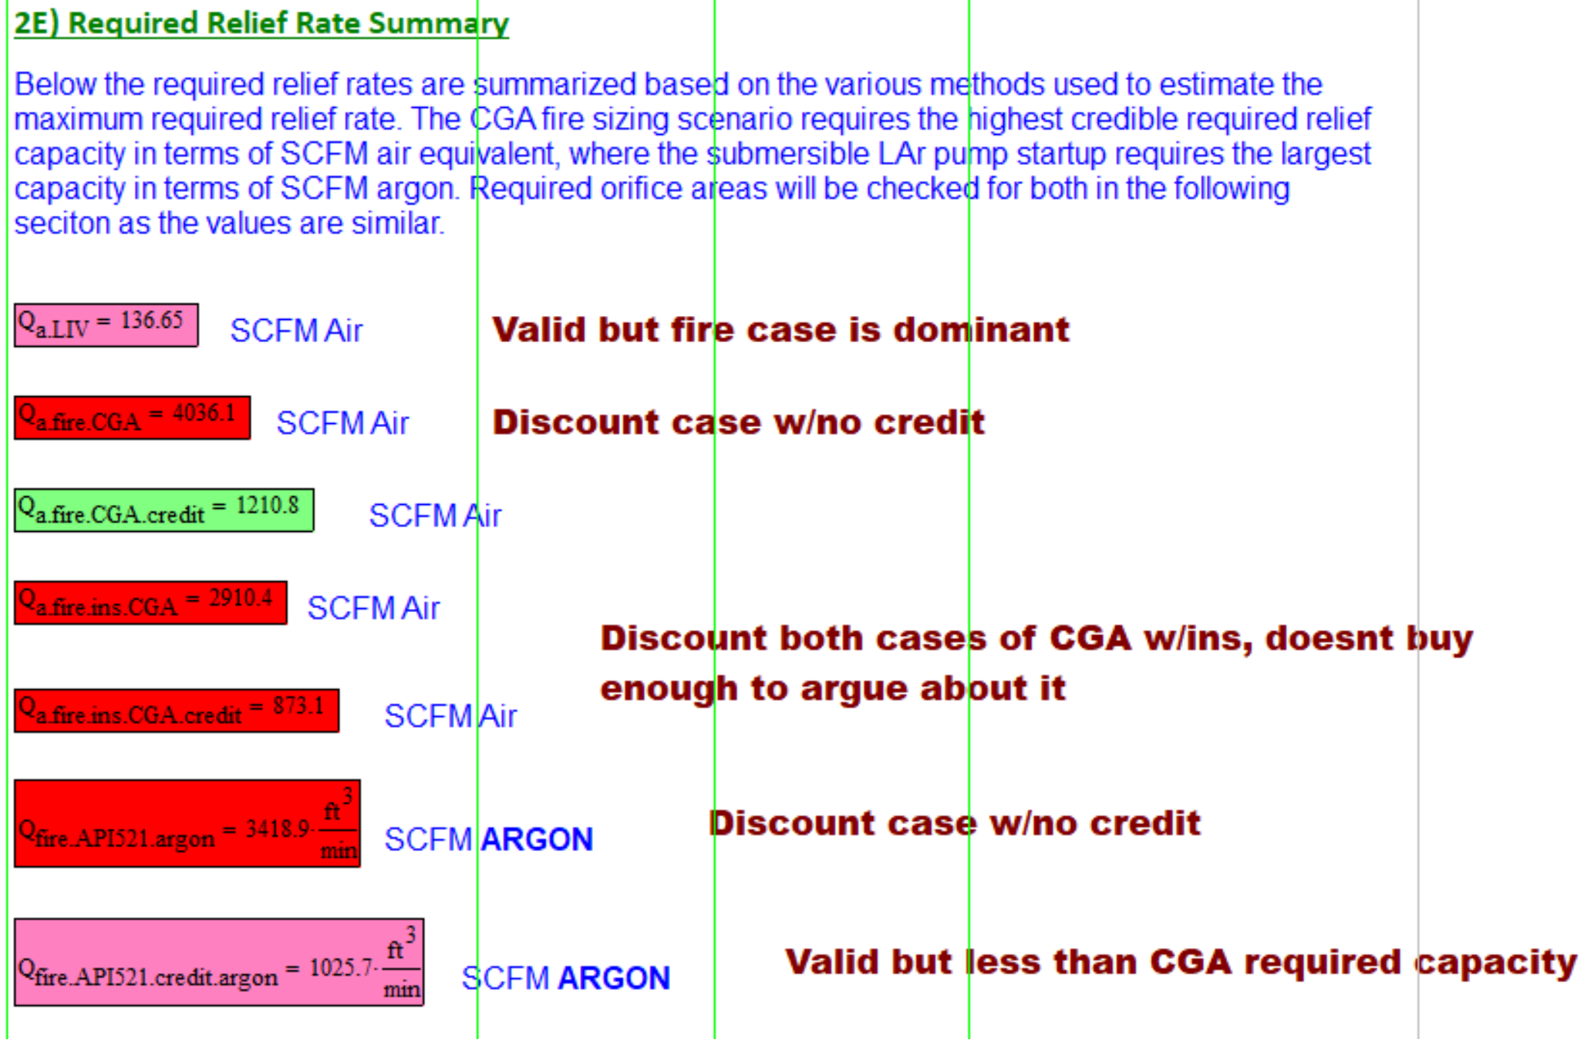
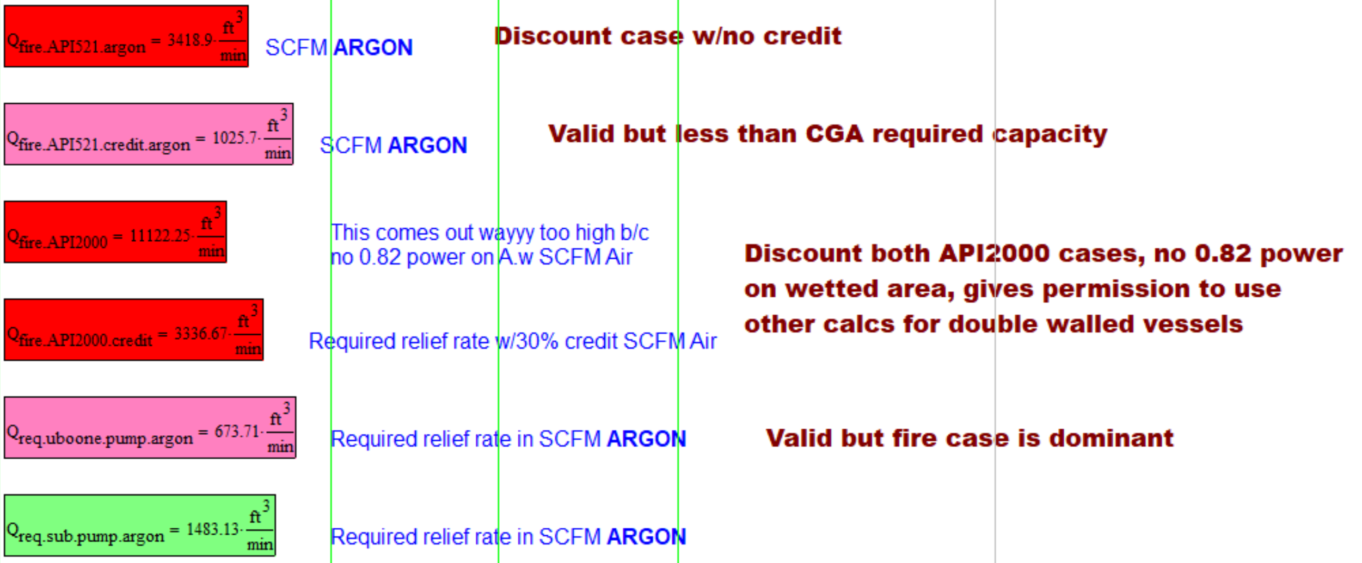
Relief Valve Sizing/Selection
Sizing: Fire and Pump startup dominant cases
  0.3 credit factor taken for lack of flammable materials per CGA
  Pump startup full flow accounted for

Slide 10
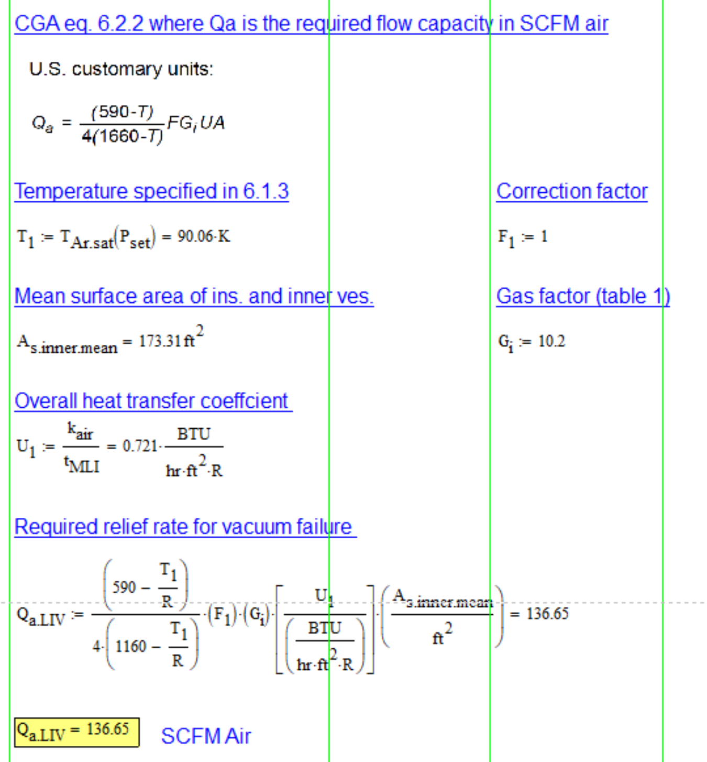
Relief Valve Sizing/Selection
Sizing: Sudden loss of vacuum – Insignificant

Slide 11
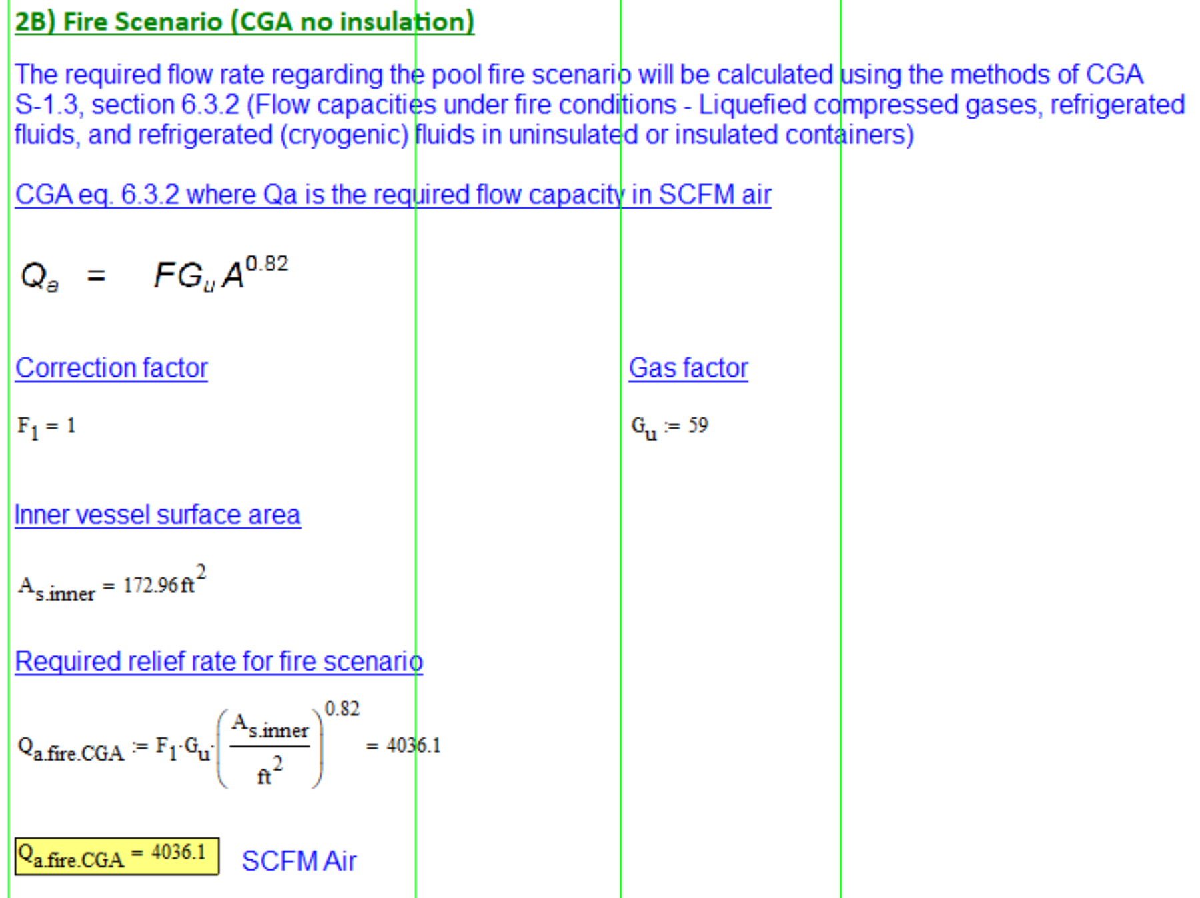
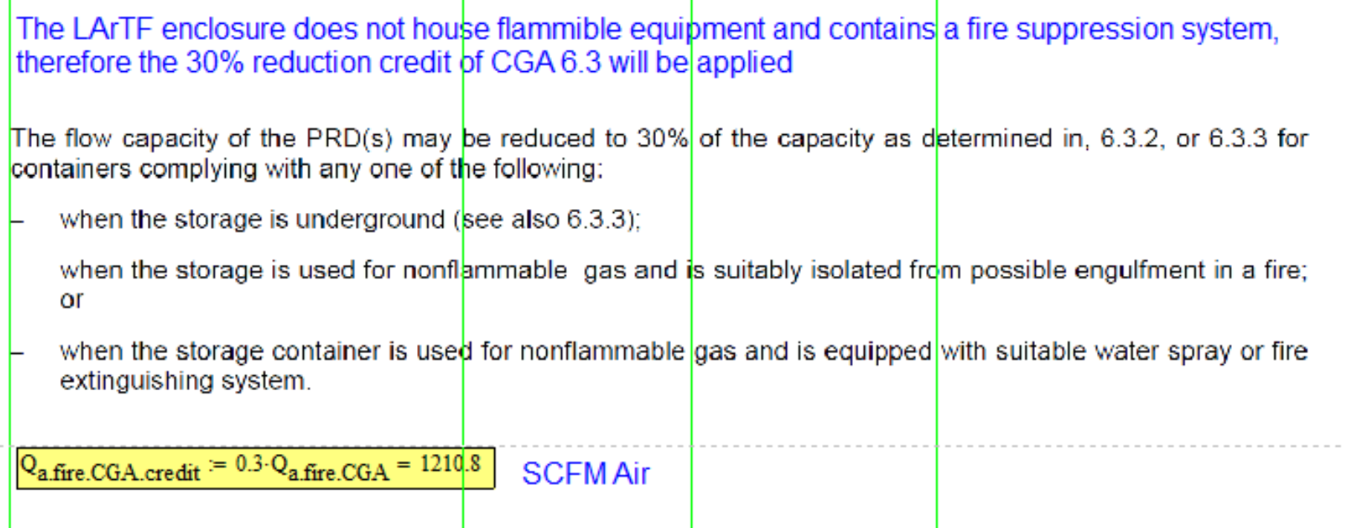
Relief Valve Sizing/Selection
Sizing: Fire Scenario (w/credit)

Slide 12
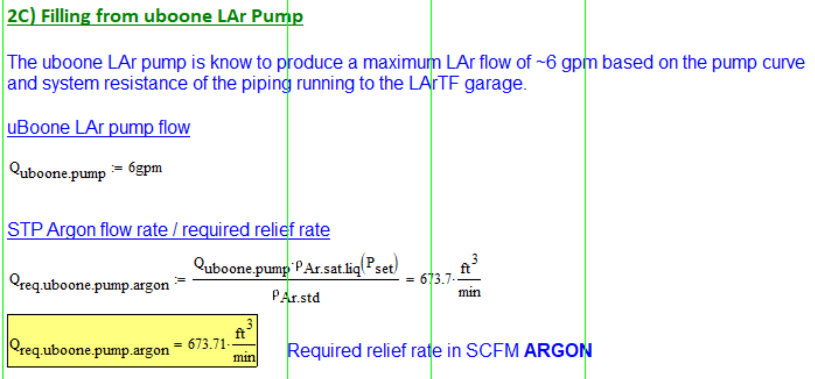
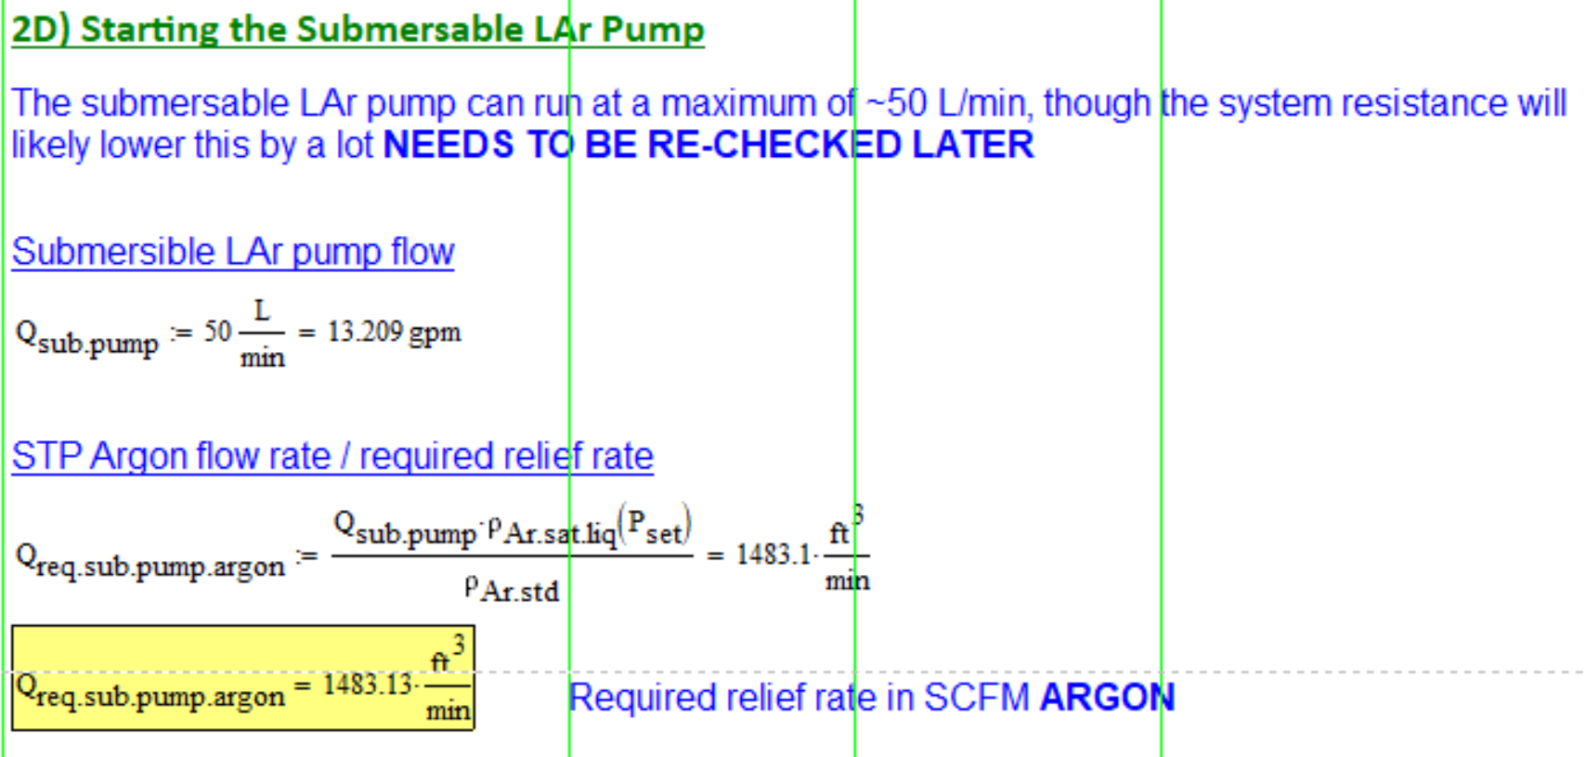
Relief Valve Sizing/Selection
Sizing: LAr Pump Startup

Slide 13
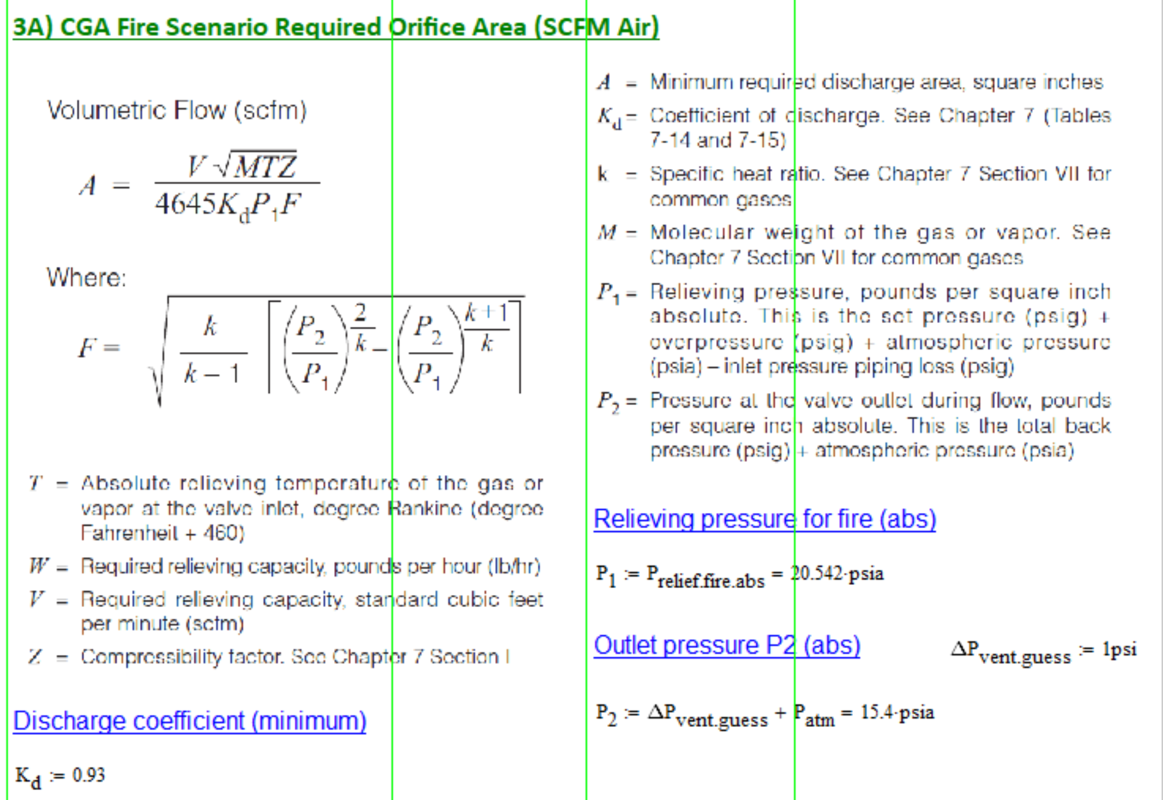
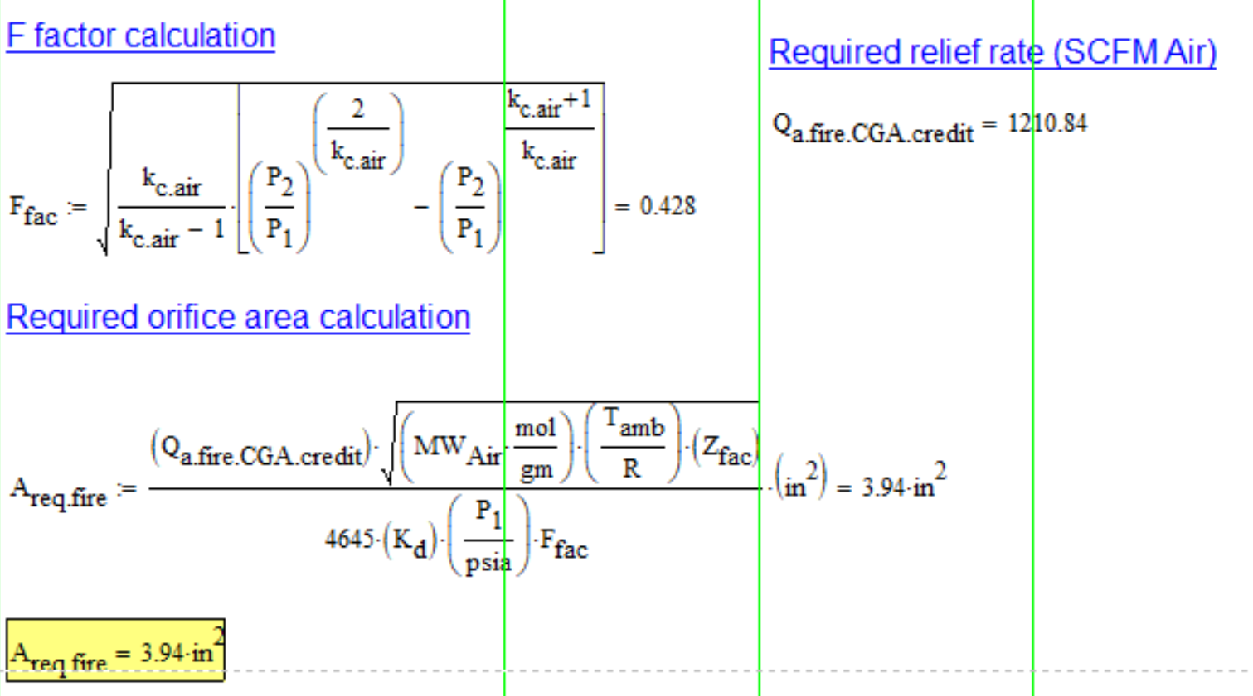
Relief Valve Sizing/Selection
Sizing: Required Orifice Area (Subsonic flow)

Slide 14
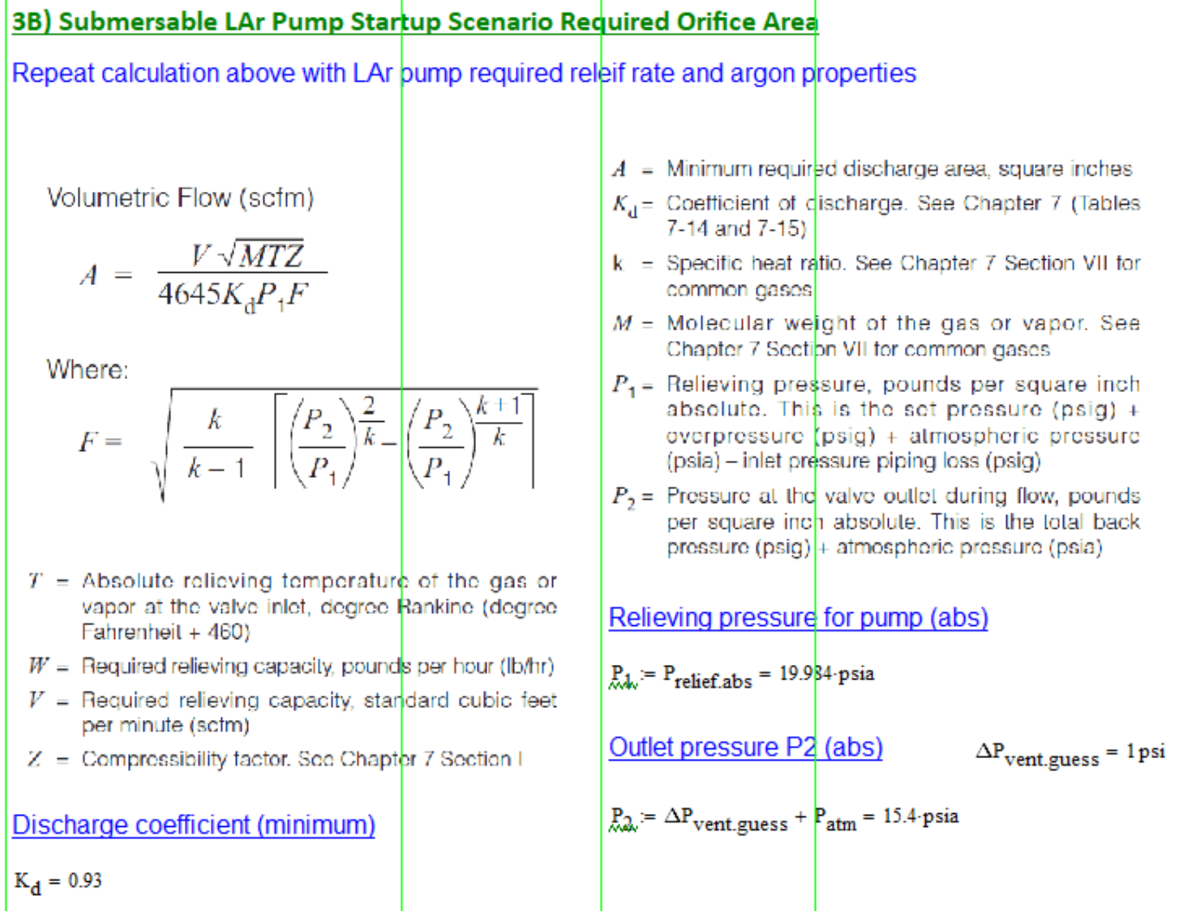
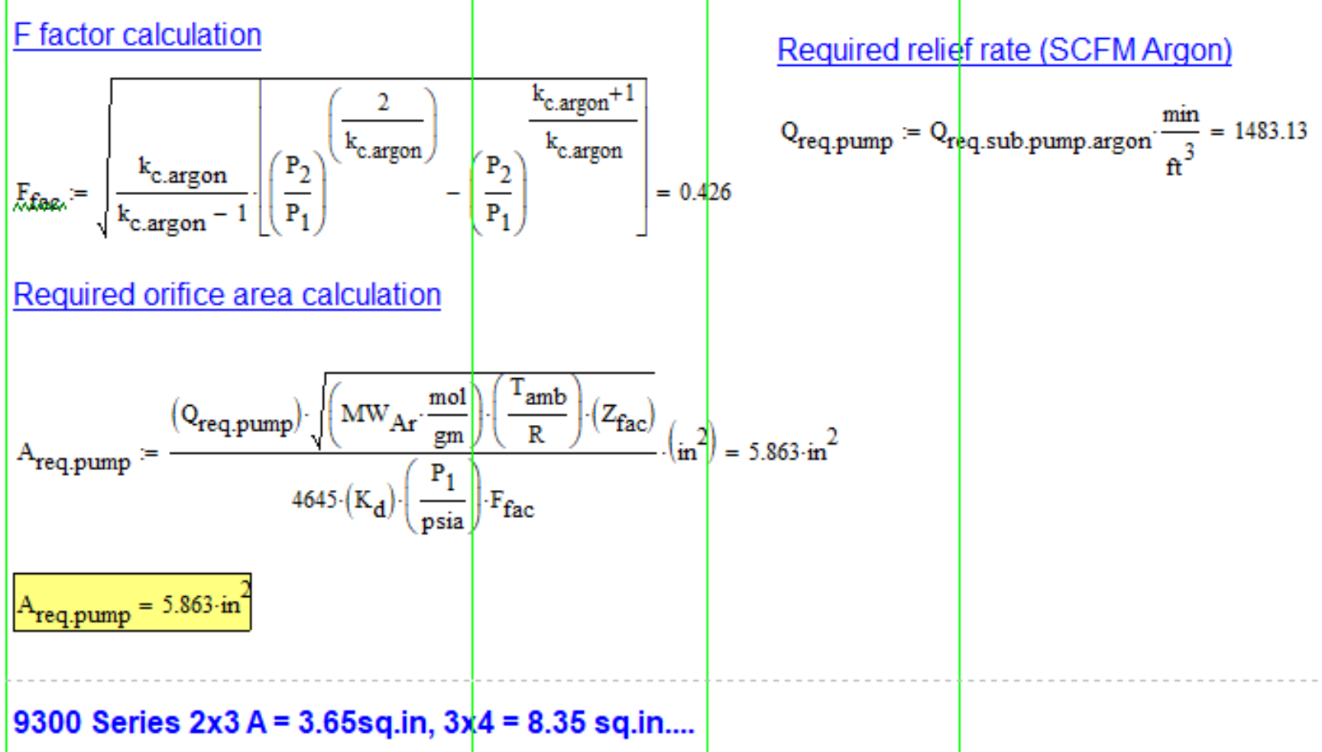
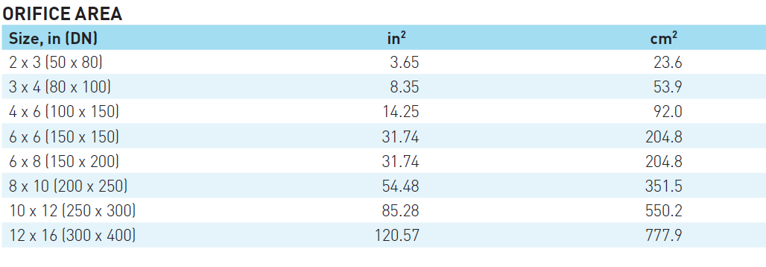
Relief Valve Sizing/Selection
Sizing: Required Orifice Area (Subsonic flow)

Slide 15
Miscellaneous
Electric Vaporizer
  PC4 (LAPD and 35T) to be reused
  ~1 gpm LAr capacity
  Used for draining, piston purge, warm gas
uBoone gas analyzer system existing at LArTF
  Single feed to analyzers (can only sample one source at a time)
  Multiple sources from 2x2
  May need vapor pump if ullage sample is needed for certain analyzers (N2, high precision O2, high precision H2O)
uBoone filter regeneration existing at LArTF
  Move filters to the pit
Transfer Lines
  Fill line, condenser inlet/outlet, other misc. transfer line sections?
ODH system
  LArTF analysis needs update, likely to stay ODH0 on ground floor
Controls system

Slide 16
Questions
Questions/Comments?

