Slide 1
CMS HL-LHC Upgrade Overview
Anders Ryd, Cornell University
MREFC PI and Deputy Project Manager
August 25, 2021
Final version, Aug. 25. Updates from draft:
New slide with R&D milestones
New slide with obligation profile
Many edits/clarifications

Slide 2
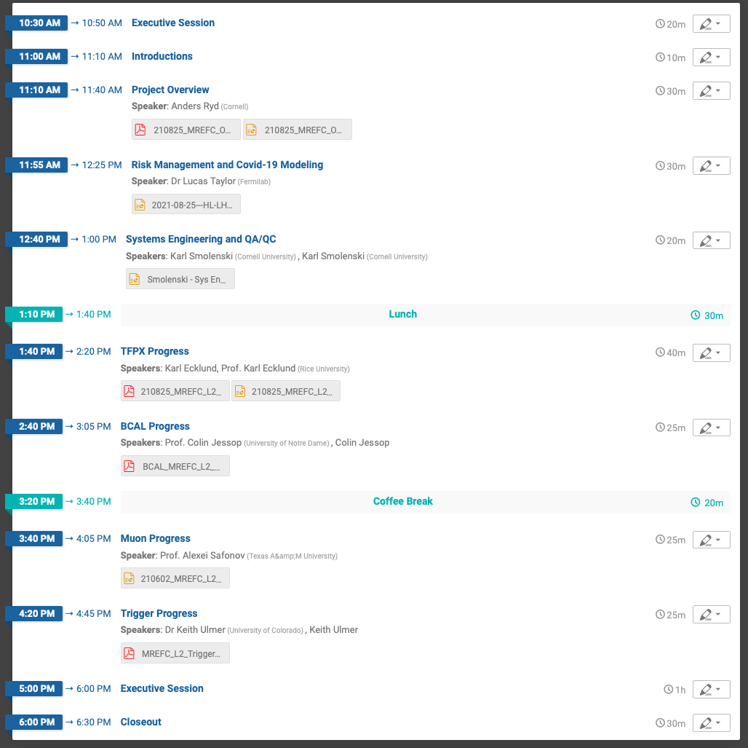
Review Agenda

Slide 3
Outline
Overview/Scope
Project Organization/Management
First Year Overview
R&D Closure
EVM process
  Accruals/Statusing
Subaward Oversight
Risk Management
Change Control
Scope Management
Plans for FY2022
Covid-19 Impact and Modelling
  Readiness for Covid-19 re-baselining
Summary

Slide 4
A. Ryd - Deputy Project Manager and NSF PI
Professor, Cornell 2003 - present
  CMS 2005-present
    HL-LHC Upgrade MREFC PI (2020-present)
    HL-LHC U.S. CMS Deputy Upgrade Project Manager (2014-present)
    CMS Run Coordinator (2010(deputy)&2011)
    Convener of Track Trigger Integration Group (2009 and 2012-2014)
    Pixel Online Software/DAQ (2005-2010)
    SUSY Searches and ttH
  CLEO-c 2003-2011
    Hadronic D-decays and Precision Tracking

Slide 5
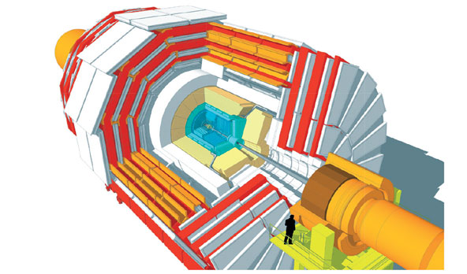
Summary of CMS HL-LHC Upgrades
DOE
and
NSF
Trigger/HLT/DAQ
Track information in L1-Trigger
L1-Trigger: 12.5 μs latency – output 750 kHz
HLT output 7.5 kHz
Barrel ECAL/HCAL
Replace FE/BE electronics
Lower ECAL operating temp. (8 ⚬C)
NSF
NSF
Muon Systems
Replace DT & CSC FE/BE Electronics
Complete Muon coverage in region 1.5<η<2.4
Muon tagging 2.4<η<3
DOE
New Endcap Calorimeters
Rad. tolerant – high granularity
3D capable
DOE
DOE
New Tracker
Rad. tolerant – high granularity – significant less material
40 MHz selective readout (p_{T}>2 GeV) in Outer Tracker for L1 -Trigger
Extended coverage to η=4
MIP Precision Timing Detector
Barrel: Crystal +SiPM
Endcap: Low Gain Avalanche Diodes
NSF

Slide 6
NSF Scope Areas
Forward Pixels (TFPX)
  Forward pixel with extension to |η|=4. NSF would deliver the full forward pixel system. U.S. has delivered the original FPIX and Phase 1 FPIX
  NSF ‘Flagship’
L2 Area | BAC ($k)
PO [WBS 402.0] | 6,195
BCAL [WBS 402.3] | 10,597
Muons [WBS 402.5] | 7,078
TFPX [WBS 402.7] | 26,810
Trigger [WBS 402.9] | 9,086
Total | 59,766
Barrel Calorimeter (EB/HB)
  NSF deliver upgrade of barrel ECAL electronics for readout at 40 MHz required by L1 trigger rate and latency increases
  Backend readout board for barrel HCAL
Muons
  NSF deliver electronics for upgrades of forward muon system (U.S. responsibility) readout and trigger interface
Trigger
  L1 Track finding to incorporate tracking in L1 trigger
  L1 Muon Trigger – endcap and barrel
NSF MREFC scope well defined and established since PDR

Slide 7
Schedule Overview – Independent L2 Areas
FDR
MREFC Funding Start
MREFC Completion
CY18
CY19
CY20
CY21
CY22
CY23
CY24
CY25
CY26
CY27
CY28
Design and Development (under operations program)
Pre-Production
TFPX
Construction
Testing and Integration
Schedule Float
Pre-Production
Construction
Muon
Testing and Integration
Schedule Float
Construction Project (MREFC)
Pre-Production
BCP
Testing and Integration
BCAL
Construction
Pre-Production
Schedule Float
FE
Testing and Integration
Construction
Schedule Float
Muon Trg.
Pre-Production
Construction
Testing and Integration
Schedule Float
Trigger
Track Trg.
Pre-Production
Construction
Testing and Integration
Schedule Float
Int’l
CMS
P5 Inst
LHC
Run 4
LS 2
Run 3
LS 3
v3.1 Aug. 1, 2021
HL-LHC Operations Start

Slide 8
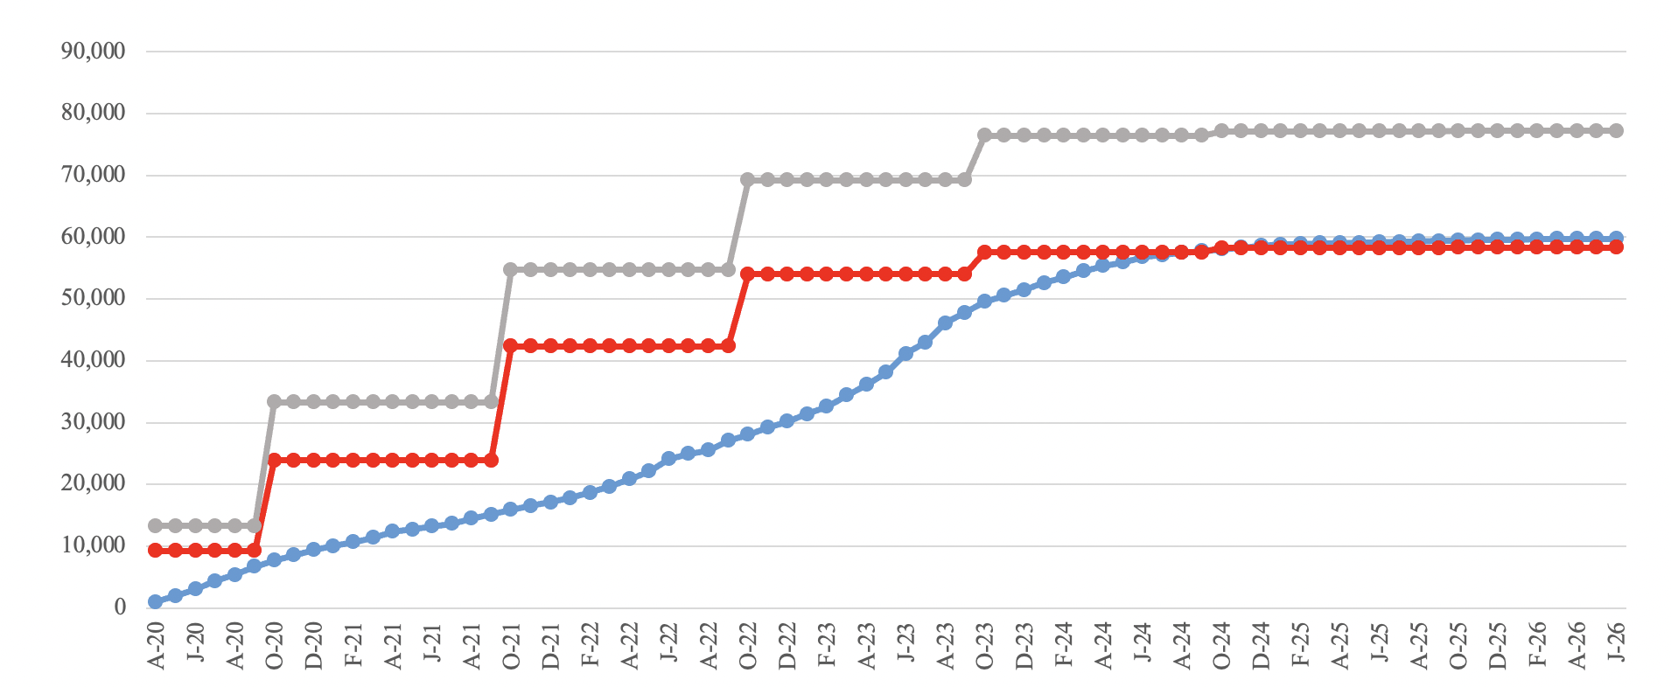
Budget and Funding Profile
NSF started funding the MREFC on April 1, 2020
  Many thanks to NSF for following through on the plans!
NSF award to Cornell is $77.225M
  $9.6M awarded in FY2020 (+4.0M for contingency)
  $14.4M awarded in FY2021
Budget projection well within funding profile
  Covid-19 has delayed project
NSF Funding Profile
(Including contingency)
NSF Funding Profile
(No contingency)
MREFC Baseline Budget Profile

Slide 9
U.S. CMS HL-LHC Management Team
Charge: 2a
402 HL-LHC CMS Detector Upgrade Project
Project Office (402.0 NSF and 402.1 DOE)
Project Manager: S. Nahn
Deputy PM (NSF): A. Ryd
Deputy PM (DOE): V. Papadimitriou
Associate PM: L. Taylor
Associate PM: C. Wilkinson
Project Scientist: C. Hill
Education and Public Outreach: S. Rappoccio
CMS HL-LHC Liaison: P. Rumerio
ESH&Q Coordinator: T. J. Sarlina
Project Controls Lead: W. Freeman
Project Controls Specialists: E. Moreno, S. Scott
Project Finance (DOE): J. Teng
Project Finance (NSF): B. Smith
Lead Systems Engineer: K. Smolenski
DOE scope
NSF scope
DOE and
NSF scope
402.2 OT
L2: P. Merkel
DL2: U. Heintz
402.3 BCAL
L2: C. Jessop
402.4 Endcap Cal.
L2: J. Mans
DL2: H. Cheung
402.5 Endcap Muon
L2: A. Safonov
402.6 Trigger/DAQ
L2: J. Berryhill, K. Ulmer
402.7 FPIX
L2: K. Ecklund
DL2: W. Johns
402.8 MIP Timing
L2: C. Neu
DL2: F. Chlebana
402.9 Trigger
L2: J. Berryhill, K. Ulmer
402.2.3 Sensors
L3: R. Demina
402.3.3 ECAL
L3: B. Hirosky
402.4.3 Sensors
402.4.4 Modules
L3: N. Akchurin, M. Paulini
402.5.3 CSC-Off
L3: D. Wood
402.6.3 Cal Trig
L3: S. Dasu
402.7.3
Sensors & ROCS
L3: S. Wagner
402.8.3 Barrel Timing Layer
L3: A. Bornheim
402.9.4 Muon Trig
L3: J. Konigsberg
402.2.4 Electronics
L3: Y. Gershtein, A. Canepa
402.3.4 HCAL
L3: A. Belloni
402.5.4 GEM
L3: K. Black
402.6.5
Correlator Trig
L3: K. Stenson
402.9.7 Track Trig
L3: P. Wittich
402.4.5 Cassettes
L3: Z. Gecse
402.7.4 Module
L3: M. Jones
402.8.4 Endcap Timing Layer
L3: A. Apresyan
402.2.5 Modules
L3: M. Narain, L. Spiegel
402.6.6 DAQ
L3: J. Berryhill, acting
402.4.6 Scintillator Cal.
L3: T. Kolberg
402.7.5 Electronics
L3: A. Ivanov
402.2.6 Mechanics
L3: D. Berry
402.4.7 Electronics and Services
L3: J. Hirschauer
402.7.6
Mech. & Assembly
L3: J. Alexander
402.2.7 Integration
L3: D. Berry
v4.2 June 14, 2021
New personnel for MREFC since FDR (Sept. 2019) in red

Slide 10
Management Updates since FDR
J. Alexander (Cornell) stepped down as co-L2 for TFPX
J. Konigsberg (U. of Florida) replaced D. Acosta (U. of Florida) as L3 for Muon Triggers
S. Scott (Patrick Engineer) is the main NSF MREFC project controls specialist
B. Smith (Cornell) manages project finances
Starting in September, 2021, J. Thom (Cornell) will take over from S. Wagner (Colorado) as the TFPX ROC&Sensor L3 manager
We have a strong and well functioning management team - we meet twice a week to coordinate activities (for both NSF and DOE scope)

Slide 11
NSF MREFC Project Execution
Charge: 2a
The April 1, 2020, start of the MREFC coincided very closely with the start of the the Covid-19 pandemic
  Most universities and laboratories closed-down in mid-March with essentially only remote work possible
    Some lab-based work resumed in June 2020 with restrictions
  More significant in-person work only started in June 2021 following vaccinations and significant reductions in cases
    New variants continue to pose a threat
Though some design and simulation related activities could proceed efficiently during the shutdown many other activities were significantly delayed due to Covid-19 limitations
  More specifics in the L2 area talks about Covid-19 impacts

Slide 12
Project Status Summary
The project performance summary as of June 30, 2021:
Schedule performance (SPI) low due to delays from Covid-19
Cost performance (CPI) overall good
  Near zero travel expenses (earned value on LOE activities)
  Avoided essentially all ‘standing army costs’
  Some Covid-19 labor inefficiency (discussed later)
L2 Area | Budget (k$) | Earned (k$) | Actual (k$) | SPI | CPI | BAC (k$)
PO | 2,540 | 2,540 | 2,202 | 1.00 | 1.15 | 6,195
BCAL | 2,051 | 1,763 | 1,282 | 0.86 | 1.37 | 10,597
Muons | 1,843 | 1,275 | 1,067 | 0.69 | 1.19 | 7,078
TFPX | 4,919 | 2,673 | 2,776 | 0.54 | 0.96 | 26,810
Trigger | 1,837 | 1,440 | 1,335 | 0.78 | 1.08 | 9,086
Total | 13,190 | 9,690 | 8,662 | 0.73 | 1.12 | 59,766

Slide 13
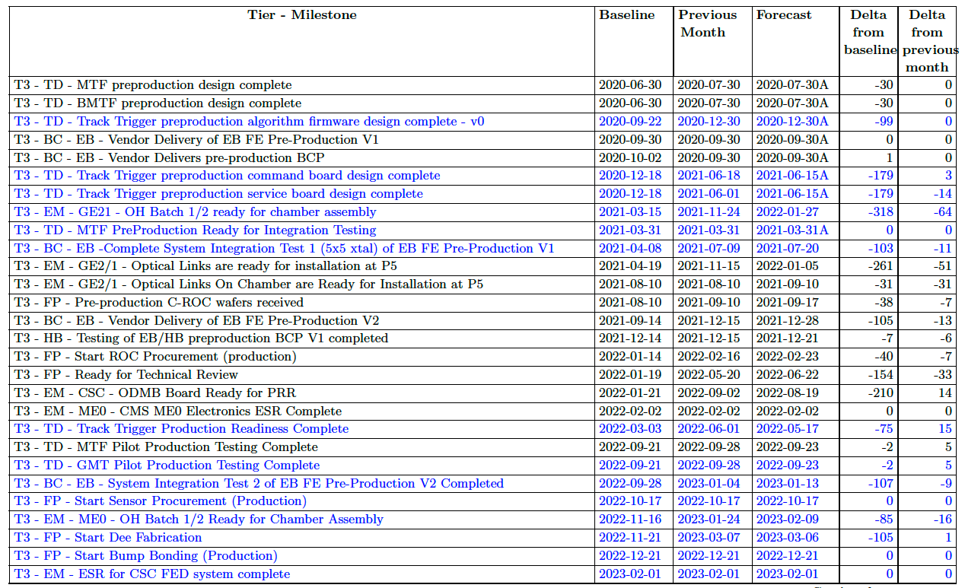
Year 1 Milestone Progress
Reporting Milestone Status as of June 30, 2021

Slide 14
R&D Completion
Charge: 1a
With the start of the MREFC on April 1, 2020, the R&D activities were rapidly ramped down
  Final invoicing summarized below (not including funds prior to the 2017 operations award)
Consistent with budget agreed with OPS program and NSF guidance
Project area | Final Spending ($k)
Project Office [WBS 402.0] | 1,800
Barrel Calorimeter [WBS 402.3] | 1,756
Muons [WBS 402.5] | 829
TFPX [WBS 402.7] | 4,245
Trigger [WBS 402.9] | 1,729
Total | 10,358

Slide 15
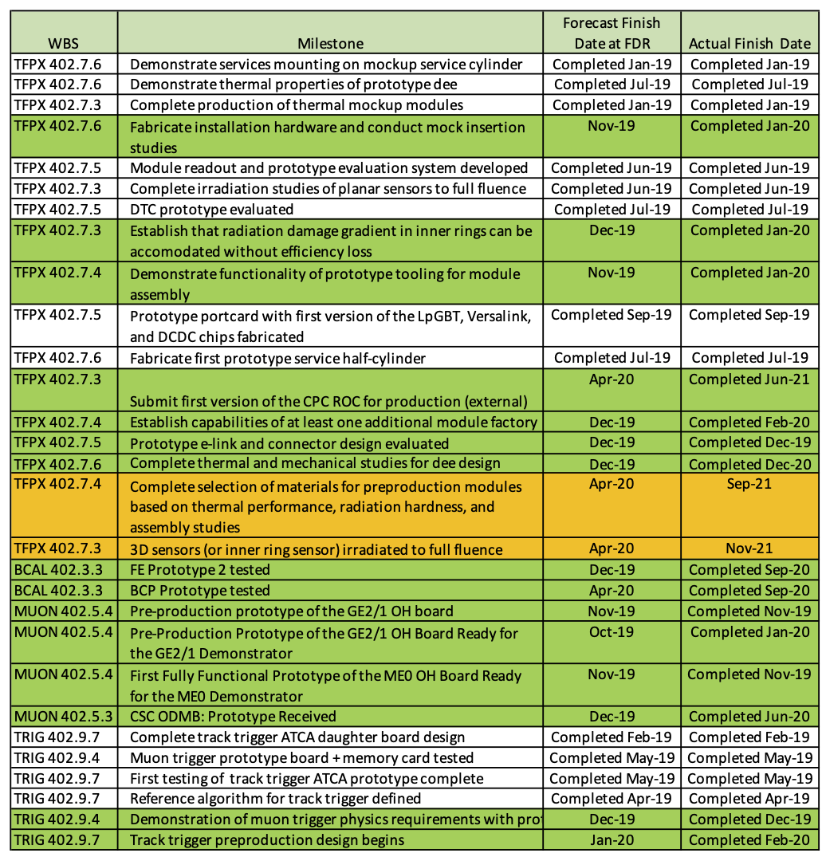
R&D Completion - Milestones
At the time of the FDR we had 17 open milestones we were tracking
  Fifteen (in green) has been completed
  Two TFPX milestones (in yellow) has been incorporate into the MREFC scope and are now near completion
More details about the milestone completion in the L2 talks
R&D Milestone Status at FDR

Slide 16
FDR Recommendations
Charge: 1a
We had eleven recommendations from the FDR (DocDB-13905):
  Five TFPX recommendations – addressed in K. Ecklund’s TFPX presentation
  One BCAL recommendation – addressed in C. Jessop’s BCAL presentation
  Two systems engineering recommendations – address in K. Smolenski’s Systems Engineering presentation
  Three EPO related recommendations – these were reviewed as part of the Operations Review on July 27-28, 2021
These recommendations have been addressed and a document that summarizes our response is available in DocDB-14309

Slide 17
Technical Review
Charge: 4b
One of the main recommendations from the FDR was a Technical Review of the critical TFPX ASICs and Sensors
With the delays caused by Covid-19 the TFPX team estimates Summer 2022 as the time when they will be ready for this technical review
  C-ROC (CMS Pixel Readout Chip) has been submitted and expected to be available in Sept. 2021
  The CMS sensor selection is planned for Nov. 2021
  Many other designs will be finalized, and prototypes will be available
The CMS EDR (Engineering Design Review) is now schedule for early 2023 and this will allow holding the technical review before the EDR
More details in K. Ecklund’s talk

Slide 18
Monthly EVM Cycle
Charge: 2a
Following NSF guidance, we collect EVM status monthly
At the end of each month (typically around the 25th) we send out a call for current month’s:
  Schedule statusing (turnaround report)
  Accruals
This information is completed by CAMs, L2s, and L3s, working with the subaward institutions
PCS (primarily S. Scott for the MREFC) implements the statusing (typically by the 10th of the following month) and generates the Cobra reports and uploads results and VARs to the Fermilab CAM eToolbox
VARs are completed in the CAM eToolbox by CAMs and approved by PCS, L2s, and PM. VARs at L3 over the NSF agreed reporting threshold are included in monthly reports to NSF
Having implemented ~15 statusing cycles this is routine now. Main challenge is to get timely input from the about 30 subaward institutions

Slide 19
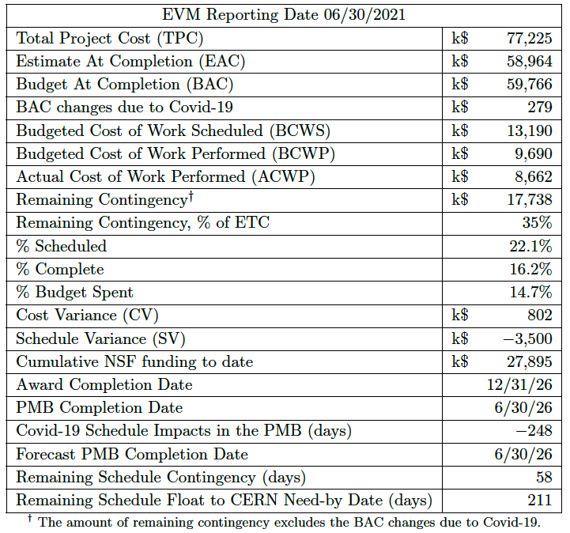
Monthly EVM Summary
Charge: 2a
Sample monthly EVM summary on the NSF requested format
  From the June 2021 reporting period

Slide 20
Project Performance
The Covid-19 pandemic has had a significant impact on the project – significant delays to many activities
Since the start of the project, we have had a significant schedule variance
  Some MREFC activities did not start directly as R&D activities were still wrapping up in 2020. But mainly Covid-19 did delay many planned activities
SPI is slowly improving (0.76 for July statusing)
CPI has remained stable around 1.10 to 1.20

Slide 21
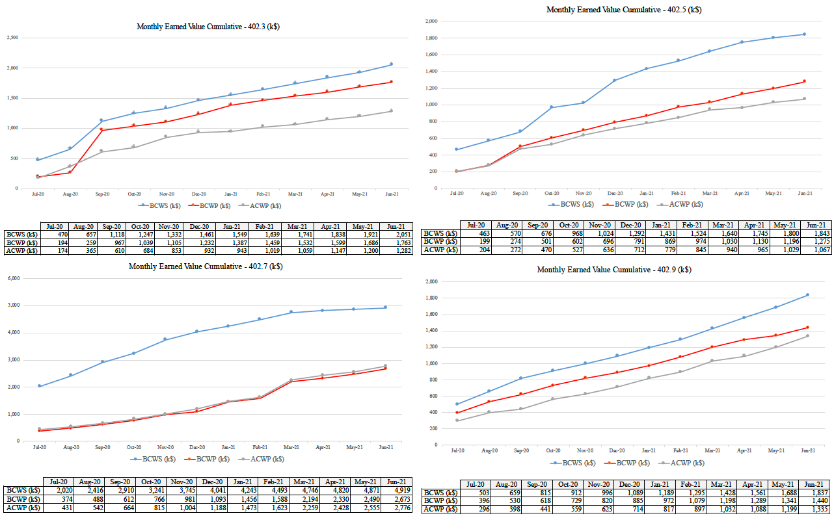
L2 Area SPA Trend Plots
BCAL [402.3]
Budget
Muons [402.5]
Earned
Actual
TFPX [402.7]
Trigger [402.9]

Slide 22
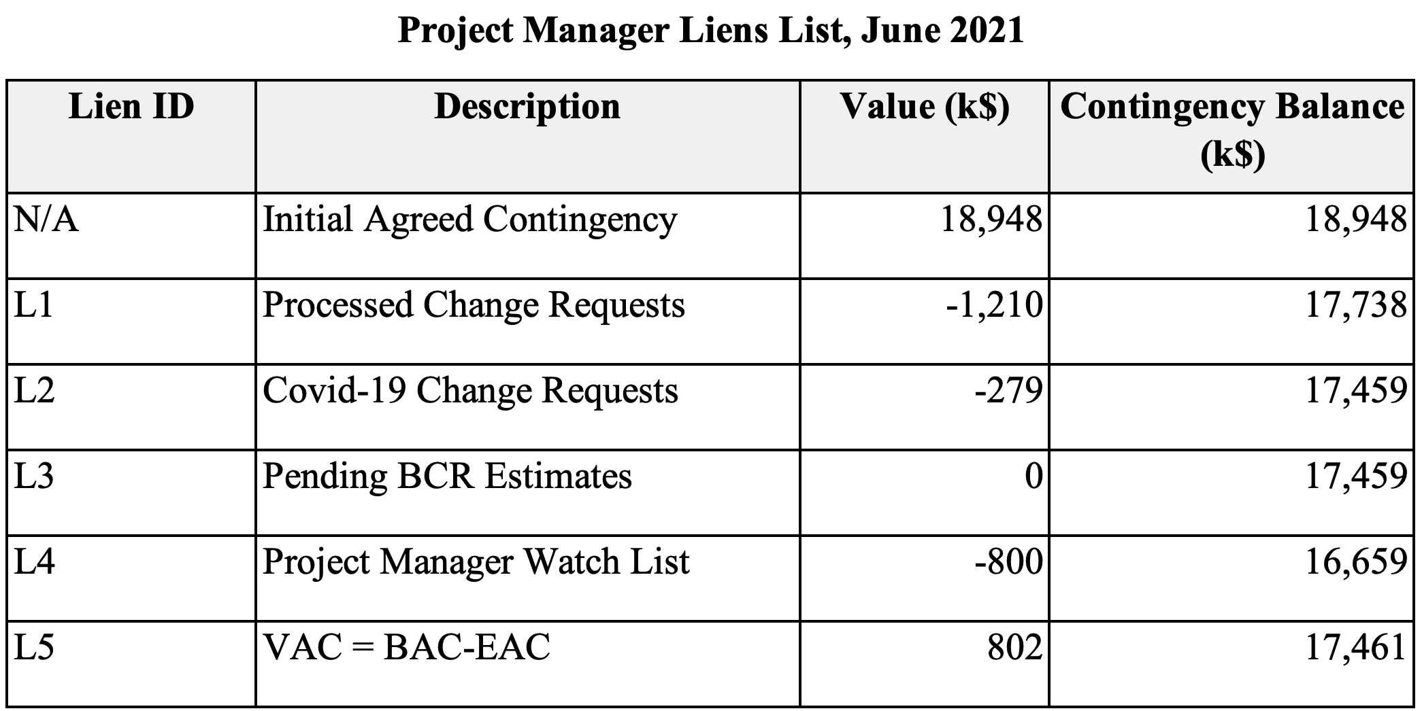
Contingency and Liens List
The project has allocated $1,489k to the BAC through the BCR process
  $279k is due to Covid-19 BCRs
On the Liens List we have $550k for the currently unfavorable exchange rate to CHF and $250k for variances that will be recovered in the PO and BCAL

Slide 23
Subaward Oversight
Charge: 2a
The project has several mechanism for oversight of the subward institutions:
  Yearly SOWs developed by the L2/L3s based on the activities in the P6 schedule
  Annual progress report by the subaward institutions
  Monthly statusing cycle where CAMs/L2/L3 collect information about institution performance, technical progress and financials
    Progress on milestones
  Invoicing is reviewed at Cornell (B. Smith/A. Ryd)
  Subaward travel is sporadically audited by the project
The project also calculates EVM performance metrics by institution (this is done outside the Cobra framework as Control Accounts often span more than one institution)

Slide 24
U.S. CMS Institutions on MREFC Scope
CMS MREFC Institutions
32 Subaward institutions – 50 Yearly SOWs (by L2 area)
Inst. | L2 area(s) |  | Inst. | L2 area(s)
BU - Boston U. | TFPX, Trigger |  | PC - Purdue Northwest U. | TFPX
CL – UC Los Angeles | Muon, Trigger |  | PD - Purdue U. | TFPX
CN - Cornell U. | PO, Trigger, TFPX |  | PR - U. of Puerto Rico | TFPX
CO - U. of Colorado | Trigger, TFPX |  | RI - Rice U. | Muon, Trigger, TFPX
CUA - Catholic U. of Americas | TFPX |  | RU - Rutgers U. | Trigger
FL - U. of Florida | Trigger |  | SU - SUNY Buffalo | TFPX, PO
FT – Florida Institute of Tech. | Muon |  | TAM - Texas A&M U. | Muon, Trigger
JH - Johns Hopkins | TFPX |  | UCD - UC Davis | TFPX, Muon
KA - U. of Kansas | TFPX |  | UCR - UC Riverside | TFPX
KS - Kansas State U. | TFPX |  | UCSB - UC Santa Barbara | Muon
MA - U. of Maryland | BCAL |  | UIC – U. of Illinois Chicago | TFPX, Trigger
MN - U. of Minnesota | BCAL |  | UTK - U. of Tennessee | TFPX
NA - U. of Nebraska | TFPX |  | UV - U. of Virginia | BCAL
ND - Notre Dame U. | BCAL, Trigger |  | UW - U. Wisconsin | Muon
NEU – Northeastern U. | BCAL, Muon, Trigger |  | VB - Vanderbilt U. | TFPX
NU – Northwestern U. | Trigger |  | WSU - Wayne State U. | Muon
OS – The Ohio State U. | Muon, Trigger, TFPX, PO

Slide 25
Change Management
Charge: 2a
The project has executed 46 BCRs (Baseline Change Request) since the start of the MREFC on April 1, 2020 (BCR log in DocDB-13888, BCRs under topicid 857)
BCRs can be categorized into four main categories:
  Schedule updates due to CERN Dec. 2019 LS3 schedule updates – LS3 delayed by one year
  Updates to cost and schedule due to plan or cost updates
  Covid-19 schedule updates. These changes only move activities delayed by Covid-19. Cost changes solely due to escalation as activities are pushed later
  Technical schedule updates, e.g., risk hooks and Covid codes that does not affect cost of schedule
BCRs are discussed in the weekly management board meetings and approved electronically in the BCR tool prior to implementation
  Written approval from NSF obtained if required (CMP DocDB-12907)

Slide 26
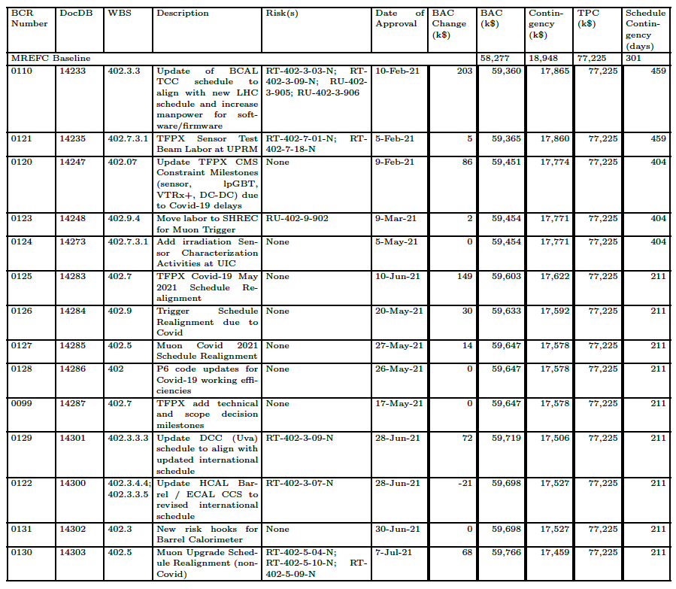
BCR Log Summary
BCR log summary for the last about six months (from May monthly report)

Slide 27
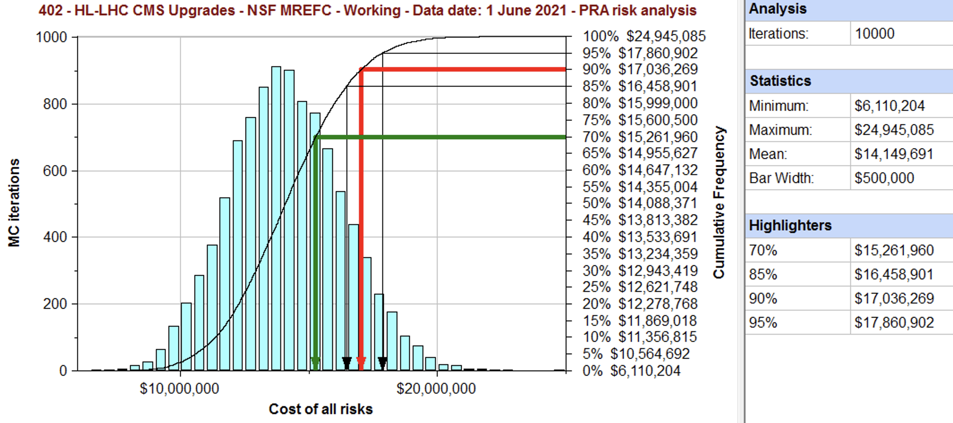
Risk Management
Charge: 2c
Project holds regular RMB (Risk Management Board) meetings every other month to review and update risks
  Minutes are available in DocDB topicid=873
  Risk Register is available in DocDB-12897
The risk MC has been updated DocDB-13408 (details in L. Taylor’s slides)
Remaining contingency:
$17,857k
Contingency need:
$17,036k (90% C.L.)
Available contingency predicts 95% C.L. to finish project within cost
Not including Covid-19 risks

Slide 28
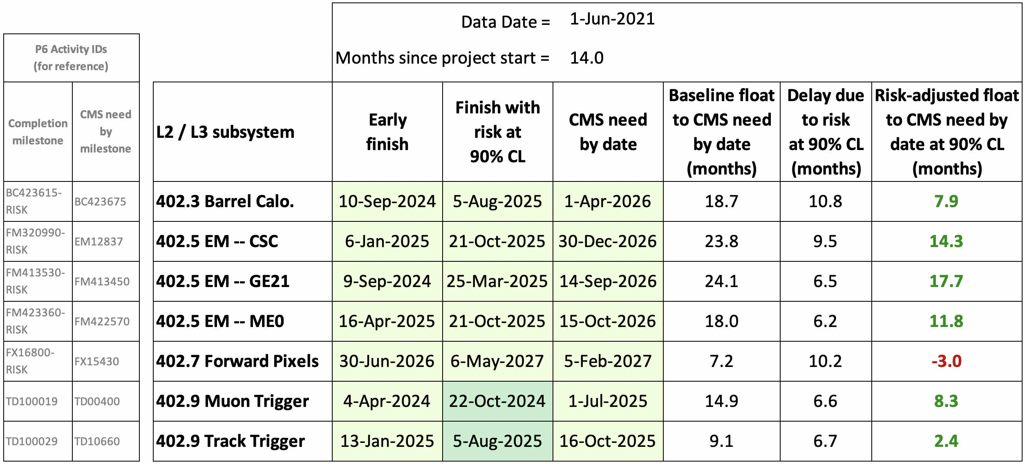
Schedule Contingency
Charge: 2a
The Risk MC also models the remaining schedule float
  With Covid-19 delays now integrated in the baseline we have reduced float, particularly for TFPX
CMS need by dates not adjusted for Covid-19 delays
  Will discuss CERN schedule later

Slide 29
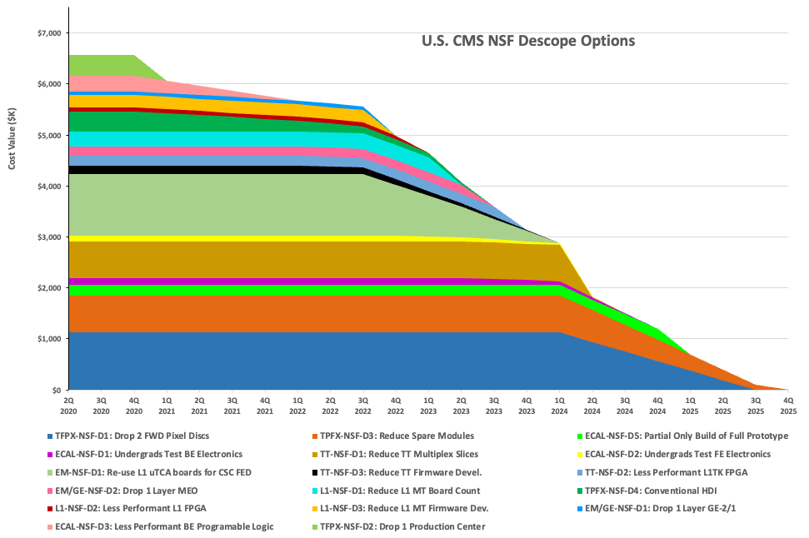
Scope Management
Charge: 2c
The scope options document (DocDB-13357) was updated in July 2021 – mainly updates to timeline due to Covid-19 delays
We have about $6M in possible descope options

Slide 30
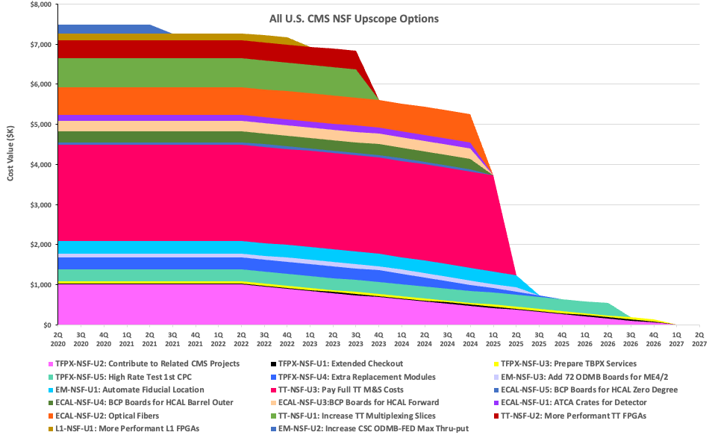
Upscopes
We have about $7M in possible upscope options

Slide 31
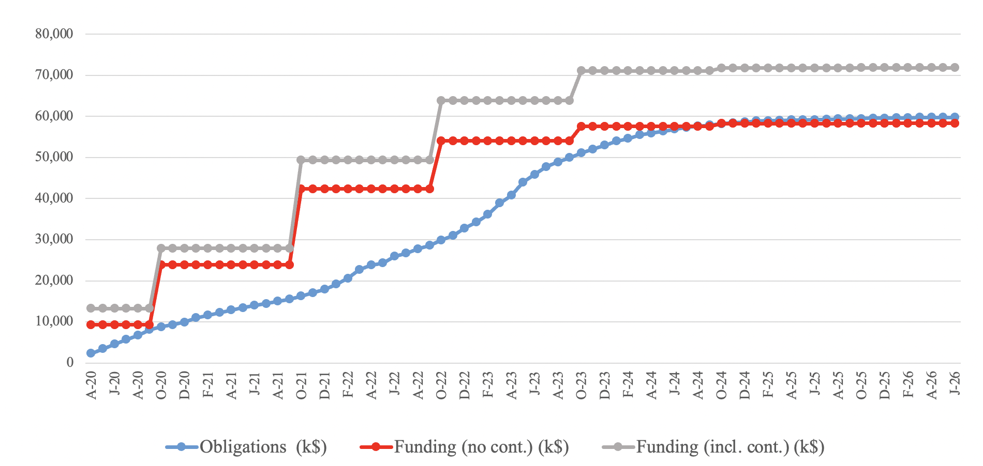
Plans for FY2022
Charge: 3c
Obligation and Funding Profile
Summary of FY2022 funding needs:
Well within NSF planned $18.4M – spending delayed (mainly) due to Covid
NSF Funding Profile
(Including contingency)
NSF Funding Profile
(No contingency)
Obligation Profile
Funds Allocated FY20+FY21 (SOWs+CRs) | NSF Funding (not incl. cont.) | Carry-over | Obligation budget (FY20-FY22) | Required FY22 Funding
$18,984k | $23,895k | $4,910k | $29,882k | $5,987k

Slide 32
Covid-19 Approach
Charge: 2c
The project has followed the guidance from NSF (DocDB-14136)
  NSF expects that the project will not be able to follow the plan presented at FDR and that variances will accumulate
  Resources should not be added to the baseline for Covid-19 expenditures
    Expenses for Covid-19 are tracked separately (reported monthly to NSF)
  Schedule updates due to Covid-19 delays allowed (even retroactively for activities that have not started – used only in very few cases). Costs due to increased escalation tracked in BCR log
Delays due to Covid-19 has caused significant Schedule Variances in most areas
  In particular, due to delayed procurements
We have negative cost variances in some areas, mainly in labor
  Partially offset by positive variances for, e.g., travel that has not been possible
  In some areas scientific labor has been used instead of paid technicians/engineers due to hiring freezes at universities
  We have largely avoided standing army costs, e.g., for TFPX module production were staff hiring has been delayed
The rate of SV increase has been reduced over the last few months as we return to more regular working conditions and some delayed procurements are executed
We have implemented a series of “Covid-19 BCRs” to align the project baseline schedule closer with the working schedule
  Goal is to have a baseline that more closely tracks actual progress
  These BCR only address schedule delays – we are not adding new resources

Slide 33
Realized Covid-19 Costs
Charge: 2c
The Covid-19 expenses the project has incurred so far has almost entirely been due to labor inefficiency
  Working from home with limited resources and reduced communication
  Work restrictions, e.g., number of people in a lab at the same time
  Travel limitations, e.g., work at test beams, but also prevents valuable in person meetings
We estimate these losses by L3 area on a monthly basis using expert opinion for the labor inefficiency
We also have BAC changes due to escalation when implementing the Covid-19 delays in the baseline

Slide 34
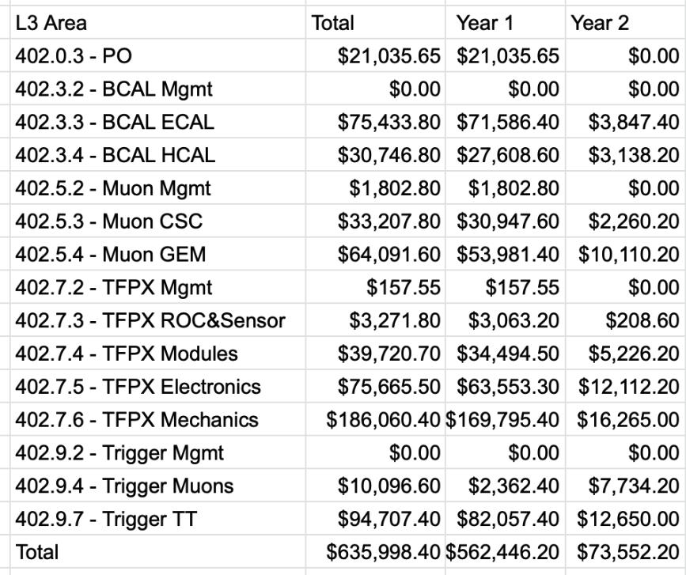
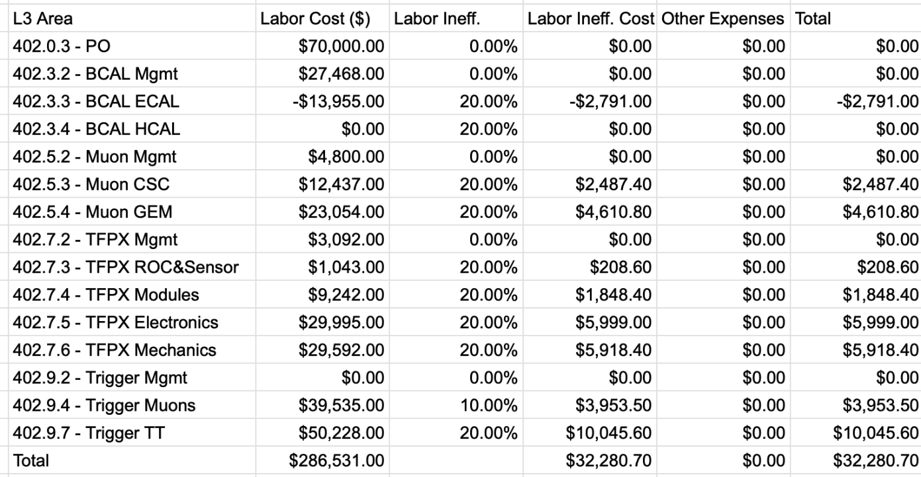
Summary of Actual Covid-19 Costs
In the first 14 months of the project, we have incurred to following costs due to Covid-19
Expense category | Cost $k
Actuals (mainly labor inefficiency) | 636
BAC Changes from ”Covid-19 BCRs” | 279
Total | 915
Total Covid-19 Expensed by L3 Area
Example of expenses in May 2021

Slide 35
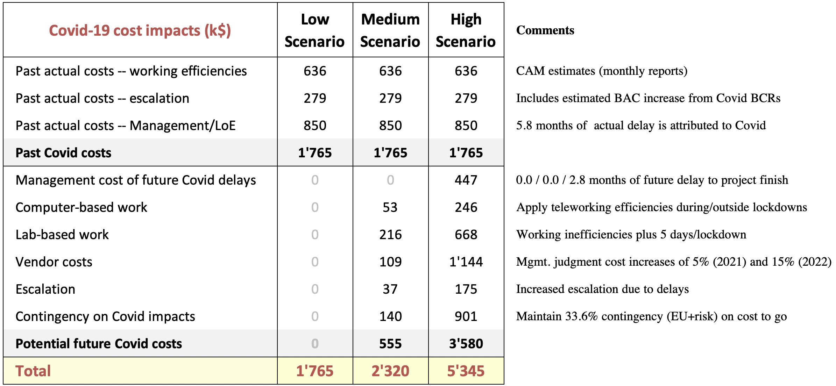
Covid Impact Modelling
Charge: 2c
Three scenarios has been considered
  We estimate a 5.8 months incurred delay so far
  The High Scenario adds 2.8 month of future delays
This table below summarizes the cost impact of the different scenarios
Details in L. Taylor’s Presentation

Slide 36
Covid-19 Re-baselining
NSF has presented guidance for the process to re-baseline the project
  This would allow adding budget to the project
  Changes over $10M (CMS+ATLAS) will require NSB approval
The delays due to Covid-19 has affected all aspects of the CMS (and ATLAS) HL-LHC upgrades
  The current CERN schedule for LS3 provides insufficient float for several of the HL-LHC upgrades
    This is a more significant issue for the non-NSF scope – but we have also lost significant float during the start of the MREFC
    The P2UG has made is clear that several projects don’t have sufficient float
CERN has started a process to understand the impact of the delays
CERN is encouraging projects to proceed as fast as possible and review what schedule gains can be made with descopes or staging of upgrades
  Any updates to the CERN schedule for LS3 are probably not expected until at the earliest end of this calendar year

Slide 37
Readiness for Rebaselining
The CMS MREFC is in a position to prepare an updated baseline including the anticipated costs for Covid-19 in early 2022
  Uncertainties, e.g., in supply chains, will remain and would be treated as risks
With the current CERN schedule for LS3 this will not provide sufficient schedule float, in particular, for TFPX
  Options to expedite module production (foreseen as a possibility by the FDR) or to stage some of the disks could provide for additional schedule float
We plan to work with NSF to decide when the remaining Covid-19 uncertainties are sufficiently under control to proceed with a rebaselining
  Getting funding in FY24 would require rebaselining in the next 12 months
  The project appreciate the opportunity to
  rebaseline once the conditions are understood

Slide 38
Summary
The MREFC project started April 1, 2020, just as the Covid-19 pandemic shut down most universities and labs
  Continued to make good progress in many areas for design and simulations etc.
  Many lab-based activities, e.g., irradiations and test beams were significantly delayed
  The project has accumulated significant delays due to Covid-19
    Many of these delays are now incorporated in the baseline as we proceed towards more normal working conditions with respect to Covid-19
Project is reporting EVM status to NSF on a monthly basis
TFPX ready for technical review by Summer 2022
Re-baseline for Covid-19 could be possible in early 2022
  Need input from CERN on LS3 schedule to understand schedule contingency
We thank NSF for their continued support for CMS upgrades

Slide 39
Backup / Reference

Slide 40
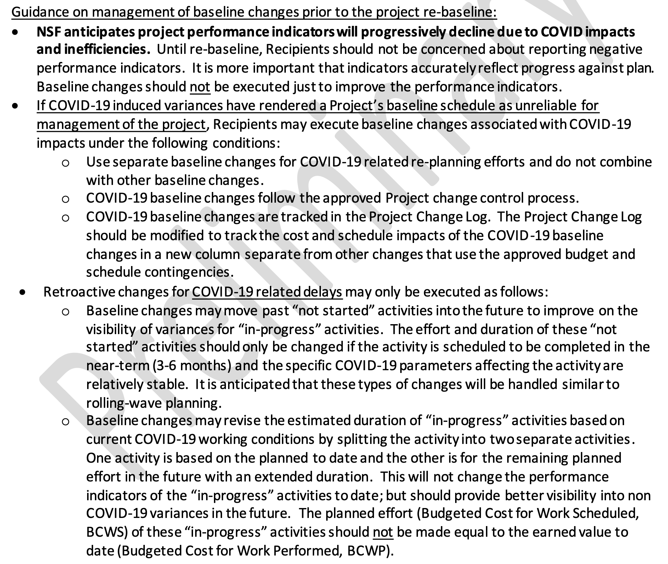
NSF Covid-19 Guidance (DocDB-14136)

