Slide 1
Risk Analysis and Covid-19
Draft updated
25th Aug 2021
Version 2
Lucas Taylor
HL-LHC CMS Upgrades Associate PM
Fermilab Risk Manager
PIP-II Risk Manager
NSF MREFC Annual Review, 25th August 2021

Slide 2
Outline
Non-Covid-19 Risk Analysis
Charge 2c: Risk management process, […] adequacy of the contingency budget and schedule to mitigate future non-COVID risks. […] completeness of the risk register […] non-COVID related threats and opportunities with appropriate probabilities and estimated cost and schedule.
Covid-19 Risk Scenario Analysis
Charge 3a: […] COVID impact modelling […] of forecast COVID-related cost and schedule impacts. […] realism of assumptions and the credibility of the models used, and […] additional schedule and budget needs. […]
Towards a re-baseline
Charge 3d: Do the materials […] provide adequate substantiation for re-baselining within the next 6-12 months? If not, what criteria must be satisfied as a precondition for conducting a re-baselining review that would confidently bound estimates for additional schedule and budget […]?

Slide 3
Outline
Non-Covid-19 Risk Analysis
Charge 2c: Risk management process, […] adequacy of the contingency budget and schedule to mitigate future non-COVID risks. […] completeness of the risk register […] non-COVID related threats and opportunities with appropriate probabilities and estimated cost and schedule.
Covid-19 Risk Scenario Analysis
Charge 3a: […] COVID impact modelling […] of forecast COVID-related cost and schedule impacts. […] realism of assumptions and the credibility of the models used, and […] additional schedule and budget needs. […]
Towards a re-baseline
Charge 3d: Do the materials […] provide adequate substantiation for re-baselining within the next 6-12 months? If not, what criteria must be satisfied as a precondition for conducting a re-baselining review that would confidently bound estimates for additional schedule and budget […]?

Slide 4
Risk Management Process
We follow the Fermilab-standard risk management procedures which are based on PMI’s PMBOK, NSF MFG, DOE O 413.3b
Threats: negative risks – minimize probability and impacts
Opportunities: positive risks – maximize probability and impacts
Uncertainties: positive or negative – need to manage them
Risk identification is carried out by SMEs, CAMs, L2s, PM
Risk workshops, brainstorming, reviews of WBS and RBS
Estimate risk probability, cost and schedule impacts → Risk Register
Risk mitigations are pre-emptive actions in our base plans
R&D, pre-production, QA/QC, multiple vendors, redundant facilities…
Risk response plans cope with residual risk that cannot be mitigated
Risk responses use cost and schedule contingency
In extremis: exercise downscope options → CMS-doc-13357
MC analysis aggregates all risks to determine contingency needs

Slide 5
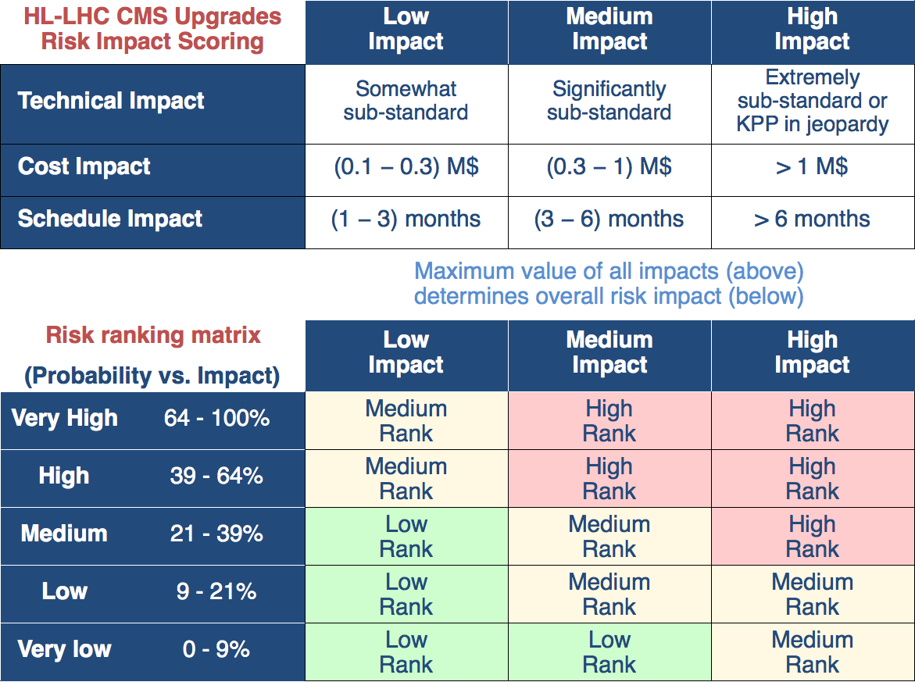
Risk Management Process
Risks documented in the Fermilab-standard Risk Register tool
Risk Ranking Matrix grades risks according to management level
High rank → PM
Medium → L2
Low → CAM
Risk Management Board reviews all risks every ~2 months
Risk Register → CMS-doc-12897
Risk Mngt. Plan → CMS-doc-13408

Slide 6
Cost estimate uncertainty (EU)
Each P6 activity has cost EU to help mitigate cost risk from uncertainties in labor needs, vendor costs, etc.
EU is percentage of base cost, depending estimate maturity
~$1.4M of EU “released” so far as activities were completed
EU is parametrized by min/likely/max
In the risk analysis, EU is modeled with
triangle probability distribution functions
Correlations are taken into account by grouping related activities into categories of “Cost drivers”
E.g. multiple batches of the same item have correlated costs
Probability
Mean
Min
Max
Impact
Likely
(point estimate)

Slide 7
Risks
54 risks in total
1 risk
3 risks
10 risks
3 risks
2 risks
4 risks
1 risk
3 risks
5 risks
7 risks
3 risks
12 risks

Slide 8
Risk changes since MREFC / pandemic start
Reviewed and updated all risks: 9 decreased, 2 increased
Main cost savings from project wide risks
RU-402-1-01-N PM - Foreign exchange rates $777k → $463k
RU-402-1-02-N PM - Future escalation rates $433k → $327k
Merged L2 lpGBT risks into single common correlated risk
Retired three risks
RT-402-1-15-N PM - Change of overhead rates
RT-402-5-06-N EM – lpGBT or VL+ components delays GE2/1
RT-402-7-21-N FP – Module production delayed
Added 6 new Trigger risks for improved performance
More physics capability … but at a potential mean cost of ~ $444k
Muon Trigger: RT-402-9-[11,12,13,14]
Track Trigger: RT-402-9-[15,16]

Slide 9
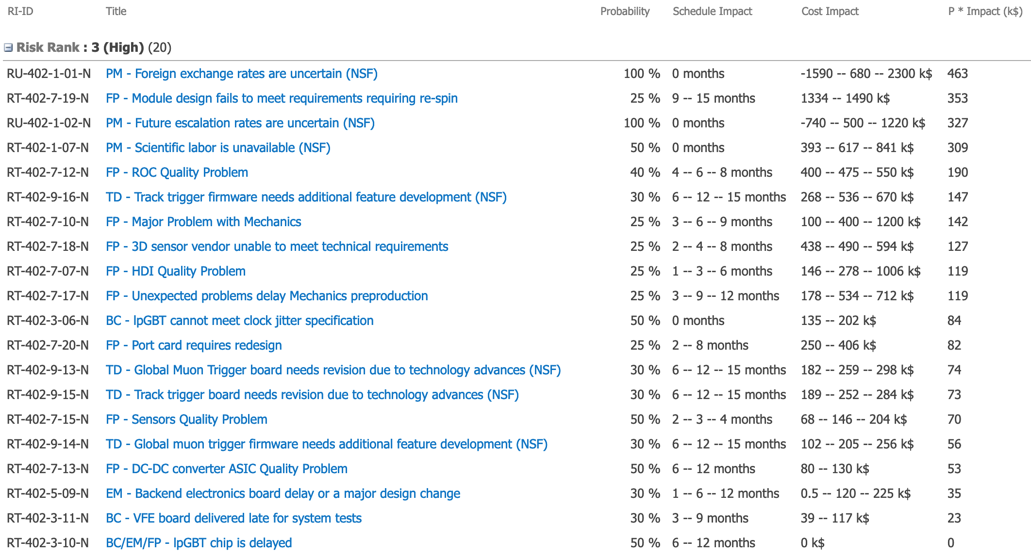
High Rank Risks
Risk Register → CMS-doc-12897
Risk Mngt. Plan → CMS-doc-13408
*
*
*
*
*
Common risks

Slide 10
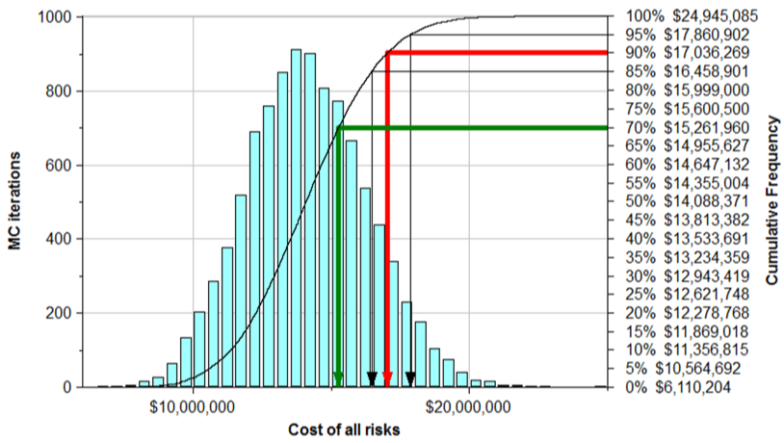
Contingency Analysis
Risk Register → CMS-doc-12897
Risk Mngt. Plan → CMS-doc-13408
We aggregate the cost and schedule impacts of all risks using Oracle’s Primavera Risk Analysis Monte Carlo framework
Primavera P6
Resource
Loaded Schedule
Risk
Register
PRA Risk Monte Carlo
Risks do or do not happen according to their probabilities
Sample the ranges of impacts
Results in a new project scenario
Repeat 1. – 3. → many scenarios
Probability
Mean
Min
Max
Likely
Impact
MC produces probability distributions for total cost and schedule impacts
→ cost and schedule contingency needs at given confidence levels
Cost and schedule probability distributions

Slide 11
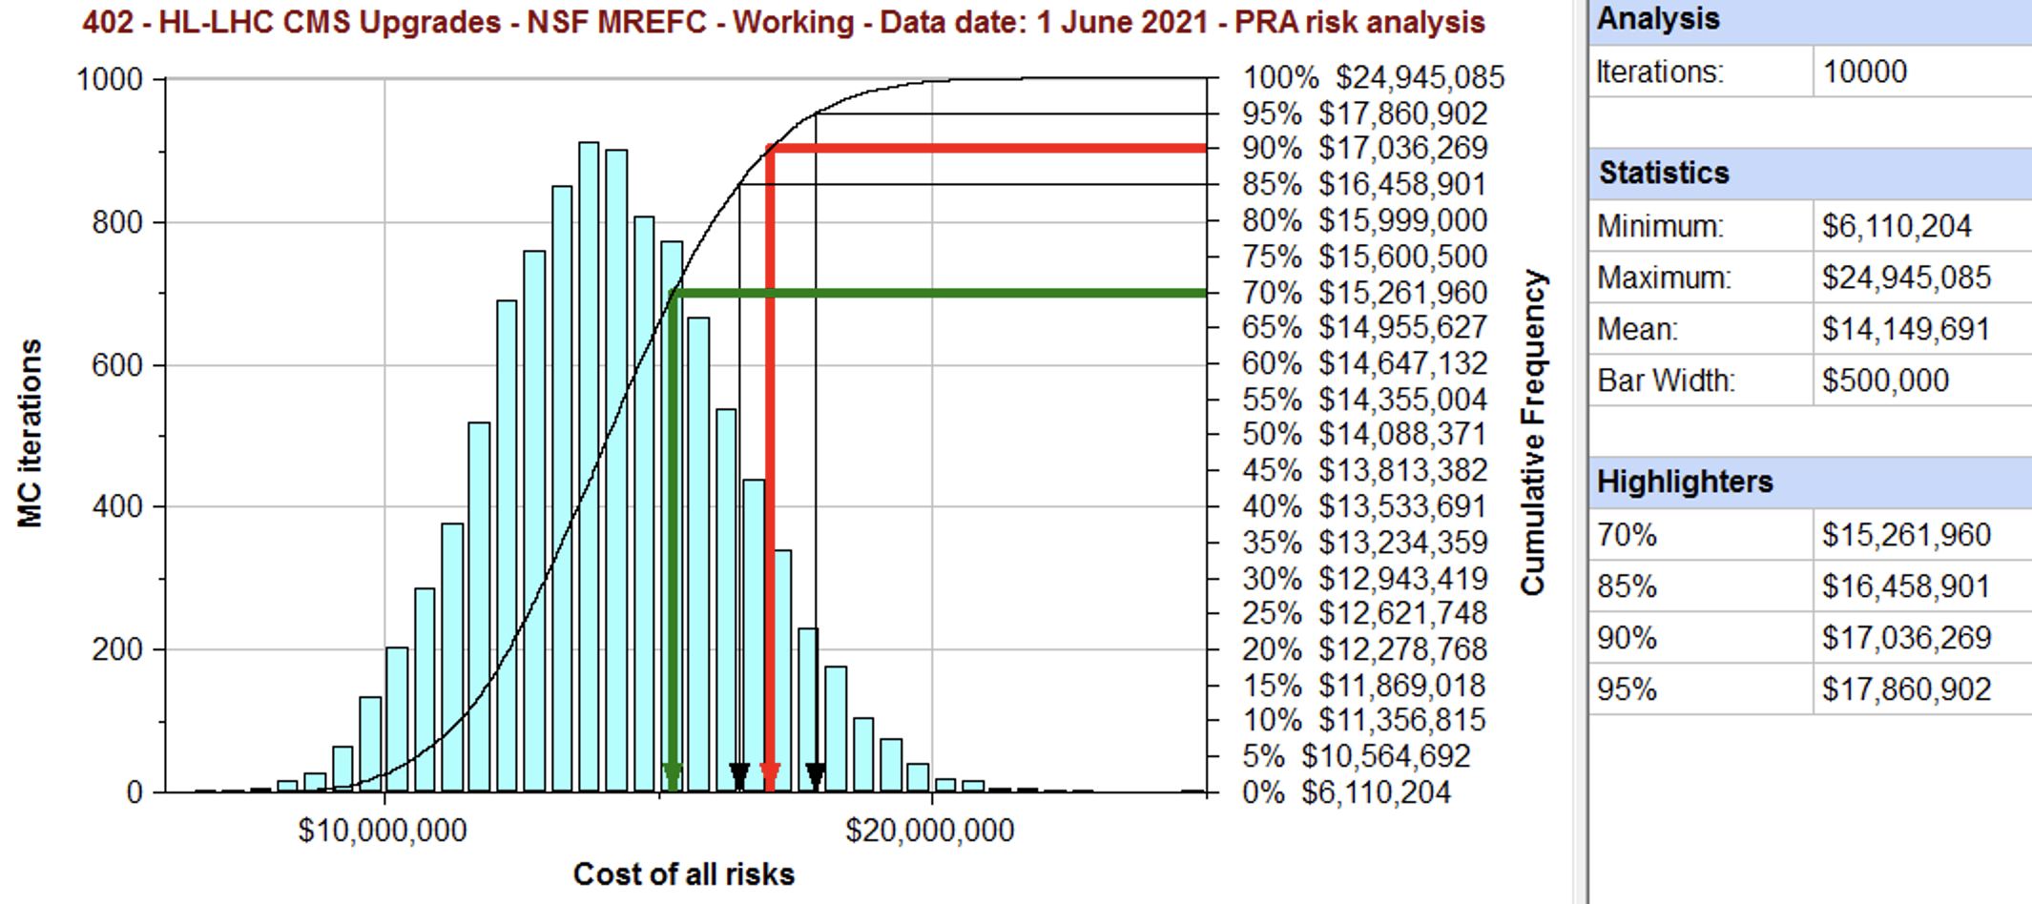
Cost contingency (non-Covid risks)
Contingency available = $ 17,857 k
Data Date = 1 June 2021 (Monthly report #14, CMS-doc-14298)
Contingency need = $17,036 k (EU + risk MC at 90% CL)
We can complete the project within cost at 95% CL
Not including future Covid risks

Slide 12
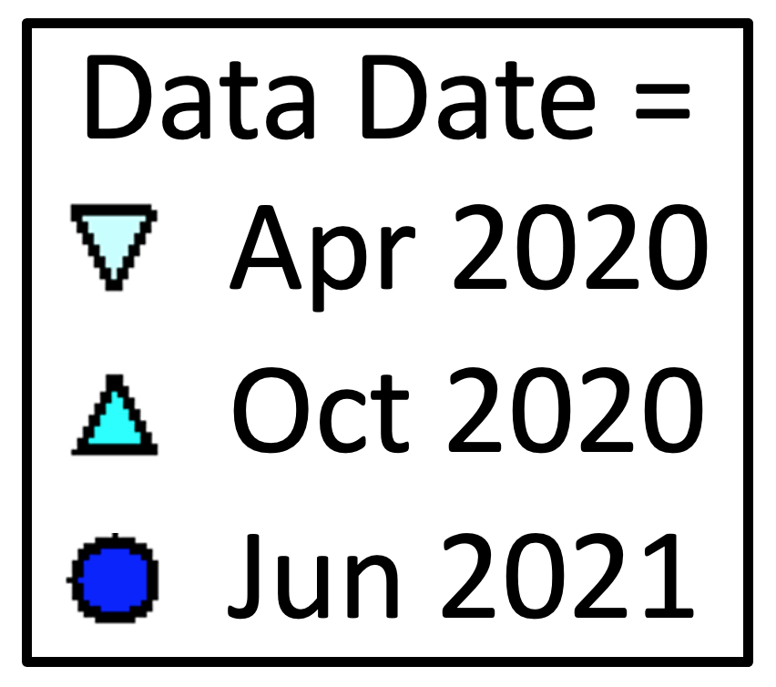
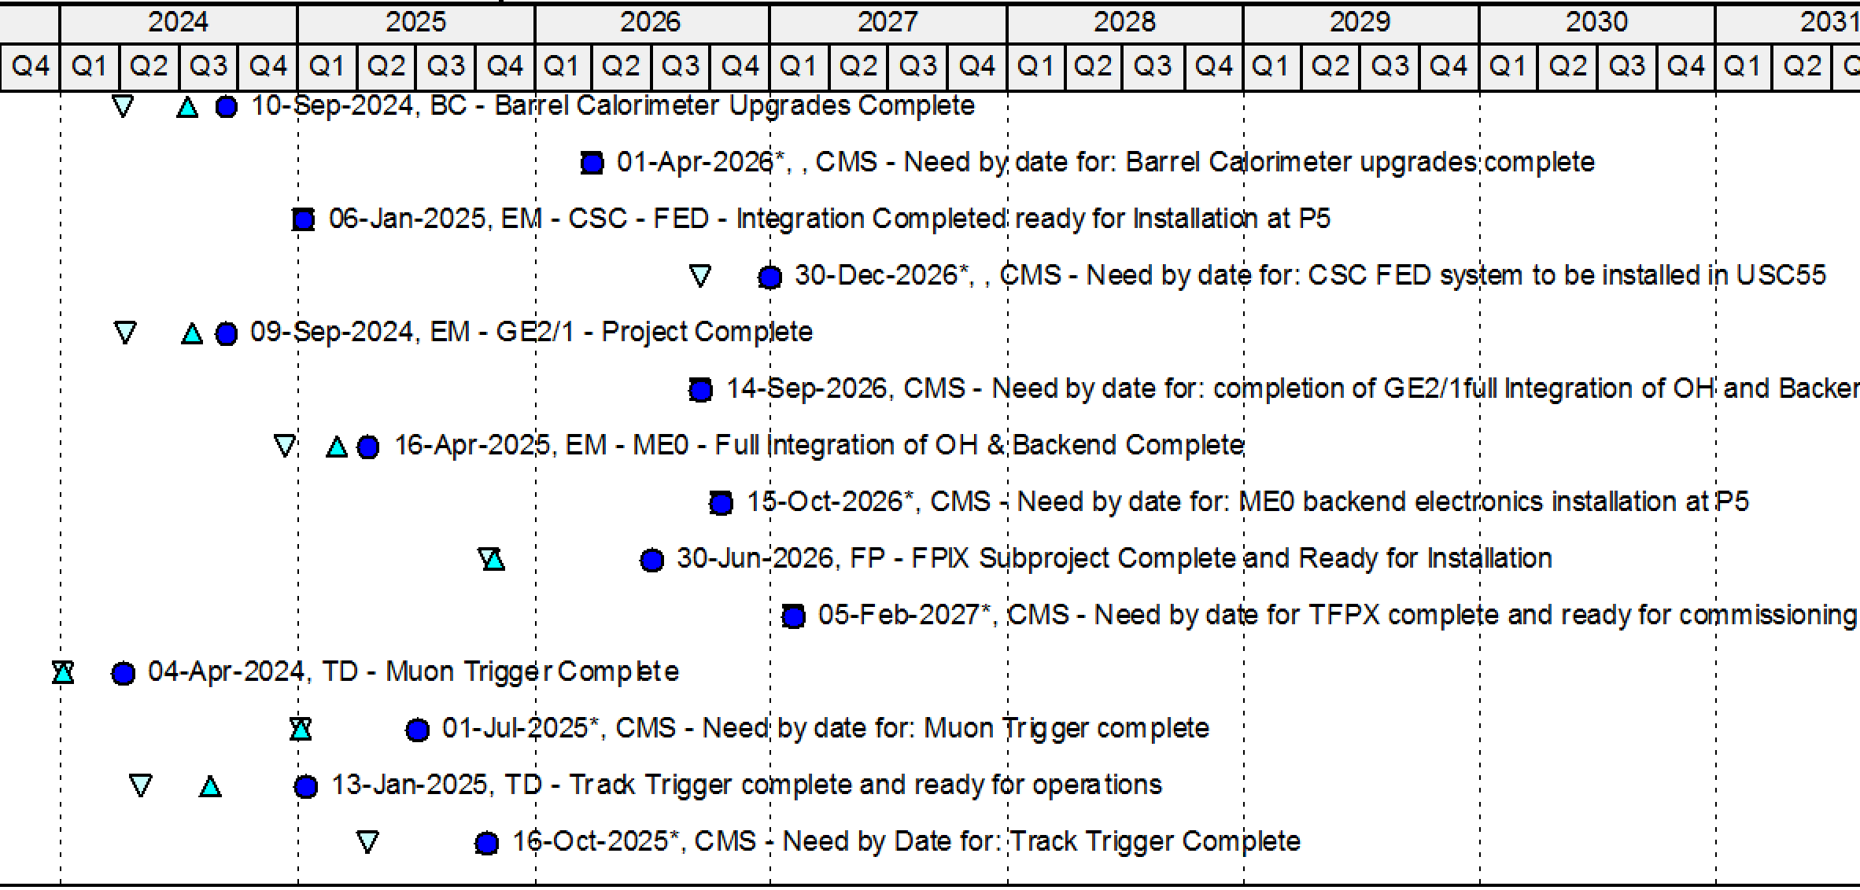
Schedule delays since MREFC start
Barrel Calo.
EM - CSC
EM - GE2/1
EM – ME0
Forward Pixels
Muon Trigger
Track Trigger
LHC and CMS need by dates ( ) remain fixed, despite Covid
L2 / L3 finish dates ( ) are all sliding due to Covid, eating float

Slide 13
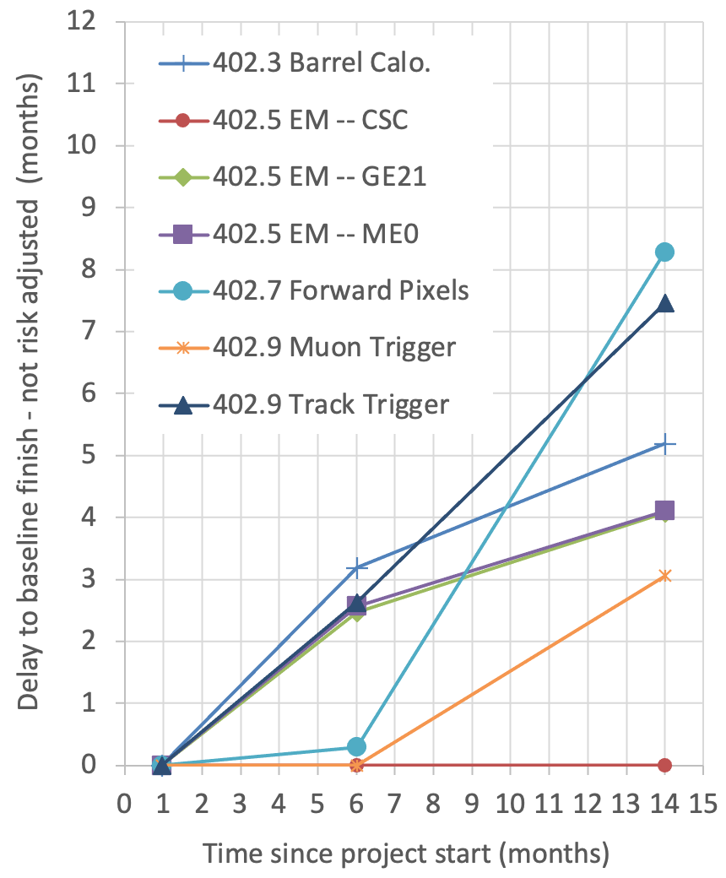
Schedule delays since MREFC start
L2/L3 finish dates are delayed up to 8 months since start of MREFC / pandemic (→ plot)
Delays are mostly due to Covid lockdowns, Covid safe-working inefficiencies, and Covid delays of partners / vendors
LHC schedule and hence the CMS need-by dates have not yet been updated for Covid
Hence, Covid delays have eaten into our schedule contingency

Slide 14
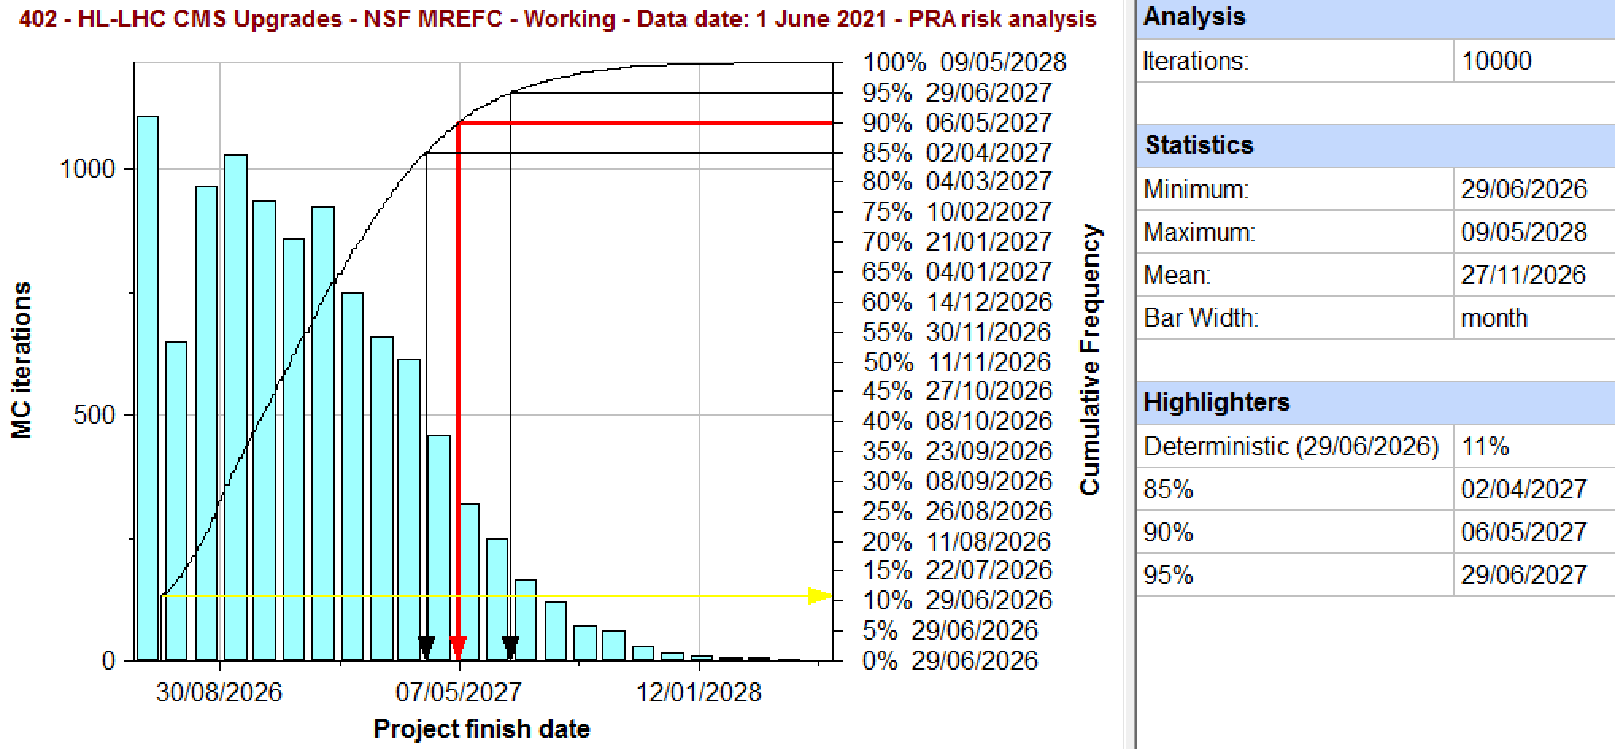
Non-Covid risk MC analysis – TFPX example
402.7 Forward Pixels
TFPX can be delivered before the CMS need by date at only 75% CL
including all delays so far, and future risks, but not yet including future Covid delays
Early
finish
30 Jun 2026
CMS
need by
5 Feb 2027
Finish including
risk at 90% CL
6 May 2027

Slide 15
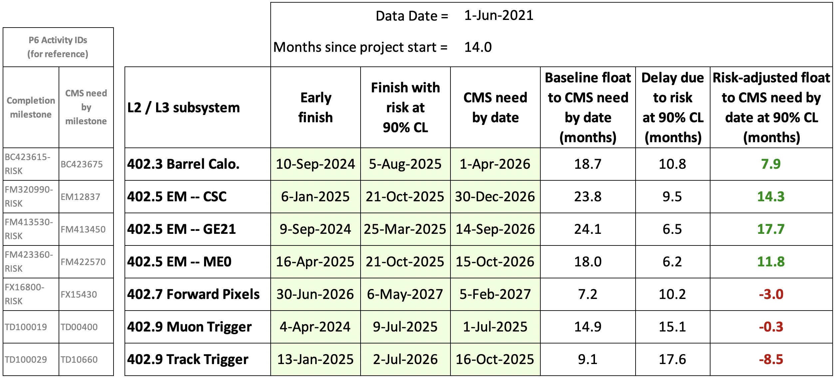
Non-Covid-19 schedule risk
Including all risks
Early finish dates (baseline plan, without risk) precede CMS need by dates by 7 – 24 months
Not all deliverables have enough float at 90% CL
Non-Covid risks delay L2/L3 finish dates by 6 – 18 months (at 90% CL)

Slide 16
Non-Covid-19 schedule risk
Barrel Calorimeter and Endcap Muons have adequate schedule contingency allowing for all non-Covid-19 risks.
7.9–17.7 months of contingency (at 90% CL) before need by dates
Forward Pixels: 90% CL is 3 months after CMS need by
The project can only finish on time at 75% confidence level (which is uncomfortable) … not including any additional Covid delays
Muon Trigger and Track Trigger: much of the risk delay is due to potential CMS decisions to pursue higher performance options
We assume CMS would not “self-inflict” such risk delays if they could jeopardize on-time delivery of the Trigger
Re-run risk MC without these risks, i.e. RT-402-9-[11,12,13,14,15,16]
Muon Trigger has 8.3 months of float at 90% CL (was –0.3 months)
Track Trigger has 2.4 months of float at 90% CL (was –8.5 months)
Also, the need by date for the Track Trigger is being re-evaluated

Slide 17
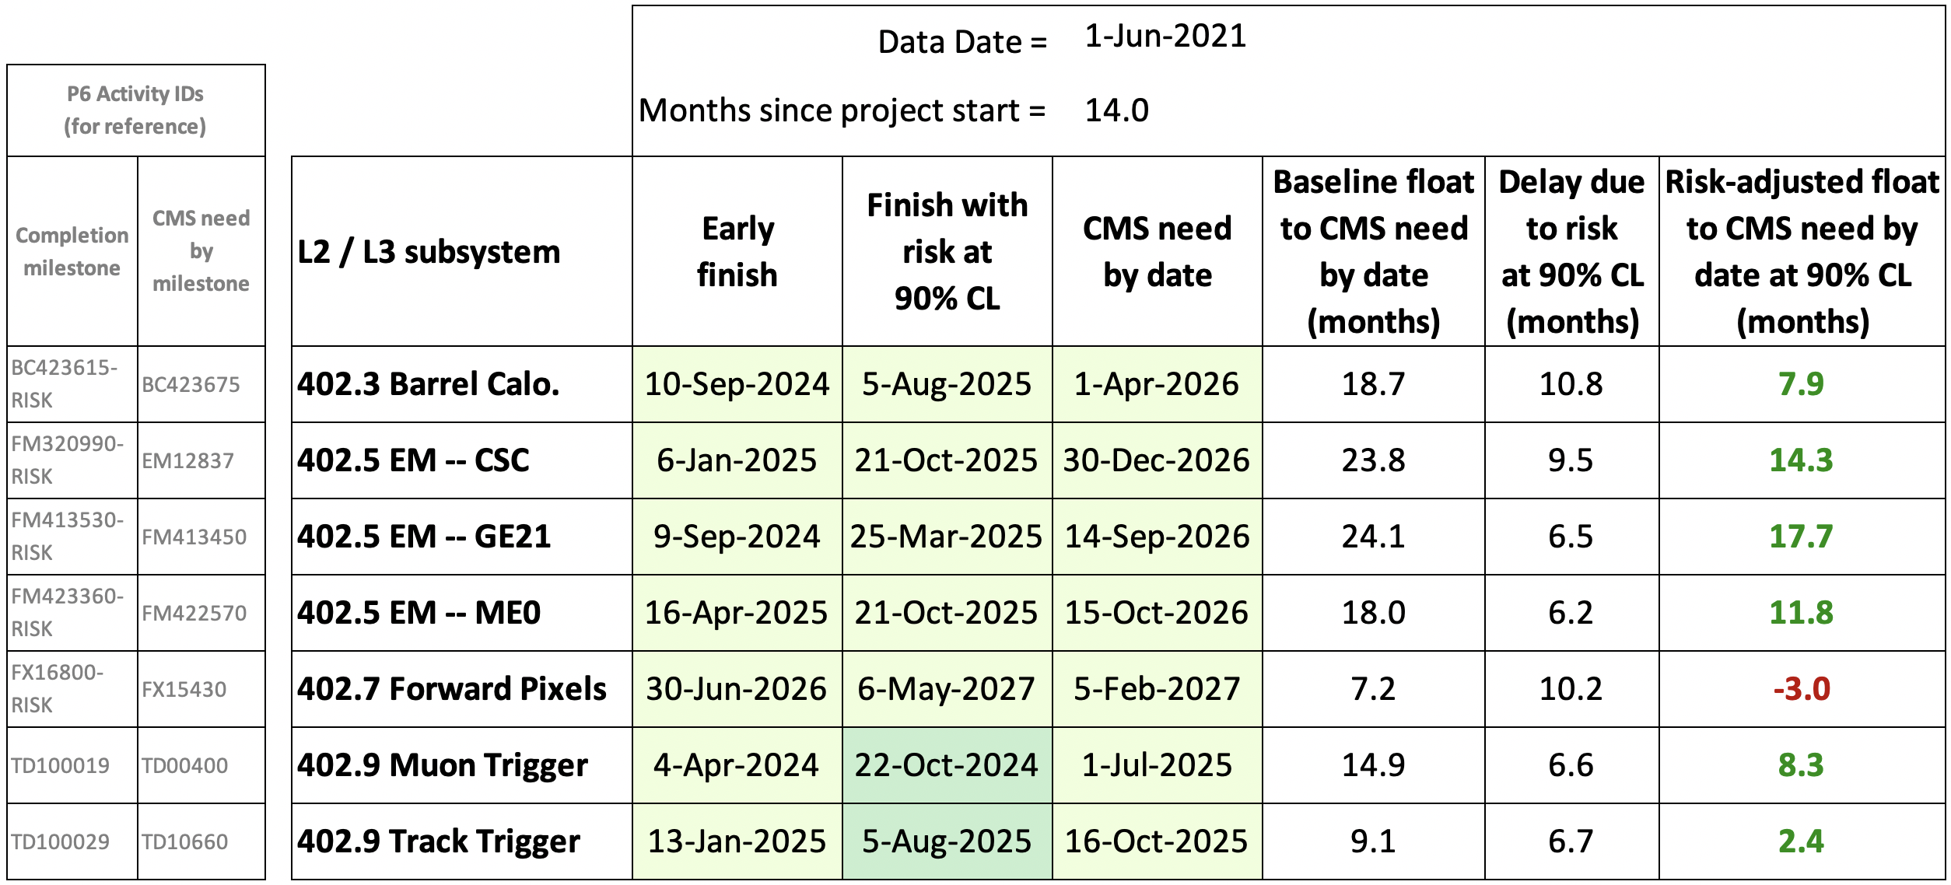
Non-Covid-19 schedule risk
Without risks related to enhancing the Trigger performance
Re-run MC analysis excluding Trigger risks related to enhanced Trigger performance
RT-402-9-[11,12,13,14,15,16]
All deliverables now have enough float at 90% CL, except TFPX (only 75% CL)
Not including future Covid delays

Slide 18
Outline
Non-Covid-19 Risk Analysis
Charge 2c: Risk management process, […] adequacy of the contingency budget and schedule to mitigate future non-COVID risks. […] completeness of the risk register […] non-COVID related threats and opportunities with appropriate probabilities and estimated cost and schedule.
Covid-19 Risk Scenario Analysis
Charge 3a: […] COVID impact modelling […] of forecast COVID-related cost and schedule impacts. […] realism of assumptions and the credibility of the models used, and […] additional schedule and budget needs. […]
Towards a re-baseline
Charge 3d: Do the materials […] provide adequate substantiation for re-baselining within the next 6-12 months? If not, what criteria must be satisfied as a precondition for conducting a re-baselining review that would confidently bound estimates for additional schedule and budget […]?

Slide 19
Covid-19 impacts
Lockdowns in Spring 2020 restricted access to labs; then labs re-opened with enhanced safety (PPE, distancing)
Many people have been teleworking from home
Project work has continued but with diminished efficiencies
Computer-based work continues by teleworking with > ~80% efficiency for Project Office, design work, firmware, software, etc.
Lab-based work has ~50 - 100% efficiency due to Covid safe-working. We endeavor to measure and increase these efficiencies
Deliverables from vendors may be delayed or more expensive. Ongoing concerns (e.g. Si chip foundries).
International partners also delayed by Covid. LHC and CMS have not yet revised schedules to account for Covid
Increased activity and project durations
Increased labor, M&S, marching army and escalation costs

Slide 20
Covid-19 costs incurred so far
Covid actual costs (April 2020 – June 2021) | Covid actual costs (April 2020 – June 2021) | Cost
Covid working inefficiencies | Covid working inefficiencies increase the labor costs. These are tracked as EVMS variances (NSF guidance). CAMs/PIs estimate the Covid contributions to these cost variances in the monthly reports. | $636k
Escalation | Covid BCRs that reschedule future work result in increased escalation costs. | $279k
Management/ LoE labor | Covid has increased the project duration by 8.2 months due to non-Covid and Covid effects, which are hard to disentangle. We estimate 5.8 months is due to Covid and 2.5 months is not (based on Phase 1 FPIX delays of 2.1 months / year). The Covid cost impact is given by (Covid delay) × (management / LoE labor burn rate). | $850k
Total |  | $1,765k

Slide 21
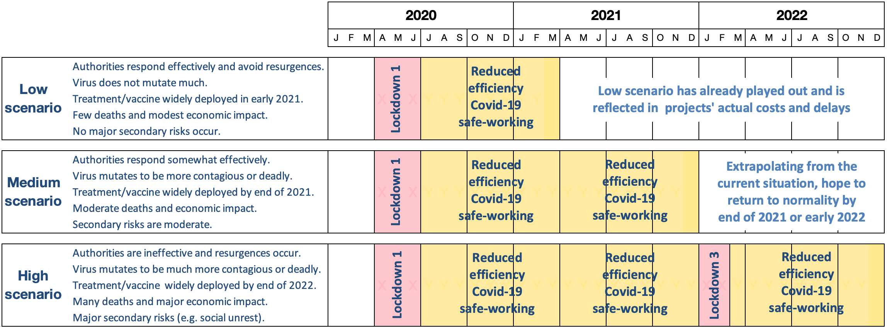
Covid-19 scenario analysis model
ppp-DocDB-2104
To bracket potential future Covid impacts, we use a novel Covid scenario analysis methodology developed at Fermilab
We model lower working efficiencies due to Covid by reducing the effective no. of working hours per day in the P6 calendars
This stretches activity durations, causing knock-on delays
today

Slide 22
Covid-19 scenarios – Working efficiencies
Working efficiency factors…
…are different during lockdowns and afterwards
…depend on the nature of the work and location-specific restrictions
…are estimated by CAMs based on actual experience
…are applied at the lowest level (P6 activities)
Methodology widely discussed with experts, Lab mgmt, agencies.
Used by many projects and well received in external reviews

Slide 23
Covid-19 potential future cost impacts
Category | Impact modeling
Management / LoE | Labor stays the same but teleworking inefficiency degrades quality of work. Covid delays overall project finish, increasing total Management / LoE labor. ► Cost = (Delay to project finish) × (management/LoE labor burn rate)
Computer-based work | Teleworking inefficiency increases durations and costs by a factor (1/eff. – 1). ► Cost = (Cost of labor that is teleworking) × (1/eff. – 1)
Lab-based work | Safe-working inefficiency increases activity durations by a factor (1/eff. – 1). ► Cost = (Cost of Lab-based labor) × (1/eff. – 1) Plus additional labor to safely close/re-open Labs before/after lockdowns. ► Cost = (No. of days to safely stop/restart Labs) × (labor cost in Labs per day)
Vendor work | Task durations increase by (1/eff. – 1). Cost impact from mgmt. judgment: ► Cost = (Vendor costs in scenario timeframe) × (5%/15% for M/H scenarios)
Escalation | ► Cost = (P6 cost of scenario delayed by Covid) – (P6 cost for working file)
Contingency (=EU + risk) | Assume Covid costs have same % contingency need as the rest of the project. ► Cost = (Covid costs, excl. Mgmt/LoE) × (baseline contingency of 34% on CTG)

Slide 24
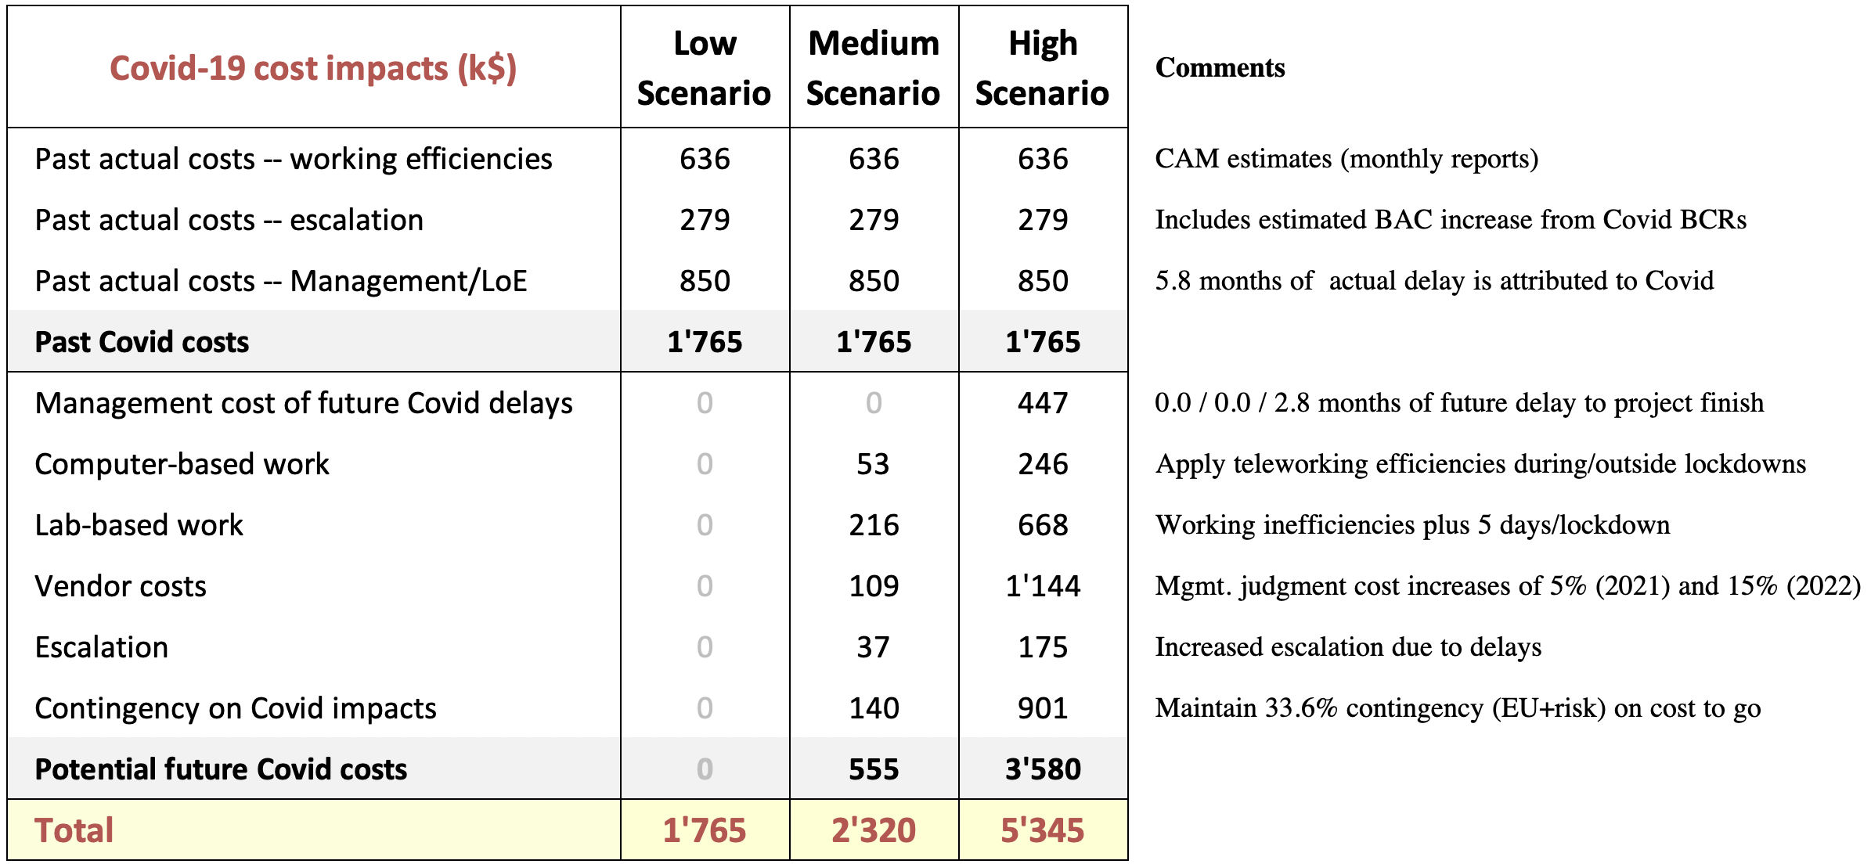
Covid-19: Cost impacts
← Erratum 25 Aug 2021: this increased by $125k due to a bug fix in the contingency calculation
Cost increase due to Covid is up to $5.3M (High scenario)

Slide 25
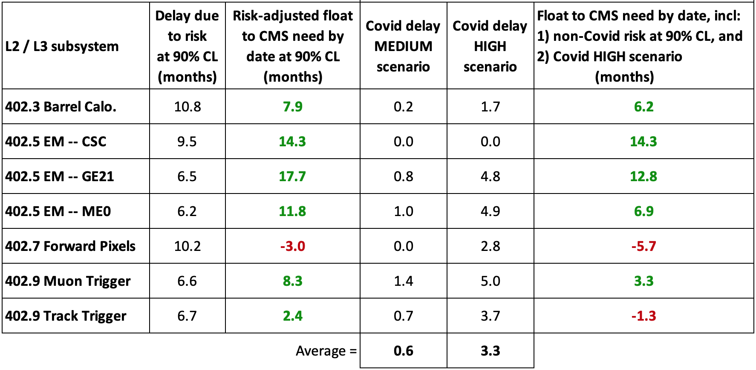
Non-Covid-19 + Covid-19: Schedule impacts
Non-Covid risks (90% CL)
Covid scenarios
Non-Covid plus Covid impacts
Non Covid risk delays of up to 11 months
Future Covid delays of up to 5 months
Not all deliverables have enough schedule contingency at 90% CL
Allowing for risks (at 90% CL) and Covid (High scenario): the project (TFPX) will finish late by up to 5.7 months

Slide 26
Outline
Non-Covid-19 Risk Analysis
Charge 2c: Risk management process, […] adequacy of the contingency budget and schedule to mitigate future non-COVID risks. […] completeness of the risk register […] non-COVID related threats and opportunities with appropriate probabilities and estimated cost and schedule.
Covid-19 Risk Scenario Analysis
Charge 3a: […] COVID impact modelling […] of forecast COVID-related cost and schedule impacts. […] realism of assumptions and the credibility of the models used, and […] additional schedule and budget needs. […]
Towards a re-baseline
Charge 3d: Do the materials […] provide adequate substantiation for re-baselining within the next 6-12 months? If not, what criteria must be satisfied as a precondition for conducting a re-baselining review that would confidently bound estimates for additional schedule and budget […]?

Slide 27
Towards a re-baseline
The project expects to be ready to re-baseline in Spring 2022, subject to the following two pre-requisites
CERN and CMS schedules have been revisited considering the impacts of Covid, meaning either:
CERN delays the LHC master schedule, in which case CMS and the US project need to revise their schedules accordingly
CERN does not delay the LHC master schedule, in which case CMS and the US project need to either accelerate the current scope (at additional cost) or defer (stage) some scope
Covid cost and schedule uncertainties are reduced to an acceptable level, meaning all risks plus the residual risk of the Covid High scenario are covered by the project cost and schedule contingency at ~90% confidence level

Slide 28
Summary – numbers
Total cost estimate = $ 81,254k
Estimate at complete = $ 58,908k
Based on working file (DD = 1 Jun 2021). Includes contributions of Covid to past actual costs
($636k) and escalation costs from Covid-induced delays in processed BCRs ($279k)
Non-Covid-19 contingency (EU + risk at 90% CL) = $ 17,036k
Liens list items L3 (pending BCRs) + L4 (PM watch list) = $ 880k
PM watch list includes provision for the current poor exchange rates – to revisit early FY22
Covid future costs = $ 4,430k
= Future LoE costs of past Covid delays ($850k) + Covid High scenario ($3,580k)
Total current funding = $ 77,225k
Additional funds needed to deliver within cost at 90% CL = $ 4,029k
Schedule summary (driven by TFPX)
Non-Covid risk: TFPX has –3.0 months float at 90% CL (0m at 75% CL)
Covid High scenario: TFPX loses 2.8 more months of float due to Covid
Non-Covid risks + Covid: TFPX is on time at ~50% CL (will be late half the time)
Additional float needed to deliver on time at 90% CL = 5.7 months

Slide 29
Summary
Non-Covid-19 Risk Analysis (Charge 2c)
The project has a mature risk management process, risk register, and risk MC
Cost contingency adequately covers the non-Covid risks
Schedule contingency is no longer comfortably sufficient, due to Covid
Covid-19 Risk Scenario Analysis (Charge 3a)
The project uses the Fermilab-standard Covid analysis methodology
A range of Covid impacts is bracketed using three scenarios
Including activity-level inefficiencies, impacts of lockdowns, teleworking, lab safe-working, vendor Covid impacts, escalation and marching army costs
Covid may potentially increase the project cost by $5.2M (High scenario)
The project expects to be ready to re-baseline in Spring 2022 (Charge 3d), subject to the following two pre-requisites
CERN and CMS schedules have been revisited, allowing for Covid
Covid cost and schedule uncertainties are at an acceptable level
The project currently would need an additional ~$4.0M and 5.7 months of float to finish on time and under budget at 90% CL

Slide 30
Thank you

Slide 31
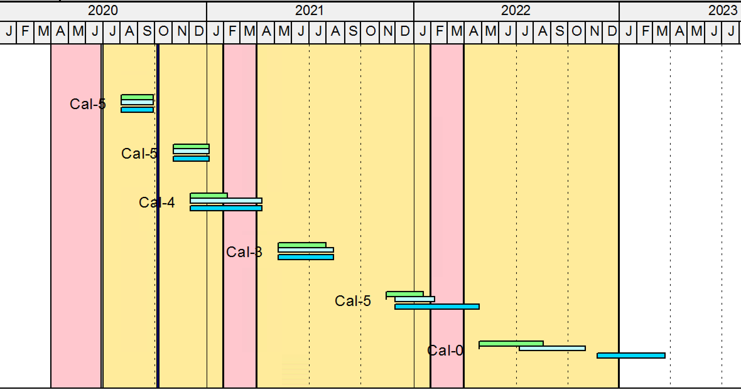
Covid-19 scenarios – Schedule impacts
Working efficiencies → longer durations and hence delays
Examples
Ex 1: No Covid impacts in scenario analysis
(activity is in the past)
P6 Activities: Legend
Baseline (incl. Low)
Medium scenario
High scenario
Ex.2: No Covid impacts in scenario analysis
(Covid efficiencies covered in baseline)
Ex 3: Medium / High scenarios both delayed by lockdown #2
Ex 4: Medium / High scenario durations increase due to efficiencies
Ex 5: High scenario delayed by lockdown #3 (but not the Medium scenario)
Ex 6: Activities not directly impacted, but are they delayed by predecessors
Note: the assumed timing of lockdowns has evolved since this graphic was created, but the concepts of the model remain the same
Lockdown #1
Lockdown #2
Lockdown #3

