Slide 1
Systems Engineering and Quality Assurance
Karl Smolenski, Systems Engineer
HL-LHC Project Management Meeting
Aug 25, 2021 - Draft updated Aug. 24, 2021 for minor layout / clarification

Slide 2
Outline
Bio
System Engineering Implementation
  FDR Recommendations
Quality Assurance Plan
FDR Recommendations
Interface Control
Requirements based QA/QC
Status of QA/QC implementation

Slide 3

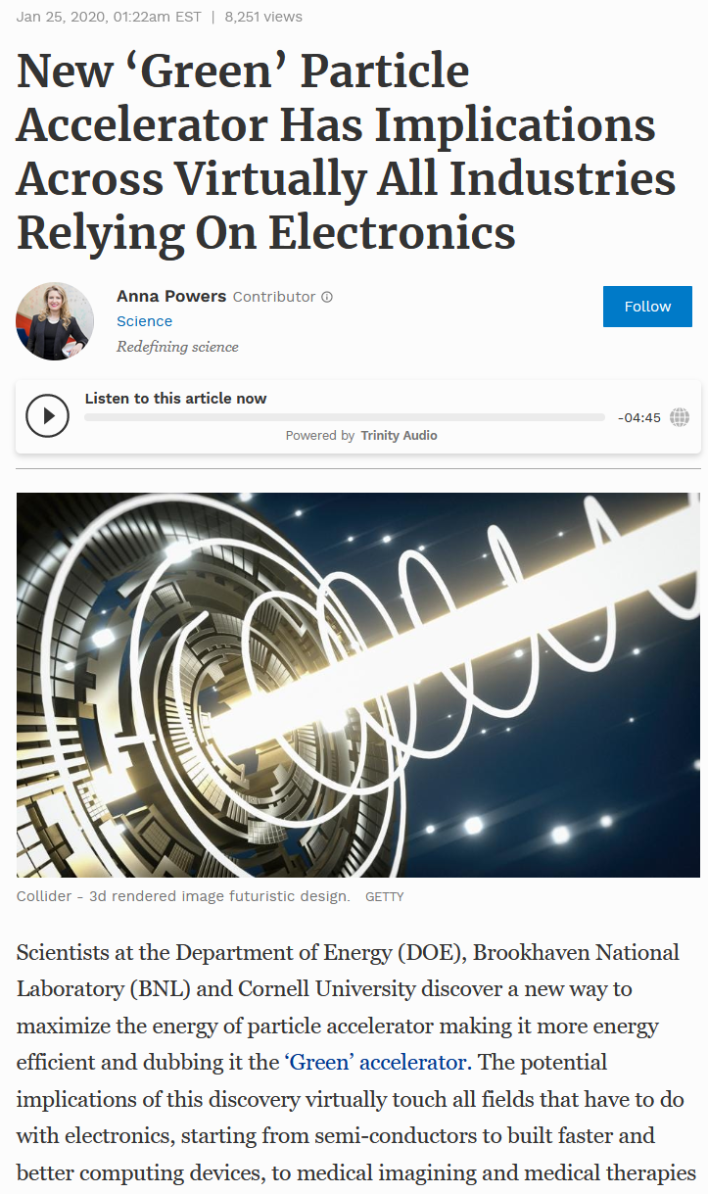
Bio Sketch
Karl Smolenski, Cornell University 1993-
  BS Mechanical: Cornell 1991
  MS Material Science: UCSB 1993
  MEng Management: Cornell 2010
CESR b-factory design team
CHESS lead engineer (1990s)
Cornell ERL (2000s)
Project Manager / Systems Engineer for CBETA – 4 Pass ERL test accelerator
CMS (2019) – Systems Engineer

Slide 4
Systems Engineering Suite
Systems Engineering Management Plan
  (CMS-doc-13194)
Configuration Management and Change Control Plan
  (CMS-doc-12907)
Quality Assurance Plan
  (CMS-doc-13093)
  QAP Appendix – details of each sub-project

Slide 5
Systems Engineering Suite
Barrel Calorimeter Systems Engineering (CMS-doc-13317)
Forward Muon Systems Engineering (CMS-doc-13281)
TFPX Systems Engineering (CMS-doc-13304)
Trigger Systems Engineering (CMS-doc-13318)
  Interface Control Documents (ICD)
  Requirements Documents (REQ)
  QA/QC tasks (QAQC)
  QC tests / specifications
Each of the sub-detectors will cover their QA/QC status

Slide 6
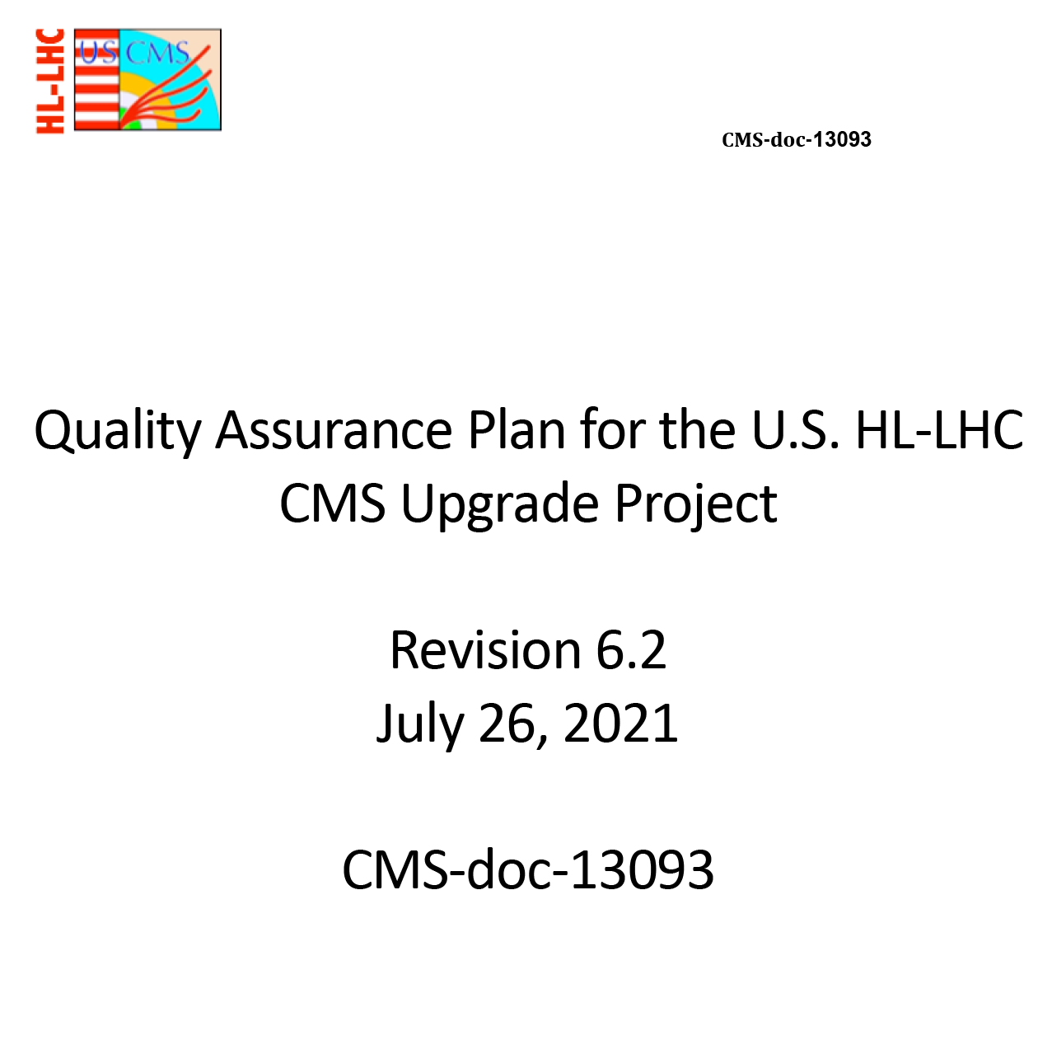
Quality Assurance Implementation
Quality Assurance Plan (QAP) - owned by PO
  Consistent across entire upgrade project for both DoE and NSF
  Based on existing FermiLab policy / practice
  Serves as an overarching plan, with individual institutions applying to their sub-project
  Graded requirements
  Dedicated quality coordinator - T.J. Sarlina [FNAL]
402 HL-LHC CMS Detector Upgrade Project
Project Office (402.0 NSF and 402.1 DOE)
Project Manager: S. Nahn
Deputy PM (NSF): A. Ryd
Deputy PM (DOE): V. Papadimitriou
Associate PM: L. Taylor
Associate PM: C. Wilkinson
Project Scientist: C. Hill
Education and Public Outreach: S. Rappoccio
CMS HL-LHC Liaison: P. Rumerio
ESH&Q Coordinator: T. J. Sarlina
Project Controls Lead: W. Freeman
Project Controls Specialists: E. Moreno, S. Scott
Project Finance (DOE): J. Teng
Project Finance (NSF): B. Smith
Lead Systems Engineer: K. Smolenski

Slide 7
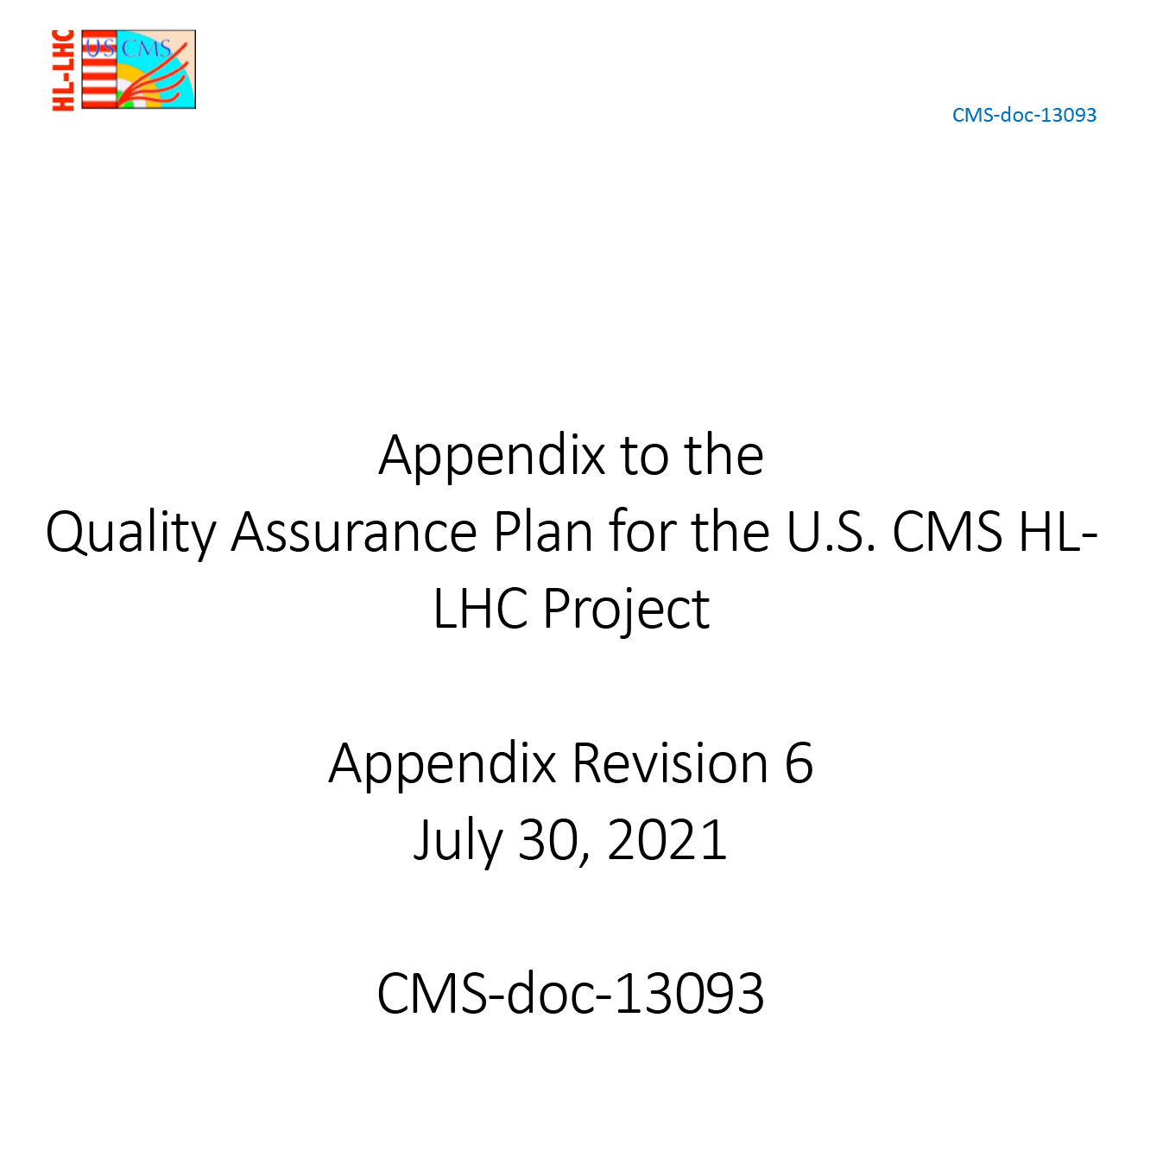
Quality Assurance Implementation
QA Appendix - owned by L2 Managers
  Details for each sub-detector
  Recently updated (May-July 2021) to reflect latest scope and specification development
Science Requirements - Project Scientist
Engineering Requirements - L2 Managers
QA/QC activities - L3 management and subject matter experts

Slide 8
FDR Recommendations
Two Systems Engineering recommendations at FDR
  (DocDB-13905)
A document that summarizes our response to these recommendations is available in DocDB-14309
The project should establish the customary verification and compliance matrices to track predicted performance. Compliance expectations are management tools precipitating risks and in turn mitigation actions. Verification matrices and plans will ensure a consistent framework and methodology for system, subsystem, and component verification.
The project should introduce a robust referencing system in configuration management, where documents have uniquely assigned document identifiers (numbers).

Slide 9
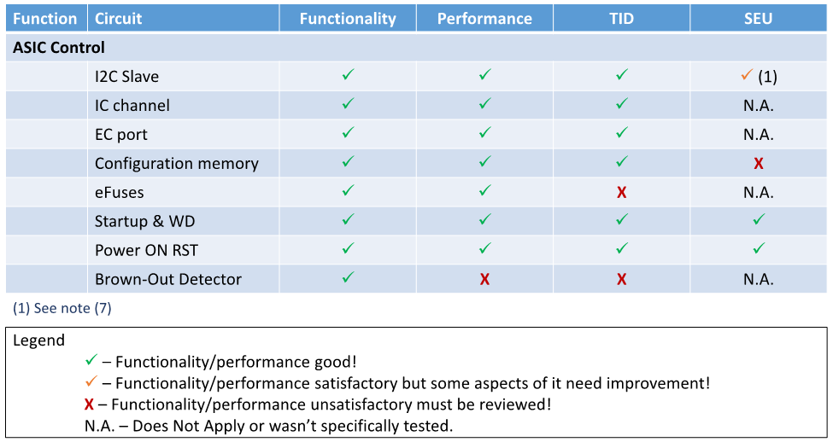
FDR Recommendations – (1)
Verification / Compliance Matrices
  Starting implementation across all systems.
  Also being used by common project ASIC development teams for c-ROC, LpGBT, VTRX+, DC-DC converters, etc. Based on engineering requirements documents and detailed specifications.
lpGBT Compliance Matrix

Slide 10
FDR Recommendations – (2)
Configuration Management
  Distributed data management systems for designs (CAD, Manufacturing, ASICs design, software, and circuits) makes this challenging.
  Typically, at each L3 level data is collected via local systems. For example: TFPX mechanical drawings at Cornell U vs. electronics drawings at Rice U. Version control is implemented and tracked within these system.
  EDR / ESR leads to approval of a final design configuration. Design data are then transferred to the CERN central EDMS system.
  Full configuration / version control is then applied to the CERN EDMS system

Slide 11
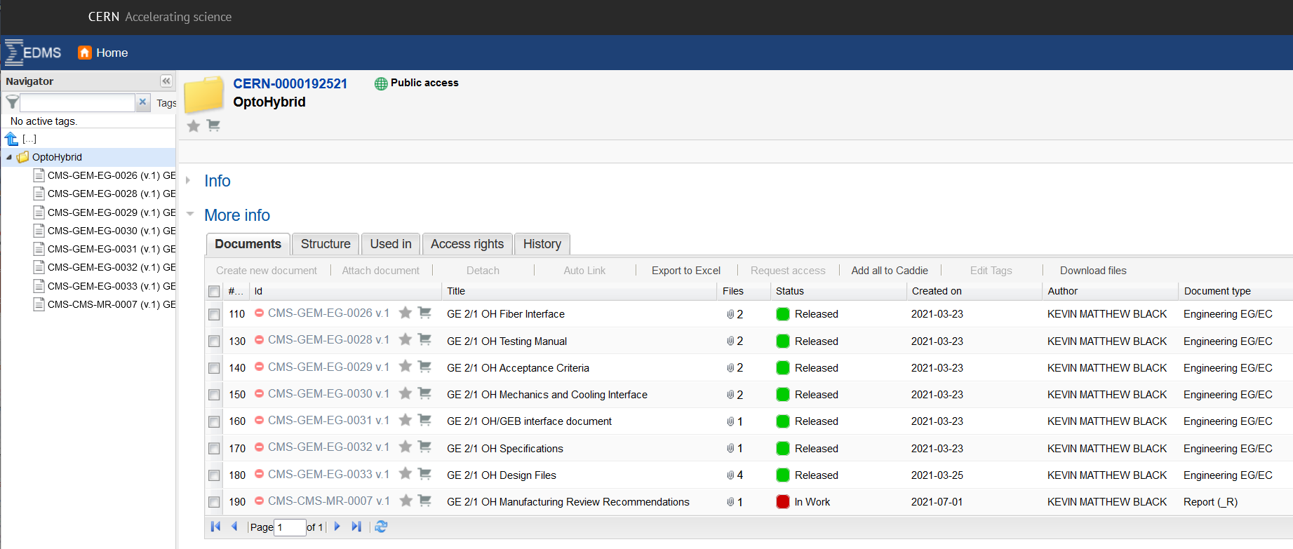
FDR Recommendations – (2)
Configuration Management
  Implemented for “Early” Componets (GE21 Optohybrids)

Slide 12
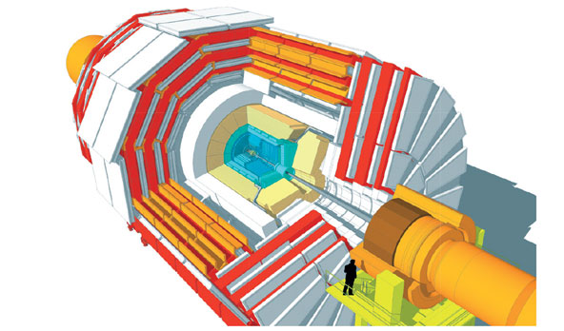
Summary of CMS HL-LHC Upgrades
DOE
and
NSF
Trigger/HLT/DAQ
Track information in L1-Trigger
L1-Trigger: 12.5 μs latency – output 750 kHz
HLT output 7.5 kHz
Barrel ECAL/HCAL
Replace FE/BE electronics
Lower ECAL operating temp. (8 ⚬C)
NSF
NSF
Muon Systems
Replace DT & CSC FE/BE Electronics
Complete Muon coverage in region 1.5<η<2.4
Muon tagging 2.4<η<3
DOE
New Endcap Calorimeters
Rad. tolerant – high granularity
3D capable
DOE
DOE
New Tracker
Rad. tolerant – high granularity – significant less material
40 MHz selective readout (p_{T}>2 GeV) in Outer Tracker for L1 -Trigger
Extended coverage to η=4
MIP Precision Timing Detector
Barrel: Crystal +SiPM
Endcap: Low Gain Avalanche Diodes
NSF

Slide 13
Interface Control
Interface Control Documents for each sub-detector
Clearly understood and followed boundaries for most
Tracker volume closely monitored
  NSF and DoE Interfaces (e.g.: ITST to TBPS)
  Tightly defined by CERN Detector Engineering group
  Weekly meetings across interfaces
Not only technical interfaces:
  Inner tracker / outer tracker resource sharing (e.g.: BTST & ITST engineering)
  Systems Engineer role spans DoE and NSF project
  Funding benefits (shared equipment)
  Resource schedule challenges

Slide 14
Requirements Flow Down
Science Requirements
Engineering Requirements
QA / QC Implementation
Individual Specifications / Tests / procedures

Slide 15
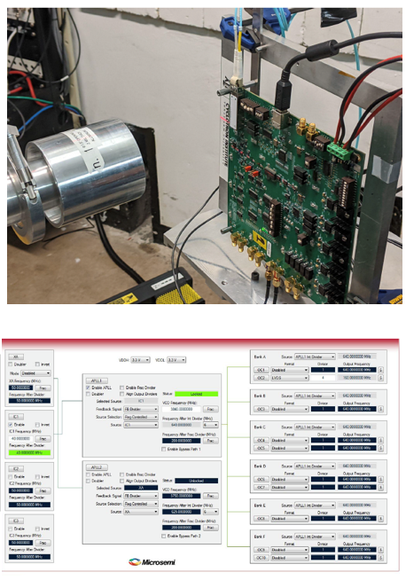
Quality Assurance Implementation
CMS-doc-13281
Requirements
QA/QC Process
Detailed QC plan given in separate document
Responsible Party

Slide 16
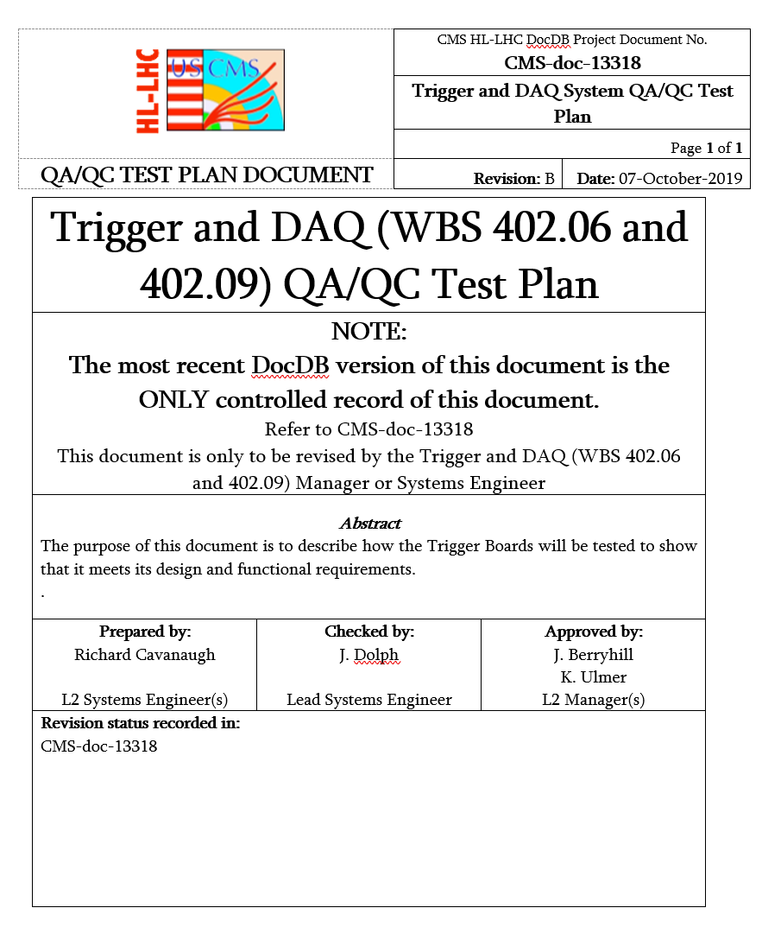
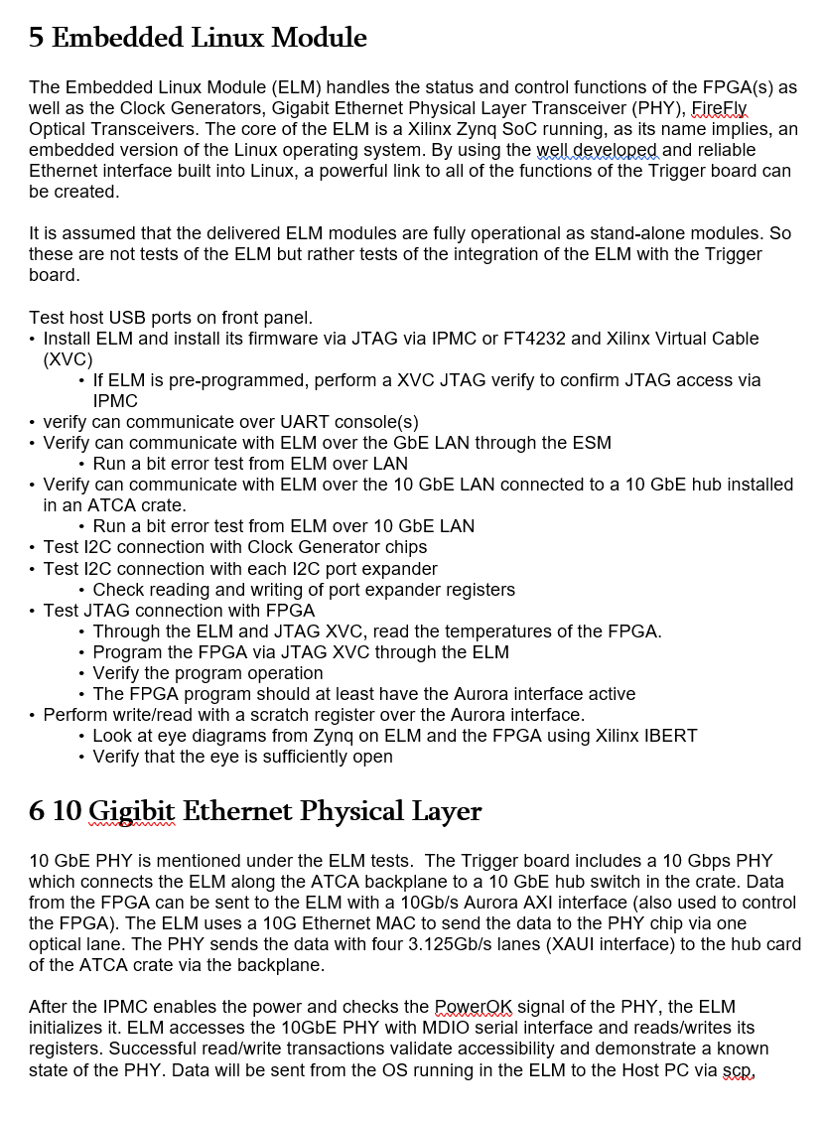
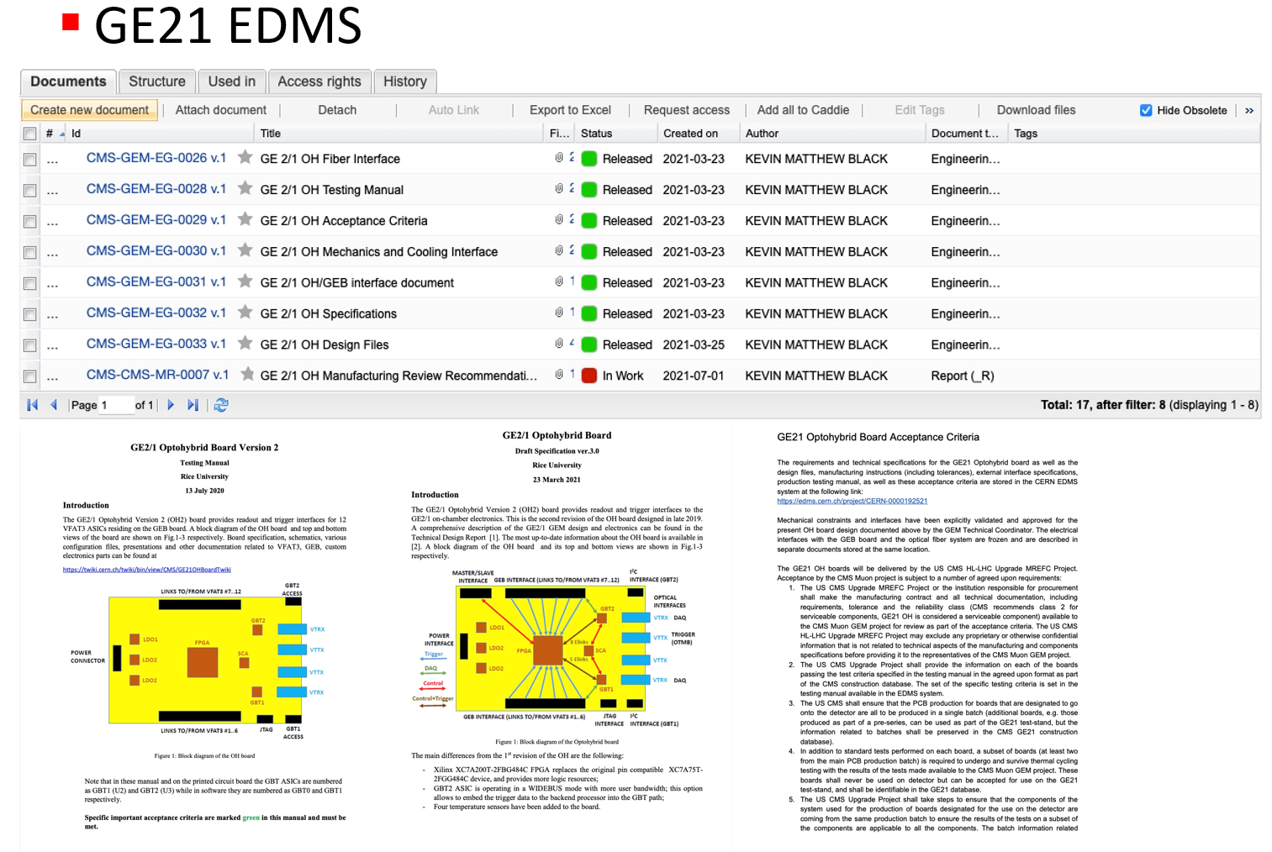
Status of QA/QC Implementation
“Early” projects have well advanced specifications / QC test plans
Trigger (CMS-doc-13318)
Forward Muons (CMS-doc-13281)

Slide 17
TFPX practice from Phase I
Current TFPX leadership participated in Phase I
  Wealth of existing Phase I QA/QC procedures are proven and well documented
  Updating for HL-LHC upgrade in progress
    Flex circuit testing
    DCDC testing
    Encapsulation
    Module testing
    Module visual insp.
    HDI gluing
    HDI visual inspection
    Portcard testing
    Module X-ray testing
    Module shipping
    Thermal cycling
    Wirebonding
    Etc.

Slide 18
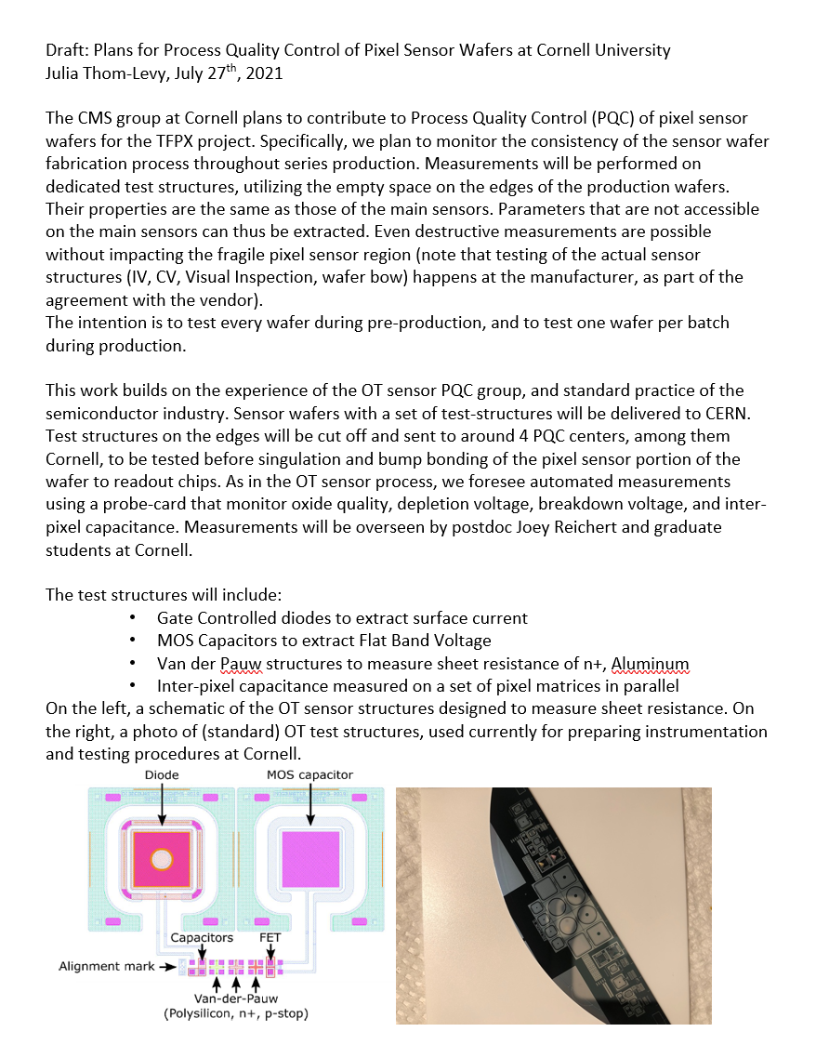
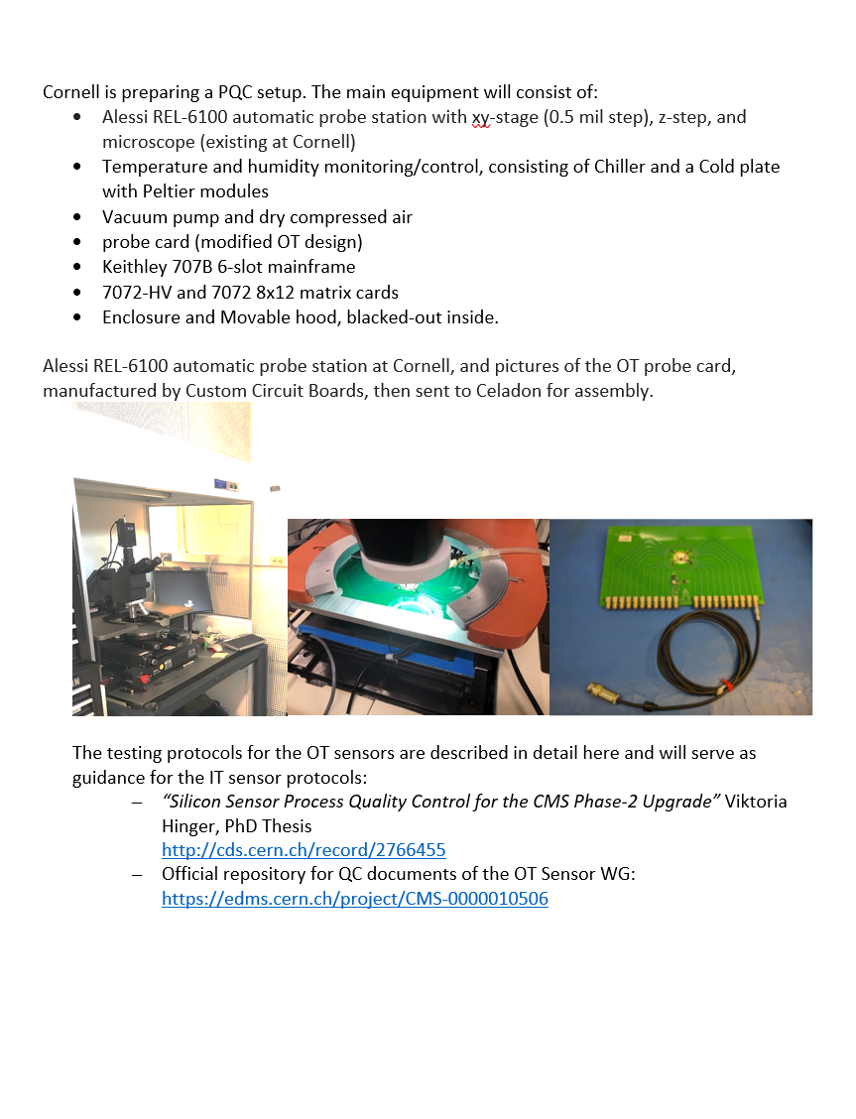
TFPX example - sensor testing
QC test documentation being prepared for early production components

Slide 19
Summary
Robust Systems Engineering ecosystem in place
Travel restrictions and reduced in-person meetings have limited some of the oversight functions
As design work concludes, configuration control and centralized data management will be implemented
QA/QC audit (spring 2021) has led to refinement of existing requirements and development of QC test plans
Development of test procedure documentation has progressed well for “early” production sub-projects and has begun for the rest

Slide 20
Thank you

