Slide 1
Endcap Muons
Charge is in DocDB-14259
Alexei N. Safonov, Level-2 Manager
MREFC Annual Review
August 25, 2021

Slide 2
Outline
Overview/Scope
Completion of R&D
Progress Overview – Technical
EVM Status
  Milestones/Schedule
  Earned Value Summary
  Summary of Change Control Actions
Plans for 2022 and iCMS updates
QA/QC Implementation
Summary of Covid Impacts and Plans
  Cost/Schedule/Forecast
Supplementary information requested by the reviewers

Slide 3
Key Biographical Sketches
L2 Manager– Alexei Safonov
  Professor of Physics, Texas A&M University
  Current: CMS GEM Deputy PM, CMS GEM Upgrade Coordinator, CSC OTMB electronics improvements campaign (under M&O/DOE), R&D for HL-LHC GEM/CSC backend systems
  Past: CMS CSC GEM-CSC Trigger Coordinator, CMS Forward Upgrade Project Office, CMS GEM DPG convener, CMS Tau convener, CMS Phase-2 Muon Upgrade TDR chapter co-editor, GE1/1 TDR co-editor, CMS Phase-1 TP Chapter co-editor, CSC ME1/1 OTMB mezzanine & base boards, GEM GE11 OH board design, USCMS LS1 radiation hardness studies, CDF experiment at FNAL
L3 CSC Upgrade – Darien Wood
  Professor of Physics, Northeastern University
  Current: USCMS M&O Endcap Muon PM (L2), CMS Muon Deputy System Manager, US CMS CSC MEX/1 LS2 Electronics Replacement Program (under Ops) Manager
  Past: CMS CSC Upgrade Coordinator, CMS CSC ME1/1 Electronics Replacement Program, CMS Phase-2 Muon Upgrade TDR chapter co-editor, Spokesperson of the DZero collaboration at FNAL; PM of DZero trigger upgrade, UA2 experiment at CERN, Mark II experiment at SLAC
L3 GEM Upgrade – Kevin Black
  Professor, University of Wisconsin – Madison
  Current: CMS GEM Run Deputy Coordinator, FNAL LPC Coordinator
  Past: US ATLAS L0 MDT Trigger Project L3 Manager, US ATLAS L1 Physics Support Deputy Manager, ATLAS Muon Trigger Signature Group convenor, ATLAS Reprocessing Coordinator, Operations Leader for the D0 Silicon Track Trigger

Slide 4
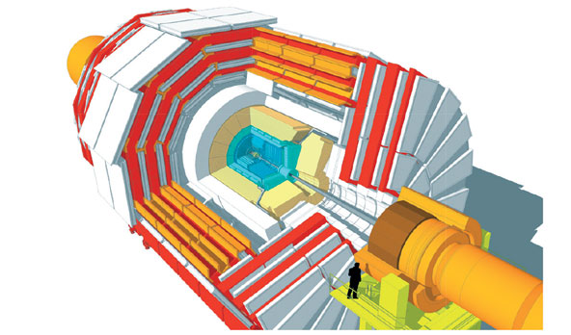
HL-LHC Upgrade Overview
DOE
and
NSF
Trigger/HLT/DAQ
Track information in L1-Trigger
L1-Trigger: 12.5 μs latency – output 750 kHz
HLT output 7.5 kHz
Barrel ECAL/HCAL
Replace FE/BE electronics
Lower ECAL operating temp. (8 ⚬C)
NSF
NSF
Muon Systems
Replace DT & CSC FE/BE Electronics
Complete muon coverage in region 1.5<η<2.4
Muon tagging 2.4<η<3
DOE
New Endcap Calorimeters
Rad. tolerant – high granularity
3D capable
DOE
DOE
New Tracker
Rad. tolerant – high granularity – significant less material
40 MHz selective readout (p_{T}>2 GeV) in Outer Tracker for L1 -Trigger
Extended coverage to η=4
MIP Precision Timing Detector
Barrel: Crystal +SiPM
Endcap: Low Gain Avalanche Diodes
NSF

Slide 5
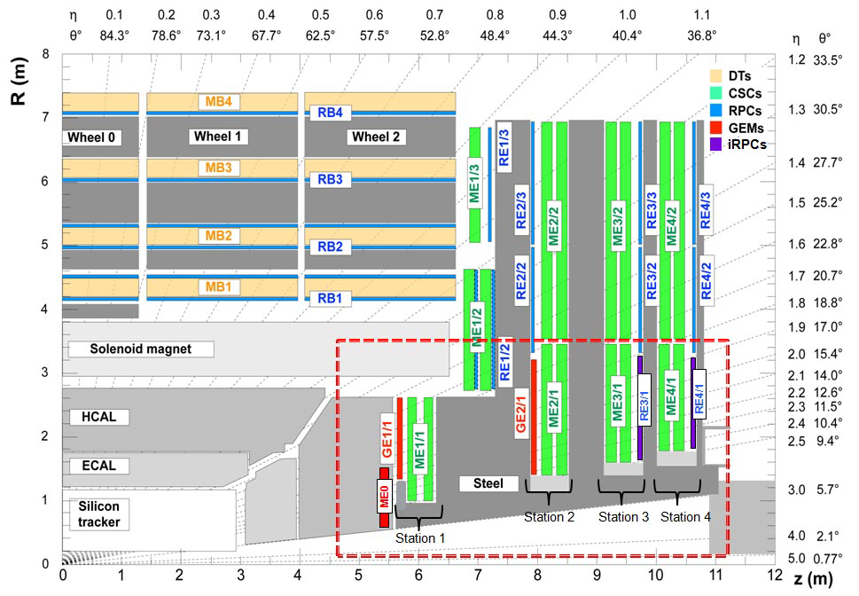
CMS Muon Upgrade Scope
CMS HL-LHC upgrade scope:
  Barrel electronics upgrade (no US involvement)
  Forward muon upgrades: maintain trigger, increase offline coverage
Endcap Muon Cathode Strip Chambers (CSC):
  Upgrade ME1-4/1 electronics to cope with data volume/bandwidth
New Gas Electron Multiplier (GEM) detectors:
  GE1/1 and 2/1 work with CSC ME1/1 and ME2/1 to maintain muon trigger
  ME0 works with ME1/1 to maintain trigger and extends offline coverage η=2.4 ➔2.9

Slide 6
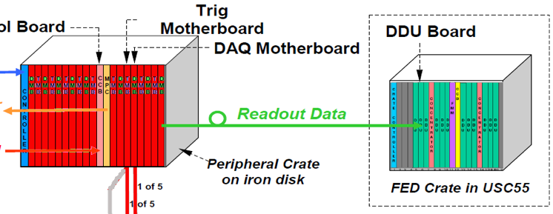
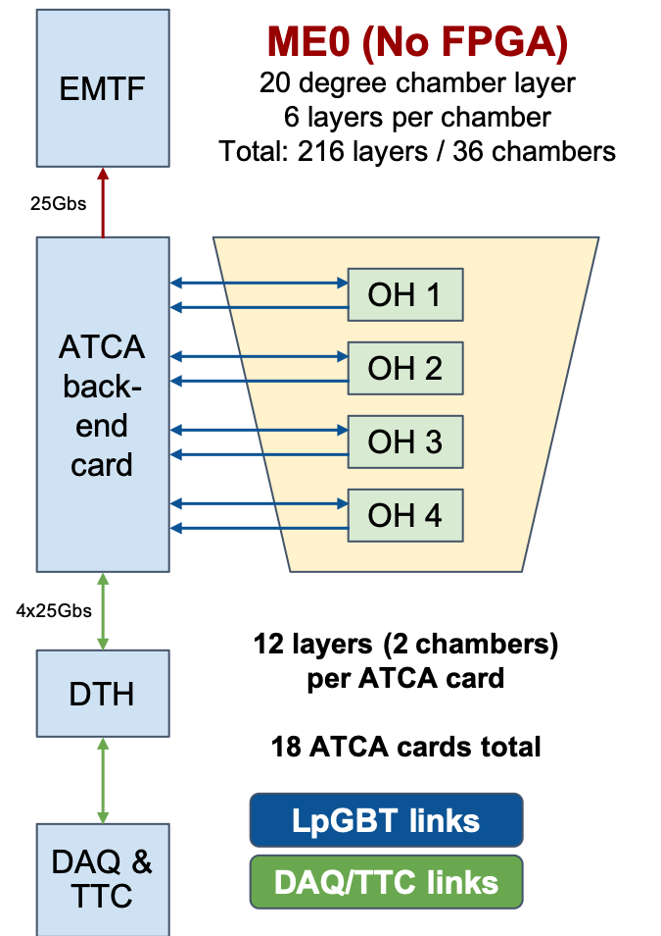
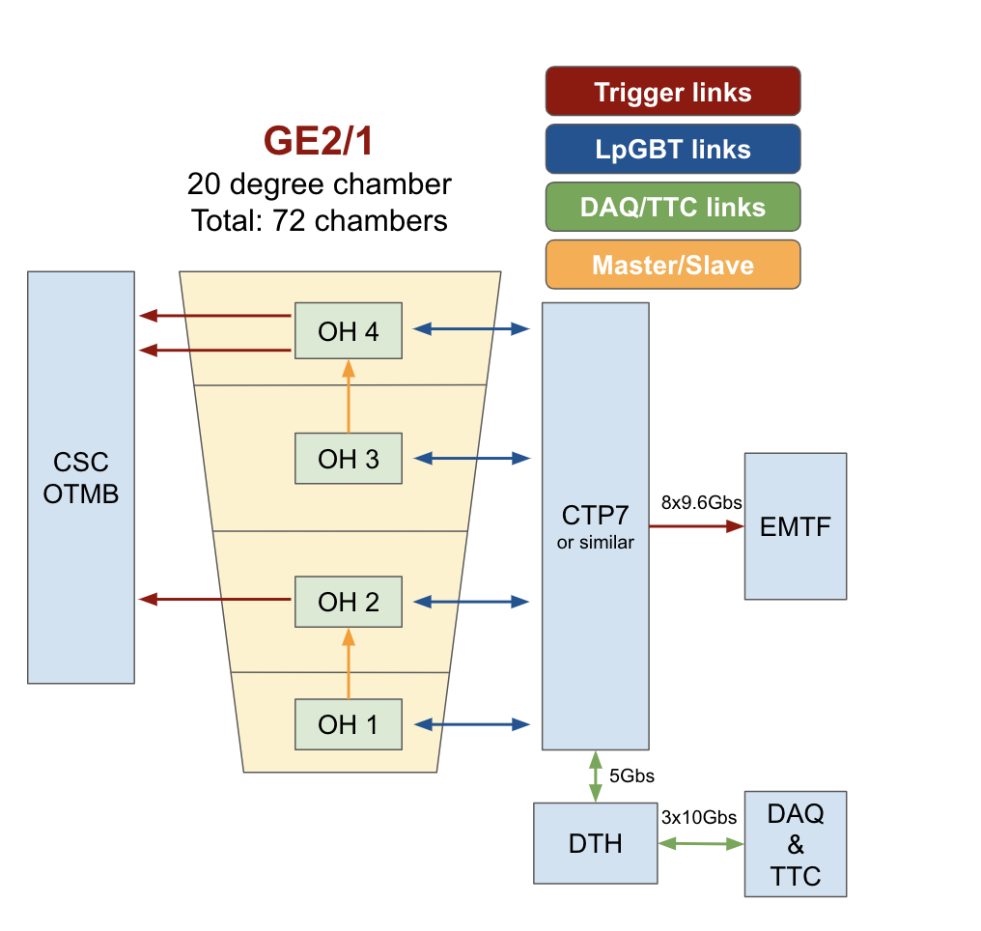
NSF Scope in CMS Muon Upgrades
Focus on maintaining good performance of the CSCs and forward muon trigger
  Strong US expertise and historical area of US leadership in CMS
  Scope remains stable since CDR
    We released one specific link to our international collaborators
Upgrade of the off-chamber electronics for muon CSC stations ME1/1-ME4/1:
  Address bandwidth limitations, add capabilities for internal re-synchronization necessary in high rate environment
    Upgrade optical link and electronics connected to it
Design and build Trigger/DAQ electronics system for GEM detectors GE2/1 and ME0:
  Maintain forward muon trigger performance and expand muon coverage
    Electronics system performing reconstruction and triggering algorithms
    Data concentration, processing and routing to the CSC Optical Trigger Motherboard (OTMB) and CSC Track Finder (TF)
    Matching CSC system updates to implement new reconstruction algorithms in firmware
In Peripheral Crates:
Replace DAQ mother boards (only) – one per chamber
Additional high bandwidth optical fibers
FED system is replaced with all new crates and modules

Slide 7
Upgrade Scope Summary
The NSF scope in CMS Muon upgrades is focused on electronics complete with required firmware/software:
  Upgrade of elements of the existing CSC electronics system
  Construction of a part of the electronics readout system for two new GEM detectors
Technically well understood, includes several types of custom electronics boards plus backend based on ATCA standard
  Custom boards well understood, similar to boards built in recent past, based on standard technologies (FPGA, optical links), recent prototypes in most cases
  Backend will use a commonly developed CMS processor card
Modest number of interfaces and dependences
  Interfaces are identified, continuously tracked, work in progress towards documenting agreements and placing under control
While there are challenges routinely expected from projects of this type, there are few technical risks
  Those that exist are well understood and constantly monitored, mitigation in progress, response plans are well developed

Slide 8
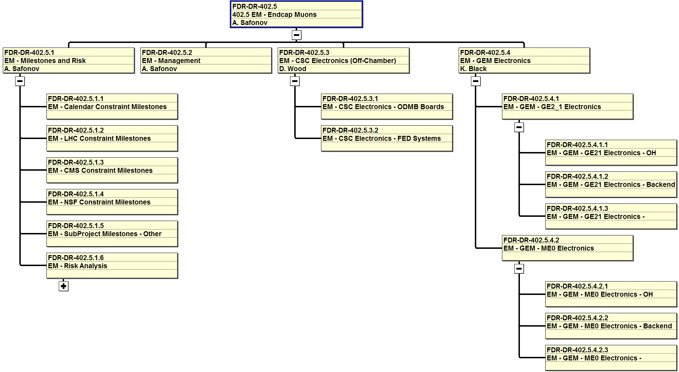
Management Structure
Charge: 2a
OBS (Organizational Breakdown Structure) mirrors the WBS
  Remains the same for construction
Level-3 Managers and System engineers:
  CSC: D. Wood (L3, NEU), M. Matveev (SE, Rice)
  GEM: K. Black (L3, Wisconsin) S. Goadhouse (SE, Virginia)

Slide 9
CSC Upgrade: Deliverables
Key project deliverables for the CSC Off-chamber electronics upgrade:
    ODMBv2 Boards receiving optical data from CSC on-chamber electronics:
      180 Optical DAQ Boards (ODMBv2) for the CSC chambers, capable of transmitting data at >10 Gbps each, complete with firmware and control software, tested and delivered to CERN
    Backend (FED = Front End Driver) system receiving data from DMB/ODMB boards, processing, concentrating and transmitting event data to CMS central DAQ and optical links
      2 ATCA crates with power supplies and control cards, tested and delivered to CERN
      12 high power/bandwidth standard CMS ATCA processing cards complete with firmware and control software, tested and delivered to CERN
      2 standard CMS ATCA clock/interface cards (one per crate) complete with firmware and control software, tested and delivered to CERN
      120 12-fiber bundles of optical fibers connecting original DMB & new ODMBv2 boards to the backend, tested and delivered to CERN
    Operational spares and a test-stand at CERN

Slide 10
GEM Upgrade: Deliverables
Key project deliverables for the GE2/1 and ME0 Trigger/DAQ Electronics Upgrade
    Optohybrid (OH) boards receiving data from front-end chips for processing and concentration:
      288 GE2/1 OH boards, 864 ME0 OH boards complete with firmware and control software, tested and delivered to CERN
    Backend system(s):
      1 ATCA crates for GE2/1 and 2 ATCA crates for ME0 with power supplies and control cards, tested and delivered to CERN
      4 high power/bandwidth standard CMS ATCA processing cards for GE2/1 and 18 cards for ME0 complete with firmware and control software, tested and delivered to CERN
      3 standard CMS ATCA clock/interface cards (one per crate) complete with firmware and control software tested and delivered to CERN
    Optical Links:
      GE2/1: a dedicated fiber plant (provides 792 optical fiber links) connecting OH to backend, tested and delivered to CERN
      ME0: a dedicated fiber plant (incudes 2610 optical fibers links) connecting OH to backend, tested and delivered to CERN
    Operational spares and components for a test-stand at CERN

Slide 11
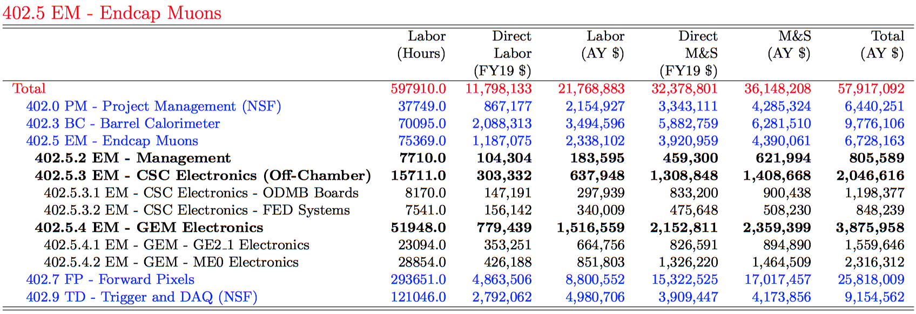
Budget Summary
Budget nearly unchanged since the FDR (above)
  As of last month, we are at about 19% to completion

Slide 12
Muon Summary Schedule
FDR
MREFC Funding Start
MREFC Completion
CY18
CY19
CY20
CY21
CY22
CY23
CY24
CY25
CY26
CY27
CY28
Design and Development (under operations program)
Construction Project (MREFC)
Pre-Production
Production
Testing and Integration
Schedule Float
Int’l
CMS
ESRs
Need-by-date
PRRs
LHC
LS 2
Run 3
LS 3
Run 4
v3.0 Jul. 28, 2021
HL-LHC Operations Start
Phases of MREFC schedule:
  Preproduction – qualify using final parts and design
  Construction – production of full quantity
  Testing & Integration – QA/QC all levels, ready for CMS installation

Slide 13
Muon R&D Spending
Charge: 1a, 1b
Some R&D tasks continued past April 1, 2020 (start of the MREFC):
  Tracked and billed separately, no overlap
  Variety of reasons for delay (technical, dependences on other sub-projects, international partners delays, COVID induced impacts)
Institution | Spending ($)
FIT | 33,396
Northeastern | 3,177
Ohio State | 88,956
Rice | 180,359
TAMU | 281,158
UCLA | 187,839
Virginia | 26,162
Wisconsin | 27,818
Total | 828,868

Slide 14
Progress Summary: CSC ODMB
Charge: 4a
CSC ODMB pre-production board (OSU + UCSB)
  Pre-production ODMB7 manufactured in 2020
    Passed comprehensive testing, only small tweaks for production
    Firmware development and testing the interfaces with new and legacy CSC components
    Radiation qualification completed in April’21
  Procurement to manufacture the pre-production ODMB5 (the second flavor of ODMB) has been green lighted
    Some delay due to the FPGAs long lead time
  Testing and integration
    Production testing setup at UCSB
    Full ATCA test stand at CERN for integration
  4-6 months behind the original baseline
    Still a comfortably large float

Slide 15
CSC ODMB7: Radiation Testing
Charge: 4a

Slide 16
CSC LS-2 Upgrades
Not in MREFC scope, but an important pre-requisite for the success of LS-3 upgrades: new xDCFEB boards and OTMB boards become interfaces for the LS-3 deliverables
CSC LS-2 upgrades installation have been completed, testing and commissioning progressing very well
Various isolated issues typical for re-commissioning are being identified and resolved
  E.g. fuseholders inside junction boxes for LV in station 1 heating up due to increased resistance (and also increased currents with new electronics) – replaced with unused spares solved the problem indicating aging – looking for an alternative part
Firmware and software updates and upgrades
  DCS, GEM-CSC interface development etc.

Slide 17
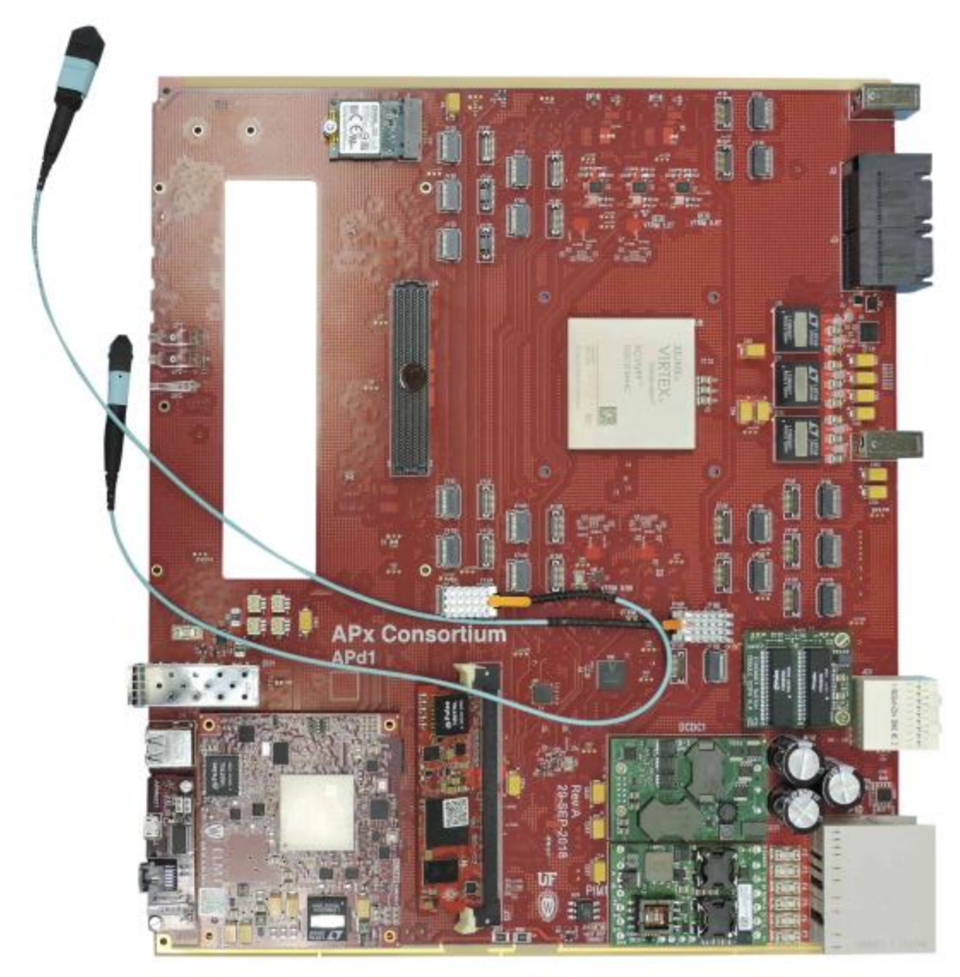
Progress Summary: GEM GE21
Charge: 4a
“Early” Phase-2 project
  System installation in late 2023, a demonstrator chamber to be installed in Fall’21
In CMS, GE21 is now nearly completely in construction phase:
  Infrastructure and services released by a PRR in 2018
  Chamber production released in EDR in 2019
  Electronics production released in ESR in Jan.2021
    US scope elements approved in Jul.2020 in a special PRR to allow acquisition of
      Long lead items (FPGAs mainly) for the Optohybrid (OH) Board
      The on-chamber and on-disc parts of the optical fiber plant to install the on-disc fibers ahead of schedule in LS-2 to shorten the time required for installation in 2024)
  The only item left is the backend that has been kicked into a separate PRR in the future:
    We have been planning to use one of the existing CMS ATCA boards from the trigger project, but the pre-production boards are behind schedule
    CMS ESR review agreed with us that the interface with the backend is not a concern for the rest of the system
    Schedule delay is not a concern as it is all off-detector and there is a very substantial float
Construction schedule is behind but is picking up steam:
  After initial delays due to COVID and funding availability (India, in particular has been a concern), chamber components production is ramping up
  Electronics production: the VFAT3 (front end ASIC) manufacturing schedule slipped due to availability reductions at TSMC, but the delay is not as large as originally expected
  Chamber assembly to start in Dec.2021 (need-by date for the US-built OH board)
APx prototype (Wisconsin)
X20 Prototype (UF/UCLA)

Slide 18
GEM GE21: Optohybrid Board
Charge: 4a
Technically, CMS reviewed the OH design and approved production back in July.2020
  Purchased all long lead items but been waiting with starting the board manufacturing until the CMS ESR to minimize risks that other non-US electronics may undergo a design change
Following the ESR review in Jan’21, we released the pre-series boards production, which have been fully tested and certified in April 2021
  The pre-series validated the halogen-free material required by CERN ES&H (not expecting surprises, just due diligence), also temperature cycling tests to validate the quality of manufacturing and assembly
Been artificially holding sending boards for full production
  Pluggable CERN-built VTRX optical transceivers may need repairs for a potential technical issue discovered in calorimeter operations
  Official CERN recommendation is expected at the end of May, expected to include a proposed fix, in which case we start production
  A potential backup option with the CERN VTRX+ and a special adapter PCB is in place
    Not a preferred solution as while it has been validated from the electronics stand point, it remains unclear if the cooling system can be modified to accommodate for these changes or we would need to update the OH design (which likely implies a 3-6 months delay)
  With the CMS GE21 schedule updates, OHs will arrive well ahead of the actual need-by-date determined by the start of the chamber assembly
Final green light for production at the very beginning of July following a series of successful reviews (including QA/QC, acceptance and handover to CMS documentation)
  Updates to the planning to accommodate for the re-testing with “cured” VTRX devices at CERN via BCR (approved in June)

Slide 19
GE21 Optical Fiber System
Charge: 4a
Three parts:
  On-chamber, on-disk, and off-detector (the sign off on the latter will happen together with the backend sign-off in a dedicated CMS PRR)
On-disk part installed at the end of 2020
  Connects GE21 OH boards with the backend and the CSC OTMB board for integrated GEM-CSC triggering
  Approved by CMS PRR on July 30, 2020 along with the GE21 OH to allow early installation
    Mitigates risks associated with the short window available for GE21 installation
  One of our engineers traveled to CERN to lead testing and oversee installation in November of 2020
On-chamber part fully approved in EDR/ESR in Jan’21:
  We are holding off the procurement in case we do need to change the OH design to use VTRX+ (if no reliable solution for fixing VTRX is available)
All documentation in CERN EDMS
  Requirements, system specs, interfaces, manufacturing files, acceptance criteria etc.
  Electronic approvals and full document versioning control
  Set a standard for the new documentation (GE21 and ME0)

Slide 20
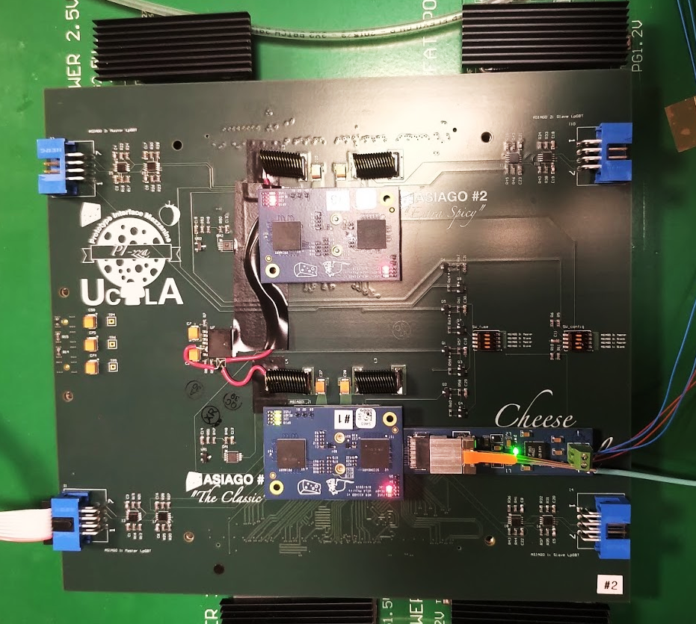
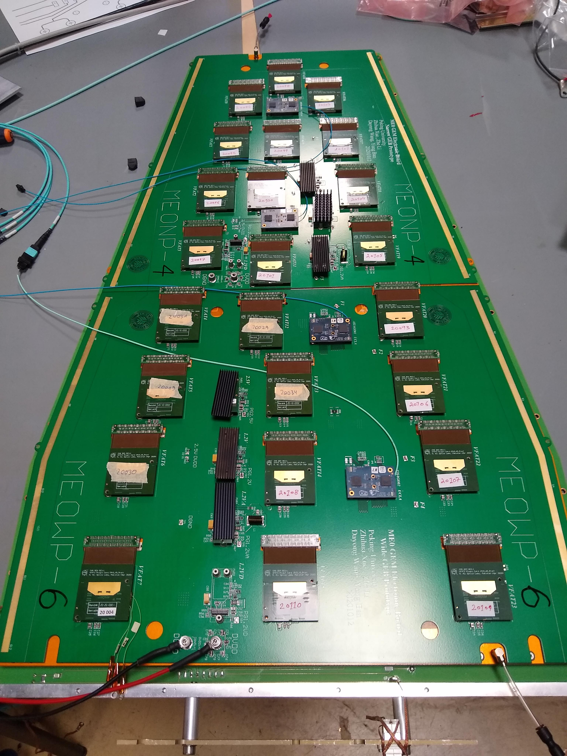
Progress Summary: GEM ME0
Charge: 4a
A good quality ASIAGO prototype in hand since Fall of 2019
  Support/adaptor boards (CACIO, PIZZA) allowed full validation (except mechanics/cooling) with the GE21 demonstrator
Electrical design validation in Fall of 2020:
  Test compatibility with the new VFAT3 and LpGBT, ATCA backend, CERN VL+ ransceivers, communications using new multi-VFAT3 addressing schema, internal control (IC) path validation
Full set of pre-production electronics integrated at CERN in Spring’21
  Pre-production prototypes for full ME0 design integration unavailable (planned for early 2020, but the delay with LpGBT until September made it impossible), but good quality of the previous generation of prototypes allowed integration and validation of the full module with electronics to proceed
    Integrates OH (US), GEB (PKU), plug-in cards (INFN), and the detector module (CERN et al.)
  LpGBT delay forced ME0 ESR to be shifted by 3 month to February 2022
    ME0 electronics schedule has comfortably large floats, so this is not a concern
PIZZA
BOARD
PIZZA & ASIAGO & CACIO on GE2/1 GEB
Full ME0 On-Chamber Electronics System (Spring’21)

Slide 21
EVM Summary
Charge: 2a
Established a regular monthly routine
  A joint meeting of L2, L3s, systems engineers + invitees (PIs, and technical experts)
    Review past month technical progress and consistency of the un-invoiced accruals reported by institutions with the expectations based on the previous month planning and the progress made
    Review and approve plans for the coming month, including planned hours on various tasks
      PIs can use it as a reference when they provide personnel salary payment allocation and time & effort to their university accounting
    Been able to catch a lot of common mistakes in reporting (and PI’s understanding of what we are asking of them)
    Discuss project wide issues (risks, personnel, documentation, BCR planning)
  Specialized technical meetings
    Typically once a month by GEM and CSC (separate meetings unless some common issues are discussed)
  L2/L3 managers well versed in using project management tools
    Many less comments or correction requests from the PO as they review variance reports
  Established reporting flows and link people at institutions
    Most PIs are familiar with the un-invoiced accruals protocols
    Fast resolution of various funding and sub-award issues
      Thanks to Brenda and other people at Cornell who have been there to help

Slide 22
EVM Summary: Cost/Schedule
Charge: 2a
BCWP lags behind BCWS: sub-projects schedule delays
  Typically 3-6 months, various reasons, including COVID impact
  More details later
Costs are generally within the original envelope
  CPI is somewhat skewed upwards due to unspent travel/COLA
  Zeros in Actuals are due to COLA for postdocs and students who we could not place at CERN due to COVID
Institution | Budget | Earned | Actual | CPI | SPI
BU | 48,290 | 31,129 | 19,499 | 1.60 | 0.64
CL | 183,677 | 128,446 | 120,815 | 1.06 | 0.70
FT | 36,911 | 25,326 | 18,231 | 1.39 | 0.69
NEU | 12,905 | 12,905 | 0 | - | 1.00
OS | 192,883 | 155,963 | 129,540 | 1.20 | 0.81
RI | 620,406 | 382,782 | 370,532 | 1.03 | 0.62
TAM | 510,946 | 342,523 | 284,699 | 1.20 | 0.67
UCD | 8,532 | 9,413 | 0 | - | 1.10
UCSB | 41,488 | 41,489 | 37,237 | 1.11 | 1.00
UV | 53,701 | 53,702 | 34,985 | 1.53 | 1.00
UW | 120,831 | 76,917 | 51,881 | 1.48 | 0.64
WSU | 12,798 | 14,119 | 0 | - | 1.10
Total | 1,843,372 | 1,274,714 | 1,067,420 | 1.19 | 0.69

Slide 23
EVM Summary: Milestones
Charge: 2a
Not many reportable (T3) milestones yet
Projected delays for early milestones are not negligible
  Significant impact of external factors: LpGBT delays, ASIC and FPGA shortages, international partners progress delaying major reviews
  In some cases, schedule variances are artificial
    E.g. of the “delayed” GE21 optical links, all the important ones are actually already installed at P5, but it looks like we are 9 months behind
But impact on the project is so far limited
  Later milestones delays are only ~3 months due to substantial internal floats
Milestone | Baseline | Projection
T4- CMS - Start of ME0 Demonstrator Chamber Assembly | 7-Oct-20 | 01-Jul-21A
T4 -CMS - PRR for GE2/1 Backend | 29-Sep-21 | 26-May-22*
E4 - CMS - GE 2/1 OH Design Review (ESR) - CMS planned date | 21-Aug-20 | 21-Jan-22A
E4- CMS - NBD: ME0 OH prototype ready for demo chamber | 11-Jan-21 | Fall’21
T3 - EM - GE21 - OH Batch 1/2 ready for chamber assembly | 15-Mar-21 | 27-Jan-22*
E4 - CMS - lpGBT PreProduction Chips Available | 30-Sep-21 | 30-Sep-21
T3 - EM - GE2/1 - Optical Links are ready for installation at P5 | 19-Apr-21 | 5-Jan-22
T3 - EM - GE2/1 - Optical Links On-chamber Ready for Inst. at P5 | 10-Oct-21 | 1-Sep-21
T3 - EM - CSC - ODMB Board Ready for PRR | 21-Jan-22 | 19-Aug-22
T3 - EM - ME0 - CMS ME0 Electronics ESR Complete | 02-Feb-22 | 02-Feb-22
T3 - EM - ME0 - OH Batch 1/2 Ready for Chamber Assemb | 16-Nov-22 | 16-Nov-22
T3 - EM - ESR for CSC FED system complete | 01-Feb-23 | 01-Feb-23
T3 - EM - Testing Begins of ODMB5 Production Boards | 02-Mar-23 | 29-Sep-23
T3 - EM - GE2/1 - Backend electronics is ready for inst. at P5 | 05-May-23 | 23-Aug-23
T3 - EM - CSC - All ODMB Boards Ready for Installation | 27-Sep-23 | 01-May-24
T3 - EM - GE2/1 - Full Integration of OH & Backend Complete | 11-Jan-24 | 28-Mar-24
T3 - EM - ME0 - Backend Electronics and Links Ready for Installation | 19-Nov-24 | 12-Feb-22
T3 - EM - CSC - FED - Integration Completed ready for Installation at P5 | 03-Jan-25 | 03-Jan-25
T3 - EM - ME0 - Full Integration of OH & Backend Complete | 22-Jan-25 | 08-Apr-25
T2 - EM - Endcap Muons Upgrades Complete | 22-Jan-25 | 08-Apr-25

Slide 24
Covid Impacts
Charge: 2a
Main Covid impacts
  Relatively modest delays associated with labs/facilities closures in Spring-Summer 2020 slowing down testing
  Significant delays with interface testing due to closures and restrictions at CERN in Summer-Fall 2020
  Significant delays with manufacturing and shipping due to COVID impact on vendors
    Most impacted the GE21 pre-production electronics
  Significant delays from Fall’20 to now due to FPGA shortages and new ASIC manufacturing capacity limitations
    Impacted all projects (CSC, GE21, ME0) and common backend
  Significant delays due to ongoing difficulties placing personnel at CERN for integration testing and validation as well as acceptance testing
    GEM GE21 affected the most, but others are affected due to slower progress with the backend
  Inability to travel reduces efficiency of management and flexibility to provide expert technical manpower at CERN at the time when it is needed there
Most of these factors impact the efficiency of technical work (higher labor costs than originally planned) and introduce schedule delays
  Most M&S costs are well within the projected envelopes

Slide 25
Plans for FY2022 and iCMS Updates
Charge: 2b, 2d
Plans for 2022
  CSC: complete ODMB5 and ODMB7 testing and pass CMS ESR/PRR for production boards manufacturing
  GE21: complete delivery of the Optohybrid boards, provide temporary maintenance and support for hardware until installation (handover to the Operations Program), shift main focus to software/firmware deliverables
  ME0: complete testing of the pre-production Optohybrid boards, pass CMS ESR review to allow full production to commence
  Backend: expect major progress (GE21 PRR, development of software/firmware for GEMs and CSCs)
Schedule updates to realign with significant iCMS schedule changes, reflect changes in planning or resource availability
  Several BCRs implemented in 2020 and 2021
More details in backup
BCR Number | Title | WBS Number | Owner | Status | Final |  | Implemented Date
 |  |  |  |  | Cost Impact | Sched. Impact
HL-LHC CMS-NSF_0130 | Muon Upgrade Schedule Realignment (non-COVID) | 402.05 | Safonov, Alexei | Implemented | $67,685.00 |  | 7/7/2021
HL-LHC CMS-NSF_0127 | Muon COVID 2021 Schedule Realignment | 402.05 | Safonov, Alexei | Implemented | $13,733.00 | -16 days | 6/4/2021
HL-LHC CMS-NSF_0115 | Muon FY21 Baseline Planning Updates for SOWs | 402.05 | Safonov, Alexei | Implemented | $45,018.00 |  | 12/9/2020
HL-LHC CMS-NSF_0101 | Forward Muons: Corrections of Minor Resource Type and Code Assignment Mistakes | 402.05 | Safonov, Alexei | Implemented | $2,472.41 |  | 9/1/2020

Slide 26
QA/QC Implementation
Charge: 2d
Of the sub-projects, GE21 is the most advanced as it is an “early LS-3” project
  Some of the deliverables handed over to CMS (on-disk part of the fiber plant installed at the end of 2020), others are in production (GE21 Optohybrid)
QA/QC planning documentation underwent a significant expansion of the details for the items in the original list (requirements leading to specs and verification methods)
  A series of reviews to establish robust QA planning for prevention and early detection of potential problems
  Detailed specs documents, interface documents and versioning control of the design documentation using the CERN EDMS system
    We insisted on non-US collaborators following this commonly agreed schema
  A detailed manual for the GE21 Optohybrid (OH) establishing a full QC protocol to validate and verify specs listed in the original documentation (also in CERN EDMS)
  Acceptance agreement co-signed by CMS and US CMS management establishing handover protocols and acceptance criteria (arising from specs), an agreement for warranty/service of the OH hardware for about ~1.5 year period until handed over to the Operations program
Sets the precedent to follow for other sub-projects
  CSC, ME0, common backend

Slide 27
QA/QC Implementation
Charge: 2d
Specific links to documents filled in the QA/QC document for the GE21 OH QA/QC procedures as they become better understood and detailed documentation becomes available
CMS Document 13281

Slide 28
QA/QC Implementation
Charge: 2d
CERN EDMS documentation for GE21 Optohybrid Board

Slide 29
Summary
All sub-projects are progressing well despite many expected (and unexpected) challenges
  All US deliverables are meeting the CMS need-by dates
We have been able to respond to changes in a timely fashion to minimize delays and extra costs:
  Redistributing work among institutions, pro-actively mitigating risks (GBTX for GE21), early limited scope CMS reviews to allow procurement of US deliverables, redistributing work to avoid standing army costs due to external factors (ASIC/FPGA/LpGBT delays)
Using project management tools to plan, monitor and anticipate
  Monthly meetings to review overall progress and in each L3 area, accruals and turnaround reporting, several BCRs processed and implemented, planning of funding (SOWs)

Slide 30
Additional Information
Requested at the pre-meeting n Aug. 20

Slide 31
GE21 and MREFC Risk Evolution
added in 2020
added in 2020
retired in 2019
retired in 2020
added in 2020
GE21 is one of the earliest projects in MREFC: installation in the Fall of 2023
Active risk management/mitigation been an integral part of our planning
  Optohybrid boards: first boards needed for the start of assembly
    CMS forecast for chamber installation: late December
  Optical Fiber-plant (partially installed):
  Backend electronics: the (soft) need-by-date agreed upon with CMS is March 2024

Slide 32
GE21 OH: Risk Evolution
GE21 Optohybrid boards:
    We insisted on modifying the design to remove the LpGBT chip from the design
      CMS eventually agreed with us and we retired the corresponding risk at the end of February of 2020
    Approved by CMS for procurement in August of 2020 in a special PRR review by CMS (we requested it so we could buy the long lead items on time)
      To finalize the validation of external interfaces, we built our own GE21 plug-in cards (a non-US scope) that have been designed by our collaborators but not produced due to funding issues
    Remaining GE21 electronics approved by CMS for construction in Jan’21
      At that time the likelihood of interface changes has been vastly reduced, but new concerns emerged about the CERN VTRX optical transceivers losing performance (a part of the CERN rad hard versatile link system that includes GBTX+VTRX)
      Finally sent into production in July’21 once a fix for the VTRXs has been identified by CERN (we also have identified a backup solution while waiting)
      Some modification to the production testing plan (extended the testing program at CERN as the VTRXs will be installed onto the OHs at CERN now)
    Extensive preparation for production board testing in the US and at CERN
      Detailed QA/QC planning, documentation, testing manuals, setting up a new test stand at CERN
    Handing over the boards to CMS in late Fall’21 (first boards) – Winter’22 (last ones)
      A number of risks will be updated as GE21 will no longer be subject to those risks
  Backend electronics: the need-by-date agreed upon with CMS is March 2024
    We agreed with CMS to separate the approval of the backend and the off-disk part of the optical fiber plant from the rest, planned for the Fall of 2021
    Tracked under RT-402-5-09

Slide 33
GE21: iCMS Risk Register
xc

Slide 34
GE21: iCMS Risk Register 1/2
GE21 project wise, most significant risks are in detector production
  Driven by funding delays and COVID

Slide 35
GE21: iCMS Risk Register – 2/2
Likelihood of significant electronics related risks realizing is quickly diminishing, given extensive integration and maturity of the designs
  Multiple cycles of prototyping, extensive integration, qualified vendors, funding in place

Slide 36
GE21 iCMS Schedule
The schedule is driven by the module/chamber assembly that starts once all the electronics is in place
  Expect last pieces to be the plug-in cards that require ASICs
  Current float is 24 weeks

Slide 37
References

Slide 38
R&D Milestones
CSC ODMB : Prototype Received
Longest delay in the R&D stage driven by waiting for validating interfaces in GEM GE21 project:
  Ended up manufacturing a small electronics board designed by an international collaborator using their blueprints and separated US deliverables into a separate CMS PRR review for approval to proceed with the long lead items procurement and not wait for a delayed GE21 ESR review, which saved at least 6 months of schedule delay
  Other delays: (i) the backend system test stand setup at CERN, been waiting for the backend driver board prototypes (use boards from another US CMS project to save on development and future maintenance costs, (ii) testing CSC ODMB components for radiation hardness
CSC ODMB : Prototype Received
No formal recommendations at the FDR closing for the R&D completion stage

Slide 39
Muon Dates (Cartoon Schedule)
Milestone | Date | Comment
NSF CDR | 2016-03-15 | Actual date
NSF PDR | 2017-12-12 | Actual date for review
NSF FDR | 2019-09-18 | Actual date for review
NSF MREFC start | 2020-04-01 | Actual MREFC start
NSF MREFC end | 2026-12-31 | Target end. (6th year of project ends)
R&D end | 2020-04-01 | End R&D when we have MREFC funds
Pre-Prod. start | 2020-04-01 | Start pre-prod. when we have MREFC funds
Pre-Prod. end | 2022-06-07 | Scheduled pre-prod end
Production start | 2021-07-03 | Actual Production start
Production end | 2023-07-31 | Scheduled Production end
Int. start | 2022-11-22 | Scheduled Integration start
Int. end | 2025-01-22 | Scheduled Integration end
TDR available | 2017-09-12 | Actual date
PRR | 2021-09-29 | Schedule PRR
PRR | 2022-03-30 | Scheduled PRR
ESR | 2021-01-20 | Schedule ESR
ESR | 2022-02-02 | Schedule ESR
ESR | 2023-02-01 | Schedule ESR
CMS need-by-date | 2025-12-01 | Planned need by date

Slide 40
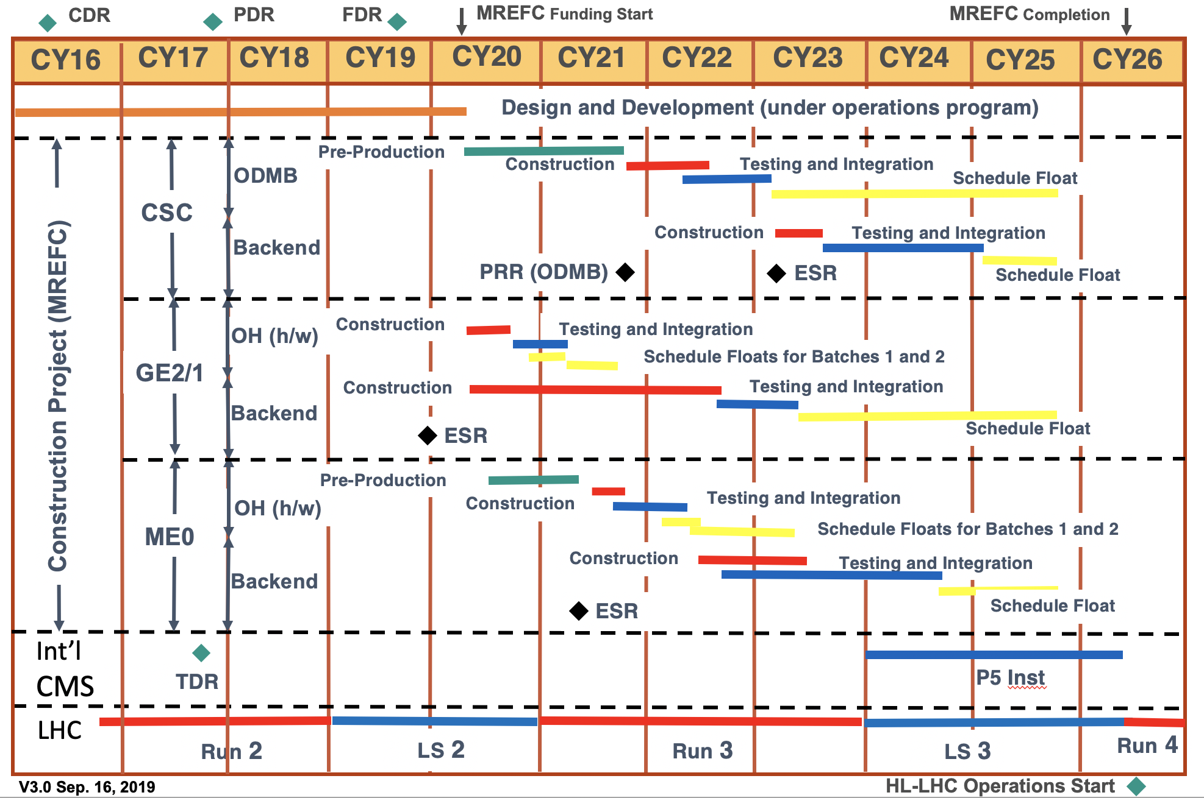
Schedule Summary (at FDR)
Phases of MREFC schedule:
  Preproduction – qualify using final parts and design
  Construction – production of full quantity
  Testing & Integration – QA/QC all levels, ready for CMS installation

Slide 41
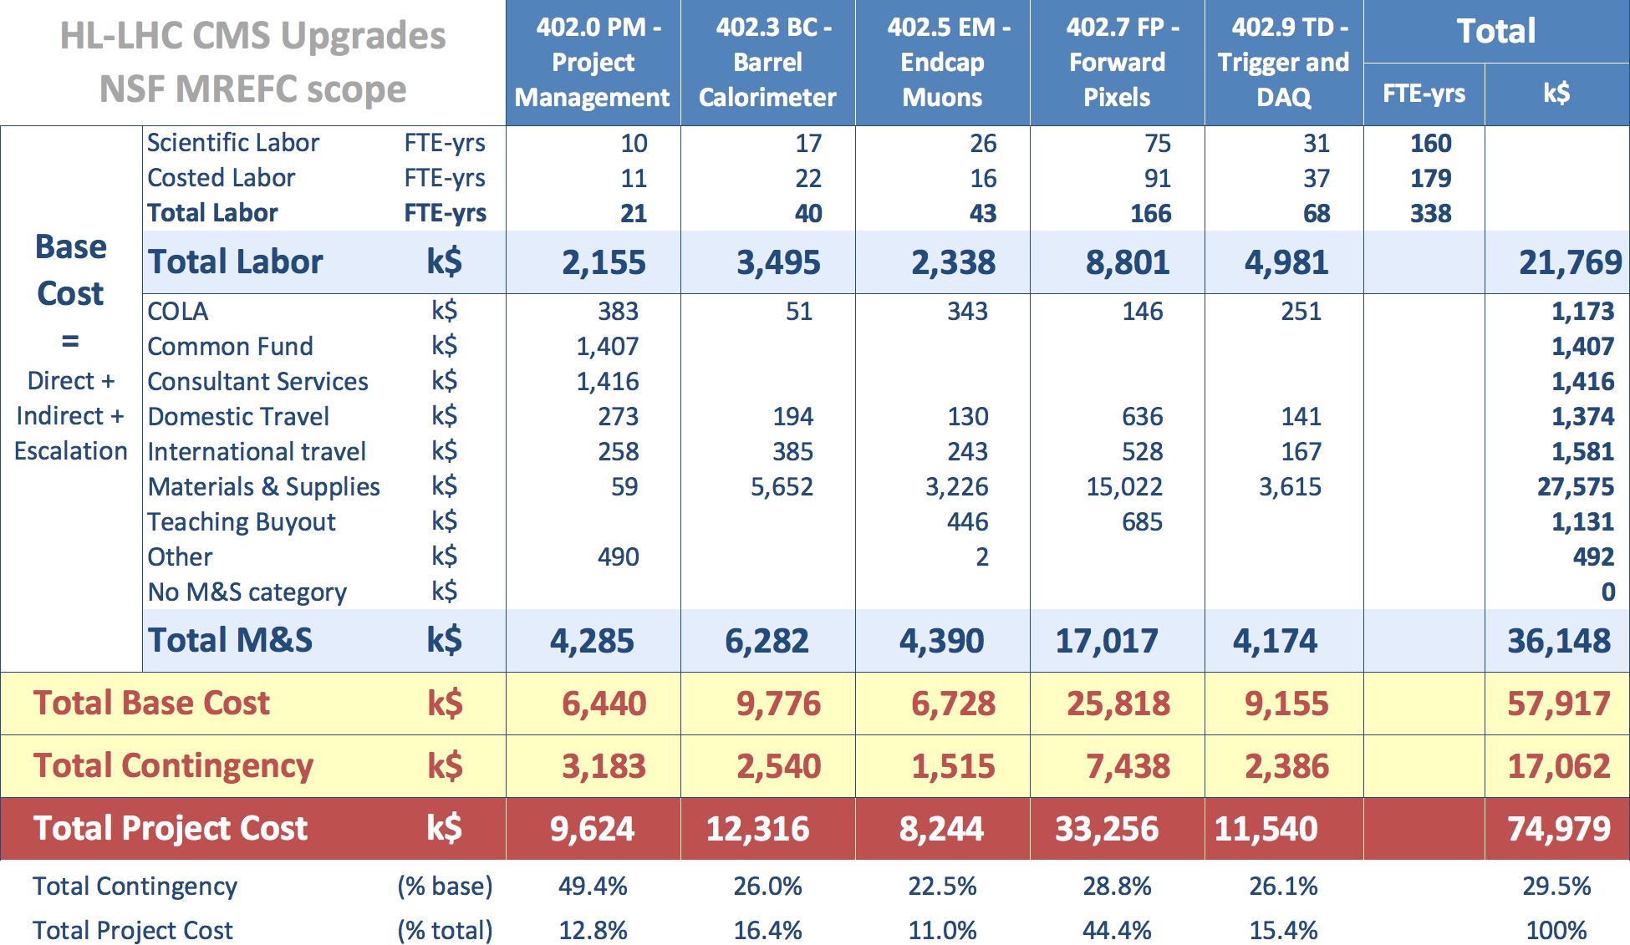
Budget Summary (at FDR)
Show Cost Summary Table from Lucas’ common slides.
Summarize/explain changes with respect to PDR
More details in cost/schedule/risk breakout

Slide 42
BCR 130: Non-COVID
As COVID BCR only allowed moving activities, some COVID impact is difficult to disentangle
  If not COVID, CERN electronics experts would have likely found a fix for VTRX devices sooner

Slide 43
BCR 127: COVID Impact
Agreed to only move future activities (in the baseline), so SPI did not jump to 1.0
No added M&S costs or labor, only moving future delayed activities to better align with the schedule

Slide 44
BCR 115: FY21 Realignment
Addressed engineers moving between institutions (which added a new institution), updated time sharing of the engineering time in cases where engineers shared with Operations or other projects

Slide 45
BCR 101: Clerical Fixes
Corrected mistakes in P6 coding that sneaked into the MREFC planning documents

