Slide 1
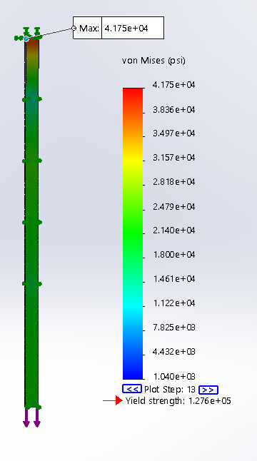
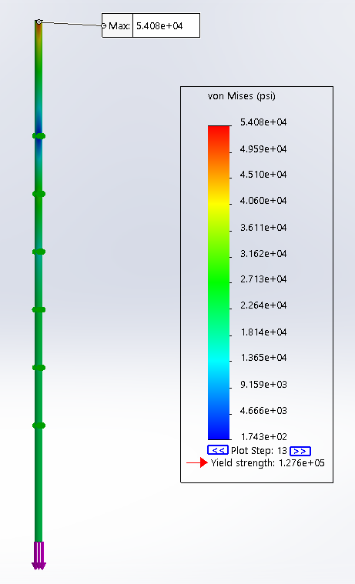
Optimization of Dilution Refrigerator Mechanical Supports
Thomas Douglas, SULI Undergraduate Intern FERMILAB-POSTER-21-033-STUDENT
Introduction
One of the goals of the SQMS center is to construct a dilution refrigerator with a cooling platform of 2m diameter by 1m height. The design of this refrigerator is unique, as it incorporates the existing HAB 4 K Cryoplant. The mechanical supports for this refrigerator must reduce thermal conduction while maintaining adequate strength through optimization of the material, size, and geometry. In this work, I’ve examined materials used in other large dilution refrigerators and assessed various support designs aided by SOLIDWORKS simulations.
Table 1: Simulation results run on supports running from the room temperature to base temperature (20 mK) cold shields, in cylindrical and rectangular rods. Stress values are in 10⁴ psi. No simulations were run on ME771 for the rectangular geometry due to the large longitudinal strain observed in the cylindrical geometry, which ruled out the material as a viable candidate.
The dilution refrigerator will have cold shields at room temp, 80K, 5K, 2K, 1K, 0.1K, and 0.02K, made from aluminum at above and copper below 5K. The thermal contraction of these plates during cooling will introduce transverse loads to the supports. Two materials used in the CUORE cryostat were examined: 316LN Stainless Steel, a carbon reduced, nitrogen enhanced grade of 316 SS; and Ti6Al4V, a superconducting titanium alloy (Barucci et al., 2008). Additionally, two promising reinforced epoxy laminates, G10-CR and ME771 (Woodcraft et al., 2009), were also examined.
By dividing the supports in two, we hoped to reduce the transverse stress applied to the support and allow for different designs at lower temperatures. The 5K plate is the best choice for splitting the support, as much of the stress was focused there. Since the stress on the support above the 5K plate is identical to that seen in previous models, no further investigation was needed. However, a lower cross-sectional area can be used for the supports below the 5K plate, since the thermal contractions are much smaller. Simulations were run on the supports between 5K to 20mK plates for the stress present during cooldown, as the stress from the large temperature gradient will limit the stress.
Results
Figure 1: Example full support simulation results. Left: Model showing locations of transverse and axial loads. Right: Results plot of stress for a cylindrical geometry of Ti6Al4V radius 0.4 inches.
The simulations assumed a maximum axial load of 5,000 kg, based on potential uses beyond SQMS. The green arrows show the location of cold shield displacements, from room temperature at the top, to 20mK at the last shield. The max stress occurred at the fixed point (room temperature plate) for most simulations and was used as a metric for the overall stress. We consider a viable factor of safety (FoS) to be above 2 in our assessment. Table 1 shows the full simulation results.
Figure 2: Example split support simulation results. Left: Model showing transverse and axial loads. Right: Results plot of stress for a rectangular geometry of Ti6Al4V, dimensions 0.4in x 1.25 in.
Table 2: Simulation results run on supports running from the 5K to base temperature (20 mK) cold shields. Stress values are in 10⁴ psi.
Conclusion and Future Work
From these simulations, it is apparent that the split support design reduces stress on the supports, and we can see that the Titanium alloy and G10-CR show less stress than the 316LN stainless steel. This project will conclude with calculations based upon the results of these simulations, investigating the heat flow through each support at the smallest viable geometry for each material. The results of these calculations will inform the choice of material for the supports in the final dilution refrigerator.
This manuscript has been authored by Fermi Research Alliance, LLC under Contract No. DE-AC02-07CH11359 with the U.S. Department of Energy, Office of Science, Office of High Energy Physics.

