Slide 1
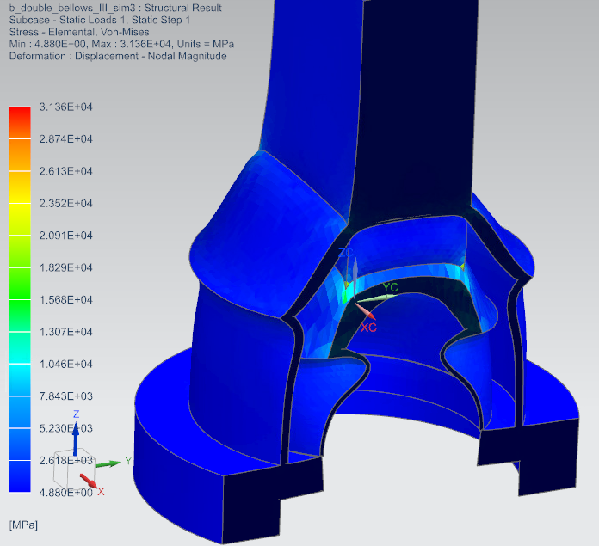
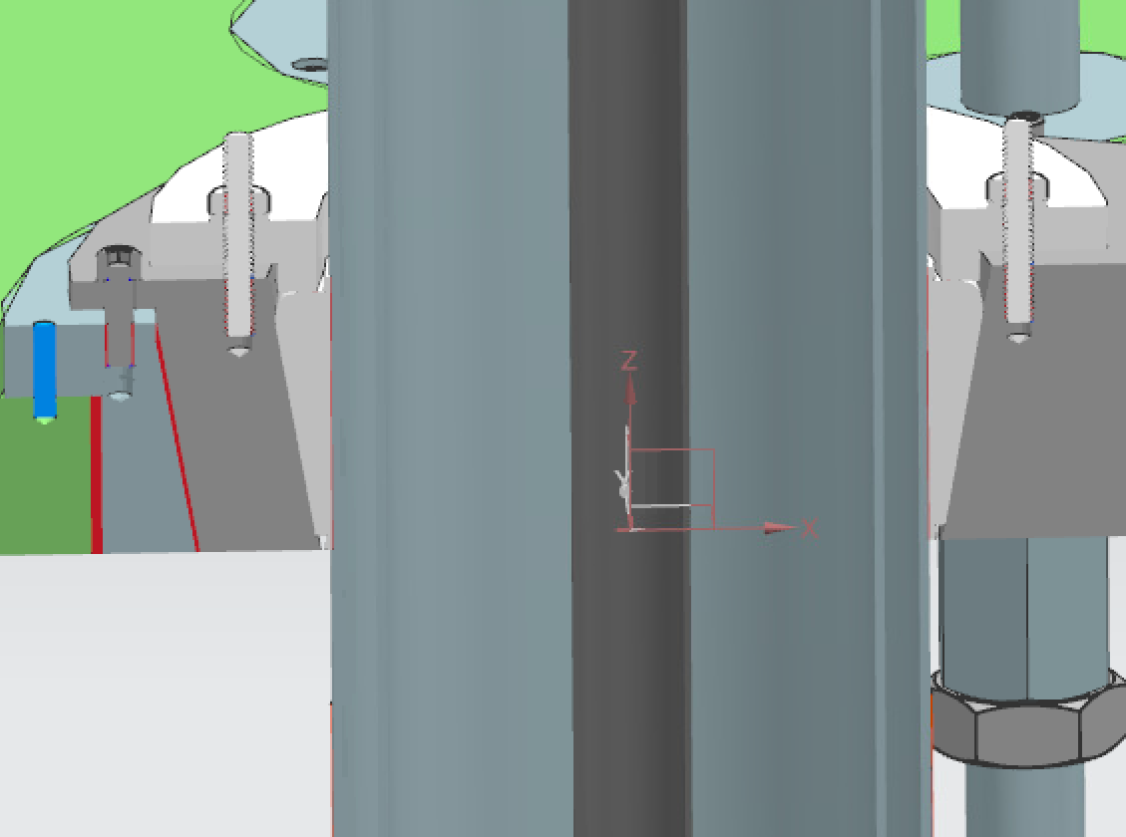
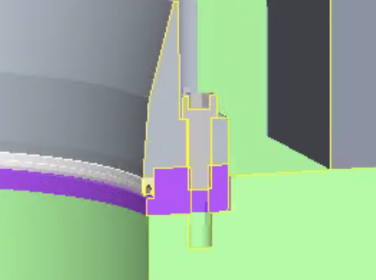
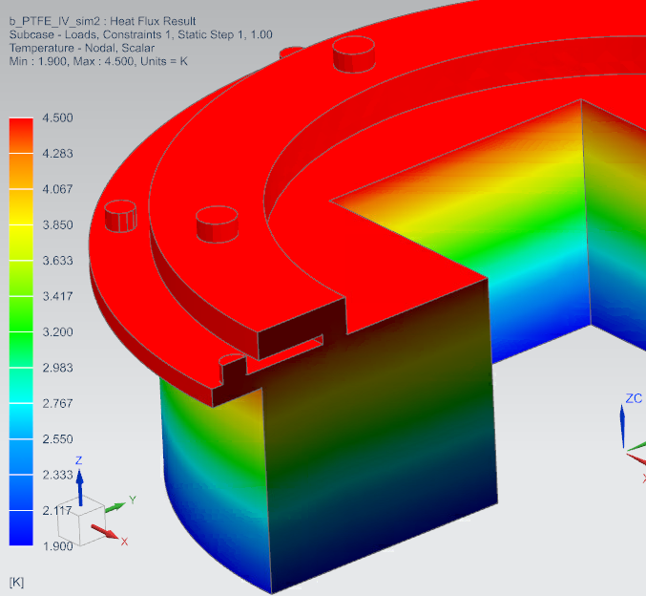
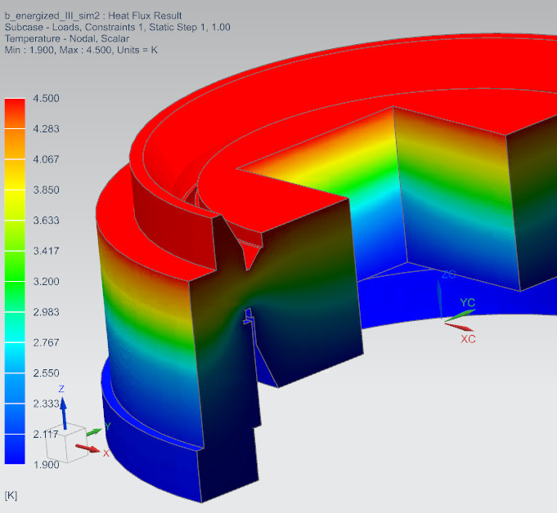
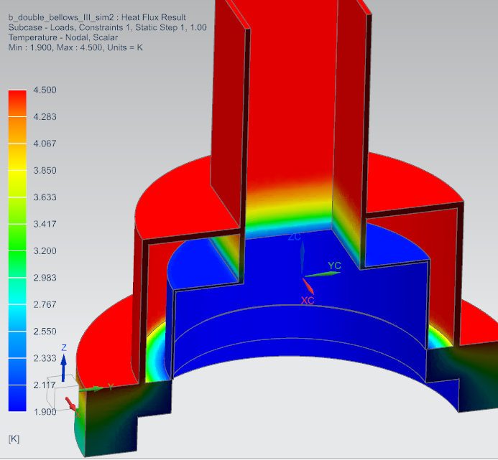
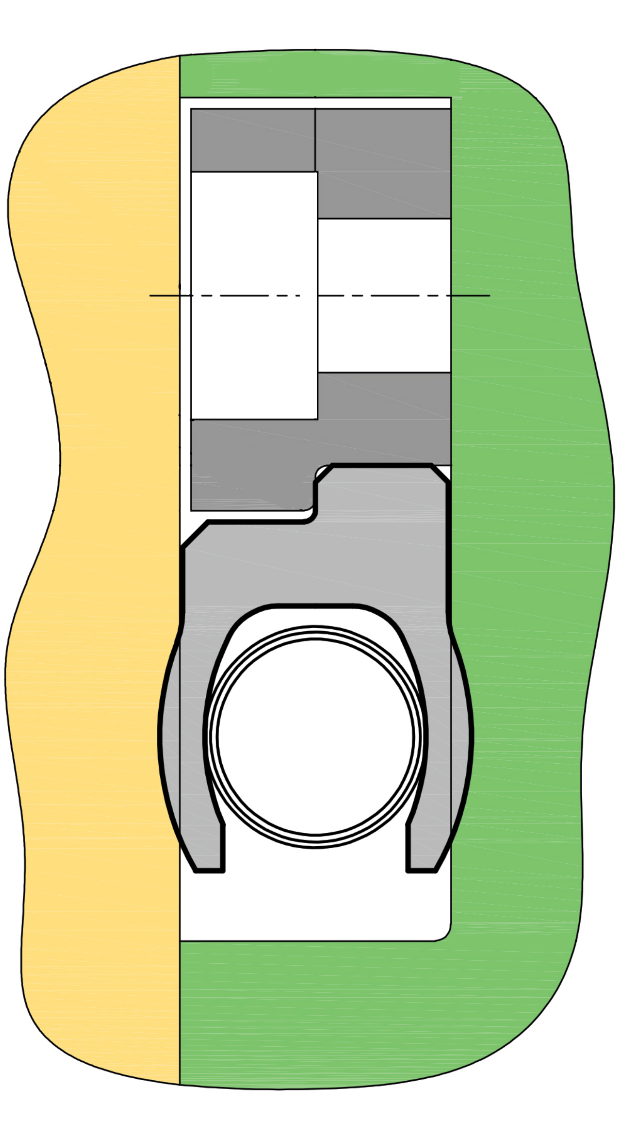
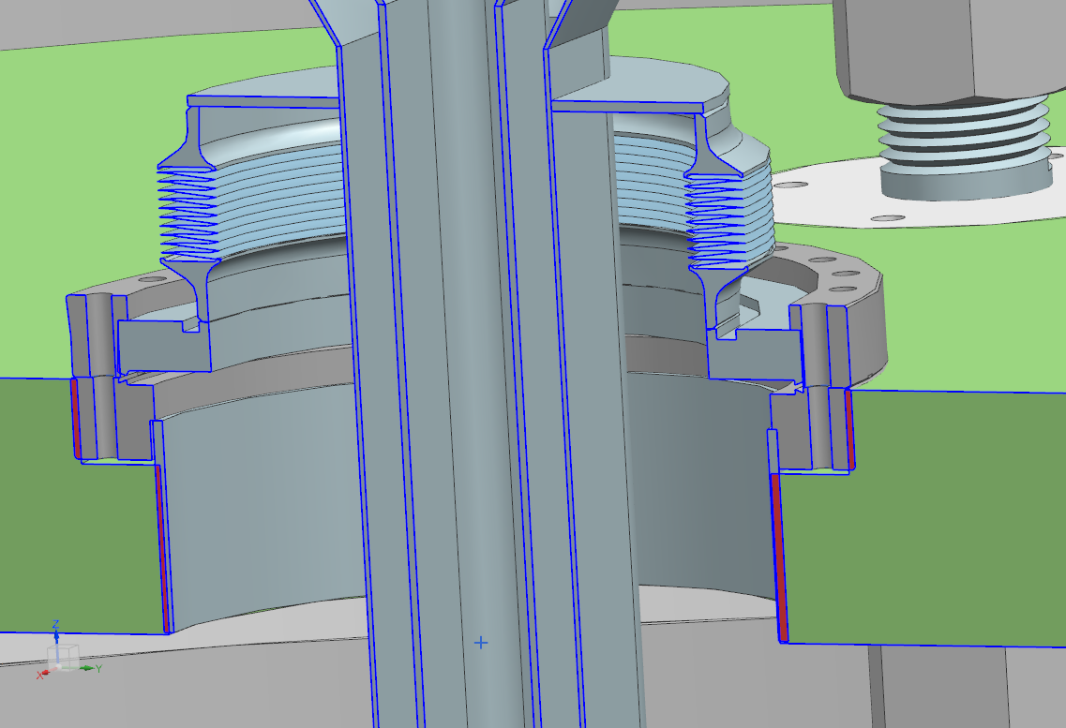
Lambda Plate Seal for HFVMTF Anticryostat
Brett Gasior, University of Kentucky – SULI Program | Sergey Koshelev – Fermilab | POSTER-21-098-STUDENT
Introduction
Analysis
Fermilab is currently designing a High Field Vertical Magnet Test Facility in order to test superconducting cables and magnets. The goal of this project was to analyze the thermal performance of three different seal designs and provide recommendations for the HFVMTF.
Preliminary analysis on simplified geometry provided us with a baseline for the heat flow rate and showed that the CF Flange design needed improvement. This design was updated by using vacuum insulation instead of a single wall bellows to reduce heat flow. The seals were modeled in more detail and finite element analysis was performed to estimate the heat flow rate. Structural analysis of the updated CF Flange Seal was performed for design verification.
Seal Designs
Lambda Plate
The first seal design consists of a PTFE plug wedged in between a SS collar and an anticryostat wall. The plug is held in place by a bolted flange. The SS collar is bolted to the lambda plate in a similar fashion for additional support.
Total stress experienced by CF Flange Seal.
Total stress experienced by CF Flange Seal with upper bellows.
Anticryostat
Seal Type | Initial Heat Flow Rate (by hand) (Watts) | FEA Heat Flow Rate (Watts)
PTFE Plug | 0.369 | 0.195
Spring Energized Seal | 0.654 | 0.331
CF Flange Seal | 976 [Initial Design] | 0.663
PTFE Plug
Stainless Steel Collar
Table regarding Seal models and their respective heat flows rates during initial calculations and FEA.
PTFE Plug Model
The second design uses a custom spring energized PTFE seal compressed by the anticryostat on the line of contact. Design includes a PTFE Collar (not shown) between the spring and anticryostat.
Line of contact
Spring Energized Seal Design
Spring Energized
Lambda Plate
Temperature distribution in the PTFE Plug
Temperature distribution in the Spring Energized Seal
Temperature distribution in the
CF Flange Seal
Spring Energized Seal Model
Results and Conclusion
Anticryostat
Bellows
The PTFE Plug showed the best thermal performance. It has a quality track record of use at Fermilab. The Spring Energized Seal has a slightly higher heat flow rate and has been used at BNL successfully. The CF Flange has the worst thermal performance of three and requires a bellows on the anticryostat due to the excessive stresses it undergoes caused by thermal contraction. The effect of superfluid helium leaks on the heat flow wasn’t included in the analysis. This introduced bias against the CF flange seal, having potentially higher leak tightness. Investigation of heat flow rate due to superfluid helium is recommended. Final recommendation for the HFVMTF at this moment is the PTFE Plug.
Top Flange
The third design utilizes a standard conflat (CF) Flange with the top flange welded to the anticryostat via a bellows and the bottom embedded in the lambda plate. The bellows will allow the seal to retain structural integrity over contraction and expansion due to temperature change.
Lambda Plate
Bottom Flange
CF Flange Seal Model
This manuscript has been authored by Fermi Research Alliance, LLC under Contract No. DE-AC02-07CH11359 with the U.S. Department of Energy, Office of Science, Office of High Energy Physics.
Notes:
This manuscript has been authored by Fermi Research Alliance, LLC under Contract No. DE-AC02-07CH11359 with the U.S. Department of Energy, Office of Science, Office of High Energy Physics.

