Slide 1
Clocking
Intention: both a fixed and variable oscillator in order to provide:
Options for development/design requirement changes
A non electomechanical option (SI500)
Arguable redundancy contribution
Notes:
Name
Project

Slide 2
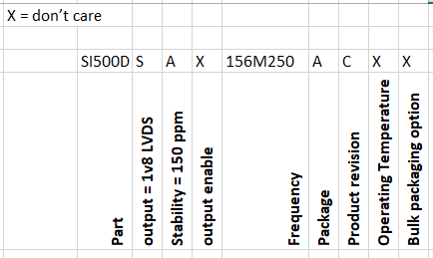
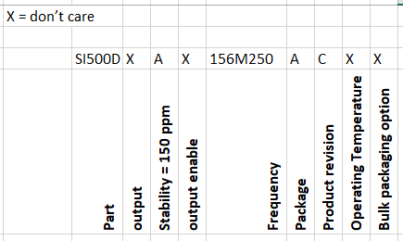
Fixed Clock SI500D (Frequency = 156.25MHz)
Ideal part – should exist but nobody normally stocks. Could possibly approach manufacturer.
If we relax voltage requirements – We get normally stocked parts (but out of stock: 20wk or 35 wk stated)
If we relax frequency requirement then we get some normally stocked options
If we relax ‘All Silicon’ Requirement then more options and some immediate stock
A lot of these options are footprint compatible (common 5x7mm package)
The same story is true for 320MHz (other option for 10Gbe)
Notes:
Name
Project

Slide 3
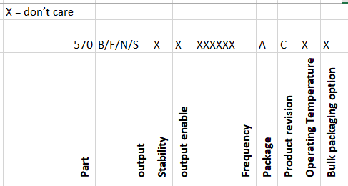
Variable Clock SI570
Not available in LVDS at 1v8
If we relax the voltage requirement, then we get some immediate availability for SI570 at Vdd = 2.5 and 3.3 v
If we open part types option, then we get some options at Vdd = 1v8:
SI514, SI544, SI549 – all of which are reasonably functionally and footprint compatible with si570
Notes:
Name
Project

Slide 4
Options
Generate power rail for 2v5 or 3v3 parts
Use crystal alternative to SI500 and alternative to Si570
Forget about 156.25 MHz
Create provision to decide this later
Notes:
Name
Project

