Slide 1
LBNF/DUNE Project Scope & Timeline
Elaine McCluskey, LBNF/DUNE-US Project Manager
NS Storage and Assembly Planning Workshop
4 August 2021

Slide 2
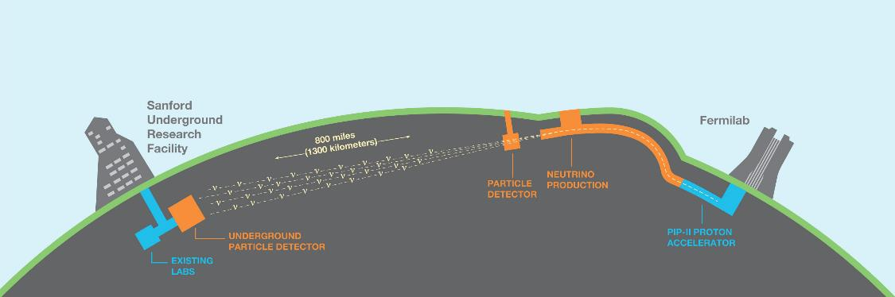

Implementing the vision for the Deep Underground Neutrino Experiment
Science collaboration (DUNE) has 1,347 collaborators from 204 institutions in 33 countries (plus CERN)
  Origin of matter. Investigate leptonic CP violation. Are neutrinos the reason the universe is made of matter?
  Neutron star and black hole formation. Ability to observe neutrinos from supernovae events and perhaps watch formation of black holes in real time.
  Unification of forces. Investigate nucleon decay.
This project enables the United States to host the global high energy physics community to advance world class discovery science into the fundamental nature of matter
Notes:
50/50 US and non-US
Almost 150 more than last year
Executing P5 plan and building for discovery
Nobel prize winning discovery potential

Slide 3
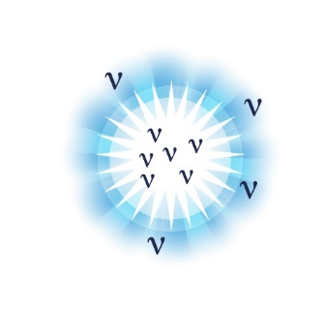

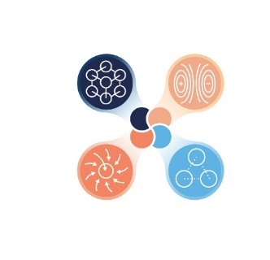
DUNE – a global collaboration probing mysteries of the universe
1234 collaborators from
201 institutions in 32 countries (plus CERN)
Origin of matter
Discover what happened after the big bang: Are neutrinos the reason the universe is made of matter?
Black hole formation
Use neutrinos to look into the cosmos and watch the formation of neutron stars and black holes in real time
Unification of forces
Move closer to realizing Einstein’s dream of a unified theory of matter and energy

Slide 4
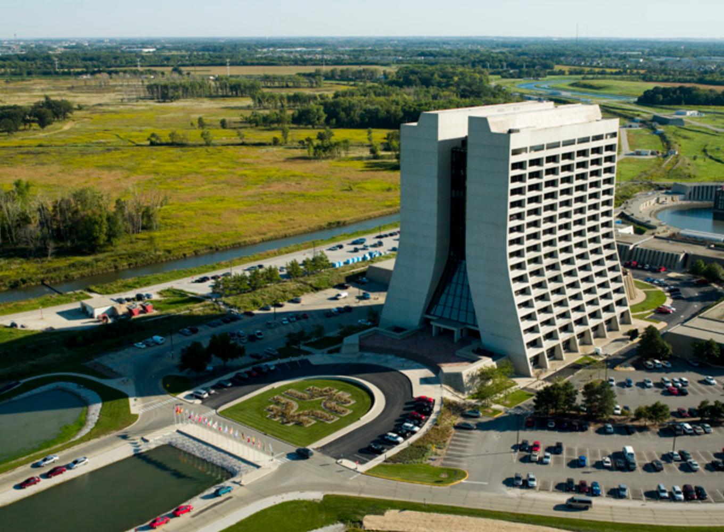
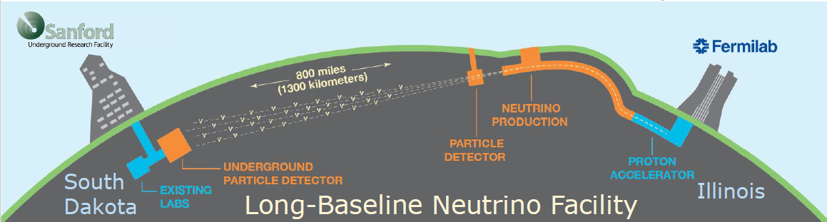
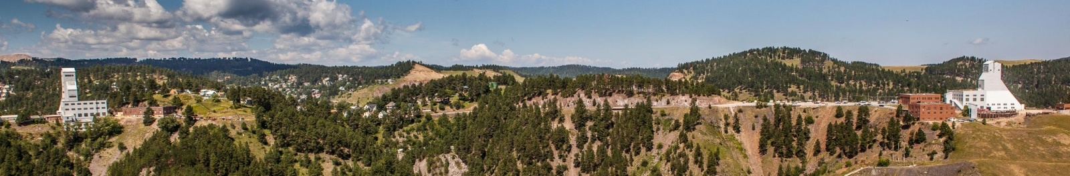
Project Locations
Today’s workshop focuses mainly on this site
But also highlights needs for FS items temporarily at Fermilab
  Near Site – Fermilab, Batavia, Illinois – U.S. Department of Energy national laboratory
  Far Site – Sanford Underground Research Facility (SURF), Lead, South Dakota
    SURF is managed by the South Dakota Science and Technology Authority (SDSTA) with operations supported by DOE
    Project’s access to SURF is secured through lease and temporary construction easements between DOE and SDSTA
Ross shaft headframe
Yates shaft headframe

Slide 5
Project scope across both sites

Slide 6
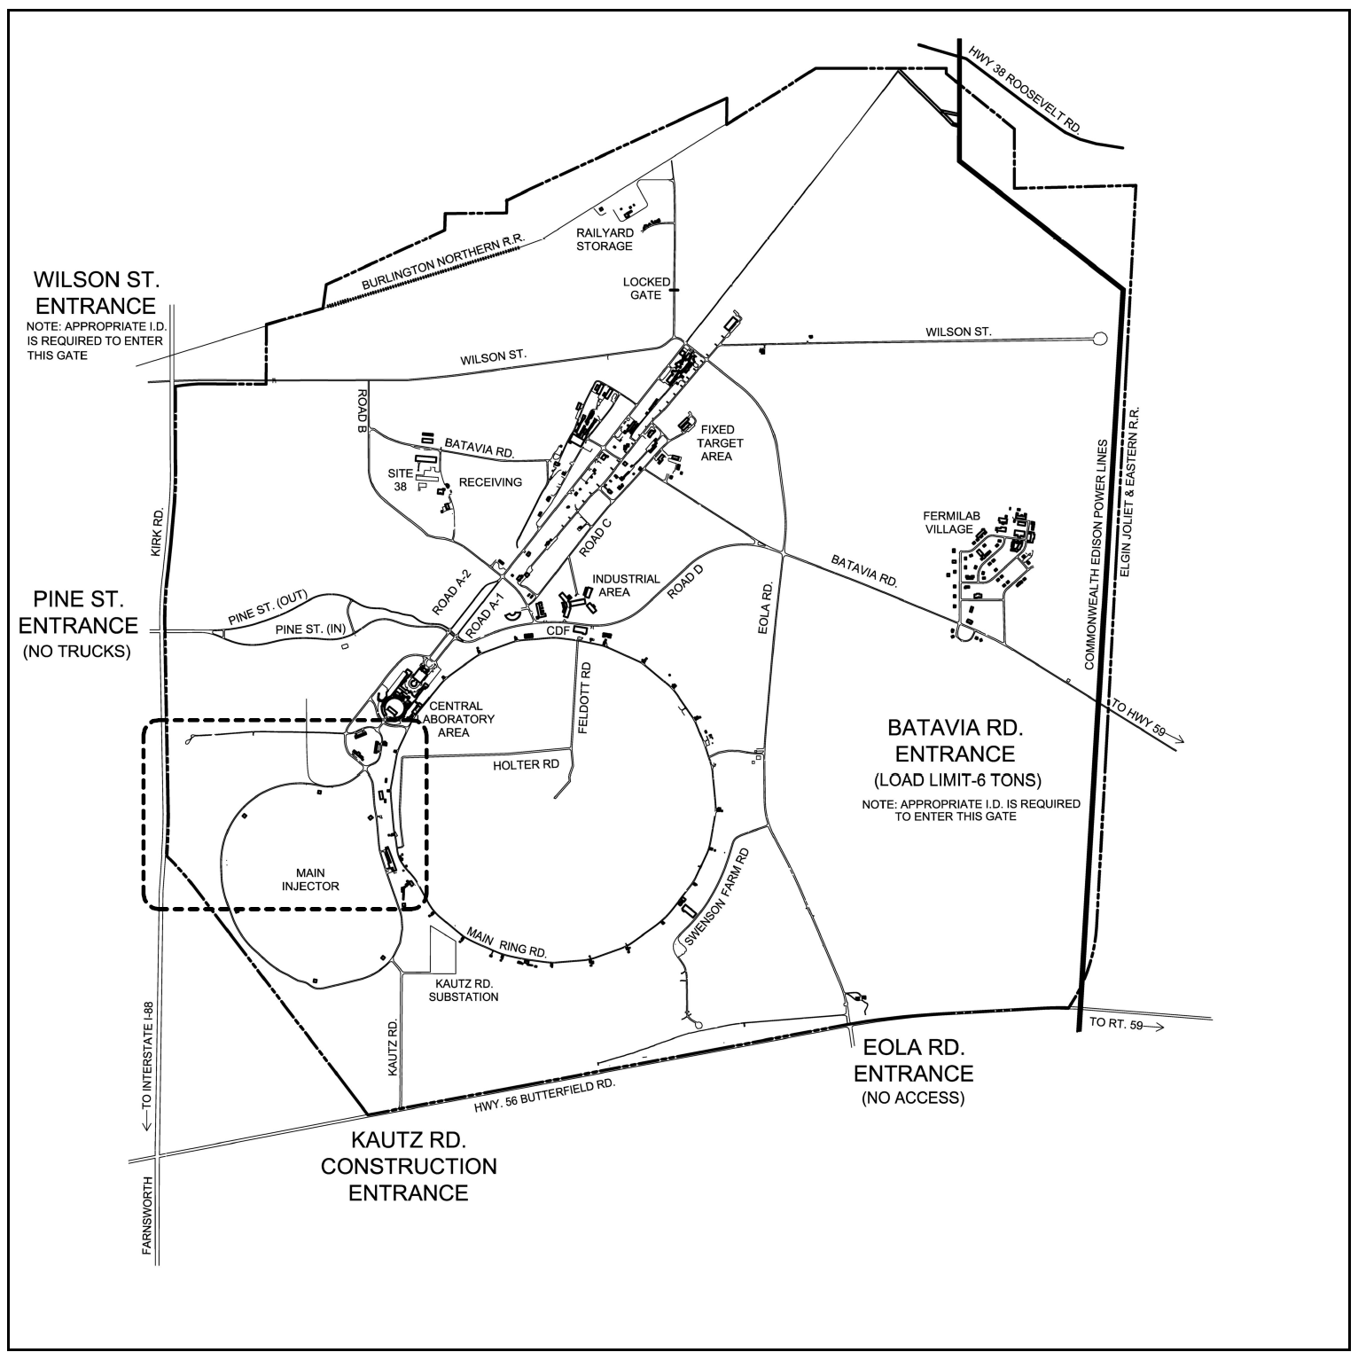
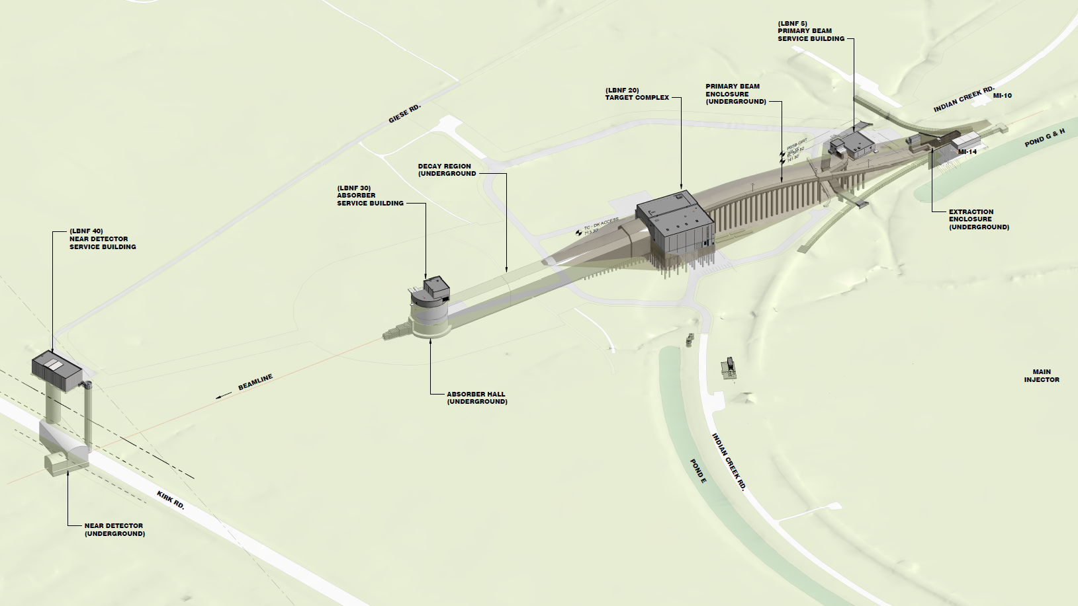
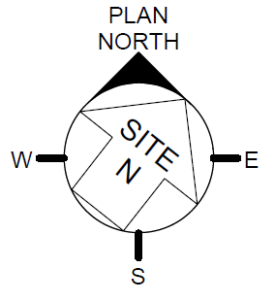
Near Site Conventional Facilities
House and Support the Beamline and Near Detector
New service buildings, underground enclosures, utilities, roads, hardstands, and other CF features needed for operation
PRIMARY BEAM ENCLOSURE (UNDERGROUND)
(LBNF 5)
PRIMARY BEAM SERVICE BUILDING
(LBNF 20)
TARGET COMPLEX
DECAY REGION (UNDERGROUND)
(LBNF 30) ABSORBER SERVICE BUILDING
EXTRACTION ENCLOSURE (UNDERGROUND)
(LBNF 40)
NEAR DETECTOR SERVICE BUILDING
← Beamline
ABSORBER HALL (UNDERGROUND)
MAIN INJECTOR
NEAR DETECTOR (UNDERGROUND)
N

Slide 7
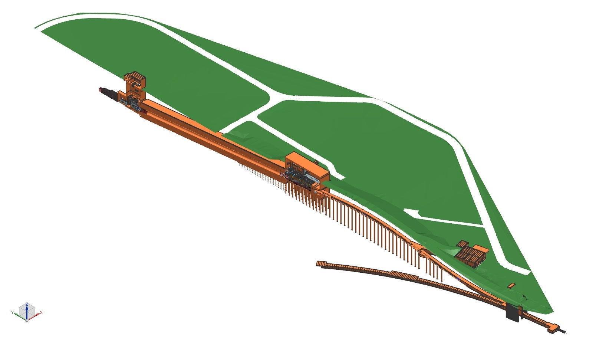
Beamline Technical Components
Nu Beam
to SURF, SD
Absorber Complex
Primary Beam Complex
Decay Pipe
Target
Complex
Primary
Beamline
Fermilab Main Injector Tunnel
Fermilab
Main Injector
Tunnel
Proton Beam Extraction
Proton Beam
from MI-10

Slide 8
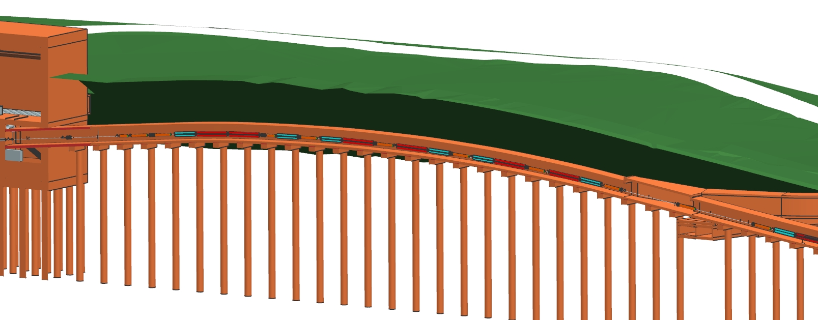
Primary Beam Complex
Beam optics, magnets, magnet power supplies, water systems, vacuum, beam instrumentation, installation
  Already have corrector magnets in hand as in-kind contribution

Slide 9
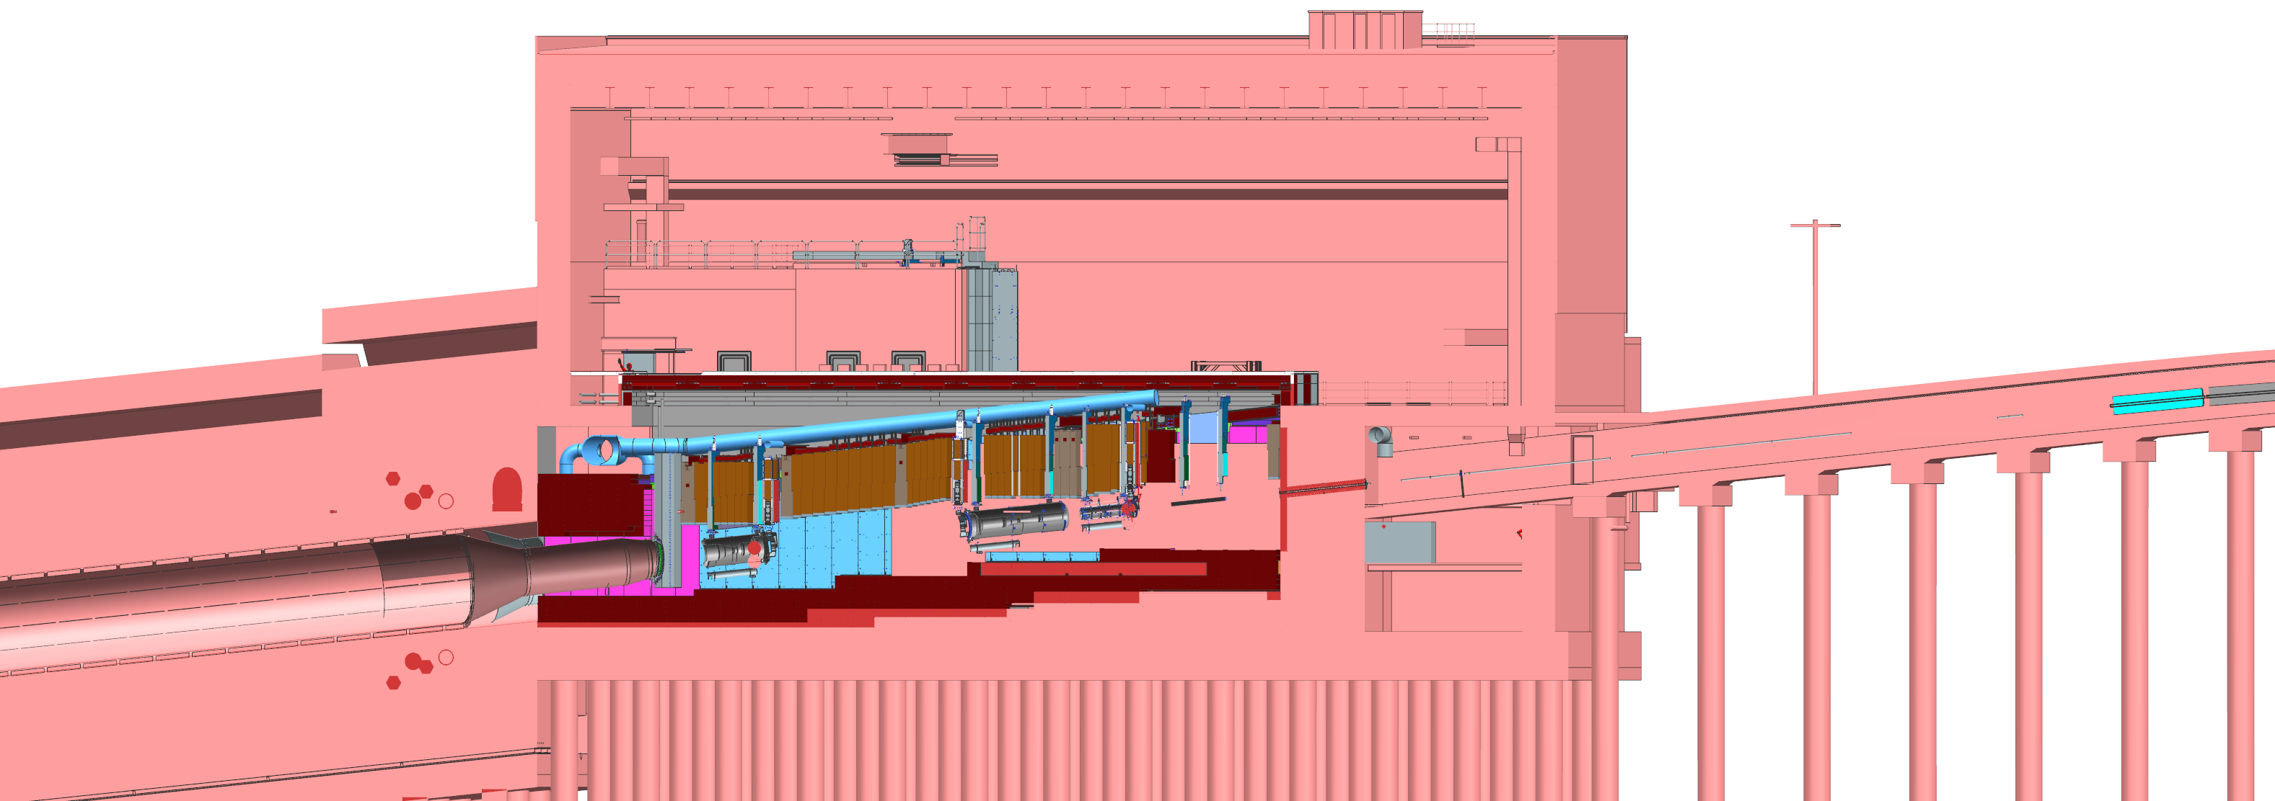
Target Complex
Hatch Covers
Work-Cell
Target
Hall
←Beam
Decay
Pipe
Primary Beamline
He Gas
Primary Beam Window
Decay Pipe Window
Horn C
Cooling Panels
Horn A with Target
Baffle
Steel Shielding
Horn B
Baffle, target, focusing horns, support modules, horn power supply, target shield pile, radioactive water systems, remote handling, storage of radioactive components
Preparing to prototype Horn A now

Slide 10
Decay Pipe and Absorber
Decay Pipe
Muon
Monitoring
Shielding
Beam Direction
Hadron
Absorber
Hadron
Detector
Primary beam window, decay pipe cooling and windows, hadron absorber, hadron monitor, muon systems

Slide 11
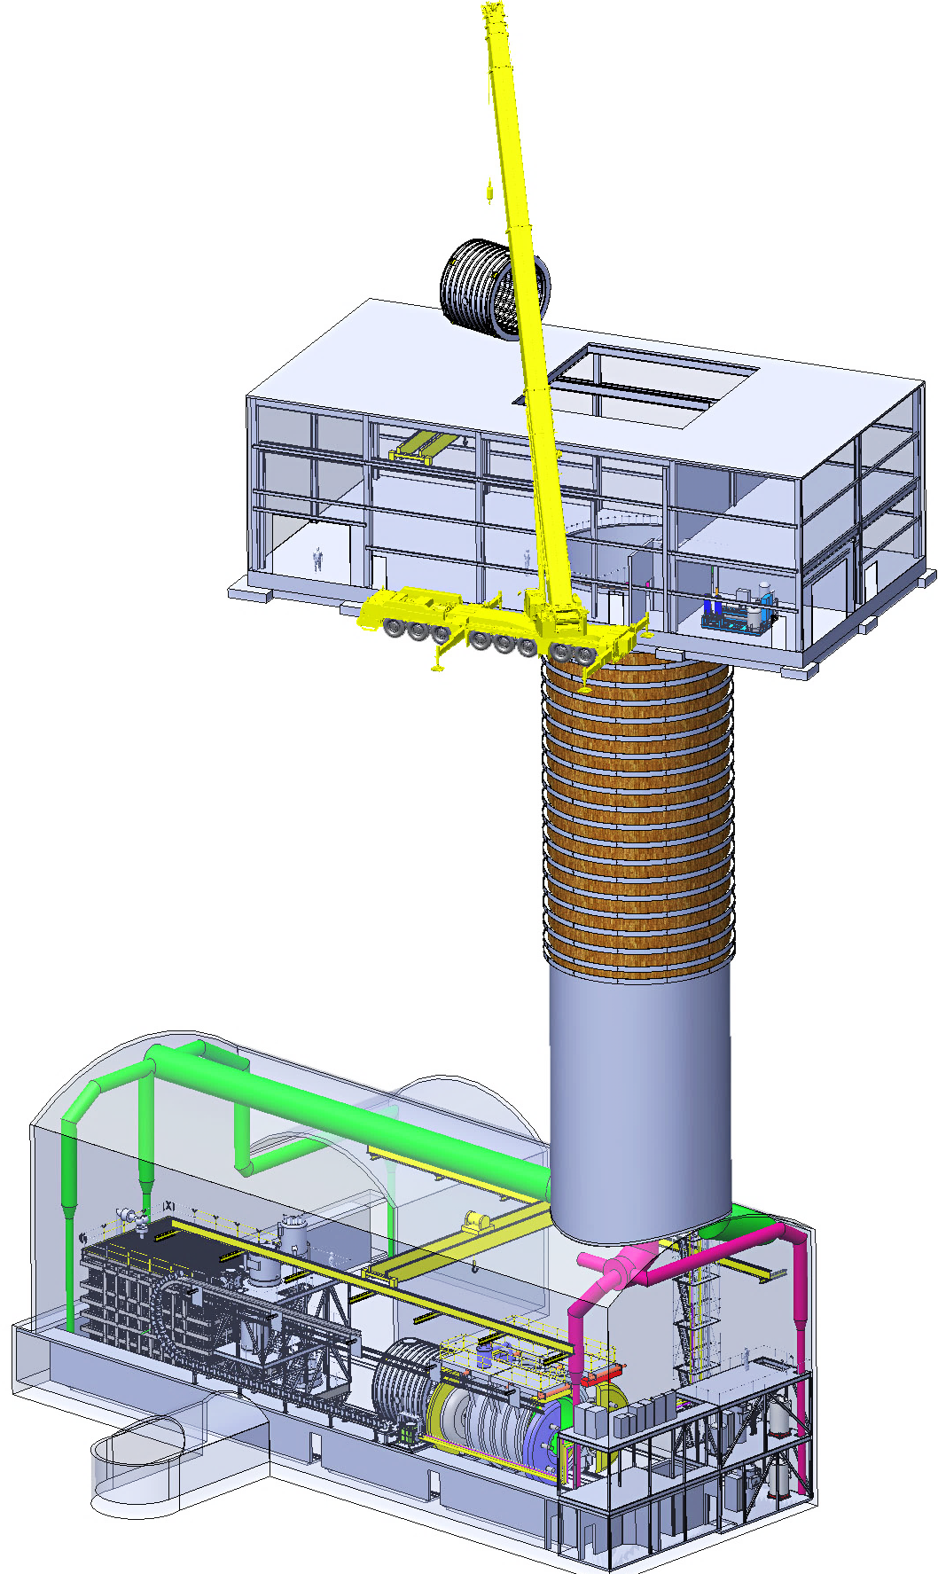
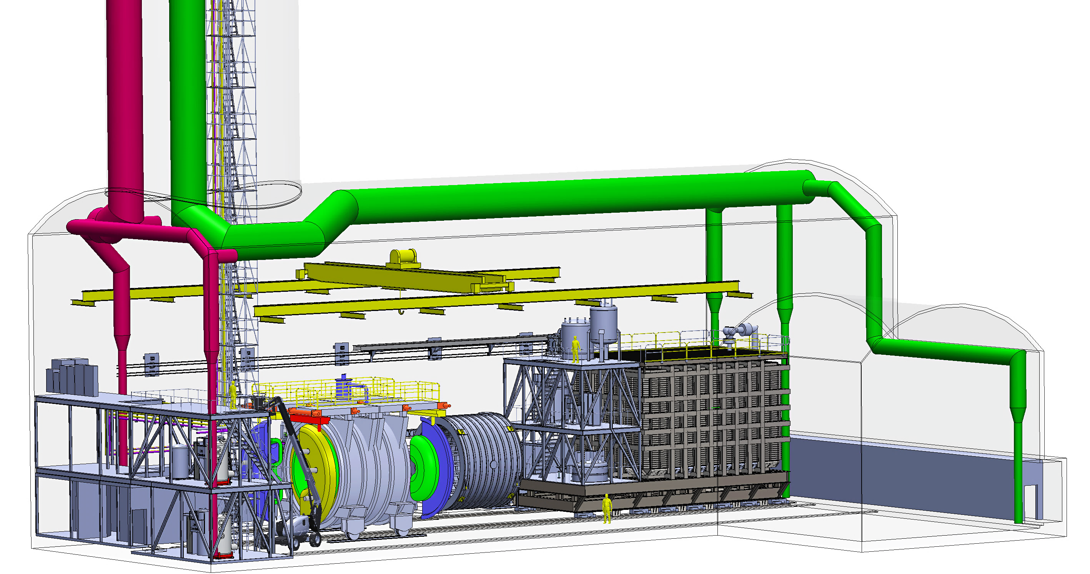
Near Detector and Cryogenics in new ND Complex Facility
Cryo surface facilities not shown.
LAr Cryogenics
LHe Cryogenics
LAr Detector
SAND Alcove
SAND being inserted in iron yoke
Courtesy of M. Leitner
Notes:
NS Cryo supports:
LAr Detector → 300 ton LAr.
SAND → Superconductive magnet.

Slide 12
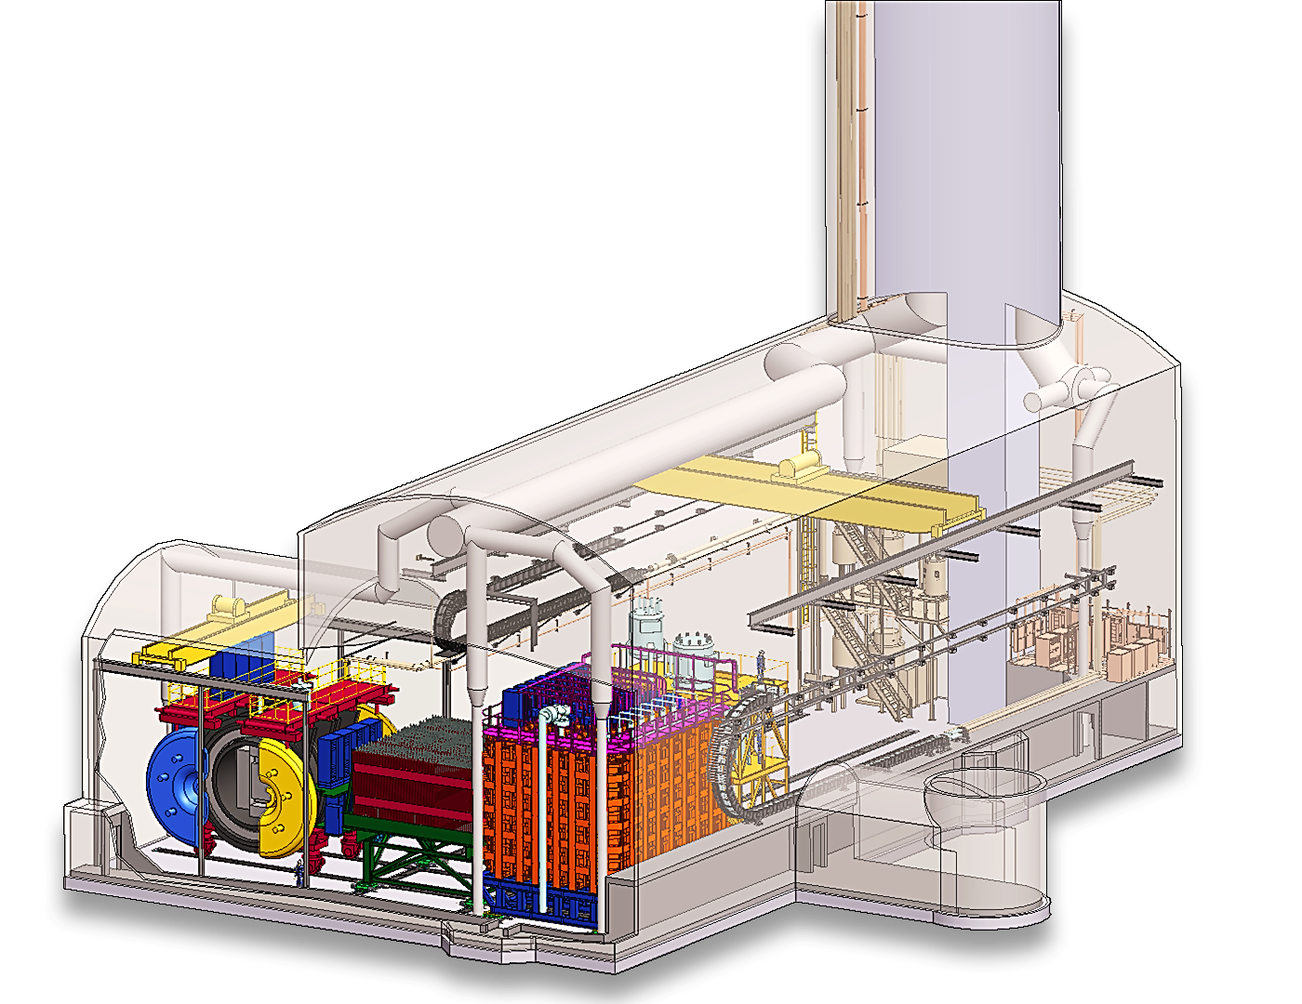
Near Detector
TMS
SAND Beam Monitor
ND-LAr Detector

Slide 13
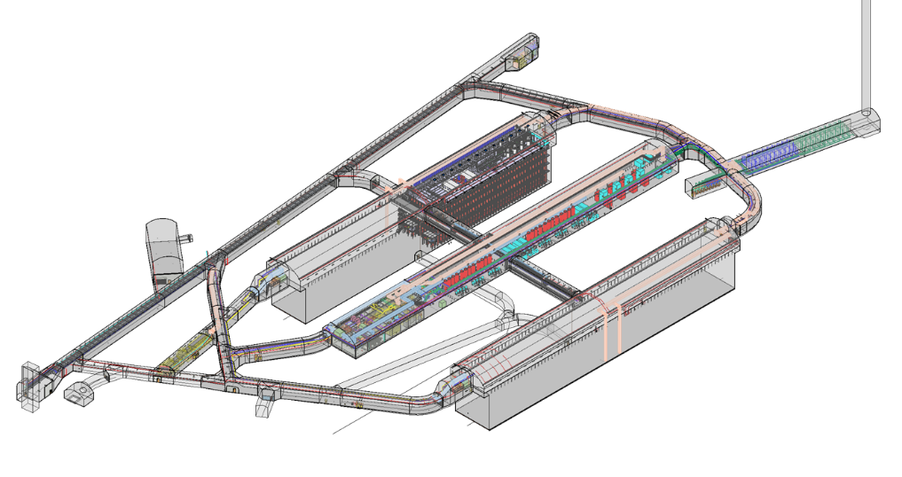
Far Site Conventional Facilities
Raise Bore
Vent shaft
Rock removal system, new caverns and drifts underground with conventional utilities to support cryogenic systems and Far Detectors
Cryostat with SP APA detector
Nitrogen and Argon Cryogenics systems
North Detector Cavern
CUC Cavern
Ross Shaft
South Detector Cavern

Slide 14
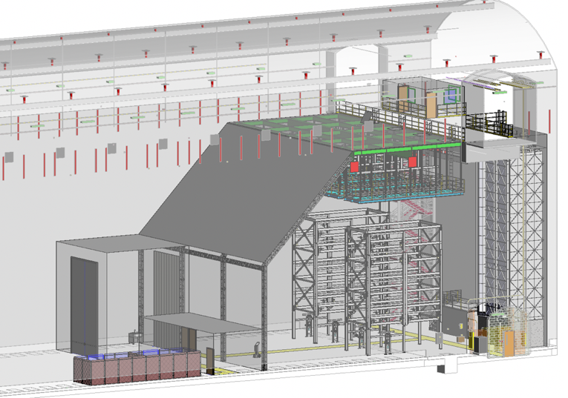
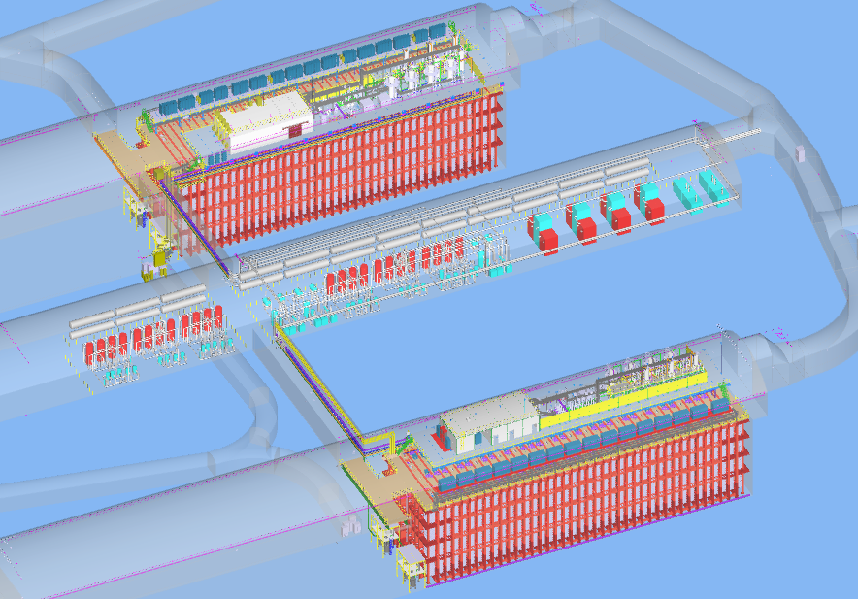
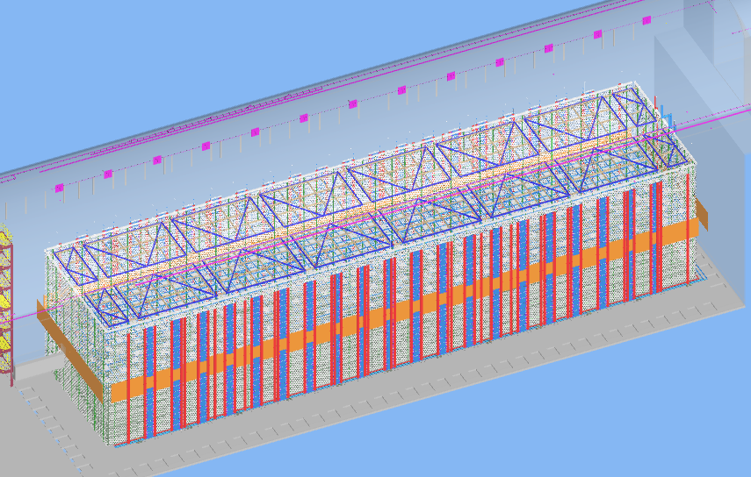
Detectors & Cryo Infrastructure at SURF
Two large cryostats containing detector components in liquid argon
Cryogenic systems to cool, purify, and recirculate the argon
Temporary cleanroom & assembly space planned underground at SURF
FD1
Cryogenics equipment
FD2
FD2 equipment that is inside cryostat

Slide 15
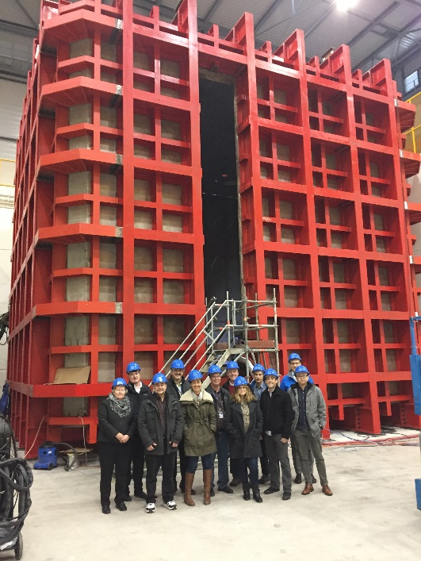
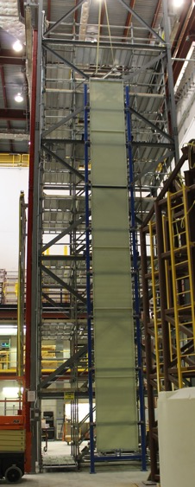
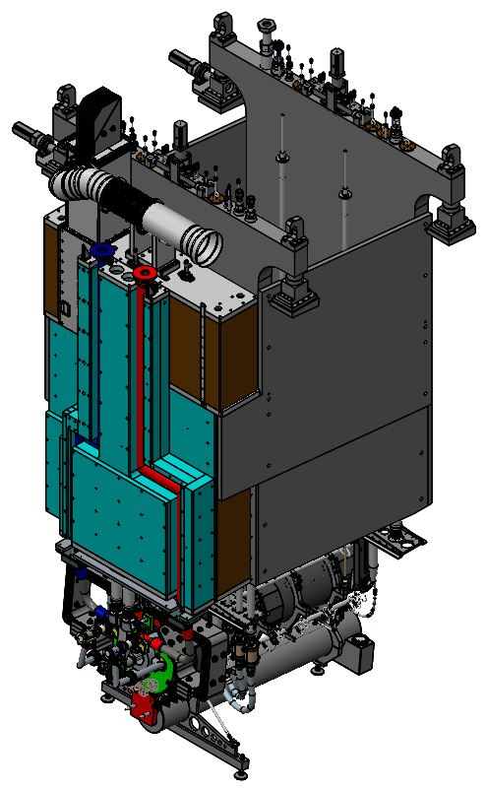
LBNF/DUNE Project Timeline
Project has been in planning since 2010, expected to start science ~ in late 2020s. Significant design underway or completed.
Global collaborators are partners who provide in-kind contributions.
Cutting-edge technology development underway to plan and prototype components that will make the neutrinos and detectors that will examine the neutrinos.
STORAGE AND ASSEMBLY SPACE AT FERMILAB
Note: Schedule subject to funding availability

Slide 16
Introduction Summary and what we hope for today
The project has a broad scope at 2 sites
  Planning for logistics, storage and assembly at SURF well underway
  Starting now to think about storage and assembly needs at Fermilab
Some items that will be ultimately installed at SURF will need to be stored and/or tested at Fermilab.
Variety of items to be stored, assembled, and moved at Fermilab just now being quantified – project team will provide high-level information today.
This workshop helps both project team and Fermilab space providers understand
  For the project: what might be available
  For the space providers: initial look at what might be required
PIP-II has already started this process and is at a much more detailed level of planning; coordinating with that team as possible will be important.
Thanks to all who are participating!

