Slide 1
Beamline Storage and Assembly Needs
Jonathan Lewis
Rich Andrews
4 August 2021

Slide 2
Primary Beam
Magnets
Correctors on site – stored in Village Lab 8
Main dipoles and quads
Require 30 ton crane
Agreement with PPD to store at Wideband (PB7)
Included in MOA
Lab supposed to upgrade crane controls
Magnet Installation
Magnet Stands
~1100 sq ft indoor storage needed
Magnet mover
25’x8’ space needed when not in use
Probably use D0 MVA

Slide 3
Primary Beam
Power Supplies
500 sq ft indoor staging space
Store cables in AD shipping containers
LCW and Bus
1200 sq ft close packed
Clearly larger
Pipe bundles, components on pallets, stack of copper bus
Probably store components and bus in shipping containers
SS pipe bundles might be on hardstand
All field assembled
Vacuum
Guess 200 sq ft indoor storage for pipe and pumps
Field assembled

Slide 4
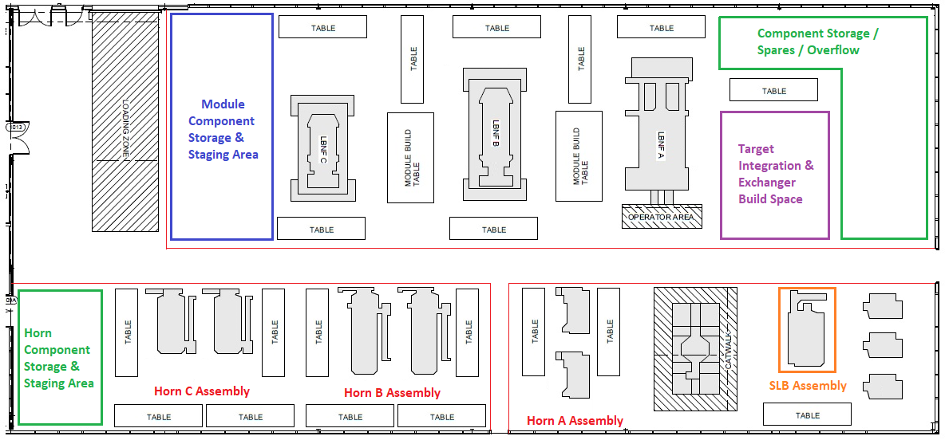
Neutrino Beamline: Horns and Target
MI8 and TSIB
Detailed planning underway
Excludes target cooling
Guess that cooling will need few 100 sq ft for major components and shipping container for small parts

Slide 5
Neutrino Beamline: Target Shield Pile
Bulk Shielding
Assembly at MAB
Storage required for raw material and finished blocks
Try to minimize handling and travel times
Storage can be outside
Covered with tarps
Suggest storing along a road to minimize space
1.4 acres in a yard or 1700 ft along a road
T-blocks and Hatch Covers need to be out of weather
Expect to use Shieldblock Storage Building (SBSB)
Need ~20k sq ft with 30T forklift
T-block fab either in industry or at MAB
Carriage beams
OK for outdoor storage
Cooling panels
1000 sq ft out of weather (SBSB?)

Slide 6
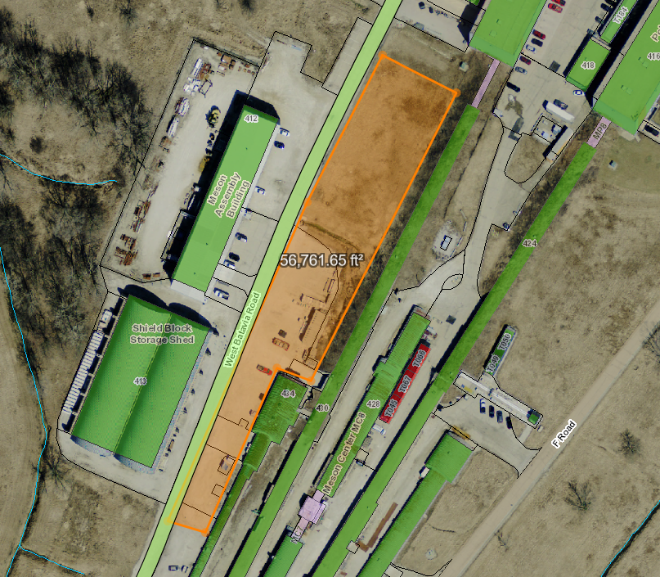
Target Shield Pile: Fabrication and storage possibilities
MAB
Extend hard stand?
30000 sq ft
SBSB
Existing hard stand:
25000 sq ft
Additional roadsides

Slide 7
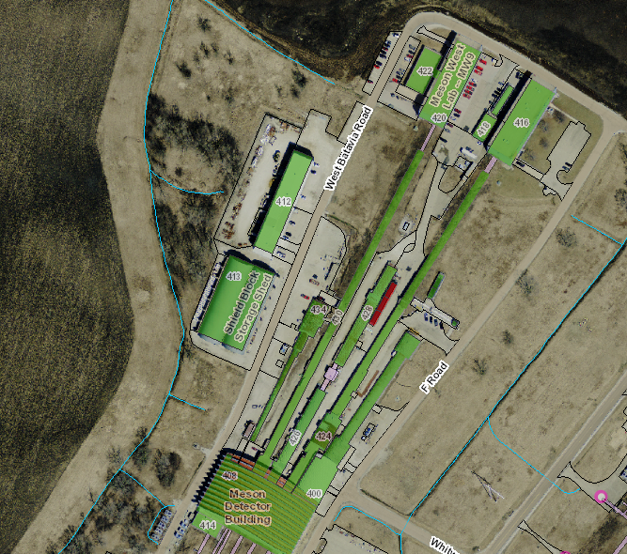
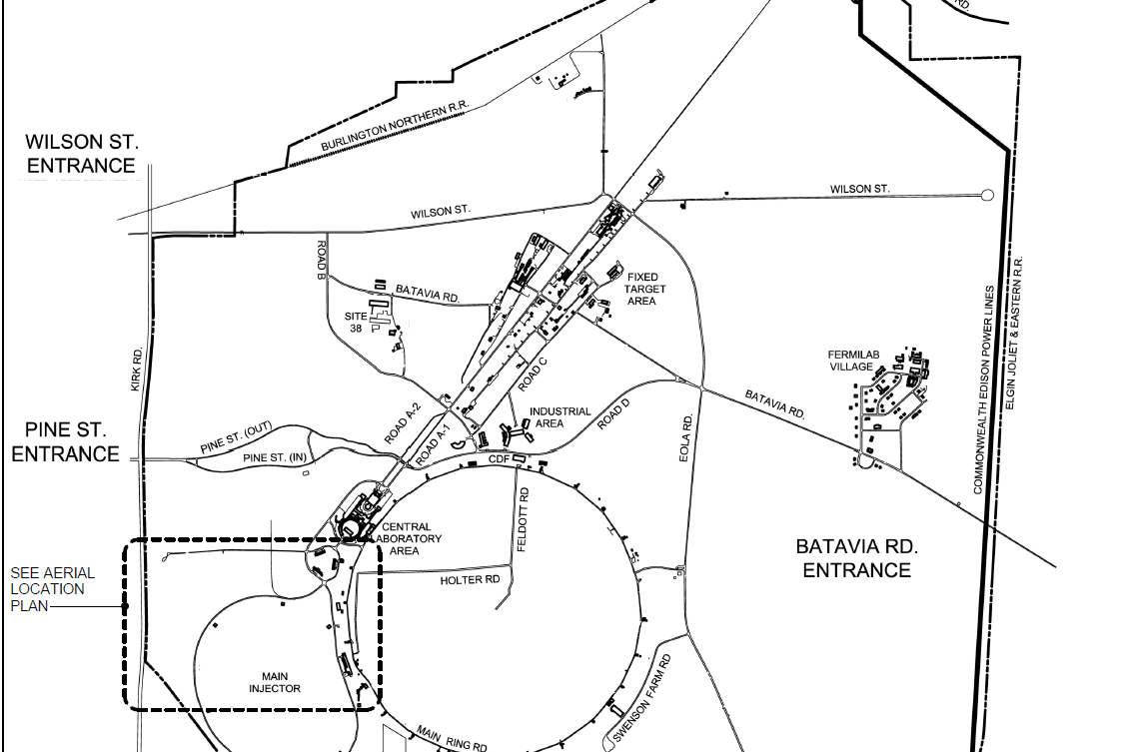
Target Shield Pile: Route to Target Complex
Fabricate here
Direct route ~2.5 miles
Install here

Slide 8
Neutrino Beamline
Horn Power Supply
2000 sq ft needed for assembly
Indoors, crane, forklift access
Stripline
No info yet. Guess ~2000 sq ft indoors for assembly
Windows
Probably fits at MI8
Absorber
500 sq ft storage out of weather
Use SBSB
Instrumentation
No info yet. Relatively small need. Probably accommodated within regular departmental space

Slide 9
Neutrino Beamline
RAW
Store the tanks, valves, fittings, skid frame hardware, and heat exchangers at A0 south.
Store the piping indoors -- at SBSB?
Fittings in Shipping containers at TC?
Some skids assembled in situ, smaller ones at vendor
Remote Handling
Work cell, shield doors, morgue
Steel for doors etc. out of weather
~1500 sq ft
SBSB?
Sensitive components need climate control
~500 sq ft

Slide 10
System Integration
Controls and Interlocks
Accommodate within departmental spaces

