Slide 1
NSCF Storage and Assembly Needs and Assumptions
J. Szott
LBNF/DUNE-US NS Storage and Assembly Planning Workshop - 1st meeting
4 August 2021
DUNE DocDB 23129

Slide 2
Outline
NSCF Scope Overview
Major Elements and Types
Pre-Construction Phase Storage and Assembly Needs and Assumptions
Blue Blocks and other Shielding Steel – Stored at Railhead
Lighting Ballasts Purchased by the Lab on Behalf of LBNF – Warehouse
No Assembly or Fabrication Space Needed
Construction Phase Storage and Assembly Needs and Assumptions
Anticipated parking
Stockpiles
Batch plant
Etc.

Slide 3
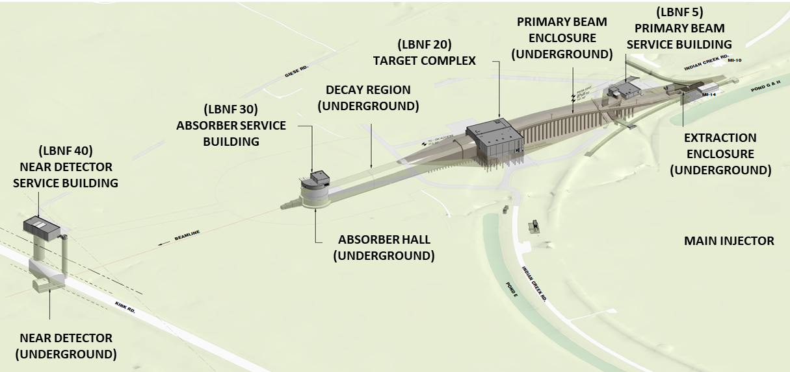
Overview of NSCF Scope
Two Construction Subcontracts
Beamline Complex
Near Detector Complex
Near Detector Complex
Beamline Complex

Slide 4
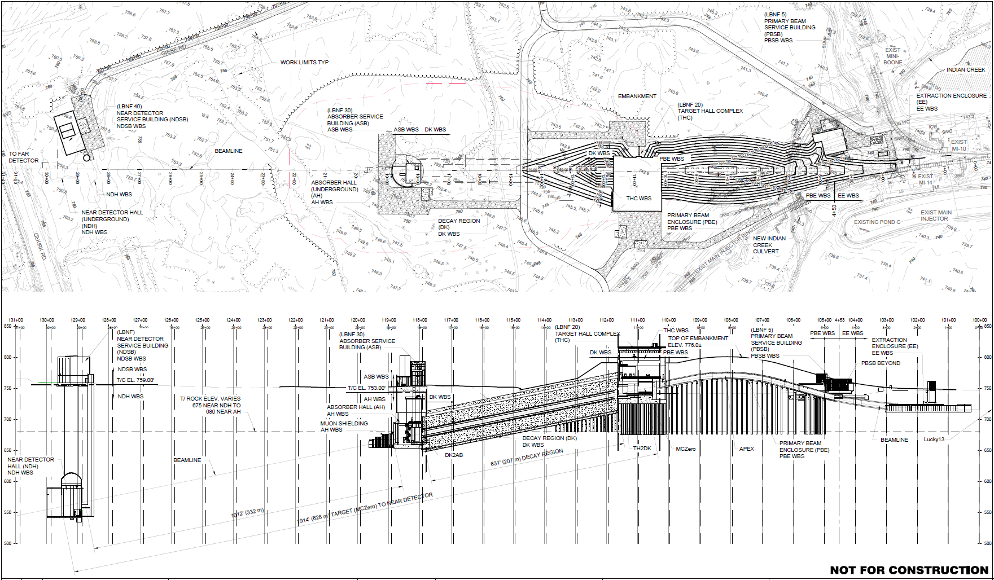
Overview of NSCF Scope – Sense of Scale
NSCF project area approx. 175 acres
Deep Surface Excavation: 1000ft Long x 500ft Wide
Beamline
Near Detector Complex
Absorber Hall:
100ft Below Grade
Beam: 30ft Above Grade
Hill: 60ft Above Grade
Beamline Complex
Existing Grade
Soil/Rock Interface
ND Cavern:
200ft Below Grade
Soil
Soil
Rock
Rock
Near Detector
Complex
Neutrino Beam Passing Through Rock
Absorber
Complex
Decay Region
Target
Complex
Pre-Target
(Extraction Enclosure, Primary Beam Enclosure, Primary Beam Service Building)

Slide 5
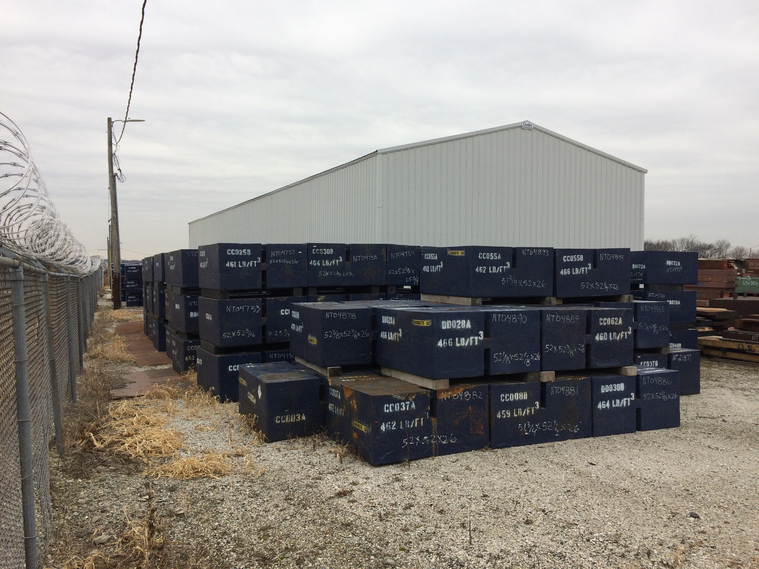
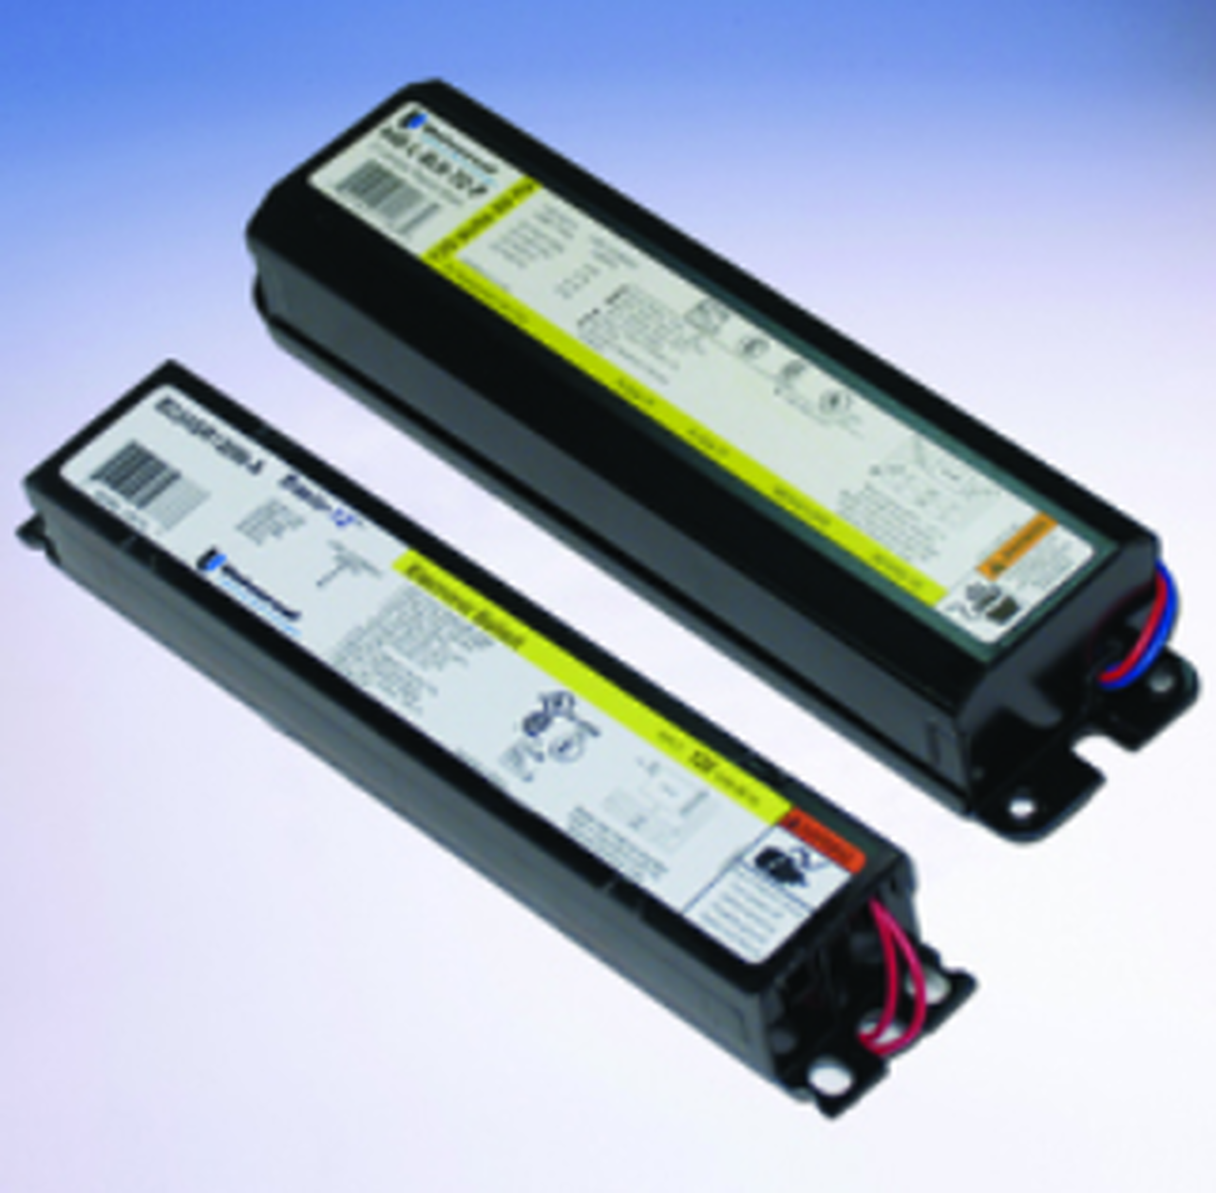
Pre-Construction Phase Storage and Assembly Needs and Assumptions
Blue Blocks and other Shielding Steel
Stored at Railhead as Blue Blocks are received until Beamline Subcontractor ready to stage/install.
Rad Area Lighting Fixture Ballasts
Lighting fixture ballasts purchased by the Lab on behalf of LBNF Project and are currently stored at the Warehouse.
Assembly or Fabrication Space
No pre-construction assembly or fabrication space planned or needed.

Slide 6
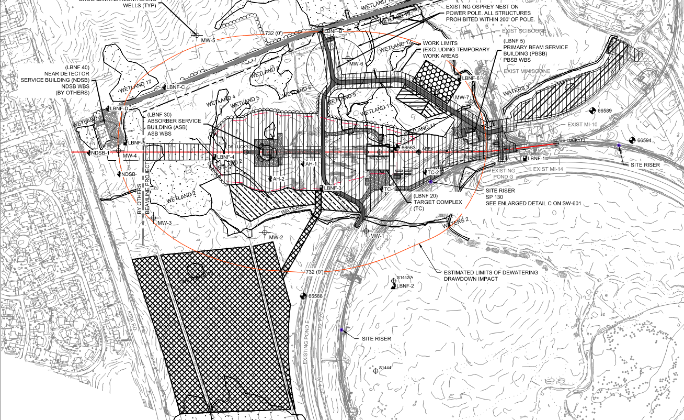
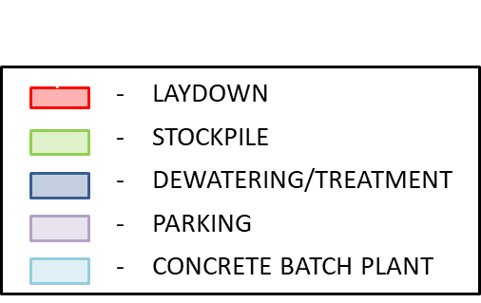
Construction Phase Storage and Assembly Needs and Assumptions
Storage and Assembly needs within the Construction Areas
Construction traffic entering Fermi from Kautz Road (average 2 to 5 trucks per hour and 200 to 325 worker cars per day)

Slide 7
Construction Phase Storage and Assembly Needs and Assumptions
Most Construction Phase temporary “hardstand” areas will remain after NSCF completion.
~200’ x ~400’
~250’ x ~400’
~25’ x ~250’
~150’ x ~300’
~200’ x ~900’
~100’ x ~200’
~80’ x ~80’
~100’ x ~100’
~100’ x ~100’
RESTORED AREA
HARDSTAND (Fermi Detail)
HARDSTAND (Contractor Req’t)

Slide 8
Q & A

Slide 9
BACKUP SLIDES

