Slide 1
FD1+C Anticipated Space Requirements for Storage
Jolie Macier & Eric James, for the FD1+C team
LBNF/DUNE-US NS Storage and Assembly Planning Workshop
4 August 2021

Slide 2
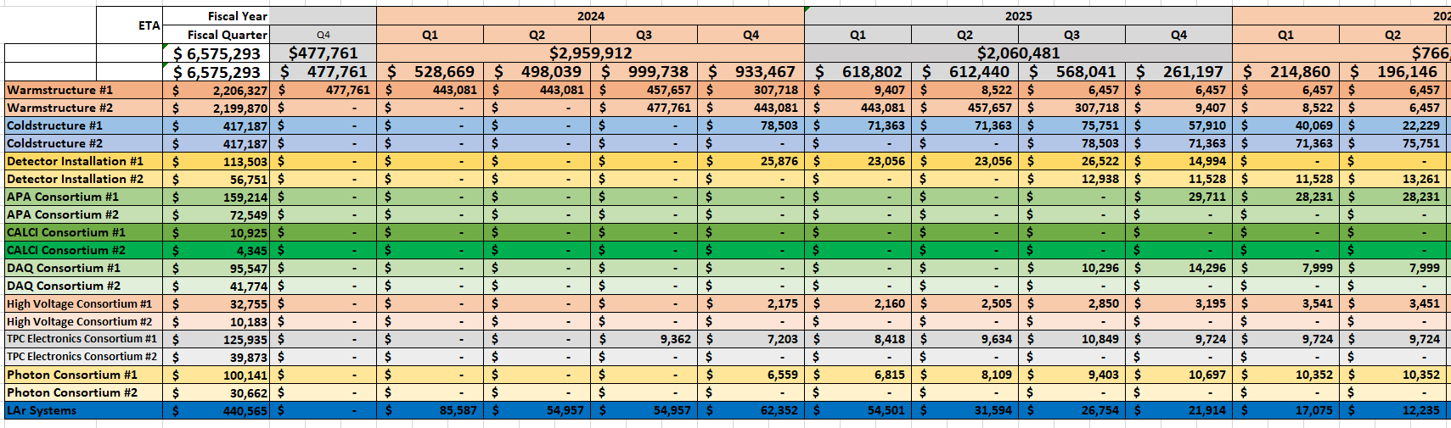
FD1+C Anticipated Space Requirements for Storage - REQUEST
Type of equipment or materials needing space at Fermilab
Storage space needs – outdoor, climate controlled, warehouse (not climate controlled)
Assembly space needs – possible crane coverage, extraordinary size needs
Planning for South Dakota Warehouse Facility based
on installation timeframes for FD1+C components
--
Earliest needs are warm cryostat & TPC electronics

Slide 3
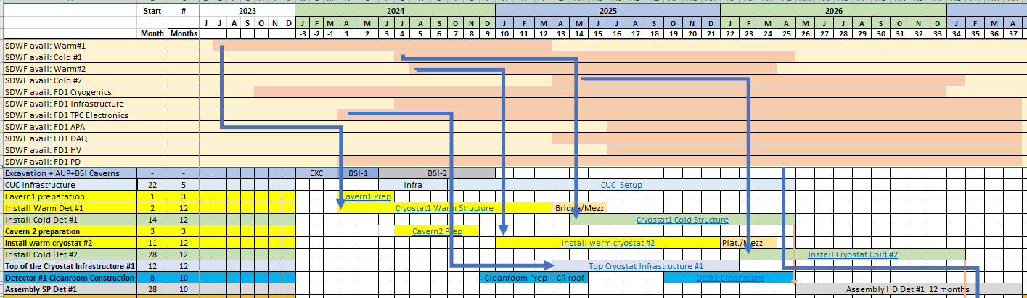
FD1+C Elements & Requirements
Technically limited schedule, Jun 2021
Warm cryostat
TPC electronics
APA installation starts
FNAL-Batavia storage requirements for FD1+C driven by FD1 production timeline and availability of SDWF
Most significantly, UK APAs will begin full-scale production in 2022, requiring early storage location

Slide 4
FD1+C Summary of Requirements at FNAL-Batavia
 | Storage at FNAL-Batavia | Time Frame | Conditions | Volume
Warm Cryostat #1-2 | No | N/A | N/A | N/A
Cold Cryostat #1-2 | No | N/A | N/A | N/A
Cryogenics Infrastructure | No | N/A | N/A | N/A
Installation Infrastructure | No | N/A | N/A | N/A
APA | Yes | Fall 2022 – Feb 2027 | Inside | Up to 38 wooden boxes* 570 m² (8m x 2.6m x 3.1m)
PD | No | N/A | N/A | N/A
HV | No | N/A | Inside | N/A
DAQ | No | N/A | N/A | N/A
TPC Electronics | Yes | Mar 2024 – XXX | Inside | incidental
*precise phasing TBD

Slide 5
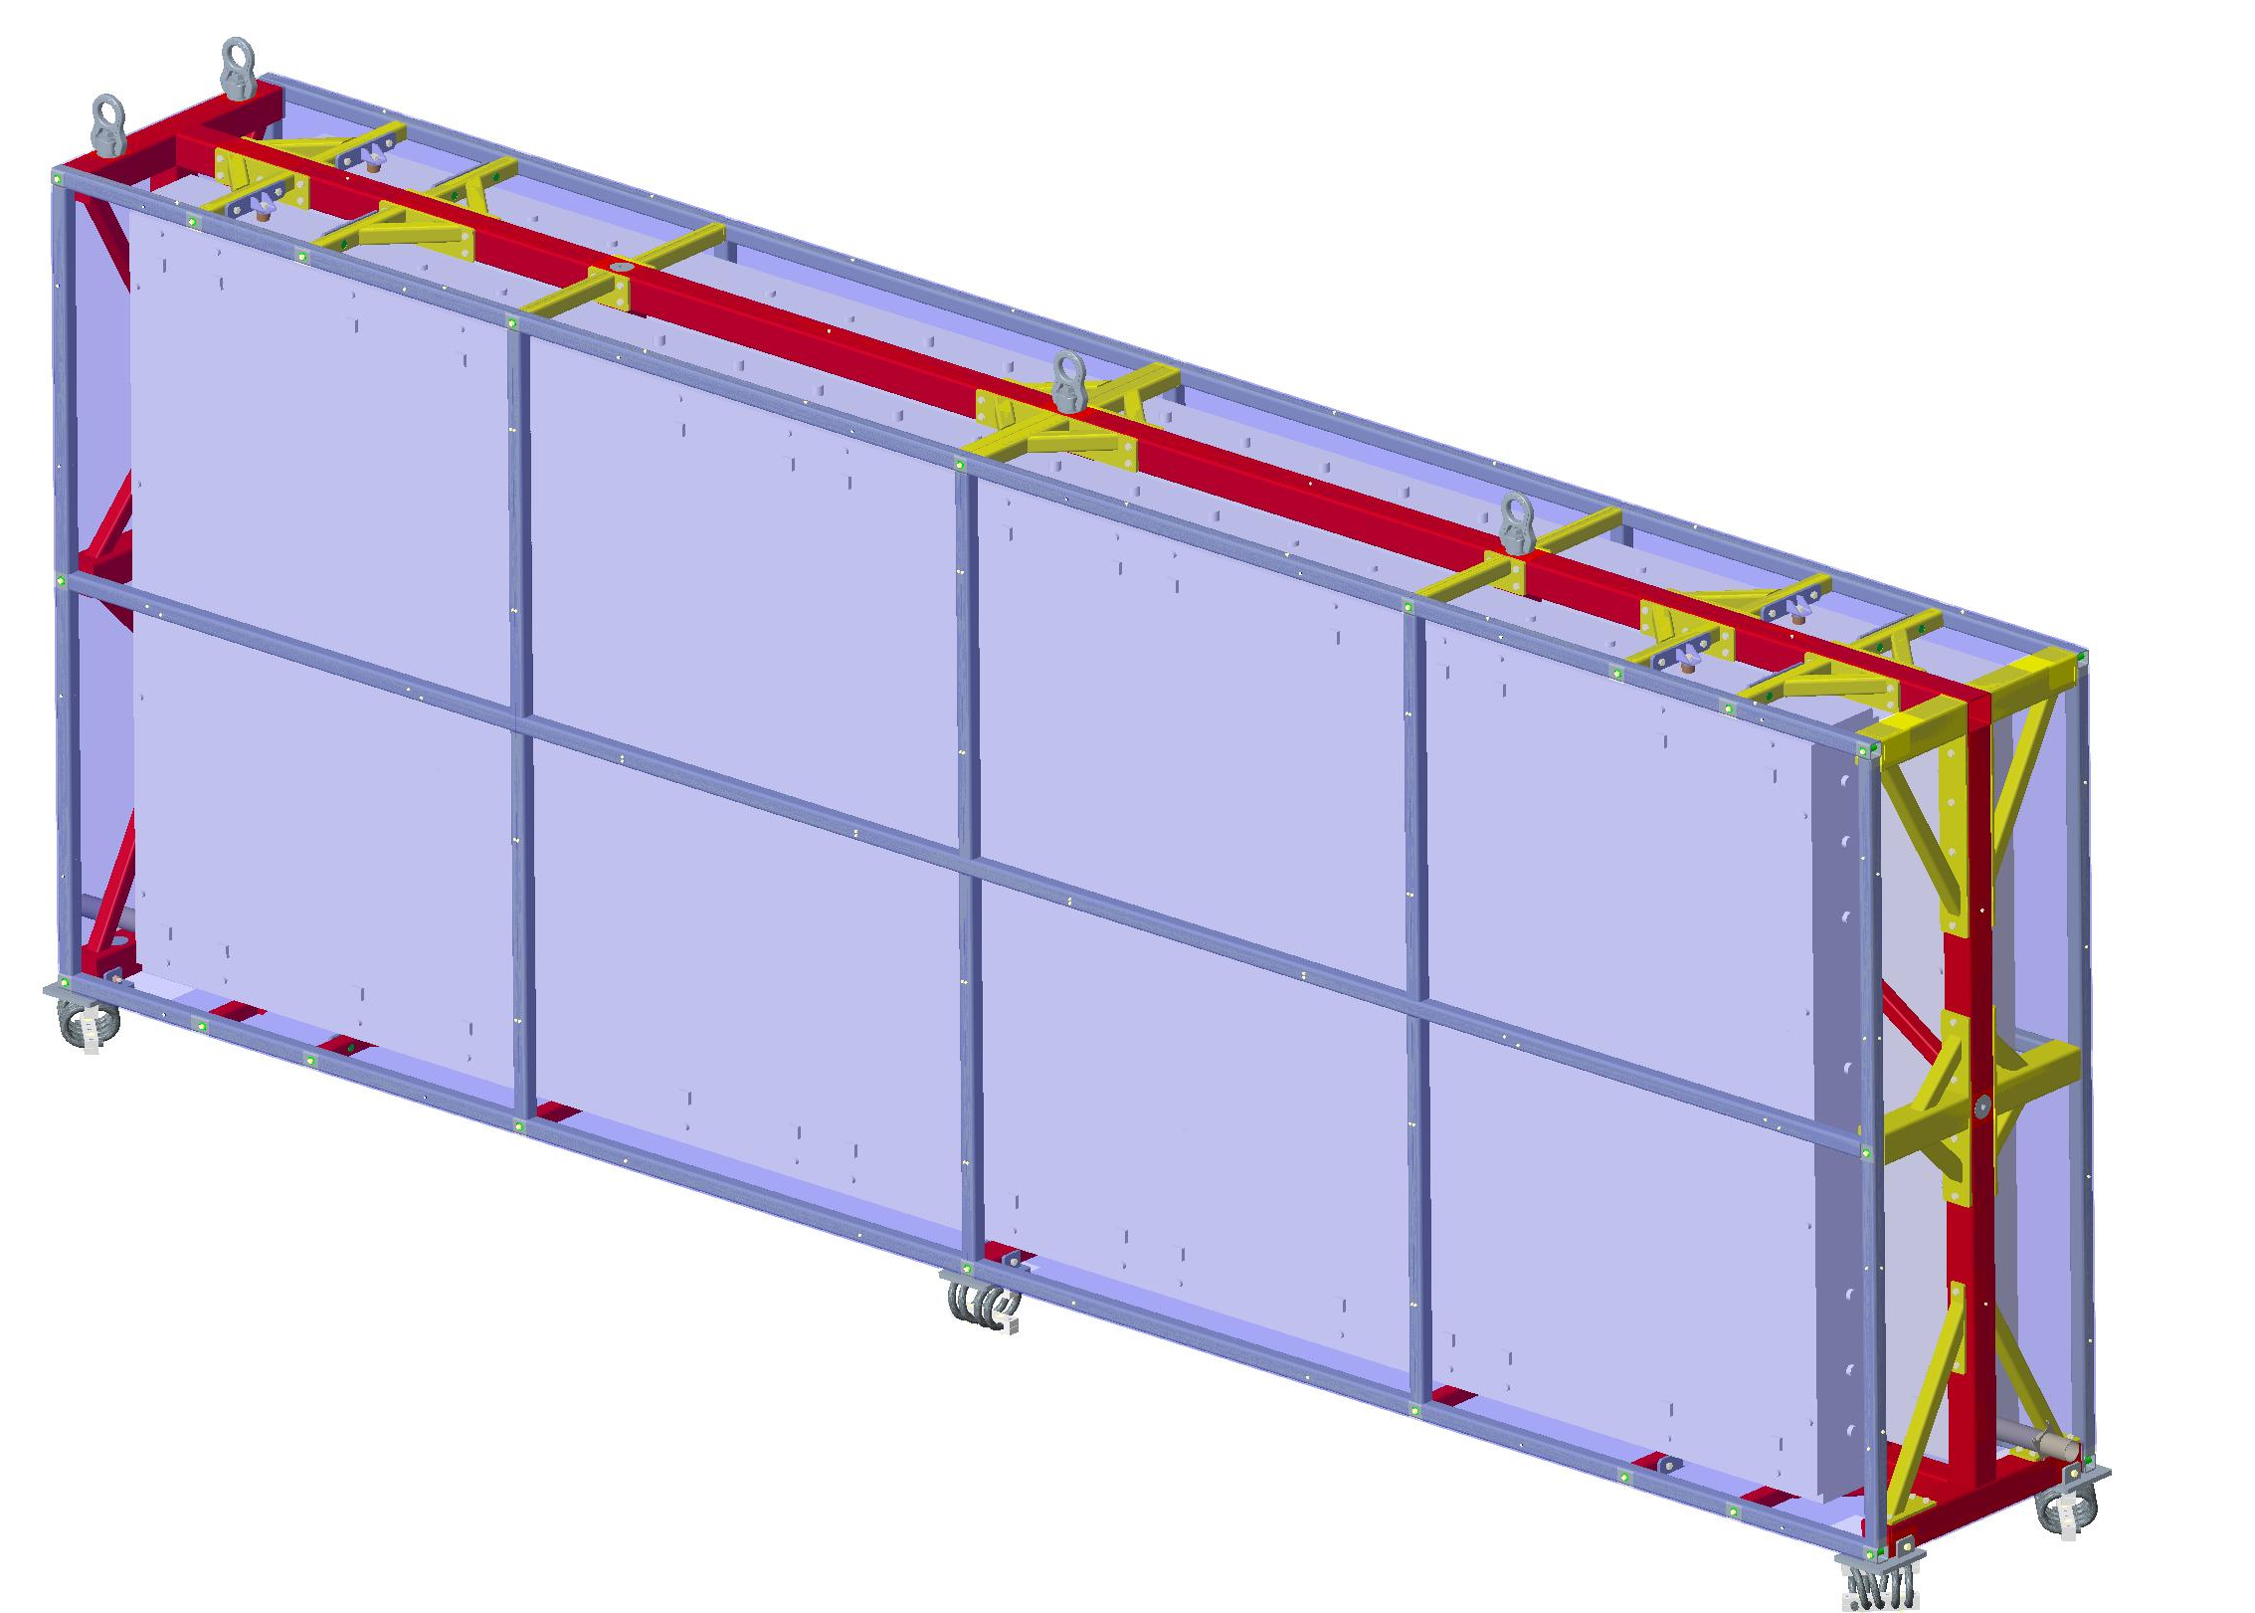
FD1+C Summary of Requirements – Material Detail – APA Storage
0.95m
38 total wooden boxes (each with 4 APAs)
  All boxes will not be stored at FNAL concurrently
Staggered shipping from production sites, 2022 through 2027
  UK (33)
  UChicago (3)
  UW-Madison (2)
APA installation starts June 2026
Late production APAs may ship direct to SURF
Forklift(s) needed for loading/unloading
6.8m
2.7m
~1 shipment/year, 2023-2025

Slide 6
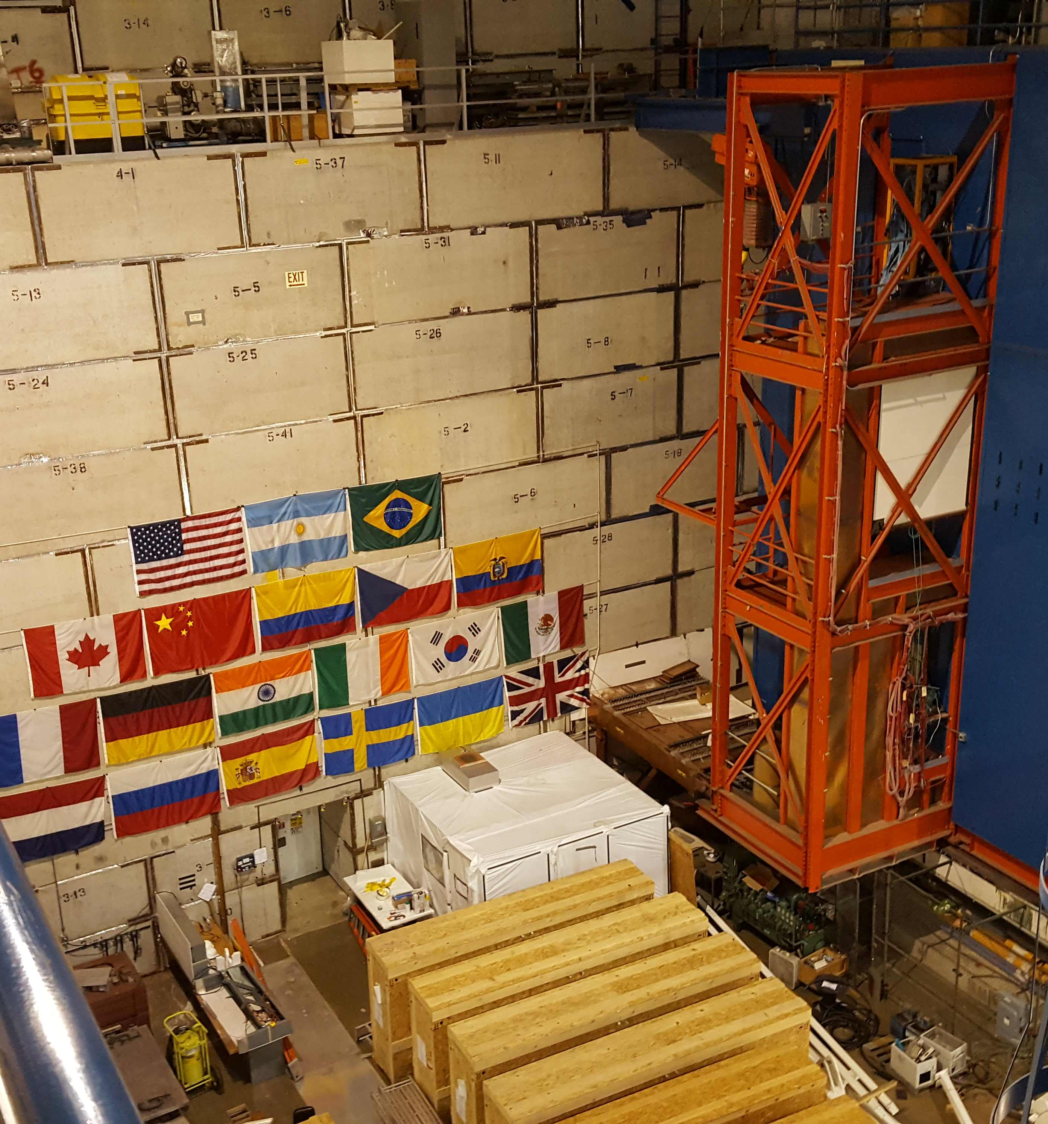
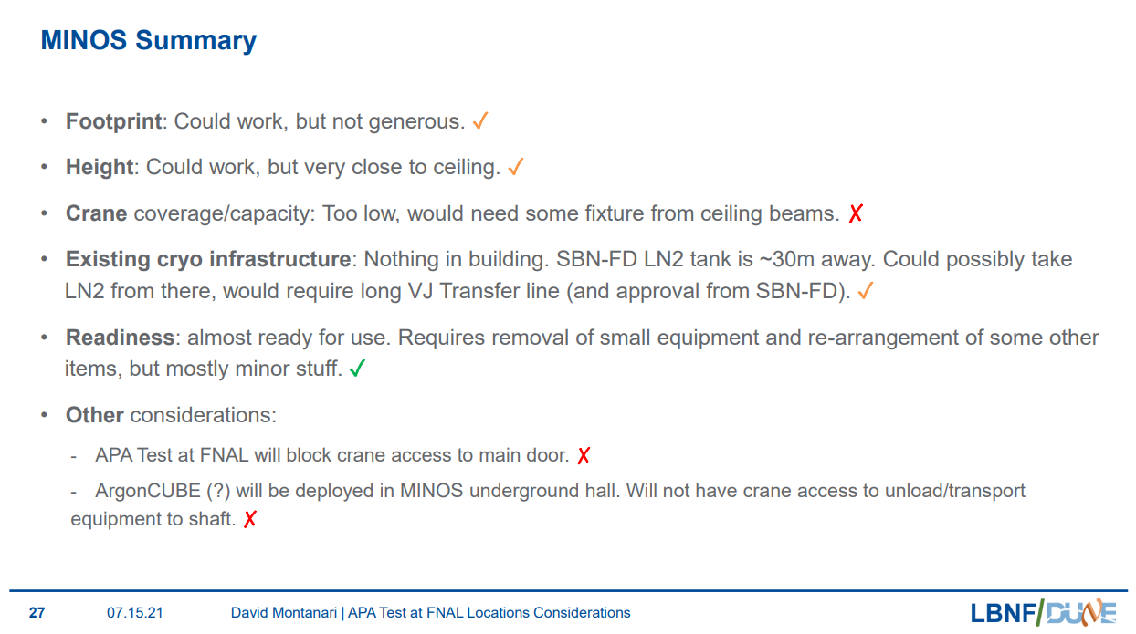
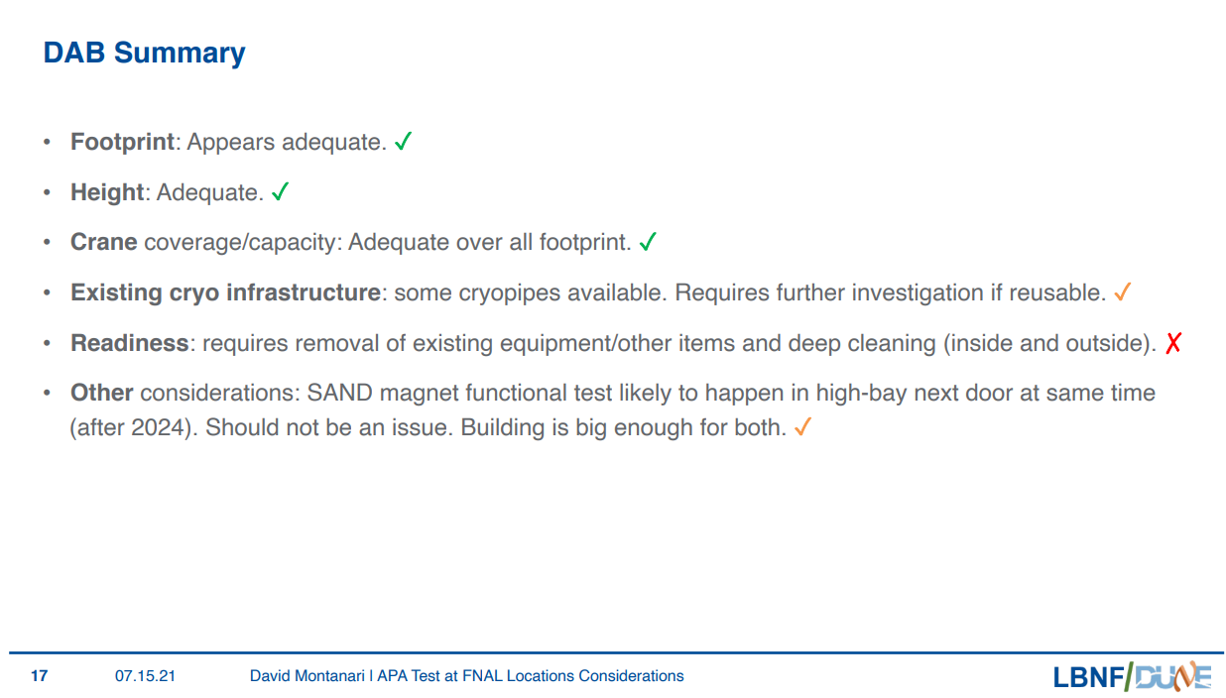
FD1+C Summary of Requirements – Material Detail – APA Integrated Cold Box Tests
10% QC testing
Enhanced space requirements
Prototype updated cold box design
Prototype N2 cold
box cryogenics
Supported by BCR#642
Site analysis
results
Would require up to the entire DAB pit
Evaluating option to perform ICB tests at CERN

Slide 7
FD1+C Summary & Actions Needed
Clarify phased APA delivery schedule to understand maximum APA storage requirement
Resolve Integrated Cold Box Testing plan & associated FNAL space requirements

