Slide 1
Optical Communications for HL-LHC detectors
ANL/FNAL/UC/VWS Meeting
Nov. 28, 2011
Alan Prosser
CD/ESE
Fermilab

Slide 2
Optical Communications for HL-LHC
Motivation
Sub-detectors for the HL-LHC will require more on-detector communications bandwidth than is conveniently available from current optical transceivers (even arrays)
Increase in on-detector bandwidth requirements must be provided within
thermal and mass budgets
Past issues with VCSEL reliability indicate that a new approach NOT based upon
on-detector laser sources may be favorable
An approach based on externally modulated optical communications offers
advantages
1. Low on-detector power dissipation
2. High data rates
3. Improved reliability (no lasers on detector)

Slide 3
General Link Requirements
Next generation HEP experiment requirements:
Flexible data rates (10Gbps up to 200Gbps).
High reliability in a range of radiation environments.
Low power consumption
Small size (≤2-3cm²)
Moderate cost:
Part cost – COTS where possible (use industry standards – Ethernet, ITU, etc.)
Design and testing cost- low capital equipment (Test equipment cost becomes prohibitive with channel speed >10Gbps).
Installation and maintenance costs – low fiber count, small connectors/devices
Proposed Solution: A Multi-Gbps (per single mode fiber) link combining:
1. Rad-hard, small footprint, low power optical modulator device technology
2. Wavelength Division Multiplexing

Slide 4
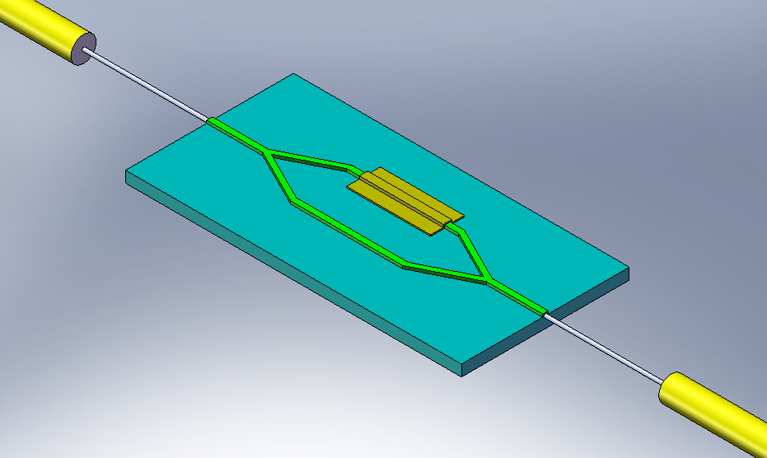
Key Component - Mach-Zehnder Modulator (MZM)
Phase Control
V_{mod}
10-40Gbps Data Rate
Input Fiber:
CW laser
3dB Optical Splitter
Output Fiber:
10-40Gbps signal
InP substrate
Rad Hard Mach Zehnder Modulator
Intensity modulation achieved through phase shift of optical wave along one leg of
interferometer (phase control electrode)
Input laser operates as a continuous wave source located off detector (reduced detector
thermal load, no issues of rad-hardness for off detector laser)
Compact rad-hard assembly needed (current COTS devices are rather large)
High data rates achievable (10 Gbps – 40 Gbps in current devices) with minimal power dissipation

Slide 5
System Concept Proposal
Multiple CW laser diodes
λ₁, λ₂ …λ_{i}
SM PANDA fiber
Receivers
Demux
Control Room
Mux
Detector/
Experiment
10Gbps per λ_{i}
SM PANDA fiber
Modulator
Wavelength Division Multiplexing (WDM) at 10Gbps/channel with external CW laser sources and modulators at the experiment.

Slide 6
Advantages/Features
Lower Capital Costs: Test equipment costs lower for 10Gbps channel data rates.
Minimized Cable/Infrastructure: WDM minimizes cabling from the control room.
Channel Speed Upgrade: Modulators could upgrade speeds to 25Gbps ‘easily’ – drive electronics are the limitation.
Reliability:
Channel redundancy possible for improved reliability.
External modulators
Reduced Size:
Demux at the detector outer layers, distribute fibers to various layers/locations on the detector.
Demux size is less critical if located outside the detector
Integrated modulators possible.
COTS Components:
Lasers, receivers could be easily modified COTS parts.
Modulators may need some customization
Demux/mux could be COTS.

Slide 7
ANL/FNAL/UC collaborative Effort
All three institutes are involved in the HL-LHC detector upgrade
They have common interest of developing a new generation of optical link based on new optical modulators
All three groups have the expertise and experience to pursue this type of research
Together, they will work with an industrial partner, Vegawave Inc. on this.
Each institute will have a well defined activity during the initial phase.

Slide 8
Collaborators, Tasks, Contributions
Proof of Concept (Test System)
Collaborators:
Argonne National Laboratory
Radiation testing of commercial modulators
Fermi National Accelerator Laboratory
System performance testing, prototype PCB design
University of Chicago
Irradiation control station, radiation testing
Vega Wave Systems
Device fabrication, device testing

Slide 9
ANL Proposed Modulator Test Setup
USB
FPGA board
PC
Shielded from radiation
~100 m
CW Lasers
8 SMA
8 SMA
USB
12 V
QSFP board
I2C Main
+ Power
I2C + Power
I2C
2 x Differential I2C
Power
PM Fiber
QSFP
4 Fiber
QSFP board
QSFP
SMA
SMA
8 Fiber
4 fibers
Receivers
4 fibers
Fiber SM
12 Fiber
MPO
12 x fiber fanout
LiNbO3
InP
4Fiber
Power
QSFP
Plan to test 3 types of modulators (all @ all in-hand)
LiNbO3 (have 2) 10Gb/s,
InP (have 1, may need to modify)
Molex/Luxtera (2 in hand 1 in order)
Radiation Exposure Region
Electrical feedback

Slide 10
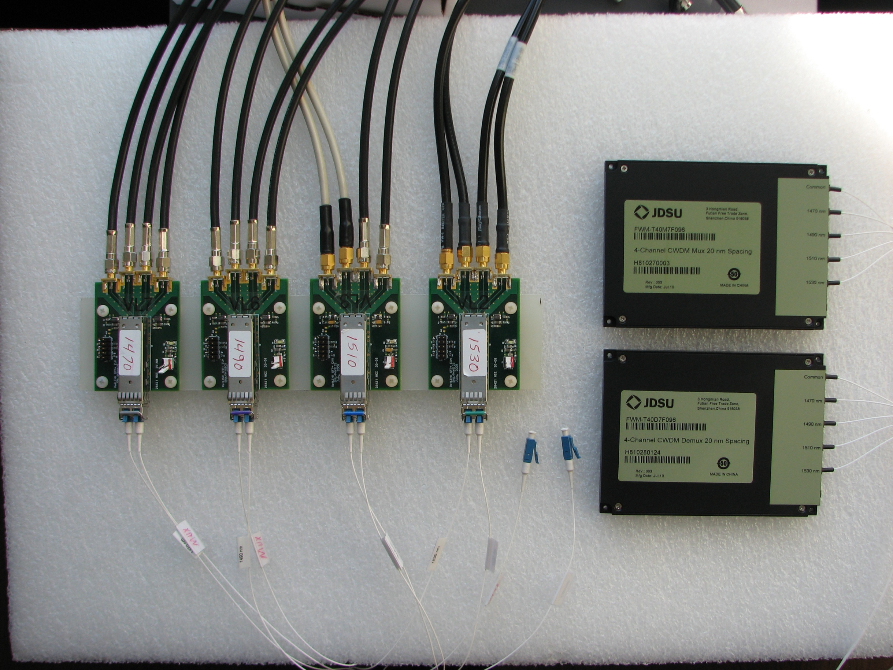
FNAL CWDM Modulator System
+
MZM x 4 (40 sq mm target)
COTS CWDM Components
40 Gbps line rates are a challenge (design, testing, costs)
Solution – Combine MZ Modulators (4) with Coarse Wavelength Division Multiplexing (CWDM)
10 Gbps line rates can be tested with our current equipment
Use of multiple line wavelengths and modulators reduces single point of failure issues
Wavelength implicitly encodes address of data source

Slide 11
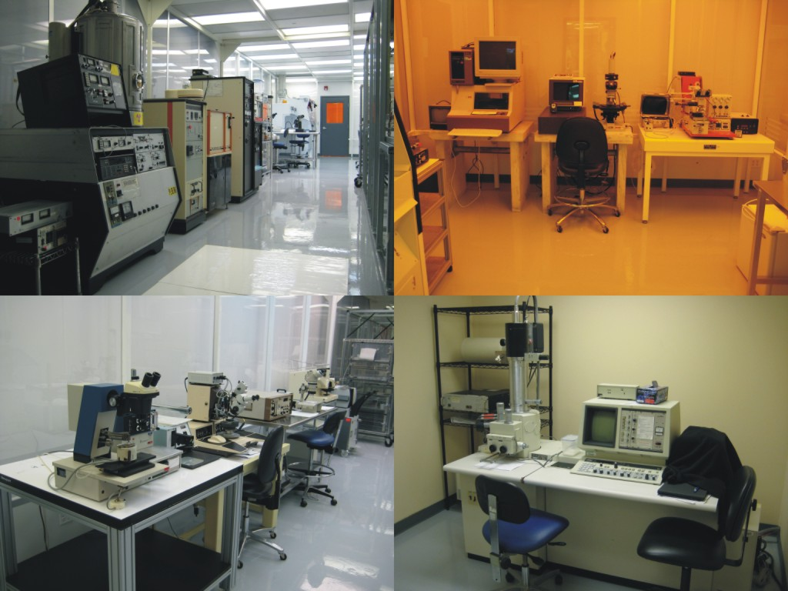
Vega Wave Systems
Fabrication and Device Characterization
Designs and manufactures fiber optic devices and optical links for communications.
Two PhDs, 3 technicians,
5000 sf facility with 2000sf Class 1000 clean room for semiconductor fabrication and packaging.
Semiconductor component and system test capability from DC-50GHz
Capabilities: Compound Semiconductor components and subsystems.
Laser diodes (850nm, 1300nm, 1550nm): high power and single mode.
Photodetectors/photovoltaics (p-i-n, APD)
Silicon Optical Benches (Si v-grooves)
Fiber optic amplifiers/Fiber Lasers
Transceivers

Slide 12
Extra slides

Slide 13
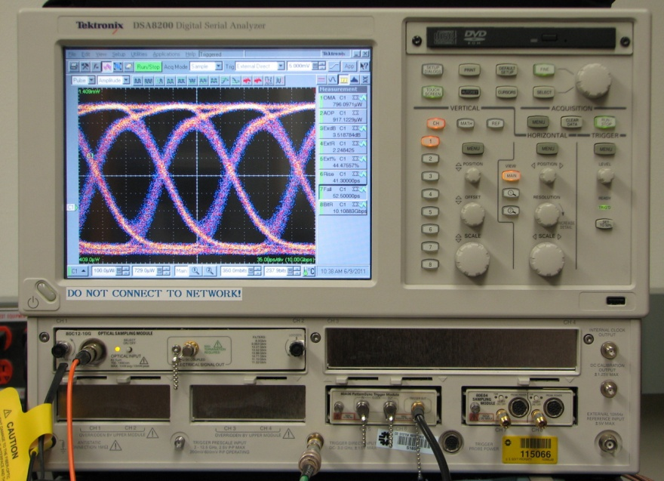
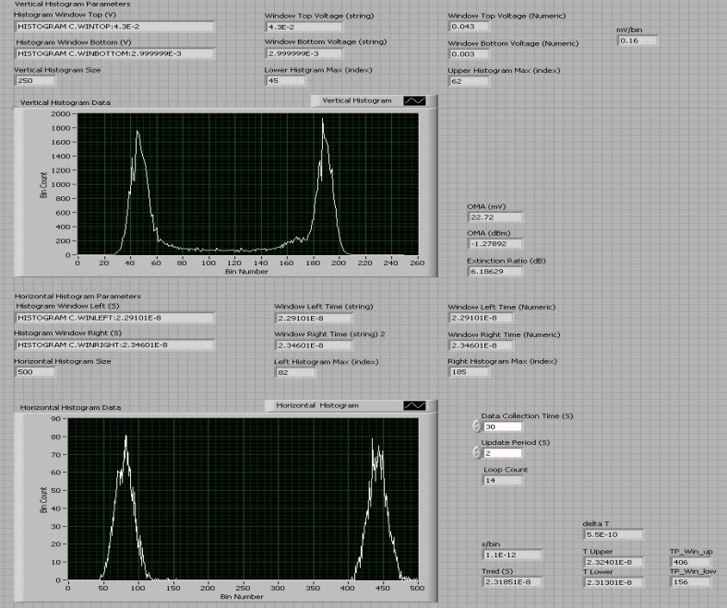
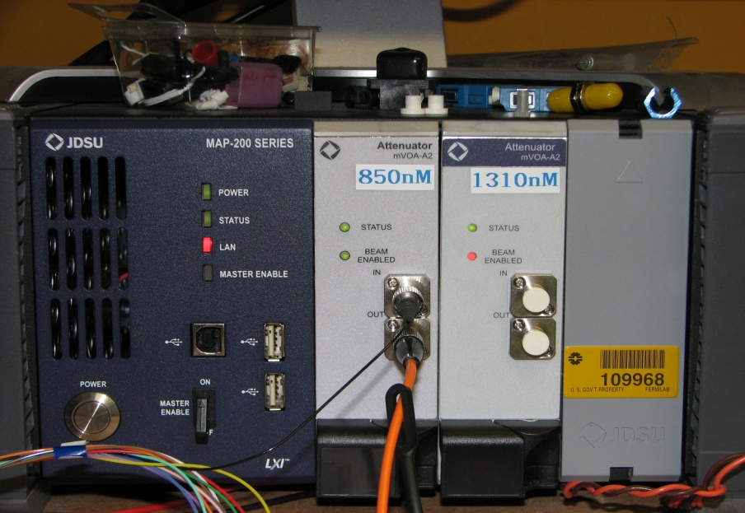
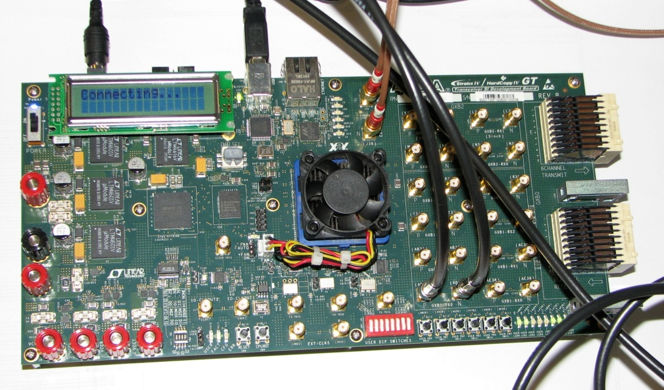
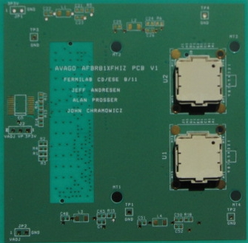
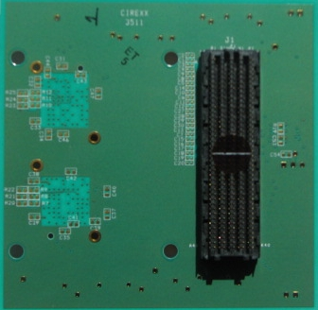
FNAL Optical Test and Measurement
Digital Signal Analyzer (Eye Patterns, Jitter)
Labview VIs (Histogram Analysis)
Variable Optical Attenuators (Sensitivity Analysis)
FPGA Signal Integrity Kit (BERT, PRBS Generation)
High Speed Optical Component
PCB Design
Notes:
I think our slide should spell out very clearly that we will study a proof of concept of modulators and DWDM using commercial parts.

Slide 14
Mach-Zehnder CWDM Demonstration System
Single Channel and Array Devices
SFP (Tx)
Array Rx
1470 nm
SMF
COTS MZM
SMF
SMF
1470 nm
LVDS
Rx0
CW
10 Gbps
10 Gbps
10 Gbps
Driver_Tx0
1490 nm
SMF
COTS MZM
SMF
SMF
1490 nm
LVDS
Rx1
CW
10 Gbps
10 Gbps
10 Gbps
Driver_Tx1
CWDM
Mux
SMF
CWDM
DeMux
40 Gbps
1510 nm
SMF
COTS MZM
SMF
SMF
1510 nm
LVDS
Rx2
CW
10 Gbps
10 Gbps
10 Gbps
Driver_Tx2
1530 nm
SMF
COTS MZM
SMF
SMF
1530 nm
LVDS
Rx3
CW
10 Gbps
10 Gbps
10 Gbps
Driver_Tx3
Devices that need to be obtained for demo
Driver_Tx0
Tx0
COTS MZM Driver
LVDS
LVDS
Rx0
Driver_Tx1
10 Gbps
COTS MZM Driver
Tx1
LVDS
LVDS
Rx1
Driver_Tx2
10 Gbps
FPGA
COTS MZM Driver
Tx2
LVDS
10 Gbps
LVDS
Rx2
Driver_Tx3
Tx3
COTS MZM Driver
LVDS
LVDS
Rx3
10 Gbps
Notes:
In this test system, 4 SFP transceivers will again provide the continuous wave power as inputs to the modulators (MZMs). The signal modulation is provided by MZM drivers driven by an FPGA and possibly amplifiers at 10 Gbps. The 4 modulated optical wavelengths will be multiplexed (by the CWDM Mux) on to one single mode fiber (SMF) with an aggregate date rate of 40 Gbps. The received optical signal will then be demultiplexed into 4 optical streams each at 10 Gbps with separate wavelengths. However, instead of using the SFP receivers, an array receiver (such as the Avago MiniPod Rx) can be used (the performance may depend on the response of the pin diodes at these wavelengths). The electrical output of these array receivers can then be returned to the FPGA inputs to complete the loop for BERT testing at an aggregate bit rate of 40 Gbps.

Slide 15
Optical Communications for Future Trackers
Evolution of Versatile Link for ATLAS/CMS
Phase III R&D targeting:
1. Low Power GigaBit Transceiver (LP-GBT)
2. Small Footprint Versatile Link Transceiver (SF-VL)
The characteristics of links based on these components would be:
1. Low power laser driver for a 5 Gbps VCSEL-based transceiver
for tracker applications
2. 10 Gbps optical engine (VCSEL array) and package for calorimeter
applications
We propose to take the next step with a Modulator Based Array

