Slide 1
Welcome to the CEA / FNAL Quality Workshop
N. BAZIN

Slide 2
Objectives of this workshop
  Understand roles and responsibilities of all the stakeholders involved in the PIP-II Quality Management System
  Present the CEA PIP-II Quality Management System
  Share good practices and lessons learnt
Outcome
  Record of Discussions (RoD) with a list of decisions and actions (if any)

Slide 3
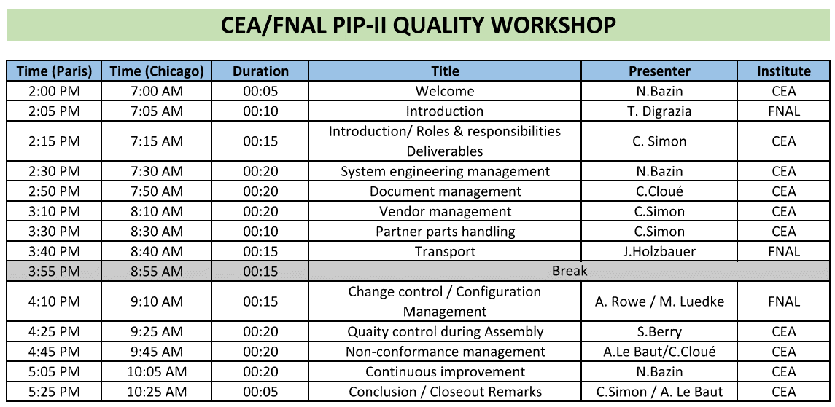

Slide 4
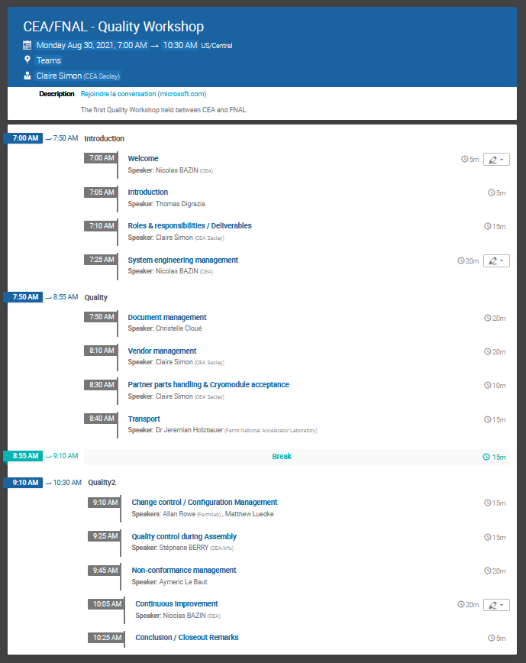
Indico site: https://indico.fnal.gov/event/50404/

Slide 5
Enjoy the workshop and let’s have fruitful discussions!

