Slide 1
Introduction, Deliverables, Roles & responsibilities
Claire SIMON

Slide 2
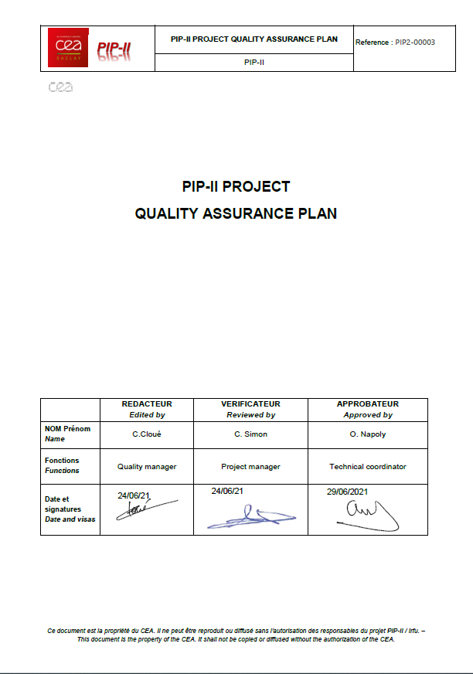
Quality Assurance Plan
  The purpose of the Quality Assurance Plan (QAP) is to ensure that deliverables will meet the specified requirements
  The CEA PIP-II QAP covers the following:
    Deliverables
    Role and responsibilities
    Communication plan
    Document management
    Configuration management
    Non-conformance management
    Competences and training
    Quality control (manufacturing, assembly and tests)
    Acceptance
    Quality for storage, handling and transport
    Measurement and test equipment monitoring
    Continuous Improvement
  The Quality Assurance Plan is under review by Fermilab
  before being released

Slide 3





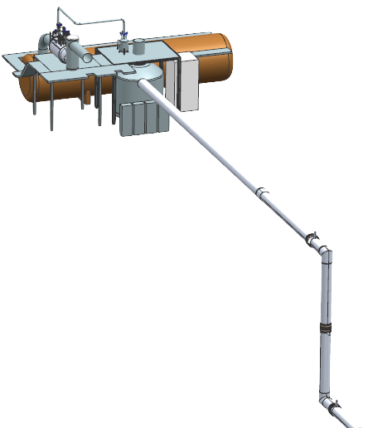





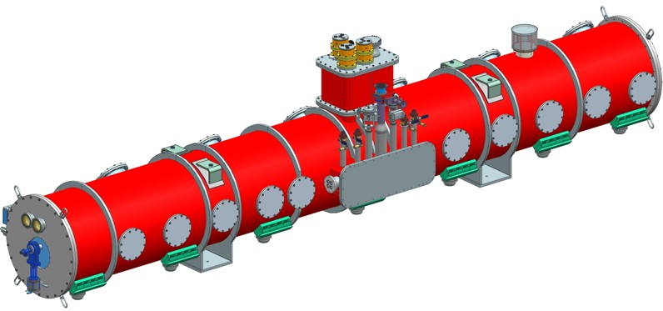
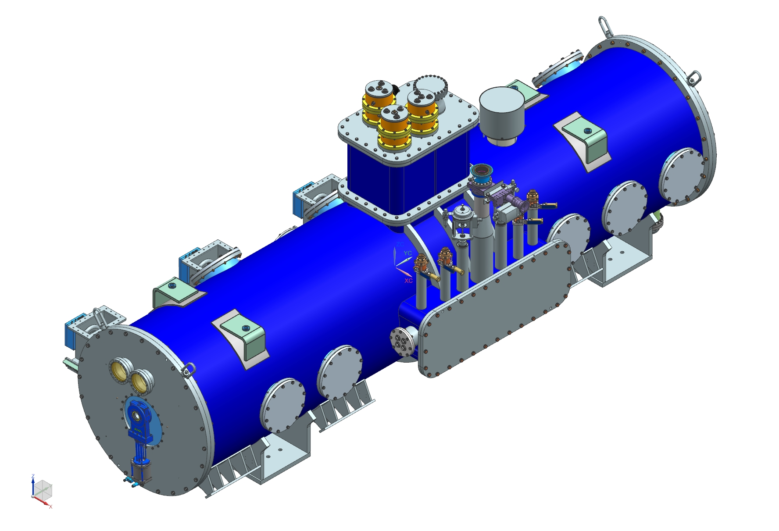

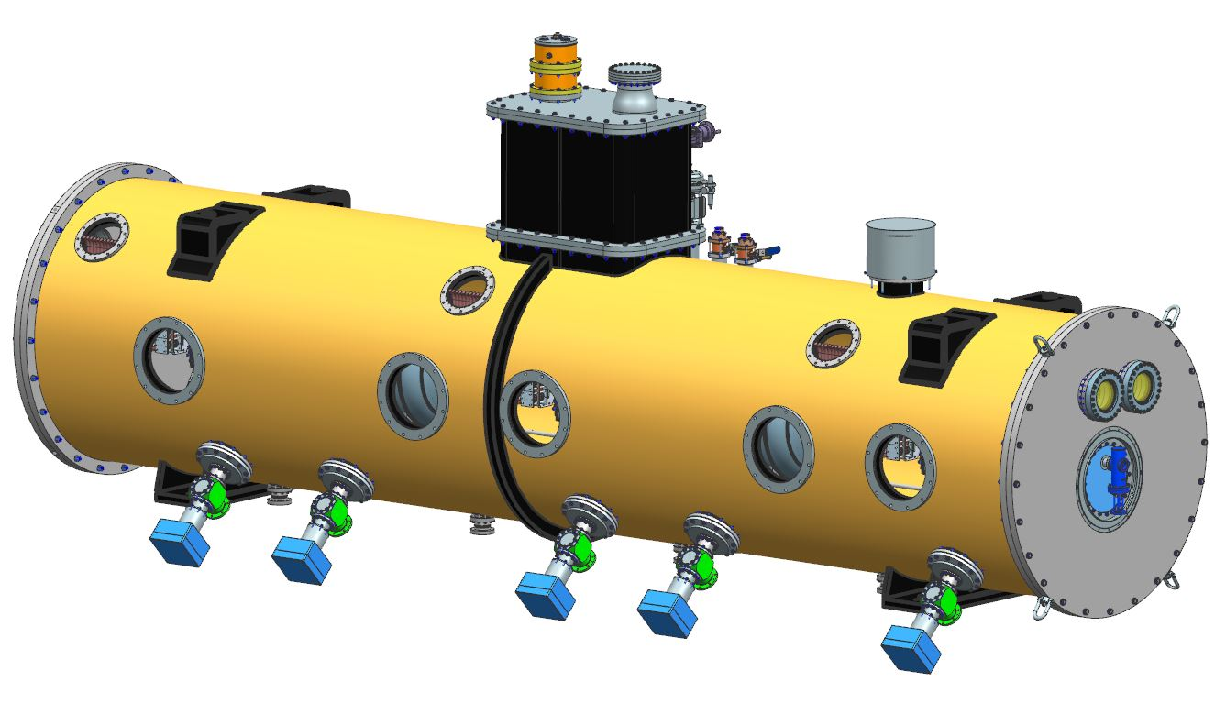
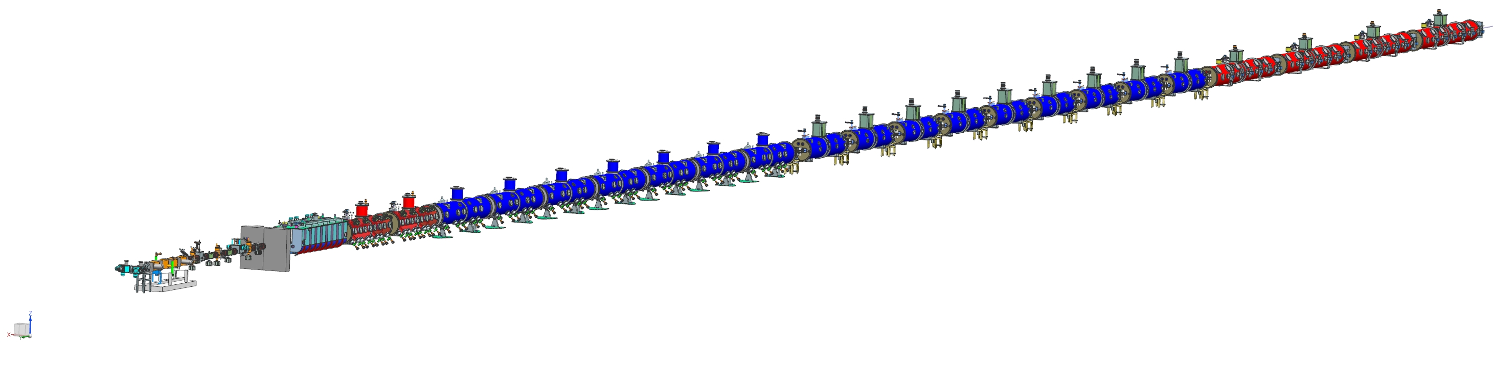
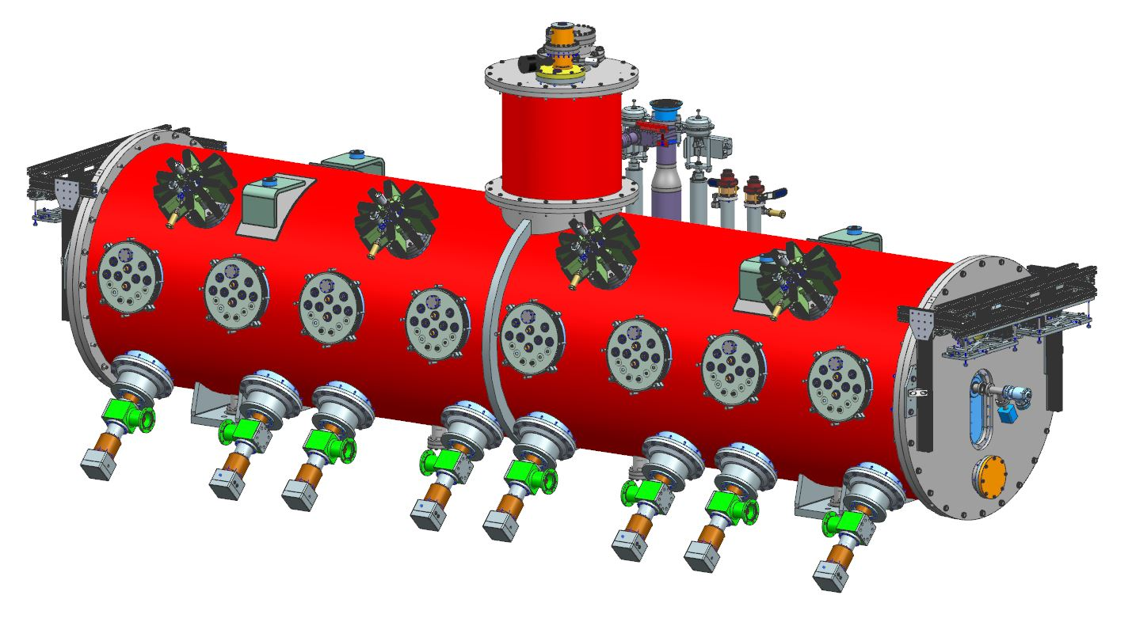

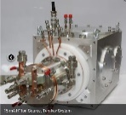
CEA In-Kind Contribution to PIP-II
PIP-II Superconducting RF CW Linac, 800 MeV Consists of Five Types of Cryomodules
Elliptical
HB650 X 4
24 Cavities
650 MHz
Cryoplant
Elliptical
LB650 X 9
36 Cavities
650 MHz
Single Spoke
SSR1 X 2
16 Cavities
325 MHz
Single Spoke
SSR2 X 7
35 Cavities
325 MHz
HWR
8 Cavities
162.5 MHz
CDS
833 MeV
H- Ion source
516 MeV
177 MeV
Superconducting
RFQ
CEA IKC
10 MeV
32 MeV
2.1 MeV
Room Temperature
PIP-II is the world’s highest energy and power CW proton linac, and the U.S. first accelerator project to be built with major international contributions

Slide 4
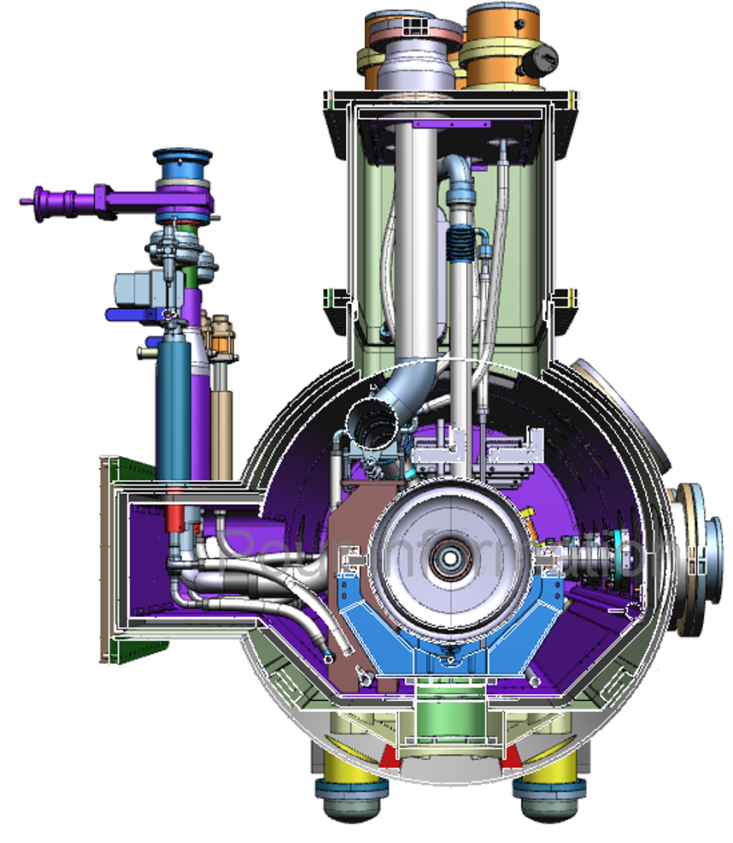
CEA Scope of Work
The Scope of Work of CEA includes:
  the design of the LB650 cryomodules (1 pre-production + 9 production)
  the procurement of cryomodule components*
  the assembly of the LB650 cryomodules (1+9), including all necessary tooling
  the RF tests of the LB650 cryomodules (1+9), including cryogenics and RF equipment
  the system acceptance reviews of the LB650 cryomodules (1+9)
  the licensing of the LB650 cryomodules (1+9)
  the design of the LB transport frame, fabrication of 2 units, and road tests
  the disassembly (warm couplers, cryogenic cap) and preparation of LB650 cryomodules for shipment.
  * Several components are provided by Fermilab (cf. presentation “Part Partner handling”).

Slide 5
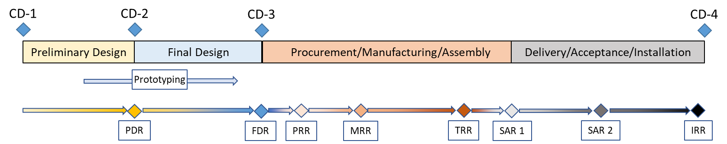
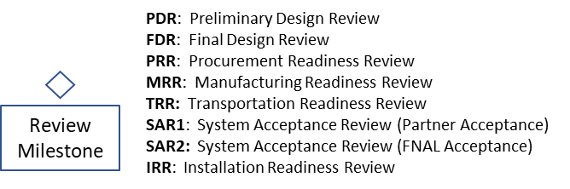
CEA-Fermilab Collaboration
This contribution relies on a strong and fully open collaboration model between Fermilab and CEA.
A series of Reviews (design, system acceptance, transportation) are defined in the ‘Project Planning Documents’ that will serve as technical annexes to PIP-II CEA-DoE Agreement.
The fabrication of the HB650 prototype cryomodule (pCM) is a critical precursor of the LB650 activity, in terms of design, assembly and tests.
  Regarding design: the project strategy is to maximize the common components, e.g. couplers, tuners, cavity supports, endgroups, valves, etc. and also to have a direct filiation of the scalable parts, e.g. strongback, thermal shield, magnetic shield, piping, etc.
    CEA team joined the HB650 pCM design team and was responsible for the strongback design

Slide 6
CEA-Fermilab Collaboration
  Regarding assembly: CEA will make the most both from its current ESS experience, e.g. industrial contractor, clean room tooling, etc., and from the HB650 pCM assembly at Fermilab
    CEA team was responsible for the design of the endcap closing tool, a direct descendant from the ESS tool.
    CEA team will observe the HB650 pCM assembly at Fermilab
  Regarding cold RF testing: Fermilab and CEA are collaborating on the Acceptance Criteria List and the Test Plan of the HB650 pCM.
    The LB650 Acceptance Criteria List and Test Plan will be scaled from the HB650 pCM documents
    CEA plans to observe the HB650 pCM testing.
  The fabrication and test of the ‘pre-production’ LB650 cryomodule (ppCM) will serve as a second validation, mostly for the CEA procedure and infrastructure specifics.
Fermilab plans to repeat the RF testing of the LB650 ppCM and first 3 CMs, at Fermilab after transportation.

Slide 7
LB650 Schedule: P6 compatible
LB650 pre-production CM0
Assembly (6 months)
RF Tests (3 months)
Transport + Tests RF at Fermilab
LB650 production CM1 to CM9
Assembly (3 months)
RF Tests (1 month)

Slide 8
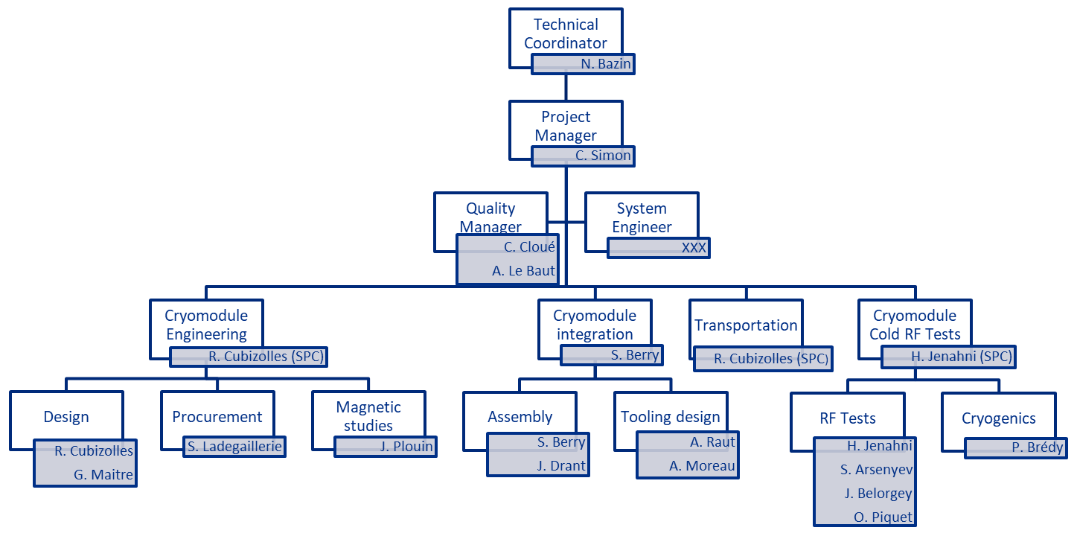
CEA PIP2-LB650 Organization Chart

Slide 9
Communication Plan
CEA internal project meetings are chaired on a regular basis by the TC to communicate general PIP-II information, follow internal progress and organize the future work of the CEA team.
Follow-up of the upcoming hold, notification, or approval points by CEA to the PIP-II L2 Manager is done two times per month to ensure adequate surveillance and execution of hold points.
CEA provides a status report at the monthly meetings called by the 650 MHz L3 manager to share and communicate the overall status of cryomodule fabrication and integration activities amongst all 650 MHz Partners.
CEA contributes to the monthly reports due to the Fermilab ICK manager with an account of International PIP-II Partners project progress, including monthly achievements and collections of In-Kind Contribution (IKC) MileStones (MS) status and forecast.

Slide 10
Concluding Remarks
The CEA PIP-II QA Plan is in place, being implemented for the success of the PIP-II Project.
This contribution relies on a strong and fully open collaboration model between Fermilab and CEA
“Quality is everyone’s responsibility” – W. Edwards Deming

Slide 11
Thank you for your attention

