Slide 1
System Engineering Management
N. BAZIN

Slide 2
Definition
“System engineering is a robust approach to the design, creation, and operation of systems. In simple terms, the approach consists of identification and quantification of system goals, creation of alternative system design concepts, performance of design trades, selection and implementation of the best design, verification that the design is properly built and integrated, and post-implementation assessment of how well the system meets (or met) the goals.”
NASA Systems Engineering Handbook, 1995.

Slide 3
Reference Documents
“System engineering is a robust approach to the design, creation, and operation of systems. In simple terms, the approach consists of identification and quantification of system goals, creation of alternative system design concepts, performance of design trades, selection and implementation of the best design, verification that the design is properly built and integrated, and post-implementation assessment of how well the system meets (or met) the goals.”
Main reference documents for the LB650 cryomodule:
PIP-II LB650 Technical Requirements Specifications (TRS), ED0009658
PIP-II 650 MHz β=0.61 Cryomodule Functional Requirements Specification (FRS), ED0001830
Other applicable documents:
PIP-II Global Requirements Documents, ED0001222
LB650 FRS Metadata Sheet
PIP-II Cryogenic Heat Load Analysis, ED0008200
PIP-II SRF Cavity Parameters PRD, ED0010221
The Fermilab Environment, Safety and Health Manual (FESHM), mainly chapter 5031 (Pressure Vessels) and chapter 2110 (Ensuring Equivalent Safety Performance When Using International Codes and Standards)
LB650 cryomodule
PIP-II Requirement Types & Flowdown

Slide 4
Design Reviews
“System engineering is a robust approach to the design, creation, and operation of systems. In simple terms, the approach consists of identification and quantification of system goals, creation of alternative system design concepts, performance of design trades, selection and implementation of the best design, verification that the design is properly built and integrated, and post-implementation assessment of how well the system meets (or met) the goals.”
The design verification process is documented in the PIP-II Technical Review Plan (ED0008163)
This document defines:
Review classes
Roles and responsibilities
Procedure to execute and closeout reviews
Typical design deliverables (all documents deliverables are listed in the Project Planning Document – PPD)
Past and upcoming reviews for the LB650 pre-production cryomodule:
Preliminary Design Review (PDR) in March 21 – formal close in July (https://indico.fnal.gov/event/47833/ )
Final Design Review (FDR) in May 22

Slide 5
“System engineering is a robust approach to the design, creation, and operation of systems. In simple terms, the approach consists of identification and quantification of system goals, creation of alternative system design concepts, performance of design trades, selection and implementation of the best design, verification that the design is properly built and integrated, and post-implementation assessment of how well the system meets (or met) the goals.”
During the design phase:
Definition of the licensing frame to be applied for the design, manufacturing and qualification of the LB650 cryomodule
Definition of the interfaces and the associated requirements
Configuration of the 3DMU and the parts supplied by the partners (cavities, power couplers, valves, cryogenic equipment …)
During the production phase:
Tests and controls during the manufacturing of the components
Tests and controls during the assembly of the components
Cold RF tests
Non-conformance management
Configuration of each built cryomodule
During all the phase of the project:
Documentation management
Change control
Presentation “Partner Parts Handling & Cryomodule Acceptance”
Presentation “Vendor management”
Presentation “Quality control during assembly”
Presentation “Partner Parts Handling & Cryomodule Acceptance”
Presentation “Non-conformance management”
Presentation “Document management”
Presentation “Change control / Configuration Management”

Slide 6
Licensing of Pressurized Equipment
CEA will follow chapter 5031 for the design, manufacturing and qualification of the pressurized equipment of the LB650 cryomodule → ASME BPVC (Boiler and Pressure Vessel Code) and B31.3 (for piping)
A document shall be prepared soon to list all the requirements for the material procurement, the manufacturing and the testing of each component
The manufacturing documentation of each individual pressurized equipment shall have the CEA identification part (see presentation “Vendor management” for details)

Slide 7
Interface Management Process
Interface management process is documented in the PIP-II Interface Management Plan – ED0007942
“The Interface Management Plan provides a process to develop, control, identify, manage, verify, review, approve, release and revise technical interfaces for the PIP-II project.”
All the interfaces are listed in the Master Interface Control Document (ICD) – ED0010433
L3 to L3 interfaces
L3 to Fermilab external interfaces (i.e. to other accelerators/infrastructure)
Partner interfaces (Partner to Fermilab, Partner to Partner)
Below L3 at the discretion of the L2 Design Authority
« External » interfaces = between the LB650 cryomodule and other systems of the accelerator
« Internal » interfaces = between the components of the cryomodule procured by CEA and the ones provided by partners
Most of the information presented on this slide are taken from «PIP-II Interface Management Process », Alex Martinez, presentation at the PIP-II Technical Workshop, December 2020

Slide 8
Interface Management - Status
The ‘L3 – L3’ interfaces and the ‘Partners to CEA’ interfaces impacting the design of the components under the responsibility of CEA have been identified and included in the Master Interface Control Document (ICD)
Work to be done:
Define the interfaces: many interfaces have been agreed, but many other are still under discussion
Write the Interface Specification Document for the LB650 cryomodule

Slide 9
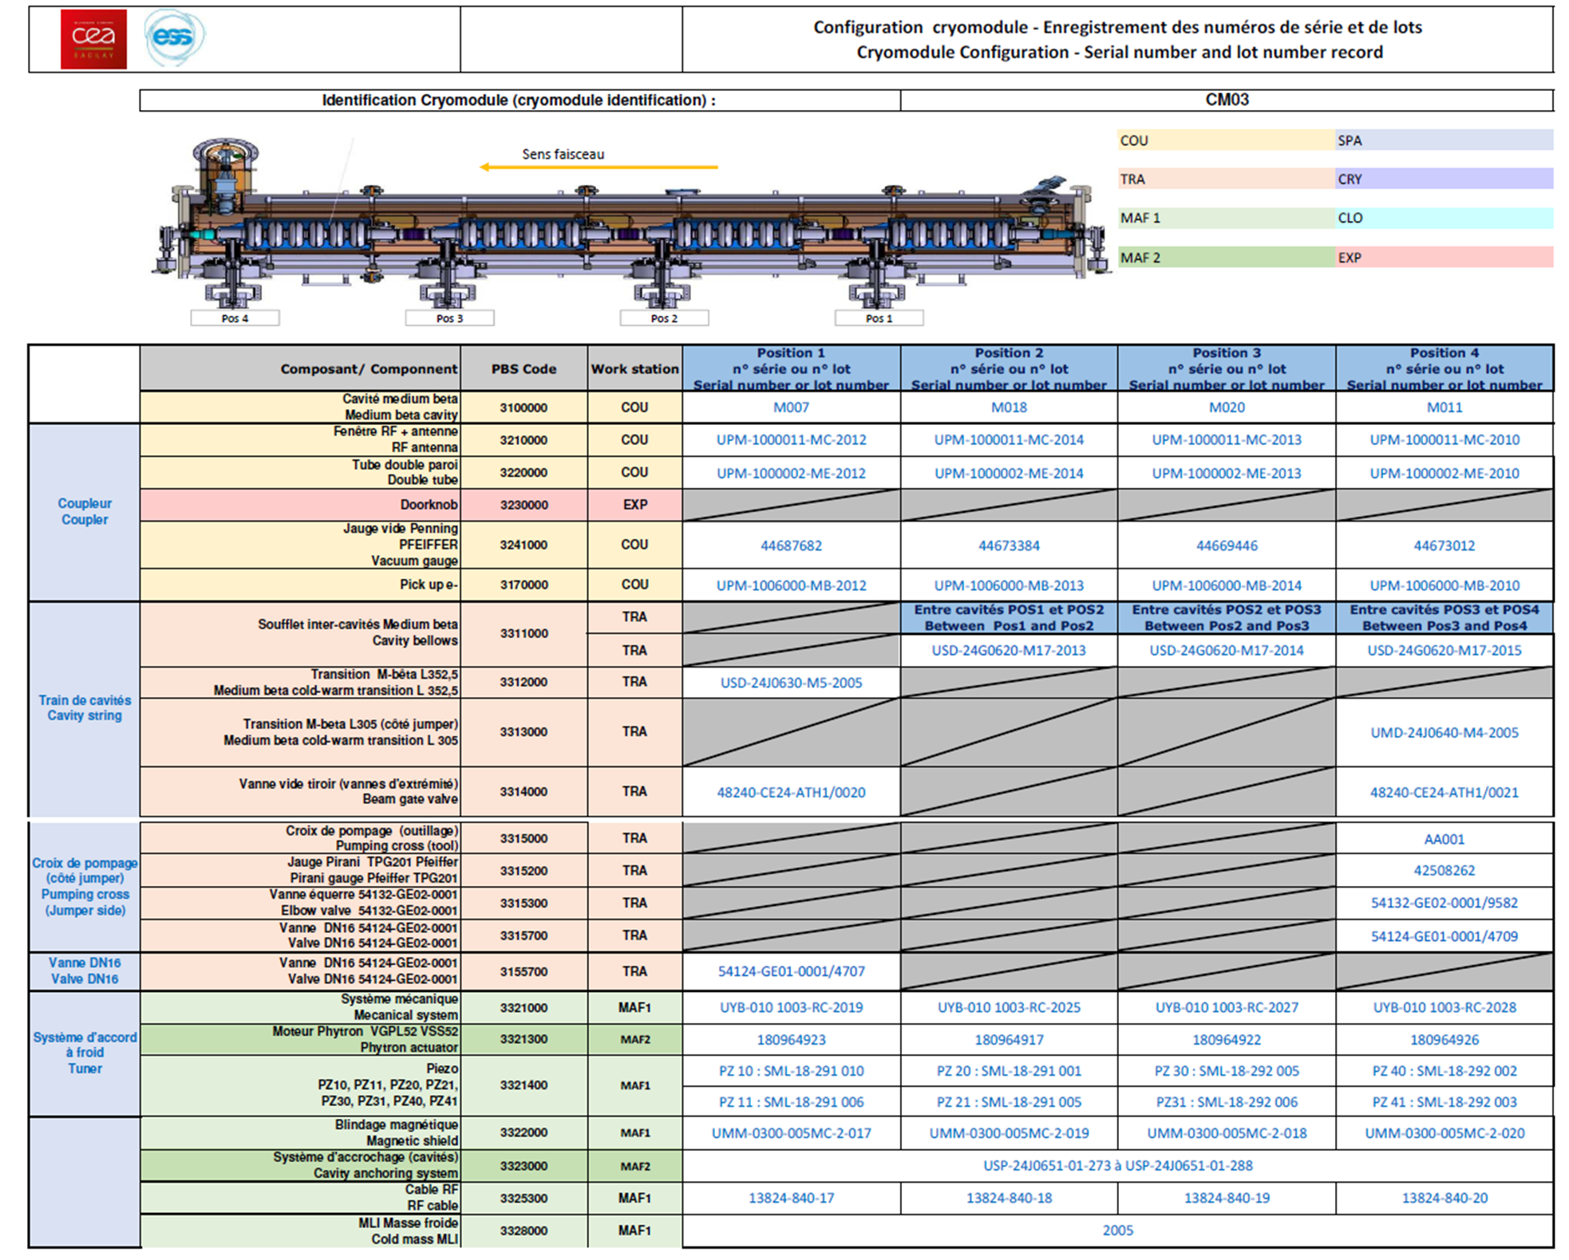
Configuration of each built cryomodule
In order to trace which component is installed in which cryomodule, a bill of material lists all the identification / serial numbers

Slide 10
Thank you for your attention

