Slide 1
Document management
Quality workshop – August 2021
Christelle Cloué

Slide 2

Objectives of the document management
Record and store all the data related to the project
Guarantee the reliability and the quality of the information disseminated.
Provide traceability and revision history of documents.
Use of the same document version by all the project members
Provide access to information for all stakeholders (up-to-date documentation)
The project members should be informed on the existence of a document, its access modalities and its evolutions
To reach these goals, the document management defines the rules of
Identification,
Approval,
Evolution,
Diffusion of the documents as well as the storage procedure

Slide 3
Types of documents
Technical description of the project (requirements, technical notes …)
Records , travelers, quality documents
(manufacturing, assembly, test…)
Description of what is planned in terms of, management, quality assurance, development, manufacturing, testing ...
Procedures, operating methods; description of how to perform activities
Templates used to create documents, forms to be fill out
  Requirements,
  Technical notes,
  Risk registers,
  Mangement Plan, Quality Assurance Plan…
  Interface documents,
  Specifications,
        Procedures,
        Documents exchanged with suppliers
        Delivery receipts,
        Acceptance reports
        Meeting minutes
        Presentations (reviews, meetings)
        Progress reports
        Test reports
        Non conformance reports
        Change request reports
        …

Slide 4
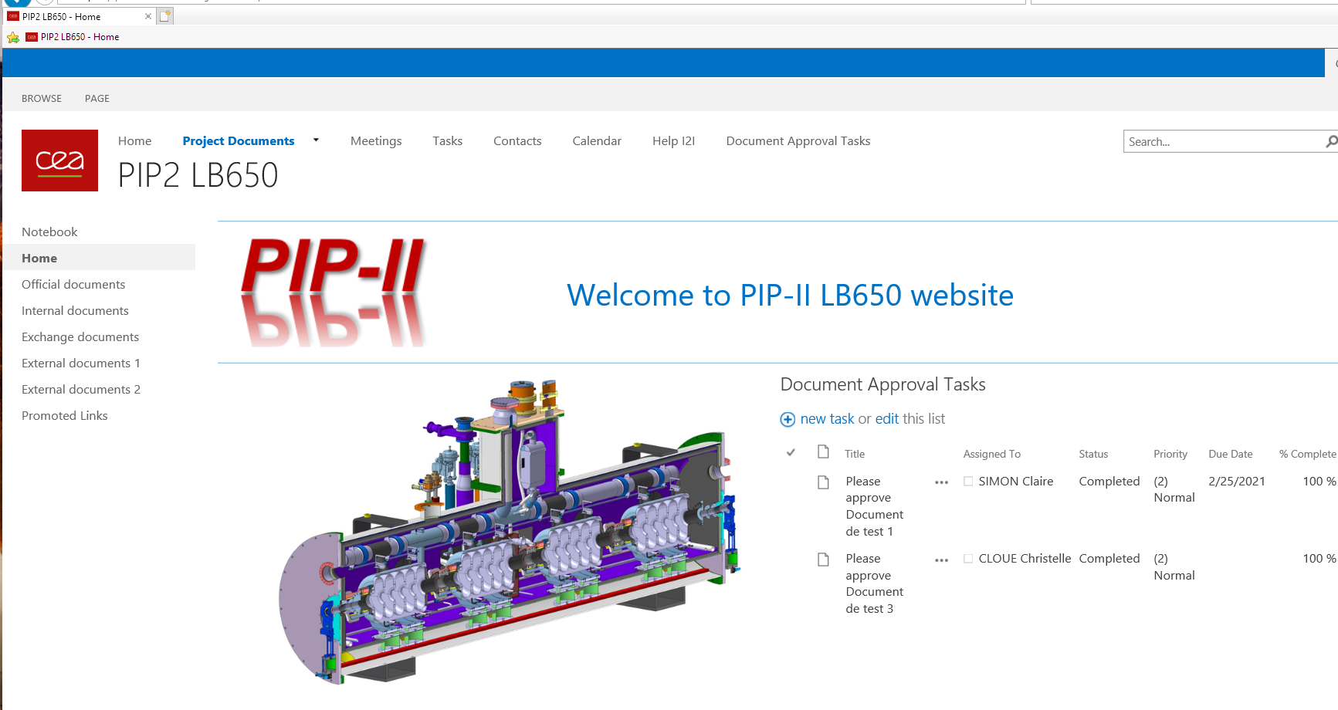
I2I Document management system
  The document management is based on the I2I Document Management system (sharepoint), chosen as a tool for sharing and archiving information of the PIP-II project.
Main characteristics :
Redaction of documents in collaborative mode (edit files simultaneously)
Identification of documents,
Tracking version history,
Approval workflow for the validation,
Easy search function of documents by key words or full text,
Files access controlled by access rights
Files sharing with people outside CEA
Archiving

Slide 5
Document management workflow
Document edition
PIP-II Templates
External document from Fermilab and other partners
Document creation
Using a template to ensure the homogeneity of the documents on the project
The template should contain all the information needed for the document management
Document record on I2I and identification
Unique reference
Index version
Right properties
Document record on I2I
Check & approval
Reviewers and approvers names
The documents are identified by
  a unique identification number
  a revision number
Release of the document on I2I
Availability of the document
Changes management, version history
Revision of the documents, the previous versions are stored on I2I
P | I | P | 2 | - | x | x | x | x | x | - | X | . | Y
Chronological number attributed by I2I (5 digits)
The revision has 2 digits X.Y
X.0 main revision,
Y secondary revision (or draft).
History archive
At the end of the project

Slide 6
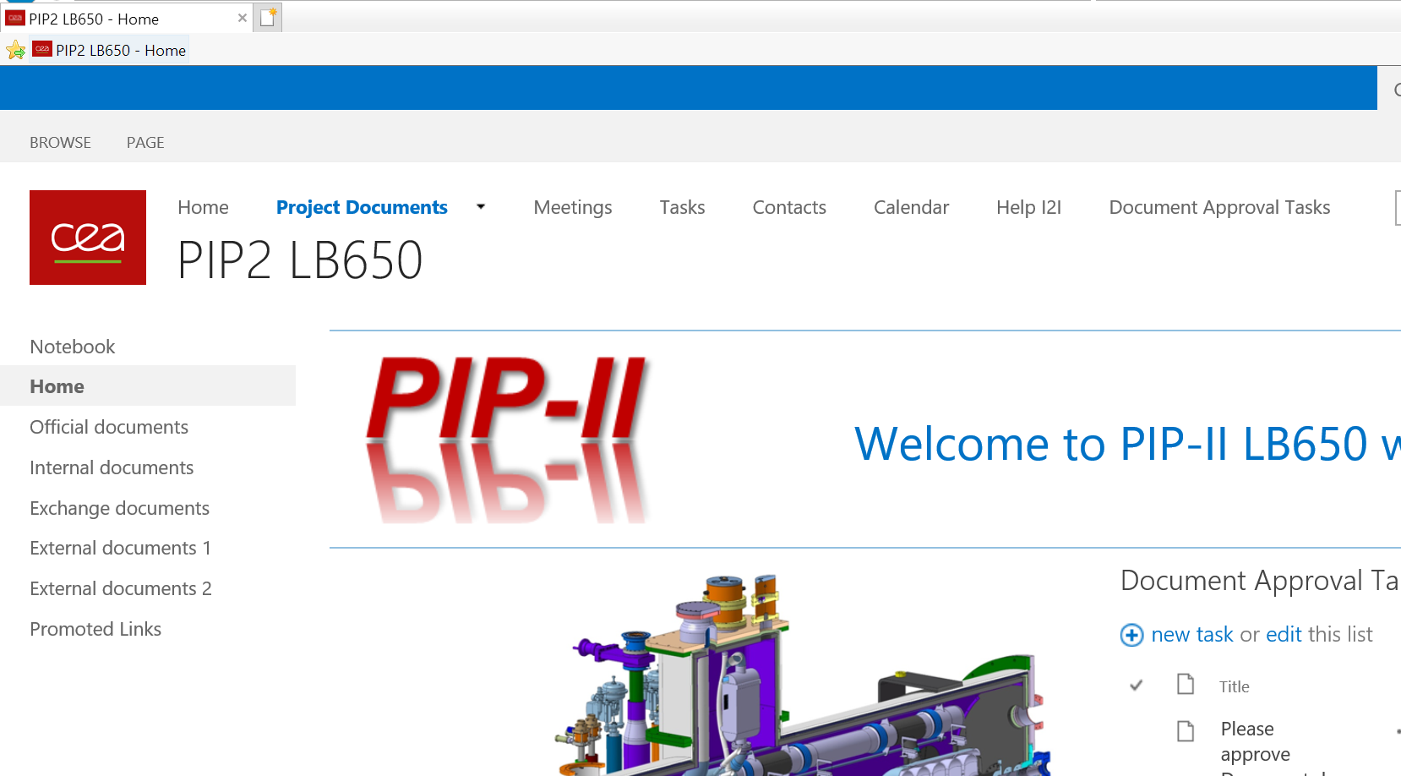
Description of the librairies
Official documents - CEA only
Library with all the documents edited by CEA
Identification of the documents
Approval workflow
Possibility to restrict read and write access to some folders
Internal documents
For internal purpose, working documents, internal exchanges
Exchange documents - with Fermilab
The documents in the library « Exchange document » will be accessible to Fermilab
Documents from the “Official documents” library can be copied if needed to make them available for Fermilab
Approval workflow
External documents 1 &2
Libraries on reserve

Slide 7
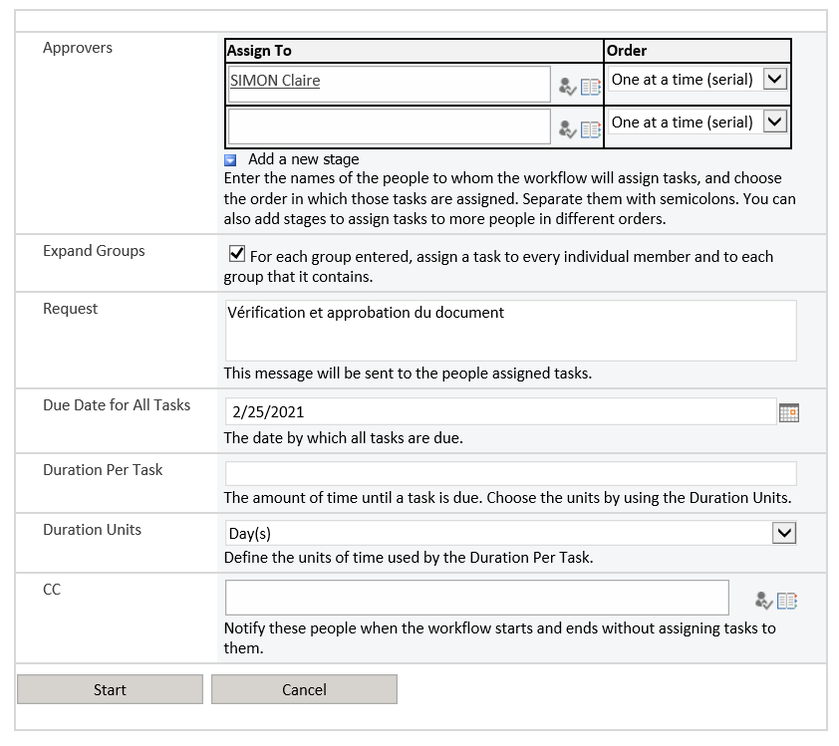
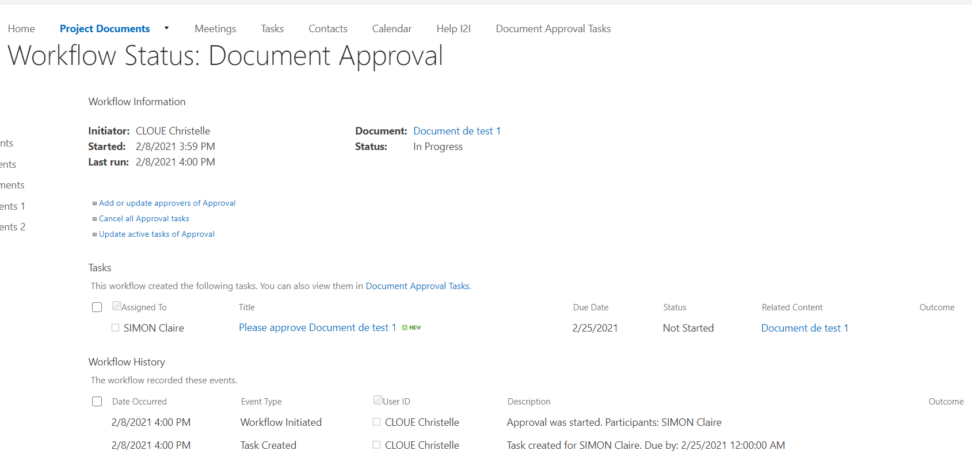
Approval workflow
The approval workflow allows to assign approval tasks (in parallel or in series) to one or more people.
It is possible to customize the request, add a deadline and people for information.
The concerned persons receive a message with a link to the task to be performed.
In Outlook, it is possible to click directly on the link "Open this task".
Reviewers/approvers should also manually add their signatures on the document.

Slide 8
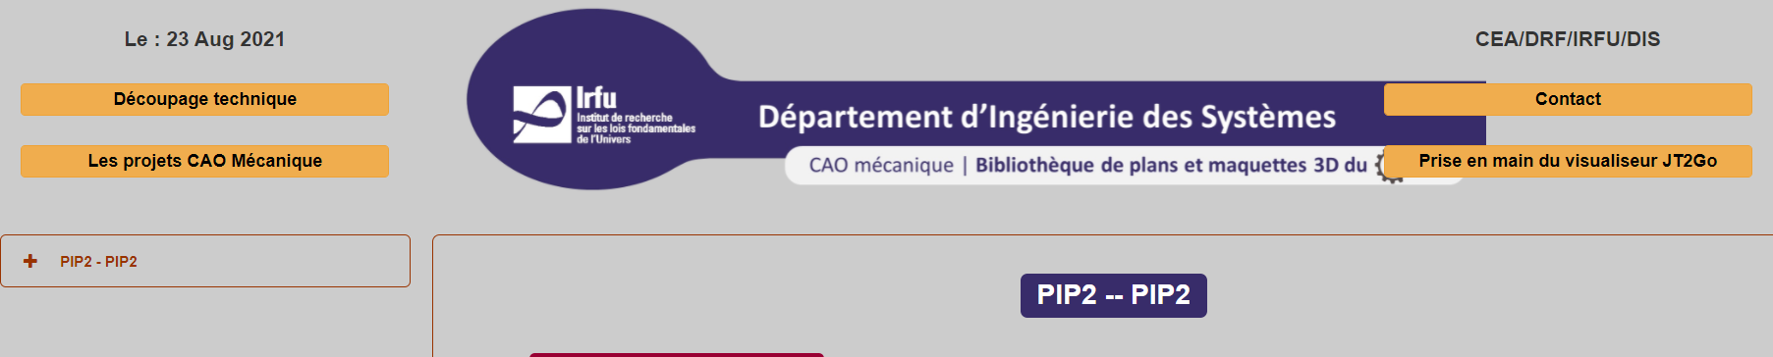
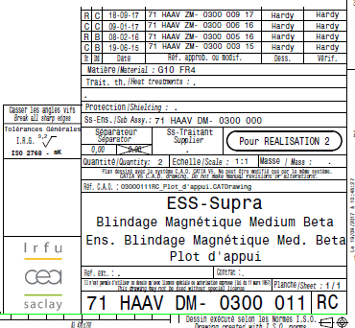
CAD Drawings database
The CAD drawings are not stored on the I2I Platform. There is a specific platform for all the IRFU CAD drawings.
Drawing number format according to the IRFU procedure naming convention for the drawings
Approval workflow
Revision history (document to follow-up the changes).

Slide 9
Thank you for your attention

