Slide 1
Vendor Management
Claire SIMON

Slide 2
Outline
Procurement plan strategy
Procurement process
Identification of CEA Parts
Contract standard architectures
Follow-up

Slide 3
Procurement plan strategy
Calls for tenders are placed for the whole components of the series in one batch
(1+ 9 sets of components for pre-production and production)
CEA procurement department standards are used for the calls for tenders and selection of companies.
For each contract, a team is identified for the contracts follow up:
• Business manager
• Product manager (technical and performance aspects)
• Product assurance officer (quality assurance)
• Experts team
• Procurement Buyer from CEA procurement department

Slide 4
Procurement process
Main steps of the procurement process:
Identification of a needed item
Establishment of technical, quality requirements and procurement documents
Evaluation and selection of a Supplier
Monitoring of Supplier performance
Handling of deviations from requirements
Acceptance of items and services

Slide 5
Identification of the CEA parts
Rules for the identification of the manufactured parts from CEA drawings
The identification may be a label or engraving, the method which shall be submitted by the supplier to the CEA and shall be approved by the CEA before application.
The marking place shall be clearly visible and readable
The identification of each component shall be indicated on the manufacturing traveler of the corresponding component.
The components in stock will have an identification code defined by the manufacturer.
Supplier
Drawing reference
Serial number
Corresponds to a code for identifying the supplier
Corresponds to the last 7 numbers of CEA drawings
Corresponds to the chronological number of manufacturing (the first digit indicates if it is pre-serie or serie part)

Slide 6
Contract standard architectures
Each contract is supported by two documents:
The commercial contract, backed by the CEA general purchase clauses,
The technical specifications of the product, which specify the technical and Quality Assurance requirements. This document also includes the management specifications, which express the monitoring and reporting requirements of the contract.
The Technical specifications are attached to the call for tenders.
The quality requirements are included in the technical specifications
Manufacturing quality plan including quality control
Application of ISO 9001;
Application of manufacturing and materials standards
Identification and labelling of each component under the CEA responsibility;

Slide 7
Contract standard architecture
Contract Signature
between the company and CEA …
Kickoff Meeting
Manufacturing studies
Holdpoint n°1 : Acceptance of the manufacturing studies (drawings, …) -> MRR
Pre-production unit fabrication + FAT
Holdpoint n°2 : Test of pre-production (SAT)
+ updated manufacturing studies if needed and MRR
Production units fabrication + FAT
End of the contract after the test of production (SAT)
FAT: Factory Acceptance Test on subcontractor site
SAT: Site Acceptance Test on CEA site
MRR: Manufacturing Readiness Review

Slide 8
Factory Acceptance Test, Site Acceptance Test
Each component or set of components must be declared Ready For Assembly (RFA) before being sent to the assembly team. The RFA status is reached when the component has successfully passed the Factory Acceptance Test (FAT) and the Site Acceptance test (SAT).
Manufacturing operation
Controls
& Tests
Factory acceptance test
Site acceptance test
Ready for assembly
Responsibility
Manufacturer
Manufacturer & CEA
CEA
According to the CEA technical specifications and the validation of the quality plan of the manufacturer
Visual inspection
Leak test
Dimensional control
Documentation check
Etc.
Visual inspection
Leak test
Dimensional control
Etc.
Quality control
Manufacturer folder (tests & controls reports, etc.)
Factory acceptance test report
Site acceptance test report
Traceability of controls and acceptance
Manufacturer
Manufacturer
CEA
Manufacturer
CEA

Slide 9
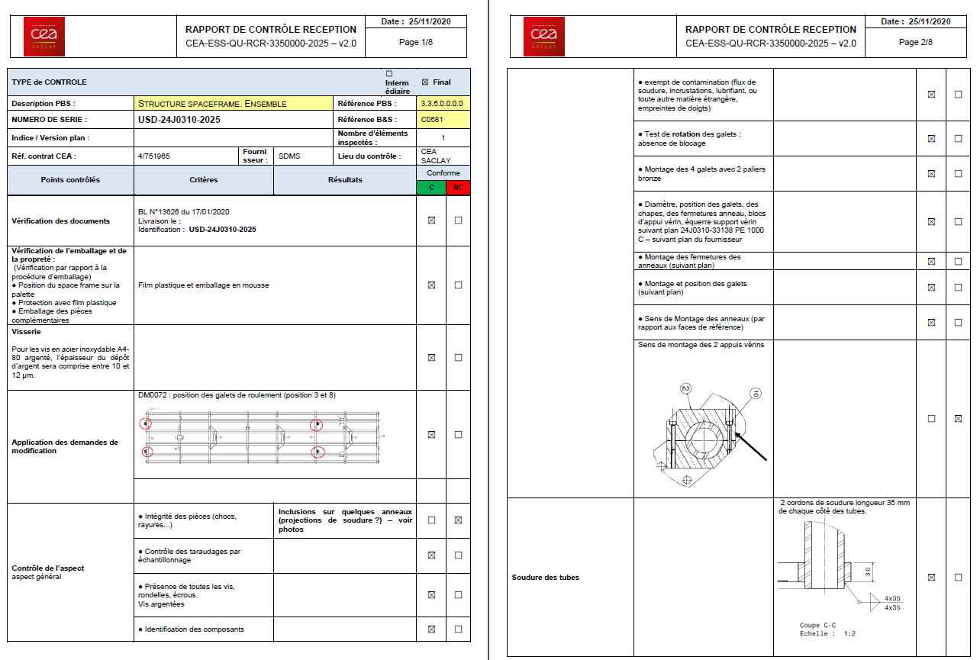
Incoming inspection -SAT
After the delivery of the components at CEA, an incoming inspection is performed and a report is filled.
The incoming inspection report is used as an input data for the Site Acceptance Report

Slide 10
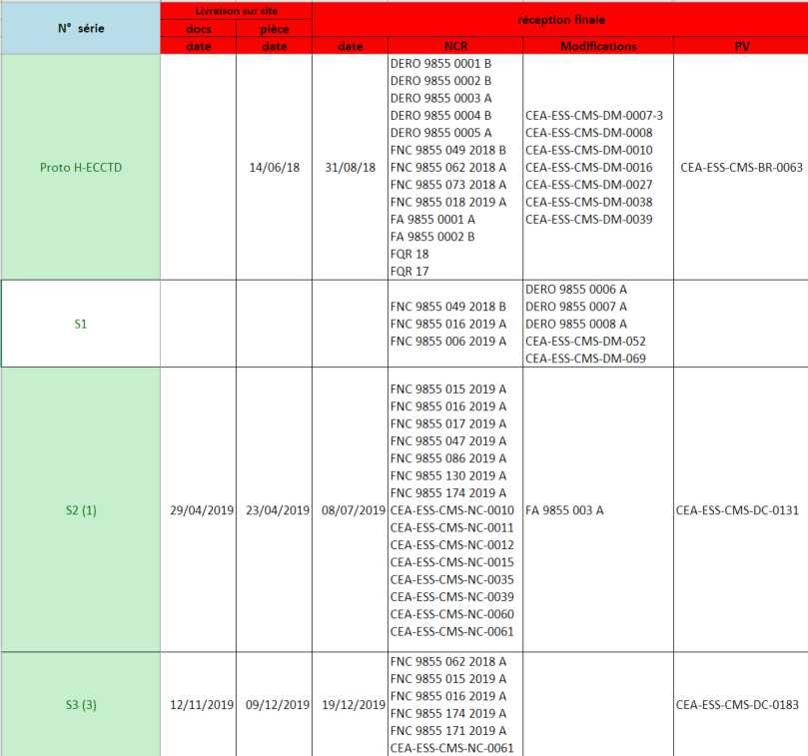
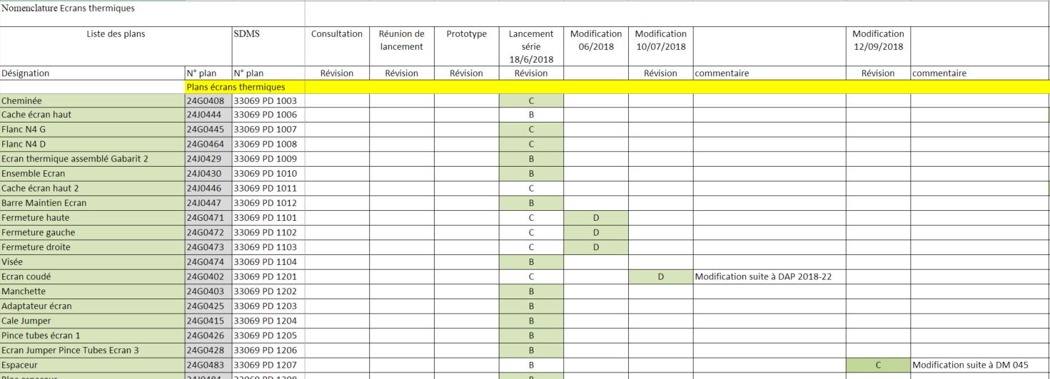
Follow-up
For the follow-up of the component production, several tables are filled in by the Business manager / Product manager.
Follow-up table of the part deliveries, with references to acceptance reports, non conformities and changes
Follow-up table for the traceability of the drawings revision, following change requests from suppliers or CEA

Slide 11
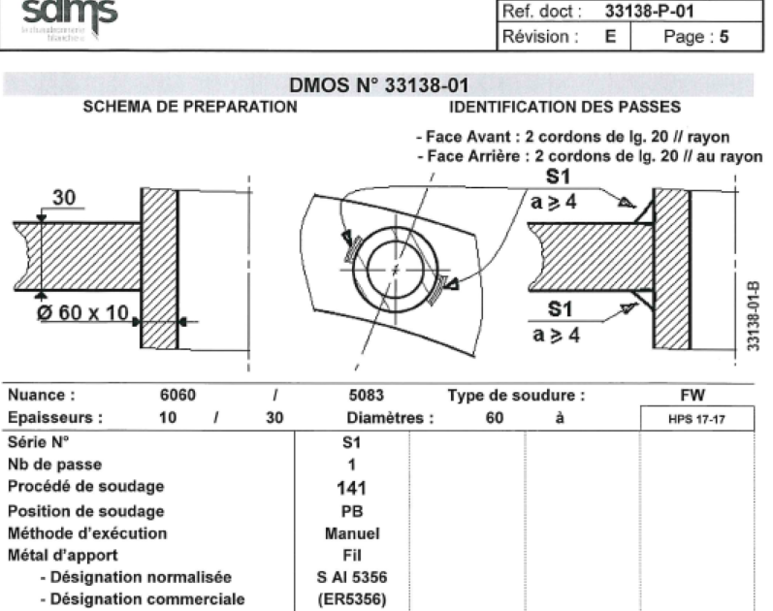
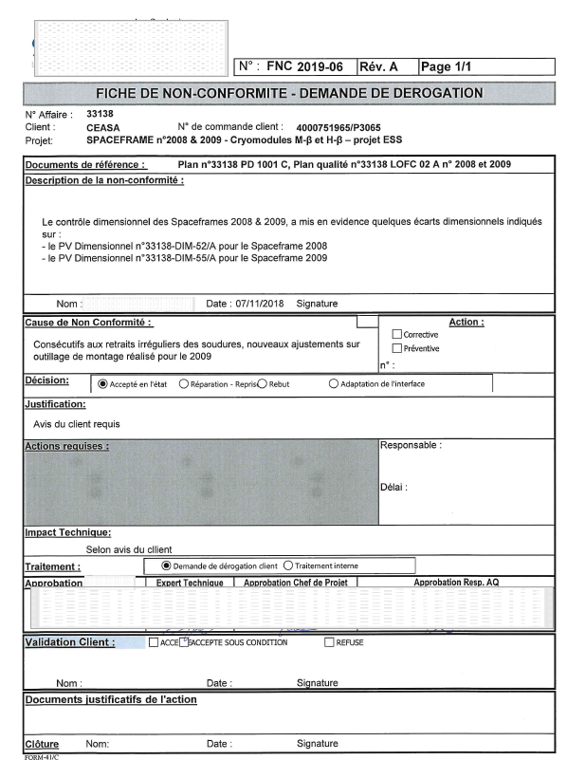
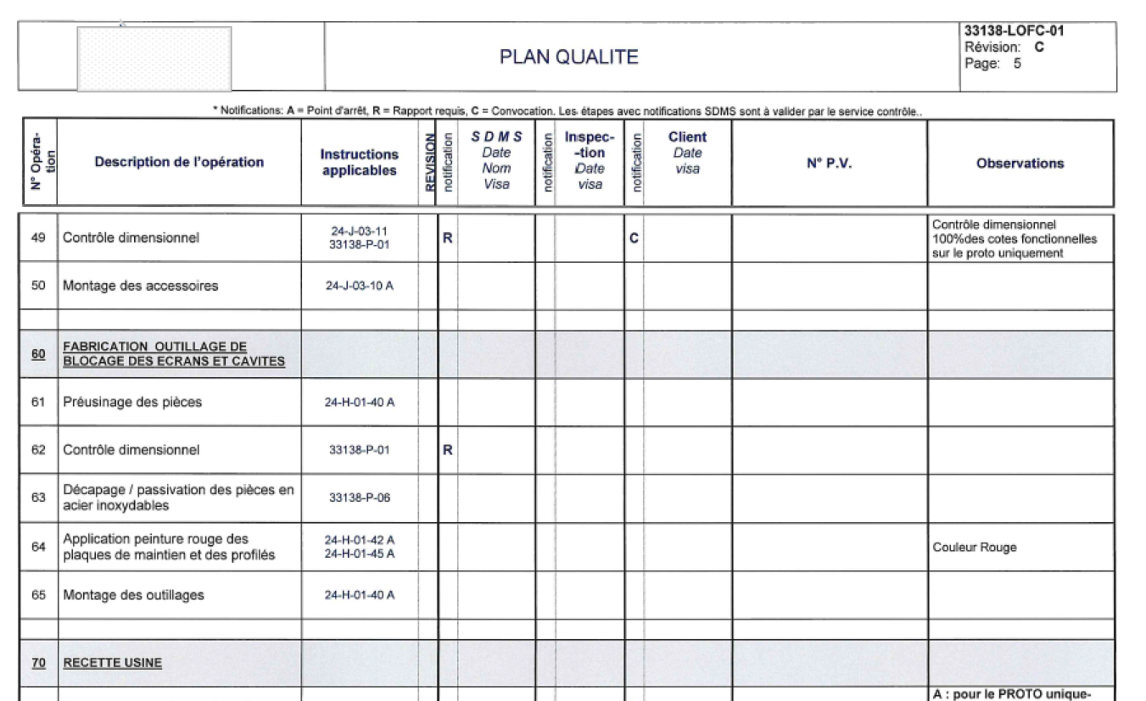
Examples of documents from a vendor
Welding procedure qualification record (WPQR)
Non conformance report from a supplier
Quality control plan

Slide 12
Thank you for your attention Question ?

