Slide 1
Partner Parts Handling & Cryomodule Acceptance
Claire SIMON

Slide 2
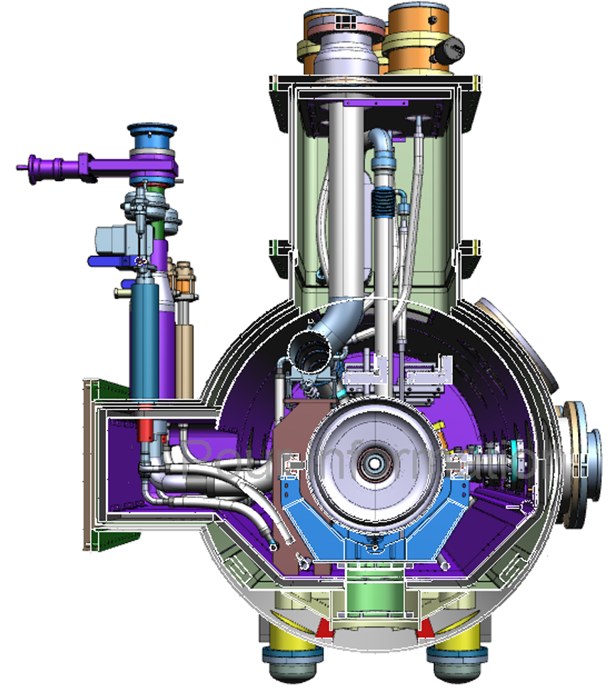
CEA Scope of Work
The CEA Scope of Work includes:
the design of the LB650 cryomodules (1 pre-production + 9 production)
the procurement of cryomodule components
the assembly of the LB650 cryomodules (1+9), including all necessary tooling
the RF tests of the LB650 cryomodules (1+9), including cryogenics and RF equipment
the system acceptance reviews of the LB650 cryomodules (1+9)
the licensing of the LB650 cryomodules (1+9)
the design of the LB transport frame, fabrication of 2 units, and road tests
the disassembly (warm couplers, cryogenic cap) and preparation of LB650 cryomodules for shipment.

Slide 3
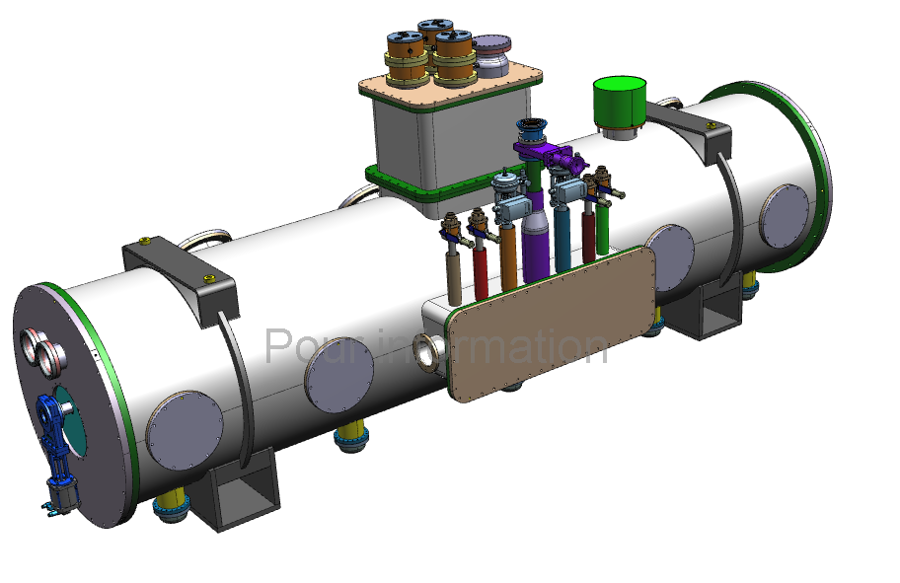
CEA Scope of Work
The cryomodule components procured by CEA include:
the inter-cavity bellows and cold-warm beam line transitions
the hardware, fasteners and gaskets for string assembly
the strong-backs, cavity posts and supports, and C-blocks
the cold and warm magnetic shields
the 50 K thermal shields
The 2K, 5K and 50 K Helium circuit pipes and bellows
the superinsulation blankets
the vacuum vessels
the hardware, fasteners and seals for module assembly
The cryomodule components provided by Fermilab include:
the RF cavities equipped with their Helium jacket including bi-metallic transition and di-phasic tee, and their pick-up antenna
the RF couplers equipped with their vacuum gauge and electron pick-ups
the beamline gate valves
the frequency tuners with step-motor, piezo-mechanisms, electric cables and end-switch
the RF cables, thermal sensors, and pick-up cables
the instrumentation flanges equipped with connectors
the alignment instrumentation such as HBCAM tool kit, HBCAM optical target subassemblies
the cryogenics equipment such as valves, heat exchangers, bayonets, Helium guards and relief stack columns

Slide 4
Responsibilities and Logistics
Fermilab Responsibility
CEA Responsibility
Cryomodule assembly + RF tests
Components provided by Fermilab
Cavities
Cryomodule tests + installation
Responsibilities need to be clearly defined
Hand-off of components only after Acceptance Tests
CEA responsible for cryomodule assembly utilizing components from different partners but components always property of Fermilab

Slide 5
Partner Parts Handling - Components provided by Fermilab
Acceptance Plans (TDB - EDxxxx documents)
Describe the process for acceptance for each component between partners and Fermilab, including OK to ship to CEA, and final checks at CEA after receiving
Acceptance Criteria (at FNAL)
All requirements from FRS will be verified with a test or a set of measurements during production and/or during final tests.
Component becomes property of Fermilab
Incoming Inspection report (at CEA)
Series of tests/measurements (visual inspection, Leak tests…) to be carried out at CEA to confirm no damage after shipment
Incoming inspection report by CEA
CEA begins cryomodule integration
Fermilab
CEA
Acceptance tests
Notification to CEA & final documentation sent to CEA
Shipment verification and Incoming inspection report
OK to ship to CEA
Notification to Fermilab & ready for integration
Acknowledgement

Slide 6
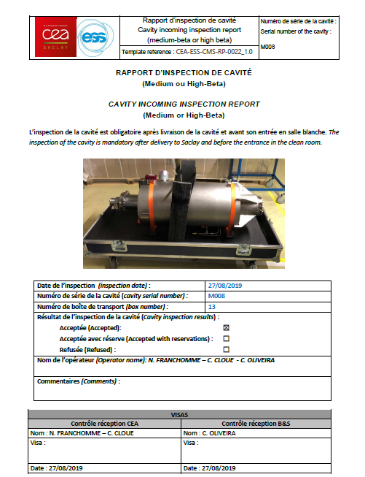
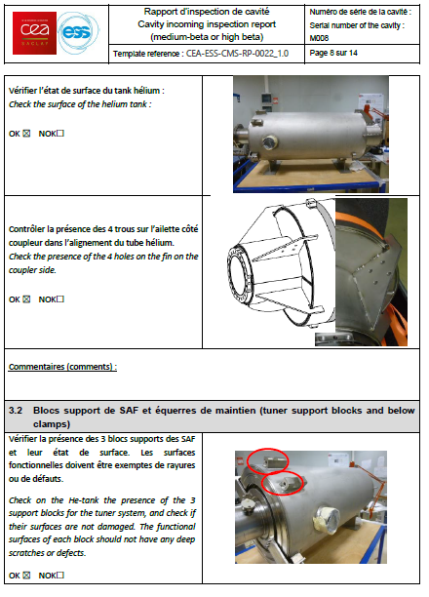
Exemple of Incoming Inspection report
Cavity Incoming Inspection Report

Slide 7
System Acceptance Reviews for LB650 cryomodule
SARs occur in two phases and are defined as SAR1 and SAR2 with each identified by milestone.
SAR1 is the Post-production acceptance review done at CEA.
SAR2 is the post RF-cold testing acceptance review done at CEA
At the completion of the SAR2, the ownership of the deliverable and associated technical risk transfers to FNAL.

Slide 8
Cryomodule Acceptance
LB 650 MHz Cryomodule Acceptance Plan (TBD -ED00XXXXX)
Defines division of responsibilities, acceptance stages, and non-conformance resolution
Describes the process for acceptance between CEA and Fermilab, including OK to ship to Fermilab, and final checks at Fermilab after receiving
Critical Acceptance Stage 1 (Post-production acceptance at CEA) (Acceptance Criteria Stage 1 TBD ED00XXXX)
Critical Acceptance Stage 1 is done at CEA after the completion of cryomodule production and before cold validation testing at CEA.
All requirements from Test plan will be verified with a test or a set of measurements.
Closeout of SAR1 occurs before deliverable is sent for CM cryogenic RF Testing.
Critical Acceptance Stage 2 (Post-cold testing acceptance at CEA) (Acceptance Criteria Stage 2 TBD ED00XXXX)
Critical Acceptance Stage 2 occurs after cold validation testing at CEA.
All requirements from test plan will be verified with a test or a set of measurements during RF tests.
Need to define when is SAR2 (after warm-up??)
Need to define if disassembly and preparation for shipment is done after the SAR2 closure or can be done before
Transfer of Title of LB650 cryomodules will take place at CEA-Saclay, before shipment
Cryomodule becomes property of Fermilab
CEA
Fermilab
Assembly, test results
Acceptance Criteria Stage1
Notification to Fermilab & final documentation sent to Fermilab
Review board
Cold RF tests
Acceptance Criteria Stage2
Notification to CEA and OK to close SAR1
Review board
Notification to Fermilab & final documentation sent to Fermilab
Disassembly (warm couplers, cryogenic cap) and preparation of LB650 cryomodule for shipment
Notification to Fermilab and Inspection report
Notification to CEA and OK to close SAR2
Transfer of Title
Ship to Fermilab
Acknowledgement
Shipment verification &
Notification to CEA
8

Slide 9
Thank you for your attention Question?

